Slide 1
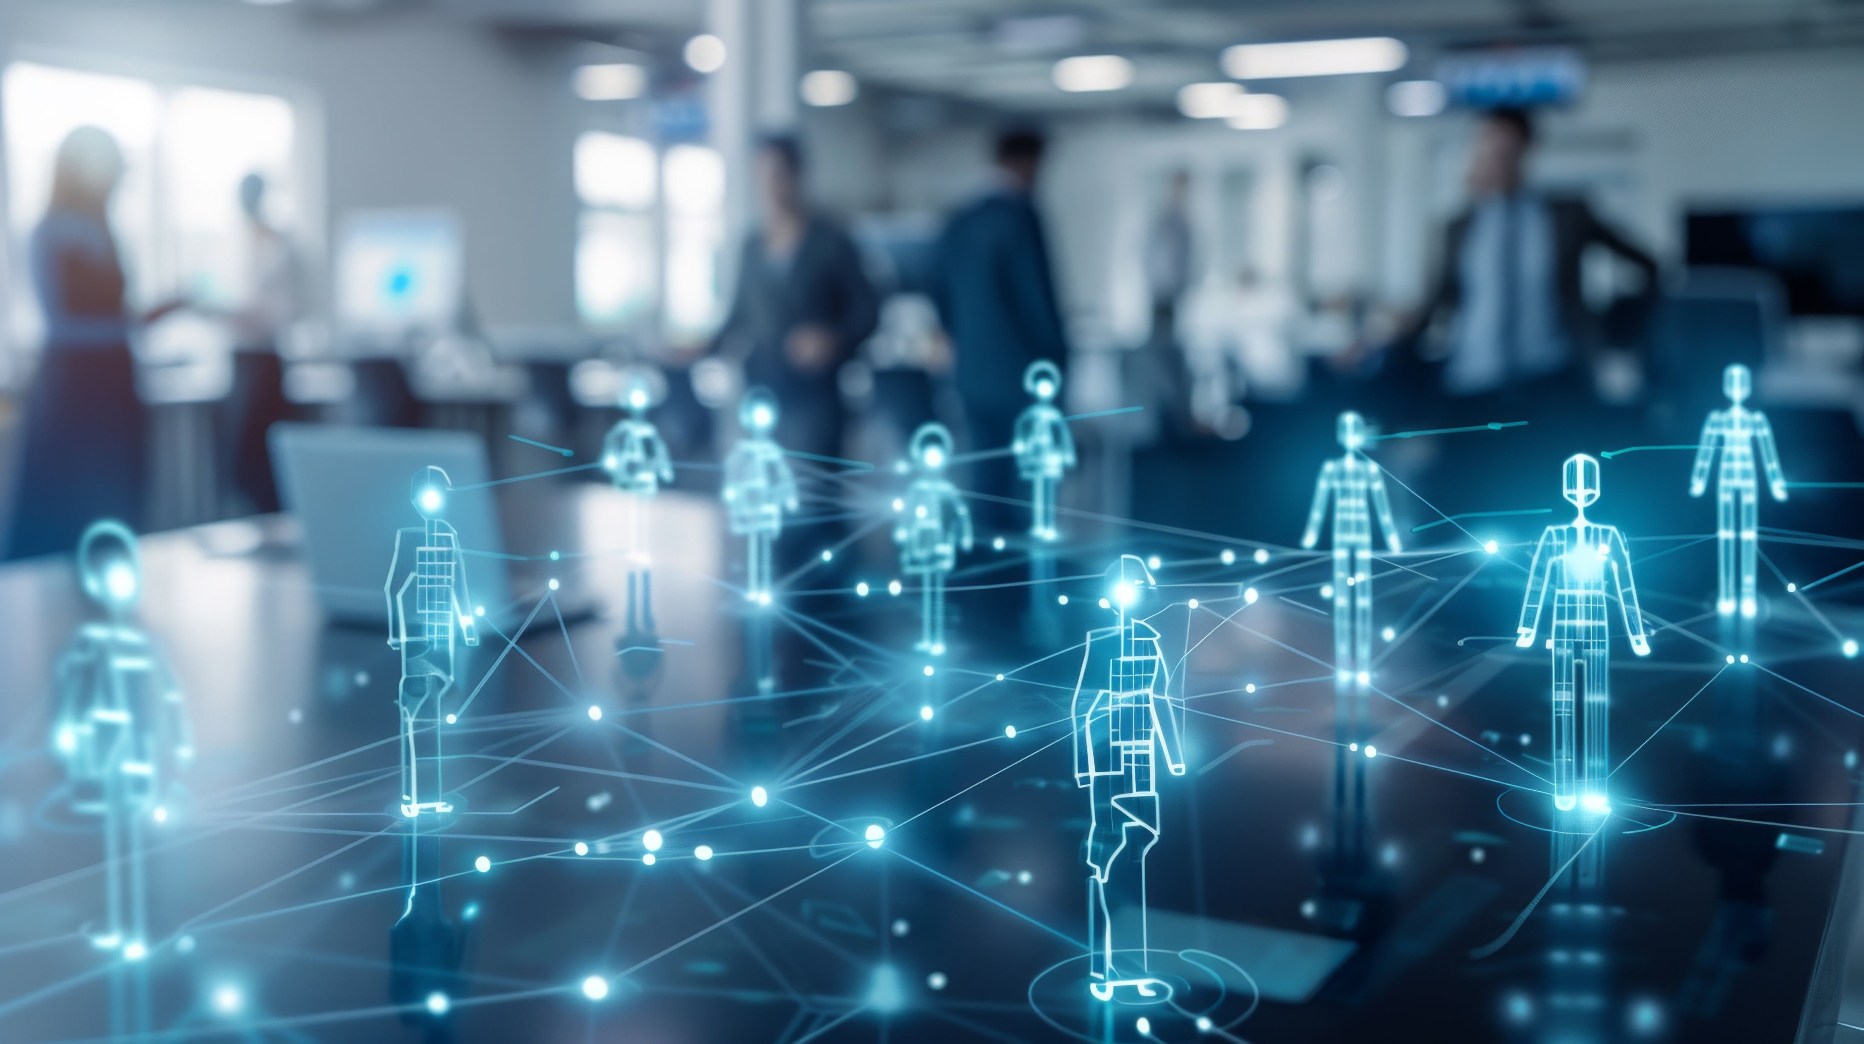

Reframing Membership
Welcome!
In the chat:
Name
State Affiliate
Share a moment when you realized you could be more than a rank-and-file member
Raising Expectations
An NEA UniServ & Organizer Support Online Discussion

Slide 2
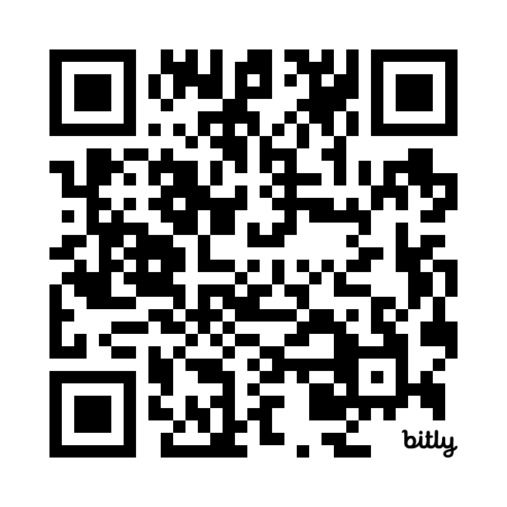
UniServ & Organizer Support
NEA’s UniServ Training Program is designed as a “peer-to-peer” learning model. Our Academies are facilitated by a cadre of currently practicing UniServ Directors from across the country, who receive additional training in adult learning theory and racial and social justice. This year’s training cadre members come from the following states: AK, AL, CA, CO, IN, LA, ME, MI, MN, MO, MS, NJ, NY, OH, OR, PA, SC, TN, UT, VA, VT, WA, WY.
Discover more UniServ training programs:
www.nea.org/UD-Org-Support

Slide 3

Land Acknowledgement
We begin by acknowledging that through a history of colonization and brutality, we are currently on the traditional lands stewarded by generations of the Indigenous people.
We honor these Indigenous people, all elders, past, present, and emerging. We are called to learn and share these learnings about this tribal history, culture, and contributions that have been suppressed in the telling of the story of what we now call the United States of America.

Slide 4
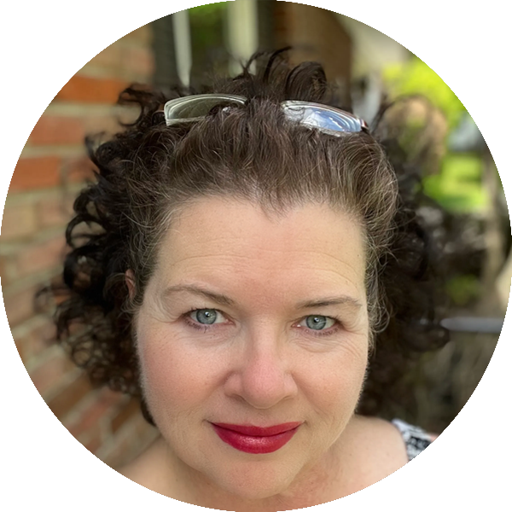
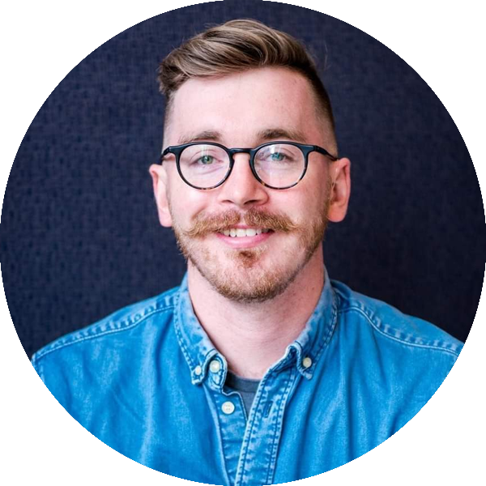
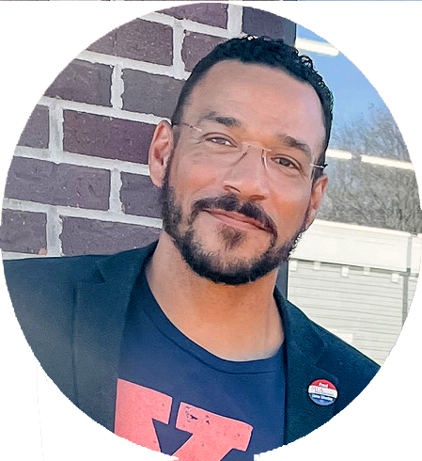
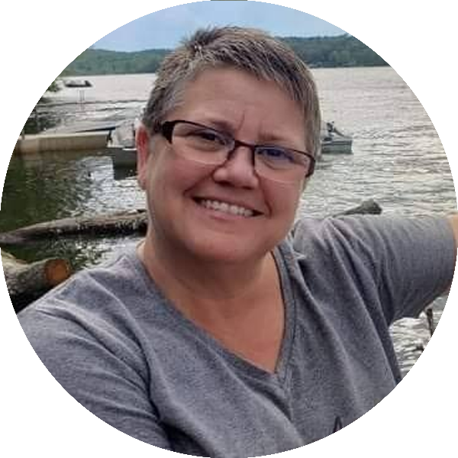
Facilitators:
Dawn Moretz
UniServ Director
Montgomery County
Education Association
dmoretz@mceanea.org
Zach Johnson
UniServ Director
Colorado
Education Association
zjohnson@coloradoea.org
Chad Williams
UniServ Consultant
Michigan
Education Association
cwilliams@mea.org
Ellen Holmes
Organizational Specialist
National
Education Association
eholmes@nea.org

Slide 5
Training Outcomes
Staff Perspective Matters:
It starts with you. Reducing barriers, building trust, and high participation organizing
Messages Matter:
A website is often the first impression. Understanding union semantics
Messengers Matter:
The first touch likely won’t be from staff. Who is doing the ask is important

Slide 6

Staff Perspective Matters
It starts with you. Reducing barriers, building trust, and high participation organizing

Slide 7
Three Theories of Power
JANE MCALEVEY
Organizing
Mobilizing
Advocacy
Best
Better
Good
Notes:
(Chad)
We’ve typically discussed these theories of power in terms of a disconnected rank order of actions instead of an interconnected strategy
Advocacy DOES alter power relations
Mobilizing IS NOT exclusively one direction
Organizing IS the culmination of Advocacy and Mobilizing

Slide 8

Three Theories of Power
JANE MCALEVEY
Advocacy as a stand-alone theory:
This approach is characterized by an elite theory of power. ​ Advocacy groups seek one-time wins or narrow policy changes, often through courts or back-room negotiations, without permanently altering the relations of power.
Reframing Advocacy as Interconnected:
Though a sustained shift in power is the desired outcome, the advocate often must be the initiator, the preparer of conditions for that shift. Advocates can do things and explain what they do. Advocates are the “proof of concept” that attracts others. That must be you.
Advocates are those who have the privilege to advocate. ​
Mobilizers- not as connected ​
Organizers- Leaders who are trusted and respected.
Notes:
(Chad)
We’ve typically discussed these theories of power in terms of a disconnected rank order of actions instead of an interconnected strategy
Advocacy DOES alter power relations
Mobilizing IS NOT exclusively one direction
Organizing IS the culmination of Advocacy and Mobilizing

Slide 9
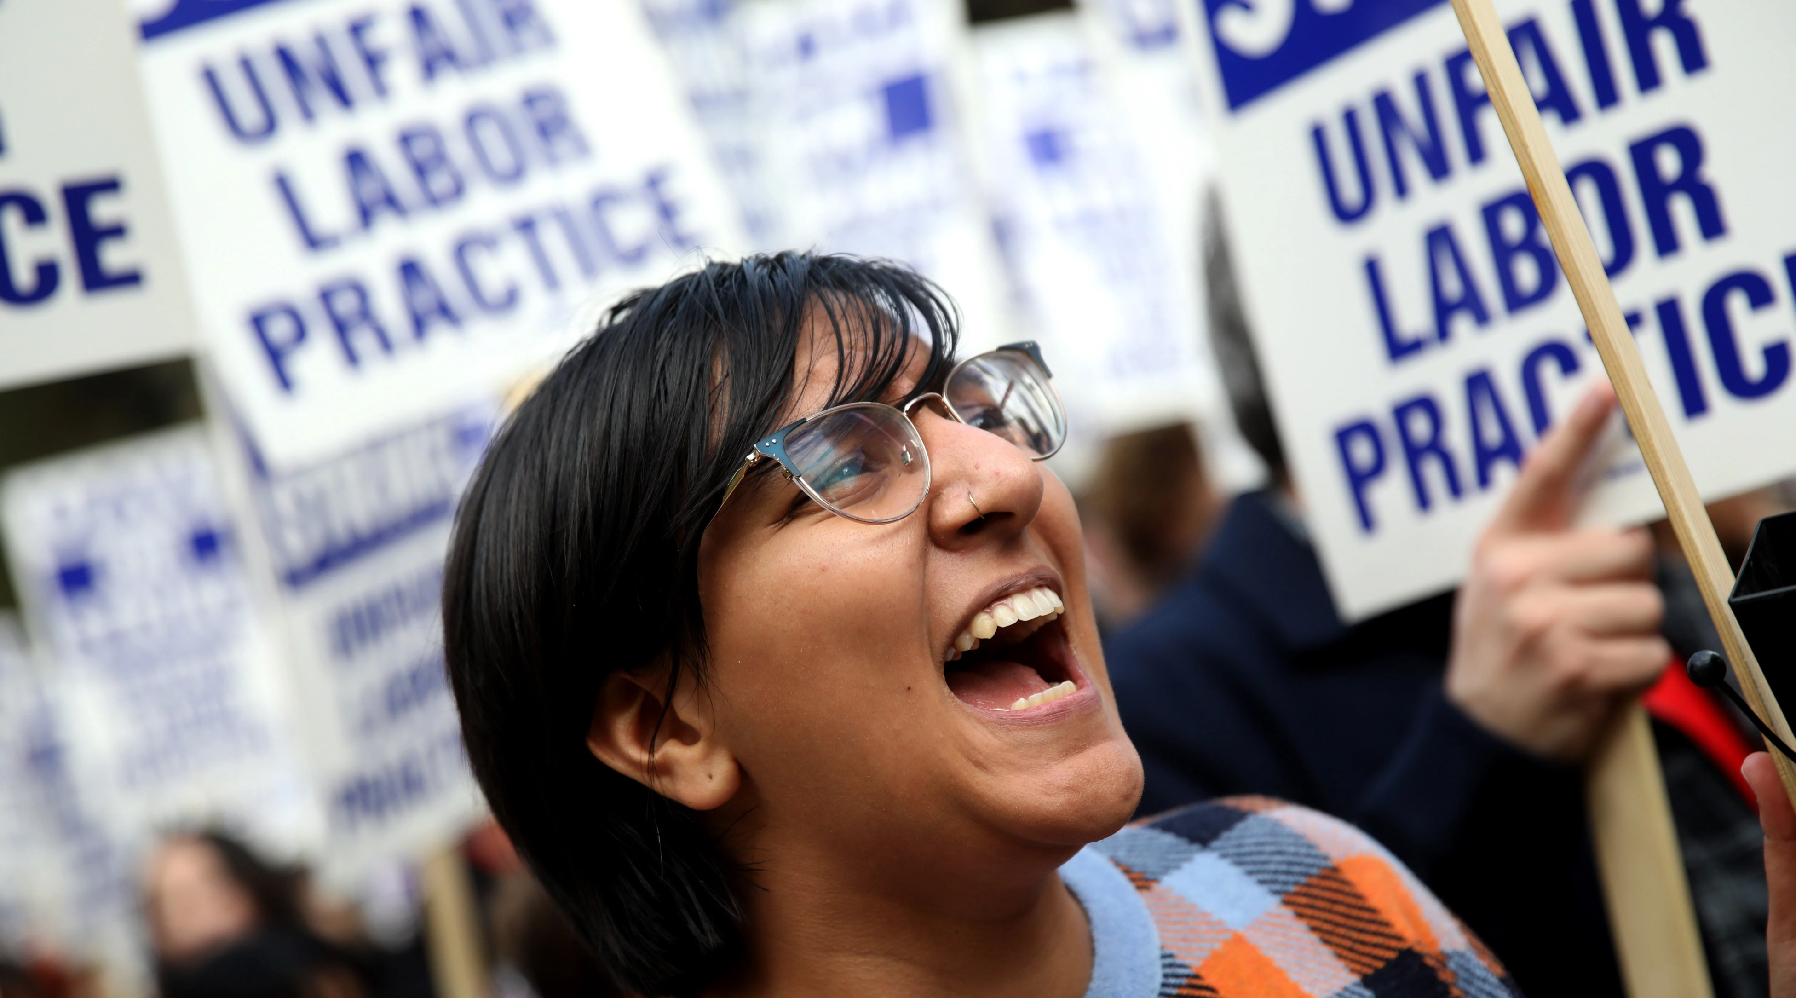
Three Theories of Power
JANE MCALEVEY
Mobilizing as a stand-alone theory:
This approach is primarily elite-driven. ​ Professional staff or activists set goals and direct the mobilization efforts. ​ While it brings large numbers of people to the fight, it often involves the same dedicated activists and lacks the full mass of their coworkers or community. ​ The strategy is controlled by the staff, and the participants have little say in the power analysis or strategy.
Reframing Mobilizing for as interconnected:
Mobilizing is doing, and the mobilized do stuff. For staff, mobilizing is the way we identify other potential advocates (leaders). Mobilizing should be the way we test strategy, assess strengths and weaknesses, provide practical experience for identified potential advocates – learning, growing power and our ability to project it.
Advocates are those who have the privilege to advocate. ​
Mobilizers- not as connected ​
Organizers- Leaders who are trusted and respected.
Notes:
(Chad)
We’ve typically discussed these theories of power in terms of a disconnected rank order of actions instead of an interconnected strategy
Advocacy DOES alter power relations
Mobilizing IS NOT exclusively one direction
Organizing IS the culmination of Advocacy and Mobilizing

Slide 10
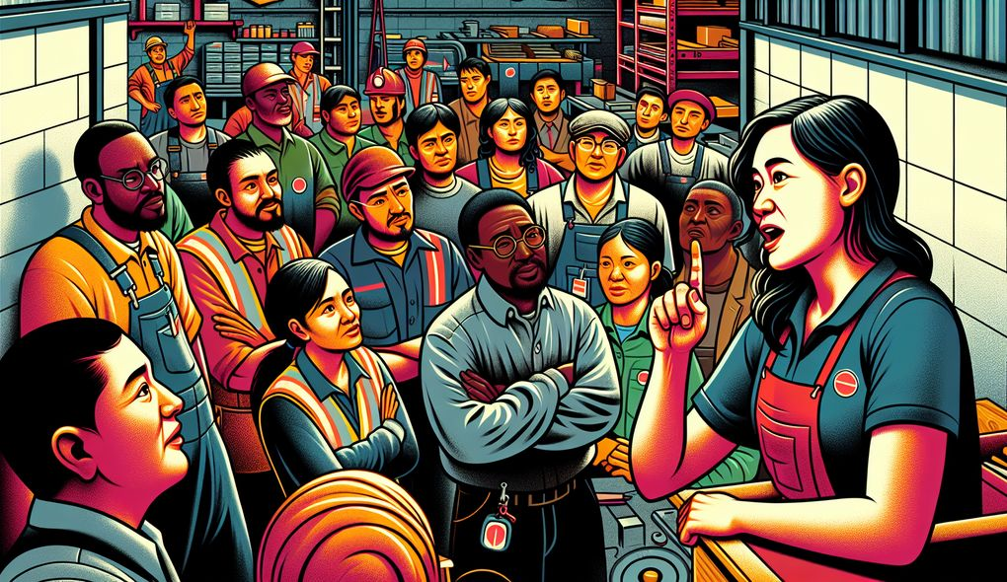
Three Theories of Power
JANE MCALEVEY
Organizing as a stand-alone theory:
This approach is mass, inclusive, and collective. ​ It aims to transform the power structure to favor constituents and diminish the power of their opposition. ​ Organizing involves ordinary people in the power analysis and strategy, focusing on mass negotiations and sustained actions to achieve significant change. ​ The goal is to transfer power from the elite to the majority.
Organizing reframed as interconnected:
This approach is mass, inclusive, and collective (Mobilize). ​ It aims to transform the power structure to favor constituents and diminish the power of their opposition. ​ Organizing involves ordinary people (Advocates) in the power analysis and strategy, focusing on mass negotiations and sustained actions to achieve significant change. ​ The goal is to transfer power from the elite to the majority.
Advocates are those who have the privilege to advocate. ​
Mobilizers- not as connected ​
Organizers- Leaders who are trusted and respected.
Notes:
(Chad)
We’ve typically discussed these theories of power in terms of a disconnected rank order of actions instead of an interconnected strategy
Advocacy DOES alter power relations
Mobilizing IS NOT exclusively one direction
Organizing IS the culmination of Advocacy and Mobilizing

Slide 11
Interconnecting Theories of Power
Jane McAlevey & Jo Freeman
Organizing reframed as interconnected:
This approach is mass, inclusive, and collective (Mobilize). ​ It aims to transform the power structure to favor constituents and diminish the power of their opposition. ​ Organizing involves ordinary people (Advocates) in the power analysis and strategy, focusing on mass negotiations and sustained actions to achieve significant change. ​ The goal is to transfer power from the elite to the majority.
The Tyranny of Structurelessness
Jo Freeman
Informal hierarchies and power dynamics still emerge, often favoring those with pre-existing social advantages.
Power and the structures of power are inevitable, and staff serve to ensure that they be intentionally designed to serve the group’s goals and values.
Advocates are those who have the privilege to advocate. ​
Mobilizers- not as connected ​
Organizers- Leaders who are trusted and respected.
Notes:
(Chad)
We’ve typically discussed these theories of power in terms of a disconnected rank order of actions instead of an interconnected strategy
Advocacy DOES alter power relations
Mobilizing IS NOT exclusively one direction
Organizing IS the culmination of Advocacy and Mobilizing

Slide 12
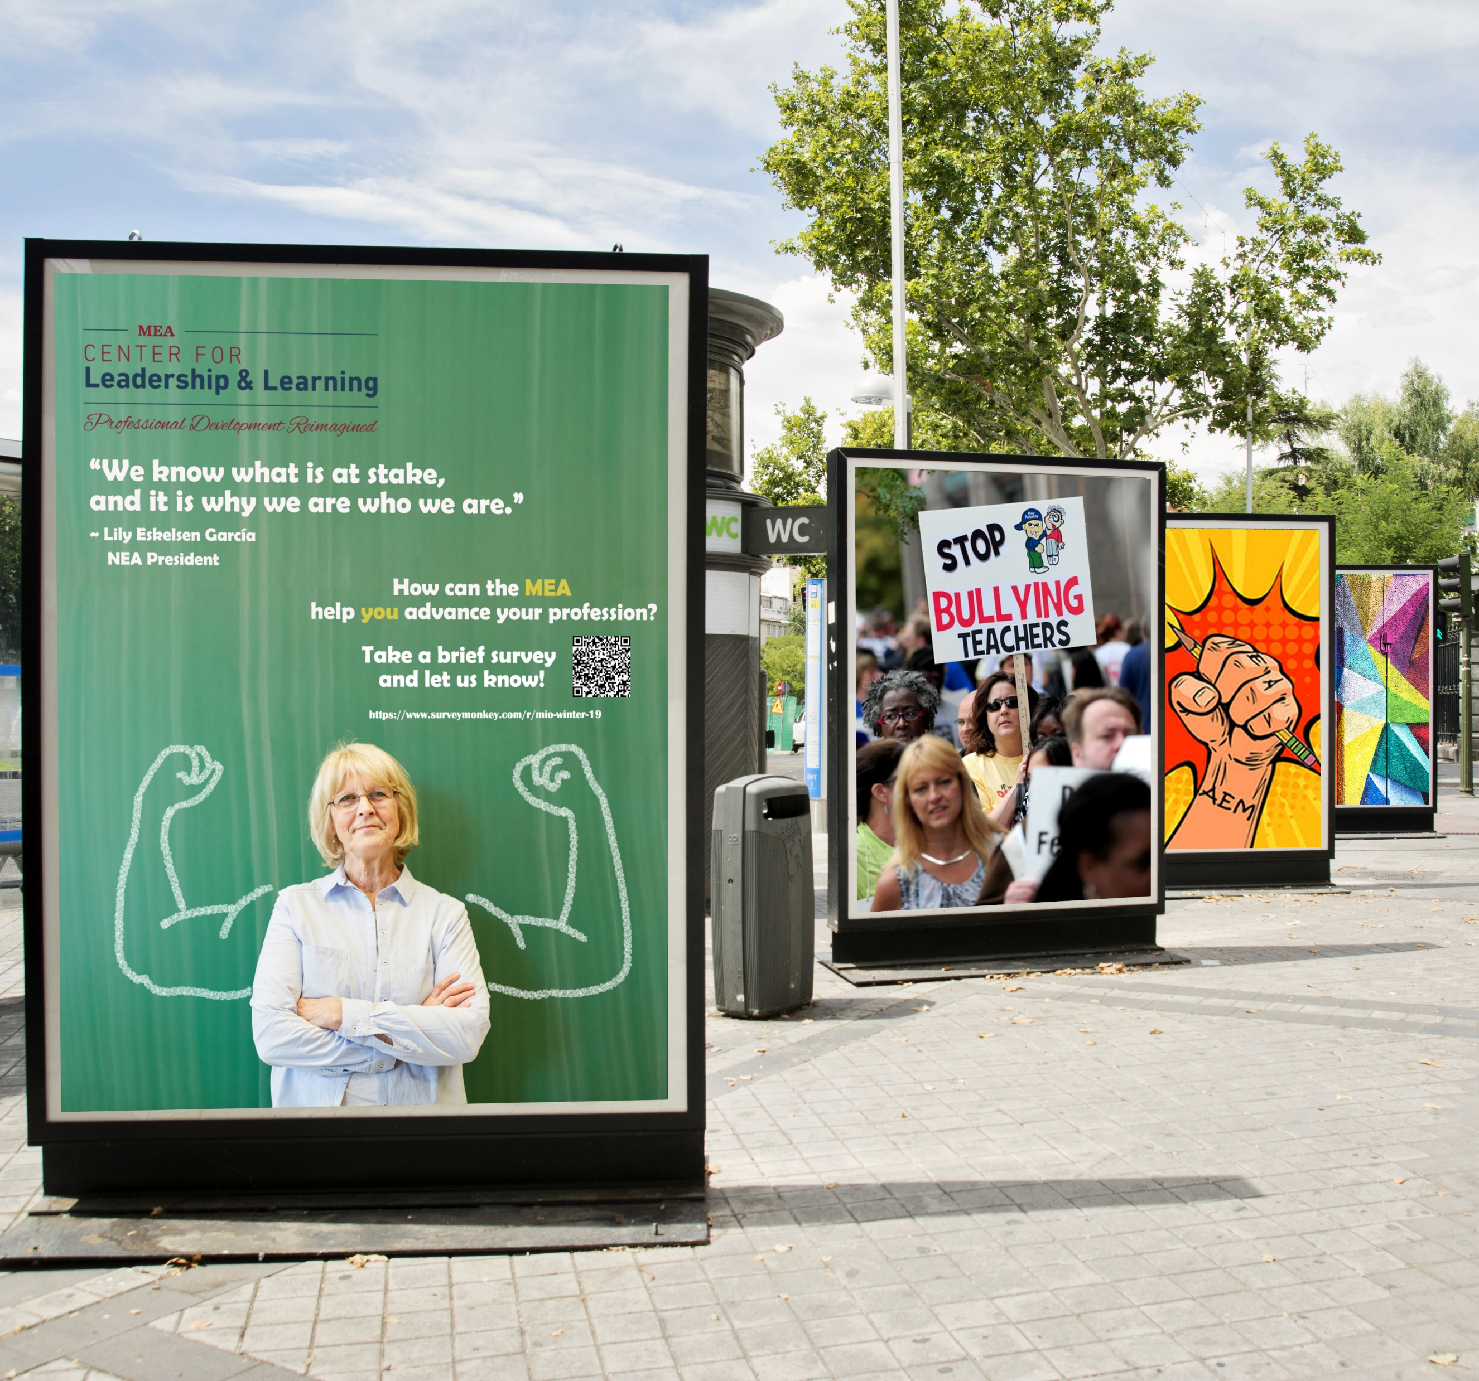
Three Theories of Power Jane McAlevey
The Tyranny of Structurelessness Jo Freeman
Advocacy
Mobilizing
Organizing

Slide 13

Embodying Core Values
Fairness, honesty/integrity, responsibility, compassion/empathy, safety, health, generosity, hard work/responsibility, community, freedom, democracy, binding contracts, equality, opportunity, respect, stability/security, unity, quality work, justice, collective action, dignity/respect, charity/community service, and due process.
Ideally:
Unions advance the welfare of all workers. They are based on the idea of justice, progress, and betterment of self and of society. They embody the universal ideal of human rights and the need to aspire to become more complete human beings. By becoming an active participant in the labor movement, members become part of something larger than themselves.
But this training isn’t about members…it’s for us staff

Slide 14
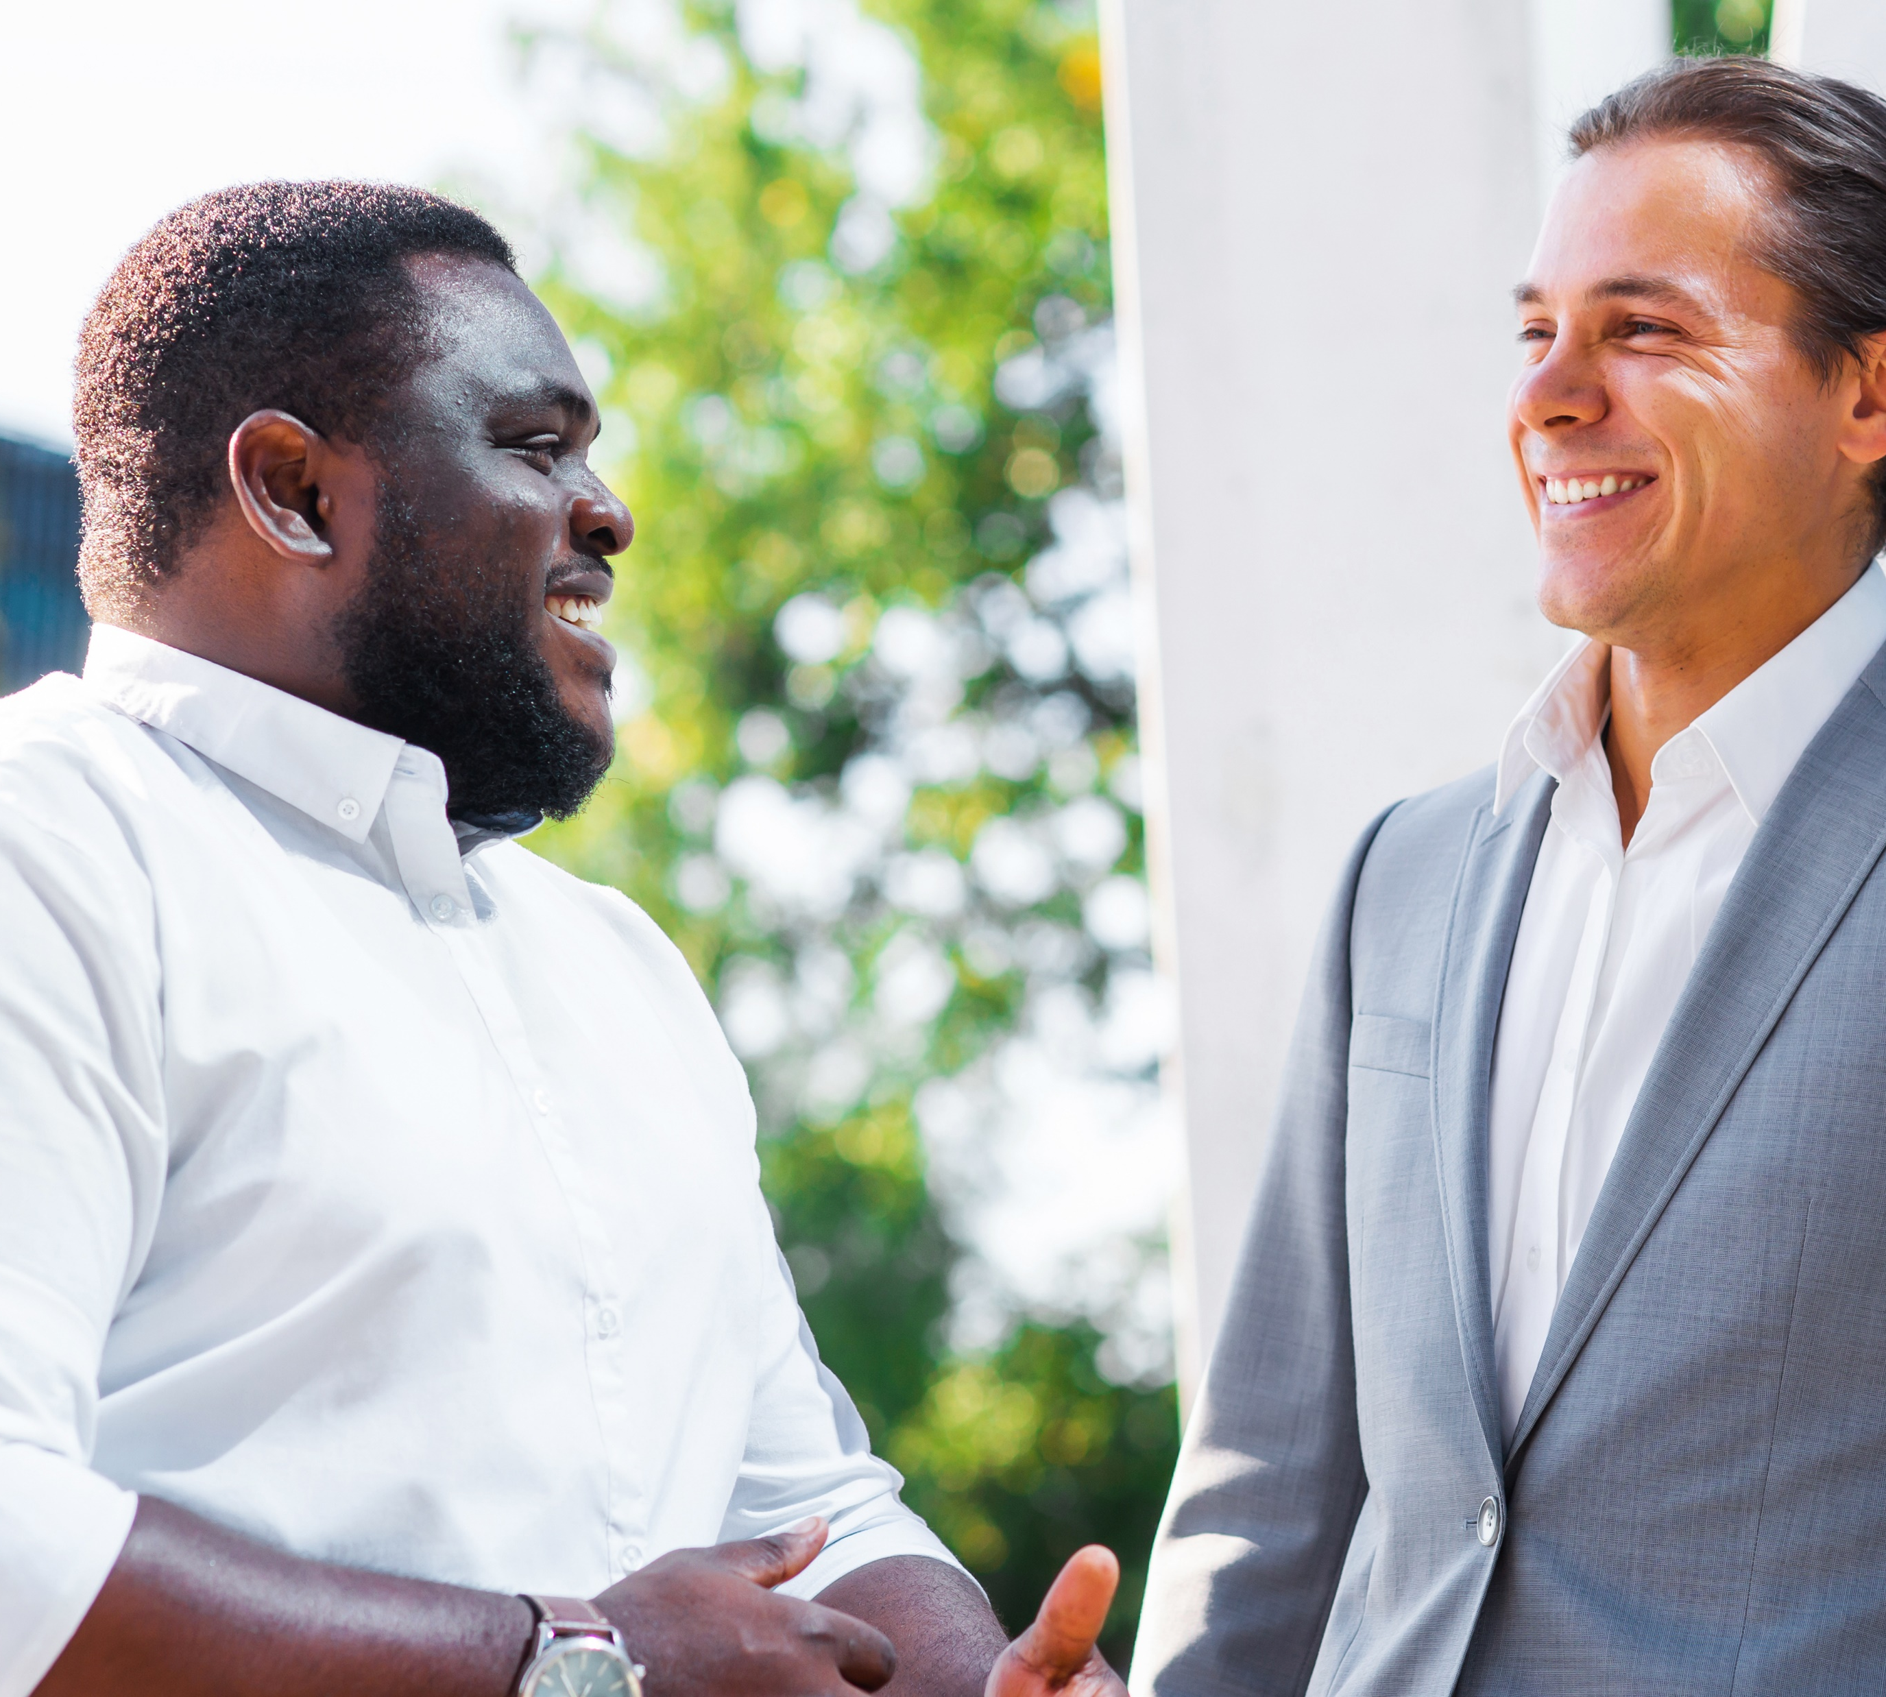
What Happens When We Say…
Fairness, honesty/integrity, responsibility, compassion/empathy, safety, health, generosity, hard work/responsibility, community, freedom, democracy, binding contracts, equality, opportunity, respect, stability/security, unity, quality work, justice, collective action, dignity/respect, charity/community service, and due process.
What privileges might union staff have compared to members / potential members (e.g., income, job security, safety)?
How might these privileges create barriers to trust or solidarity?

Slide 15

Planning
Coaching
Partnering
Included
Hooked
Activated
Intrigued
Interested
Aware
Unaware
What barriers must be reduced and how do we build trust through Advocacy and /or Mobilizing to create the environment to achieve high-participation organizing?

Slide 16

Planning
Coaching
Partnering
Included
Hooked
Activated
Intrigued
Interested
Aware
Unaware
What barriers must be reduced and how do we build trust through Advocacy and /or Mobilizing to create the environment to achieve high-participation organizing?

Slide 17
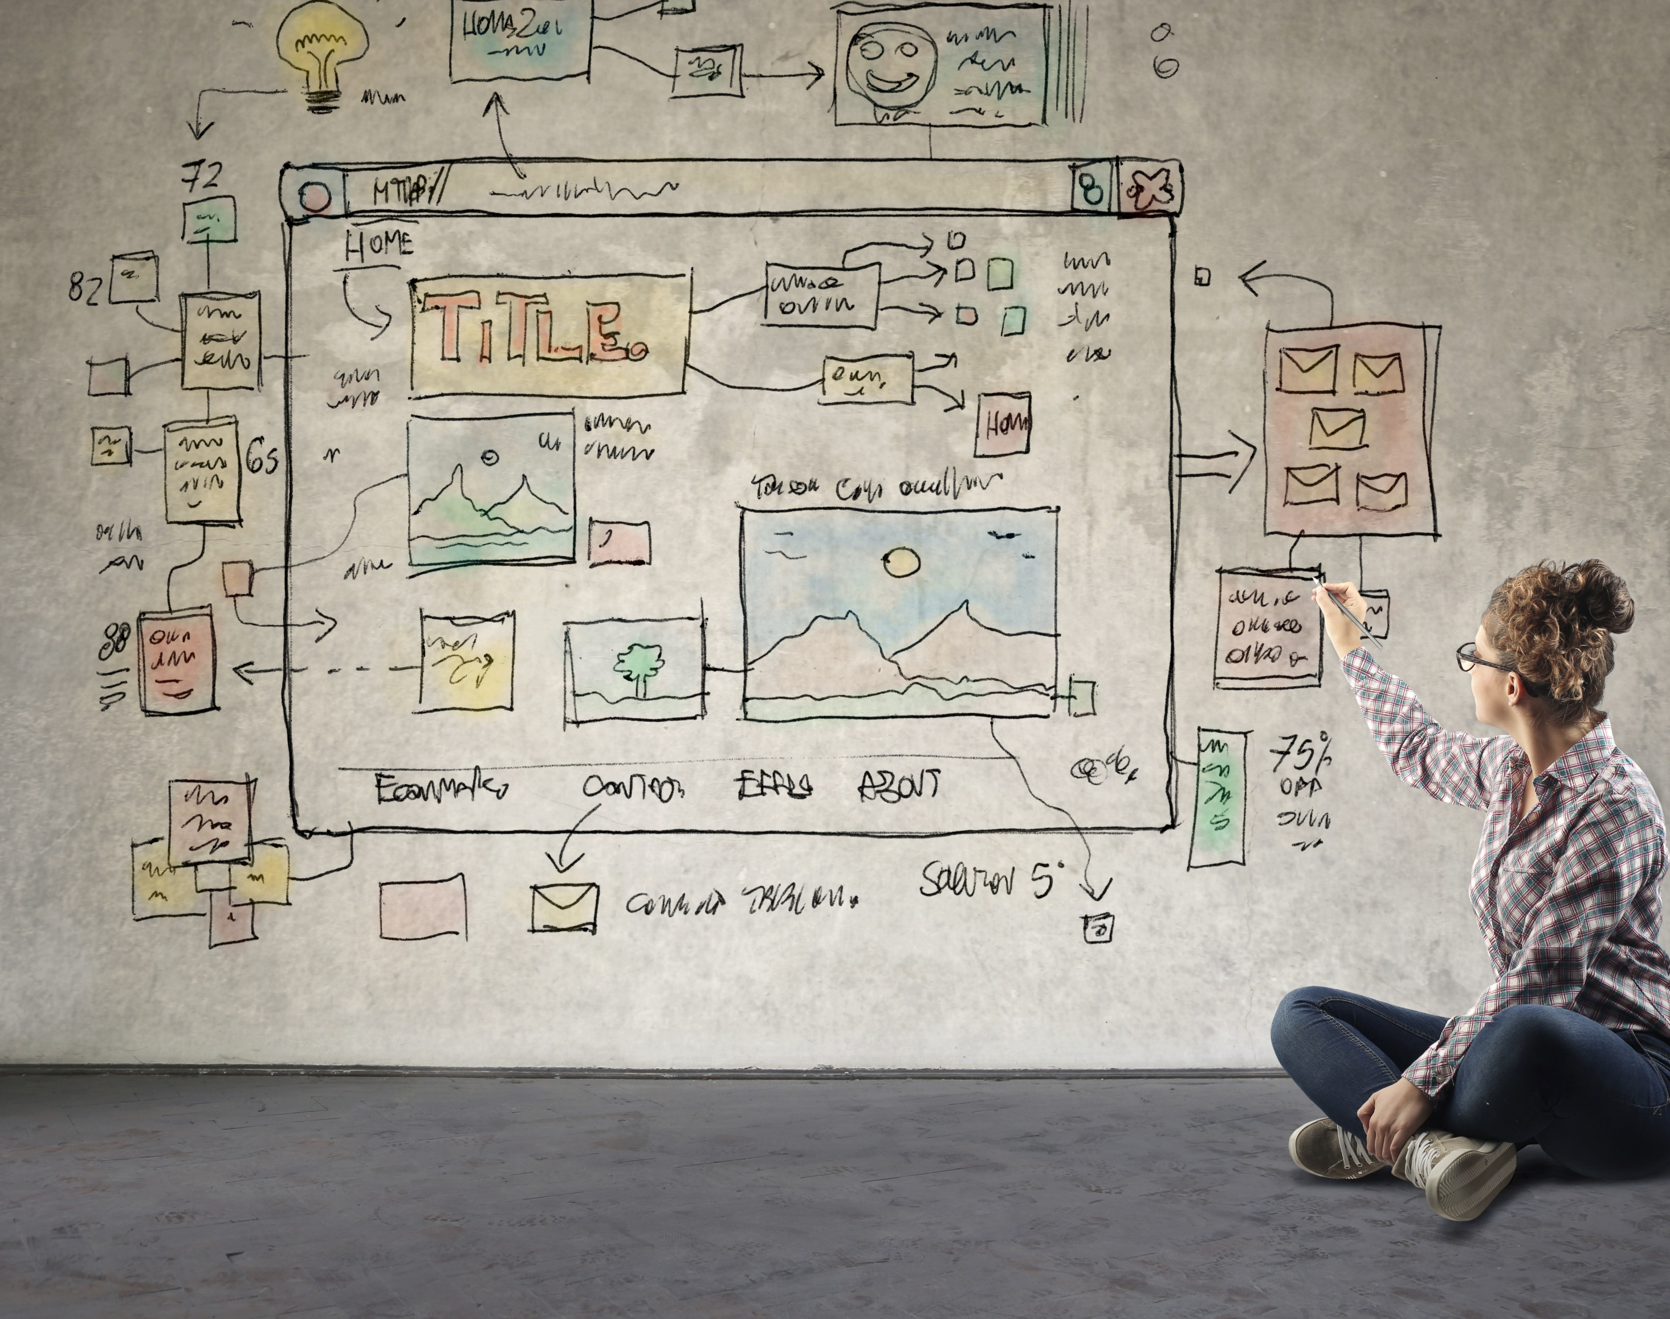
Messaging Matters
A website is often the first impression. Understanding union semantics

Slide 18
Find the webpage link matching your group number. Determine a SCRIBE and Reporter
(See Google Doc)
1- What message is being delivered by the webpage?
2- What are the strengths and weakness of the page?
Slide 17: Breakout Rooms for Website Analysis (5 min)
1. Explain how the breakout rooms are going to work and how to scroll to correct example that matches Breakout room # on the Google Form.
2. Ensure each group has both a scribe and a reporter

Slide 19
Find the webpage link matching your group number. Determine a SCRIBE and Reporter
(See Google Doc)
1- What message is being delivered by the webpage?
2- What are the strengths and weakness of the page?

Slide 20
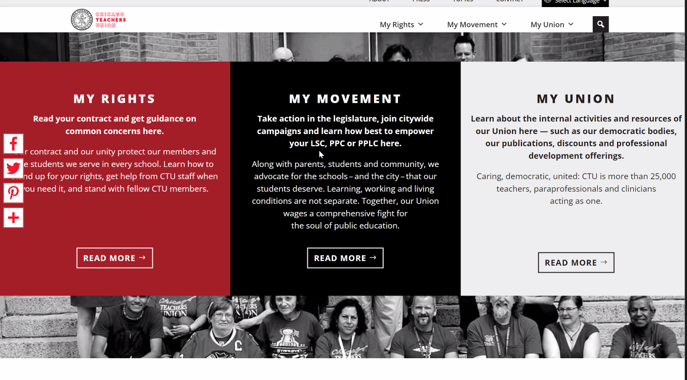
Messaging Matters
A website is often the first impression. Understanding union semantics

Slide 21
Don’t 3rd Party The Union
Even the smallest words represent a fulcrum of power. Referring to “the union” rather than “me” or, better, “us” linguistically denotes it as a third party.

Slide 22
Find the group of phrases matching your group number. Determine a SCRIBE and Reporter
(See Google Doc)
1- Rewrite the phrases reframing the phrases to eliminate 3rd party or patronizing language

Slide 23
Find the group of phrases matching your group number. Determine a SCRIBE and Reporter
(See Google Doc)
1- Rewrite the phrases reframing the phrases to eliminate 3rd party or patronizing language

Slide 24

The Messenger
Matters
The first touch likely won’t be from staff. Who is doing the ask is important

Slide 25
Who is the best person to be inviting workers to join their union?
What methods and/or resources do these people need to invite workers to join their union?
Is this how it is typically done where you work?

Slide 26
Who is the best person to be inviting workers to join their union?
What methods and/or resources do these people need to invite workers to join their union?
Is this how it is typically done where you work?

Slide 27

Building power requires…
the intentional and continual inclusion of those who are not already part of the base.

Slide 28
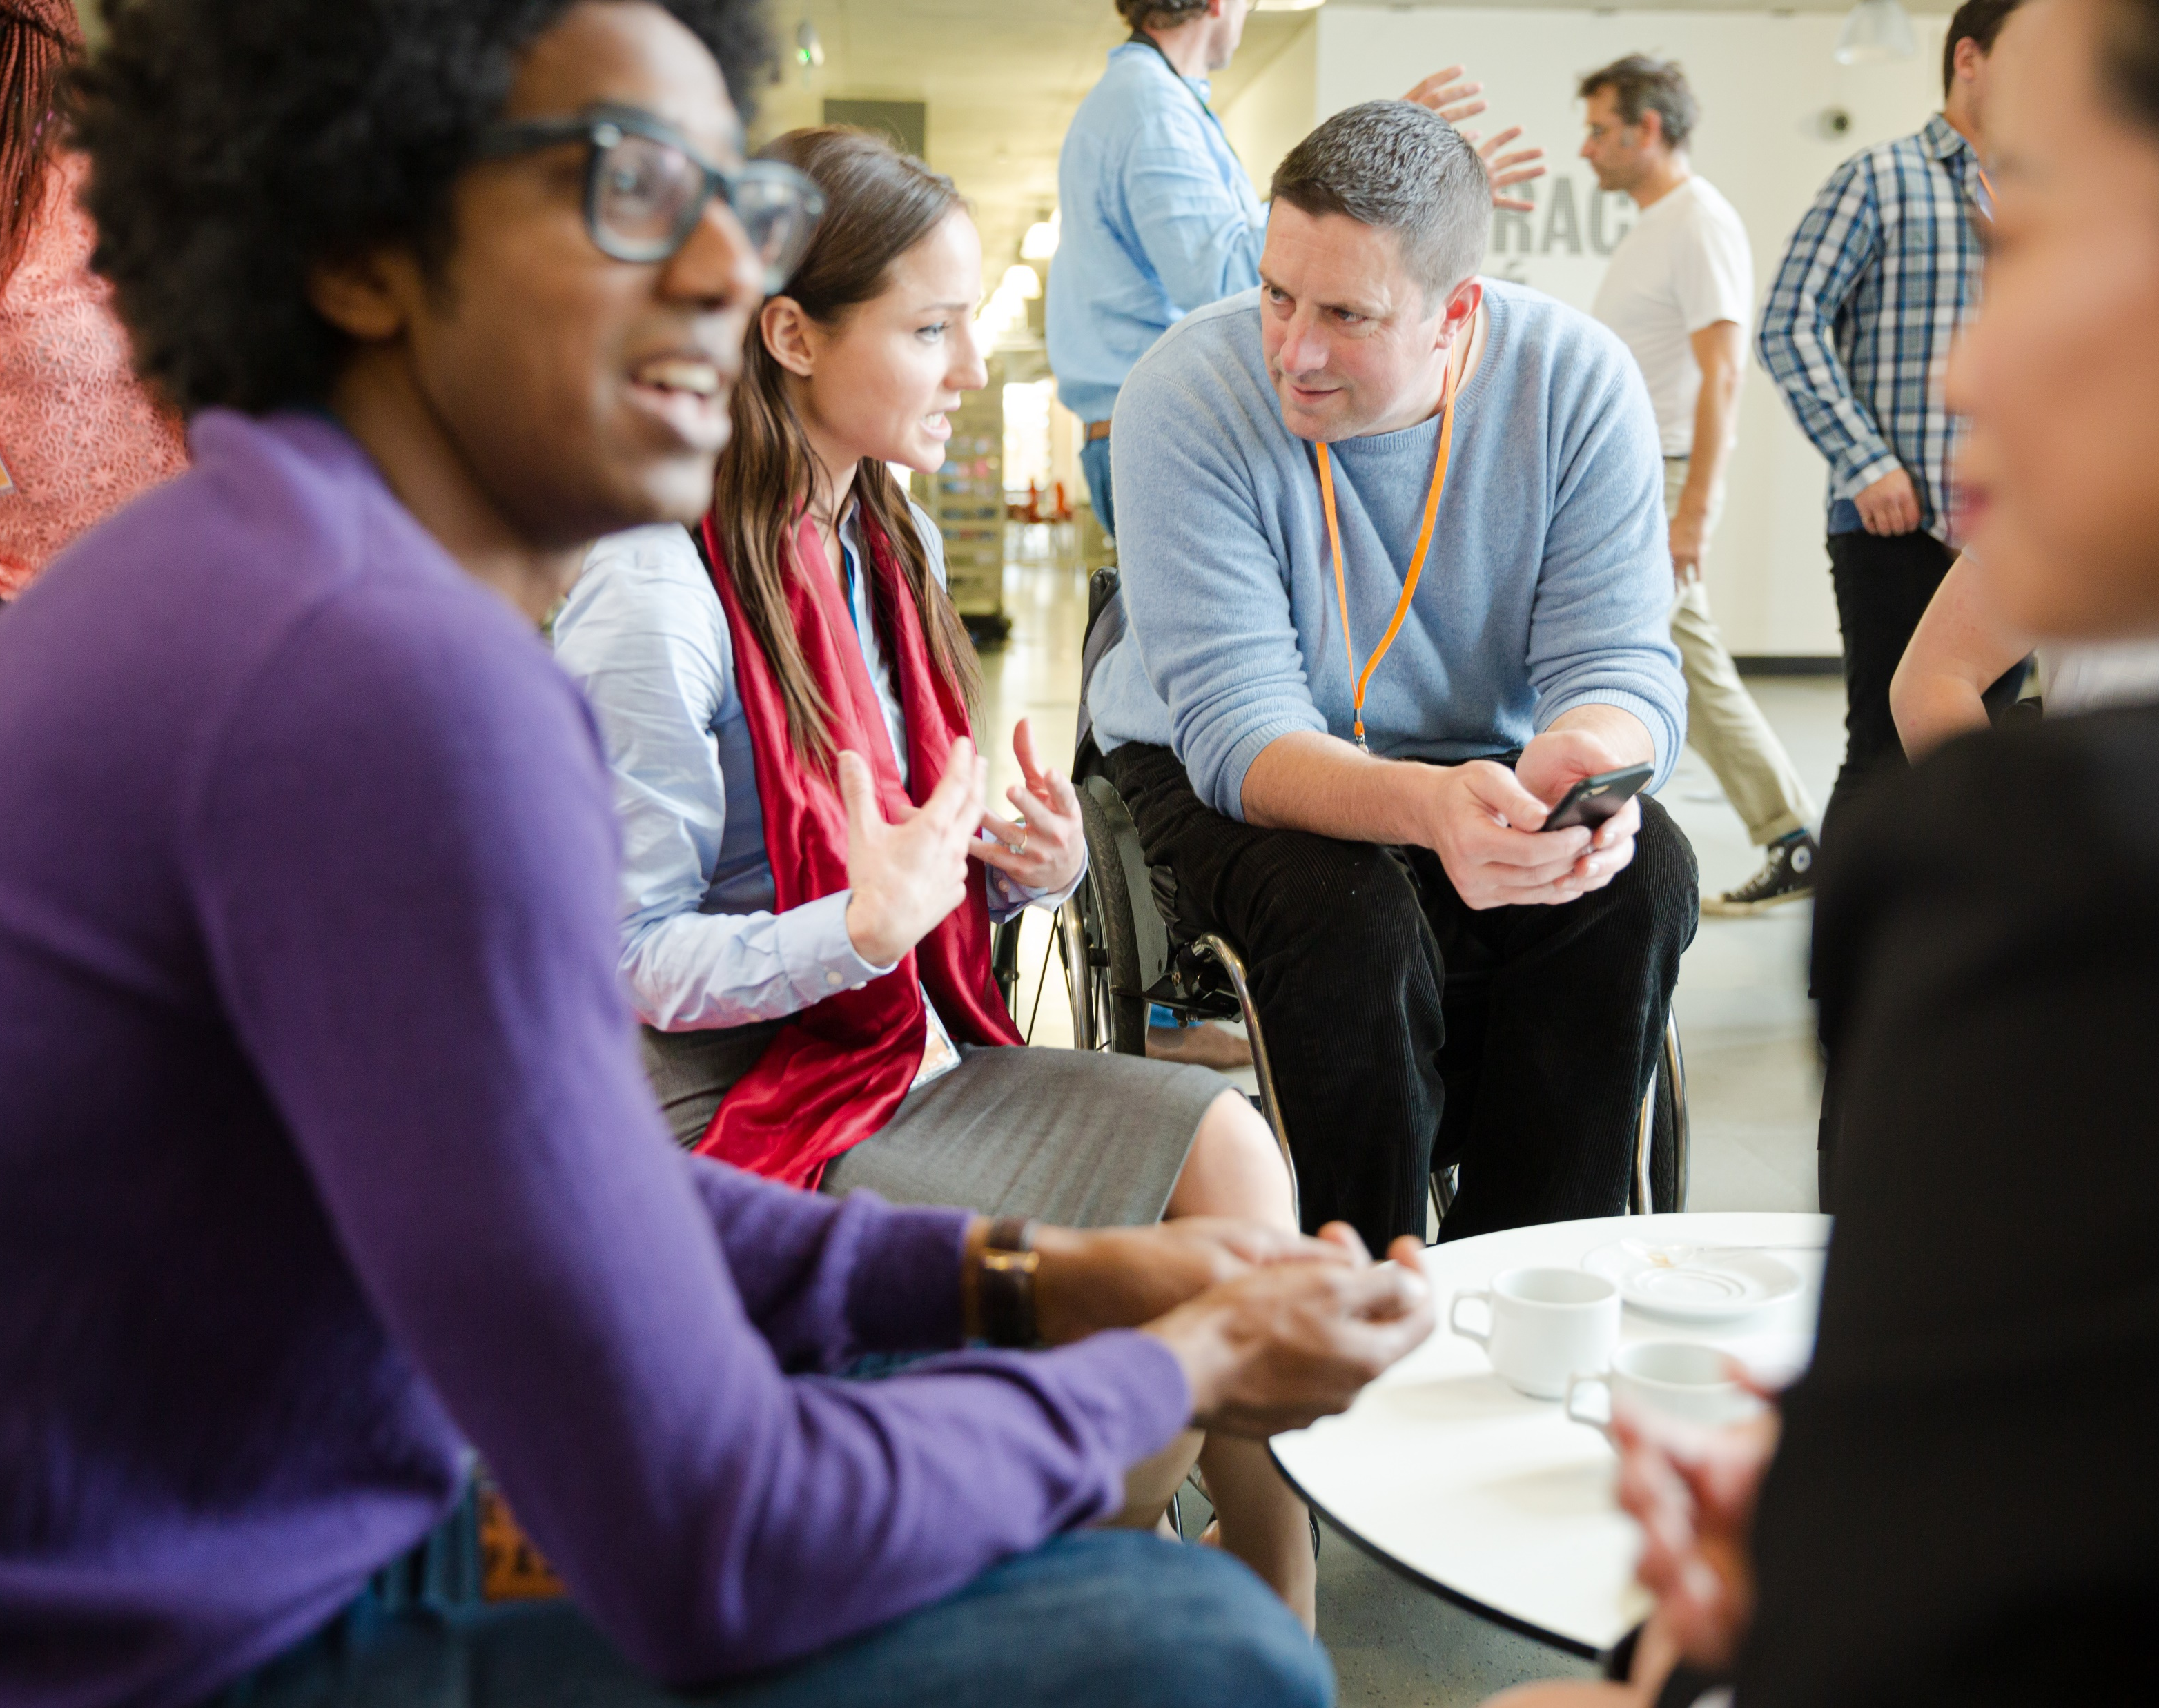
Reframing Membership:
The best person to make the invitation…
Is trusted and respected
Can present a relatable, value centered why
Is honest about the risk involved with making change

Slide 29
Ending It Right
Reframing Membership
Raising Expectations
Next Online Session
February 23
Flipping School Board Elections
Next F2F Event
January 31- February 2, Constituency Organizing, From Club to Fighting Union
All UniServ & Organizer Support Programming

Slide 30
Contact Us:
Dawn Moretz
UniServ Director
Montgomery County
Education Association
dmoretz@mceanea.org
Zach Johnson
UniServ Director
Colorado
Education Association
zjohnson@coloradoea.org
Chad Williams
UniServ Consultant
Michigan
Education Association
cwilliams@mea.org
Ellen Holmes
Organizational Specialist
National
Education Association
eholmes@nea.org

