Slide 1


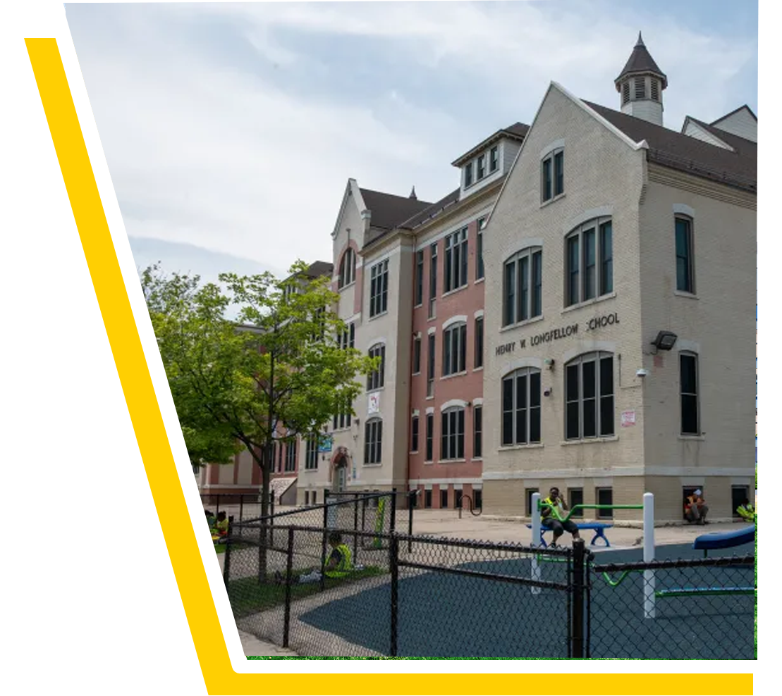


Promoting Environmental and Occupational Health and Safety
Eunice Salcedo
Sr Health and Safety Specialist
National Education Association
esalcedo@nea.org
Chad Williams
UniServ Consultant Michigan
Michigan Education Association
cwilliams@mea.org

Slide 2

Learning Objectives
Review common health and safety hazards in educational settings.
Identify what resources are available for health and safety, including tools.
Recognize and prioritize the health and safety issue around which to organize members and build a campaign.
This Photo by Unknown Author is licensed under CC BY-SA

Slide 3
The Series
This workshop is one of three workshops focusing on health and safety.
Promoting Environmental and Occupational Health and Safety (Today)
2. Safe Schools – Advocating for Student Well-being and Restrictions on Student Personal Device Use (February 17)
3. Strong and Effective Sex Ed Advocacy to Promote Student Health and Academic Success (March 5)
This Photo by Unknown Author is licensed under CC BY-SA

Slide 4
Please type in the chat the health and safety issues members have expressed concerns about in the past year.

Slide 5
Health and Safety Issues
(Selected List)
Allergies
Asbestos
Bloodborne hazards
Bullying
Chemical use/storage/exposure
Climate justice
Cold
Disaster preparation
Ergonomic hazards
Food-service concerns (burns, etc.)
Formaldehyde
Gun violence
Health education
Health Services
Heat
Immunization/vaccination
Infectious diseases
Indoor air quality
Infrastructure
Lead (in paint, water, etc.)
Mental health and stress
Mercury
Mold
Musculoskeletal problems
Natural disasters
Opioids
Polychlorinated biphenyls (PCBs)
Pollution (generation of/proximity)
Safe passage
Sexual and reproductive health
Slips, trips, and falls
Smoking
Staffing and workload
Vaping
Violence (threats, attacks)
Water (access to clean water)
Notes:
First, we would like to hear from you.
Ask participants what health and safety issues have members expressed concerns with. Please type them in the chat.
Highlight any patterns, similar, or unique issues.

Slide 6
Health and Safety Issues
(Selected List)
Allergies
Asbestos
Bloodborne hazards
Bullying
Chemical use/storage/exposure
Climate justice
Cold
Disaster preparation
Ergonomic hazards
Food-service concerns (burns, etc.)
Formaldehyde
Gun violence
Health education
Health Services
Heat
Immunization/vaccination
Infectious diseases
Indoor air quality
Infrastructure
Lead (in paint, water, etc.)
Mental health and stress
Mercury
Mold
Musculoskeletal problems
Natural disasters
Opioids
Polychlorinated biphenyls (PCBs)
Pollution (generation of/proximity)
Safe passage
Sexual and reproductive health
Slips, trips, and falls
Smoking
Staffing and workload
Vaping
Violence (threats, attacks)
Water (access to clean water)
Notes:
The health and safety issues listed on this slide are a selected list, meaning there are a lot of other issues that are not listed because of space limitations. The health and safety issues in orange are the health and safety issues the NEA program has worked on with state affiliates.
I would like to convey that we respond to affiliate requests, so even if there’s a health and safety topic they don’t hear about, we are happy to assist folks think it through and find the support they need.

Slide 7
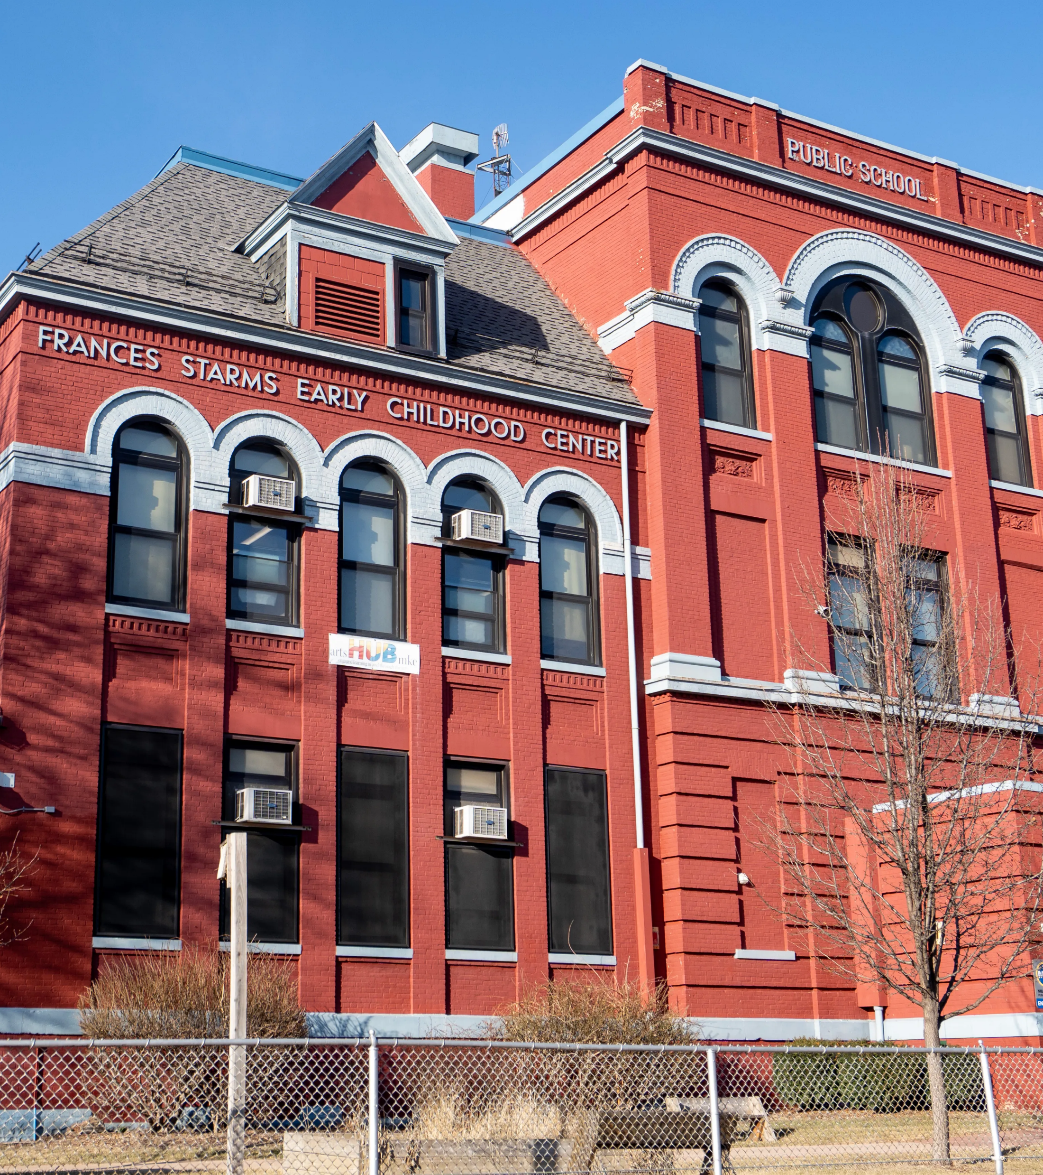
Unique Characteristics of a School
Occupants are close together, with the typical school having approximately four times as many occupants as office buildings for the same amount of floor space.
A variety of pollutant sources are introduced during learning activities, such as supplies and materials for art, science, home economics, and industrial or vocational arts classes.
Multiple HVAC units and other mechanical equipment can place an added strain on custodial and maintenance staff.
Maintenance often receives the largest cut during budget reductions resulting in staff reductions and deferred maintenance practice.
Notes:
Schools are unique ecosystems. They have characteristics that are different from other workplaces.

Slide 8

Common Pollutants
Viruses, bacteria and fungi
Carbon monoxide, carbon dioxide, cleaning products
Particulate matter 2.5, 10
  asbestos
  lead dust

Slide 9
Indoor Air Quality
Poor Indoor Air Quality
Health Outcomes
Learning outcomes
Behavior outcomes
Notes:
The COVID-19 pandemic demonstrated the importance of good indoor air quality.
We will begin exploring the variety of ways health and safety issues manifest. The idea and term “indoor air quality” should be explained as a comprehensive term that often refers to the quality of the overall indoor air in an environment.
Major Causes for Poor IAQ
Pollution sources, like mold, CO2, wildfire smoke
Improperly operated and maintained HVAC, there are a variety of pollutant sources some of which are introduced for learning, such as supplies and materials for art, science, home economics, and industrial or vocational arts classes
occupants are close together
Poor IAQ affects teaching and learning
Increased absenteeism due to illness. Asthma is the leading chronic disease-causing school absenteeism a total of 10 million missed school days per year.
Poor IAQ can lead to headaches, dizziness, sleepiness, and other factors inhibiting performance in the class. Difficult to concentrate.
Why Haven’t We Made it Safer to Breathe in Classrooms?” https://www.nytimes.com/2023/08/09/opinion/air-filter-covid-smoke-schools.html

Slide 10
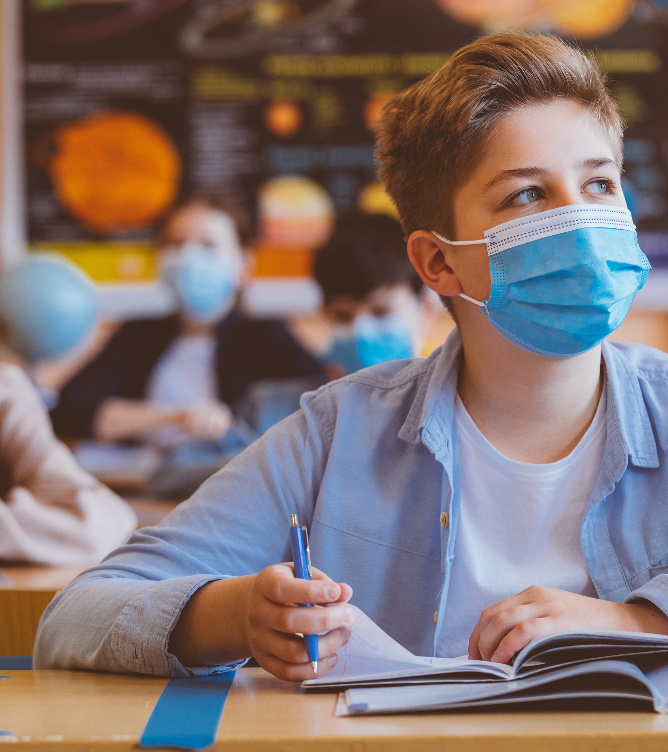
Impacts of Indoor Air Quality
Student achievement: Higher ventilation rates improve math and reading scores.
Cognition & productivity: Poor IAQ reduces cognitive performance and increases sick days.
Health & safety: Better IAQ lowers disease spread and respiratory risks.
Learning conditions: Lower CO₂, better airflow, and cooling improve focus and test performance.
Notes:
A study of 100 U.S. schools found a direct association between student academic achievement and classroom ventilation rates, and that measurable progress in math and reading scores were observed when school indoor air quality was improved.
Poor IAQ in schools has been linked to cognitive deficits and negative and tangible economic impacts in the workplace, including impacts on the number of employee sick days and job retention.
Improving IAQ will diminish routine exposure to airborne diseases, limit outbreaks or epidemics, and lower risks of noninfectious respiratory conditions like asthma that affect the health of millions each year.
Studies have identified that increasing ventilation rates, decreasing CO2 levels, and providing cooling can improve student academic performance. As such, many studies have focused on specific indicators including concentration, distraction, memory, fatigue, task completion speed, test scores, and overall grade point average.

Slide 11

Environmental Racism Explained
Notes:
Cut Video at 1:57 Minute \
when hearing health complaints from members, how often did you connect the complaint to the individual or building, and how often have you connected the complaint to a community?

Slide 12
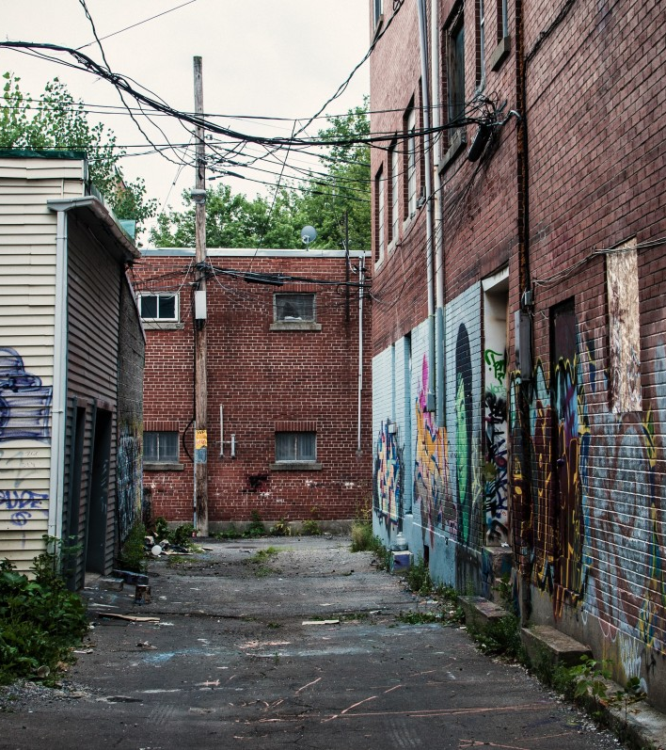

Environmental Injustice

Slide 13

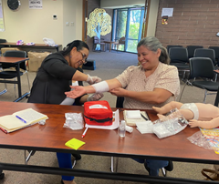
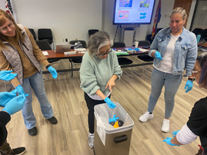



NEA Health and Safety Program

Slide 14



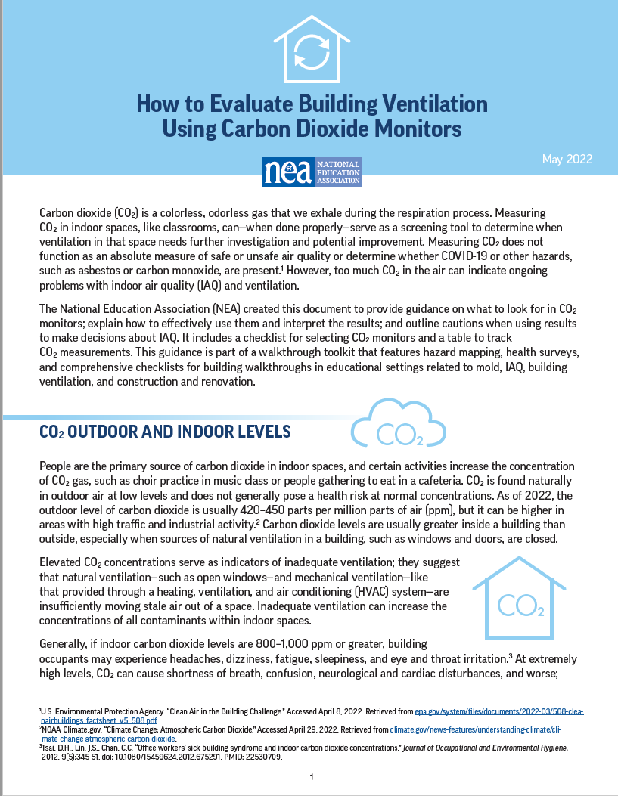

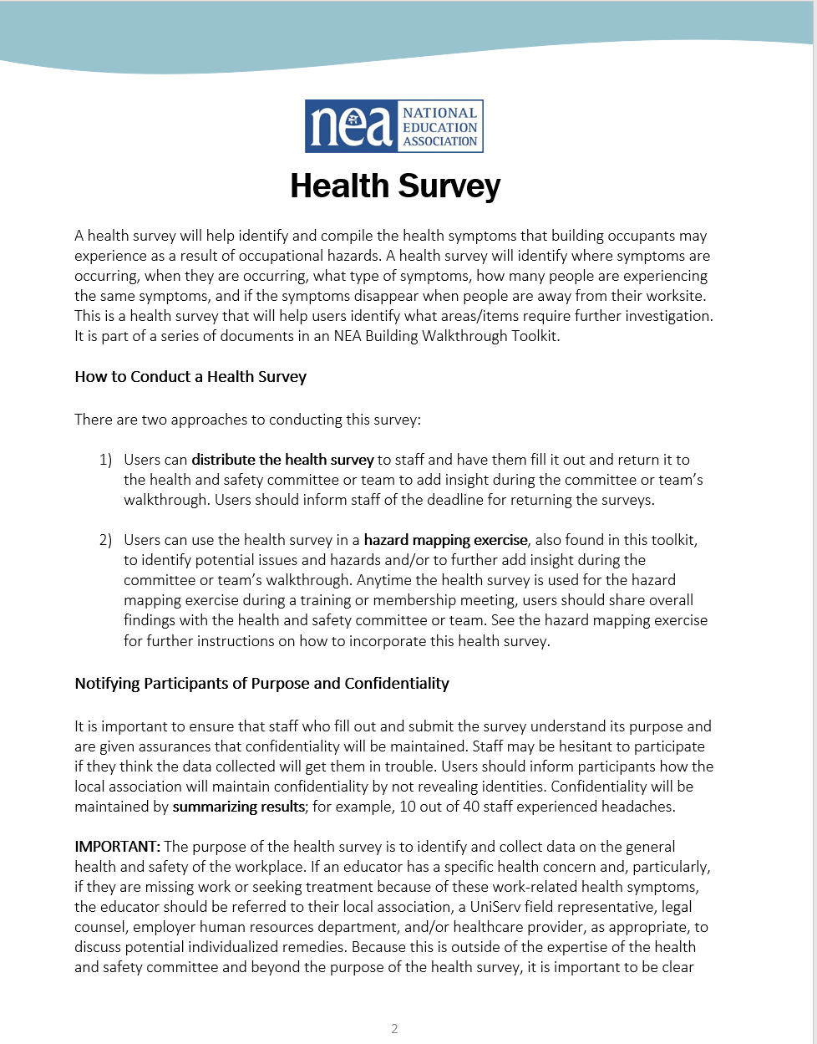
NEA Health and Safety Webpage
& Resources
Evaluating ventilation using
CO2 monitors
NEA building walkthrough toolkit
Notes:
Building Walkthrough Toolkit: Healthy Buildings & Systems | NEA
Evaluating Ventilation using CO2 Monitors: How to Evaluate Building Ventilation Using Carbon Dioxide Monitors | NEA

Slide 15
Agencies or Organizations
OSHA – OSHA State plans cover public sector workers
EPA – resources on IAQ, and other health and safety issues
National COSH—strategies, resources, training on occupational safety and health www.coshnetwork.org​
ACGIH—mold remediation guidelines www.acgih.org​​
ASHRAE—ventilation/thermal comfort standards
AIHA—find recommended consultants for mold and other safety issues www.aiha.org
Notes:
Building Walkthrough Toolkit: Healthy Buildings & Systems | NEA
Evaluating Ventilation using CO2 Monitors: How to Evaluate Building Ventilation Using Carbon Dioxide Monitors | NEA

Slide 16

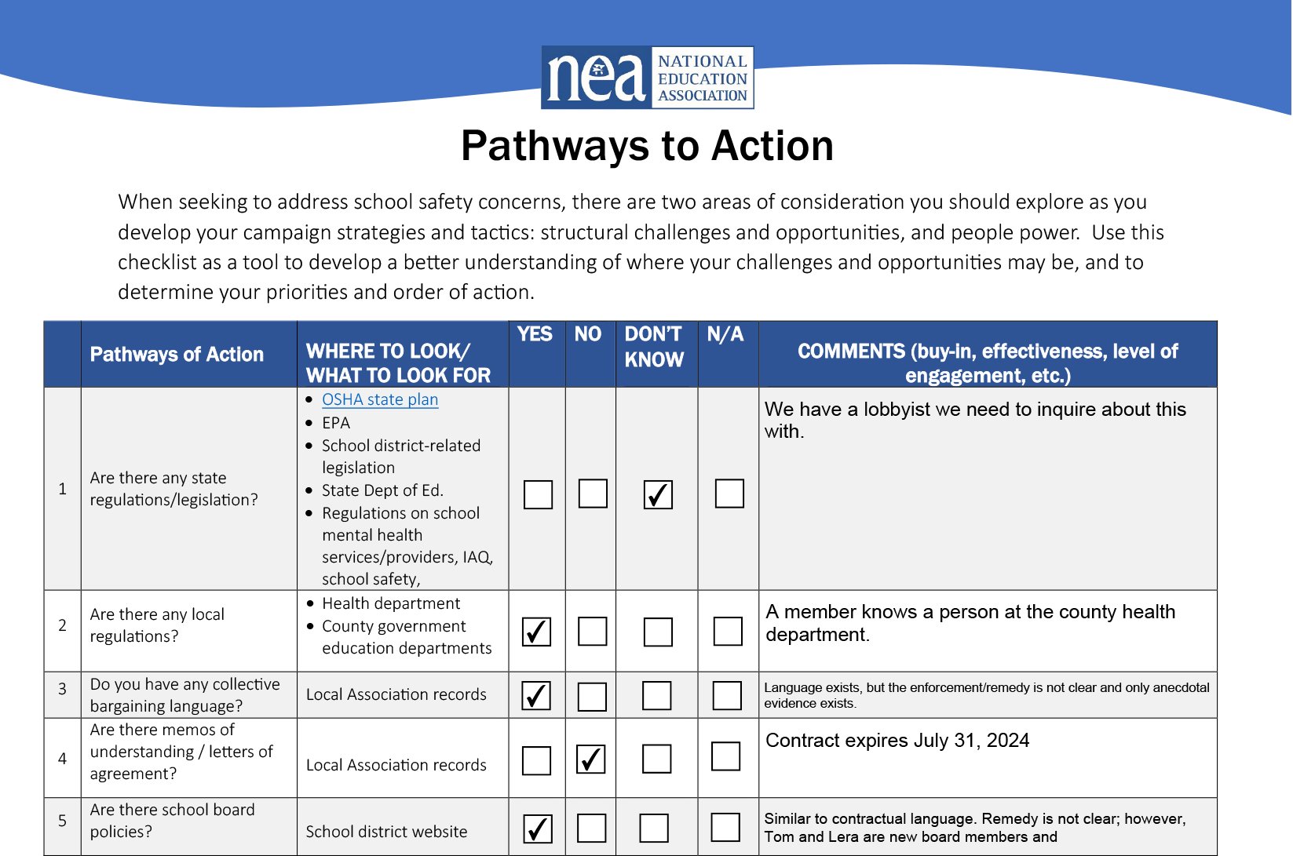
Organizing around Health and Safety
Pathways to Action Tool
Understand the organizing landscape
Identify winnable objectives
Determine if the objectives can be part of a larger campaign
Engage more stakeholders
Communicate clearly, simply, viscerally, and consistently

Slide 17

Organizing around Health and Safety
Pathways to Action Tool
Look over the Pathways to Action Tool.
How might you use this tool for assessment, prioritizing, and organizing around health and safety?
Notes:
Break out session 10 minutes
In the breakout group questions to consider:
Scan document
ID a current health and safety issue in your work
how could you use this
What way can this tool direct my work in a different way than I typically use?

Slide 18
Milwaukee
In January 2025, Milwaukee Public Schools (MPS) became the center of a major public health crisis after a student at Golda Meir Lower Campus tested positive for elevated blood lead levels.
The Milwaukee Health Department traced the exposure directly to conditions inside the school building. This discovery triggered an emergency response that city and district leaders described as unprecedented for Milwaukee and rare nationally.

Slide 19
Scenario:
Milwaukee Public Schools Lead Remediation
1) We will divide up into small breakout groups ​
2) Discuss the scenario in your small group
    Identify some of the issues and determine the most widely felt and winnable issue.
    How might the Pathways To Action Tool help you organize around the issue?
    Think of a slogan or statement that frames the essential idea of the campaign
3) We will bring the group back together and share.
Notes:
https://docs.google.com/presentation/d/1u79ANfv5py_bYHXpK-LXFJfFLdzqSDVrZGjJ19-Pi9o/edit?usp=sharing

Slide 20

From your small group discussion
    What were some of the issues and determine the most widely felt and winnable issues.
    How might the Pathways To Action Tool help you organize around the issues?
    What might be a slogan or statement that frames the essential idea of the campaign
Report Back

Slide 21


Slide 22

Action Steps and Take Aways
How will you use something you've learned today to facilitate positive change in worksite health and safety?
How would you be able to measure a win in worksite health and safety?
What have you learned today that would add to how you work with your locals?

Slide 23

Questions

Slide 24
Promoting Environmental and Occupational Health and Safety
Eunice Salcedo
Sr Health and Safety Specialist
National Education Association
esalcedo@nea.org
Chad Williams
UniServ Consultant
Michigan Education Association
cwilliams@mea.org

Slide 25
Title
Text

Slide 26



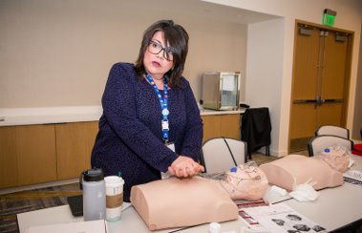
NEA Health and Safety Program
01
Indoor Air Quality Legislation, MD
.
02
EPA Chemical Safety Rule
03
CPR/AED & First Aid in Spanish and other trainings
04
Racine, Wisconsin
Notes:
Since the program started in 2021, we have worked on various issues.
We assisted our affiliate in Maryland as subject matter experts by presenting our testimony for an indoor air quality bill.
We are working with other unions to make EPA’s Risk Management Program (RMP) Rule. this rule is stronger and more protective. The RMP rule has a lot of requirements that toxic industrial facilities must comply with in order to keep workers and communities safe. A lot of these toxic polluting facilities in close proximity of communities of color and schools.
We have facilitated two, we have another one set up in October, Red Cross CPR/AED and First aid classes in Spanish for ESP members. Training in language members is so important, and it is some time we are working to expand it.
In Racine, we are working with the local and school district on architecture design plans of the newly constructed schools to prevent through design and eliminate any safety hazards there could be around violence, indoor air quality, accessibility,, and safe passage.

