Slide 1




Advocating For Student Well-being and Restrictions on Student Personal Device Use
Notes:
Chad - We will be starting soon!
In the chat, please let us know the following:
1. Name
2. State affiliate and/or Local
3. Share a fall highlight

Slide 2


Facilitators
MaryBeth Szydlowski
Sr Health and Safety Specialist
National Education Association
mszydlowski@nea.org
Chad Williams
UniServ Consultant Michigan
Michigan Education Association
cwilliams@mea.org
Notes:
Chad- Welcome and Introductions

Slide 3

Land Acknowledgement
We begin by acknowledging that through a history of colonization and brutality, we are currently on the traditional lands stewarded by generations of the Indigenous people.
We honor these Indigenous people, all elders, past, present, and emerging. We are called to learn and share these learnings about this tribal history, culture, and contributions that have been suppressed in the telling of the story of what we now call the United States of America.

Slide 4

School Health and Safety Series
Healthy buildings, systems, and schools.
Gun Violence and Crisis Guide Review
Safe Schools and Student Well-Being: Restricting Student Use of Personal Devices.
Notes:
MaryBeth
This is the 3rd installment of our 4 part series on health and safety topics
Today we will focus on school safety and creating resilient buildings and schools

Slide 5
Please type in the chat the health and safety issues members have expressed concerns about in the past year.
Notes:
MB
First, we would like to hear from you.
Ask participants what health and safety issues have members expressed concerns with. Please type them in the chat.

Slide 6
Health and Safety Issues
(Selected List)
Allergies
Asbestos
Bloodborne hazards
Bullying
Chemical use/storage/exposure
Climate justice
Cold
Disaster preparation
Ergonomic hazards
Food-service concerns (burns, etc.)
Formaldehyde
Gun violence
Health education
Health Services
Heat
Immunization/vaccination
Infectious diseases
Indoor air quality
Infrastructure
Lead (in paint, water, etc.)
Mental health and stress
Mercury
Mold
Musculoskeletal problems
Natural disasters
Opioids
Polychlorinated biphenyls (PCBs)
Pollution (generation of/proximity)
Safe passage
Sexual and reproductive health
Slips, trips, and falls
Smoking
Staffing and workload
Vaping
Violence (threats, attacks)
Water (access to clean water)
Notes:
First, we would like to hear from you.
Ask participants what health and safety issues have members expressed concerns with. Please type them in the chat.
Highlight any patterns, similar, or unique issues.

Slide 7
Health and Safety Issues
(Selected List)
Allergies
Asbestos
Bloodborne hazards
Bullying
Chemical use/storage/exposure
Climate justice
Cold
Disaster preparation
Ergonomic hazards
Food-service concerns (burns, etc.)
Formaldehyde
Gun violence
Health education
Health Services
Heat
Immunization/vaccination
Infectious diseases
Indoor air quality
Infrastructure
Lead (in paint, water, etc.)
Mental health and stress
Mercury
Mold
Musculoskeletal problems
Natural disasters
Opioids
Polychlorinated biphenyls (PCBs)
Pollution (generation of/proximity)
Safe passage
Sexual and reproductive health
Slips, trips, and falls
Smoking
Staffing and workload
Vaping
Violence (threats, attacks)
Water (access to clean water)
Notes:
The health and safety issues listed on this slide are a selected list, meaning there are a lot of other issues that are not listed because of space limitations. The health and safety issues in orange are the health and safety issues the NEA program has worked on with state affiliates.
I would like to convey that we respond to affiliate requests, so even if there’s a health and safety topic they don’t hear about, we are happy to assist folks think it through and find the support they need.

Slide 8

What's Going On In Your State Or Locals?
Notes:
MaryBeth
Open question for participants in the chat or mic themselves to share what they know or have heard is going on in their state about addressing the mental health concern with student access to cellphones and social media
** Chad can send chat comments to MaryBeth during slides 9-13

Slide 9
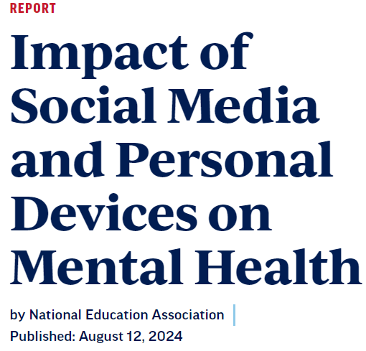
Polling of NEA Members
CONCERNS
Over half say phones are very disruptive
Social Media is concerning: leads to cyberbullying, impedes social skill development, disrupts instructional time
90% feel student mental health is a serious issue
ACTION
Want school-wide policy, with parent and educator collaboration
District policy limiting personal devices
  90% support during instructional time
  83% support during the entire school day
86% Support state and federal regulations to hold social media corporations accountable
Impact of Social Media and Personal Devices on Mental Health | NEA
Notes:
MaryBeth-
Review NEA member polling from the summer of 2024. Will share with participants what NEA members are seeing in schools pertaining to: students personal device use, the health concerns from using social media, the disruption the cause to the learning environment and what educators would support in the form of policy to reduce personal device use that would positively impact the health of students

Slide 10
Social Media Impact on Mental Health
Research
Brain development impacted and neurological pathways linked to risky behavior
Adolescents who experience cyberbullying are more than FOUR TIMES as likely to report thoughts of SUICIDE AND ATTEMPTS as those who didn’t
Nearly half (46%) of teens ages 13-17 say they feel worse about their body image due to social media
Relationship between excessive social media use and poor sleep quality, reduced sleep duration, sleep difficulties, and depression among youth
51% of 13-17 yr olds have experienced online harassment in the last 12 months , 21% had emotional or mental health challenges. Main sties Facebook and Instagram.
Notes:
MaryBeth
Will provide current data on the detrimental impact on student mental health when using social media.
APA chief scientist outlines potential harms, benefits of social media for kids
Cyberbullying linked with suicidal thoughts and attempts in young adolescents | National Institutes of Health (NIH)
Social Media & Eating Disorders: Statistics, Pros & Cons
Interplay between social media use, sleep quality, and mental health in youth: A systematic review - ScienceDirect
Online-Hate-and-Harassmen-2023_0_0.pdf
Online harassment can include many types of unwanted or hostile contact on digital platforms–including social media, chat, and email–such as verbal abuse, hate speech, trolling, spamming, impersonation, and defamation. More severe forms include ongoing harassment campaigns, sexual harassment, stalking, doxing4, and swatting5. By hate, we mean abuse and harassment targeting someone for their identity, specifically as part of a marginalized group
Social media companies have practices in place that are harmful to the health and wellness of students
Section 230 of the Communications Decency Act offers internet service providers immunity from liability for content posted by third parties on their platforms.

Slide 11
Impact on Health
Brain development impacted and neurological pathways linked to risky behavior​
Adolescents who experience cyberbullying are more than FOUR TIMES as likely to report thoughts of suicide and attempts as those who didn’t​
Nearly half (46%) of teens ages 13-17 say they feel worse about their body image due to social media ​
Relationship between excessive social media use and poor sleep quality, reduced sleep duration, sleep difficulties, and depression among youth​
51% of 13-17 yr olds have experienced online harassment in the last 12 months, 21% had emotional or mental health concerns
26% of Instagram users under the age of 16 witnessed hostility against someone based on their race, relation or identify
Notes:
APA chief scientist outlines potential harms, benefits of social media for kids
Cyberbullying linked with suicidal thoughts and attempts in young adolescents | National Institutes of Health (NIH)
Social Media & Eating Disorders: Statistics, Pros & Cons
Interplay between social media use, sleep quality, and mental health in youth: A systematic review – ScienceDirect
Online-Hate-and-Harassmen-2023_0_0.pdf
His Job Was to Make Instagram Safe for Teens. His 14-Year-Old Showed Him What the App Was Really Like. - WSJ

Slide 12
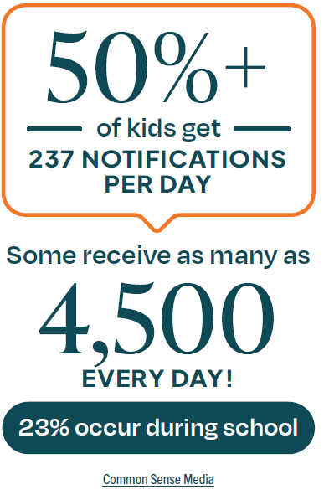
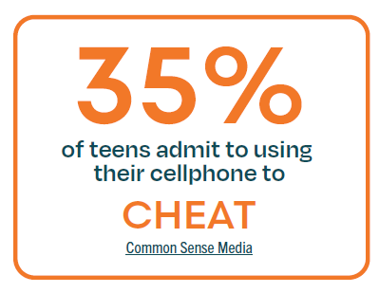
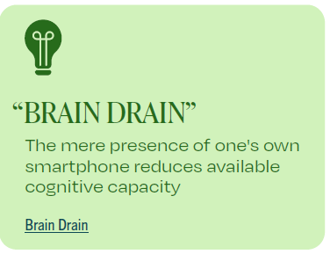
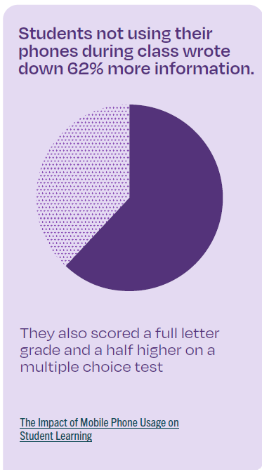
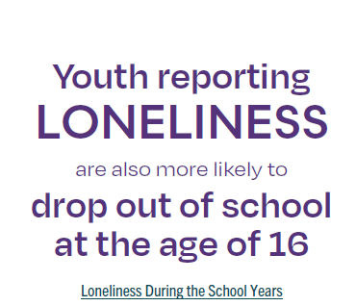
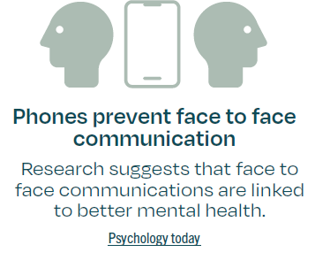
Impact on Interactions and Educational Environment
Phone-Free Schools Movement | Protecting Student Well-Being
Notes:
The Impact of Mobile Phone Usage on Student Learning: Communication Education: Vol 62, No 3
Face-To-Face Communication: Healthier Than Digital? | Psychology Today
2023-cs-smartphone-research-report_final-for-web.pdf
Loneliness During the School Years: How It Affects Learning and How Schools Can Help* - Jefferson - 2023 - Journal of School Health - Wiley Online Library
Brain Drain: The Mere Presence of One’s Own Smartphone Reduces Available Cognitive Capacity | Journal of the Association for Consumer Research: Vol 2, No 2

Slide 13

Limiting access to personal devices in schools
    77% of US schools prohibit non- academic use of cell phones or smartphones
    during school hours
    School-wide, implemented consistently and uniformly
_________________________________________
Limiting access to personal devices in schools
  Over 30 states: ban or restrict, recommend or incentivize for local school policy
  Legislation continues to be introduced
Holding social media companies accountable
    Privacy –Defaults--Age-Appropriate Design Code
    Algorithmic
    Age authentication
__________________________________________
Holding social media companies accountable
    Kids Online Safety Act (KOSA)
    Children and Teen’s Online Privacy Protection Act (COPPA 2.0)
Local
State
Federal
Student Personal Device
Policy Action
Notes:
MaryBeth
Share the action that is taking place at the local, state and federal level to address policy on limiting personal devices use in schools and/ or corporate accountability to improve the online safety and privacy of students
Educators had long advocated for device restriction in instructional settings, it’s just that now state and federal policy have caught up with it – It’s just about what it “looks” like. We have moved from enforcement framing to responsible/healthy use framing. This is now an opportunity for members to now be able to define/design the implementation of the policy.

Slide 14
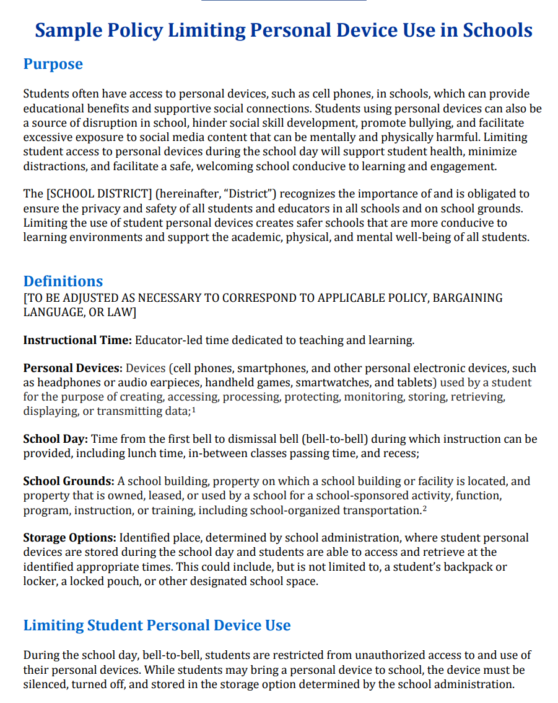
NEA
Student Personal Device Use Model Policy
Bell-to Bell Restrictions
Exceptions for medical, disability, and language proficiency.
Communication
Compliance
Assessment of policy
74% of U.S. adults support classroom bans
49% support no personal devices during the school day
74% of students support limits to personal device use in school
NEA Model Resolution and Policy
Notes:
Share NEA Resources: Model Resolution and Policy and Action Guide. Review the recommended core components and discuss the identified advocacy strategies.

Slide 15
Preliminary Outcomes
School – Bell-To-Bell Policy
Florida state law – Instructional Time
since the school began enforcing the policy three years ago
  chronic absenteeism rates dipped from 39% to 11%
  suspensions dropped by 70%
after the initial implementation and adjustment period
  disciplinary incidents disappeared, including significant reduction in unexcused absences
  student test scores improved modestly.
Cellphone Ban Adopters Share How They Did It—and How It's Changed Students
Notes:
One school principal, whose school implemented a bell-to-bell policy, shared that chronic absenteeism rates dipped from 39% to 11% and suspensions dropped by 70% since the school began enforcing the policy three years ago. She believes the policy is in large part responsible for the positive statistics. A study evaluating the implementation of the Florida state law restricting student use of personal devices during instructional time found that, after the initial implementation and adjustment period, disciplinary incidents disappeared, including significant reduction in unexcused absences, and student test scores improved modestly.
Cellphone Ban Adopters Share How They Did It—and How It's Changed Students
This is where it works, because it works for Admin amongst the community – this underscores the importance of moving or creating external pressure to allow for internal agreement and action.

Slide 16
Recommendations: affiliate actions
Co-Collaborators
Promote Affiliate Position
Active Role in Policy Development
Collective Bargaining or other Labor Management
Notes:
MaryBeth- Will share suggestions that affiliates can take to address policy on personal device use to positively impact the mental health of students.
Co-Collaborators
Lobby for policies and laws
Engage in coalitions
Focus groups to gain community and affiliate insight
Promoting the affiliate position
Op-Ed
Resolutions
Concern for student mental health
Educator safety
Active Role in Policy Development
Advise on policy language
Share policy examples
Support data collection
Collective Bargaining or other
ec

Slide 17
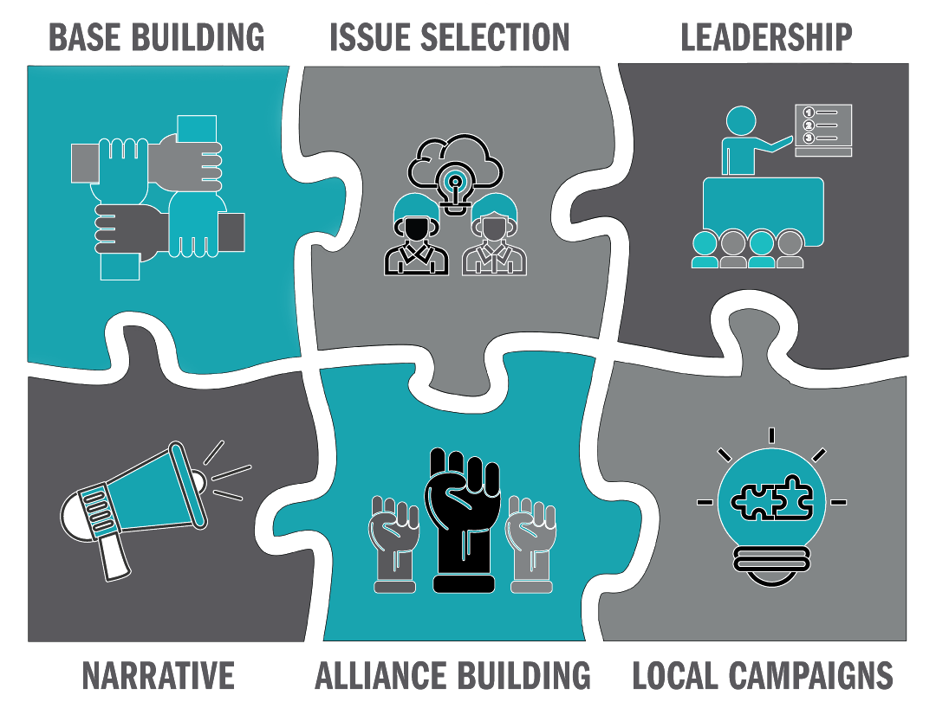
Organizing Around Creating Safe Schools
--------- affiliate action in practice
Notes:
CHAD-
Resource: Chad
WHAT MAKES HEALTH AND SAFETY A GOOD ORGANISING ISSUE? Building organizing unions
Look over the Pathways to Action Tool. How might you use this tool for assessment, prioritizing, and organizing around health and safety?
We have provided an overview of School Safety, the foundations of building safe school culture and some considerations for action before, during, and after a crisis
Now lets use the lens of organizing, advocacy, and coaching to examine what we can do in the same context--
Think about these in the context of before , during, and after
Introduction to scenario
Preview- Role of Staff – Before During and After
Chad- Before Considerations
Coaching and organizing in the prevention and preparation phase
Response
Recovery- is also a sequence of preparation and organizing
** What would staff do in each phase
CHAD-
We have provided an overview of School Safety, the foundations of building safe school culture and some considerations for action before, during, and after a crisis
Now lets use the lens of organizing, advocacy, and coaching to examine what we can do in the same context--
Think about these in the context of before , during, and after
Introduction to scenario
Preview- Role of Staff – Before During and After
Chad- Before Considerations
Coaching and organizing in the prevention and preparation phase
Response
Recovery- is also a sequence of preparation and organizing
** What would staff do in each phase

Slide 18
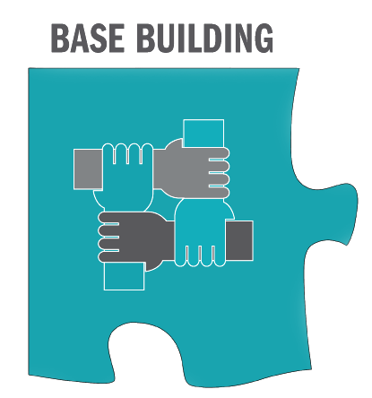
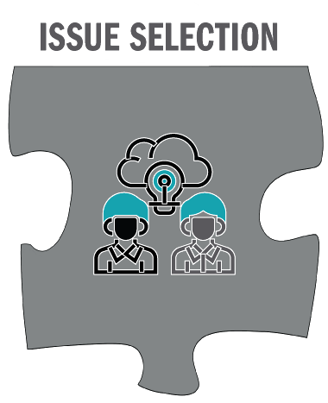


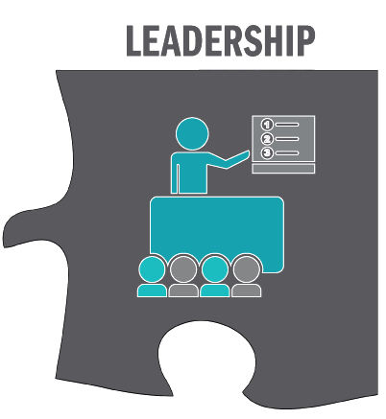

The Role of Staff in School Safety: Before
One-on-one’s
Local capacity
Potential growth
Issue identification
Local resources
Demands
Targets
Tactics
Internal organizing
External relationships
Trainings on law & policy
Meaningful updates and surveys
Messaging
What is the “now” that connects to the future
Coaching and Organizing to Build Capacity
Notes:
Chad- Gap Analysis-
Frame role of staff in what they should consider or be doing in the three phases ( 5 min)
*** Put a Text box under each icon
**Chad – During
Coaching and organizing Before an incident
Examples of what staff can do to:
Understand organizing landscape
Identify winnable objectives
Determine Campaign Objectives
Engage stakeholders
Communicate
promotes physical and psychological safety

Slide 19
The Role of Staff in School Safety: During
Leader support
Active Assessment
Active assessment
Keeping ally and organization com going
Availability and location of resources
Supportive accountability
Messaging
What is the “now” that supports today
Advocacy to Manage the Moment
Notes:
Chad- Frame role of staff in what they should consider or be doing in the three phases
*** Put a Text box under each icon
Coaching and organizing During a Crisis
Examples of what staff can do to:
Understand organizing landscape
Identify winnable objectives
Determine Campaign Objectives
Engage stakeholders
Communicate

Slide 20
The Role of Staff in School Safety: After
Reflection on structure
New leaders
New allies
What’s new
What’s old
What needs strengthening
Inertia, opportunity and new/available resources
Leveraging relationships to deliver resources
Sustaining the enlarged leadership structure and issue focus
Messaging
What is the “now” that reflects on before and connects to the future
Coaching and Organizing to Build Resilience
Notes:
Chad-- Frame role of staff in what they should consider or be doing in the three phases
*** Put a Text box under each icon
Coaching and organizing After a Crisis
Examples of what staff can do to:
Understand organizing landscape
Identify winnable objectives
Determine Campaign Objectives
Engage stakeholders
Communicate

Slide 21
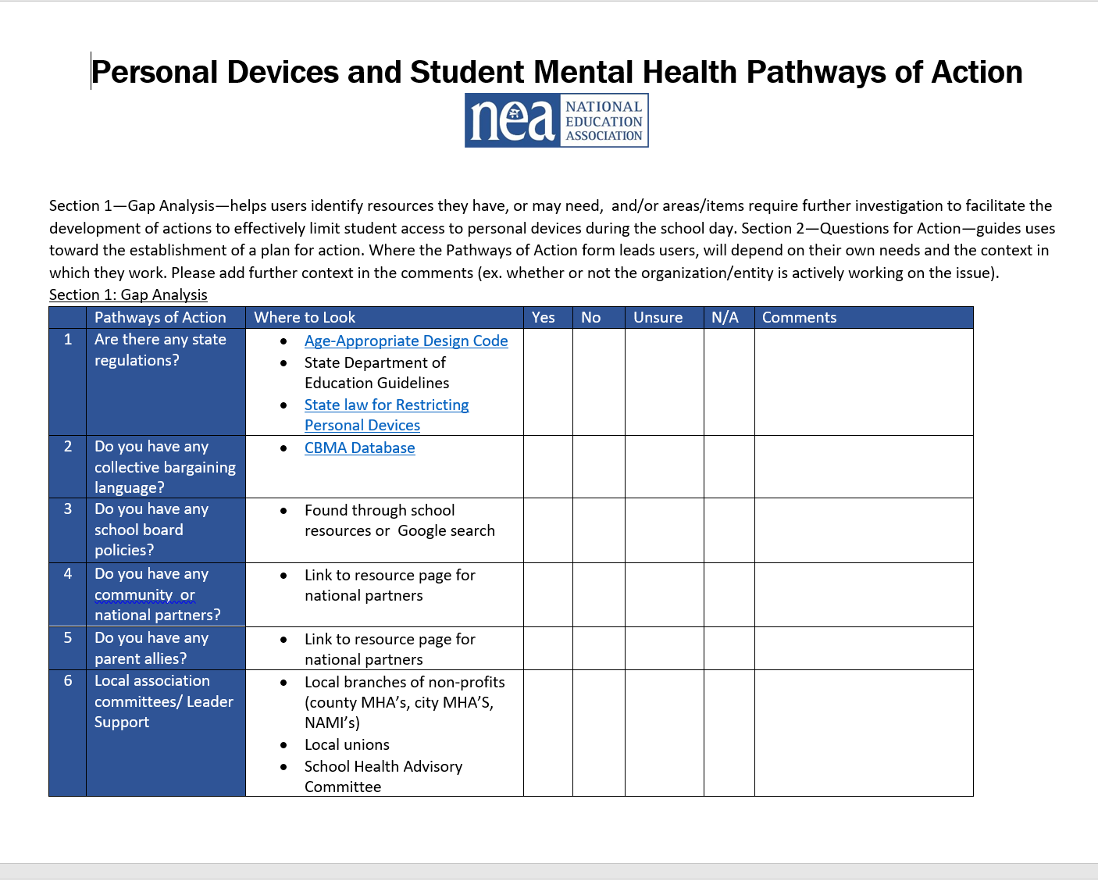

Pathways to Action Tool
Notes:
MB -- Pathways to action tool – link here to mental health one -- Social Media/ Device Usage

Slide 22
Organizing around Health and Safety
Look over the Pathways to Action Tool.
How might you use this tool for assessment, prioritizing, and organizing around health and safety?
Notes:
Chad----Break out session 10 minutes
In the breakout group questions to consider:
Scan document
ID a current health and safety issue in your work
how could you use this
What way can this tool direct my work in a different way than I typically use?

Slide 23

Scenario
Notes:
Video 2:18
Video shows state and school district across the country trying to grapple with personal devices in schools and the impact on students mental health, educaotrs, and the learning environment.

Slide 24
Scenario
The state does not have a law restricting student personal devices in all public school districts
Some guidance from the Department of Education has been provided for restricting student personal device use, if a policy is developed.
  During the school day
  At minimum, exceptions for medical and disability needs
  School are to determine how personal devices will be prohibited or stored
Other states have laws that can be reviewed for guidance
While educators are “fed-up” with cell phones, it is unclear what they want for their schools.
School district is considering a policy for the next school year
Notes:
Put scenario in the chat
***Chad: use the pathway to action tool to center the activity--- Review “where to look” – identify gap areas (possible areas for running a campaign to fill) (Get the document down to 1 page)
Possible questions:
- Impact to Staff- Mental Health and Safety
Impact to Students – Mental Health and Safety
Impact to Safe School Culture – Mental Health and Safety
What Mechanisms are in place to address the issue
What is the objective?
ASK CHAD--? –( If time) Activity – If you were to Build a Campaign
-- Determine Key Components- Show on Slides for a guide- to help them frame the conversations
Who are the targets?

Slide 25

We will divide up into small breakout groups ​
Discuss the scenario in your small group
  Identify some of the issues and determine the most widely felt and winnable issue.
  How might the Pathways To Action Tool help you organize around the issue?
How might you organize around the issue?
  Key idea: Mental health hook – A messaging focus that is simply understood and can be broadly applied
We will bring the group back together and share.
Notes:
Chad- 20 minutes
Group: 4 groups – go to the month of your birthday – groups done in month quarters Jan-March, etc.) ​
​
15 min- 20 minute
Uniserv
5 minutes intro, 5 Minutes for initial content. 5 minutes for Tool, 10 minutes breakout, 5 minutes report out. 5 minutes resource
Uniserv
15 minutes breakout and 10 minute debrief
like 1
***Chad: use the pathway to action tool to center the activity--- Review “where to look” – identify gap areas (possible areas for running a campaign to fill) (Get the document down to 1 page)

Slide 26

Action Steps and Take Aways (Uniserv)
How will you use something you've learned today to facilitate positive change in school safety?
How would you be able to measure a win?
What have you learned today that would make your work with locals different than you always have?
Notes:
Chad
MaryBethComments, as needed
How can we use this to support our locals?
What have you learned today that would make your work with locals different than you always have?
how can you use this toolkit to challenge your work to try a new avenue of thinking to solve health and safety issue
In your work

Slide 27



The NEA Health and Safety Program
Environmental and occupational health and safety, including mold, indoor air quality, chemical safety, and more
Violence prevention and response, and the creation of safe school cultures
School health, including social media, student personal device use, mental health, vaccines, and more
Notes:
Health and Safety Program Information and Resources
Add a link in the chat ** Get QR Code for Brochure
School Health & Safety | NEA
** Discuss what we offer and how we can individualize request**
In the next few slides, I will be sharing and explaining the variety of NEA resources available to staff and members, as well as briefly review the relevant agencies and organizations that staff can obtain health, safety, and policy information.
- mention resources specific to pathways to action and what resources we have that could be useful in the pathways
** Add additional resource links– bargaining resources

Slide 28
Contact Us
MaryBeth Szydlowski
Sr Health and Safety Specialist
National Education Association
mszydlowski@nea.org
Chad Williams
UniServ Consultant Michigan
Michigan Education Association
cwilliams@mea.org
Notes:
Chad- Welcome and Introductions

Slide 29
School Health and Safety
1. Prevention – actions taken to prevent crisis
2. Response – steps taken to stabilize a crisis once it has occurred.
3. Recovery – actions taken to restore the school environment.
Notes:
MB-- How does the impact of social media and personal device usage on mental health relate to school safety
The issue of social media and device usage poses a threat to mental health that can be addressed through school safety prevention , response, and recovery measures.
To maintain safety, we can turn to the phases of school safety related to prevention and response.
School Safety includes behavior regulations for buses and bus stops, student code of conduct, crisis planning for threats and emergencies, emergency drills , school safety audits, security officers, security equipment, student prevention and intervention programs, and procedures for visitors and school events.
Next we will look at ways we create safe school culture. These programs are not only to create a safe school culture that fosters prevention ….they may also be a part of the supports that are used to respond to threats to school safety. That support psychological safety….which also connects safety to mental health support in school.
**Psychological Safety
Natural cues– what I want to move on to next--- next we will …

Slide 30

Safe School Culture and Psychological Safety
School Safety encompasses a range of responses from prevention to crisis response.
When making efforts to build a school culture of safety, schools strive to make a continuous effort to:
Ensure students and staff feel safe and included.
Create an environment that supports psycho-social development and academic achievement
Ensure that daily instruction and other activities are not disrupted by negative events
Create and environment of mutual respect of students, staff, and administrators
Notes:
mb
Psychological Safety – How mental health supports building safe school culture. Mental health supports entail direct services and environmental constructs that support positive social-emotional development

Slide 31
Recommendations: Mental Health Policy
Comprehensive School Mental Health Systems in Schools
Adequate staffing is needed – counselors, social workers, school psychologists, nurses, and others
Access to mental health supports, interventions can be gained through external partnerships with medical entities, non-profits
Educational workshops and programming to boost both student and educator knowledge and capacity on mental health promotion and incident prevention
The Benefits of Mental Health Programs in Schools | K-12 Schools | U.S. News
Implementing School Mental Health Supports: Best Practices in Action
Notes:
MaryBeth

