Slide 1

Mental Health and School Safety
Health and Safety UniServ Academy: Session 2
We will be starting soon!
In the chat, please let us know the following:
1. Name
2. State affiliate and/or Local
3. Share a fall highlight

Slide 2

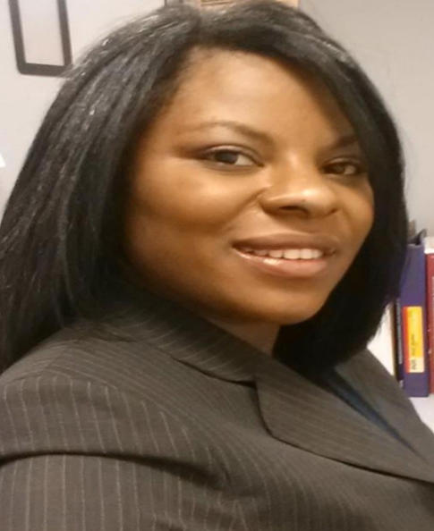
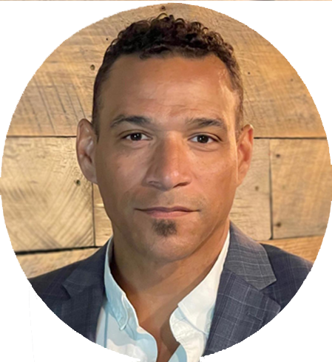
Facilitators:
Karuna aNTANI
CRYSTAL FOXX
Chad williams
Sr Health and Safety Specialist
National Education Association
kantani@nea.org
Sr. Program Specialist/Policy Analyst
National Education Association
cfoxx@nea.org
UniServ Consultant
Michigan
Michigan Education Association
cwilliams@mea.org
Notes:
Chad- Welcome and Introductions

Slide 3

Learning Objectives
Upon the completion of the workshop, participants will be able to:
Review mental health and safety hazards in educational settings.
Recognize and prioritize the health and safety issues around which to organize members and build a campaign.
Identify and understand what resources are available for mental health and safety, including tools and funding.
Notes:
Crystal

Slide 4

Introduction
This workshop is one of three workshops focusing on health and safety.
1. Healthy buildings, systems, and schools.
2. Safe buildings, systems, and schools.
Focusing on mental health and safe schools.
3. Gun Violence and Crisis Guide Review
Notes:
Crystal

Slide 5
Health and Safety Issues
Allergies
Asbestos
Bloodborne hazards
Bullying
Chemical use/storage/exposure
Climate justice
Cold
Disaster preparation
Ergonomic hazards
Food-service concerns (burns, etc.)
Formaldehyde
Gun violence
Health education
Health Services
Heat
Immunization/vaccination
Infectious diseases
Indoor air quality
Infrastructure
Lead (in paint, water, etc.)
Mental health and stress
Mercury
Mold
Musculoskeletal problems
Natural disasters
Opioids
Polychlorinated biphenyls (PCBs)
Pollution (generation of/proximity)
Safe passage
Sexual and reproductive health
Slips, trips, and falls
Smoking
Staffing and workload
Vaping
Violence (sexual)
Violence (threats, attacks)
Water (access to clean water)
Notes:
Karuna
First, we would like to hear from you.
Ask participants what health and safety issues have members expressed concerns with. Please type them in the chat.
- Highlight any patterns, similar, or unique issues.

Slide 6
Health and Safety Issues
(Selected List)
Allergies
Asbestos
Bloodborne hazards
Bullying
Chemical use/storage/exposure
Climate justice
Cold
Disaster preparation
Ergonomic hazards
Food-service concerns (burns, etc.)
Formaldehyde
Gun violence
Health education
Health Services
Heat
Immunization/vaccination
Infectious diseases
Indoor air quality
Infrastructure
Lead (in paint, water, etc.)
Mental health and stress
Mercury
Mold
Musculoskeletal problems
Natural disasters
Opioids
Polychlorinated biphenyls (PCBs)
Pollution (generation of/proximity)
Safe passage
Sexual and reproductive health
Slips, trips, and falls
Smoking
Staffing and workload
Vaping
Violence (sexual)
Violence (threats, attacks)
Water (access to clean water)
Notes:
Karuna
The health and safety issues listed on this slide are a selected list, meaning there are a lot of other issues that are not listed because of space limitations.
The health and safety issues in orange are the health and safety issues the NEA program has worked on with state affiliates. I would like to convey that we respond to affiliate requests, so even if there’s a health and safety topic they don’t hear about, we are happy help folks think it through and find the support they need.

Slide 7
What is School Safety?
1. Prevention – actions taken to prevent crisis
2. Response – steps taken to stabilize a crisis once it has occurred.
3. Recovery – actions taken to restore the school environment.
Notes:
Crystal -- Look at “term” Emergency– Learning Environment– Not just the classroom
To maintain safety we have to look at all phases of school safety from prevention and response.
School Safety includes behavior regulations for buses and bus stops, student code of conduct, crisis planning for threats and emergencies, emergency drills , school safety audits, security officers, security equipment, student prevention and intervention programs, and procedures for visitors and school events.
Next we will look at ways we create safe school culture. These programs are not only to create a safe school culture that fosters prevention ….they may also be a part of the supports that are used to respond to threats to school safety. That support psychological safety….which also connects safety to mental health support in school.
**
Natural cues– what I want to move on to next--- next we will …

Slide 8
What is School Safety?
School Safety encompasses a range of responses from prevention to crisis response.
When making efforts to build a school culture of safety, schools strive to make a continuous effort to:
Make sure students and staff are not fearful or anxious- culture of safety
Provide an environment where students can focus on healthy psycho-social development and academic achievement
Daily instruction and other activities are not disrupted by negative events
Students, Staff, and Administrators respect each other
Notes:
Crystal
Students and Staff--- to include administrators ; Staff and Administrators
Check Graphic– Enlarge the bottom graphic---- Font too small

Slide 9
Mental Health
Adequate staffing is needed – counselors, social workers, school psychologists, nurses, and others
Ideal staffing ratio according to the
American School Counselor Association: 250 to 1
Access to mental health supports, interventions can be gained through external partnerships with medical entities, non-profits
Educational workshops and programming to boost both student and educator knowledge and capacity on mental health promotion and incident prevention
Notes:
Karuna

Slide 10

Bullying and Violence
Bullying can both be a cause for violence, and a form of violence
It is rooted in both psychological and physical violence
These behaviors are usually repeated over time
While violence is against the law, bullying toes the line. Sometimes it can cross over into becoming harassment or assault, but other times it does not.
There are strong links between bullying and eventual school violence.
Notes:
Karuna

Slide 11
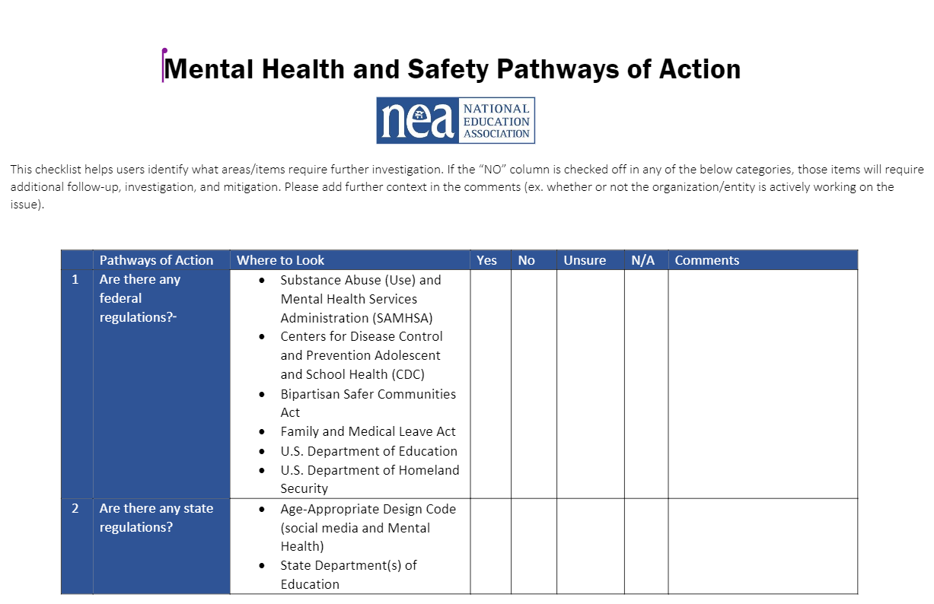

Pathways to Action Tool
Notes:
Chad Introduce
Karuna/ Crystal Comments as needed
Pathways to action tool – link here to mental health one

Slide 12

Organizing around Health and Safety
Understand the organizing landscape
Identify winnable objectives
Determine if the objectives can be part of a larger campaign
Engage more stakeholders
Communicate clearly, simply, viscerally, and consistently
Notes:
Resource: Chad
WHAT MAKES HEALTH AND SAFETY A GOOD ORGANISING ISSUE? Building organizing unions

Slide 13

Organizing around Health and Safety
Look over the Pathways to Action Tool. How might you use this tool for assessment, prioritizing, and organizing around health and safety?
Notes:
Chad----Break out session 10 minutes
In the breakout group questions to consider:
Scan document
ID a current health and safety issue in your work
how could you use this
What way can this tool direct my work in a different way than I typically use?

Slide 14


NEA Health and Safety Resources
Notes:
Karuna and Crystal- Review of HAS Resources
Add a link in the chat ** Get QR Code for Brochure
School Health & Safety | NEA
** Discuss what we offer and how we can individualize request**
In the next few slides, I will be sharing and explaining the variety of NEA resources available to staff and members, as well as briefly review the relevant agencies and organizations that staff can obtain health, safety, and policy information.
- mention resources specific to pathways to action and what resources we have that could be useful in the pathways
** Add additional resource links– bargaining resources

Slide 15

Scenario
Aspen School District sues social media companies over impact on youth mental health
Notes:
Chad (chad will find the scenario)
Look at adding Educator to Educator Violence – Case Study? Multiple solutions
** Parent engaging educators to respond to student bullying– and the educator is bullied by the parent
** Discuss with Chad and UniServ staff
Social Media Bullying Scenario– Parent and Educator Online Issue
Ask Participants to Identify the Harm to….Mental Health and Psychological Safety
Each Breakout group can talk about a different aspect of mental health and safety and a social media issue----
***Chad: use the pathway to action tool to center the activity--- Review “where to look” – identify gap areas (possible areas for running a campaign to fill) (Get the document down to 1 page)
Possible questions:
- Impact to Staff- Mental Health and Safety
Impact to Students – Mental Health and Safety
Impact to Safe School Culture – Mental Health and Safety
What Mechanisms are in place to address the issue
What is the objective?
ASK CHAD--? –( If time) Activity – If you were to Build a Campaign
-- Determine Key Components- Show on Slides for a guide- to help them frame the conversations
Who are the targets?

Slide 16

Notes:
Video Runtime: 2 minutes
Video shows school district trying to grapple with social media mental health impacts at the school district by suing the social media companies; however, what isn't addressed are the how these student/school district issues are impacting staff.
Social Media Scenario
Ask Participants to Identify the Harm to….Mental Health, Psychological Safety, and workplace impacts for school employees
Each Breakout group can talk about a different aspect of mental health and safety and a social media issue----
***Chad: use the pathway to action tool to center the activity--- Review “where to look” – identify gap areas (possible areas for running a campaign to fill) (Get the document down to 1 page)
Possible questions:
- Impact to Staff- Mental Health and Safety
Impact to Students – Mental Health and Safety
Impact to Safe School Culture – Mental Health and Safety
What Mechanisms are in place to address the issue
What is the objective?
ASK CHAD--? –( If time) Activity – If you were to Build a Campaign
-- Determine Key Components- Show on Slides for a guide- to help them frame the conversations
Who are the targets?

Slide 17

Breakout Groups
​
1) We will divide up into small breakout groups ​
2) Discuss the scenario in your small group
a. Assume/imagine some aspects of the scenario
using the Pathways to Action Tool
b. Identify some of the issues and determine the most widely felt and winnable issue.
How might you organize around the issue?
3) We will bring the group back together and share.
Notes:
Chad- 20 minutes
Group: 4 groups – go to the month of your birthday – groups done in month quarters Jan-March, etc.) ​
​
15 min- 20 minute
[1:47 PM] Uniserv
5 minutes intro, 5 Minutes for initial content. 5 minutes for Tool, 10 minutes breakout, 5 minutes report out. 5 minutes resource
[1:48 PM] Uniserv
15 minutes breakout and 10 minute debrief
like 1
***Chad: use the pathway to action tool to center the activity--- Review “where to look” – identify gap areas (possible areas for running a campaign to fill) (Get the document down to 1 page)

Slide 18

Report Back
Notes:
Karuna
Groups will report

Slide 19

Social Media in Education Guide
Upcoming guide on NEA.org highlighting the role social media plays in education
Concerns, goals, recommendations for educators, school districts, state and local affiliates
Focusing on topics of communication, relationships (comments, media), educator freedom of expression, time management in the learning environment, student concerns, model contract language
Notes:
Karuna

Slide 20
Agencies and Organizations
SAMHSA – Substance Abuse and Mental Health Services Administration
CDC – Centers for Disease Control and Prevention
Mental Health America
Active Minds
National Alliance for Mental Illness
U.S. Department of Education
U.S. Department of Homeland Security
SchoolSafety.Gov
Notes:
Karuna

Slide 21

Action Steps and Take Aways (Uniserv)
How will you use something you've learned today to facilitate positive change in school safety?
How would you be able to measure a win?
What have you learned today that would make your work with locals different than you always have?
Notes:
Chad
Karuna/ Crystal Comments, as needed
How can we use this to support our locals?
What have you learned today that would make your work with locals different than you always have?
how can you use this toolkit to challenge your work to try a new avenue of thinking to solve health and safety issue
In your work

Slide 22

Notes:
Evaluations
https://forms.office.com/r/PBp0r3QXNN

Slide 23
Contact Us!
Karuna aNTANI
CRYSTAL FOXX
Chad williams
Sr Health and Safety Specialist
National Education Association
kantani@nea.org
Sr. Program Specialist/Policy Analyst
National Education Association
cfoxx@nea.org
UniServ Consultant
Michigan
Michigan Education Association
cwilliams@mea.org
Notes:
Chad- Welcome and Introductions

