Slide 1

Leadership to End Gun Violence: How to Prepare and Respond Using NEA’s New Gun Violence Crisis Guide
Joel Solomon, Ovidia Molina, and Crystal Foxx
Notes:
The info below is guidance for this slide. You may delete this information once you have used it and add your notes for your presentation.
In an effort to have consistency with our messaging, we require all presenters to use the 2024 NEA National Leadership Summit PowerPoint template for your presentation.
Unless explicitly stated, please do not make any changes to the template, font (style, size or color), or content.
SLIDE 1
This slide should be the slide displayed as participants enter the room. We recommend displaying this slide 10-15 minutes before your session begins (or earlier if you are able to access the room).
Replace the text (Name of Session and Name of Presenters) with the required information. For the title, please use font style Calibri (or similar) and keep the font color as white. Due to various title lengths and presenters, you may need to change the size of the text.

Slide 2
NEA MEMBERS ONLY
THIS EVENT IS ONLY FOR NEA AFFILIATE MEMBERS & NEA AFFILIATE STAFF. ALL OTHERS MUST SIGN-IN AT THE REGISTRATION DESK.
Notes:
10 minutes
Thru slide 7
This is a legally required slide and should come after the title slide.
SLIDE 2
It is required to display and read the content on this slide. Do not make any changes to this slide.
Encourage participants to use our social media handles to share/reinforce their learning experience.

Slide 3
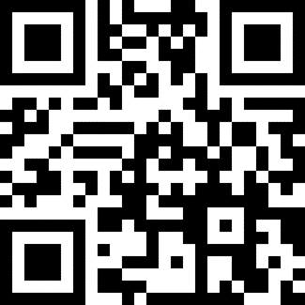
Presenters
Ovidia Molina
President
Texas State Teachers Association
OvidiaM@tsta.org
Crystal Foxx
Senior Program and Policy Specialist
NEA Health and Safety Program
Cfoxx@nea.org
Joel Solomon
Senior Program Manager
NEA Health and Safety Program
Jsolomon@nea.org

Slide 4
Advocacy
Identifies and discusses fundamentals of advocacy practice and theory.
Level 1: Foundational
Engages self and activists in high impact activities that produce racially and socially just policies and culturally competent advocacy plans and strategies
Level 2: Mobilizing and Power Building
Notes:
Advocacy- Level 1 foundational

Slide 5

NEA STRATEGIC GOALS
To achieve our mission and to grow and strengthen our association to promote quality education for students, educators, and America's schools, we the NEA will:
Enhance the well-being of America's students, their families, and their communities by advancing opportunities that will transform public education into a just, equitable, and excellent system.
Ensure the success of the public education system, our members, and those they serve by developing the structure, processes, and practices that strengthen our organizational capacity across the enterprise.
Notes:
Certainly, as we explore ways to develop Respectful Interactions with a Diverse Disability Community, we are working to achieve the first NEA strategic goal of enhancing the well-being of students, families, and communities to transform public education into a just and equitable system.

Slide 6

NEA STRATEGIC OBJECTIVES
In partnership with our Affiliates, NEA will:
Build Safe, Healthy, Inclusive, and Future-Focused Learning Environments
Support Professional Excellence and Respect
Advance Racial Justice and Social Justice
Strengthen Public Education as the Cornerstone of Democracy
Enhance Professional and Organizational Regard
Notes:
Tied to the NEA goal of enhancing the well-being of students, families, and communities, we focus on the objectives of building safe and inclusive environments and advancing social justice.

Slide 7
SESSION OBJECTIVES
By the end of this session , participants will:
Be able to identify the key components of NEA's recommended steps to prevent, prepare for, respond to, and recover from incidents of gun violence in schools
Critically assess their own readiness to engage in preparation and response work
Create a plan for deepening and broadening their work with their Association on gun violence issues

Slide 8
Introductions
Notes:
Introduction Activity
5 minutes

Slide 9
Session Norms
Conversations
Conversations about gun violence can be upsetting. No one is obligated to speak, and all should feel comfortable stepping out of the room if they need to.
Notes:
Review Norms with group
Stay engaged and share, as comfortable
Please limit use of electronics to minimize distractions
Ensure all voices have an opportunity to be heard​
Are there any norms the group would like to add?

Slide 10
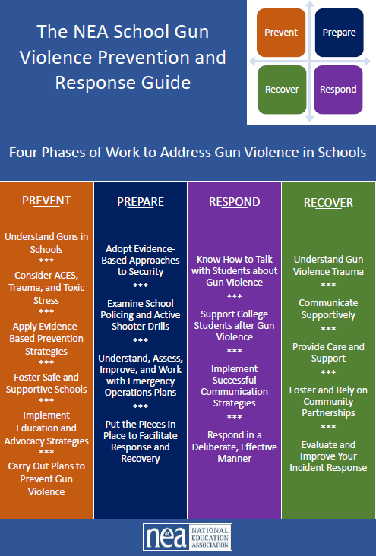
Introduction
The scourge of gun violence
January 2023 affiliate convening
The NEA School Gun Violence Prevention and Response Guide
Hopes for this session
Notes:
10 minutes

Slide 11
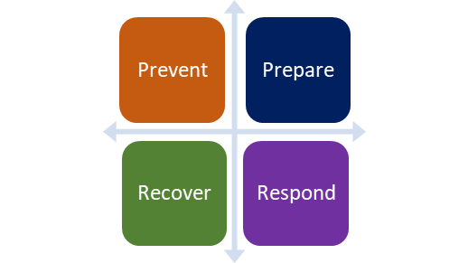
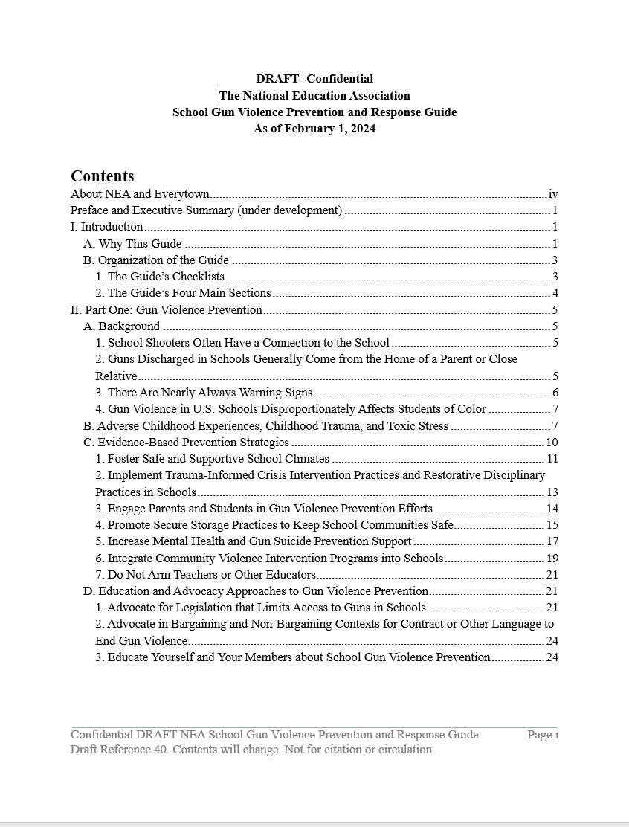
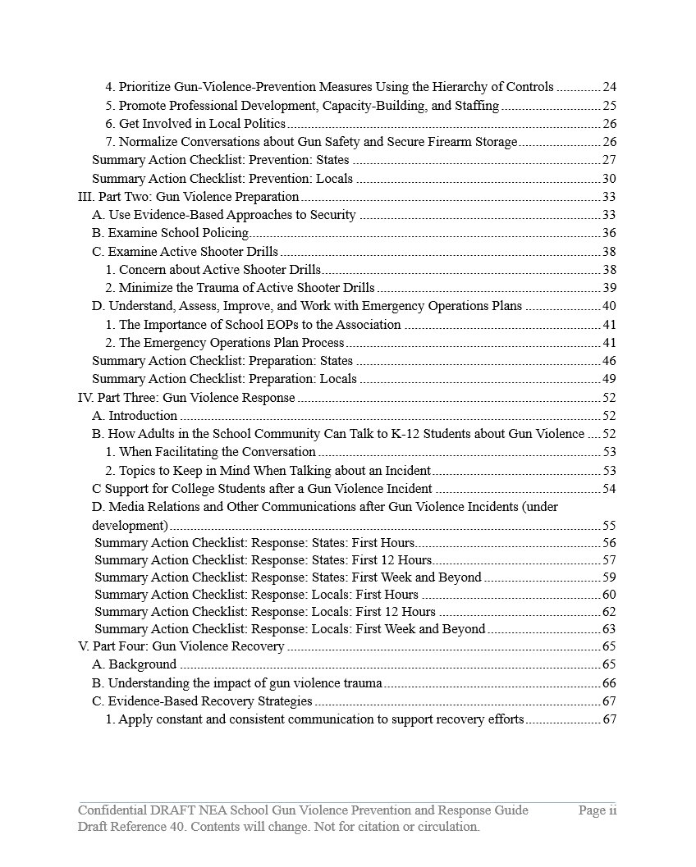
The NEA School Gun Violence Prevention and Response Guide—Table of Contents

Slide 12
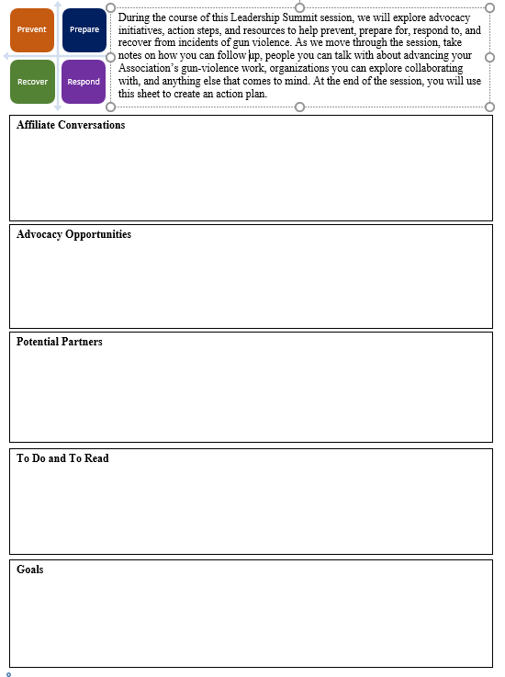
Developing and Fine-Tuning Leadership Plans on Gun Violence Prevention and Response

Slide 13
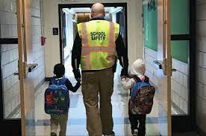
Prevention
Understanding Guns in Schools
Notes:
10 minutes

Slide 14
Prevention
Consider ACES, Trauma, and Toxic Stress
Apply Evidence-Based Prevention Strategies:
          Foster Safe and Supportive Schools
          Implement Education and Advocacy Strategies
      3. Carry Out Plans to Prevent Gun Violence
Notes:
10 minutes

Slide 15
Prevention
Carry Out Plans to Prevent Gun Violence
  Advocate for legislation
      Advocate in Bargaining and Non-Barganing Context
      Educate and Support Members and Leaders Understanding of Gun Violence
Notes:
10 minutes

Slide 16
Preparation
Adopt Evidence-Based Approaches to Security
Examine School Policing and Active Shooter Drills
Notes:
25 minutes- Intro and activity

Slide 17

Preparation
Understand, Assess, Improve, and Work with Emergency Operations Plans
Put the Pieces in Place to Facilitate Response and Recovery
Notes:
25 minutes- Intro and activity( next slide)

Slide 18
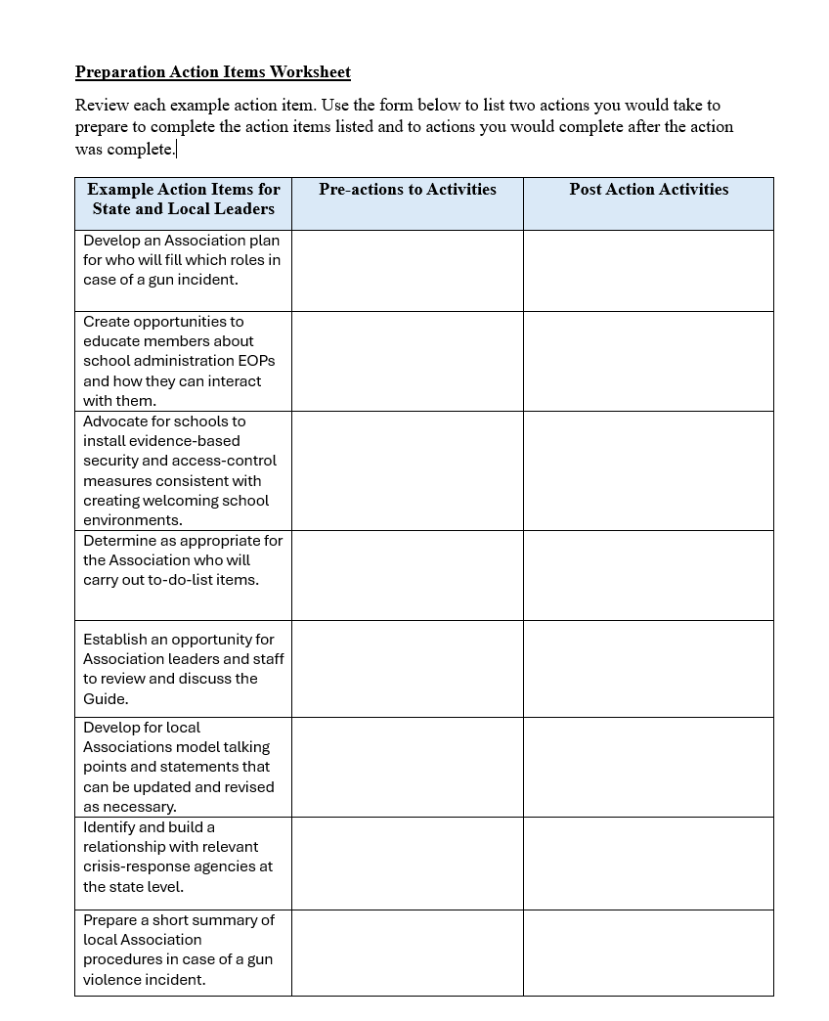
Table Talk – Preparation Action Items Worksheet
Review each action item.
Select two items .
On the form, list two actions you would take to prepare to complete the action items listed and two actions you would complete after the action was complete.
Notes:
Response Checklists- Give an example – What are three forward thinking actions and 3 backwards thinking actions
Activity-Give them “to do” items with spaces for them to fill in 2 backwards and 2 forward linkage items

Slide 19
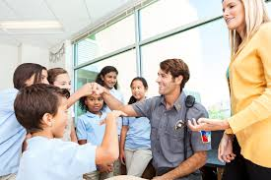
Response
Know How to Talk with Students about Gun Violence
Support College Students after Gun Violence
Notes:
25 minutes- Intro and activity

Slide 20
Response
Implement Successful Communication Strategies
Respond in a Deliberate, Effective Manner
Notes:
25 minutes- Intro and activity( next slide)

Slide 21
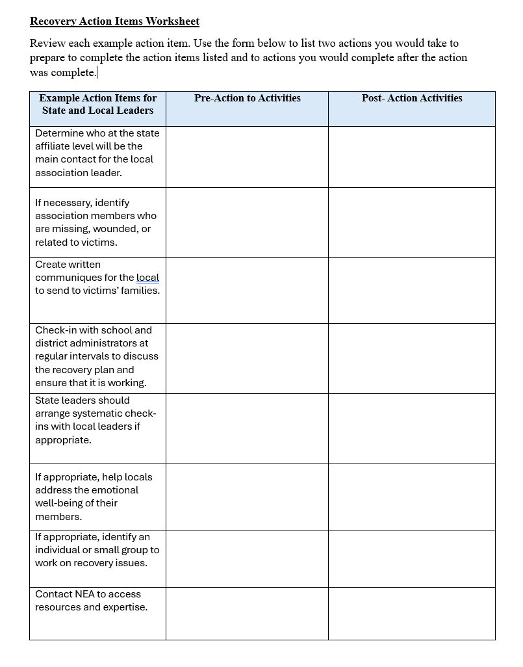
Table Talk- Recovery Checklist
Review each action item.
Select two items .
On the form, list two actions you would take to prepare to complete the action items listed and two actions you would complete after the action was complete.
Notes:
Preparation Checklists- Give an example – What are three forward thinking actions and 3 backwards thinking actions
Activity- Give them “to do” items with spaces for them to fill in 2 backwards and 2 forward linkage items

Slide 22
Recover
Understand Gun Violence Trauma
Communicate Supportively
Provide Care and Support
Foster and Rely on Community Partnerships
Evaluate and Improve Your Incident Response
Notes:
10 minutes

Slide 23
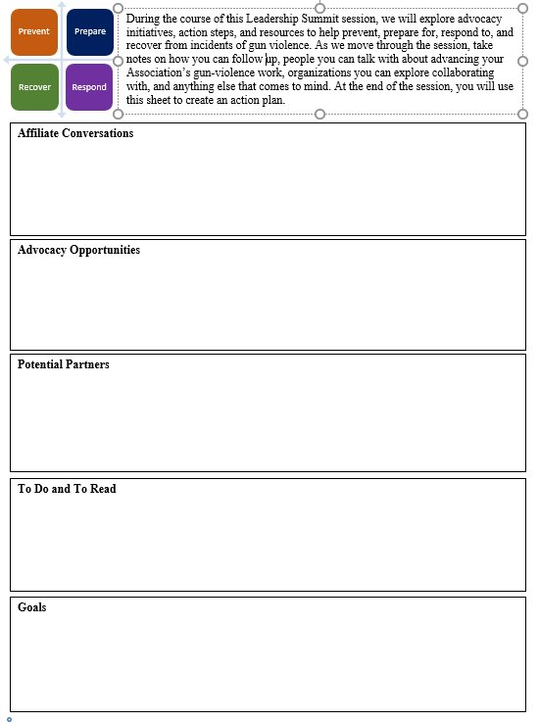
Developing a plan:
Affiliate conversations
Advocacy opportunities
Potential partners
To do and to read
Three goals when you return home
Notes:
15 minutes

Slide 24

Report Out!
Notes:
15 minutes- Participants will share a high-level review of their plan or “take aways” for leadership practices

Slide 25
NEA resources to support you
NEAs
NEA Health and Safety Program
NEA.org--Responding to Gun Violence
https://www.nea.org/gunviolence

Slide 26
Questions?
Notes:
Question and Answer- 5 to 10 minutes

Slide 27


AMPLIFY YOUR VOICE
#EdLeaders
and
#NEASUMMIT
NEA Summit Leaders
Notes:
5 minutes through slide 41
The info below is guidance this slide. Please don’t make any changes to this content.
SLIDE 11
Encourage participants to utilize our NEA Leadership Development Digital Media tools by joining our FB group, NEA Summit Leaders, and amplifying the Summit on Twitter via hashtags #EdLeaders and #NEASUMMIT

Slide 28
EVALUATION
Please complete the evaluation for this session by using the NEA Summit App
and
visit the Leadership Development Resources page at www.nea.org/leadership-development to continue your leadership growth.
Notes:
The info below is guidance for this slide. Please don’t make any changes to this content.
Slide 12
Remind participants to complete the evaluation via the NEA Summit App and visit our webpage for leadership development resources.
Please make sure adequate time is provided for participants to complete the survey

