Slide 1

Safe Schools: Resilient Buildings, Systems, and Schools
Crystal Foxx and Chad Williams
NEA UniServ May 9, meeting

Slide 2
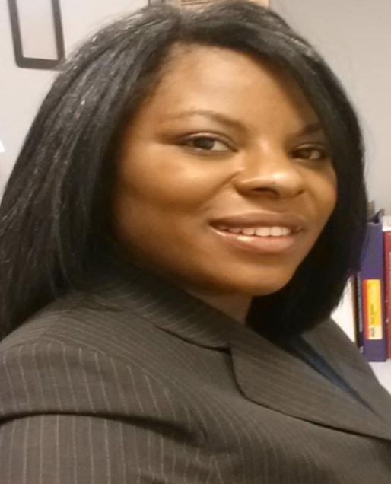
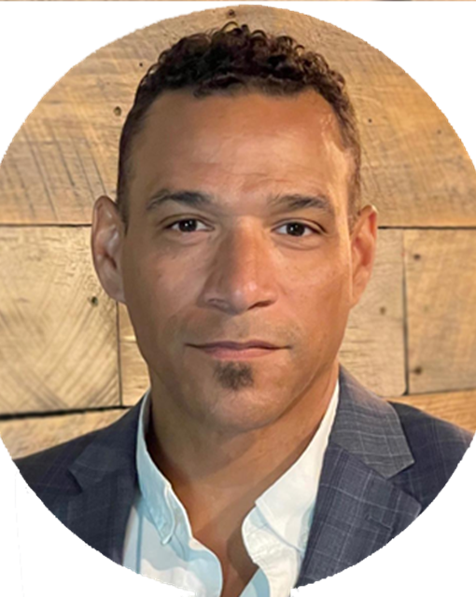

Facilitators
Crystal Foxx
Sr. Program Specialist/Policy Analyst
National Education Association
cfoxx@nea.org
Chad Williams
UniServ Consultant
Michigan
Michigan Education Association
cwilliams@mea.org

Slide 3


Introduction
This workshop is one of three workshops focusing on health and safety.
1. Healthy buildings, systems, and schools.
2. Safe buildings, systems, and schools.
Focusing on mental health and safe schools.
3. School Safety and Creating Safe School Culture and Resilience
Notes:
This is the 3rd installment of our 3 part series on health and safety topics
Today we will focus on school safety and creating resilient buildings and schools

Slide 4
Learning Objectives
Upon the completion of the workshop, participants will be able to:
Review
Review elements of safe school culture.
Recognize and prioritize
Recognize and prioritize school safety issues and school culture issues around which to organize members and build a campaign.
Identify and understand
Identify and understand what resources are available to promote safe school culture, including tools and agency resources.
Notes:
Review Objectives

Slide 5
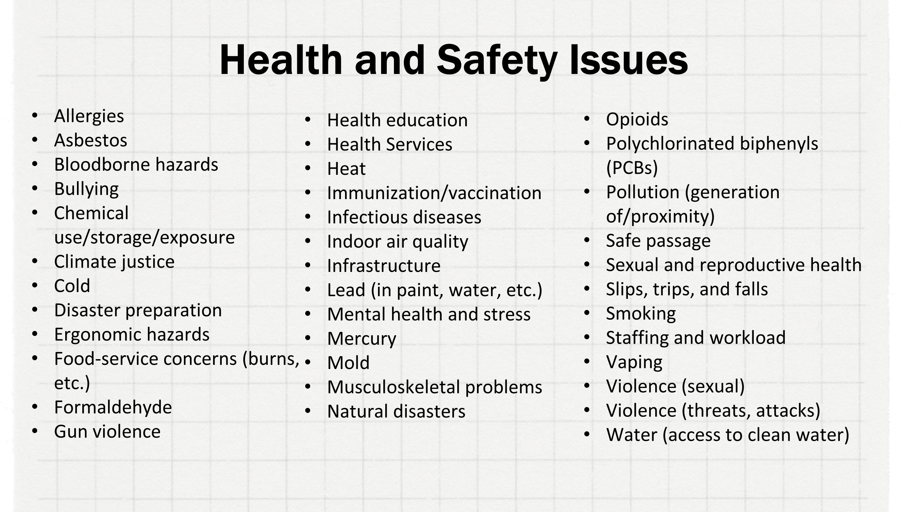
Health and Safety Issues

Slide 6
Safety and Safe School Culture can include all of these health and safety issues.
Notes:
School safety does not just encompass how we respond to hazards and crisis but how we implement and plan proactive measures to prevent cirisis
Examples– How vaccinations are a preventive measure for outbreaks – Ensuring measurs for clean air and water are safety prevention measures etc

Slide 7
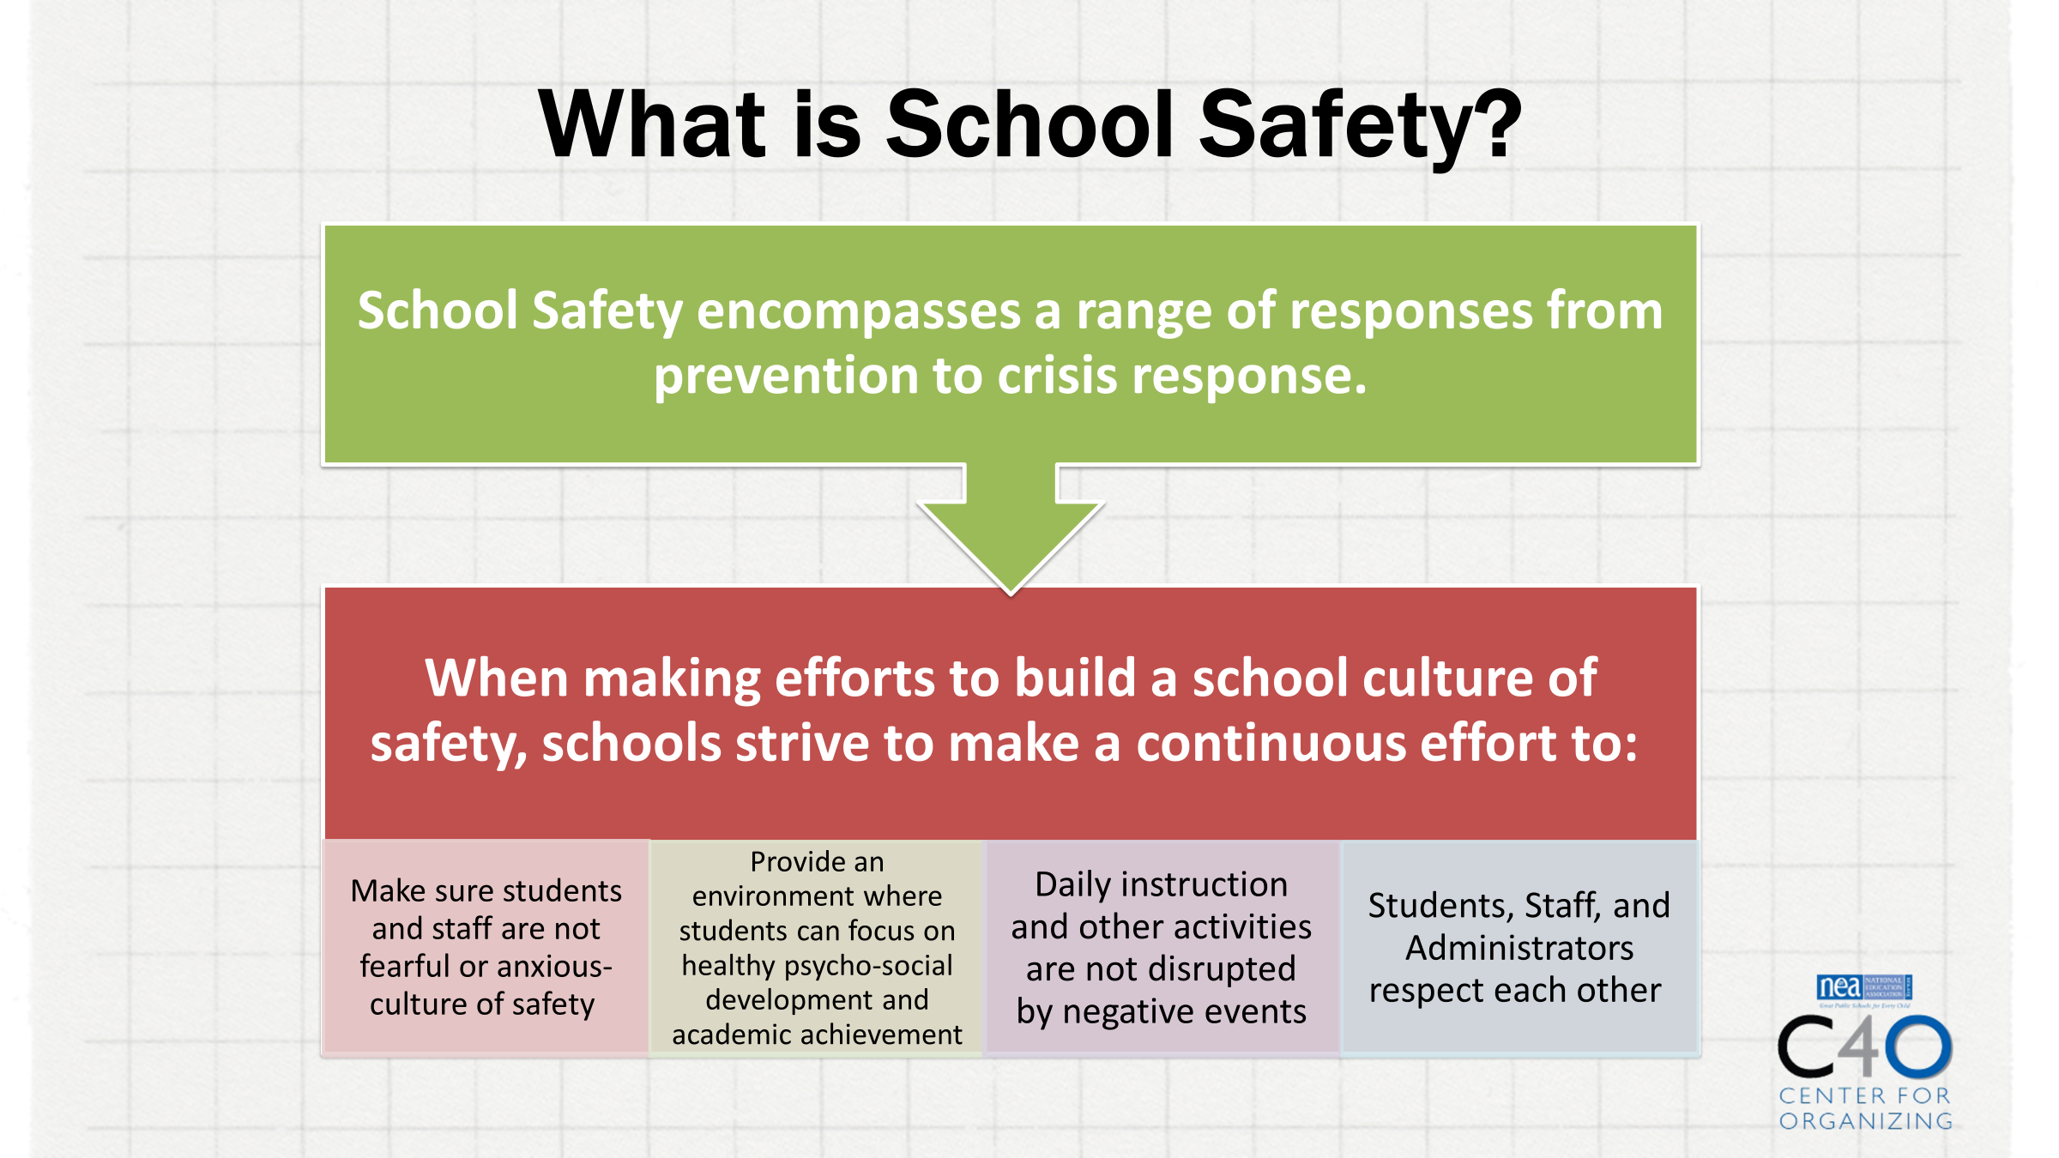
What is School Safety?
Notes:
Crystal ( 1 to 2 min)
During our last presentation– we introduced the concept of School Safety and its relationship to mental health
Today we are revisiting school safety with a focus on practical applications for applications before, during, and after
Which is built on our NEA foundation for safet school culture – that leads to…..( bottom items)
Definition of School Safety--- Not only discussing how we keep schools safe but how we create resiliency by building a culture of safety

Slide 8
Resiliency and Safe School Culture
Promoting Positive School Connections
Foster feelings of competence and self efficacy
Utilize positive reinforcement strategies
Implement restorative and trauma informed practices
Promote well-being
Utilize conflict resolution
Teach coping skills
Notes:
To foster resilience, schools must set a foundation that : ( List)
Helping students and staff to be self aware- build efficacy of self and others- be supportive- and learn strategies to deal with conflict and adversity
Why is this important to Safe school culture– because it promotes physical and psychological safety

Slide 9
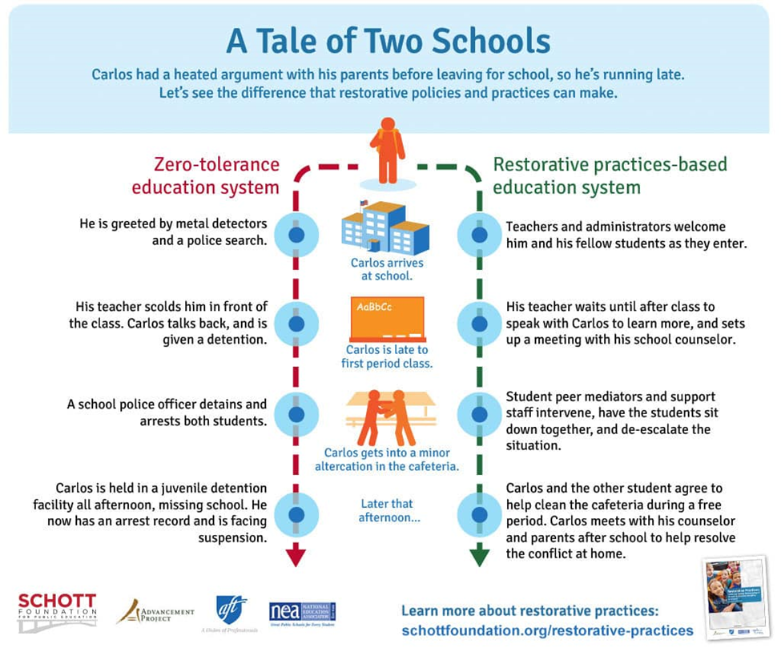

Slide 10
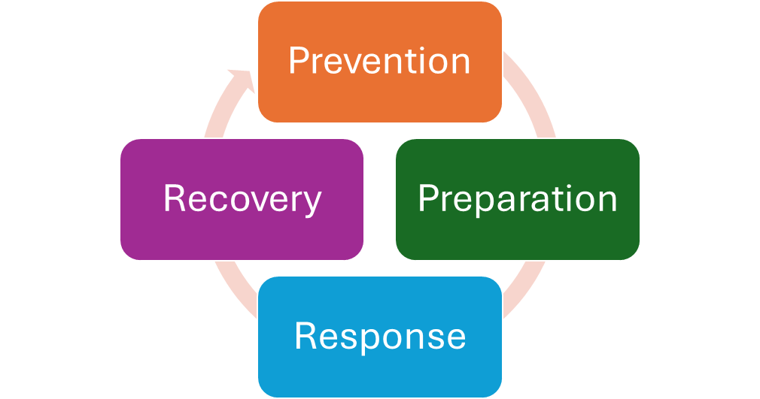
Elements of School Safety
Notes:
Elements of School Safety that reflect phases of school safety considerations– When we discuss Before During and After– we typically – refer to the technical areas of:
Prevention, Preparation, Response, and Recovery
When creating policies and programming in the school safety realm, these are areas of consideration
During Prevention Phase Schools are looking to design programming and implement strategies that support safety planning, safe school behavior, trauma informed practices, restorative practices, and support positive behavior
Having a solid prevention phases– helps to support preparation and planning that considers secondary trauma and the impmentation of practices that are research based
Response Strategies should comprehensive and include – accepted practices for emergency command, implementation of practiced drills and protocols
Recovery-- There are many considerations for recovery- from physical to psychological safety

Slide 11
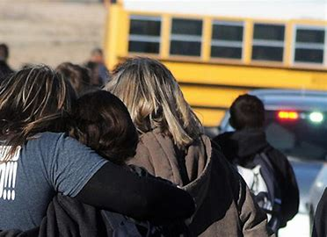
Before, During, After
What are important considerations for crisis response before, during, and after
Effectiveness of Crisis Plan Implementation
Communication with Stakeholders
Maintaining Physical Safety
Maintaining Psychological Safety
Community Support for Student, Staff, and Families
Staff wellness and planning for recovery support
Notes:
Crystal ( 30 to 45 min mark at this slide)
Through the frame of Before , During, and After- What are some things that should be considered during these phases
* Review and Discuss Examples

Slide 12
Organizing Around Creating Safe Schools
Understand the organizing landscape
Identify winnable objectives
Determine if the objectives can be part of a larger campaign
Engage more stakeholders
Communicate clearly, simply, viscerally, and consistently
Notes:
CHAD-
We have provided an overview of School Safety, the foundations of building safe school culture and some considerations for action before, during, and after a crisis
Now lets use the lens of organizing, advocacy, and coaching to examine what we can do in the same context--
Think about these in the context of before , during, and after
Introduction to scenario
Preview- Role of Staff – Before During and After
Chad- Before Considerations
Coaching and organizing in the prevention and preparation phase
Response
Recovery- is also a sequence of preparation and organizing
** What would staff do in each phase

Slide 13
The Role of Staff in School Safety: Before
Understand the organizing landscape
Identify winnable objectives
Determine if the objectives can be part of a larger campaign
Engage more stakeholders
Communicate clearly, simply, viscerally, and consistently
One-on-one’s
Local capacity
Potential growth
Issue identification
Local resources
Demands
Targets
Tactics
Internal organizing
External relationships
Trainings on law & policy
Meaningful updates and surveys
Coaching and Organizing to Build Capacity
Notes:
Frame role of staff in what they should consider or be doing in the three phases ( 5 min)
*** Put a Text box under each icon
**Chad – During
Coaching and organizing Before a Crisis
Examples of what staff can do to:
Understand organizing landscape
Identify winnable objectives
Determine Campaign Objectives
Engage stakeholders
Communicate
promotes physical and psychological safety

Slide 14
The Role of Staff in School Safety: During
Understand the organizing landscape
Identify winnable objectives
Determine if the objectives can be part of a larger campaign
Engage more stakeholders
Communicate clearly, simply, viscerally, and consistently
Leader support
Active Assessment
Active assessment
Keeping ally and organization com going
Availability and location of resources
Supportive accountability
Advocacy to Manage the Moment
Notes:
Frame role of staff in what they should consider or be doing in the three phases
*** Put a Text box under each icon
Chad – During
Coaching and organizing During a Crisis
Examples of what staff can do to:
Understand organizing landscape
Identify winnable objectives
Determine Campaign Objectives
Engage stakeholders
Communicate

Slide 15
The Role of Staff in School Safety: After
Understand the organizing landscape
Identify winnable objectives
Determine if the objectives can be part of a larger campaign
Engage more stakeholders
Communicate clearly, simply, viscerally, and consistently
Reflection on structure
New leaders
New allies
What’s new
What’s old
What needs strengthening
Inertia, opportunity and new/available resources
Leveraging relationships to deliver resources
Sustaining the enlarged leadership structure and issue focus
Coaching and Organizing to Build Resilience
Notes:
Frame role of staff in what they should consider or be doing in the three phases
*** Put a Text box under each icon
Chad – During
Coaching and organizing After a Crisis
Examples of what staff can do to:
Understand organizing landscape
Identify winnable objectives
Determine Campaign Objectives
Engage stakeholders
Communicate

Slide 16
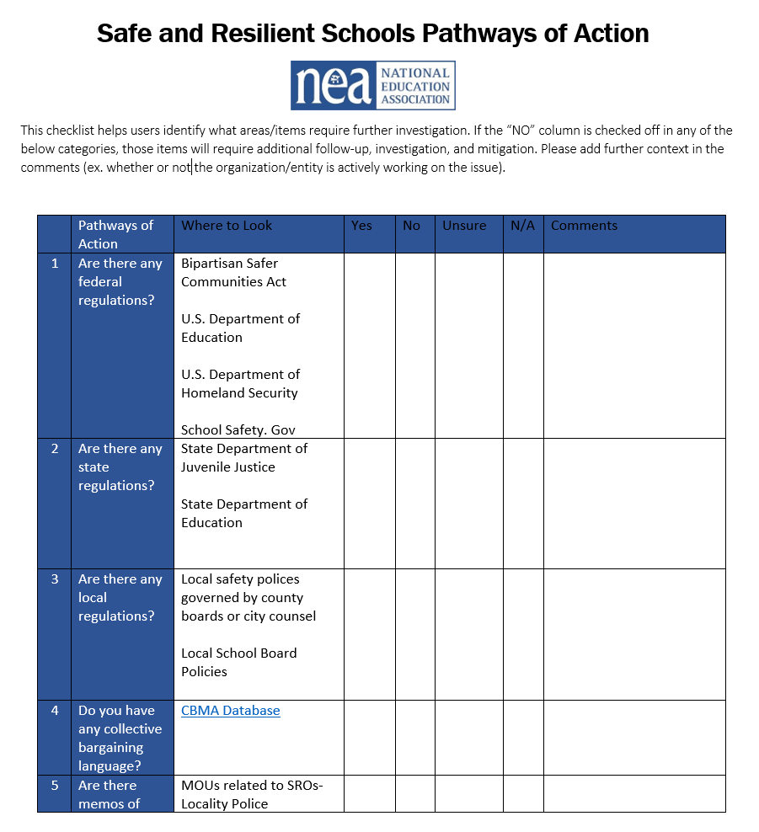

Pathways to Action Tool
Notes:
Using the Pathways to Action Tool – 10 min
Review elements and their relationship to the tool ( ICONS)
-

Slide 17


Scenario
A Failed School Shooting
Notes:
Chad
Will review the scenario in the context of before, during, and after
- Then will discuss through the lens of before, during, and after

Slide 18
Scenario
Begin by using the Pathways To Action tool conduct an analysis of the scenario; you may have to use a bit of imagination and inference where the scenario lacks some detail.
In your breakout:
Characterize the difference between coaching and advocacy as a staff person.
What coaching/organizing could/should have occurred before this incident?
What advocacy would be appropriate during and immediately after this incident?
What coaching/organizing could occur after this incident
A Failed School Shooting
Notes:
Chad
Will review the scenario in the context of before, during, and after
- Then will discuss through the lens of before, during, and after

Slide 19
Scenario
Begin by using the Pathways To Action tool conduct an analysis of the scenario; you may have to use a bit of imagination and inference where the scenario lacks some detail.
In your breakout:
Characterize the difference between coaching and advocacy as a staff person.
What coaching/organizing could/should have occurred before this incident?
What advocacy would be appropriate during and immediately after this incident?
What coaching/organizing could occur after this incident
A Failed School Shooting
Notes:
Breakout Groups will discuss the Scenario and Consider the following questions for discussion ( 10 min)

Slide 20

Group Report Out
Notes:
10 min report out

Slide 21


NEA Health and Safety Resources
Notes:
Highlight Resources
Insert Link ---
Checklists --
In

Slide 22
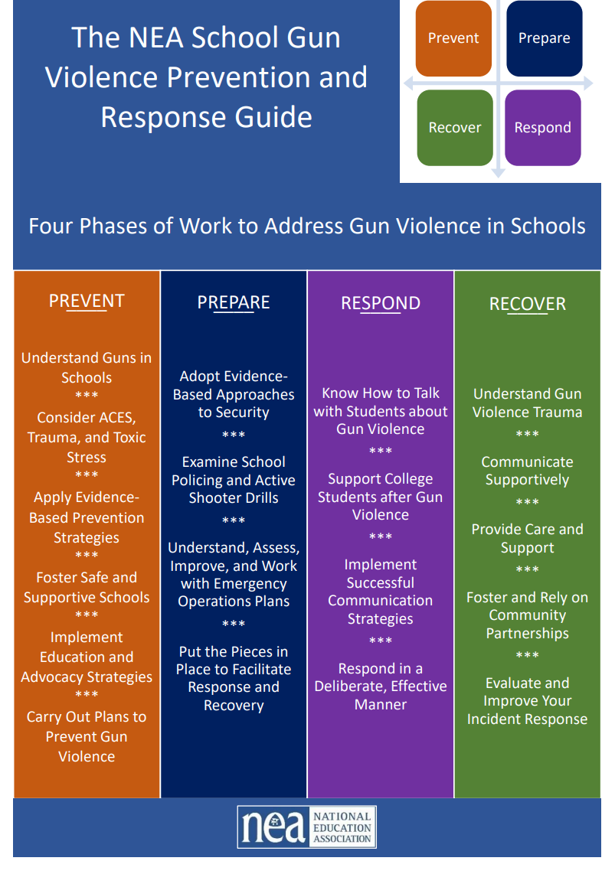
Coming Soon......
NEA Gun Violence Crisis Guide

Slide 23
Take Aways………
School safety should be grounded in creating a safe school culture where students, staff, and families feel included, heard, and cared for.
School safety includes physical and psychological safety
School safety starts with prevention. Safe schools not only respond to crisis they engage in prevention , preparation, response, and recovery programming.

Slide 24

Questions
Notes:
Questions and Discussion

