Slide 1


Safe Schools: Tools and Strategies to Address Gun Violence in Schools

Slide 2
Safe Schools: Tools and Strategies to Address Gun Violence in Schools
Welcome!
In the chat, please share your:
Name
State Affiliate and Role
One word that comes to mind when you think of Safe Schools.

Slide 3
NEA Members and External Audiences
This presentation and its contents are closed to the press and may not be further distributed or passed on to any other person or published or reproduced, in whole or in part, by any medium or in any form for any purpose. Audio/video recording, copying of slides, and the use of AI note-taking tools are prohibited without the written consent from the NEA Center For Organizing. Violation of these terms may result in legal action.
Notes:
This slide should be inserted at the beginning, middle, and end of the presentation to provide notice to those who join after the introduction.

Slide 4

Land Acknowledgement
We begin by acknowledging that through a history of colonization and brutality, we are currently on the traditional lands stewarded by generations of the Indigenous people.
We honor these Indigenous people, all elders, past, present, and emerging. We are called to learn and share these learnings about this tribal history, culture, and contributions that have been suppressed in the telling of the story of what we now call the United States of America.
Notes:
Time Allotment: 1 minute
Chad

Slide 5

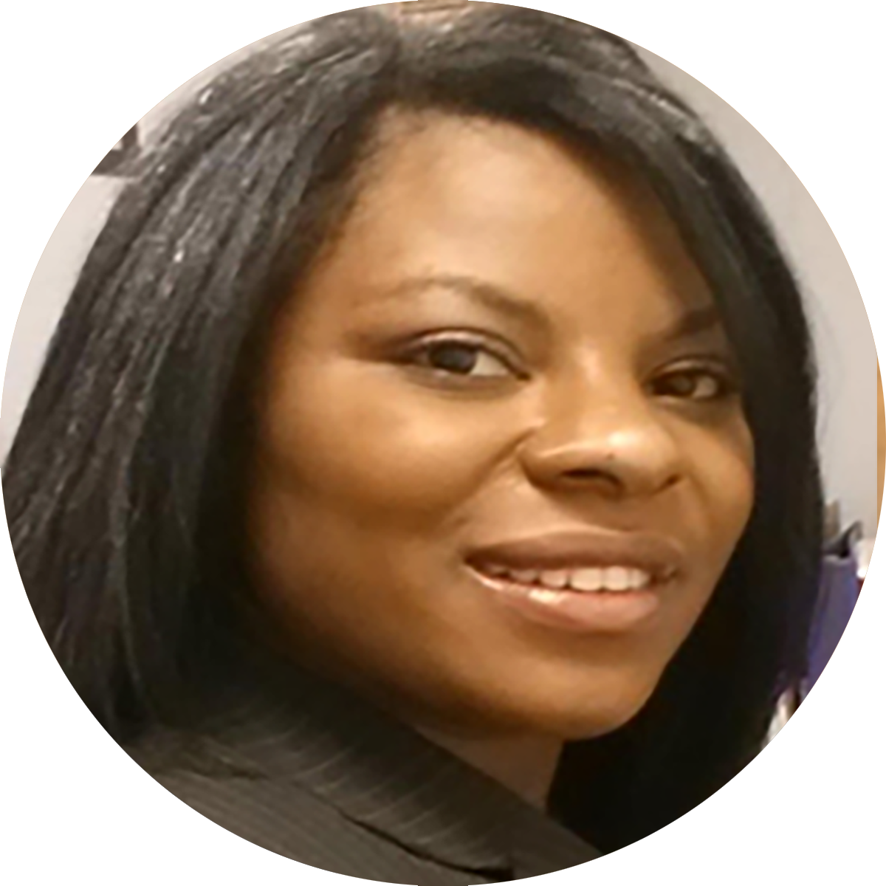
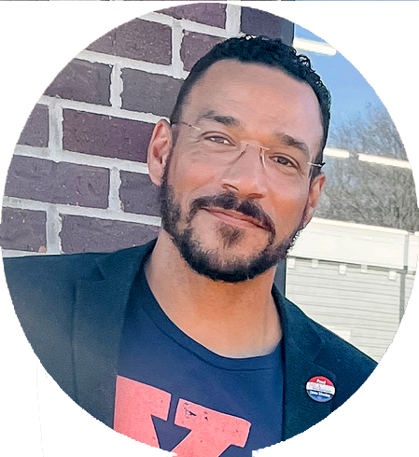
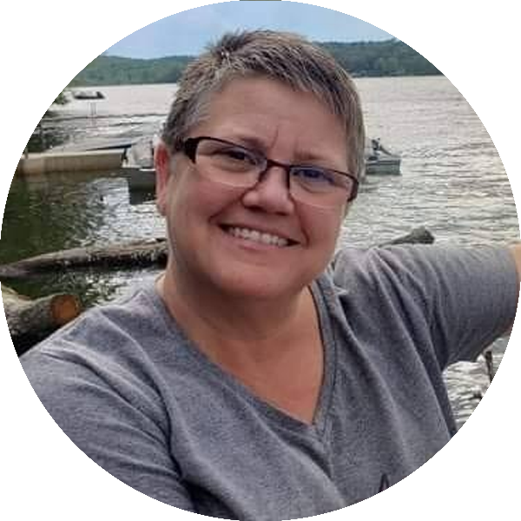



Contributors
This presentation was created through the contributions of the staff at the National Education Association and State Affiliates
Crystal Foxx
Senior Program and Policy Specialist
NEA Health and Safety Program
Chad Williams
UniServ Consultant
Michigan Education Association
cwilliams@mea.org
Ellen Holmes
Organizational Specialist
National Education Association
eholmes@nea.org
Joel Solomon
Senior Program Manager
NEA Health and Safety Program
Jsolomon@nea.org

Slide 6
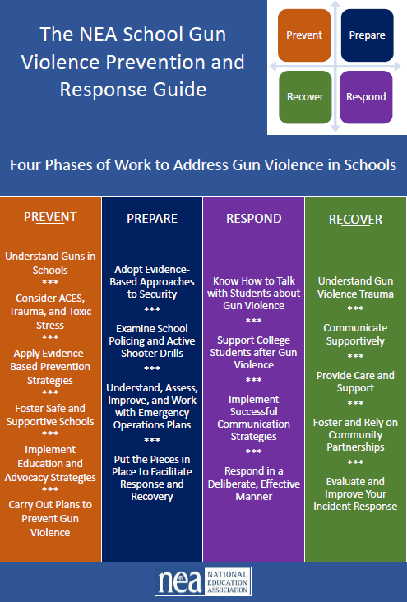
Overview
Coordinated NEA and Affiliate Action
The scourge of gun violence
The NEA School Gun Violence Prevention and Response Guide
Scenario and Discussion
Notes:
10 minutes

Slide 7

NEA STRATEGIC GOALS
To achieve our mission and to grow and strengthen our association to promote quality education for students, educators, and America's schools, we the NEA will:
Enhance the well-being of America's students, their families, and their communities by advancing opportunities that will transform public education into a just, equitable, and excellent system.
Ensure the success of the public education system, our members, and those they serve by developing the structure, processes, and practices that strengthen our organizational capacity across the enterprise.
Notes:
Certainly, as we explore ways to develop Respectful Interactions with a Diverse Disability Community, we are working to achieve the first NEA strategic goal of enhancing the well-being of students, families, and communities to transform public education into a just and equitable system.

Slide 8

NEA STRATEGIC OBJECTIVES
In partnership with our Affiliates, NEA will:
Build Safe, Healthy, Inclusive, and Future-Focused Learning Environments
Support Professional Excellence and Respect
Advance Racial Justice and Social Justice
Strengthen Public Education as the Cornerstone of Democracy
Enhance Professional and Organizational Regard
Notes:
Tied to the NEA goal of enhancing the well-being of students, families, and communities, we focus on the objectives of building safe and inclusive environments and advancing social justice.

Slide 9
SESSION OBJECTIVES
Be able to identify the key components of NEA's recommended steps to help locals prevent, prepare for, respond to, and recover from incidents of gun violence in schools
Assess local readiness to engage in preparation and response work
Conceptualize plans for deepening and broadening the work of your local Association on gun violence issues

Slide 10
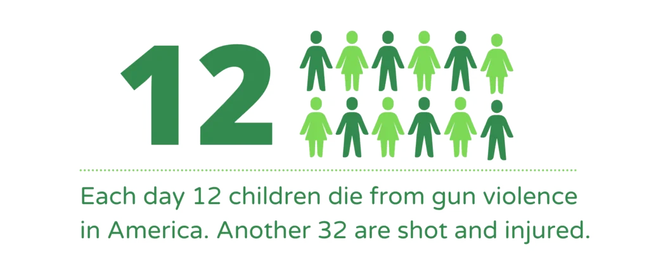

The Scourge of Gun Violence

Slide 11
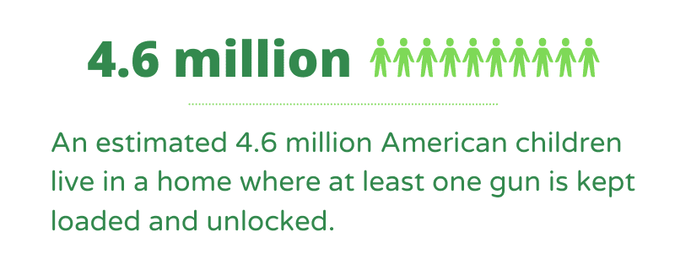
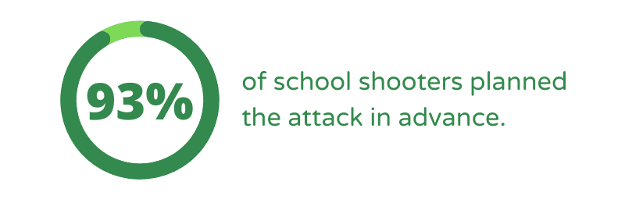
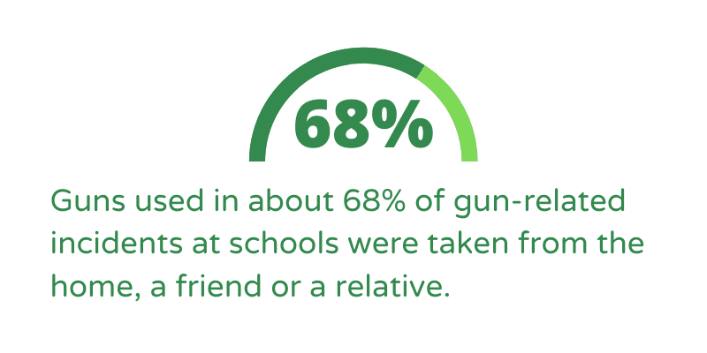
The Scourge of Gun Violence

Slide 12

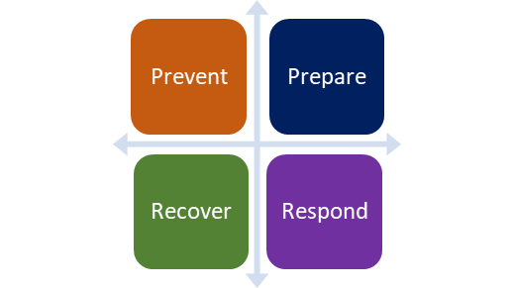
The NEA School Gun Violence Prevention and Response Guide

Slide 13
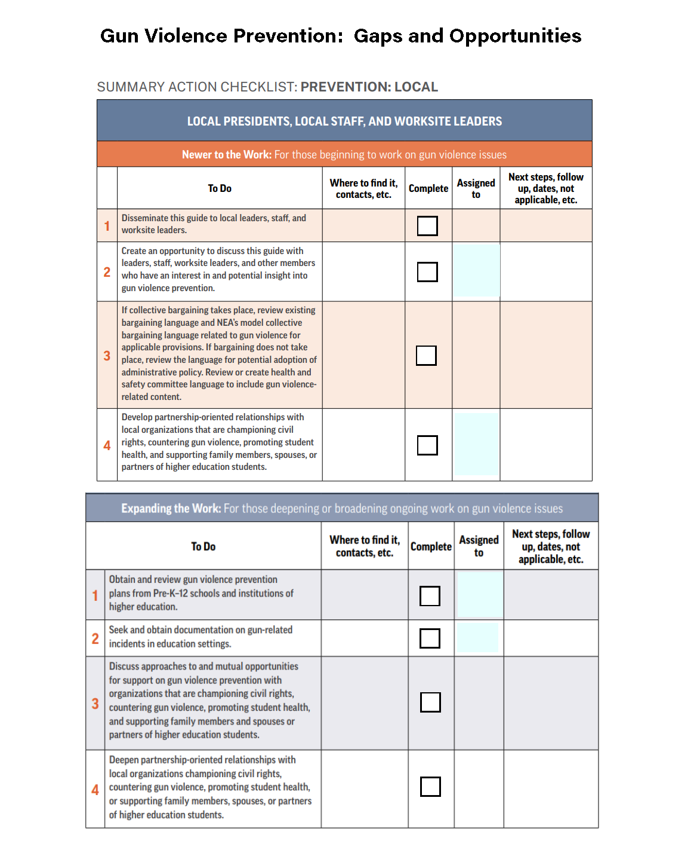
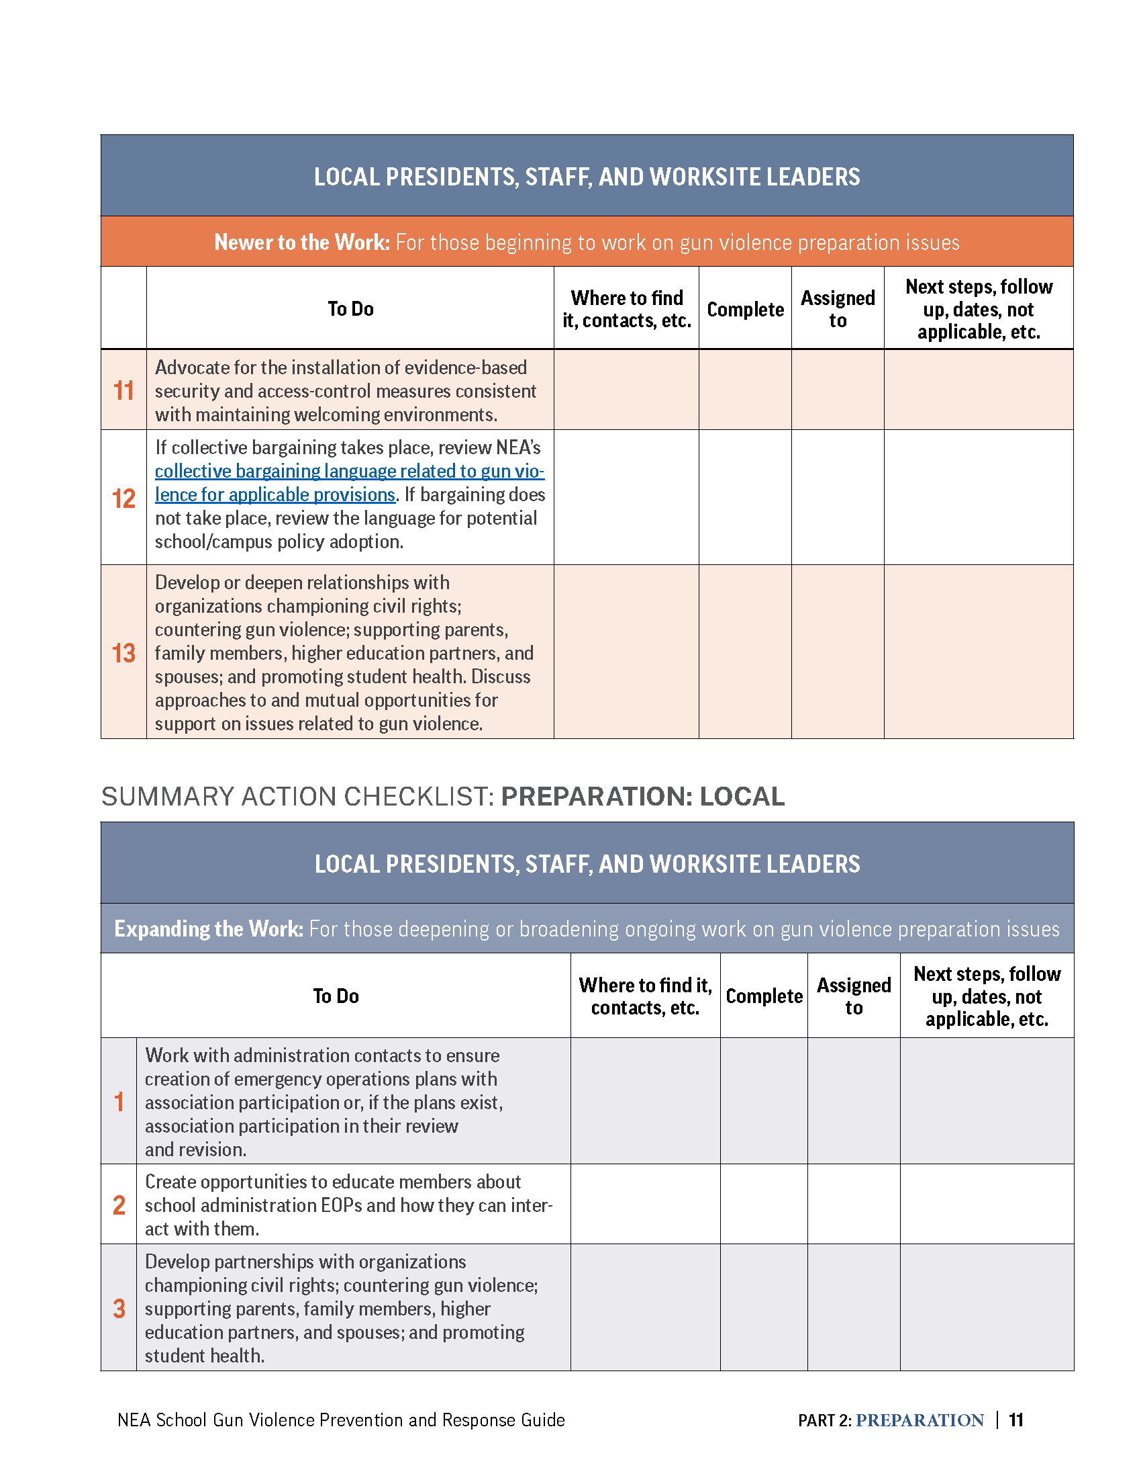
Developing Leadership Plans on Gun Violence Prevention and Response

Slide 14
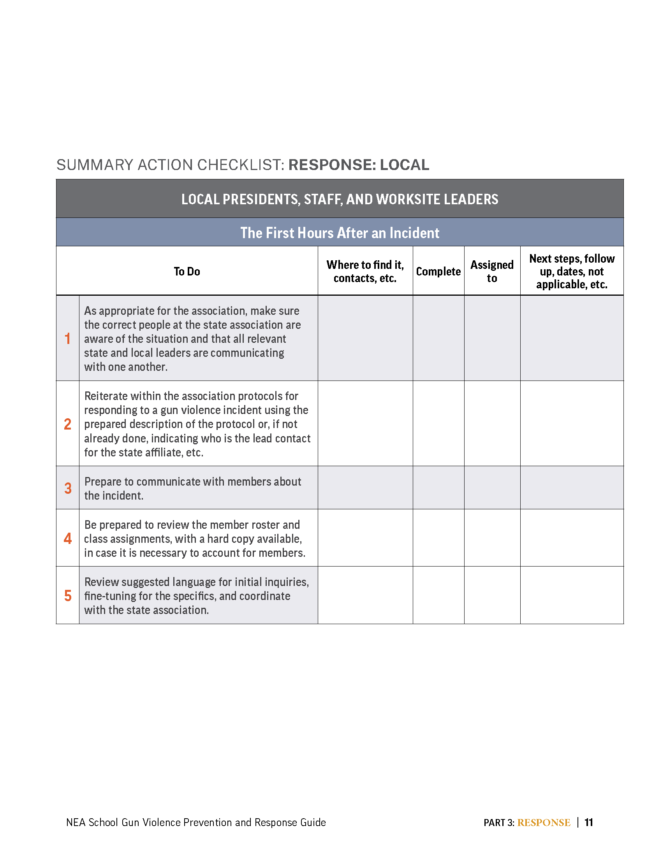
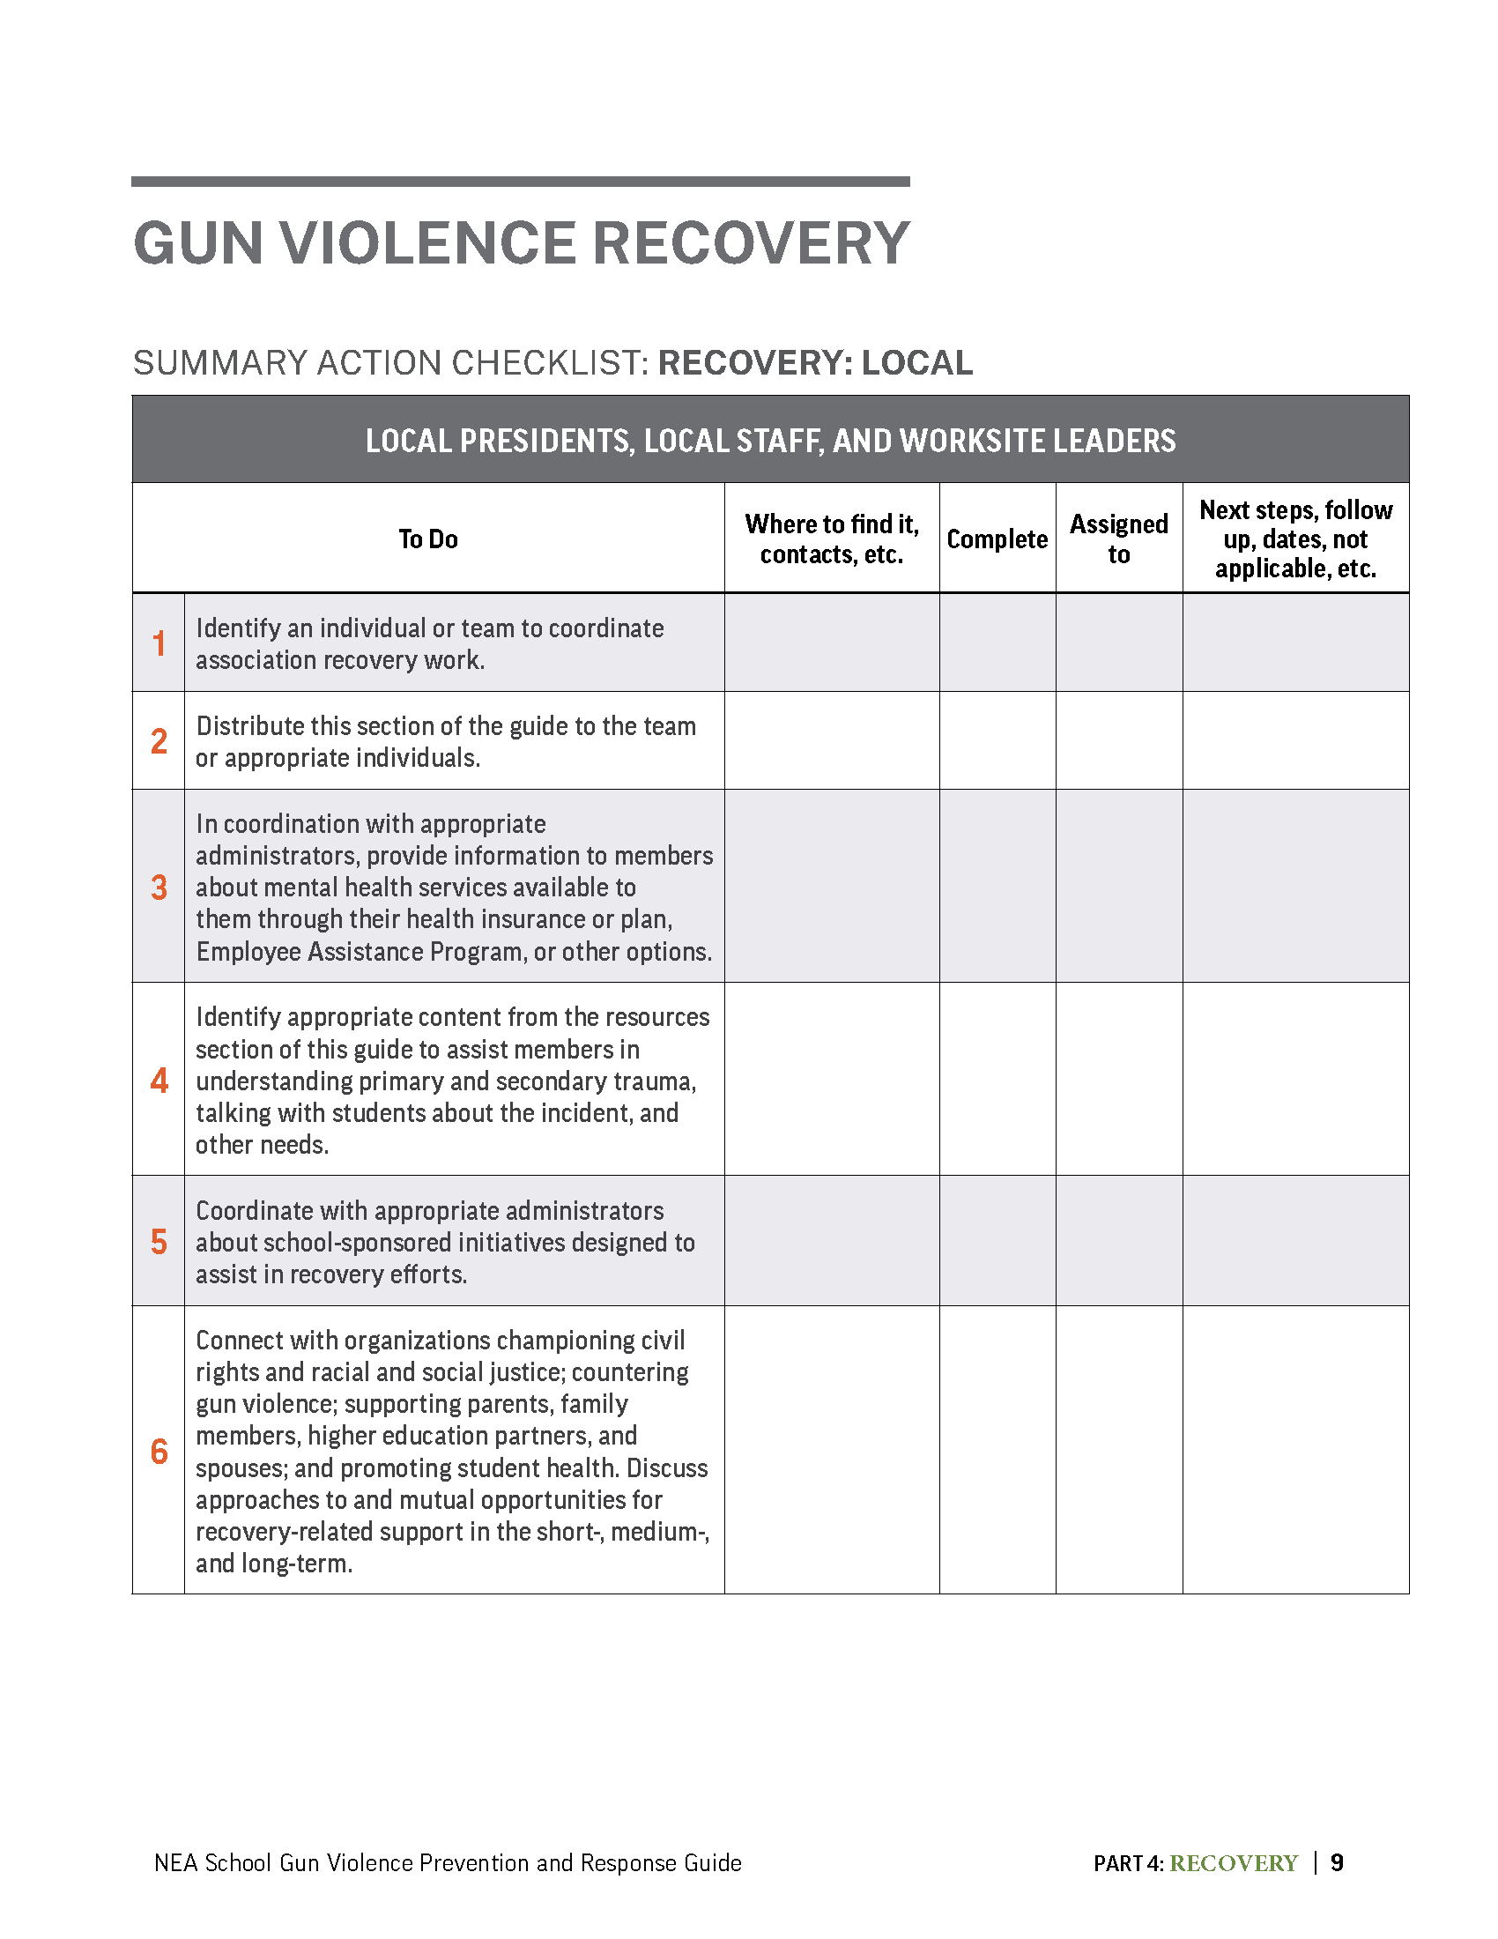
Developing Leadership Plans on Gun Violence Prevention and Response

Slide 15
Prevention – pg 16
Notes:
Emphasize the importance of developing PROCEDURES for communication and operation amongst and between staff, leadership, and other parties.

Slide 16
Prevention
Thinking about your role as a staff person, what are ways you might incorporate the guide and Prevention tasks into:
Member Engagement and Relationship Building
Issue Identification and Framing
Strategic Data and Mapping
Leadership Development
Power Building and Mobilization
https://bit.ly/PreventionStaffBrainstorm
Notes:
Link to share document - https://bit.ly/PreventionStaffBrainstorm

Slide 17
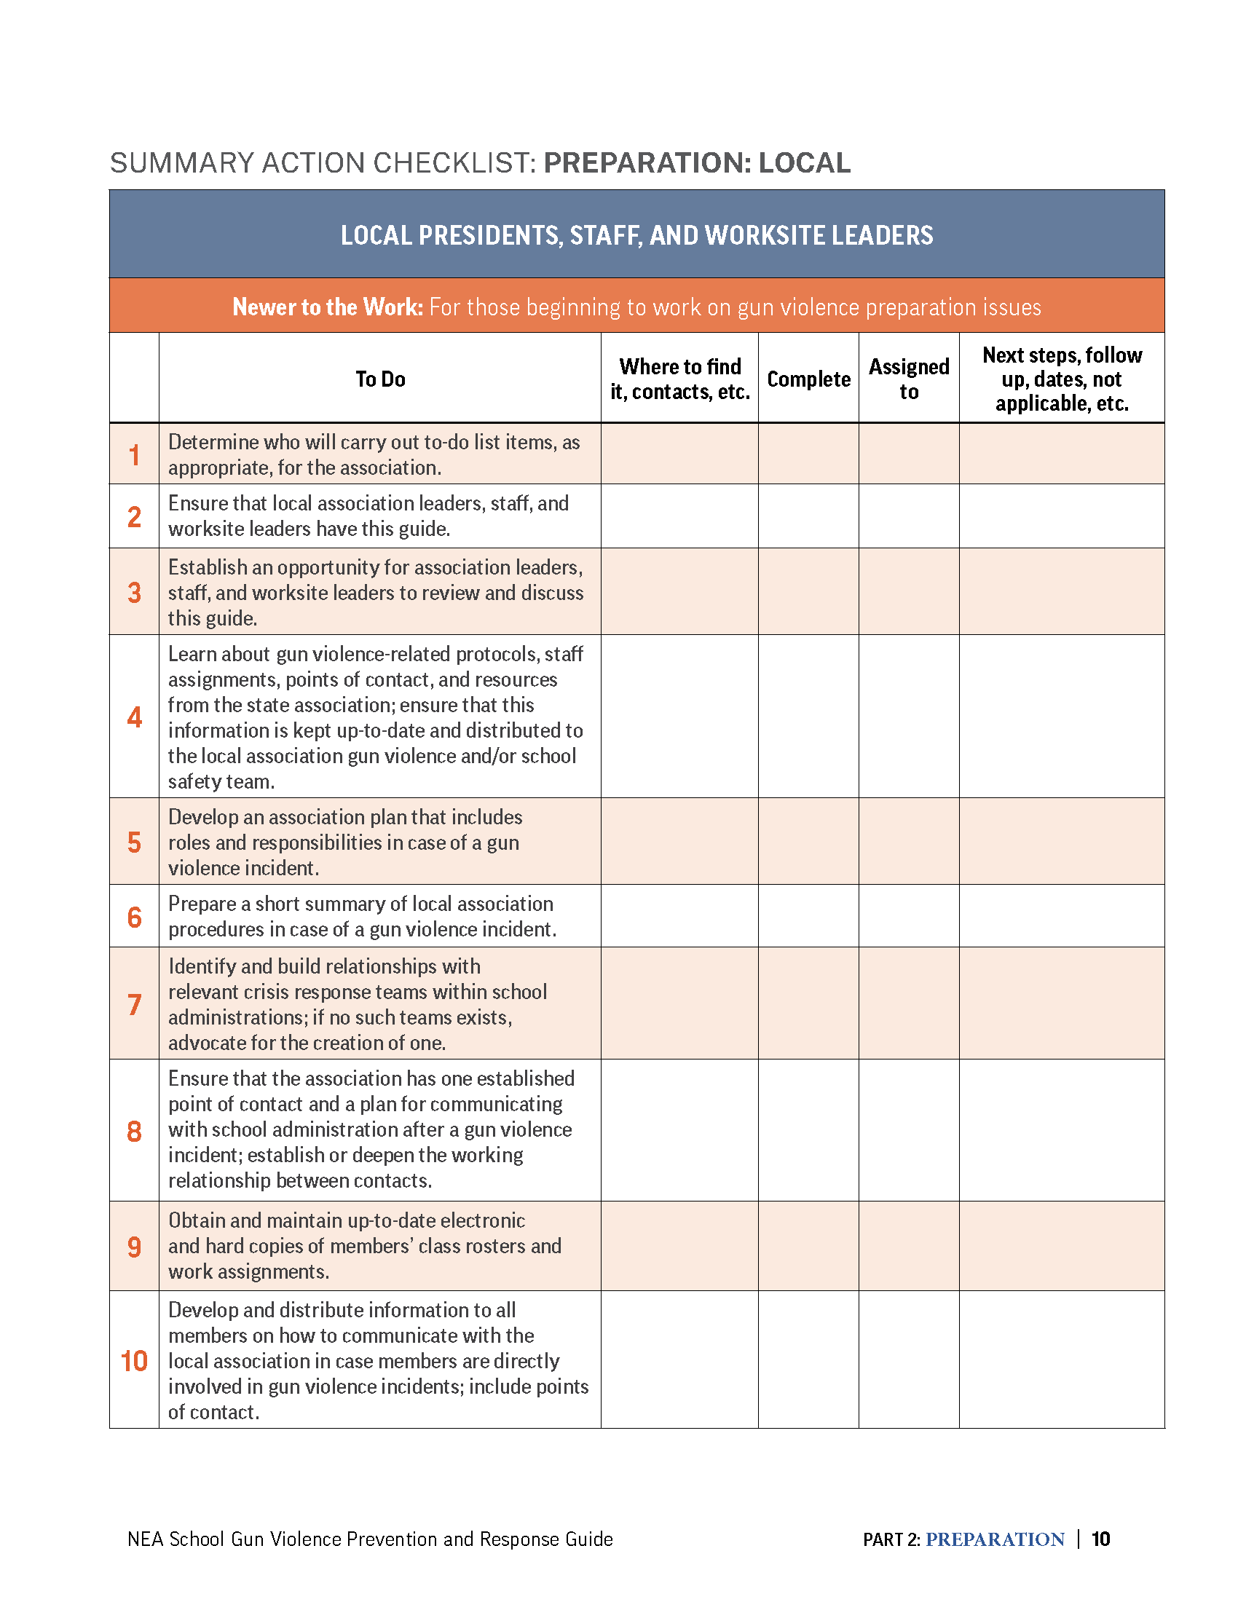
Preparation – pg 70

Slide 18
Prevention
Thinking about your role as a staff person, what are ways you might incorporate the guide and Preparation tasks into:
Member Engagement and Relationship Building
Issue Identification and Framing
Strategic Data and Mapping
Leadership Development
Power Building and Mobilization
https://bit.ly/PreaparationStaffBrainstorm
Notes:
Link to share document - https://bit.ly/PreaparationStaffBrainstorm

Slide 19
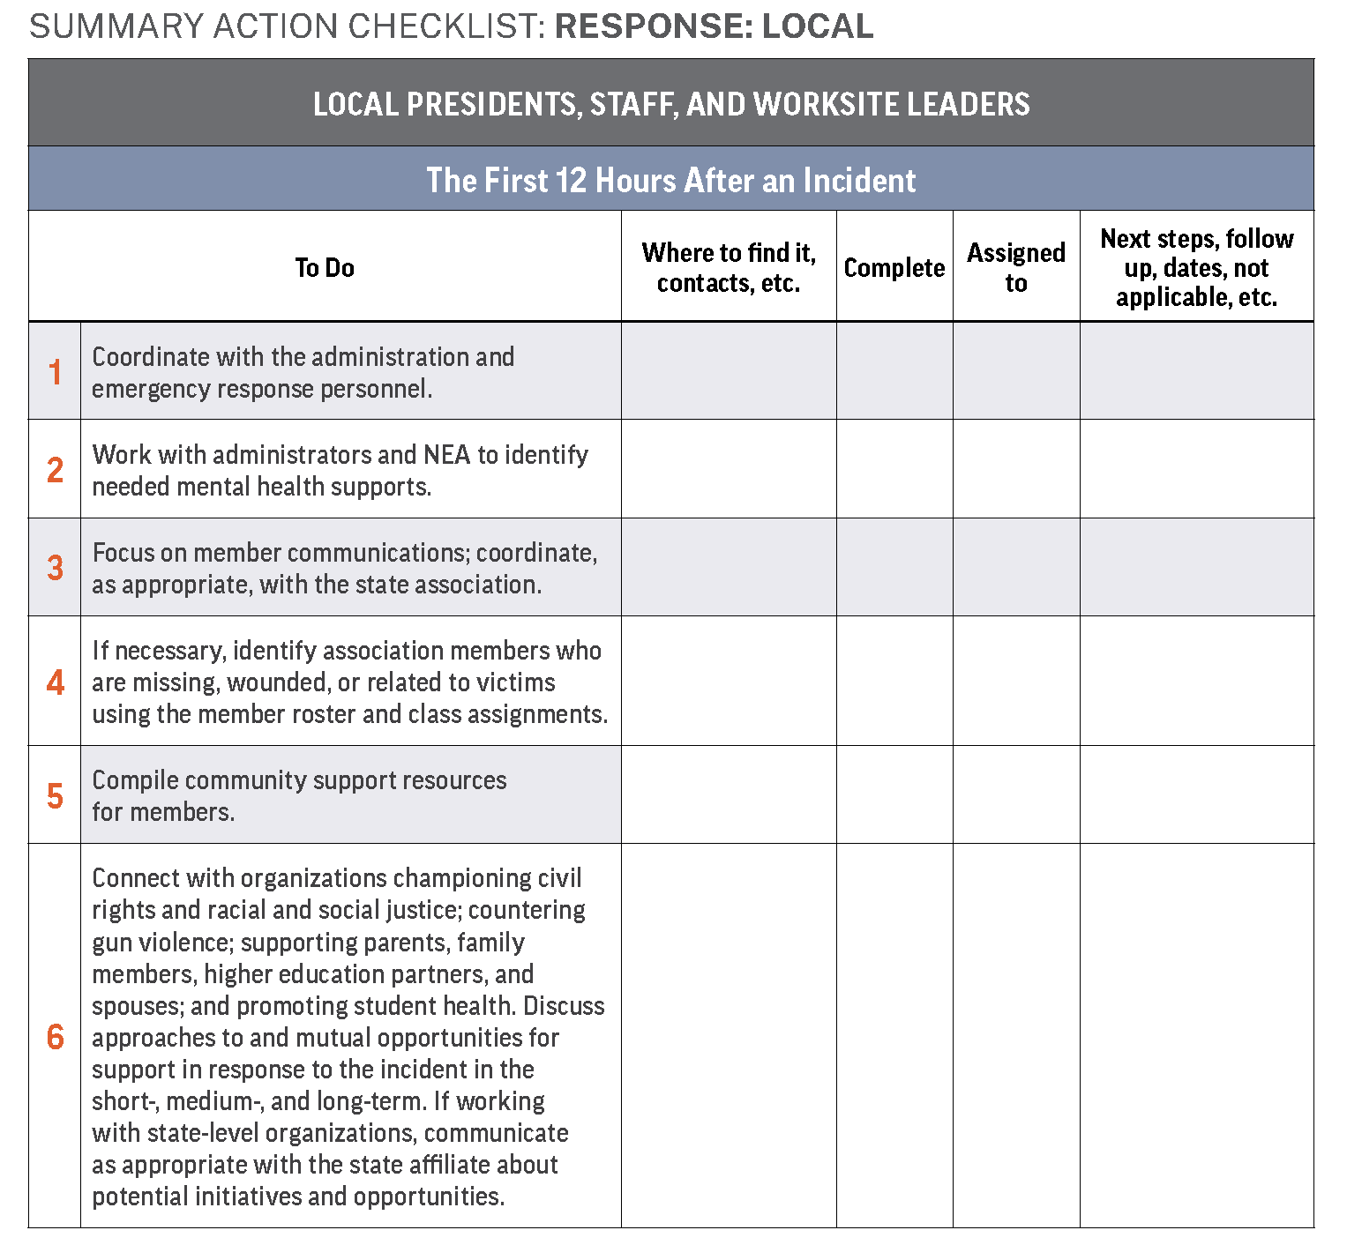
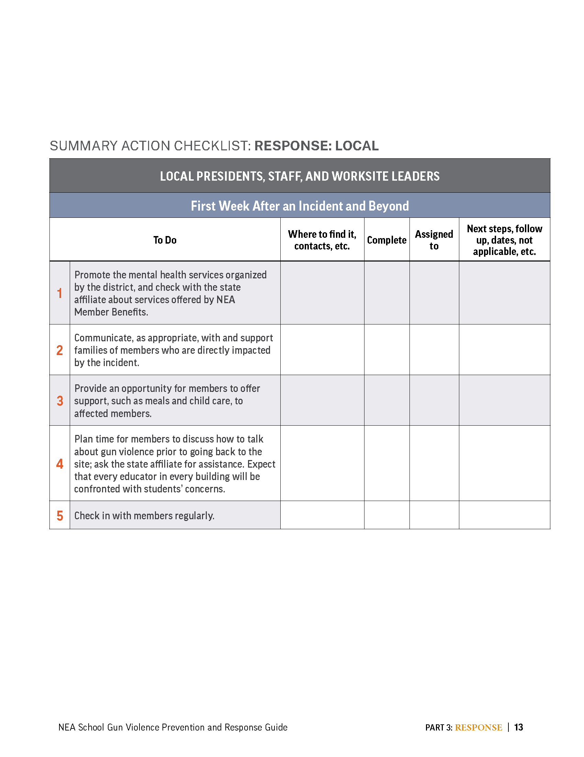
Respond – pg 108-110

Slide 20
Respond – pg 108-110
Thinking about your role as a staff person, what are ways you might incorporate the guide and Response tasks into:
Member Engagement and Relationship Building
Issue Identification and Framing
Strategic Data and Mapping
Leadership Development
Power Building and Mobilization
https://bit.ly/RespondStaffBrainstorm
Notes:
Link to share document - https://bit.ly/RespondStaffBrainstorm

Slide 21
Recovery – pg 141

Slide 22
Recovery
Thinking about your role as a staff person, what are ways you might incorporate the guide and Recovery tasks into:
Member Engagement and Relationship Building
Issue Identification and Framing
Strategic Data and Mapping
Leadership Development
Power Building and Mobilization
https://bit.ly/RecoverStaffBrainstorm
Notes:
Link to share document - https://bit.ly/RecoverStaffBrainstorm

Slide 23

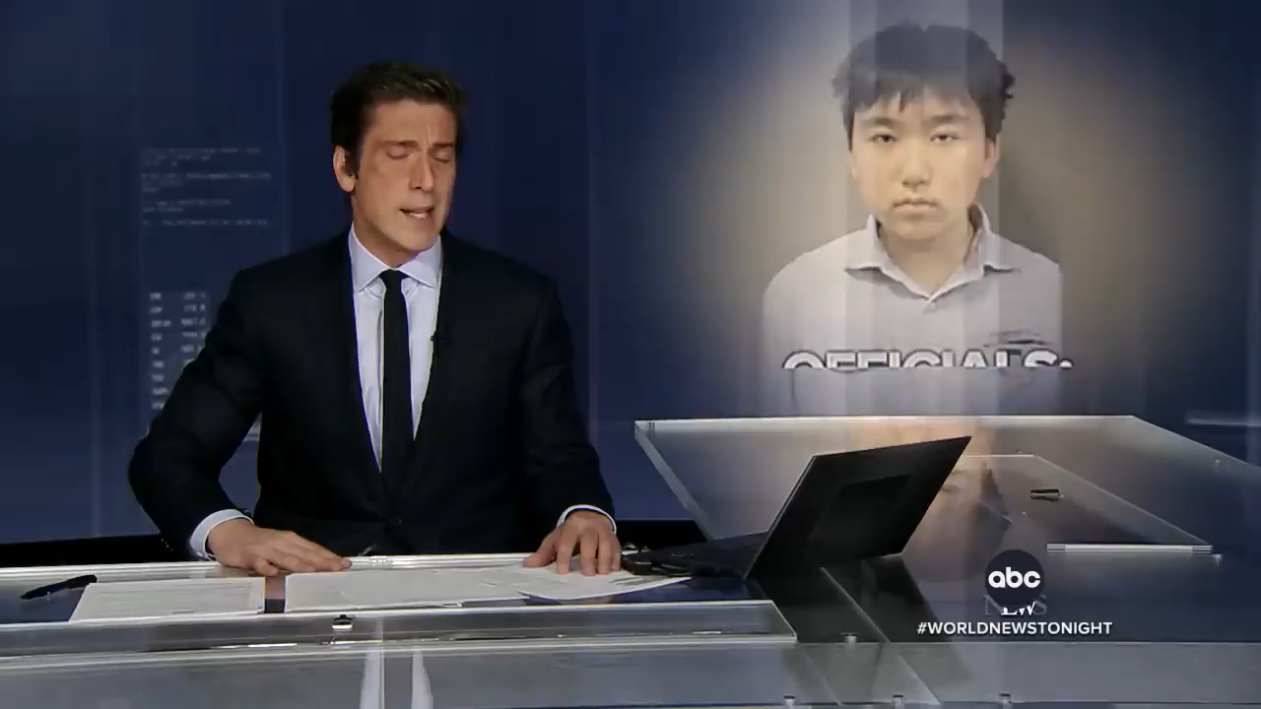
SCENARIO – A Failed School Shooting

Slide 24
SCENARIO – A Failed School Shooting
Begin by using the School Gun Violence Prevention and Prevention Guide to conduct an analysis of the scenario; you may have to use a bit of imagination and inference where the scenario lacks some detail.
In your breakout:
What coaching/organizing could/should have occurred before this incident?
What advocacy/organizing would be appropriate during and immediately after this incident?
Discuss the difference between coaching and advocacy as a staff person.

Slide 25
SCENARIO – A Failed School Shooting
Share Out
What coaching/organizing could/should have occurred before this incident?
What advocacy/organizing would be appropriate during and immediately after this incident?
Discuss the difference between coaching and advocacy as a staff person.

Slide 26
Key Take Aways
Organizing Lens: Turn Individual Crises into Collective Action
  Each phase (Prevention, Preparation, Response, Recovery) provides opportunities to engage members in shared problem-solving, leadership development, and collective advocacy.
Balance Advocacy Roles: Coach, Advocate, and Mobilizer
Think about when to be coaches (equipping members with prevention and preparation skills), advocates (representing members in the aftermath of an incident), and mobilizers (organizing members to push for systemic changes in school safety).
Integrate the Guide into Association Capacity Building
Using the guide should be embedded into ongoing staff work: new member orientations, one-on-one conversations, issue identification, and leadership training.

Slide 27
Resources
This presentation, materials and brainstorms available on POPS
More Gun Violence Prevention & Response Information:
https://www.nea.org/resource-library/gun-violence-prevention-response-guide
More UniServ & Organizer Trainings available:
                https://www.nea.org/UD-Org-Support

Slide 28

Contact US
Crystal Foxx
Senior Program and Policy Specialist
NEA Health and Safety Program
Chad Williams
UniServ Consultant
Michigan Education Association
cwilliams@mea.org
Ellen Holmes
Organizational Specialist
National Education Association
eholmes@nea.org
Joel Solomon
Senior Program Manager
NEA Health and Safety Program
Jsolomon@nea.org

