Slide 1

Secondary Traumatic Stress
Strategies to Survive, Thrive, & Realize that Resilience Starts with You

Slide 2

Your presenter today...
I want you to get credit for your attendance today! To sign in, please go to http://bit.ly/STShello
Jessica Minguez
Presenter
UniServ Director, NEA-Alaska
jessica.minguez@neaalaska.org

Slide 3

Housekeeping
Agenda
Disclaimers
What is STS?
Signs
Strategies
Reflections & Takeaways
Zoom Tips
Chat
Raise Hand
Mute
Questions

Slide 4

Chat Practice:
Who is in the Zoom?
Name
Role in MSBSD
One word to describe your weekend
Example: Jessica, UniServ Director, Cozy

Slide 5

THANK YOU SO MUCH!
LET’S BEGIN.

Slide 6
Secondary Traumatic Stress
Strategies to Survive, Thrive, & Realize that Resilience Starts with You

Slide 7
Disclaimers
Presenting about Self-Care
DOES NOT EQUAL
Perfect at Self-Care
Experienced Educator
BUT
Not Currently in the Schools
No Judgment Zone

Slide 8
Why this topic?
Why now?
Global Pandemic
Working with Kids
You are here.
Our Own Trauma

Slide 9
So many names...
Secondary
Toxic
Stress
Compassion
Fatigue
“the cost
of caring”
Secondary
Trauma
Secondary
Traumatic
Stress
Secondary
Victimization
Vicarious
Trauma

Slide 10


Vicarious Trauma
vicarious
trauma
For more on adverse childhood experiences and trauma-informed schools: http://www.nea.org/home/75259.htm

Slide 11


Vicarious Resilience
vicarious
resilience

Slide 12
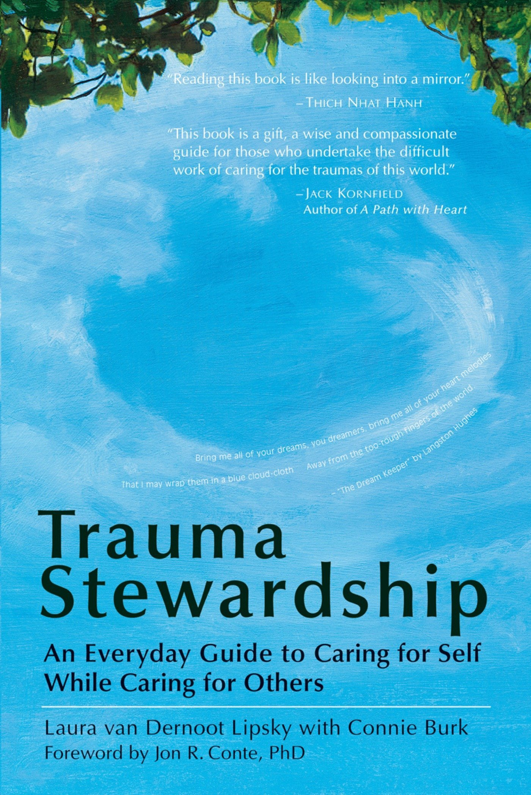
Trauma Exposure Response
“...the ways in which the world looks and feels like a different place to you as a result of doing your work.”
Trauma Stewardship:
An Everyday Guide to Caring for Self While Caring for Others

Slide 13
SIGNS OF SECONDARY TOXIC STRESS
feeling helpless/hopeless
a sense that you can’t ever do enough
hypervigilance
everything is black and white
the automatic “no”
minimizing
chronic exhaustion/physical ailments
avoidance
moments of dissociation
sense of persecution
guilt
fear
anger/cynicism
inability to empathize/numbing
addictions
In the classroom, Trauma Exposure Response can vary depending on many factors:
student manifestation
your baseline emotional/mental state
your own level of trauma
schoolwide capacity for resilience
classroom structures in place
educator strategies

Slide 14
Reflecting on Your TER
Gosh, it sounds like this student is really anxious around food insecurity. Maybe they don’t get regular meals. I need to make sure they know they won’t ever go hungry here.
Who are you when you are your best “school self”?
When I am my best school self, I frame unexpected behavior in terms of what a student is needing at that moment.
How might you act when you are experiencing Trauma Exposure Response?
When I am experiencing TER, I frame unexpected behavior in terms of the student acting against me.
Ugh, this student is having a meltdown because his lunch card isn’t in its spot! We’ll never get through the line at this rate!

Slide 15
Reflecting on Your TER
Who are you when you are your best “school self”?
How might you act when you are experiencing Trauma Exposure Response?

Slide 16
WHAT ARE SOME STRATEGIES I CAN USE TO TURN VICARIOUS TRAUMA INTO VICARIOUS RESILIENCE?

Slide 17
Developing Resilience as
An Education Support Professional
Attitude
of
Inquiry
Addressing One’s Own Trauma
Self-Care & Self-Soothing
Is this Working?
Where is
My Focus?
Models & Examples
Create a Microculture

Slide 18
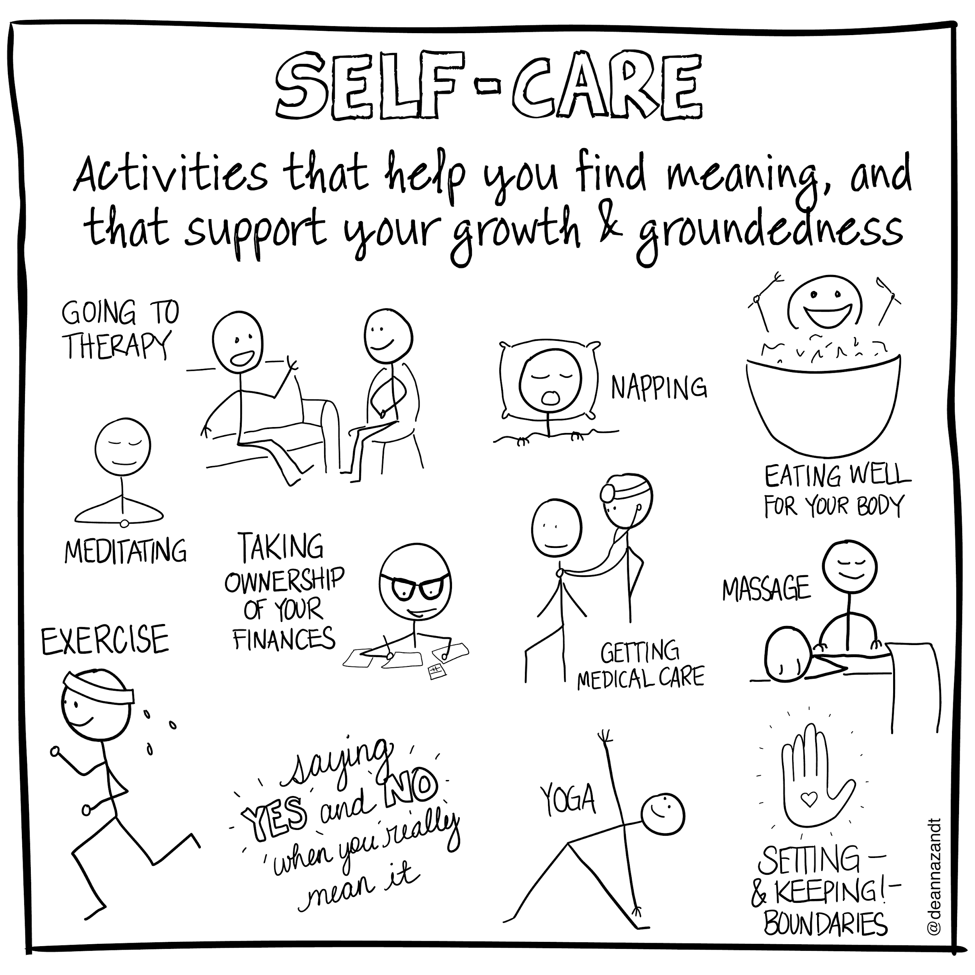
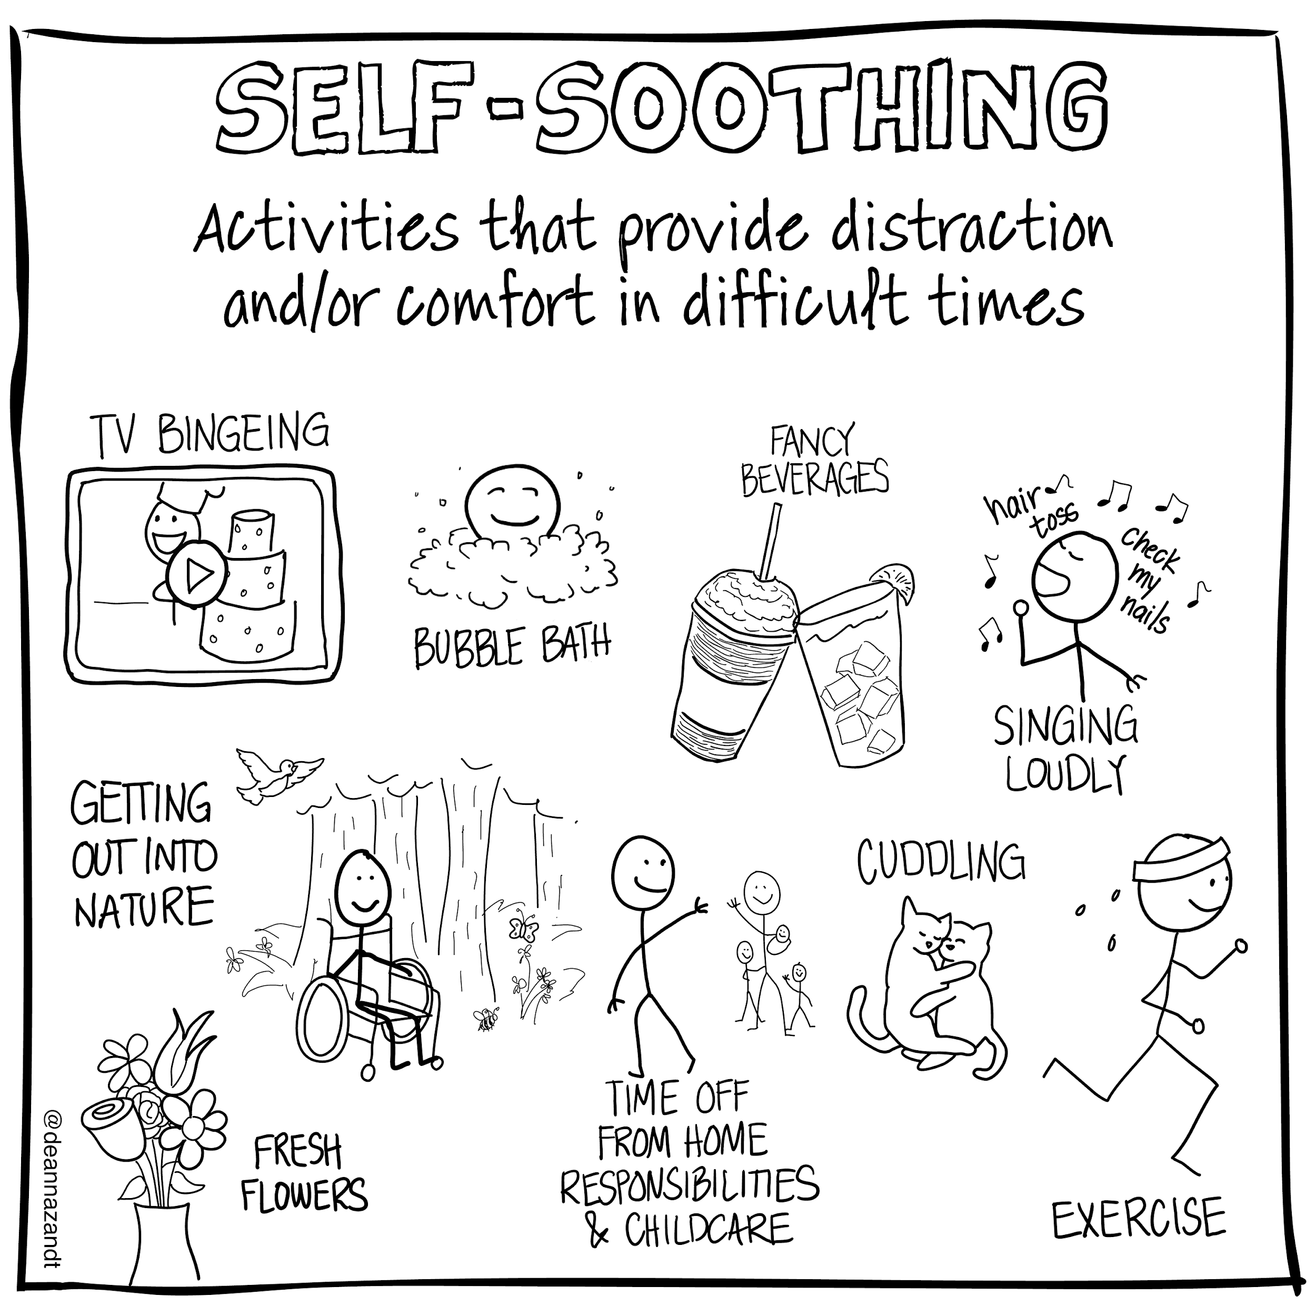

Slide 19
Reflecting on
Your Own Resilience
What are some messages you would like to tell yourself about what you need in regards to developing your own resilience?

Slide 20
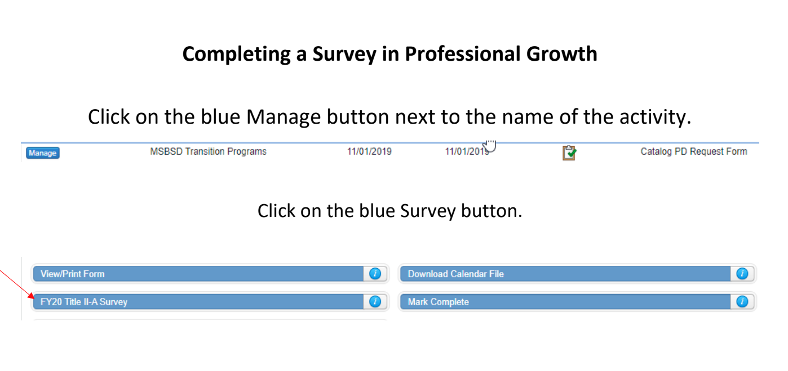
Thank You.
Forget to sign in? Here’s your chance!
http://bit.ly/STShello
I welcome your feedback.
(907) 274-0536
jessica.minguez@neaalaska.org

