Slide 1



Organizing Around School Safety
Workplace Violence and violent students
Find Workplace Safety Resources
https://bit.ly/Workplace-Safety-Resources

Slide 2


Slide 3

Tip of the iceberg
Nearly 1 in 10 educators threatened with or experience violence from students in the past 12 months.
Verbal abuse of educators has doubled since 2010 from 1 in 20 to 1 in 10 now.
Nearly 1 in 5 students report having carried a weapon at school in the past 12 months.
But only 10% of schools took serious disciplinary action in response to possession of a weapon
Mid-size towns with lowest minority populations have highest incidents of reported bullying (~1 in 5 weekly)
Only about ½ of schools do mental health assessments for students, small and rural schools even less.
1 in 5 students report hindered learning due unsafe environment
Only 35% of schools take serious action
Complete USDE & USDOJ Study: Indicators of School Crime and Safety 2021 https://bit.ly/Workplace-Safety-Resources

Slide 4

Safety is a prerequisite for education
Safety is the most powerful organizing issues crossing all interest groups.
Educators are in a unique position to leverage this issue to effect change.

Slide 5

In the moment of a Student Threat / Assault – Corporal Punishment Laws conflict with Seclusion and Restraint policies
(4) A person employed by or engaged as a volunteer or contractor by a local or intermediate school board
or public school academy may use reasonable physical force upon a pupil as necessary to maintain order and control in a school or school-related setting for the purpose of providing an environment conducive to safety and learning. In maintaining that order and control, the person may use physical force upon a pupil as may be necessary for 1 or more of the following:
To restrain or remove a pupil whose behavior is interfering with the orderly exercise and performance of school district or public school academy functions within a school or at a school-related activity, if that pupil has refused to comply with a request to refrain from further disruptive acts.
For self-defense or the defense of another.
To prevent a pupil from inflicting harm on himself or herself.
To quell a disturbance that threatens physical injury to any person.
To obtain possession of a weapon or other dangerous object upon or within the control of a pupil.
To protect property.

Slide 6

Seclusion and Restraint – Brief Background
2003 – An Autistic student in Kalamazoo died as a result of face-down prone restraint.
In 2006, the Michigan Department of Education, State Board of Education adopted “Supporting Student Behavior: Standards for the Emergency Use of Seclusion and Restraint.”
In December 2016, the State of Michigan adopted new laws restricting the use of seclusion and restraint in schools.
Approved by the State Board of Education March 14, 2017
Not later than the beginning of the 2017–2018 school year, the board of a school district or intermediate school district or board of directors of a public school academy shall adopt and implement a local policy that is consistent with the state policy under this section.

Slide 7
Safe School Legislation what’s in place now
“Matt Epling Safe School Law” – mcl 380.1310b
Named after Matt Epling, an East Lansing honor-roll student who killed himself at the age of 14 in 2002 after being assaulted by bullies at his school.
Affective date: School Year 2014-15
Requires districts to:
  Adopt anti-bullying policy
  Identify school official responsible for carrying out policy
  Publicize their policy
  Notify parent/guardian of victim and perpetrator
  Report bullying incidents to board annually
Encourages districts to:
  Form an anti-bullying task force (all stakeholders)
  Provide annual training for Admin, Staff, and Volunteers
  Provide educational programming for students and parents/guardians

Slide 8
Safe School Legislation what’s in place now
Assault by pupil against employee – mcl 380.1311a
Affective Date: School year 1999-2000, amended 2007
"Physical assault" means intentionally causing or attempting to cause physical harm to another through force or violence.
Requirements of the district:
Applies to students in 6th – 12th grade.
Requires suspension or expulsion of student. (uses the term “shall”)
If expelled, may not be reinstated for 180 days.
Must be reported to the Board.
Not liable for damages due to suspension or expulsion.
Does not supersede student right to special education services
Must report the assault to state or local law enforcement.

Slide 9
Safe School Legislation what’s in place now
Suspension and Expulsion of Pupils – mcl 380.1311
Affective Date: School year 1977-1978, amendments 1993 – 2008
Mandatory Expulsion:
Possession of a “dangerous weapon” (*there are exceptions)
  Firearm, dagger, dirk, stiletto, knife with a blade over 3 inches in length, pocket knife opened by a mechanical device, iron bar, or brass knuckles
Commits arson or sexual assault
Must be referred to social/mental services
If in grade 5 or below, may be reinstated after 60 days.
Suspensions:
Gross misdemeanor or persistent disobedience
Subject to District policy

Slide 10
Safe School Legislation what’s in place now
Statewide school safety information policy - 380.1308
Affective Date: School year 1999-2000
Requirements of the district:
Meet and confer as appropriate on the implementation of the statewide school safety information policy for each school district.
Establish procedures to be followed when such an incident occurs at school.
Develop recording and reporting procedures for criminal/violent incidents with law enforcement and school employees.
What a school should have:
School safety policy document
www.michigan.gov/documents/mde/Statewide_School_Safety_499035_7.pdf

Slide 11
“Unsafe” School Legislation what’s in place now
Federal Funding Requirement:
No Child Left Behind Act of 2001) requires that each State receiving funds under the ESEA establish and implement a statewide policy requiring that students attending a persistently dangerous public elementary or secondary school, or students who become victims of a violent criminal offense while in or on the grounds of a public school that they attend, be allowed to attend a safe public school.

Slide 12
“Unsafe” School Legislation what’s in place now
STATEWIDE SAFE SCHOOL CHOICE POLICY
Affective Date: School year 2001 - 2002
Requirements of the district:
Track and report instances where a student has committed an offense warranting suspension or expulsion for more than ten consecutive days.
Over 3 consecutive years, if more than 2.5 percent of pupils, or five pupils enrolled in the school, whichever is greater, have been suspended or expelled for offenses related to this policy each year, then the school shall be designated a “Persistently Dangerous School.”
A Corrective Action Plan must be submitted to the State Superintendent within 30 days of the school board’s report and notification that the school has been identified as a Persistently Dangerous School.

Slide 13
Violent Special Education Students
Regulated by the IDEA (Individuals with Disabilities Act)
Violent students may be removed for up to 10 days (cumulative), then a “Manifestation Hearing” must occur.
Michigan law recognizes the need for school employees to be able to protect themselves and others from injury and threats of injury from a special education student.
If the parents agree to a behavioral management approach that permits unlimited removal to prevent injury to others, then the district is not bound by the IDEA’s 10 day limit.
School employees serving on IEP teams should ensure that the IEP’s of students whose disability results in violent behavior contain provisions for dealing with the potential for violence, including the school conduct code and disciplinary measures that permit removal from the classroom to protect others' safety.

Slide 14
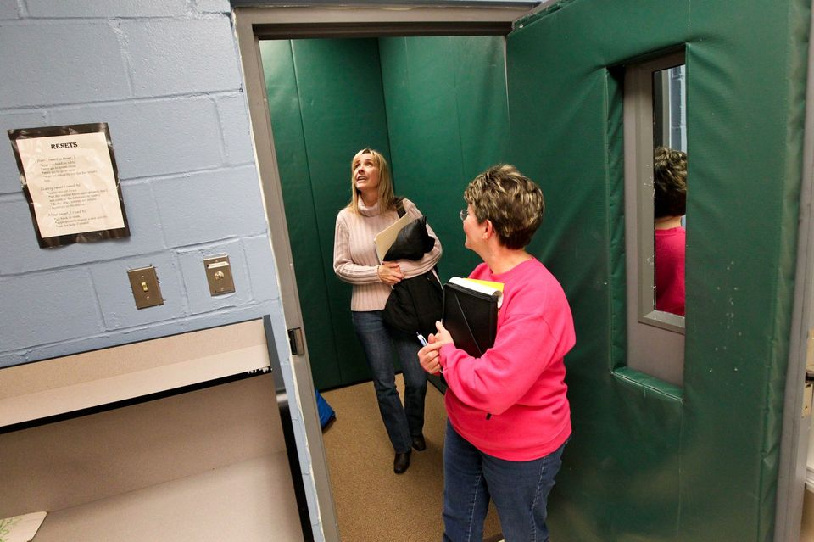
Emergency Seclusion
  What is “Emergency” seclusion?
  Seclusion is a last resort emergency safety intervention that provides an opportunity for the student to regain self-control. Seclusion is the confinement of a student in a room or other space from which the student is physically prevented from leaving and which provides for continuous adult observation of the student.

Slide 15

Emergency Seclusion Policy Requirements
Must continually observe & communicate with the pupil in emergency seclusion
Must not be locked
Must not prevent the student from exiting the area should staff become incapacitated or leave that area
Must provide for adequate space, lighting, ventilation, viewing, and the safety of the student.
Must not exceed:
  15 minutes for an elementary school pupil or
  20 minutes for a middle school or high school pupil.

Slide 16

Emergency Restraint
Chemical
Physical
Mechanical

Slide 17

Emergency CHEMICAL RESTRAINT
The administration of medication for the purpose of restraint. It should be noted that chemical restraint does not apply to medication prescribed by and administered in accordance with the directions of a physician.
***always prohibited***
      Benzodiazepines
      Antipsychotics
      Dissociative anesthetics

Slide 18
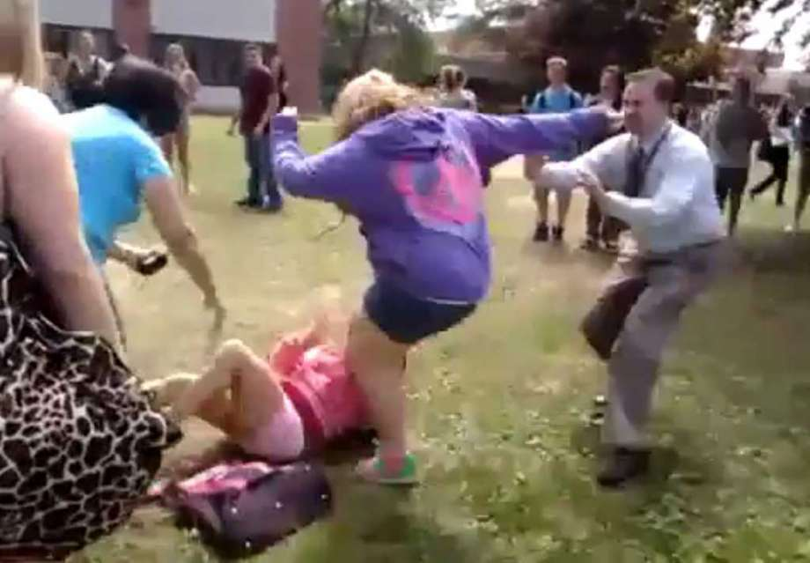
Emergency PHYSICAL RESTRAINT
Involves direct physical contact that prevents or significantly restricts a student’s movement. This is a last resort emergency safety intervention. Restraint is an opportunity for the student to regain self-control.
This policy on emergency physical restraint is not intended to forbid actions undertaken:
To break up a fight
To take a weapon away from a student
As the brief holding by an adult in order to calm or comfort
As the minimum contact necessary to physically escort a student from one area to another
To assist a student in completing a task/response if the student does not resist or resistance is minimal in intensity or duration
To hold a student for a brief time in order to prevent an impulsive behavior that threatens the student’s immediate safety (e.g., running in front of a car)

Slide 19
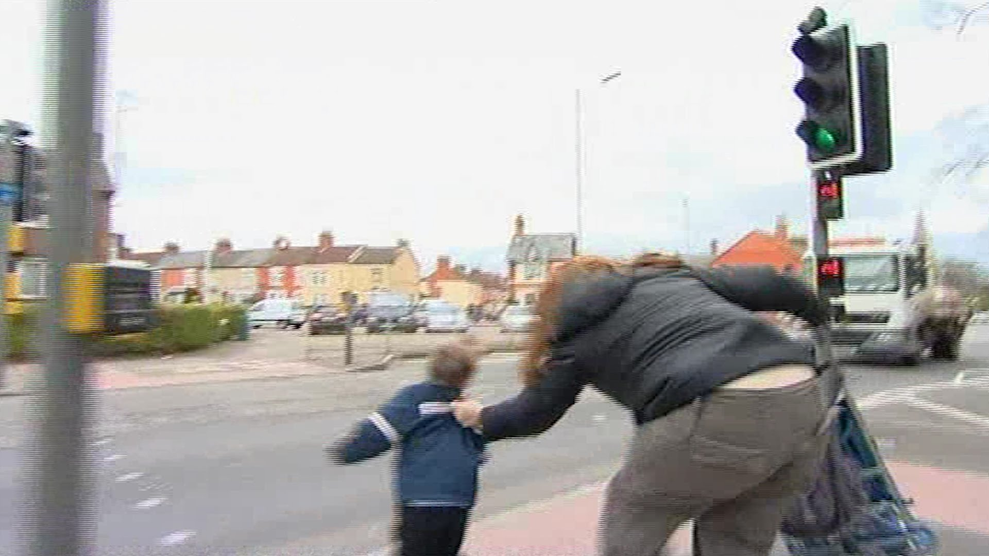
Is this an “Emergency” Restraint or not?
Imminent danger?
De-escalation?

Slide 20

“Emergency” Restraint or not?
Imminent danger?
De-escalation?

Slide 21

“Emergency” Restraint or not?
Imminent danger?
De-escalation?

Slide 22
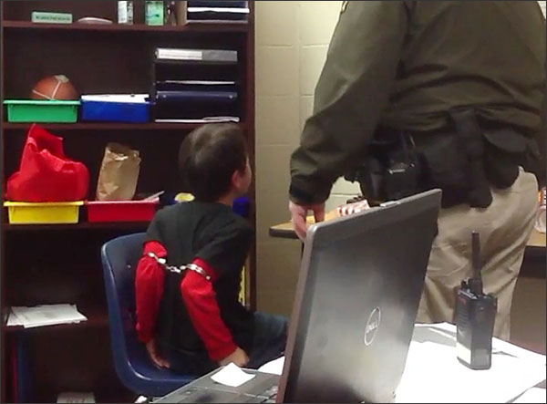
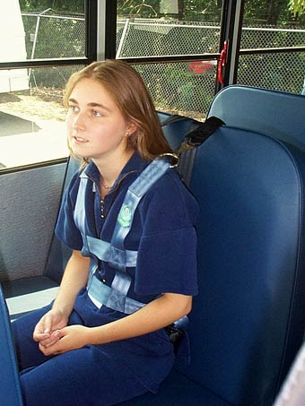
“Emergency” MECHANICAL RESTRAINT
  “Emergency” Mechanical restraint does not include:
  an adaptive or protective device recommended by a physician or therapist (when it is used as recommended)
  safety equipment used by the general student population as intended (for example, seat belts, safety harness on school transportation).
The use of any device, article, garment, or material attached to or adjacent to a student’s body that restricts normal freedom of movement and that cannot be easily removed by a student.
***always prohibited***

Slide 23

Comprehensive training framework
  The Seclusion and Restraint law mandates that a comprehensive training framework include the following:
  Awareness training for all school personnel who have regular contact with pupils.
  Awareness training for substitute teachers
  Comprehensive training for Key Identified Personnel

Slide 24

All Personnel
Training must include the following:
Techniques to identify student behaviors that may trigger emergency safety situations
Related safety considerations, including information regarding the increased risk of injury to students and staff when seclusion or restraint is used
Instruction in the use of seclusion and restraint
Identification of events and environmental factors that may trigger emergency safety situations
Instruction on the State Board of Education policy on Supporting Student Behavior: Standards for the Emergency Use of Seclusion and Restraint
Proactive practices and strategies that ensure the dignity of students
Conflict resolution
Mediation
Social skills training
De-escalation techniques
Positive behavior support strategies
***Most districts have used the video provided by Global Compliance Network or similar video to meet the needs of the training requirement***
Video length is 13 minutes

Slide 25
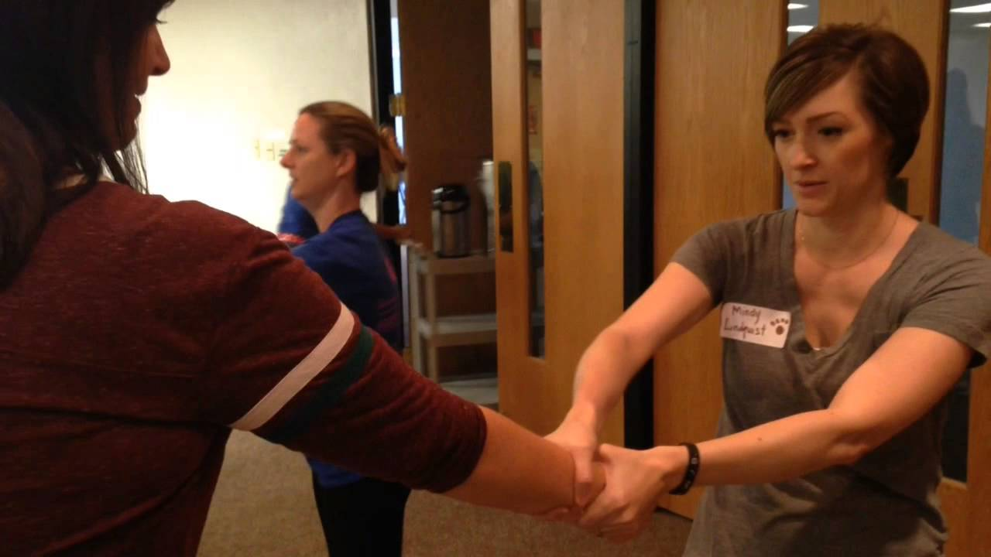
Key Identified Personnel
Training must include the following:
  Additional training for KIPs
  ***CPI training is used to meet this standard***
Description and identification of dangerous behaviors
Methods for evaluating the risk of harm to determine whether the use of seclusion or restraint is warranted
Types of seclusion
Types of restraint
The risk of using seclusion and restraint in consideration of a student’s known and unknown medical or psychological limitations
The effects of seclusion and restraint on ALL students
How to monitor the physical signs of distress
How to obtain medical assistance.

Slide 26


Notable features of the law
The law applies at any school sponsored function – on or off school property.
The law does not apply to students ages18-26.
School resource officers are not bound by the law – other school employees are.
Seclusion and restraint CANNOT be used to protect school property.
Prone restraints are prohibited.

Slide 27
Interesting Facts about the Seclusion and restraint policy:

Slide 28

Interesting Facts
Local Association Organizing Opportunity
Must a school district contract with an outside vendor to provide training to key identified personnel?
No. The local educational agency (LEA) may utilize any trainer and/or materials they choose as long as the requirements listed in the state policy and statute are incorporated into the training.

Slide 29
Interesting Facts
Local Association Organizing Opportunity
How do the new comprehensive training requirements for key personnel interact with commercially available trainings?
Many commercially available trainings meet a subset of the requirement within the statute. If a district elects to use a commercially available training, school personnel should review the training requirements for key identified personnel, and compare them with the selected training, identify the gaps, and address gaps with additional training.

Slide 30
Interesting Facts
Local Association Organizing Opportunity
Does a school need to collect data regarding seclusion and restraint?
Yes. All uses of restraint and seclusion must be documented, not just emergency seclusion or emergency physical restraint.

Slide 31
Interesting Facts
Local Association Organizing Opportunity
What must districts do with data specific to seclusion and restraint?
The data should be analyzed annually by the school and school district, public school academy, or intermediate school district as part of their school/district improvement process to determine the efficacy of the school's school-wide system of behavioral support impact on pupil attendance, suspension, expulsion, and dropout data, and for the purposes of continuous improvement of training and technical assistance toward the elimination of the use of seclusion and restraint.

Slide 32
Interesting Facts
Local Association Organizing Opportunity
What is a peer review for an IEP?
The role of a peer review is to evaluate the quality, effectiveness and least intrusiveness of the IEP. Individuals who conduct a peer review of a proposed IEP must have a legitimate educational interest in the pupil in that they provide a professional review of the plan and make recommendations to the IEP team regarding proposed interventions.

Slide 33

MEA Workplace Violence Tool Kit
Now that you have the background, let’s talk about what we can do about it.
Find Workplace Safety Resources
https://bit.ly/Workplace-Safety-Resources

Slide 34
Effecting change is a process
Awareness to action

Slide 35
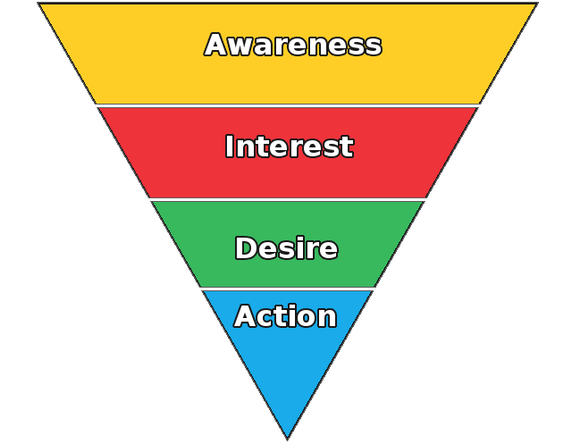
Awareness to action model
Awareness
[eyes & ears]
Understanding
[head]
Commitment
[heart]
Action
[feet]
The 4 step process is used in both political action and marketing

Slide 36

Objective: Educative [Awareness]
Audience: Internal & External
Rationale:
Developing awareness builds community
Expands the scope of engagement as a consequence of unrealized connection or interest.
Activate: Eyes and Ears
Tactics to achieve objective: ?

Slide 37

Objective: Educative [Awareness]
Audience: Internal & External
Rationale:
Developing awareness builds community
Expands the scope of engagement as a consequence of unrealized connection or interest.
Activate: Eyes and Ears
Tactics to achieve objective: ?
What ways can we help others to gain a greater awareness of local school safety issues and policies as well as the circumstances that surround them?
Notes:
Poll Title: Tactics to achieve issue awareness?
https://www.polleverywhere.com/free_text_polls/tDsGaywNEXIYnfL

Slide 38

Objective: Assess [understand]
Audience: Internal & External
Rationale:
Need to separate the actual from the assumption
Determine capacity & needs to address the issues
Activate: head
Tactics to achieve objective: ?

Slide 39
Objective: Assess [understand]
Audience: Internal & External
Rationale:
Need to separate the actual from the assumption
Determine capacity & needs to address the issues
Activate: head
Tactics to achieve objective: ?
How could you develop specific & relevant information/data about the reality of the school safety issues that exist?
Notes:
Poll Title: Tactics to assess and understand the issue(s)?
https://www.polleverywhere.com/free_text_polls/AP7QZKYDHnk8NKz

Slide 40

Objective: Assemble [commitment]
Audience: Internal & External
Rationale:
People who are aware of need, understand the issue and know there’s are others who share that knowledge and awareness are more likely to commit to act
You know the why’s, who’s and what’s…now comes the how?
Activate: heart
Who are stakeholders: ?

Slide 41
Objective: Assemble [commitment]
Audience: Internal & External
Rationale:
People who are aware of need, understand the issue and know there’s are others who share that knowledge and awareness are more likely to commit to act
You know the why’s, who’s and what’s…now comes the how?
Activate: heart
Who are stakeholders: ?
Who might be the stakeholders you would want/need to review the issue and form consensus around priorities and approach?
Notes:
Poll Title: Who are the stakeholders?
https://www.polleverywhere.com/free_text_polls/rgmNWEYaXzpFt4V

Slide 42

Objective: Implement [action]
Audience: Internal & External
Rationale:
Successful plans/policies should create structures, incentives, and celebrations that ensure long-term adaptive fidelity
Activate: feet
What does successful implementation look like: ?

Slide 43
Objective: Implement [action]
Audience: Internal & External
Rationale:
Successful plans/policies should create structures, incentives, and celebrations that ensure long-term adaptive fidelity
Activate: feet
What does successful implementation look like: ?
What would be concrete examples of a successful implementation of a safe school environment/plan?
Notes:
Poll Title: What does successful implementation look like?
https://www.polleverywhere.com/free_text_polls/4Btp52Y0IqEHl57

Slide 44
Resources
Michigan School Safety Directory
Poll Everywhere - (meeting feedback/engagement)
Survey Monkey - (email survey/engagement)
Adobe Creative Cloud - (audio/visual tools)
Office 365 - (teams) or Google docs/forms
Remind - (cellphone texting tool)
Facebook / Twitter / Instagram / Snap Chat

Slide 45
Disclaimer:
This is not an overnight process.
Expect suspicion and resistance
Success may look different than planned – go with it!
Your name may never be known – your effort/commitment will

Slide 46
Discussion?
Chad Williams
MEA UniServ Consultant
cwilliams@mea.org

