Slide 1
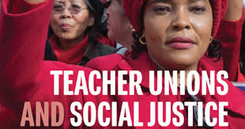

DAY 1

Slide 2
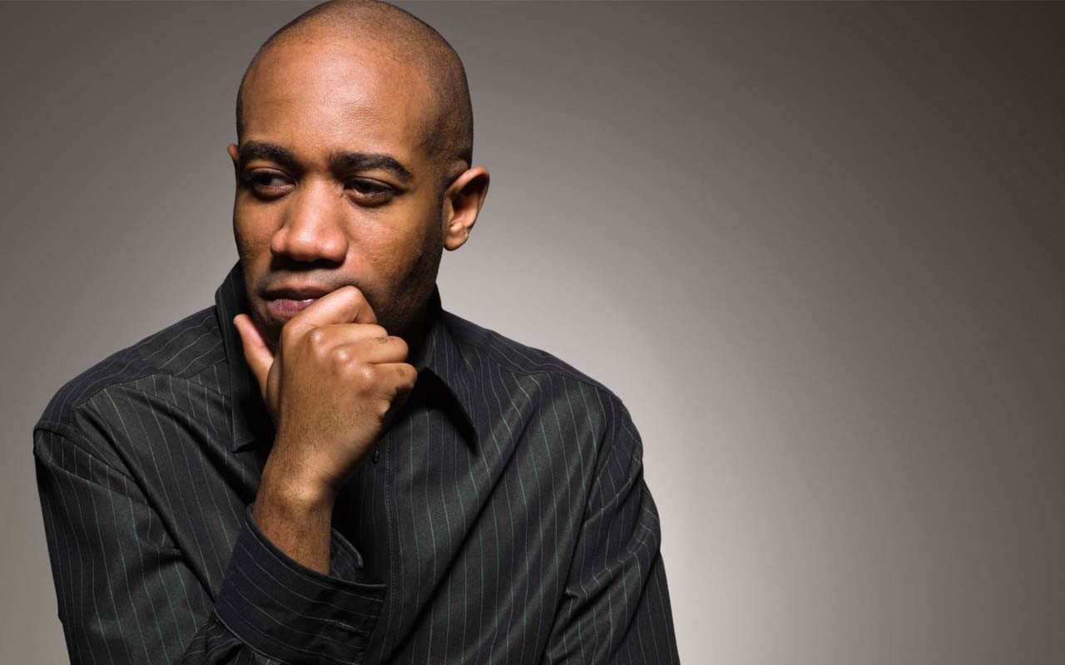
Entry Activity
What do you think Social Justice Unionism looks like?
- Use Sticky Notes and Post on Wall -

Slide 3

Honoring This Space
We begin by acknowledging that through a history of colonization and brutality, we currently reside on and are connecting from the traditional lands stewarded by generations of indigenous people.
We honor these indigenous people, all elders, past, present, and emerging. We are called to learn and share these learnings about this tribal history, culture, and contributions that have been suppressed in the telling of the story of what we now call the United States of America.

Slide 4

3 Day Agenda
Day 1
7:30-8:30 Breakfast
8:30 Work Begins
10:15-10:30 Break
12:00- 1:00 LUNCH
1:00 TUSJ Continues
2:15-2:30 Break
3:30-4:00 Choice Networking @ Sheraton
4:00 Transport to Evening Activity
Day 2
Same as Day 1
2:30-2:45 Break
4:30-5:00 Choice Networking
Day 3
7:30-8:30 Breakfast
8:30 Convene
11:00-11:15 Break
1:00 Boxed Lunch
1:00-2:00 Choice Networking
2:00 Adjourn

Slide 5

Today’s Outcomes
What is Social Justice Unionism?
What would it take to move to that?

Slide 6

Community Agreements p. 2
Using Self-Awareness and Self-Knowledge
Listening for Understanding
Being Gracious
Staying Engaged
Being Open and Suspend Judgment
Saying “I”- tell your truth
Seeking Discomfort
Reaching Empathy
Expecting Non-Resolution and Non-Closure
*Adapted from “Embracing equity and inclusion”, Annie E. Casey Foundation
Notes:
Community Agreements for Our Time
Awareness and Self-Knowledge
This requires self-knowledge and self-awareness. Self-knowledge allows you to see what causes you pain and conflict and enables you to embrace your contradictions and inconsistencies. It allows the space to work on things about yourself that you are not happy with. In turn, self-knowledge helps to prevent you from projecting your negative aspects onto other people. Bringing your best self also requires that you have a positive attitude, are willing to deeply explore your perspectives and remain open to the perspectives and experiences of others.
Listening for Understanding
Be an active listener. Active listening involves paying full and careful attention to the other person, looking him or her in the eye, avoiding interruptions, reflecting your understanding, clarifying information, summarizing the other person’s perspectives and sharing your own. Remember that most people need time to open up and might not be willing to immediately share their personal stories, hopes, fears and/or concerns.
Being Gracious
Being kind is a vital way of bringing meaning to our own lives, as well as the lives of others. Kindness is about caring genuinely for others around you, wanting the best for them and recognizing in them the same wants, needs, aspirations and even fears that you may have. Being kind and generous allows us to communicate better with others, to be more self-compassionate and to be a positive force in other people’s lives. This includes following the COVID protocols that are in place to protect the health of this learning community.
Stay Engaged
Staying engaged requires you to be morally, emotionally, intellectually and socially involved in the conversation. Staying engaged means that you are listening with curiosity and willing to deepen your understanding. Staying engaged might also require you to sustain the conversation even when it gets uncomfortable or diverted. This also means a commitment to keeping your electronic communications to a minimum with folks not present in this learning community.
Be Open and Suspend Judgment
Listening with an open mind includes being receptive to the influence of others. You can suspend judgment by becoming aware of preconceived notions and listening to everything someone has to say before jumping to conclusions. Most importantly, suspending judgment also means listening to what the speaker has to say for understanding, not just to determine whether the speaker is right or wrong.
Say “I”- tell your truth
Speaking your truth in authentic and courageous conversations about race requires a willingness to take risks. It means that you will be absolutely honest and candid about your own thoughts, feelings, experiences and opinions and not just saying what you perceive others want to hear. Speaking your truth will require you to speak from the “first person” and use “I” statements.
Seek Discomfort
Leaning in to discomfort will require you to let go of racial understandings and stereotypes that you may be holding onto in order to move forward. Leaning in means that you will avoid judgment, assume positive intent and be open to the kernel of wisdom in each individual’s experiences. Leaning in to discomfort will require you to sit through moments of embarrassment, confusion, anxiety and/or fear.
Reaching Empathy
Empathy and compassion allow you to understand the other person’s point of view. When you are empathetic, you are more understanding, patient and kind. Expanding your capacity to feel empathy will also allow others to enter your circle of human concern.
Resolution and Closure
Expect and accept that there may not be closure. It is not likely that you will resolve your personal understanding about race or another person’s racial experience in a single conversation. The more you talk about race with another person, the more you learn and the more they will learn. Authentic and productive conversations about race are continuous and always evolving.
*Adapted from “Embracing equity and inclusion”, Annie E. Casey Foundation

Slide 7

The Basics
Name Tents
Handouts
Logistics

Slide 8
One Revolution Around the Room
Name
Required Pronoun
Native Land if You Know it

Slide 9
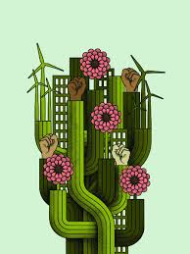
Today’s Agenda
Jessica and Naomi
Imagine if your union…

Slide 10
Imagine If
13 "Imagine if" statements
In Pairs and Trios gather around 1 statement
With those that have gathered:
Introduce yourself
Share your reaction to the statement you are gathered at
Our Debrief:
“What is something someone said that stuck with you?” (Also, please read your "Imagine if" statement first.)

Slide 11
7 Components of Social Justice Unionism p. 75
Defend the rights of its members while fighting for the rights and needs of the broader community and students.
Recognize that the parents and neighbors of our students are key allies, and build strategic alliances with parents, labor unions, and community groups.
Education unions should also work to unite all staff members at a school. They should build ongoing alliances with a wide range of groups, from other public service unions to the broader labor movement, churches, community and social organizations, advocacy groups, and business and political groups that support public schools.
Put teachers and others who work in classrooms at the center of school reform agendas, ensuring that they take ownership of reform initiatives.
Encourage those who work with children to use methods of instruction and curricula that will promote racial and gender equity, combat racism and prejudice, encourage critical thinking about our society’s problems, and nurture an active, reflective citizenry that is committed to real democracy and social and economic justice.
Forcefully advocate for a radical restructuring of American education.
Aggressively educate and mobilize its membership to fight for social justice in all areas of society.

Slide 12
How Near and How Far?
Near
Far
Component 1

Slide 13
How Near and How Far? Debrief Conversation
Thinking of your context and the Seven Components of Social Justice Unionism, which component would you consider the most “ripe” for movement? The most entrenched?

Slide 14

Key Points
It matters what your locals think more than you.
Not every local is ready for social justice work in this moment.
The successful social justice campaigns outlined in this text were not staff driven.

Slide 15

Shelly and Matt
Why do we need Social Justice Unionism?

Slide 16
Why do we need Social Justice?
“Two tensions have been specifically pivotal for teacher unionists. Although advocates of social justice in education sometimes seem to expect teachers to foreswear any self-interest or dedication to the children they teach, unionism sees teachers as agents and beneficiaries of social justices. At issue is how teachers have understood the relationship of their self-interest (sometimes represented as business or bread and butter unionism) to broader political concerns (sometimes described as social justice or social movement unionism).
A second tension involves teachers simultaneously making demands upon the state while serving it… Questions involving the relationship of self-interest to social justice and the relationship of working people to the state have shaped the history of teacher unions and their participation in movements for social change.” (pg.43)
“Teacher unions have at times challenged the inequalities of American life, and foster broader demands for the public good. At other moments, they have allied themselves with the state to place teachers’ immediate interests and privileges above more expansive ideas. At times teachers have been served reasonably well by such visions, even if their more disadvantaged students have not been. But teachers are also harmed by theories that lead them to ally themselves with class, gender, and racial privilege. In order to protect both material self-interest and the joy of their work, public school teachers must, in the long run, protect the public interest.“ (pg. 51)

Slide 17
How do you answer?
Zinn – 25-30 (27-30)
Fletcher – 34-41 (37-38)
Are these the two tensions that keep our
unions agitated, “Is it self-interest or broader
political/social concerns?”
Is this the Theory of Change we need? - “ In order to protect both material and self-interest and the joy of their work, public school educators must, in the long run, protect the public interest.”
How does your role as a staff person change within these tensions and theory of change?
Be ready to present and discuss your answers as a whole group.

Slide 18
Key Points
All work is dignified, and all workers deserve to thrive.
Our job is to get public school employees to understand that they are all workers.
Learning Conditions are Working Conditions.
There is a historical basis for why we are in the struggle we are currently in.

Slide 19


Slide 20
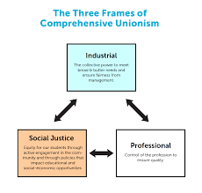
Three Models of Teacher Unionism
Sara & Albert
Three Models of Teacher Unionism

Slide 21
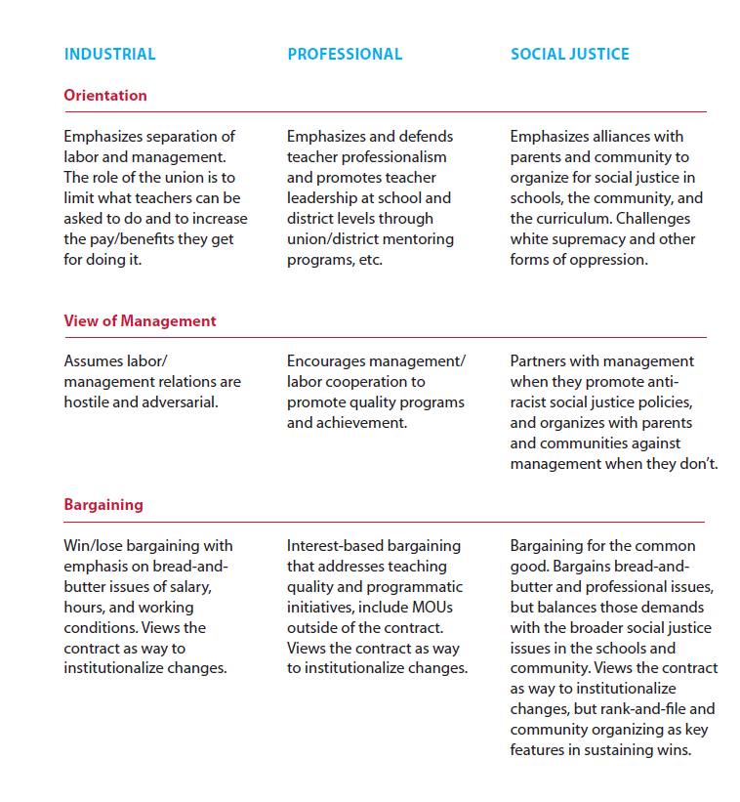
Three Models of Teacher Unionism

Slide 22
Three Models of Teacher Unionism Debrief
Do you think your local leaders would assess themselves as you have?
What shifts in your work with this local would you make to move them from where they are to a more social justice focused union?
How would/do you use this tool?

Slide 23
Key Points
This is not a linear process.
Context matters.
This is a framework to help organize thinking and work.

Slide 24

Choice Network Time

