Slide 1
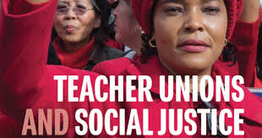

-
Day 3

Slide 2

Today’s Agenda
8:30 CONVENE
10:55-11:10 BREAK
11:10 RE-CONVENE
1:00 LUNCH & CHOICE NETWORKING

Slide 3
Today’s Agenda
How do we fight the power holders?
How do we assess our readiness?
What are successful strategies for taking on big fights?

Slide 4

Community Agreements p. 2
Using Self-Awareness and Self-Knowledge
Listening for Understanding
Being Gracious
Staying Engaged
Being Open and Suspend Judgment
Saying “I”- tell your truth
Seeking Discomfort
Reaching Empathy
Expecting Non-Resolution and Non-Closure
*Adapted from “Embracing equity and inclusion”, Annie E. Casey Foundation
Notes:
Community Agreements for Our Time
Awareness and Self-Knowledge
This requires self-knowledge and self-awareness. Self-knowledge allows you to see what causes you pain and conflict and enables you to embrace your contradictions and inconsistencies. It allows the space to work on things about yourself that you are not happy with. In turn, self-knowledge helps to prevent you from projecting your negative aspects onto other people. Bringing your best self also requires that you have a positive attitude, are willing to deeply explore your perspectives and remain open to the perspectives and experiences of others.
Listening for Understanding
Be an active listener. Active listening involves paying full and careful attention to the other person, looking him or her in the eye, avoiding interruptions, reflecting your understanding, clarifying information, summarizing the other person’s perspectives and sharing your own. Remember that most people need time to open up and might not be willing to immediately share their personal stories, hopes, fears and/or concerns.
Being Gracious
Being kind is a vital way of bringing meaning to our own lives, as well as the lives of others. Kindness is about caring genuinely for others around you, wanting the best for them and recognizing in them the same wants, needs, aspirations and even fears that you may have. Being kind and generous allows us to communicate better with others, to be more self-compassionate and to be a positive force in other people’s lives. This includes following the COVID protocols that are in place to protect the health of this learning community.
Stay Engaged
Staying engaged requires you to be morally, emotionally, intellectually and socially involved in the conversation. Staying engaged means that you are listening with curiosity and willing to deepen your understanding. Staying engaged might also require you to sustain the conversation even when it gets uncomfortable or diverted. This also means a commitment to keeping your electronic communications to a minimum with folks not present in this learning community.
Be Open and Suspend Judgment
Listening with an open mind includes being receptive to the influence of others. You can suspend judgment by becoming aware of preconceived notions and listening to everything someone has to say before jumping to conclusions. Most importantly, suspending judgment also means listening to what the speaker has to say for understanding, not just to determine whether the speaker is right or wrong.
Say “I”- tell your truth
Speaking your truth in authentic and courageous conversations about race requires a willingness to take risks. It means that you will be absolutely honest and candid about your own thoughts, feelings, experiences and opinions and not just saying what you perceive others want to hear. Speaking your truth will require you to speak from the “first person” and use “I” statements.
Seek Discomfort
Leaning in to discomfort will require you to let go of racial understandings and stereotypes that you may be holding onto in order to move forward. Leaning in means that you will avoid judgment, assume positive intent and be open to the kernel of wisdom in each individual’s experiences. Leaning in to discomfort will require you to sit through moments of embarrassment, confusion, anxiety and/or fear.
Reaching Empathy
Empathy and compassion allow you to understand the other person’s point of view. When you are empathetic, you are more understanding, patient and kind. Expanding your capacity to feel empathy will also allow others to enter your circle of human concern.
Resolution and Closure
Expect and accept that there may not be closure. It is not likely that you will resolve your personal understanding about race or another person’s racial experience in a single conversation. The more you talk about race with another person, the more you learn and the more they will learn. Authentic and productive conversations about race are continuous and always evolving.
*Adapted from “Embracing equity and inclusion”, Annie E. Casey Foundation

Slide 5
Shelly
Fighting the Power holders

Slide 6

Supports for Powerholders
Powerholders are able to maintain their unjust policies because of the support they receive from supportive pillars “organizations and institutions.” When we can win over these pillars or at the very least, neutralize them, then we erode the powerholders' grip.

Slide 7
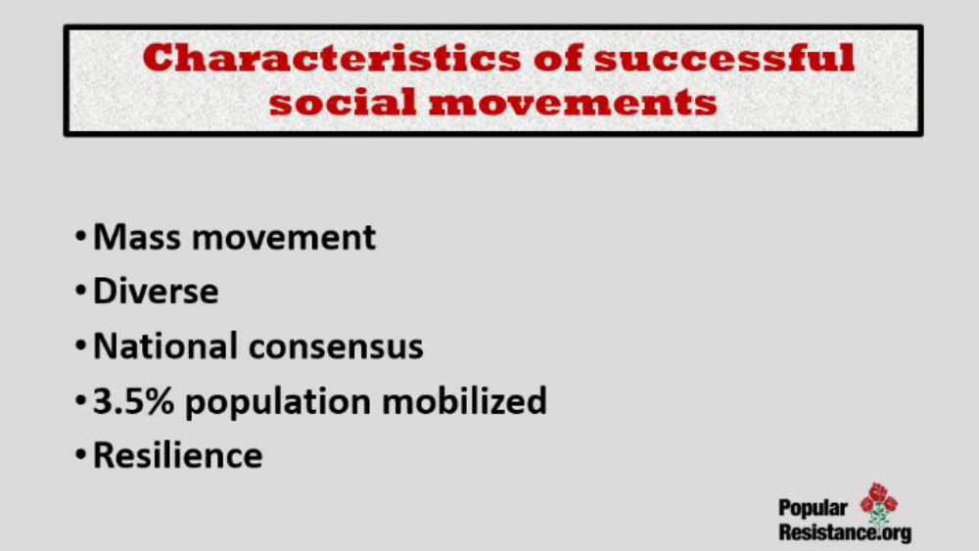

Slide 8
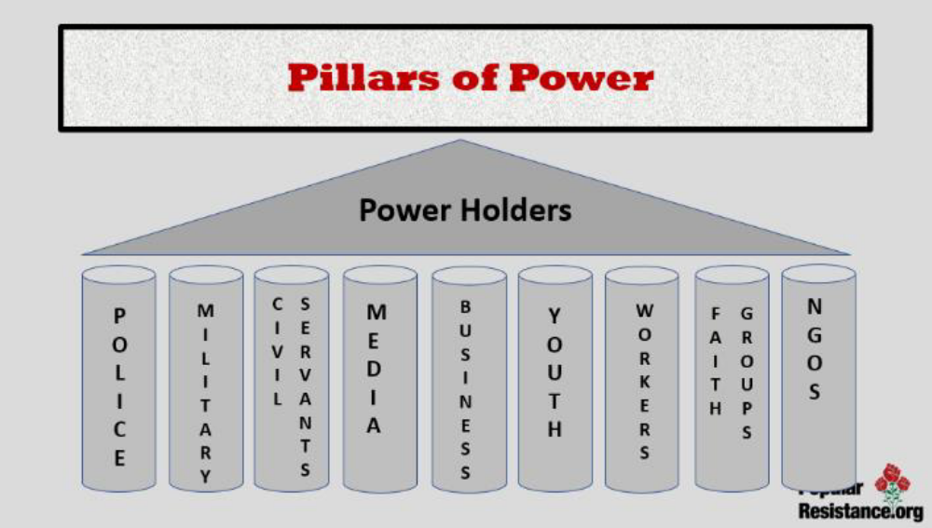

Slide 9
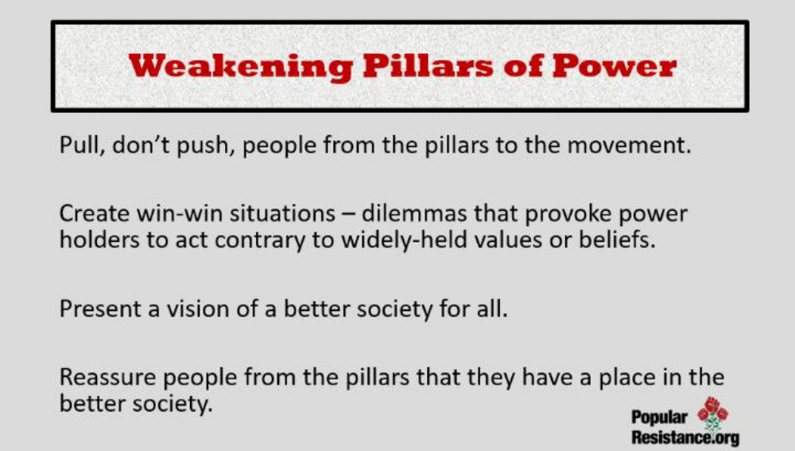

Slide 10
Group Posters!!
Teams of five-ish
Pillars of Support Content RG p. 60-61
“Mapping the Movement to Dismantle Public Education” RG p. 50-59
“The Many Faces of Privatization” TUSJ p. 315-318
Name the “Powerholders” for this issue
Identify the Pillars of Support that exist to keep this injustice going...
AND identify the pillars that YOUR TEAM believes they can win over or neutralize and how it can be achieved.

Slide 11
House of Injustice Report Out
Team Reports (3-5 Minutes Each)
Who are the powerholders?
What are the pillars of support?
Which pillars can you neutralize or turn – by doing what?
Debrief
What stands out to you?
Are there any questions you would like to ask a team?
Is there any idea you would like to hold up as an awesome idea?
El Fin

Slide 12

Key Points
Powerholders in non-violent situations maintain power because the majority of the people CHOOSE to let them.
A movement is successful when it convinces the majority to withhold that agreement to submit.
It does not require all the pillars to fall for those in power to feel enough pressure to change the unjust policy

Slide 13
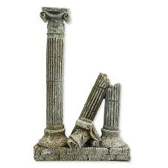
It only takes …
3.5 %

Slide 14
Naomi &
Jessica
Are you ready? Let’s Assess

Slide 15
Group Work with Self Assessment Tool Handout p.64
Social Justice Unionism Organizing Strategy Readiness Assessment
To determine readiness for using a Social Justice Unionism Organizing Strategy, locals should assess and reflect on four categories: general readiness and landscape, community/parent relationships, internal organizing capacity, and bargaining status. For each of the four categories below rate each readiness descriptors with a 1-4 in the small boxes, then use the larger box to do a brief SWOT reflection.
1 – Not yet 2 – Basic Understanding and Planning
3– Emerging Implementation 4 – In Place and Proven

Slide 16
Self-Assessment Debrief
How would you use this tool?
What are changes you would make to this tool?
What did you learn about this tool?
What is your role in this self-assessment?

Slide 17
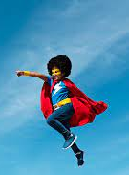
What is THE staff role?
What are the types of work Staff people are engaged in that support and cultivate readiness to take on the type of organizing described in this book?
What changes in your work/expectations would you (and your leader/manager) need to make room for in order to cultivate social justice unionism as presented in this book?

Slide 18
BREAK TIME

Slide 19
Sara
Who is winning?

Slide 20
Taking on the System
Six Teams – Could use p.79 in RG
Achievement Gap Narrative – p. 312-314
Standardized Testing Wins – p. 324-333 (Seattle and Las Cruces)
School Take Over Wins – p. 320-324 (Milwaukee)
School Funding Wins – p. 353-362 (Massachusetts)
Racial Justice Wins – p. 165-168 (UTLA)
School Funding Wins - p. 362-365 (East Baton Rouge)
Present (3-5 Minutes per group):
Issues, Targets, Tactics employed to shift the power, Win

Slide 21
Debrief Conversation
If you could ask the narrator of one of these stories one question, which story would it be and what would you ask?

Slide 22
Matt & Albert
Transformation and Agency

Slide 23

Transformation of Teachers Unions
Transactional - a trade such as dues for services
Transformation - an interaction that changes those coming together such as how a community views the union after partnering on a tactic

Slide 24
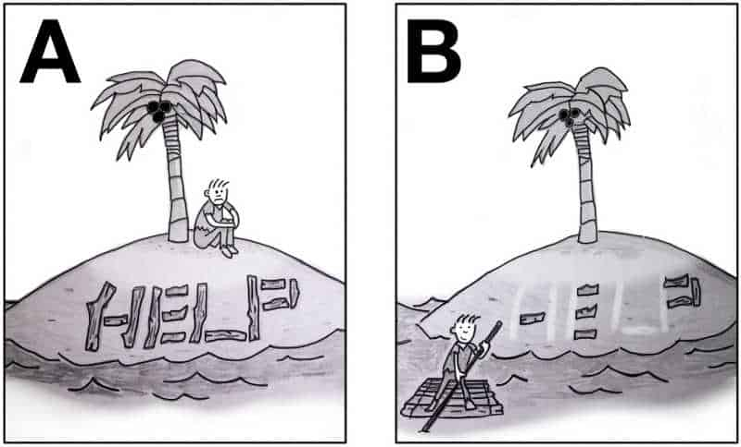
Agency within Teachers Unions
Agency is the ability for an individual to decide they can act.
Structures and Structure tests are really a technical way of thinking about whether individuals have developed their sense of agency to the point where they feel they are capable of doing what is needed to win the fights they engage in.

Slide 25
Structure Test Breakout 10 Minutes- Pg 423
What do you notice about the table in general?
What do you notice about the column on the left?
What is the role of the staff person?
  P. 68 of handouts

Slide 26
Shelly
Bringing it all Together
A Summary of How We Win

Slide 27
7 Components of Social Justice Unionism
Defend the rights of its members while fighting for the rights and needs of the broader community and students.
Recognize that the parents and neighbors of our students are key allies, and build strategic alliances with parents, labor unions, and community groups.
Education unions should also work to unite all staff members at a school. They should build ongoing alliances with a wide range of groups, from other public service unions to the broader labor movement, churches, community and social organizations, advocacy groups, and business and political groups that support public schools.
Put teachers and others who work in classrooms at the center of school reform agendas, ensuring that they take ownership of reform initiatives.
Encourage those who work with children to use methods of instruction and curricula that will promote racial and gender equity, combat racism and prejudice, encourage critical thinking about our society’s problems, and nurture an active, reflective citizenry that is committed to real democracy and social and economic justice.
Forcefully advocate for a radical restructuring of American education.
Aggressively educate and mobilize its membership to fight for social justice in all areas of society.

Slide 28

Bill Fletcher
Public Sector Roles Play 3 Roles
1. They defend the interests of their members
2. They must look out for the interests of the community (Fletcher indicates that this has almost become cliché)
3. They must defend the public sector (This is readily understood by unions in other nations but not here)

Slide 29
Bill Fletcher
This third role is critical right now. Public sector unions need to articulate a coherent and credible defense of the public sector - to explain the role of the public sector and show why any kind of civilized society must have a public sector. I don't think public sector unions do that very well. As a result, they tend to come across as merely defending the interests of their members.

Slide 30
Leaders we Need
Leaders – Trusted and respected by their colleagues in ways that cut across communities of workers--are connected by values and influential relationships with mobilizers, activists, and those not yet part of the work. Get people to move their thinking and take action.
Mobilizers – Connected to communities of workers in ways that are influential – can convene their community. Get people excited to act.
Activists – Supportive and willing to act if invited

Slide 31
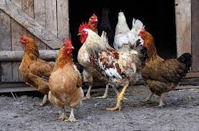
Coalitions and Allies
For you to consider at home:
One theme that persists though this text is the development of Allies and Coalitions.
There are some good resources in the RG pp. 69-78.

Slide 32
Key Points
These strategies are done with locals that are already towards the fighting union end of the continuum.
These strategies are only achievable in coalition with other groups.

Slide 33
Ellen
Taking you Home

Slide 34


Ending it Right

Slide 35
Toney
How do we win more?
Bargaining for the Common Good

Slide 36


Slide 37
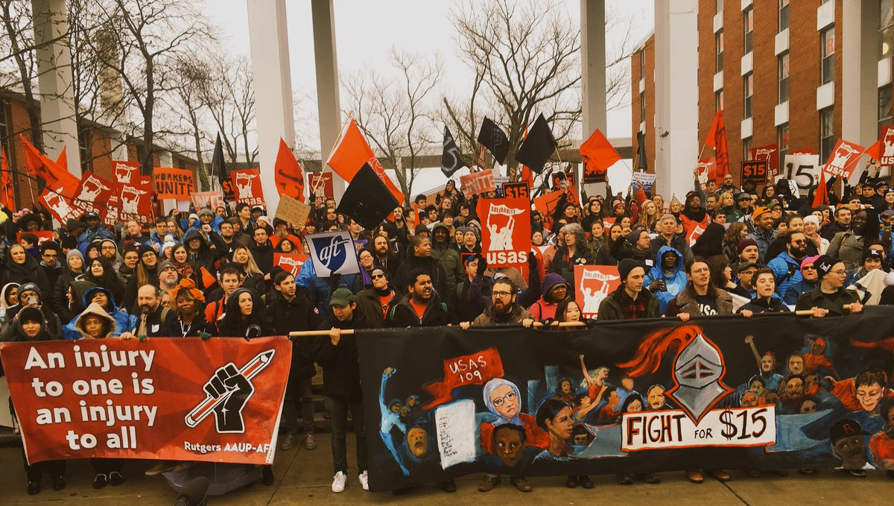
Why should Bargaining for the Common Good be a strategy for expanding expectations for our unions?
Notes:
There are exciting campaigns building around the country
What we’re going to do today--- what is BCG, why is it important now, and what are examples and explore how we can use this in our campaigns.

Slide 38

7 Elements of a Common Good Campaign pp. 107-112
  Expand the scope of bargaining beyond wages and benefits
  Go on offense in your campaign by identifying, exposing and challenging the real opposition
  Engage community allies as partners in issue development and the bargaining campaign
  Center racial justice in your demands
  Strengthen internal organizing, membership and
  member engagement
  Leverage capital in our campaigns
  The campaign doesn’t end once the union settles its contract
Notes:
There are these seven elements lifted up from all these campaigns, many are hitting on 1-2 of them, we are going to go into detail later.

Slide 39
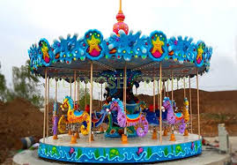
7 Elements Carousel
Go to your starting chart – Make a vertical line down the middle
  Introduce yourselves
  What are the opportunities that this element COULD provide your affiliates?
  What are the potential challenges this element could provide your affiliates?
  3 MINUTES – GO!

Slide 40
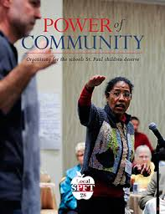
St. Paul Federation of Teachers
Smaller class sizes
Family engagement
Placing teaching before testing
Wage and benefit increases
Culturally relevant education
High quality professional development for teachers
No foreclosures

Slide 41

UTLA Bargains for the Common Good
Smaller class size
Hiring of nurses, librarians & counselors
An end to “random searches”
Green space
Immigrant defense fund
Community schools
Charter school cap
Notes:
Some of their common good victories include:
School funding- UTLA, LAUSD and Mayor’s office to jointly advocate for increased county and state funding
Class Size- immediate reduction of 7 students in secondary math and English, and elimination of contract language that previously allowed the district to unilaterally ignore all class size averages and caps. Agreement to reduce class size every year for the next four years.
A nurse in every school, with an agreement to hire 150 full time nurses
Community Schools-- by June 2019, the district will designate 20 community schools, and by June 2020 an additional 10
Privatization/Charter Cap
Librarians-- commitment to hire 82 new librarians
Counselors-- commitment to hire 17 additional counselors
Testing- joint UTLA/LAUSD committee tasked with developing a plan to reduce the amount of assessments by 50%
“Random” Searches- pilot program that exempts schools from administering random searches in 28 schools
Green Space-- joint task force tasked with developing a plan to increase green space
Immigrant Defense Fund-- district will provide a dedicated hotline and attorney for immigrant families

Slide 42
Why do we run Common Good Campaigns?
Builds Power through Leaders and Structures from the bottom up
This is the best way for us to WIN more for all!
Unions and community groups share a common, powerful opposition, and we need each other in order to win
Unions win more and community groups win bigger and broader campaigns when we work together in this way
Notes:
Two concrete examples--we will go into more depth throughout this program….

Slide 43
Ending it Right
Choice Networking
Housekeeping
Feedback via email

Slide 44
Exploring and Discussion (On your own)
What stands out to you about this approach?
What are the opportunities that this strategy
COULD provide your affiliates?
What are the potential challenges this strategy
could provide your affiliates?
Explore the BCG Webpage
https://www.nea.org/your-rights-workplace/bargaining-educator-voice/bargaining-common-good

Slide 45
What is THE staff role?
What are the types of work Staff people are engaged in that support and cultivate a Bargaining for the Common Good Strategy?
What changes in your work/expectations would you (and your leader/manager) need to make room for, in order to cultivate social justice unionism as presented in this book?

Slide 46
Yvie
How do we win more?
Community Schools

Slide 47
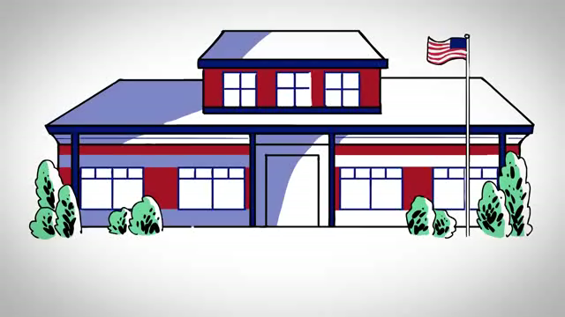

Slide 48
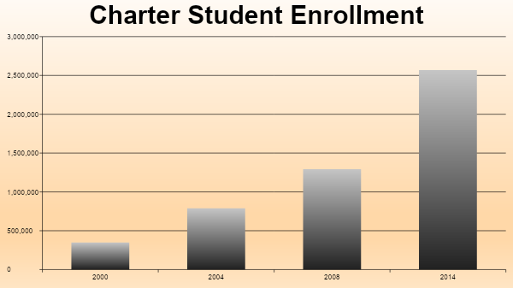
Notes:
http://www.publiccharters.org/wp-content/uploads/2014/12/2014_Enrollment_Share_FINAL.pdf
43 states with charter laws
Charter enrollment has doubled three times since 2000; it doubled from 2000 to 2004, and again from 2004 to 2008, and again from 2008 to 2014.7

Slide 49
The Education-Industry Complex
Think Tanks
State Policy Network (SPN)
Center for Ed Reform
Education Sector
EdVoice
American Federation for Children
Advocacy
BAEO
ERNA/Dems For Ed Reform
Stand for Children
ALEC
Libre Initiative
Charter Operators
K12 Inc
Whitehat
Success Academy
Funders
Walton Fdn
Gates Fdn
Dell Fdn
Broad Fdn
DeVos Fdn
Arnold Family Fdn
Robertson Fdn
Bradley Fdn
Koch
Facility Financing
Local Initiatives Support Corp.
Civic Builders
Accelerators
New School Venture Fund
Charter School Growth Fund
Charter-Related Associations
Natl. Alliance for Public Charter Schools
New York Charter School Assn
Education Cities
Human Capital
The New Teacher Proj.
New Leaders for New Schls
Notes:
Interesting origin piece on charters: https://democracyjournal.org/arguments/the-untold-history-of-charter-schools/
9-8-2018 NPE Report on Billionaire control: http://npeaction.org/wp-content/uploads/2018/09/Hijacked-by-Billionaires.pdf
Billionaire Control: https://s3.amazonaws.com/s3.alternet.org/images/who_controls_our_schools_pdf_ebook_1_1.pdf
2018 CA Billionaire control: https://greatschoolwars.files.wordpress.com/2017/05/out-of-town-billionaires-hijack-school-board-election.pdf
Koch Brothers 2018: https://www.washingtonpost.com/news/powerpost/paloma/daily-202/2018/01/30/daily-202-koch-network-laying-groundwork-to-fundamentally-transform-america-s-education-system/5a6feb8530fb041c3c7d74db/?utm_term=.4db9a6122774&wpisrc=nl_daily202&wpmm=1
State Policy Network (SPN): 2018 Article on coordinated messaging: https://www.theguardian.com/education/2018/apr/12/teacher-strikes-rightwing-secret-strategy-revealed
Education Cities https://www.chalkbeat.org/posts/us/2017/12/06/a-portfolio-of-schools-how-a-nationwide-effort-to-disrupt-urban-school-districts-is-gaining-traction/
Education Reform Now Advocacy (ERNA) & DFER groups 2017: https://www.washingtonpost.com/news/answer-sheet/wp/2017/10/29/dark-money-just-keeps-on-coming-in-school-board-races/?utm_term=.68f69c9a8f01
Database of Funders: https://www.dropbox.com/s/lks5ezfp9ej02gt/Privatization%20Database.xlsx?dl=0
Libre Initiative (Koch funded): http://thelibreinitiative.com/issue/education
Libre: https://www.washingtonpost.com/politics/conservatives-including-the-koch-brothers-go-after-the-latino-vote/2015/04/30/10732074-101e-4845-936b-77ccd3c45cd2_story.html?utm_term=.8be070fb95c4
Corporate control: https://monthlyreview.org/2017/04/01/who-is-behind-the-assault-on-public-schools/
http://2014annualreport.waltonfamilyfoundation.org/grant-reports/
California example: http://www.kidsnotprofits.com/who-they-are
Democrats for Education Reform, known as DFER. It was created in 2005 by hedge fund managers Whitney Tilson and John Petry. They held their first meeting in a plush apartment in New York City owned by another hedge fund manager, Ravenel Boykin Curry IV. https://dianeravitch.net/2016/09/05/news-democrats-for-education-reform-will-back-some-democrats-but-only-if-they-support-charters/
Inside the Bradley Foundation’s Campaign toPrivatize Education in Wisconsin: https://drive.google.com/file/d/0B8LurBVUNQZfbUFxYWJGWDJtX2c/view

Slide 50
What are community schools?

Slide 51
Defining Community Schools
“Every system is perfectly designed to get the results it gets.”
  W. Edwards Deming
Community Schools deeply understand the systems that they are operating within, they develop a holistic vision for their schools and communities, and they problem solve changes to their system to achieve their vision.

Slide 52
What are Community Schools?
Community School Coordinator
Grassroots Visioning & Needs/Asset Assessment
Grassroots & Grasstops Problem-Solving to Achieve the Vision
Stakeholder/Partner Coordination
Notes:
H

Slide 53
NEA’s Six Pillars
Strengthened curriculum and academic programs (culturally relevant and engaging).
An emphasis on high-quality teaching, not on high-stakes testing.
Coordinated & integrated wrap-around supports such as health care, eye care and social and emotional services.
Positive behavior practices such as restorative practices.
Transformational family, student and community engagement.
Shared leadership philosophy.
Notes:
Family and Community Engagement and Inclusive Leadership: https://www.youtube.com/watch?v=LMlwQdZM2Bk
Strong Curriculum and High-Quality Teaching: https://www.youtube.com/watch?v=TeRl0nh5E2k
Community Support and Positive Discipline: https://www.youtube.com/watch?v=8HN_zW4SwYY

Slide 54
6 Pillars of Community Schools Carousel
Go to your starting chart – Make a vertical line down the middle
  Introduce yourselves
  What are the opportunities that this pillar COULD provide your affiliates?
  What are the potential challenges this pillar could provide your affiliates?
  3 MINUTES – GO!

Slide 55
Exploring and Discussion (On your own)
What stands out to you about this approach?
What are the opportunities that this strategy
COULD provide your affiliates?
What are the potential challenges this strategy
could provide your affiliates?
Explore NEA Community School Webpage
https://www.nea.org/student-success/great-public-schools/community-schools

Slide 56
What is THE staff role?
What are the types of work Staff people are engaged in that support and cultivate a Community Schools Strategy?
What changes in your work/expectations would you (and your leader/manager) need to make room for, in order to cultivate social justice unionism as presented in this book?

Slide 57
Coalition Building
Objectives
Review the role of coalitions
Explore the types of coalitions
Conduct an inventory of coalition partners

Slide 58
Coalitions
An alliance of two or more groups organized for a common action or to accomplish a mutual goal.

Slide 59
Why have a coalition?
“I don’t have it, why should you?” to “I do have it and you should too!”
“Where should cuts be made in education- from school employees or students?” to “Who should pay for all the services we all need?”
NYSUT Leadership Institute Summer 2022
Notes:
Time 2 Mins

Slide 60

Why have a coalition?
Builds powerbase of coalition partners
Advances common goals
More effective strategy (e.g. resources, shared media)
More organizations, more actions, more opportunities for member engagement
Coalitions can be the voice of the voiceless
NYSUT Leadership Institute Summer 2022
Notes:
Time: 3 mins
Some partners are in a far better position to advocate on certain issues

Slide 61



New York State Constitutional Convention: An Opportunity that built lasting coalitions.
Suffolk RO
Notes:
Time: 8 mins
Who is represented in this video?
What was needed to get to the point of actually producing this video?
What could have gone wrong and why?
Additional comments
Did your local form a coalition during your local’s ConCon Campaign or Janus with other groups in your school/work community?
2. Has your local continued to work with those groups?
3. What issues and opportunities has you local used to continue to foster these relationships?

Slide 62
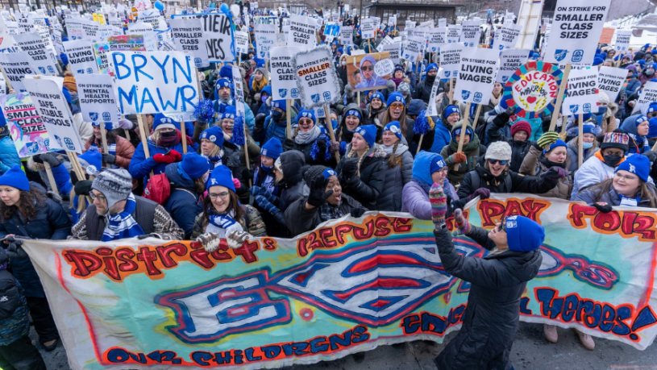
Power to the People!
Minneapolis SRP Campaign
NYSUT Leadership Institute Summer 2022
Notes:
Time: 8 Mins
Alex’s notes from another presentation
Let’s start with the word power.
When you hear the word POWER what do you think of?
What does it mean for our union to have power? What do we want to use our power for? What kinds of things do we want to achieve?
Where does Power come from (look for visible people power)
When you look at this photo, what words come to mind?
POWER –
What does it mean for a union to have power?
What do we want to use our power for ? (improving working conditions…raising salaries…changing legislation)
Where does power come from? PEOPLE!
The foundation of power is our members. And the measure of our ability lies in our Visible People Power.
What do you think that means? What does Visible People Power look like ?
How do you create visible people power? How do we make sure that people get involved? How do we make sure that people do it in a real and meaningful way.?
So that’s what organizing is all about. Thinking deeply about how we connect with people and bring them on board so we can take action together.

Slide 63
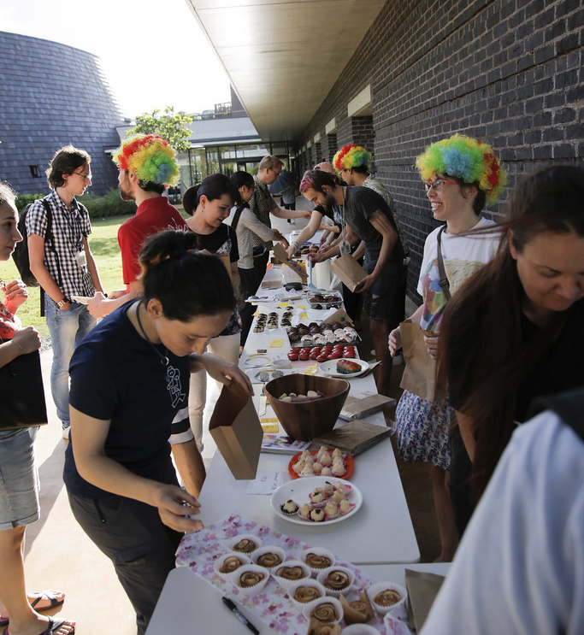
Casual Coalition
Leaders and organizations are loosely connected by their environment, situation or events
No defined goals or expectations of either group
NYSUT Leadership Institute Summer 2022
This Photo by Unknown Author is licensed under CC BY
Notes:
Time: 2 mins
Introduce that there are types of coalitions

Slide 64
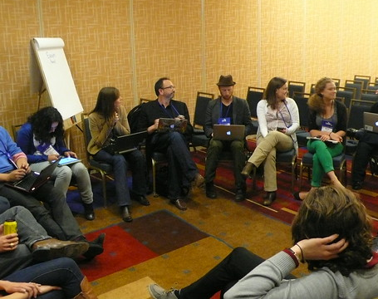
Traditional Coalition
Help each other when in need
Work to achieve a short-term goal
Often temporary
Usually formed for a particular reason
NYSUT Leadership Institute Summer 2022
This Photo by Unknown Author is licensed under CC BY
Notes:
Time: 2 mins
Typical expectations of a local’s coalition:
Help settle our contract
Support a BOE Candidate
Pass a school budget

Slide 65
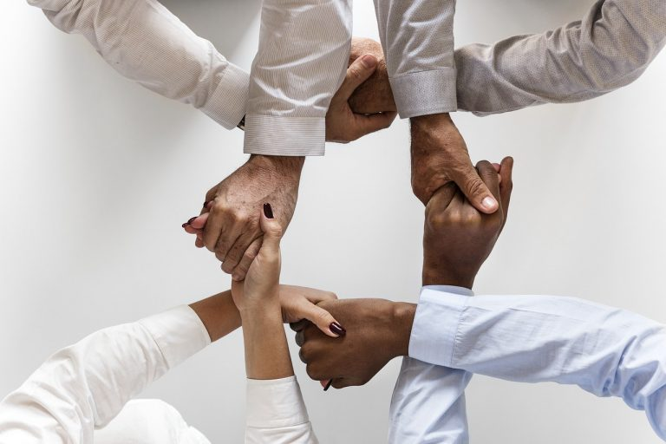
Allies
Strong relationships amongst leaders
Long-standing organizational relationships
Organizations deeply connected based on common values, interests and issues
Working side-by-side to move an agenda forward
NYSUT Leadership Institute Summer 2022
This Photo by Unknown Author is licensed under CC BY
Notes:
Time: 2 mins
A coalition that is an alliance:
Partner to support educational, social, political and/or economic issues within and beyond the District

Slide 66

Reflecting on Coalitions
Move to the corner based on the questions below:
Which type of coalition does your local THINK they have with other organizations?
Which type of coalition does your local ACTUALLY have with other organizations?
Which type of coalition would you like your local to have with other organizations?
NYSUT Leadership Institute Summer 2022
Notes:
Time: 10 Mins
Four Corners Activity

Slide 67
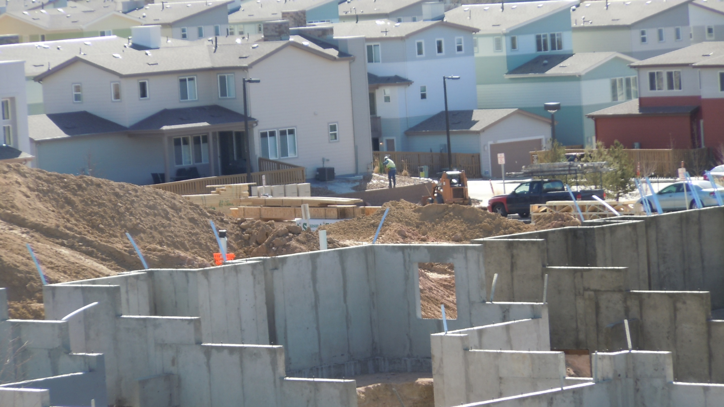
Build a Foundation
Support other groups, organizations and local efforts.
Visibility/recognition
Building long-term relationships
Building a greater appreciation of SRPs, teachers and schools within the community.
NYSUT Leadership Institute Summer 2022
This Photo by Unknown Author is licensed under CC BY-NC-ND
Notes:
Time: 3 mins
-Like physical structures, coalitions need to have a foundation. Start with developing relationships.
Support other groups initiatives that align to you union
Be sure your local is visible- branding, signage, shirts, events, etc.
Develop relationships
Celebrate and appreciate school-community and its stakeholders

Slide 68

Establishing a coalition
What is the issue?
Brainstorm potential partners
Invite people to join
Identify purpose
Define expectations
Strategic Planning
Develop an action plan
NYSUT Leadership Institute Summer 2022
Notes:
Time: 4 mins
-What is the issue? What is the issue(s) that are the driving force to create a coalition?
-Brainstorm potential partners- Make a list of all school community groups that share common ground
Staffing, budget and resources-
Invite people to join
Identify Purpose
Define expectations
Strategic Planning (Vision, Mission Values, Goals, Strategies, etc.)
Action Plan (Staffing, budget, and resources, campaign)
ASK QUESTION: What if a coalition already exists?

Slide 69
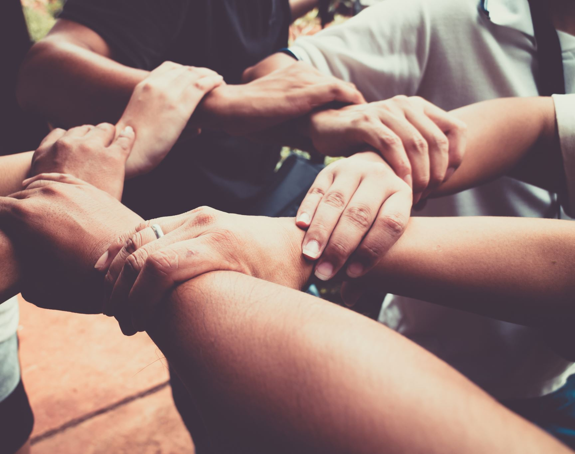
Activity:
Coalition Inventory
Are there any organizations where no relationship currently exists (potential partner)?
Which organizational relationships have the potential of becoming allies with your local?
Which traditional coalitions have the potential of becoming allies with your local?
Which would you consider existing allies?
NYSUT Leadership Institute Summer 2022
Notes:
10 mins

Slide 70
Taking Inventory of Relationships
No Relationships
Casual Coalitions
Traditional Coalitions
Alliances
Notes:
Leave this slide up to accompany handout

Slide 71
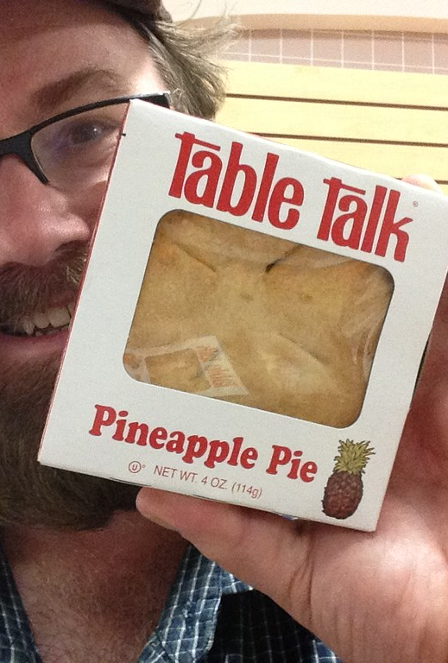
Comparing Coalitions:
Table Talk
Which organizations tend to be in the same quadrant of the chart within your Leadership Institute group?
Which organizations tend to be scattered amongst the quadrants within your Leadership Institute group?
NYSUT Leadership Institute Summer 2022
This Photo by Unknown Author is licensed under CC BY
Notes:
Time: 15 mins
Allow tables to debrief similarities and differences of coalitions.
Have a quick report out

Slide 72

How Do We Grow Our Coalitions?
Common Concerns
  Values
  Interests
  Issues
Strategies
  One-on-One Conversations
  Establish Structures
  Campaign Escalation
Social Media
  Facebook
  Twitter
NYSUT Leadership Institute Summer 2022
This Photo by Unknown Author is licensed under CC BY-ND
Notes:
Time: 5 mins
Help move coalitions from the casual relationship to an alliance.

Slide 73
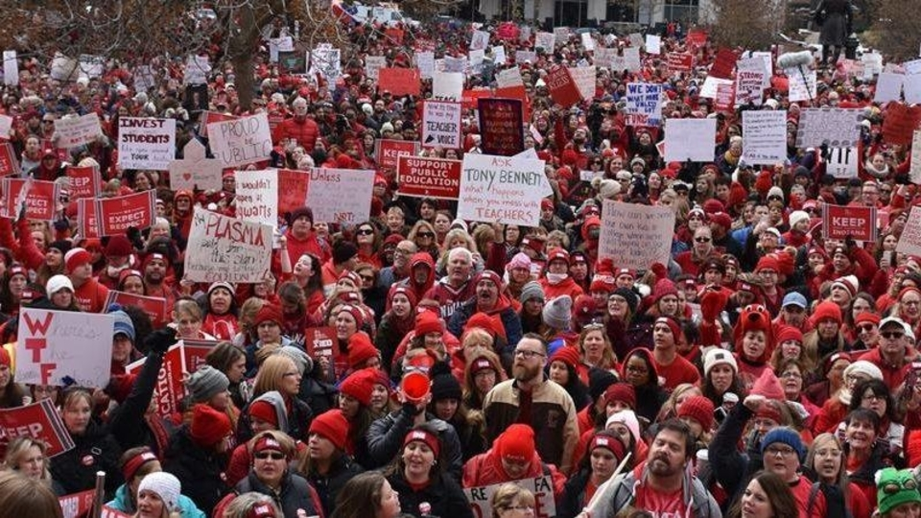
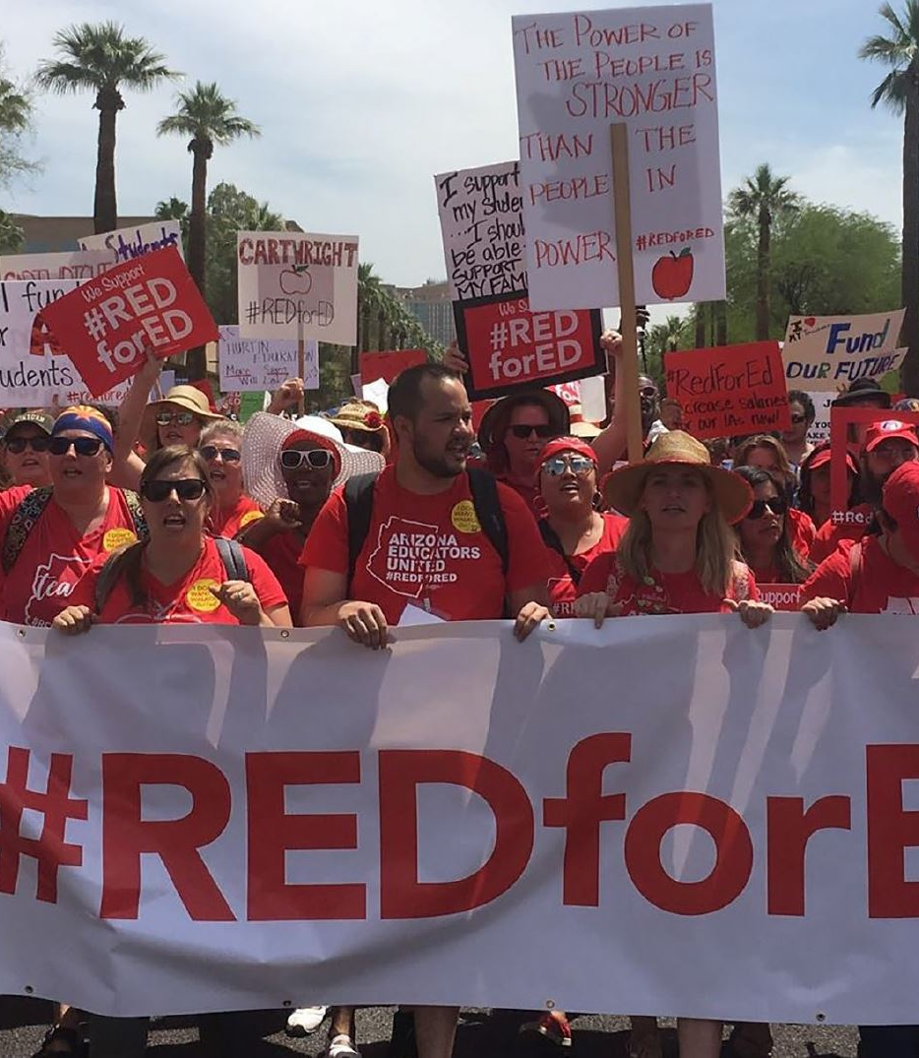
RED for ED
NYSUT Leadership Institute Summer 2022
This Photo by Unknown Author is licensed under CC BY-SA-NC
This Photo by Unknown Author is licensed under CC BY-NC-ND
Notes:
Time: 2 mins
Growing Coalitions can build movements. Case in point Red for ED. Coalitions can transform communities and bring the desired outcomes and changes.

Slide 74
Community Outreach…
Who will do it?
Local Association Membership
Officers/Executive Board
PAC Committee
Solidarity Committee
Association members affiliated with allied community organizations
New association members
Regional retiree council (if applicable)
Veteran activists of the local
NYSUT Leadership Institute Summer 2022
Notes:
Time: 5 mins

Slide 75

Questions??
NYSUT Leadership Institute Summer 2022
Notes:
Time: 15 mins

Slide 76
Thank You!

Slide 77
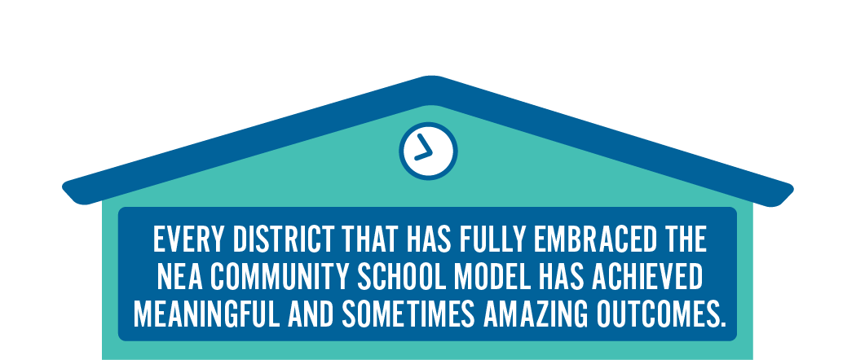
Why Community Schools?

Slide 78
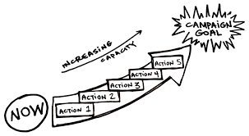
Lessons Learned
The workers, their energy, and their leadership must be at the front of the campaign
Official union leadership and staff must be willing to work with rank-and-file members AND allow them to have meaningful roles in campaigns
Must make space for rank and file to develop as leaders (training, chance to take risks, space to prove)
Community-centric approach
Democratic organizing (Marshall Ganz and Ella Barker)
Gradual escalation of tactics
Workers have power

