Slide 1

Intro Via Zoom Window
Rename your window with
Name
Required Pronoun
Native Land Where you Are
Make sure you have the Resource Documents available for the duration of this meeting.

Slide 2
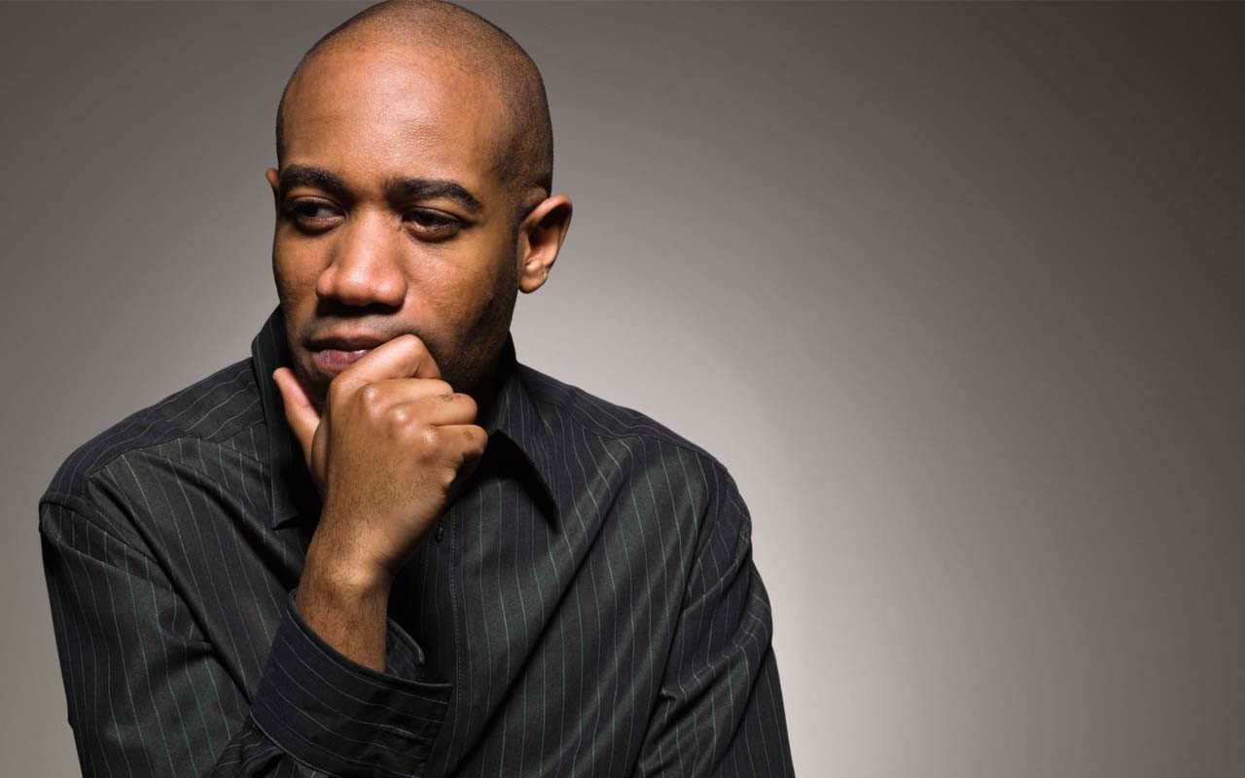
Chat WindowEntry Activity
What do you think Social Justice Unionism looks like?

Slide 3
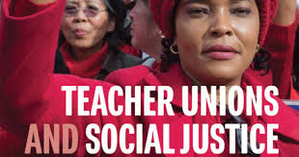

Session 1 -DefiningSocial Justice Unionism is and what it takes to achieve it

Slide 4

Community Agreements
1. Share Responsibility for the Success of Each Learning Session
2. Move up, Move back
3. Respect Confidentiality
4. Be Responsible for Building Deep Understanding
    Be timely with your presence, your speaking, and your listening
    Be fully present with speakers, open to new perspectives, and accept challenges
    Place OTHER tech on silent and stay checked-in
    Share using “I” statements
    Connect to your core values and speak from your heart
  5. Expect and Accept Imperfection
  6. Expect/accept non-closure – Agree to Disagree
Notes:
Ellen

Slide 5

Honoring This Space
We begin by acknowledging that through a history of colonization and brutality, we currently reside on and are connecting from the traditional lands stewarded by generations of indigenous people.
We honor these indigenous people, all elders, past, present, and emerging. We are called to learn and share these learnings about this tribal history, culture, and contributions that have been suppressed in the telling of the story of what we now call the United States of America.
Notes:
Gina

Slide 6

Today’s Agenda
What is Social Justice Unionism?
What would it take to move to that?
What is my role as a staff person?

Slide 7
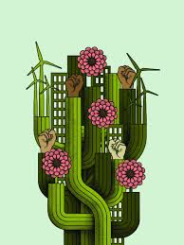
Today’s Agenda
What if…?
Ilissa

Slide 8
Imagine If- (from Page 21)
Had so much respect in the community that when a parent has a problem with a school, the parent not only talks to the principal and teacher, but also the building union rep.
Worked in ongoing alliance with community, parent, and labor groups to promote the schools and communities our students deserve.
Started programs for high school youth to serve as union interns and learn about the labor movement.
Sponsored afternoon social justice curriculum-sharing sessions at the union’s offices.
Had a diverse leadership and membership that was more reflective of the student body.

Slide 9
Imagine If – Zoom Room Work
Choose the Room of the Imagine if statement most interesting to you
Introduce yourself
Share your reactions to the statement your Zoomies are gathered at
What would it take to achieve this “If”
Our Debrief:
“What is something someone said that stuck with you?”

Slide 10

Two Tensions that Exist in Our Work
Jessica

Slide 11
Why do we need Social Justice? Zoom Room
“Two ideals are struggling for supremacy in American life today: one is the industrial ideal dominating through the supremacy of commercialism, which subordinates the worker to the product and the machine; the other, the ideal of democracy, the ideal of the educators, which places humanity above all machines, and demands that all activity shall be the expression of life. If this ideal of the educators cannot be carried over into the industrial field then the ideal of industrialism will be carried over into the school... Today, teachers of America, we stand at the parting of the ways. Democracy is not on trial, but America is."
Margaret Haley, "Why Teachers Should Organize," TUSJ p. 67-69

Slide 12
How do you answer?
Zinn – 25-30 (27-30) Odd Room
Fletcher – 34-41 (37-38) Even Room
Do these the two ideals [industrial ideal vs. ideal
of democracy/educators], two tensions that keep our
unions agitated, have us “at the parting of the ways?”
Is this the Theory of Change we need? - “If this ideal of the educators cannot be carried over into the industrial field then the ideal of industrialism will be carried over into the school.”
How does your role as a staff person change within these tensions and theory of change?
Be ready to present and discuss your answers as a whole group.

Slide 13
7 Components of Social Justice Unionism
Defend the rights of its members while fighting for the rights and needs of the broader community and students.
Recognize that the parents and neighbors of our students are key allies, and build strategic alliances with parents, labor unions, and community groups.
Education unions should also work to unite all staff members at a school. They should build ongoing alliances with a wide range of groups, from other public service unions to the broader labor movement, churches, community and social organizations, advocacy groups, and business and political groups that support public schools.
Put teachers and others who work in classrooms at the center of school reform agendas, ensuring that they take ownership of reform initiatives.
Encourage those who work with children to use methods of instruction and curricula that will promote racial and gender equity, combat racism and prejudice, encourage critical thinking about our society’s problems, and nurture an active, reflective citizenry that is committed to real democracy and social and economic justice.
Forcefully advocate for a radical restructuring of American education.
Aggressively educate and mobilize its membership to fight for social justice in all areas of society.

Slide 14
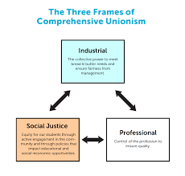
Three Models of Teacher Unionism
Three Models of Teacher Unionism
Izaak

Slide 15
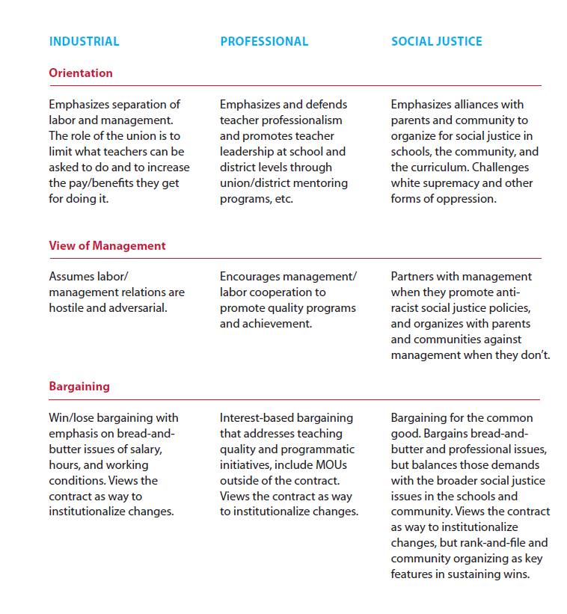
Three Models of
Teacher
Unionism
Zoom Room

Slide 16
Three Models of Teacher Unionism Zoom Room
Do you think your local leaders would assess themselves as you have?
What shifts in your work with this local would you make to move them from where they are to a more social justice focused union?
How would/do you use this tool?

Slide 17
What are the leaders and structures we need?
“The terms “social justice” and “social justice unionism” can be watered down or co-opted. Some activists and leaders believe that passing resolutions in solidarity with different struggles (a positive thing) makes a union a “social justice union.” Others label programs “social justice,” but because of top down leadership and a lack of membership involvement, such programs are less effective than they might be. A new leader or leadership team can’t just declare that by virtue of their politics they are now a social justice union. It’s hard work. Real transformation of a union encompasses change in many areas: internal decision making processes, vision, campaigns, addressing race and gender issues, relationships with parents and communities, and much more.” (pg. 175)
Given this – what is the role of union staff in leadership identification, development, and engagement?

Slide 18

Ending it Right
Next Meeting
Monday, March 18, 2024 @ 2:30PM Eastern

