Slide 1
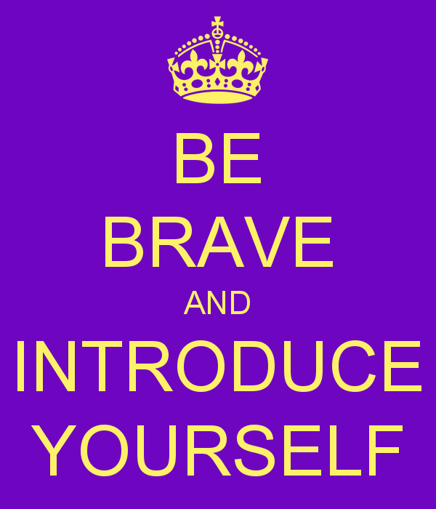
Intro Via Zoom Window
Rename your window with
Name
Required Pronoun
Native Land Where you Are
Make sure you have the Resource Documents available for the duration of this meeting.

Slide 2
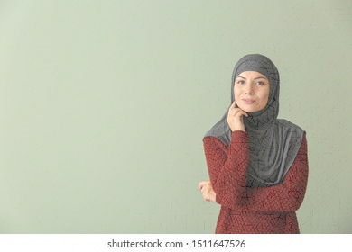
Chat WindowEntry Activity
Who are the people you need to lead social justice unionism?

Slide 3
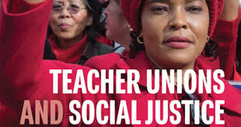

Session 2- Broadening Union Leadership and Expectations for What Unions Can Win

Slide 4

Community Agreements
1. Share Responsibility for the Success of Each Learning Session
2. Move up, Move back
3. Respect Confidentiality
4. Be Responsible for Building Deep Understanding
    Be timely with your presence, your speaking, and your listening
    Be fully present with speakers, open to new perspectives, and accept challenges
    Place OTHER tech on silent and stay checked-in
    Share using “I” statements
    Connect to your core values and speak from your heart
  5. Expect and Accept Imperfection
  6. Expect/accept non-closure – Agree to Disagree
Notes:
Ellen

Slide 5

Honoring This Space
We begin by acknowledging that through a history of colonization and brutality, we currently reside on and are connecting from the traditional lands stewarded by generations of indigenous people.
We honor these indigenous people, all elders, past, present, and emerging. We are called to learn and share these learnings about this tribal history, culture, and contributions that have been suppressed in the telling of the story of what we now call the United States of America.
Notes:
Gina

Slide 6

Today’s Agenda
Who do we need in this work?
How do we expand expectations for what we can win?
What is my role as a staff person?

Slide 7
Shelly
Who are the people we need?

Slide 8
What are the leaders and structures we need?
“The terms “social justice” and “social justice unionism” can be watered down or co-opted. Some activists and leaders believe that passing resolutions in solidarity with different struggles (a positive thing) makes a union a “social justice union.” Others label programs “social justice,” but because of top down leadership and a lack of membership involvement, such programs are less effective than they might be. A new leader or leadership team can’t just declare that by virtue of their politics they are now a social justice union. It’s hard work. Real transformation of a union encompasses change in many areas: internal decision making processes, vision, campaigns, addressing race and gender issues, relationships with parents an communities, and much more.” (pg. 175)
Given this – what is the role of union staff in leadership identification, development, and engagement?

Slide 9

Natural Leader ID Review – Pg 274-282
“Who here is trusted and respected?”

Slide 10
Definitions for Today
Leaders – Trusted and respected by their colleagues in ways that cut across communities of workers- is connected by values and influential relationships with mobilizers, activists, and those not yet part of the work. Get people to move their thinking and take action.
Mobilizers – Connected to communities of workers in ways that are influential – can convene their community. Get people excited to act.
Activists – Supportive and willing to act if invited

Slide 11
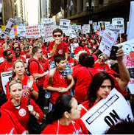


Leaders, Mobilizers, and Activists – Pg 2 of RG
Zoom Room – 15 Minutes
Shelly

Slide 12
Ilissa
How do we win more?

Slide 13


Slide 14
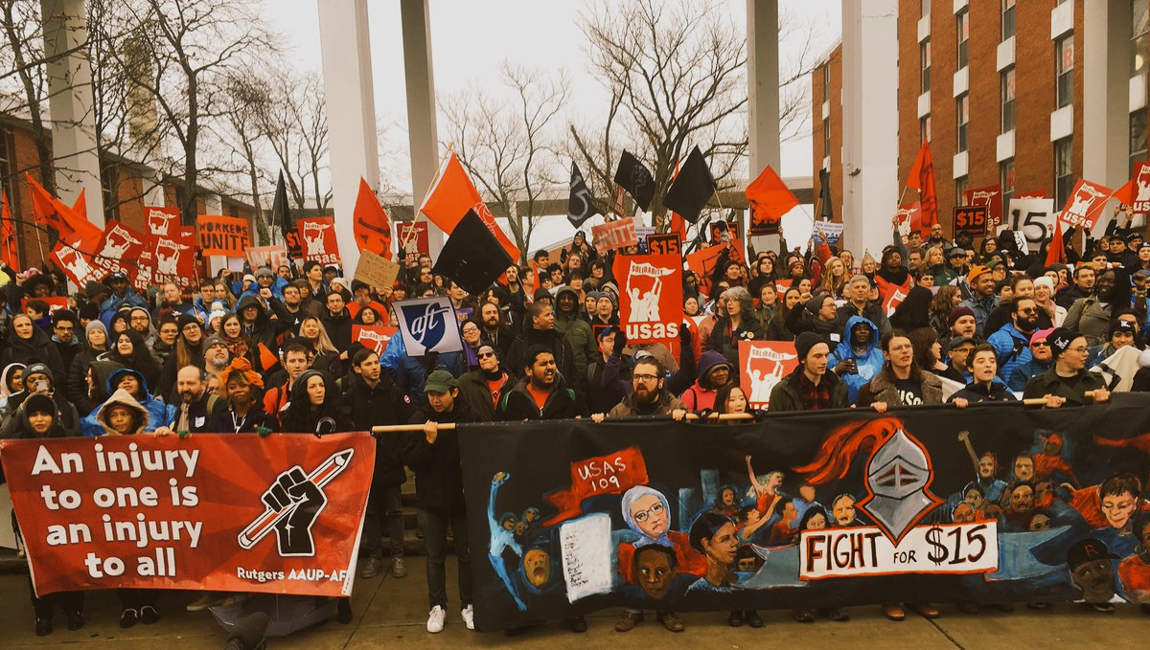
Why could Bargaining for the Common Good be a strategy for expanding leadership and expectations for our unions?
Notes:
There are exciting campaigns building around the country
What we’re going to do today--- what is BCG, why is it important now, and what are examples and explore how we can use this in our campaigns.

Slide 15

7 Elements of a Common Good Campaign Pg 107-112
  Expand the scope of bargaining beyond wages and benefits
  Go on offense in your campaign by identifying, exposing and challenging the real opposition
  Engage community allies as partners in issue development and the bargaining campaign
  Center racial justice in your demands
  Strengthen internal organizing, membership and
  member engagement
  Leverage capital in our campaigns
  The campaign doesn’t end once the union settles its contract
Notes:
There are these seven elements lifted up from all these campaigns, many are hitting on 1-2 of them, we are going to go into detail later.

Slide 16
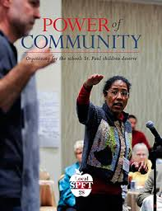
St. Paul Federation of Teachers
Smaller class sizes
Family engagement
Placing teaching before testing
Wage and benefit increases
Culturally relevant education
High quality professional development for teachers
No foreclosures

Slide 17
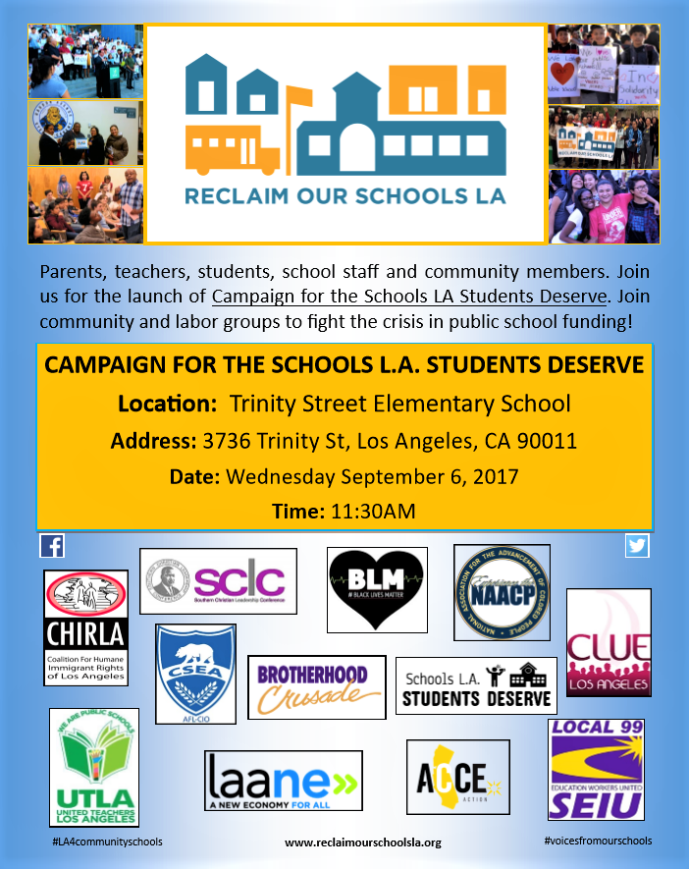
UTLA Bargains for the Common Good
Smaller class size
Hiring of nurses, librarians & counselors
An end to “random searches”
Green space
Immigrant defense fund
Community schools
Charter school cap
Notes:
Some of their common good victories include:
School funding- UTLA, LAUSD and Mayor’s office to jointly advocate for increased county and state funding
Class Size- immediate reduction of 7 students in secondary math and English, and elimination of contract language that previously allowed the district to unilaterally ignore all class size averages and caps. Agreement to reduce class size every year for the next four years.
A nurse in every school, with an agreement to hire 150 full time nurses
Community Schools-- by June 2019, the district will designate 20 community schools, and by June 2020 an additional 10
Privatization/Charter Cap
Librarians-- commitment to hire 82 new librarians
Counselors-- commitment to hire 17 additional counselors
Testing- joint UTLA/LAUSD committee tasked with developing a plan to reduce the amount of assessments by 50%
“Random” Searches- pilot program that exempts schools from administering random searches in 28 schools
Green Space-- joint task force tasked with developing a plan to increase green space
Immigrant Defense Fund-- district will provide a dedicated hotline and attorney for immigrant families

Slide 18
Why do we run Common Good Campaigns?
Builds Power through Leaders and Structures from the bottom up
This is the best way for us to WIN more for all!
Unions and community groups share a common powerful opposition, and we need each other in order to win
Unions win more and community groups win bigger and broader campaigns when we work together in this way
Notes:
Two concrete examples--we will go into more depth throughout this program….

Slide 19
Zoom Room Time -- 10 minutes p. 9-45 of the Resource Guide
What stands out to you about this approach?
What are the opportunities that this strategy
COULD provide your affiliates?
What are the potential challenges this strategy
could provide your affiliates?

Slide 20
Izaak
What is your role?

Slide 21
What do we mean… Pgs. 248-251 in the book
Advocacy
“Advocacy is the work of creating change through the actions of professionals or technical experts—lobbyists, pollsters, lawyers, communication specialists, researchers. Advocacy relies on the expertise, status, and know-how of these groups of people to make change. Advocacy usually happens in a closed-door room; ordinary people play a small to nonexistent role in its efficacy. Advocacy has become a dominant strategy for unions and liberals.”
Mobilizing
“Mobilizing, by contrast, activates an already-convinced membership. Mobilizing encourages those who already support a cause or a mission to take action to defend their belief—for example, by attending a protest, wearing a button, or signing a petition.”
Organizing
“To organize is to build mass support and strength among ordinary people. Organizing draws its power from working people’s biggest strength: our numbers. The work of organizing is systematic and rigorous: It requires connecting with every single worker in a shop, every educator in a building, every building in a district. At its core, it asks people to understand their own agency and to make choices about how they will exercise it.”

Slide 22

Advocacy, Mobilizing, Organizing Pg 248-251 in the book and on Pg 49 in resource guide
Advocate
Mobilizer
Organizer
Notes:
Ellen
20 Mins Entry activity – 4 Corners of Union Work
How do you think your locals primarily view your role with them? Social Justice Advocate, Contract Manager and Problem Solver, Leadership Coach and Developer, Campaign/Organizing Leader –
Prompts -Once at your charts, what are the opportunities that this view could have for moving towards a win and what are the challenges that this view could have?
Where is our power?
Contract Negotiation, Grievances, Member Engagement, Staff Led Programs
10 MIN debrief – so now what?

Slide 23
Zoom Discussion – Use Pg. 251 or 49 in RG
Advocate
Select the compass point that best answers where you are for each of the following questions -
1. What role do your leaders see you in currently? Why?
2. What role does your manager expect you to be in most often? Why?
3. What would your role look like if you were working with a SJ local? Why?
4. Discuss the tensions that exist and discuss your whys. How do you deal with these tensions?
Mobilizer
Organizer​
Notes:
Ellen

Slide 24
What changes in your work would you and your manager need to make room for, in order to cultivate social justice unionism?
Advocate
Mobilizer
Organizer
Notes:
Ellen
20 Mins Entry activity – 4 Corners of Union Work
How do you think your locals primarily view your role with them? Social Justice Advocate, Contract Manager and Problem Solver, Leadership Coach and Developer, Campaign/Organizing Leader –
Prompts -Once at your charts, what are the opportunities that this view could have for moving towards a win and what are the challenges that this view could have?
Where is our power?
Contract Negotiation, Grievances, Member Engagement, Staff Led Programs
10 MIN debrief – so now what?

Slide 25
What does it all mean?
Notes:
Ellen

Slide 26
Taking you Home
Jessica

Slide 27
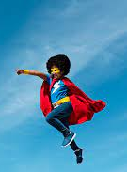
What is THE staff role?
What are the types of work Staff people are engaged in that support and cultivate the types of leaders and structures in this book?
What changes in your work/expectations would you (and your leader/manager) need to make room for in order to cultivate social justice unionism as presented in this book?

Slide 28
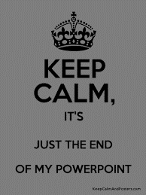
Ending it Right
Next Meeting
Tuesday, March 19, 2024 @ 2:30PM Eastern

