Slide 1


-
Session 3 Testing leaders, structures, and tactics
that result in power building

Slide 2
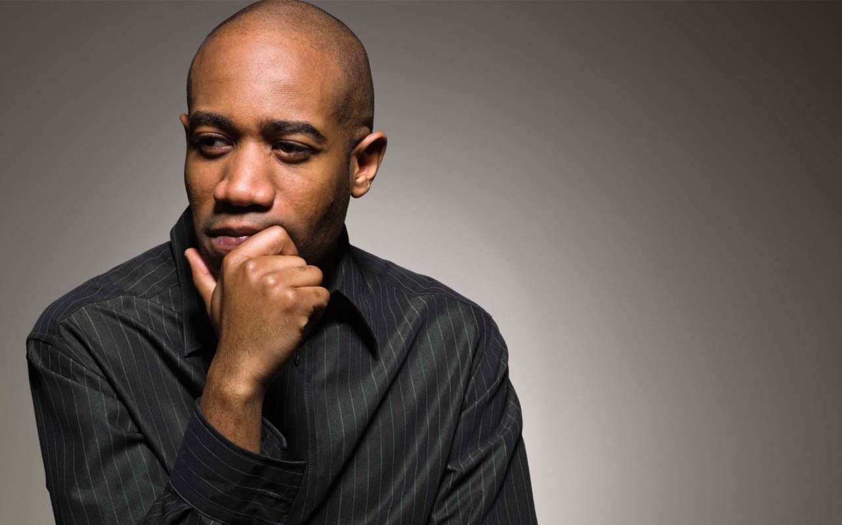
Entry Activity
What are the characteristics of a social justice unionism campaign?

Slide 3

Introductions Via Your Zoom Window
Rename with:
Your Name
Required Pronouns
Native Land

Slide 4

Honoring This Space
We begin by acknowledging that through a history of colonization and brutality, we currently reside on and are connecting from the traditional lands stewarded by generations of indigenous people.
We honor these indigenous people, all elders, past, present, and emerging. We are called to learn and share these learnings about this tribal history, culture, and contributions that have been suppressed in the telling of the story of what we now call the United States of America.

Slide 5

Community Agreements
1. Share Responsibility for the Success of Each Learning Session
2. Move up, Move back
3. Respect Confidentiality
4. Be Responsible for Building Deep Understanding
    Be timely with your presence, your speaking, and your listening
    Be fully present with speakers, open to new perspectives, and accept challenges
    Place OTHER tech on silent and stay checked-in
    Share using “I” statements
    Connect to your core values and speak from your heart
  5. Expect and Accept Imperfection
  6. Expect/accept non-closure – Agree to Disagree
Notes:
Ellen

Slide 6

Today’s Agenda
Today’s Agenda
What is required in social justice campaigns
Exploring Cases of
Transformation and Agency
Assessing Readiness

Slide 7
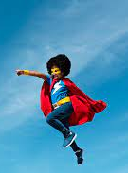
What is THE staff role?
What are the types of work Staff people are engaged in that support and cultivate the types of leaders and structures in this book?
What changes in your work/expectations would you (and your leader/manager) need to make room for in order to cultivate social justice unionism as presented in this book?

Slide 8
Shelly
What is Required in Social Justice Campaigns

Slide 9

Revitalized Union Movement – pg. 239-240
“Social Justice Unionism is an organizing model that calls for the radical boost in internal union democracy and increased member participation. This contrasts to a business model that is so dependent on staff providing services that it disempowers members and concentrates power in the hands of a small group of elected leaders and/or paid staff. An organizing model, while still providing service to members, focuses on building union power at the school level in alliance with parents, community groups, and other social movements.
Three components of social justice unionism are like the legs of a stool. Unions need all three to be balanced and strong:
  We organize around bread and butter issues.
  We organize around teaching and learning issues to reclaim our profession and our classrooms.
  We organize for social justice in our community and our curriculum. “

Slide 10
Breakout – 15 mins - Pg 2 of Resource Guide
Consider the following “requirements” for the Social Justice Unionism Organizing Model
    Internal Union Democracy
    Increased Member Participation
    Building Power at the School Site Level in Alliance with Parents, Community Groups, and Social Movements
What do each of those look like and what are the implications for you as you do your work?
To what extent do these exist in the locals you work with?

Slide 11
As we debrief – Lessons from the UTLA Strike pg. 255
“As word of our new mission spread, we attracted top-notch staff with organizing and campaign experience to work at UTLA. At the same time, we undertook the very difficult process of letting go of staff members who could not buy in to our new union vision. While this process was sometimes painful, we learned from allies around the country willing to share their experiences, that it would be a mistake not to clean house from the start. The talent and skills of our new staff have been a tremendous asset in building our union’s capacity and power.”

Slide 12
Jessica
Exploring Cases of
Transformation and Agency

Slide 13

Transformation of Teachers Unions
Transactional - a trade such as dues for services
Transformational - an interaction that changes those coming together such as how a community views the union after partnering on a tactic

Slide 14
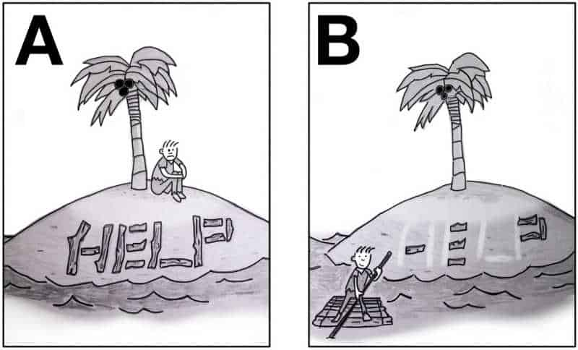
Agency within Teachers Unions (pg. 7 of RG)
Agency is the ability for an individual to decide they can act.
Structures and Structure tests are really a technical way of thinking about whether individuals have developed their sense of agency to the point where they feel they can do what is needed to win the fights they engage in.

Slide 15
Structure Test Chat - Pg 423 (pg 8 RG)
What do you notice about the table in general?
What do you notice about the column on the left?
What is the role of the staff person?

Slide 16
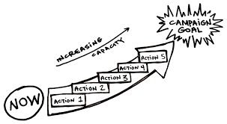
Case Studies: A Deeper Dive
NCAE: p. 227 (It's Not Magic, It's Organizing!)
Arizona: p. 189 (You Need Rank and File to Win)

Slide 17
Social Justice Wins Pg 10 of RG
Zoom Room
What are the key issues that this story “wins” ?
What are the ways that they thought of leaders and structures? How did this transform their union?
What are the small steps along the way (tactics or structure tests) that were put in place?
What do you think are the specific roles that staff played in this story?

Slide 18
Ilissa
Are you ready? Let’s Assess

Slide 19
Self Assessment Tool - Pg 19 RG
Social Justice Unionism Organizing Strategy Readiness Assessment
To determine readiness for using a Social Justice Unionism Organizing Strategy, locals should assess and reflect on four categories: general readiness and landscape, community/parent relationships, internal organizing capacity, and bargaining status. For each of the four categories below rate each readiness descriptors with a 1-4 in the small boxes, then use the larger box to do a brief SWOT reflection.
1 – Not yet 2 – Basic Understanding and Planning
3– Emerging Implementation 4 – In Place and Proven

Slide 20
Self-Assessment Debrief
How would you use this tool?
When using this tool with leaders, who might take a frank discussion about this tool personally, what kind of privilege might you need to consider? (Yours or theirs)
What did you learn about this tool?
What is your role in this self-assessment?

Slide 21
Taking you Home
Jessica

Slide 22
What is THE staff role?
What are the types of work Staff people are engaged in that support and cultivate the types of leaders and structures in this book?
What changes in your work/expectations would you (and your leader/manager) need to make room for in order to cultivate social justice unionism as presented in this book?

Slide 23

Ending it Right
Next (and Final) Meeting
Wednesday, March 20, 2024 @ 2:30PM Eastern

