Slide 1
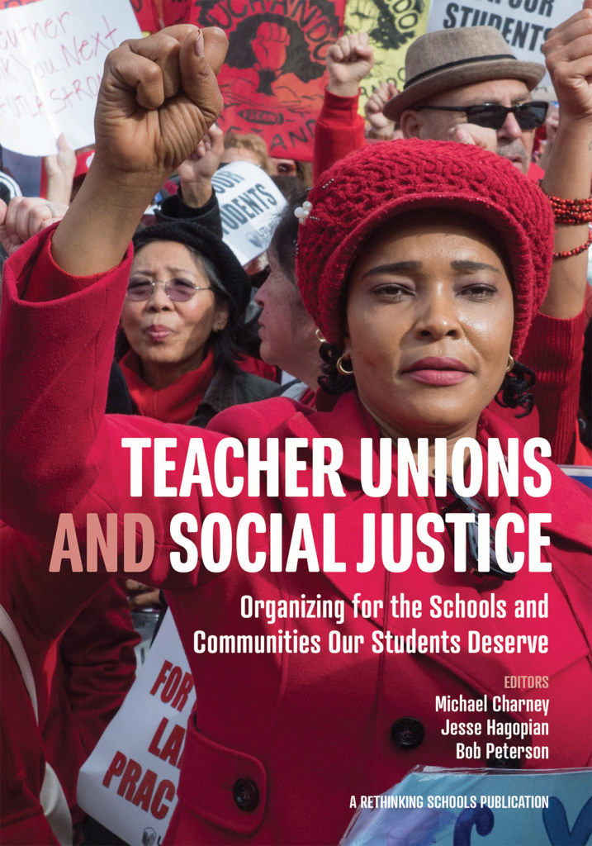
Teacher Unions and Social Justice
Session 1 of 4
What is Social Justice Unionism?
Notes:
From Ellen, She, Her, Mentor Coach to Everyone:
I think the history, and WHAT is Social Justice, and the Tension between teachers wanting to be "Of Service" and needing "Good wages" are keepers for day 1.

Slide 2
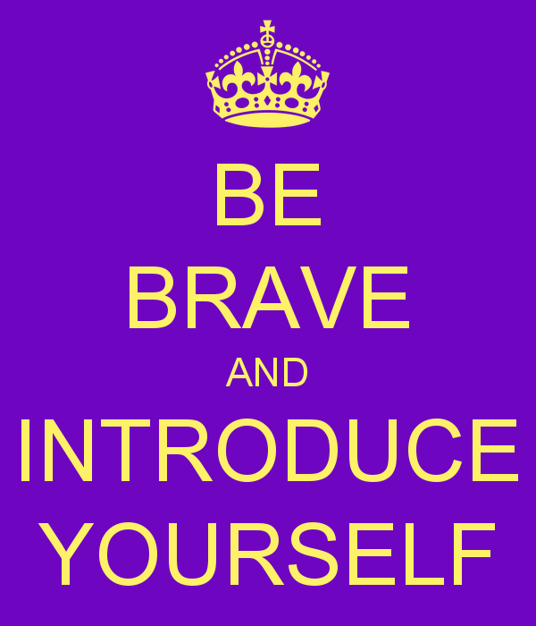
Teacher Unions and Social Justice
Rename Yourself in Zoom
  Please include:
    First and Last Name
    Pronouns
    State
Example: Ceaser Chavez(he/him)-Arizona
What are you looking forward to in 2026?

Slide 3
Teacher Unions and Social Justice
By attending this training, you confirm that you are either an NEA affiliate staff person or NEA member in good standing. The information you receive here is only for your use in your capacity as an NEA affiliate staff person or NEA member.
This presentation and its contents are confidential and may not be further distributed or passed on to any other person or published or reproduced, in whole or in part, by any medium or in any form, for any purpose unless written consent has been provided by Ellen Holmes. Audio/video recording, copying of slides, and the use of AI note-taking tools are prohibited without the written consent from Kyle Serrette. Violation of these terms may result in legal action.

Slide 4
NEA Standards of Conduct
NEA has adopted a Standard of Conduct Policy to ensure that all of our gatherings are welcoming to and free from discriminatory, harassing, or otherwise unacceptable behavior. Discrimination or harassment based on race, color, ethnicity, religion, sex, age, national origin, sexual orientation, disability, gender identity, or expression, or any other characteristic protected by law will not be tolerated. If you have experience any discriminatory or harassing behavior, please report the incident by emailing Ron "Duff" Martin (rmartin@nea.org) and Gladys Marquez (gmarquez@nea.org). Thank you for your commitment to ensuring a positive event for all.

Slide 5
Honoring This Space
We begin by acknowledging that through a history of colonization and brutality, we are currently on the traditional lands stewarded by generations of indigenous people.
We honor these indigenous people, all elders, past, present, and emerging. We are called to learn and share these learnings about this tribal history, culture, and contributions that have been suppressed in the telling of the story of what we now call the United States of America.

Slide 6
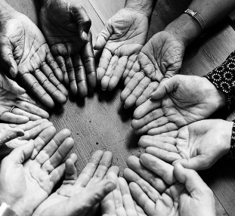
Our Invitation to YOU
Be present in this space
Listen with curiosity
Take care of yourself
Be willing to engage in this work with yourself and others
Leave with a new perspective

Slide 7
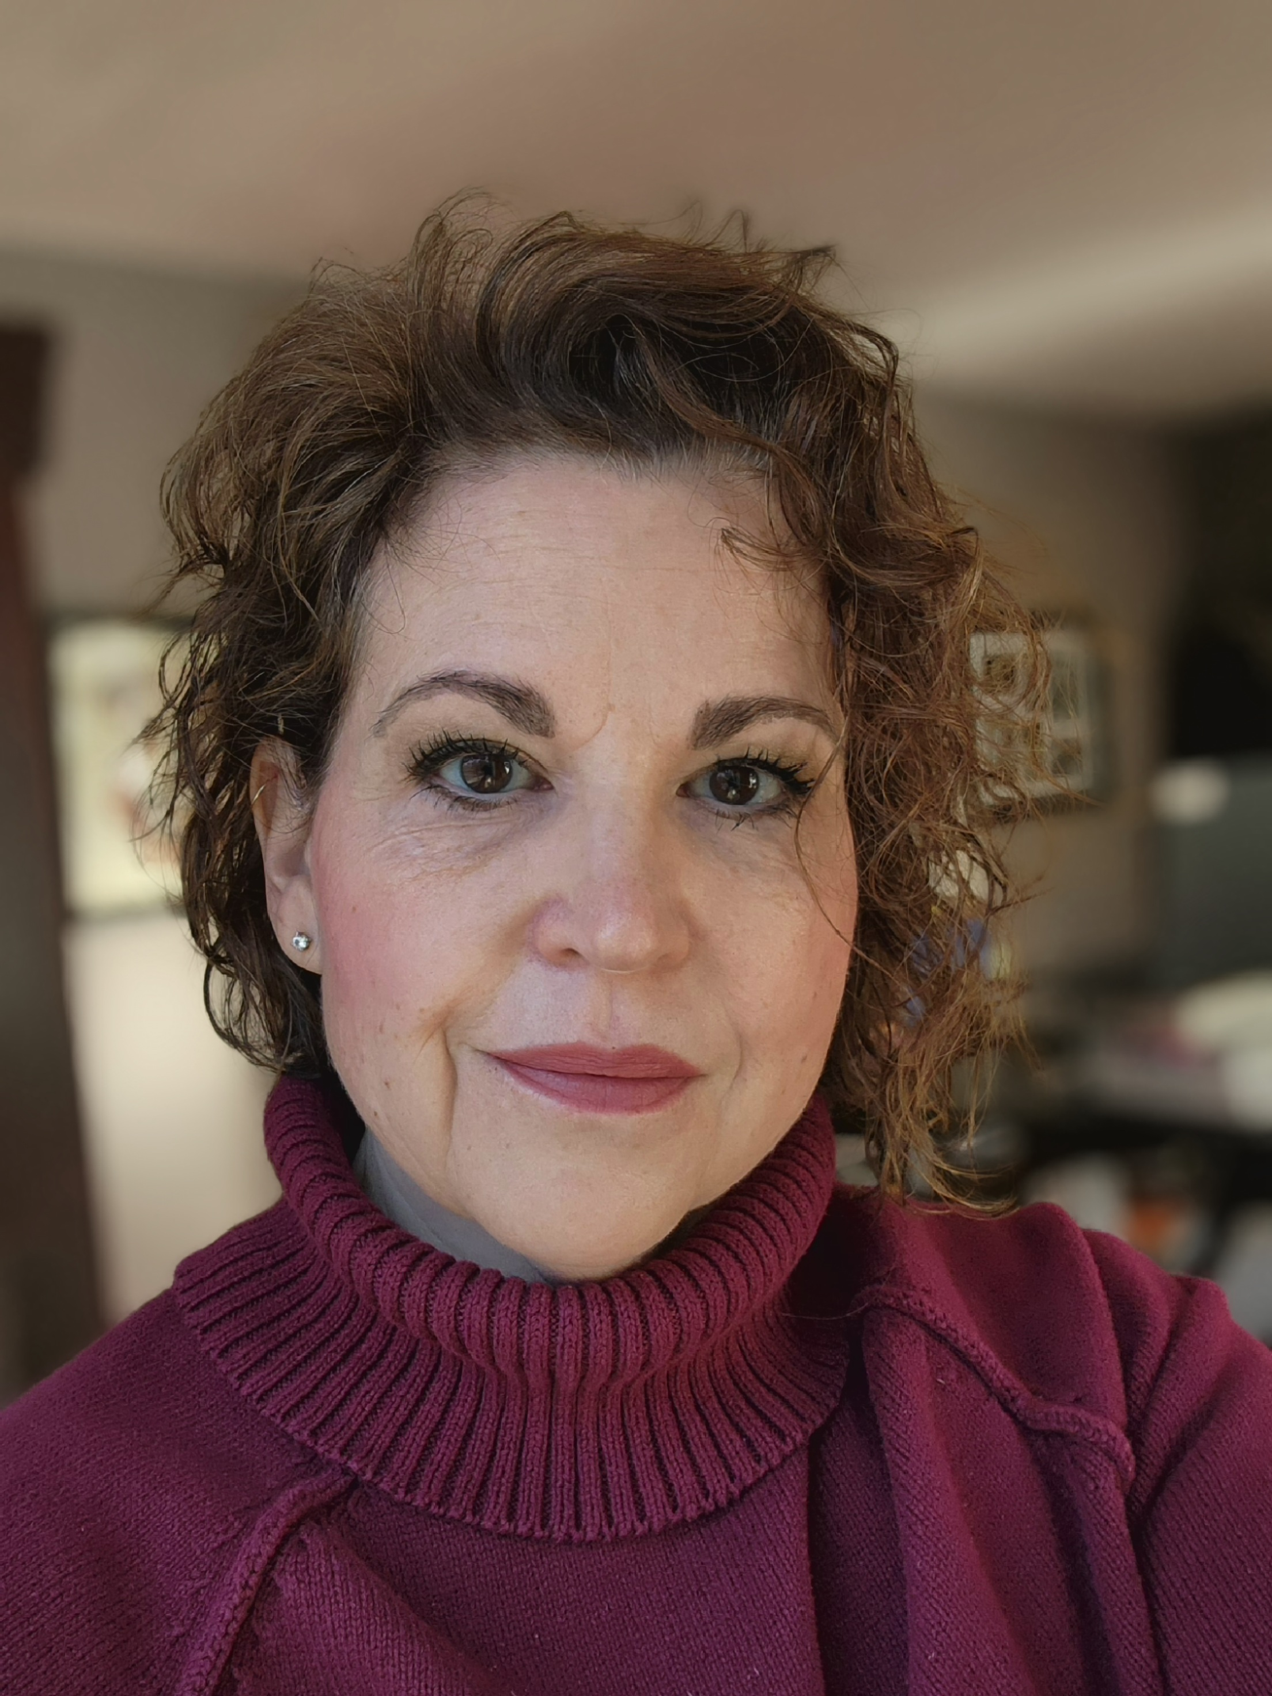
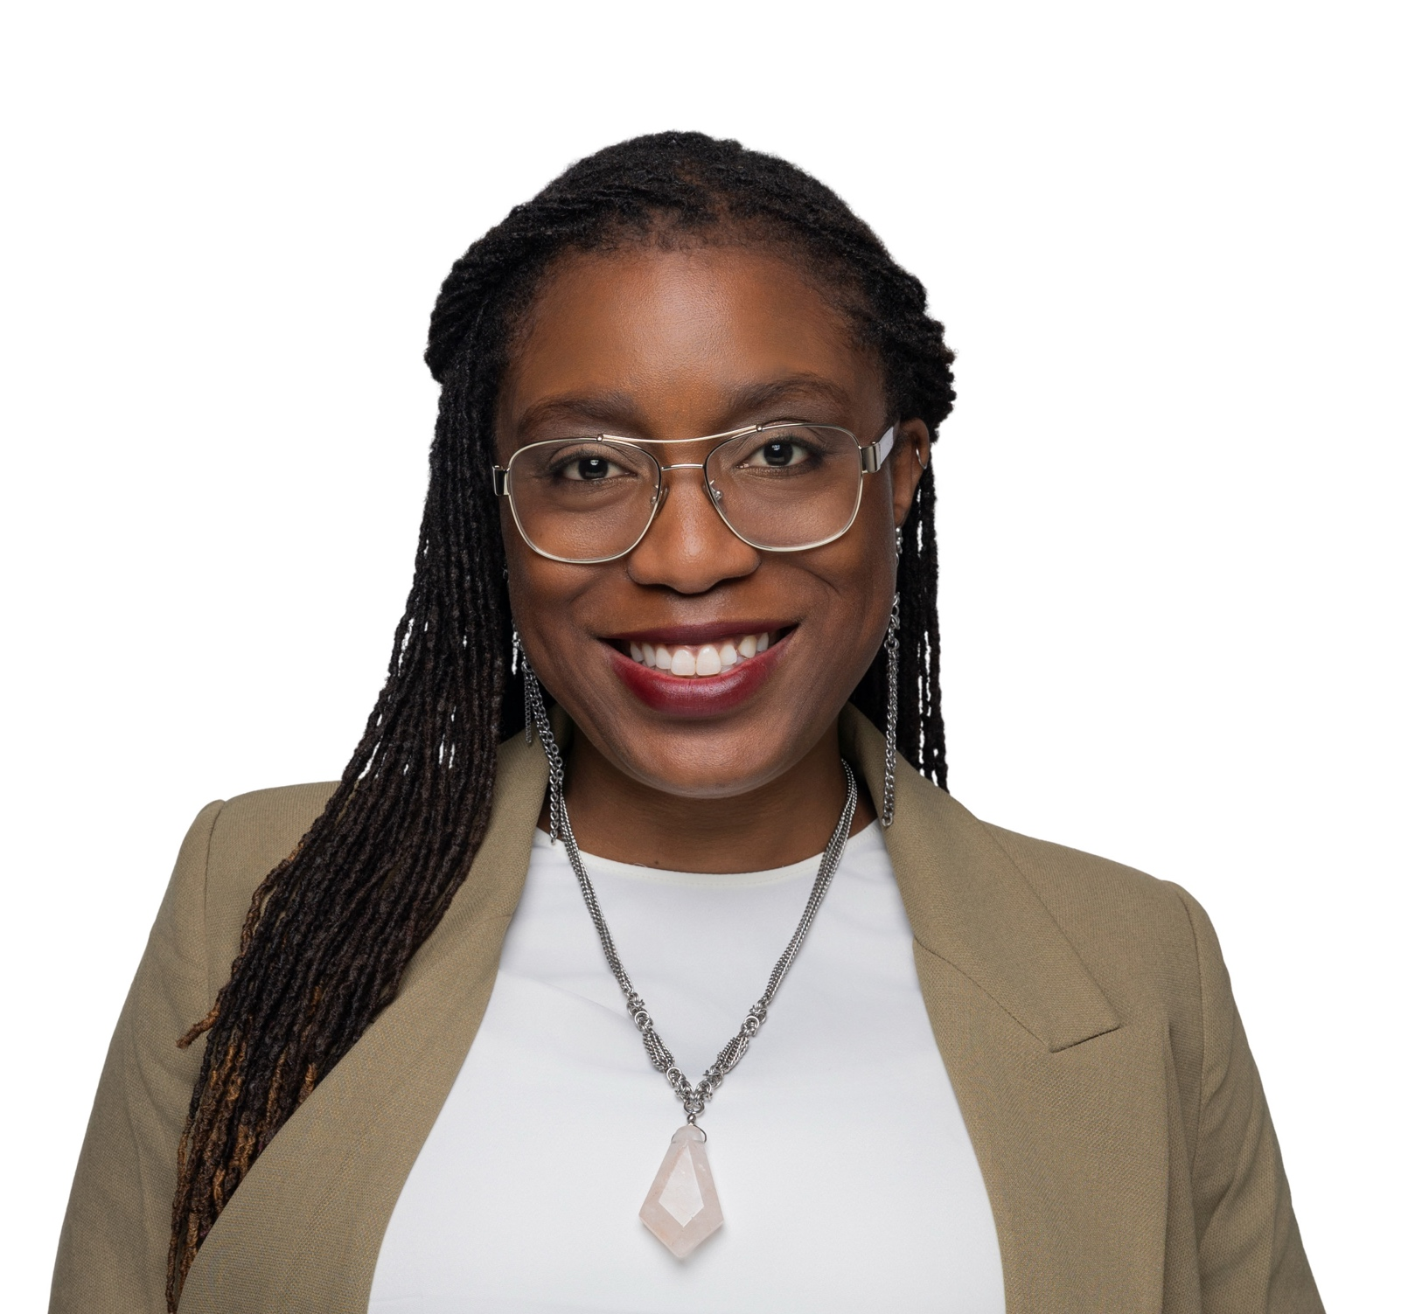
Meet Your Facilitators
Michelle Couture
(she/her/hers)
NYSUT Labor Relations Specialist for UUP
Dr. Taraja Shephard Allen
(she/her/hers)
OEA Membership Consultant

Slide 8
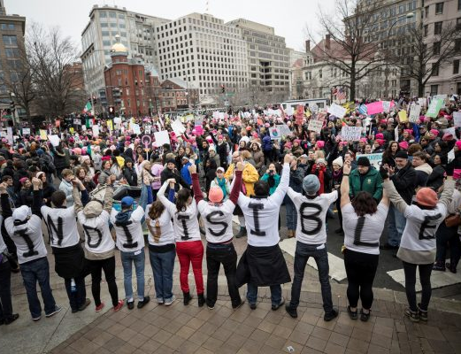
Drop in the Chat
What do you think Social Justice Unionism looks like?

Slide 9
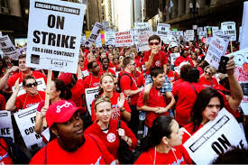

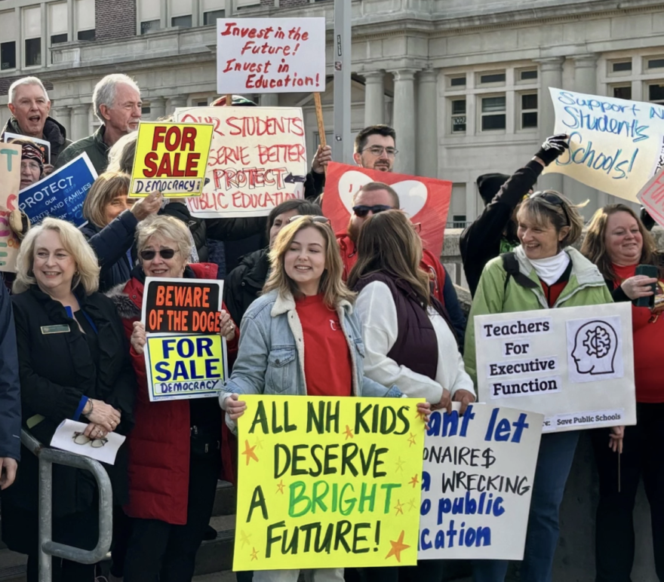
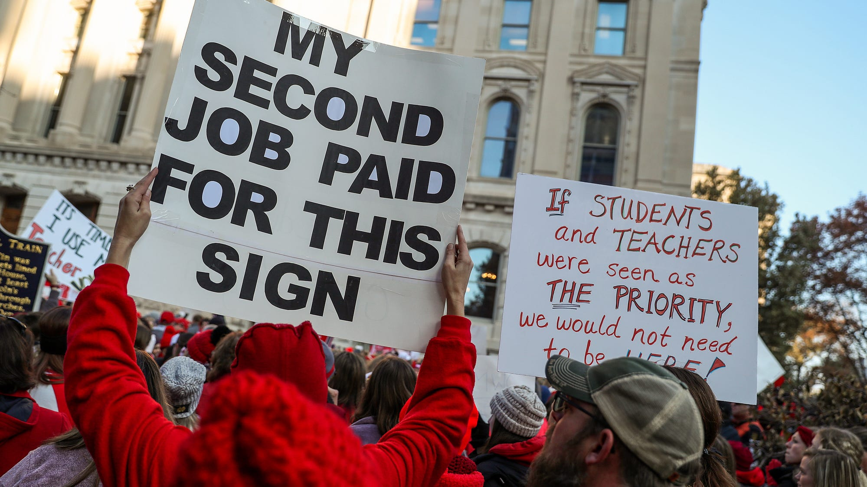
Session 1 Objectives:
What is Social Justice Unionism?
What would it take to move our locals, state unions, and communities towards it?
What can I do to support this idea as NEA affiliate staff ?

Slide 10
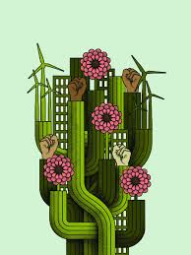
Imagine if…

Slide 11
Imagine If Educators- (from Page 21)
Had so much respect in the community that when a parent has a problem with a school, the parent not only talks to the principal and teacher, but also the building union rep...
Worked in ongoing alliance with community, parent, and labor groups to promote the schools and communities our students deserve...

Slide 12
Imagine If Educators - (from Page 21)
Started programs for high school youth to serve as union interns and learn about the labor movement.
Sponsored afternoon social justice curriculum-sharing sessions at the union’s offices.
Had a diverse leadership and membership that was more reflective of the student body.

Slide 13
Thoughts and Reflections
Introduce yourself
What imagine "If" statement resonated with you the most?
What would it take to achieve this “If” in your area?

Slide 14
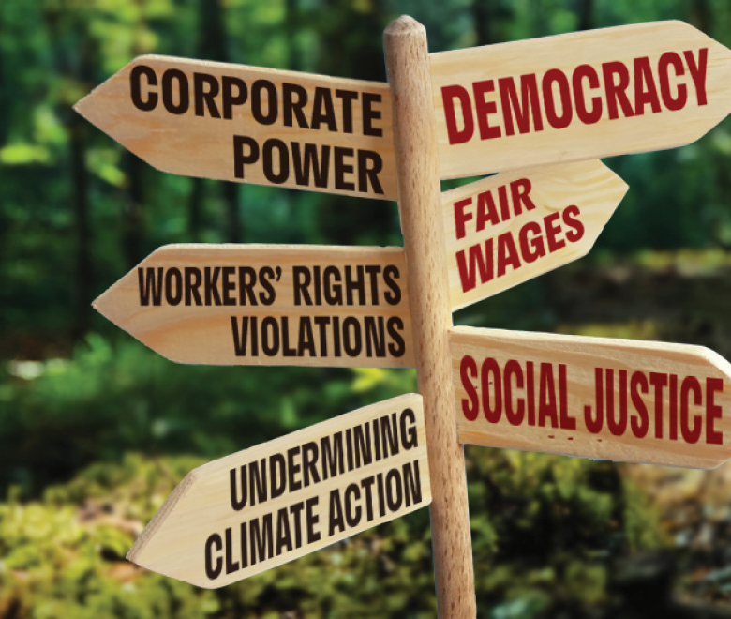
Two Tensions in the fight for Solidarity:
Industrialism vs Democracy

Slide 15
“Two ideals are struggling for supremacy in American life today: one is the industrial ideal dominating through the supremacy of commercialism, which subordinates the worker to the product and the machine;
the other, the ideal of democracy, the ideal of the educators, which places humanity above all machines, and demands that all activity shall be the expression of life.
If this ideal of the educators cannot be carried over into the industrial field then the ideal of industrialism will be carried over into the school... Today, teachers of America, we stand at the parting of the ways. Democracy is not on trial, but America is."
Margaret Haley, "Why Teachers Should Organize," TUSJ p. 67-69

Slide 16
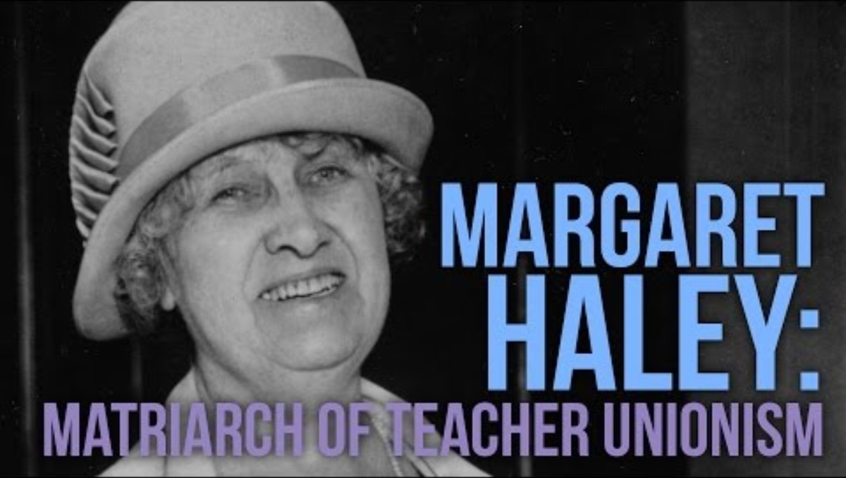
Margaret Haley: Matriarch of Teacher Unionism

Slide 17
Key Insights About the Two Ideals and Tensions
Industrial Ideal: Efficiency, hierarchy, and collective bargaining power.
Educator Ideal: Democracy, professional autonomy, and grassroots voice.
Risk: If educator ideals are not infused into union structures, industrialism will dominate schools, eroding democratic participation and professional judgment.
Core Principle: Democracy is the source of industrial power—not its competitor.

Slide 18
Our Suggested Theory of Change
Our union’s industrial strength must serve the democratic vision of educator voice and professional integrity—because when democracy drives power, we protect schools from becoming factories and transform members from customers into co-creators of change.

Slide 19
Staff Role Within This Theory of Change
From Fixer to Organizer: Move beyond solving problems for members; build capacity so members lead their own advocacy and organizing.
Guardian of Professionalism: Ensure bargaining and policy reflect educational integrity, not just efficiency metrics; translate classroom realities into union priorities.
Bridge Builder: Create transparent feedback loops so members feel ownership of union decisions; balance unity with diversity of voices during negotiations.

Slide 20
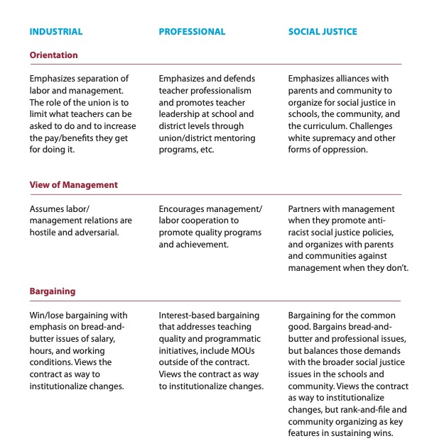
Three Frames of Teacher Unionism
Teacher unions generally operate within three primary frames of unionism:
Industrial, Professional, and Social Justice.

Slide 21
Industrial Union: Protecting Fundamental Rights and Working Conditions
Focus:
      Traditional “bread‑and‑butter” union work
      Clear distinction between labor (educators) and management (districts, school boards)
Key Areas:
      Salaries and wages
      Health care and benefits
      Working conditions (class size, workload, prep time)
      Due process and job protection
      Contract enforcement through collective bargaining
Core Purpose:
      To build collective power that ensures fairness, stability, and economic security for members.

Slide 22
Professional Unionism: Honoring Teaching as Skilled Expert Work
  Focus:
      Teaching as a profession—not just a job
      Educator voice in shaping teaching and learning
  Key Areas:
      High‑quality professional learning
      Peer Assistance and Review (PAR)
      Mentoring and induction
      Teacher leadership and shared decision‑making
      Involvement in curriculum, assessment, and instructional policy
  Core Purpose:
      To strengthen the quality, integrity, and professional standing of the teaching profession while improving student learning.

Slide 23
Social Justice Unionism: Linking Educator Power to Student and Community Needs
Focus:
      The connection between educator working conditions and student learning conditions
      Solidarity with families, students, and community partners
Key Areas:
      Educational equity and access
      Racial, social, and economic justice
      Community schools and wraparound supports
      Fair and inclusive school policies
      Addressing systemic barriers such as poverty and racism
Core Purpose:
      To advance equity and justice for all students by positioning the union as part of a broader social movement.

Slide 24
7 Components of Social Justice Unionism
Defend the rights of its members while fighting for the rights and needs of the broader community and students.
Recognize that the parents and neighbors of our students are key allies, and build strategic alliances with parents, labor unions, and community groups.
Education unions should also work to unite all staff members at a school. They should build ongoing alliances with a wide range of groups, from other public service unions to the broader labor movement, churches, community and social organizations, advocacy groups, and business and political groups that support public schools.

Slide 25
7 Components of Social Justice Unionism
Put teachers and others who work in classrooms at the center of school reform agendas, ensuring that they take ownership of reform initiatives.
Encourage those who work with children to use methods of instruction and curricula that will promote racial and gender equity, combat racism and prejudice, encourage critical thinking about our society’s problems, and nurture an active, reflective citizenry that is committed to real democracy and social and economic justice
Forcefully advocate for a radical restructuring of American education.
Aggressively educate and mobilize its membership to fight for social justice in all areas of society.

Slide 26

Why does Social Justice Unionism
matter to members?

Slide 27
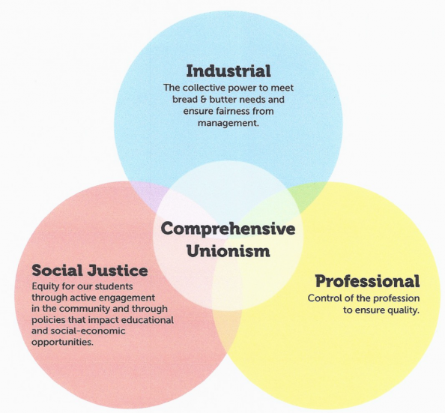
Comprehensive Unionism: Strength Through Integration
A comprehensive union does not choose one frame over another—it weaves all three together:
      Industrial → protects rights and working conditions
      Professional → strengthens practice and educator voice
      Social Justice → aligns union power with community needs
      Result:
A union that is:
      Strong at the bargaining table
      Credible in educational leadership
      Trusted in the community

Slide 28
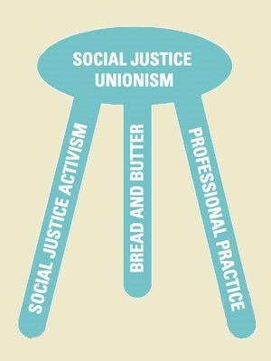
Group Reflection: Three Models of Teacher Unionism
Where do you see your members and locals fitting into these models?
What shifts in your work are necessary to move members towards a more social justice focused union model?
How could use this tool in your work?

Slide 29
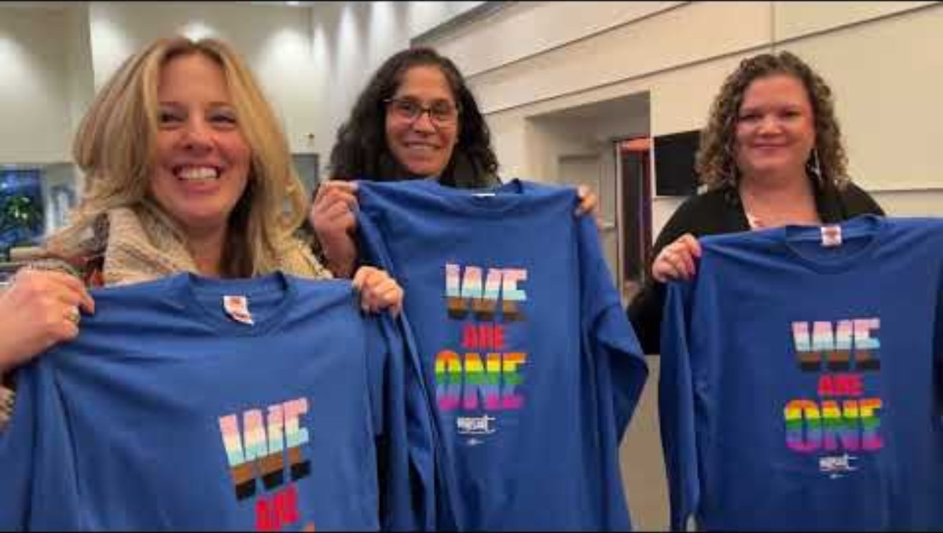
Comprehensive Framework: NYSUT

Slide 30
Coming Up Next: What are the leaders and structures we need?
“The terms “social justice” and “social justice unionism” can be watered down or co-opted. Some activists and leaders believe that passing resolutions in solidarity with different struggles (a positive thing) makes a union a “social justice union.” Others label programs “social justice,” but because of top down leadership and a lack of membership involvement, such programs are less effective than they might be. A new leader or leadership team can’t just declare that by virtue of their politics they are now a social justice union. It’s hard work. Real transformation of a union encompasses change in many areas: internal decision making processes, vision, campaigns, addressing race and gender issues, relationships with parents and communities, and much more.” (pg. 175)
Given this – what is the role of union staff in leadership identification, development, and engagement?

Slide 31
Teacher Unions and Social Justice:
Upcoming Sessions 2 -4
Thursday, January 22, 2026 @ 2:30PM Eastern
Wednesday, January 28, 2026 @ 2:30PM Eastern
Thursday, January 29, 2026 @ 2:30PM Eastern

Slide 32
Get Your Copy of the Book:
Teacher Unions and Social Justice
Send an Email: Shephardallent@ohea.org
Include:
  Name
  State Affiliate
  Address
  How do you plan to use this resource in your work?

Slide 33
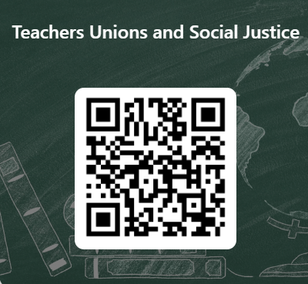
Teacher Unions and Social Justice
This learning event was designed to provide a foundational experience of the key concepts and methods needed to move members towards organizing around social justice issues and bargaining for the common good. The purpose of the four-session series is to both model a way to begin this work and build an urgency within you to continue this work.
Please let us know how we did.

