Slide 1
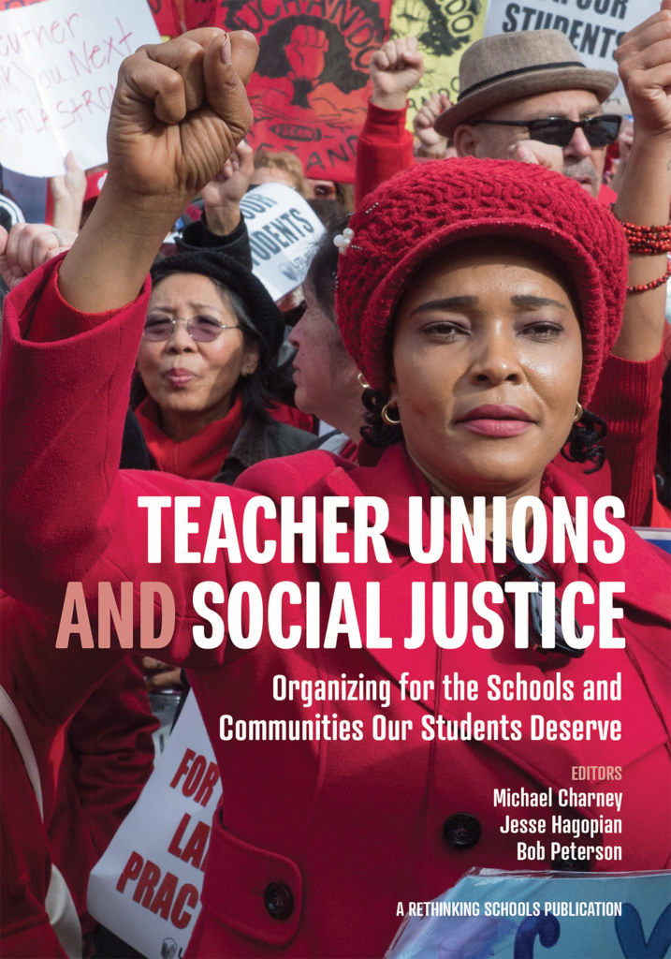
Teacher Unions and Social Justice
Session 2 of 4:
Broadening Union Leadership and Expectation for What Unions Can Win
Notes:
Rachel From Ellen, She, Her, Mentor Coach to Everyone:
I think the history, and WHAT is Social Justice, and the Tension between teachers wanting to be "Of Service" and needing "Good wages" are keepers for day 1.

Slide 2

Teacher Unions and Social Justice
Rename Yourself in Zoom
  Please include:
    First and Last Name
    Pronouns
    State
Example: Ceaser Chavez(he/him)-Arizona
What are you looking forward to this weekend?
Notes:
Rachel

Slide 3
Teacher Unions and Social Justice
By attending this training, you confirm that you are either an NEA affiliate staff person or NEA member in good standing. The information you receive here is only for your use in your capacity as an NEA affiliate staff person or NEA member.
This presentation and its contents are confidential and may not be further distributed or passed on to any other person or published or reproduced, in whole or in part, by any medium or in any form, for any purpose unless written consent has been provided by Ellen Holmes. Audio/video recording, copying of slides, and the use of AI note-taking tools are prohibited without the written consent from Kyle Serrette. Violation of these terms may result in legal action.
Notes:
Rachel

Slide 4
NEA Standards of Conduct
NEA has adopted a Standard of Conduct Policy to ensure that all of our gatherings are welcoming to and free from discriminatory, harassing, or otherwise unacceptable behavior. Discrimination or harassment based on race, color, ethnicity, religion, sex, age, national origin, sexual orientation, disability, gender identity, or expression, or any other characteristic protected by law will not be tolerated. If you have experience any discriminatory or harassing behavior, please report the incident by emailing Ron "Duff" Martin (rmartin@nea.org) and Gladys Marquez (gmarquez@nea.org). Thank you for your commitment to ensuring a positive event for all.
Notes:
Rachel

Slide 5
Honoring This Space
We begin by acknowledging that through a history of colonization and brutality, we are currently on the traditional lands stewarded by generations of indigenous people.
We honor these indigenous people, all elders, past, present, and emerging. We are called to learn and share these learnings about this tribal history, culture, and contributions that have been suppressed in the telling of the story of what we now call the United States of America.
Notes:
Rachel

Slide 6
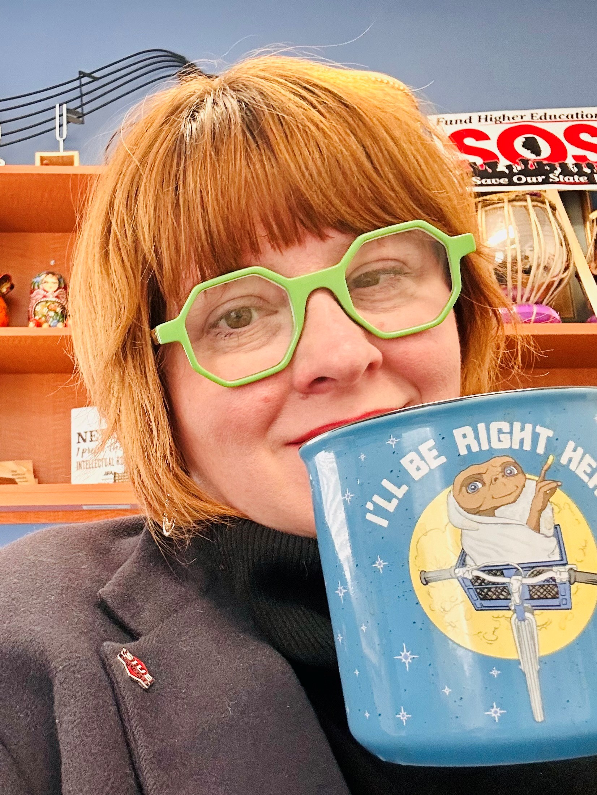
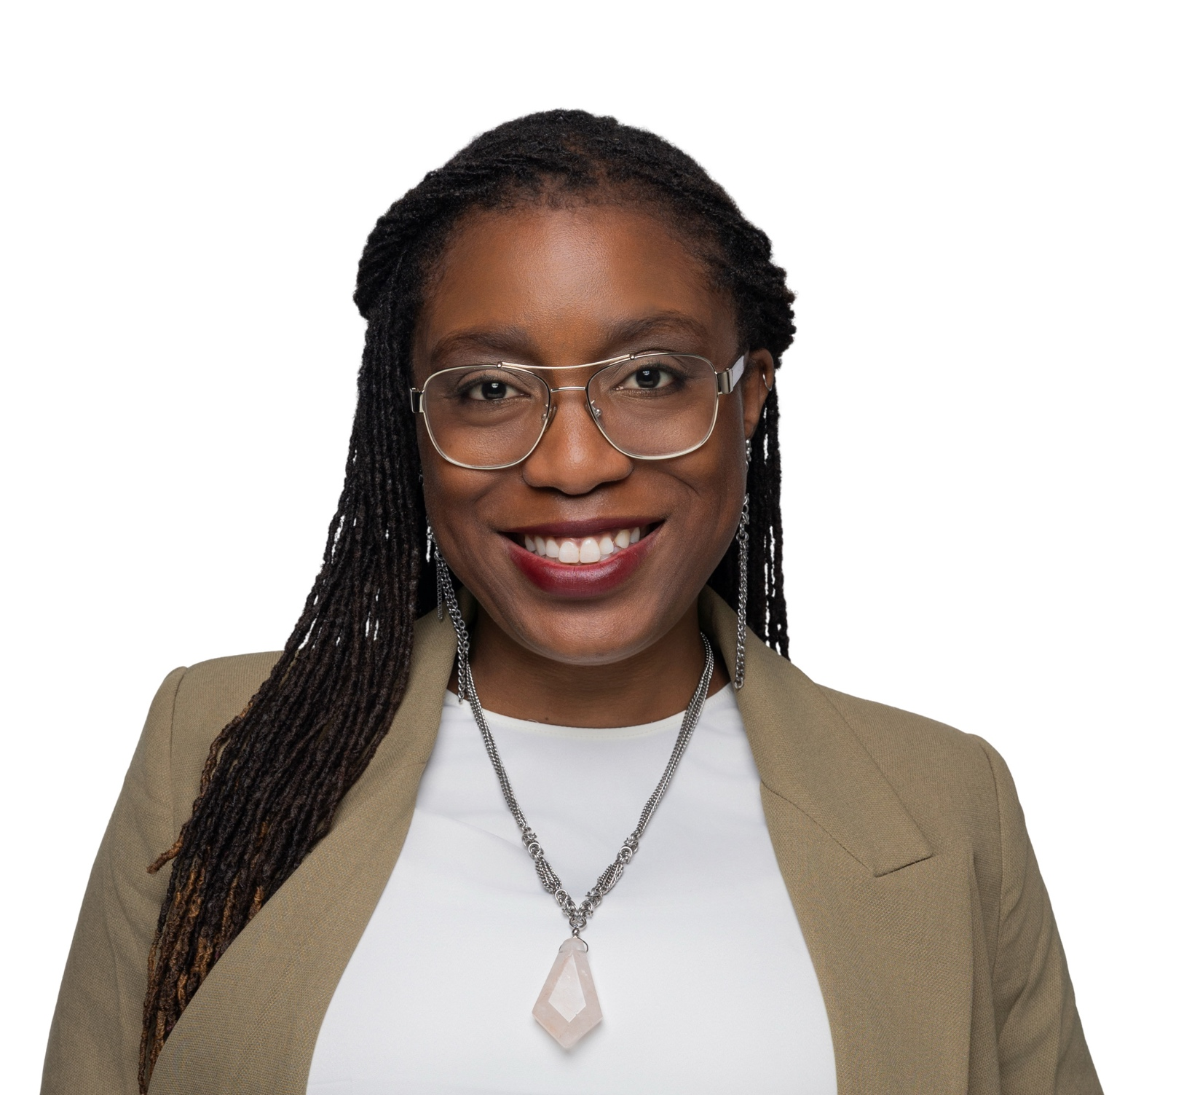
Meet Your Facilitators
Dr. Rachel Tollett
(she/her/hers)
IEA UniServ Director, Service Area HE
Dr. Taraja Shephard Allen
(she/her/hers)
OEA Membership Consultant
Notes:
Intro myself – pass to Taraja

Slide 7
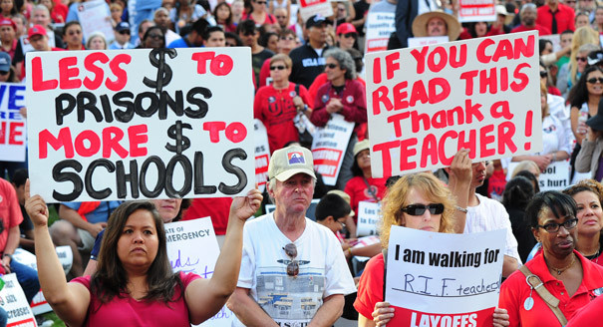
Session Objectives:
Who do we need in this work?
How do we expand expectations for what we can win?
What is my role as a staff person?

Slide 8
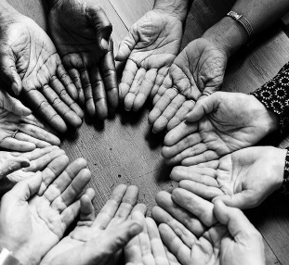
Our Invitation to YOU
Be present in this space
Listen with curiosity
Take care of yourself
Be willing to engage in this work with yourself and others
Leave with a new perspective

Slide 9
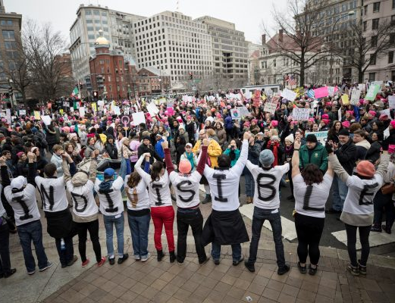
Drop in the Chat
Who are the people you need to lead social justice unionism?

Slide 10
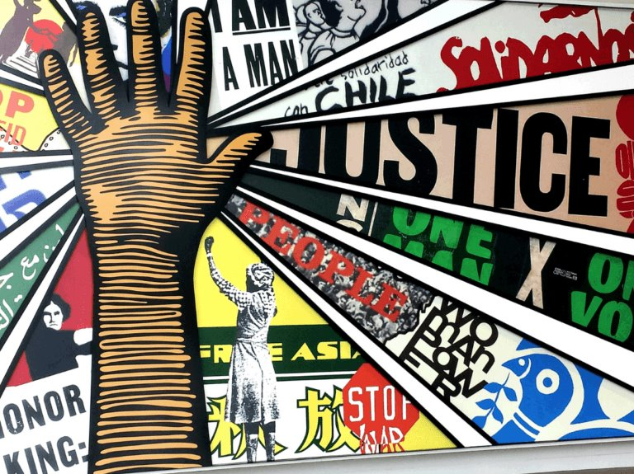
Who are the people we need?

Slide 11
What are the leaders and structures we need?
“The terms “social justice” and “social justice unionism” can be watered down or co-opted. Some activists and leaders believe that passing resolutions in solidarity with different struggles (a positive thing) makes a union a “social justice union.” Others label programs “social justice,” but because of top down leadership and a lack of membership involvement, such programs are less effective than they might be. A new leader or leadership team can’t just declare that by virtue of their politics they are now a social justice union. It’s hard work. Real transformation of a union encompasses change in many areas: internal decision making processes, vision, campaigns, addressing race and gender issues, relationships with parents an communities, and much more.” (page 175)
Given this – what is the role of union staff in leadership identification, development, and engagement?

Slide 12

Who is trusted and respected?
Leaders, mobilIzers, and Activists Activity
Natural Leader ID Review – Pages 274-282
Notes:
Rachel

Slide 13
Definitions for Today
Leaders – Trusted and respected by their colleagues in ways that cut across communities of workers- is connected by values and influential relationships with mobilizers, activists, and those not yet part of the work. Get people to move their thinking and take action.
Mobilizers – Connected to communities of workers in ways that are influential – can convene their community. Get people excited to act.
Activists – Supportive and willing to act if invited
Notes:
Rachel

Slide 14
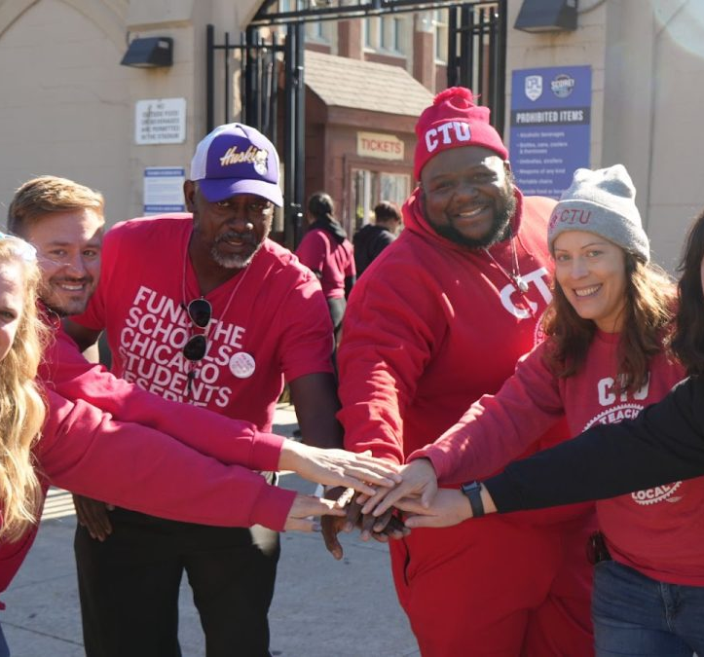
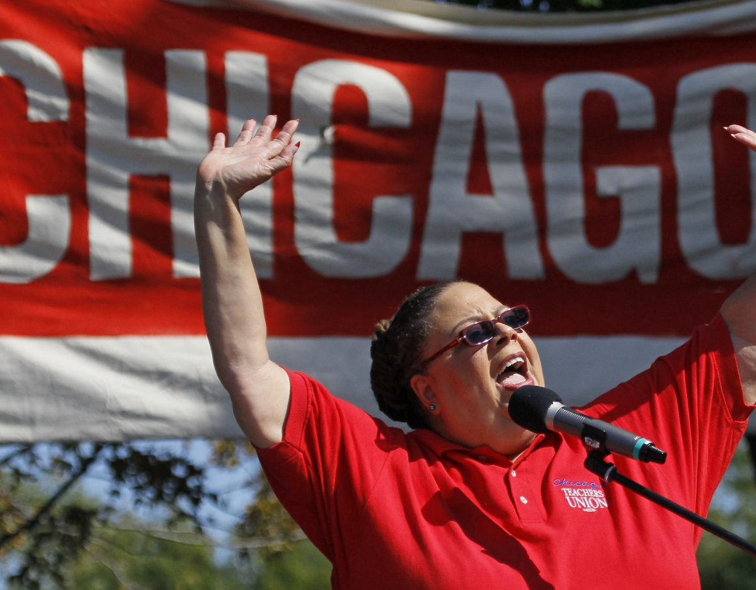
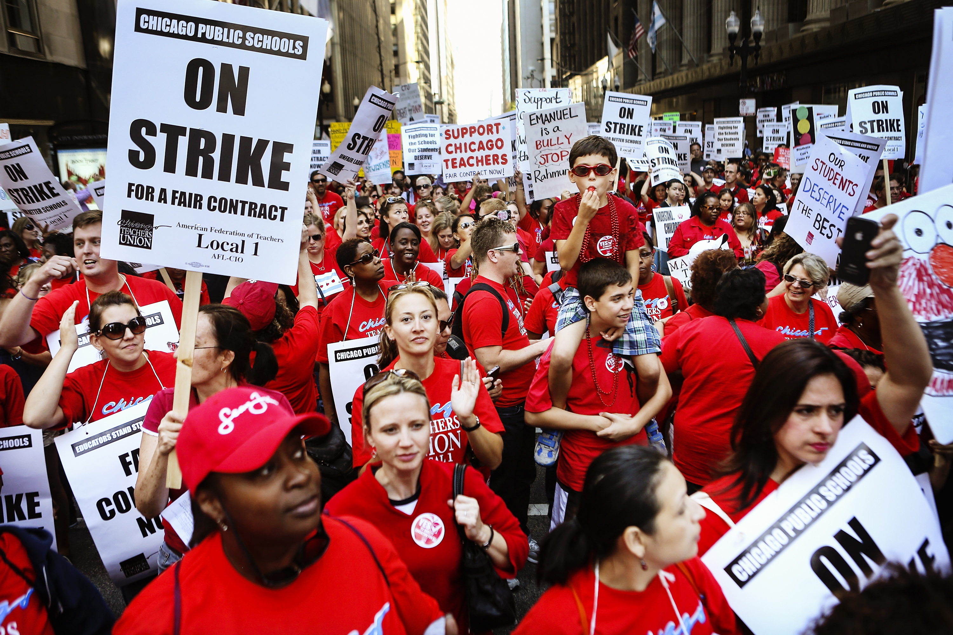
Leaders, Mobilizers, and Activists
Notes:
From Rachel T: Might be good here to make sure they are using the activity sheet in POPs and not the longer reading from the book – with our smaller group however I think we can work the scenario without breakout rooms – or at max 2 rooms for this

Slide 15
Leaders, Mobilzers, Activists
  Who are your identifiable leaders at the local or state level? How does your state facilitate leader identification? What is your role as staff?
How do you see activists operating in your state? Are they elected officers? Heads of constinuencey groups? How do your state or local dentify them? What is your role?
Are mobilizers identified by staff? Local leaders? Statewide organiziations and institutions?
In your work do you use these catagories when you think of the way members/governance interact with each other and with the statewide organizaiton?
        If not, would thinking about these are differing skill sets help you?
Notes:
Rachel

Slide 16
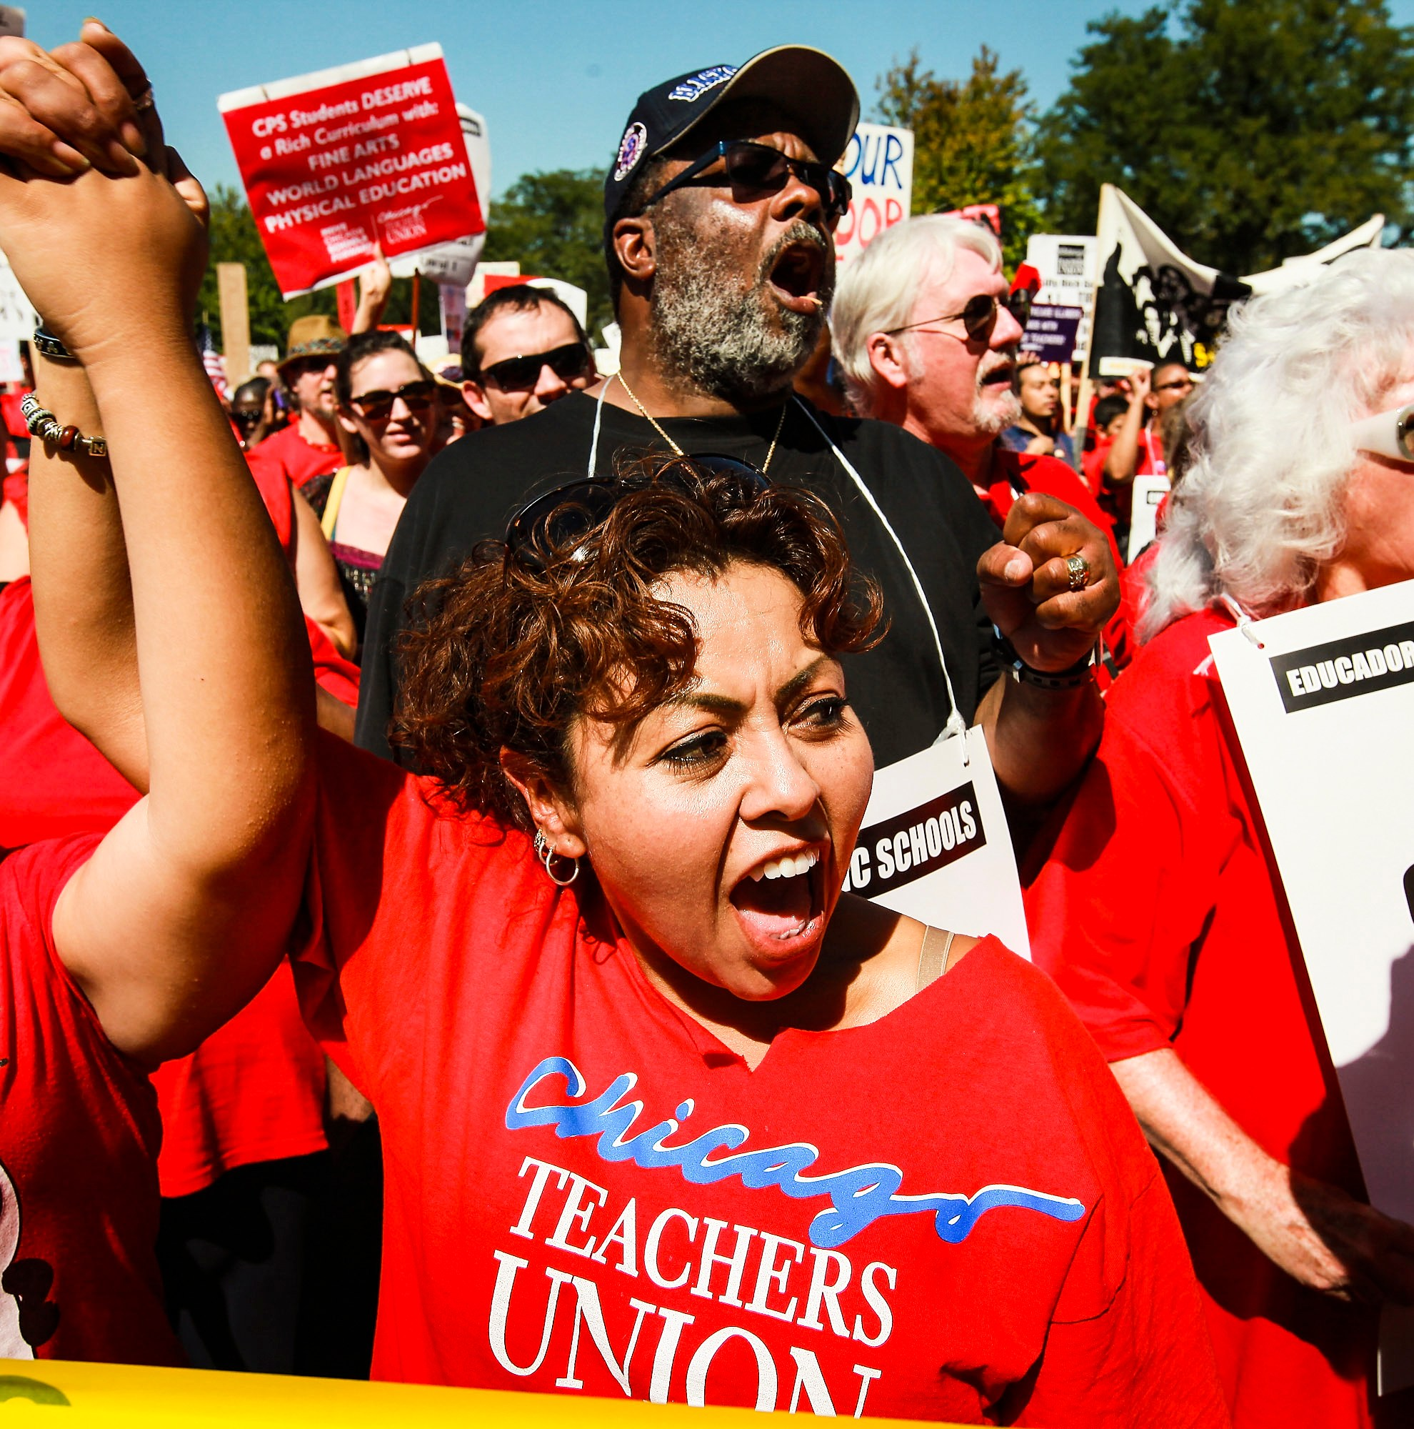
How do we win more?
Notes:
Rachel

Slide 17


Slide 18
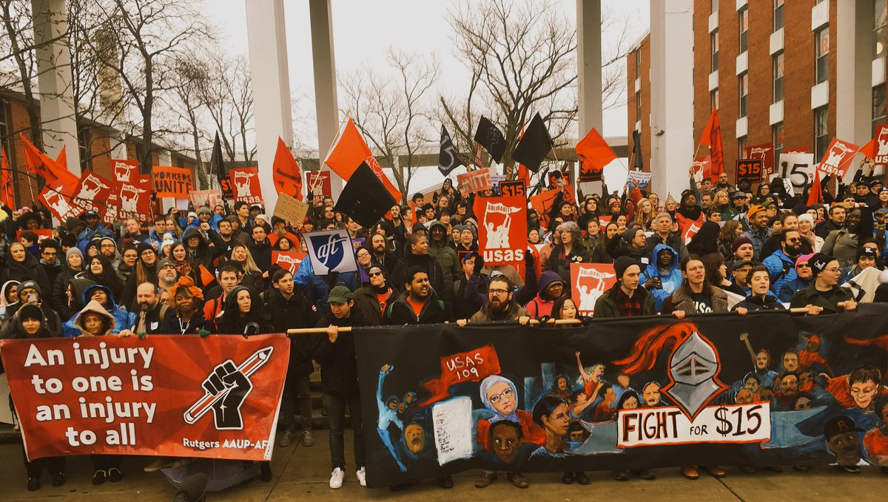
Why could Bargaining for the Common Good be a strategy for expanding leadership and expectations for our unions?
Notes:
Dr. Taraja - There are exciting campaigns building around the country
What we’re going to do today--- what is BCG, why is it important now, and what are examples and explore how we can use this in our campaigns.

Slide 19

7 Elements of a Common Good Campaign
Pages 107-112
  Expand the scope of bargaining beyond wages and benefits
  Go on offense in your campaign by identifying, exposing and challenging the real opposition
  Engage community allies as partners in issue development and the bargaining campaign
  Center racial justice in your demands
  Strengthen internal organizing, membership and
  member engagement
  Leverage capital in our campaigns
  The campaign doesn’t end once the union settles its contract
Notes:
There are these seven elements lifted up from all these campaigns, many are hitting on 1-2 of them, we are going to go into detail later.

Slide 20
Why do we run Common Good Campaigns?
Builds Power through Leaders and Structures from the bottom up
This is the best way for us to WIN more for all!
Unions and community groups share a common powerful opposition, and we need each other in order to win
Unions win more and community groups win bigger and broader campaigns when we work together in this way
Notes:
Two concrete examples--we will go into more depth throughout this program….

Slide 21

UTLA Bargains for the Common Good
Smaller class size
Hiring of nurses, librarians & counselors
An end to “random searches”
Green space
Immigrant defense fund
Community schools
Charter school cap
Notes:
Some of their common good victories include:
School funding- UTLA, LAUSD and Mayor’s office to jointly advocate for increased county and state funding
Class Size- immediate reduction of 7 students in secondary math and English, and elimination of contract language that previously allowed the district to unilaterally ignore all class size averages and caps. Agreement to reduce class size every year for the next four years.
A nurse in every school, with an agreement to hire 150 full time nurses
Community Schools-- by June 2019, the district will designate 20 community schools, and by June 2020 an additional 10
Privatization/Charter Cap
Librarians-- commitment to hire 82 new librarians
Counselors-- commitment to hire 17 additional counselors
Testing- joint UTLA/LAUSD committee tasked with developing a plan to reduce the amount of assessments by 50%
“Random” Searches- pilot program that exempts schools from administering random searches in 28 schools
Green Space-- joint task force tasked with developing a plan to increase green space
Immigrant Defense Fund-- district will provide a dedicated hotline and attorney for immigrant families

Slide 22
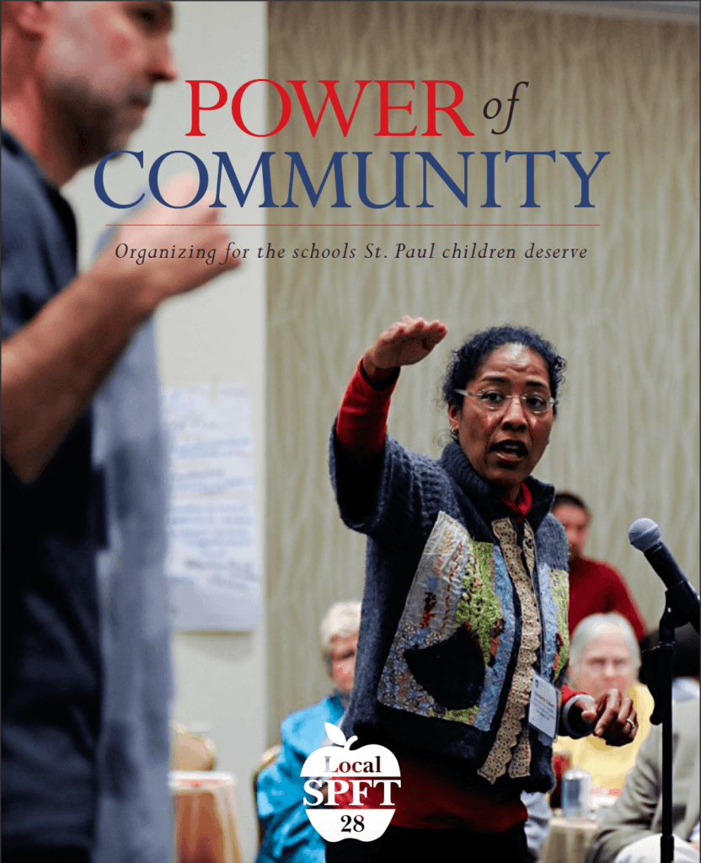
St. Paul Federation of Teachers
Smaller class sizes
Family engagement
Placing teaching before testing
Wage and benefit increases
Culturally relevant education
High quality professional development for teachers
No foreclosures

Slide 23
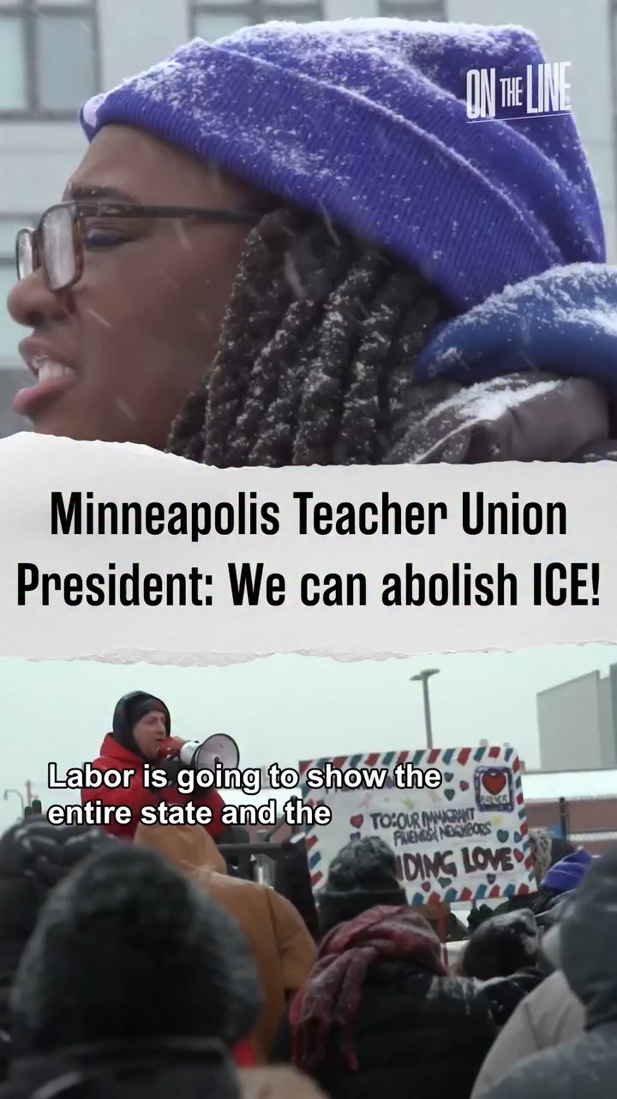
Minneapolis Teachers

Slide 24
Group Discussion: Resource Guide pages 9-45
What stands out to you about this approach?
What are the opportunities that this strategy
COULD provide your affiliates?
What are the potential challenges this strategy
could provide your affiliates?
Notes:
Depending on NUmber of participants we can make breakout rooms here if needed fro sie – two rooms perhaps for 5 ish people in each room – This is mentioned as ten minutes originally but I would give people up to 15 given the volume of pages

Slide 25
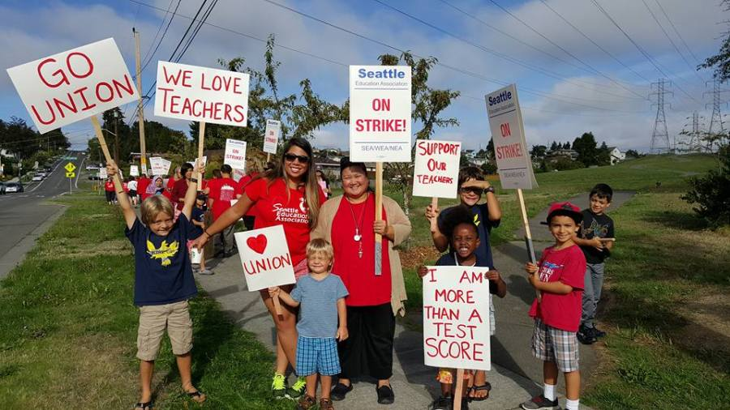
What is your role?
Notes:
24-31

Slide 26

What do we mean… Pages 248-251
Advocacy
“Advocacy is the work of creating change through the actions of professionals or technical experts—lobbyists, pollsters, lawyers, communication specialists, researchers. Advocacy relies on the expertise, status, and know-how of these groups of people to make change. Advocacy usually happens in a closed-door room; ordinary people play a small to nonexistent role in its efficacy. Advocacy has become a dominant strategy for unions and liberals.”

Slide 27
What do we mean… Pages 248-251
Mobilizing
“Mobilizing, by contrast, activates an already-convinced membership. Mobilizing encourages those who already support a cause or a mission to take action to defend their belief—for example, by attending a protest, wearing a button, or signing a petition.”

Slide 28
What do we mean… Pages 248-251
Organizing
“To organize is to build mass support and strength among ordinary people. Organizing draws its power from working people’s biggest strength: our numbers. The work of organizing is systematic and rigorous: It requires connecting with every single worker in a shop, every educator in a building, every building in a district. At its core, it asks people to understand their own agency and to make choices about how they will exercise it.”

Slide 29

Advocacy, Mobilizing, Organizing
Pg 248-251 Book or Pg 49 Resource Guide
Advocate
Mobilizer
Organizer
Notes:
Ellen
20 Mins Entry activity – 4 Corners of Union Work
How do you think your locals primarily view your role with them? Social Justice Advocate, Contract Manager and Problem Solver, Leadership Coach and Developer, Campaign/Organizing Leader –
Prompts -Once at your charts, what are the opportunities that this view could have for moving towards a win and what are the challenges that this view could have?
Where is our power?
Contract Negotiation, Grievances, Member Engagement, Staff Led Programs
10 MIN debrief – so now what?

Slide 30
Group Discussion:
Advocate
Select the compass point that best answers where you are for each of the following questions -
What would your role do you see yourself in?
What role does your manager, leadership, locals expect you to play?
What tensions exist because of discrepancies between your role and your expected role? How do you deal with these tensions?
What would your role look like if you were working with a local focused on Social Justice Unionism?
Mobilizer
Organizer​
Notes:
Ellen

Slide 31
What changes would you need in your work to be able to cultivate more social justice unionism among members or in locals ?
How do you think your locals primarily view your role?
Social Justice Advocate
Contract Manager and Problem Solver
Leadership Coach and Developer
Campaign/Organizing Leader
Notes:
Ellen
20 Mins Entry activity – 4 Corners of Union Work
How do you think your locals primarily view your role with them? Social Justice Advocate, Contract Manager and Problem Solver, Leadership Coach and Developer, Campaign/Organizing Leader –
Prompts -Once at your charts, what are the opportunities that this view could have for moving towards a win and what are the challenges that this view could have?
Where is our power?
Contract Negotiation, Grievances, Member Engagement, Staff Led Programs
10 MIN debrief – so now what?

Slide 32
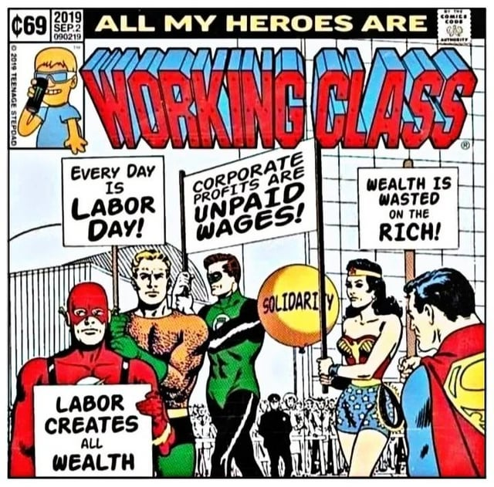
What is the role of staff?
What are the types of work Staff people are engaged in that support and cultivate the types of leaders and structures in this book?
What changes in your work/expectations would you (and your leader/manager) need to make room for to cultivate social justice unionism as presented in this book?

Slide 33
Teacher Unions and Social Justice:
Upcoming Sessions 3 -4
Wednesday, January 28, 2026 @ 2:30PM Eastern
Thursday, January 29, 2026 @ 2:30PM Eastern

Slide 34
Get Your Copy of the Book:
Teacher Unions and Social Justice
Send an Email: Shephardallent@ohea.org
Include:
  Name
  State Affiliate
  Address
  How do you plan to use this resource in your work?

Slide 35
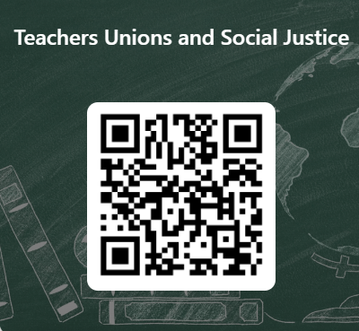
Teacher Unions and Social Justice
This learning event was designed to provide a foundational experience of the key concepts and methods needed to move members towards organizing around social justice issues and bargaining for the common good. The purpose of the four-session series is to both model a way to begin this work and build an urgency within you to continue this work.
Please let us know how we did.

