Slide 1
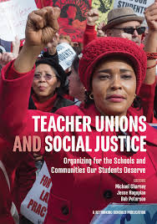
Teacher Unions and Social Justice
Session 3 of 4: Testing leaders, structures, and tactics
that result in power building
Notes:
From Ellen, She, Her, Mentor Coach to Everyone:
I think the history, and WHAT is Social Justice, and the Tension between teachers wanting to be "Of Service" and needing "Good wages" are keepers for day 1.

Slide 2

Teacher Unions and Social Justice
Rename Yourself in Zoom
  Please include:
    First and Last Name
    Pronouns
    State
Example: Ceaser Chavez(he/him)-Arizona
What are you looking forward to in 2026?

Slide 3
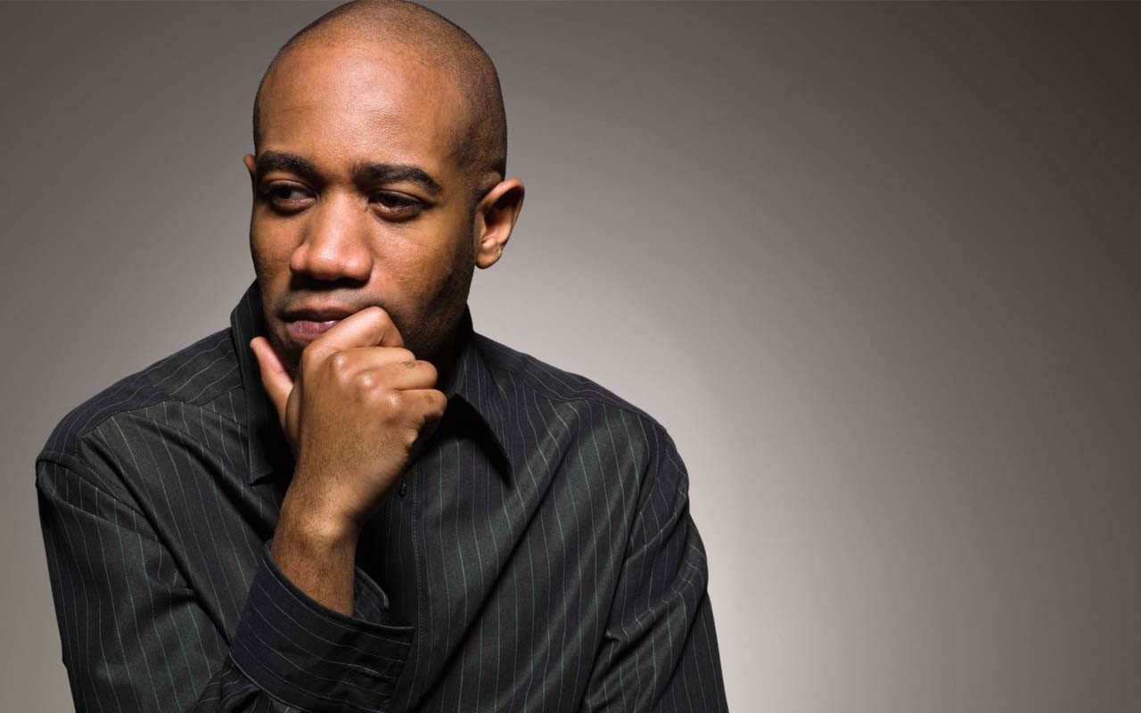
Entry Activity
What are the characteristics of a social justice unionism campaign? (answers in the chat)

Slide 4
Teacher Unions and Social Justice
By attending this training, you confirm that you are either an NEA affiliate staff person or NEA member in good standing. The information you receive here is only for your use in your capacity as an NEA affiliate staff person or NEA member.
This presentation and its contents are confidential and may not be further distributed or passed on to any other person or published or reproduced, in whole or in part, by any medium or in any form, for any purpose unless written consent has been provided by Ellen Holmes. Audio/video recording, copying of slides, and the use of AI note-taking tools are prohibited without the written consent from Kyle Serrette. Violation of these terms may result in legal action.

Slide 5
NEA Standards of Conduct
NEA has adopted a Standard of Conduct Policy to ensure that all of our gatherings are welcoming to and free from discriminatory, harassing, or otherwise unacceptable behavior. Discrimination or harassment based on race, color, ethnicity, religion, sex, age, national origin, sexual orientation, disability, gender identity, or expression, or any other characteristic protected by law will not be tolerated. If you have experience any discriminatory or harassing behavior, please report the incident by emailing Ron "Duff" Martin (rmartin@nea.org) and Gladys Marquez (gmarquez@nea.org). Thank you for your commitment to ensuring a positive event for all.

Slide 6
Honoring This Space
We begin by acknowledging that through a history of colonization and brutality, we are currently on the traditional lands stewarded by generations of indigenous people.
We honor these indigenous people, all elders, past, present, and emerging. We are called to learn and share these learnings about this tribal history, culture, and contributions that have been suppressed in the telling of the story of what we now call the United States of America.

Slide 7

Advocacy, Mobilizing, Organizing
Pg 248-251 Book or Pg 49 Resource Guide
Advocate
Mobilizer
Organizer
Notes:
Ellen
20 Mins Entry activity – 4 Corners of Union Work
How do you think your locals primarily view your role with them? Social Justice Advocate, Contract Manager and Problem Solver, Leadership Coach and Developer, Campaign/Organizing Leader –
Prompts -Once at your charts, what are the opportunities that this view could have for moving towards a win and what are the challenges that this view could have?
Where is our power?
Contract Negotiation, Grievances, Member Engagement, Staff Led Programs
10 MIN debrief – so now what?

Slide 8
Group Discussion:
Advocate
Select the compass point that best answers where you are for each of the following questions -
What would your role do you see yourself in?
What role does your manager, leadership, locals expect you to play?
What tensions exist because of discrepancies between your role and your expected role? How do you deal with these tensions?
What would your role look like if you were working with a local focused on Social Justice Unionism?
Mobilizer
Organizer​
Notes:
Ellen

Slide 9
What changes would you need in your work to be able to cultivate more social justice unionism among members or in locals ?
How do you think your locals primarily view your role?
Social Justice Advocate
Contract Manager and Problem Solver
Leadership Coach and Developer
Campaign/Organizing Leader
Notes:
Ellen
20 Mins Entry activity – 4 Corners of Union Work
How do you think your locals primarily view your role with them? Social Justice Advocate, Contract Manager and Problem Solver, Leadership Coach and Developer, Campaign/Organizing Leader –
Prompts -Once at your charts, what are the opportunities that this view could have for moving towards a win and what are the challenges that this view could have?
Where is our power?
Contract Negotiation, Grievances, Member Engagement, Staff Led Programs
10 MIN debrief – so now what?

Slide 10

Today’s Agenda
What is required in social justice campaigns?
Exploring Cases of Transformation and Agency
Assessing Readiness

Slide 11
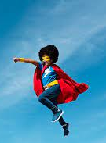
What is THE staff role?
What are the types of work Staff people are engaged in that support and cultivate the types of leaders and structures in this book?
What changes in your work/expectations would you (and your leader/manager) need to make room for in order to cultivate social justice unionism as presented in this book?

Slide 12
What is Required in Social Justice Campaigns?
Notes:
Josh

Slide 13
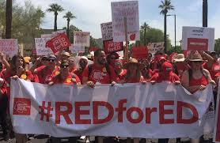
Revitalized Union Movement – pg. 239-240 Book
“Social Justice Unionism is an organizing model that calls for the radical boost in internal union democracy and increased member participation. This contrasts to a business model that is so dependent on staff providing services that it disempowers members and concentrates power in the hands of a small group of elected leaders and/or paid staff. An organizing model, while still providing service to members, focuses on building union power at the school level in alliance with parents, community groups, and other social movements.
Three components of social justice unionism are like the legs of a stool. Unions need all three to be balanced and strong:
  We organize around bread and butter issues.
  We organize around teaching and learning issues to reclaim our profession and our classrooms.
  We organize for social justice in our community and our curriculum. “

Slide 14
Conversation
15 mins - Pg 2 Resource Guide
Consider the following “requirements” for the Social Justice Unionism Organizing Model
    Internal Union Democracy
    Increased Member Participation
    Building Power at the School Site Level in Alliance with Parents, Community Groups, and Social Movements
What do each of those look like and what are the implications for you as you do your work?
To what extent do these exist in the locals you work with?
Notes:
Introduce by asking what are social justice issues. Ask for examples

Slide 15

Lessons from the UTLA Strike pg. 255
“As word of our new mission spread, we attracted top-notch staff with organizing and campaign experience to work at UTLA. At the same time, we undertook the very difficult process of letting go of staff members who could not buy in to our new union vision. While this process was sometimes painful, we learned from allies around the country willing to share their experiences, that it would be a mistake not to clean house from the start. The talent and skills of our new staff have been a tremendous asset in building our union’s capacity and power.”

Slide 16
Exploring Cases of
Transformation and Agency

Slide 17

Transformation of Teachers Unions
Transactional - a trade such as dues for services
Transformational - an interaction that changes those coming together such as how a community views the union after partnering on a tactic

Slide 18
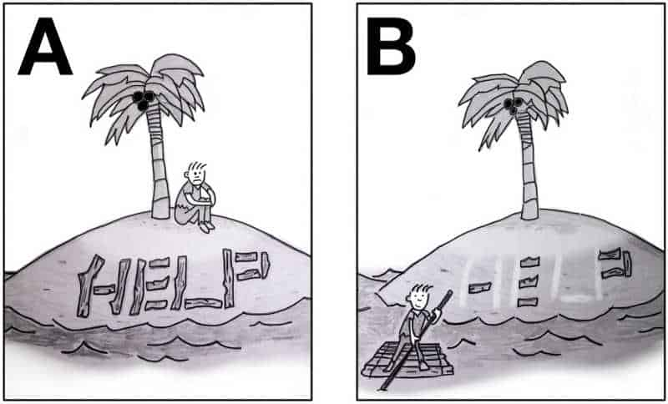
Agency within Teachers Unions pg. 7 Resource Guide
Agency is the ability for an individual to decide they can act.
Structures and Structure tests are really a technical way of thinking about whether individuals have developed their sense of agency to the point where they feel they can do what is needed to win the fights they engage in.

Slide 19
Structure Test Chat -
Pg 423 Book (pg 8 Resource Guide)
What do you notice about the table in general?
What do you notice about the column on the left?
What is the role of the staff person?
Notes:
Rachel

Slide 20
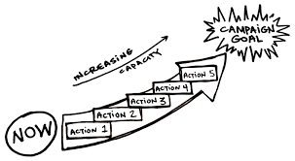
Case Studies: A Deeper Dive
NCAE: p. 227 (It's Not Magic, It's Organizing!)
Arizona: p. 189 (You Need Rank and File to Win)

Slide 21
Social Justice Wins
Pg 10 Resource Guide
Zoom Room Discussion
What are the key issues that this story “wins” ?
What are the ways that they thought of leaders and structures? How did this transform their union?
What are the small steps along the way (tactics or structure tests) that were put in place?
What do you think are the specific roles that staff played in this story?

Slide 22
Are you ready? Let’s Assess

Slide 23

Self-Assessment Tool - Pg 19 Resource Guide
Social Justice Unionism Organizing Strategy Readiness Assessment
To determine readiness for using a Social Justice Unionism Organizing Strategy, locals should assess and reflect on four categories: general readiness and landscape, community/parent relationships, internal organizing capacity, and bargaining status. For each of the four categories below rate each readiness descriptors with a 1-4 in the small boxes, then use the larger box to do a brief SWOT reflection.
1 – Not yet
2 – Basic Understanding and Planning
3– Emerging Implementation
4 – In Place and Proven

Slide 24
Self-Assessment Debrief
How would you use this tool?
When using this tool with leaders, who might take a frank discussion about this tool personally, what kind of privilege might you need to consider? (Yours or theirs)
What did you learn about this tool?
What is your role in this self-assessment?

Slide 25
Taking you Home

Slide 26
What is THE staff role?
What are the types of work Staff people are engaged in that support and cultivate the types of leaders and structures in this book?
What changes in your work/expectations would you (and your leader/manager) need to make room for in order to cultivate social justice unionism as presented in this book?

Slide 27
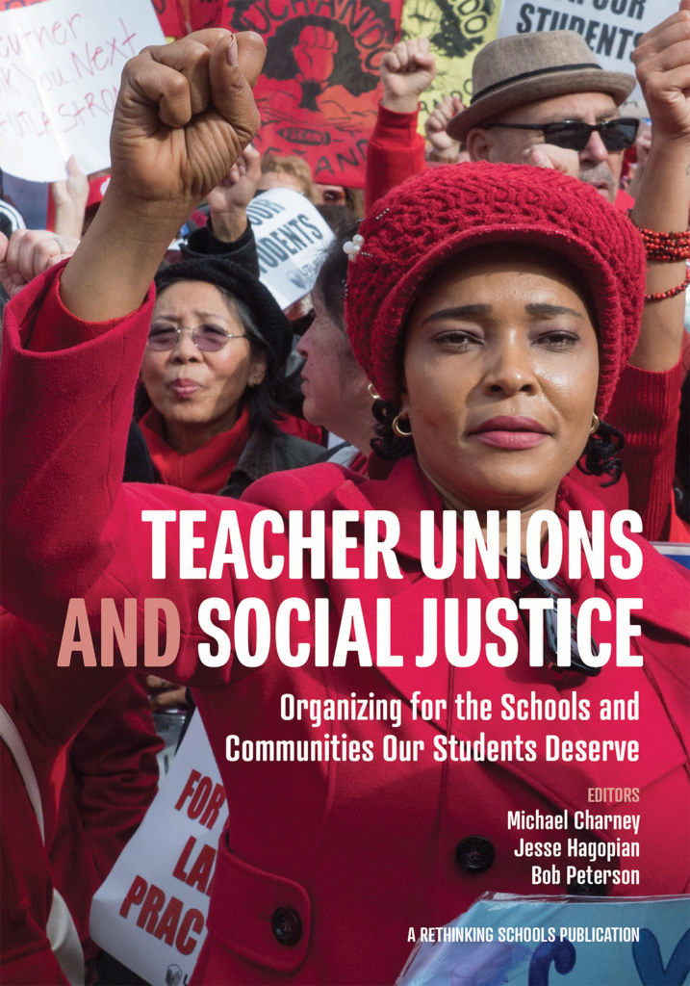
Get Your Copy of the Book:
Teacher Unions and Social Justice
Send an Email: Shephardallent@ohea.org
Include:
  Name
  State Affiliate
  Address
  How do you plan to use this resource in your work?

Slide 28
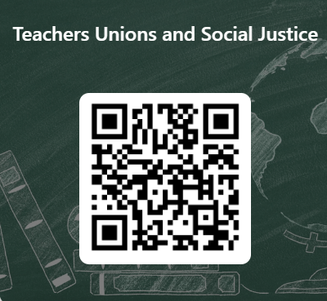
Teacher Unions and Social Justice
This learning event was designed to provide a foundational experience of the key concepts and methods needed to move members towards organizing around social justice issues and bargaining for the common good. The purpose of the four-session series is to both model a way to begin this work and build an urgency within you to continue this work.
Please let us know how we did.

Slide 29

Ending it Right
Next (and Final) Meeting
Thursday, January 29, 2026
2:30PM EST

