Slide 1
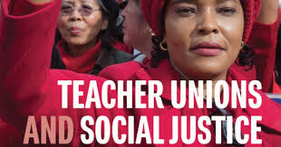

-
Session 4
Using Internal and External Structures to Fight Systems of Injustice

Slide 2
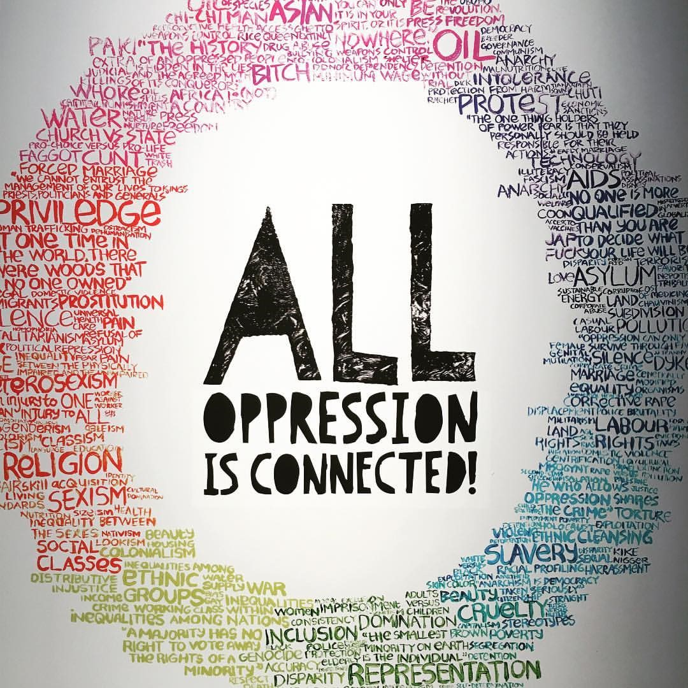
Zoom and Chat Window Entry Activity
Rename your zoom window as needed.
How are systems of oppression actively working against public schools in your state?

Slide 3

Teacher Unions and Social Justice
By attending this training, you confirm that you are either an NEA affiliate staff person or NEA member in good standing. The information you receive here is only for your use in your capacity as an NEA affiliate staff person or NEA member.This presentation and its contents are confidential and may not be further distributed or passed on to any other person or published or reproduced, in whole or in part, by any medium or in any form, for any purpose unless written consent has been provided by Ellen Holmes. Audio/video recording, copying of slides, and the use of AI note-taking tools are prohibited without the written consent from Kyle Serrette. Violation of these terms may result in legal action.
Notes:
Ellen

Slide 4
NEA Standards of Conduct
NEA has adopted a Standard of Conduct Policy to ensure that all of our gatherings are welcoming to and free from discriminatory, harassing, or otherwise unacceptable behavior. Discrimination or harassment based on race, color, ethnicity, religion, sex, age, national origin, sexual orientation, disability, gender identity, or expression, or any other characteristic protected by law will not be tolerated. If you have experience any discriminatory or harassing behavior, please report the incident by emailing Ron "Duff" Martin (rmartin@nea.org) and Gladys Marquez (gmarquez@nea.org). Thank you for your commitment to ensuring a positive event for all.
Notes:
Ellen

Slide 5

Honoring This Space
We begin by acknowledging that through a history of colonization and brutality, we are currently on the traditional lands stewarded by generations of indigenous people. We honor these indigenous people, all elders, past, present, and emerging. We are called to learn and share these learnings about this tribal history, culture, and contributions that have been suppressed in the telling of the story of what we now call the United States of America.

Slide 6

Today’s Agenda
Today’s Agenda
Systems of Injustice
Standardized Testing
Financialization
Privatization
The Push to Dismantle Public Schools
Bringing it All Together

Slide 7
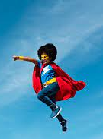
What is THE staff role?
What are the types of work Staff people are engaged in that support and cultivate the types of leaders and structures in this book?
What changes in your work/expectations would you (and your leader/manager) need to make room for in order to cultivate social justice unionism as presented in this book?

Slide 8
Izaak
The Oppression of Standardized Testing

Slide 9
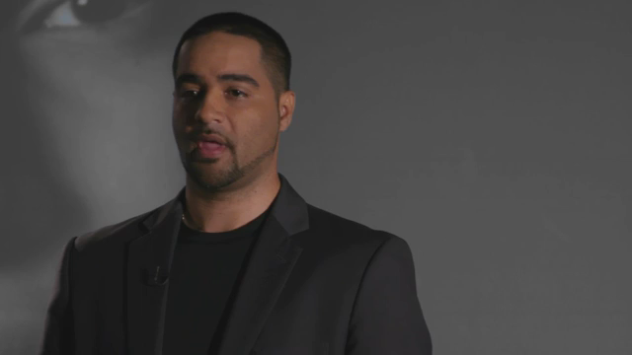
Standardized Testing

Slide 10

The White Fathers of Standardized Testing
Alfred Binet developed intelligence tests as diagnostic tools to detect learning disabilities.
Carl Brigham, Psychologist and Eugenicist wrote that African Americans were on the low end of the racial, ethnic, and cultural spectrum. Testing, he believed, showed the superiority of “the Nordic race group” and warned of the “promiscuous intermingling” of new immigrants in the American gene pool. The education system he argued was in decline and "will proceed with an accelerating rate as the racial mixture becomes more and more extensive.”
Lewis Terman, of Stamford, relied on Binet’s work to produce today’s standard IQ test, the Stanford-Binet Intelligence Tests.During World War I, these standardized tests helped place 1.5 million soldiers in units segregated by race and by test scores. The tests were scientific yet they remained deeply biased, according to researchers and media reports. In 1917, Terman and a group of colleagues were recruited by the American Psychological Association to help the Army develop group intelligence tests and a group intelligence scale. Army testing during World War I ignited the most rapid expansion of the school testing movement.

Slide 11
"To tell the truth about standardized tests is to tell the story of the eugenicists who created and popularized these tests in the United States more than a century ago. We still think there’s something wrong with the kids rather than recognizing their something wrong with the tests. Standardized tests have become the most effective racist weapon ever devised to objectively degrade Black and Brown minds and legally exclude their bodies from prestigious schools.”
-- Ibram X. Kendi

Slide 12
Key Ideas
Since their inception a century ago, standardized tests have been instruments of racism.
Students of color, particularly those from low-income families, have suffered the most from high-stakes testing in U.S. public schools.
The clearest prediction of low test scores in a school is the median property value of homes around

Slide 13
System of Standardized Testing -- RG Pg. 14
Who are the Power Holders?
Who is being oppressed?
How are the unjust policies and systems being used?
What is the overall impact on our society?
How are these injustices linked to the work of your Union?

Slide 14
Financialization, Privatization, and the Push to Dismantle Public Schools
RG p. 2-11, 17-24

Slide 15
Financialization is a process whereby financial markets, financial institutions, and financial elites gain greater influence over economic policy and economic outcomes.

Slide 16
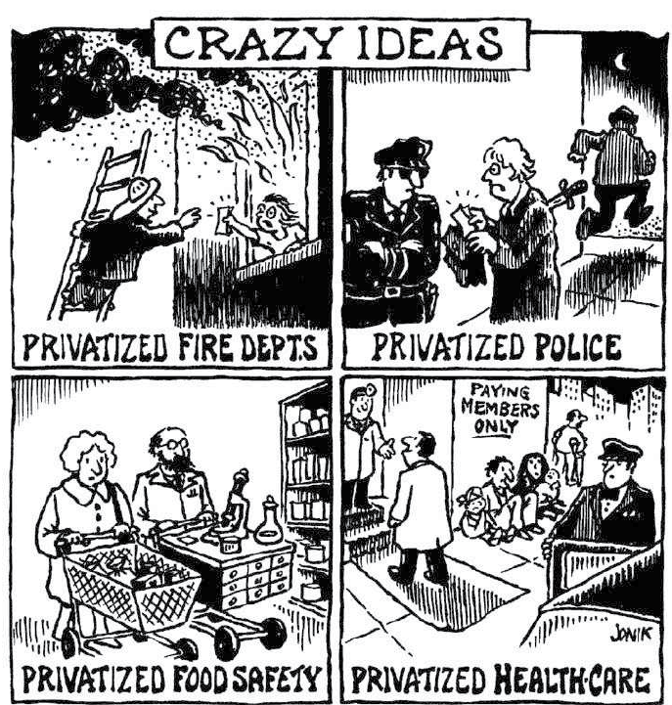
Financialization converts publicly provided goods into privately "financed goods".
Who benefits?

Slide 17
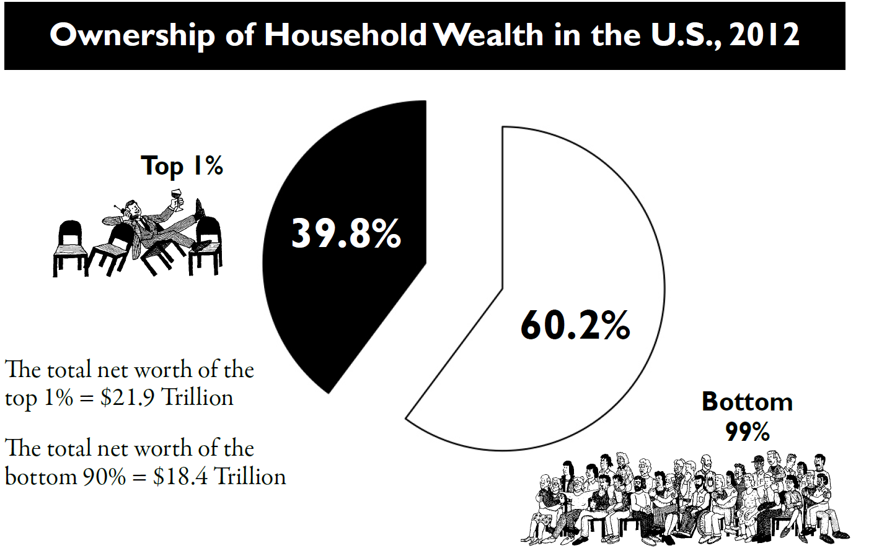

Slide 18

Key Points
Our system is designed to extract wealth and power from the lower levels of our system and move it to the top.
Financialization benefits the wealthiest.

Slide 19
What is the difference between income and wealth?

Slide 20

Income and Wealth
Income is the revenue that a person can bring into their household.
Wealth is anything that can be liquidated and/or passed from generation to generation - minus debt.

Slide 21
How are we doing?
What characterizes these two time periods in America?
Politics, Events, Union
1947-1979
1980-2014

Slide 22
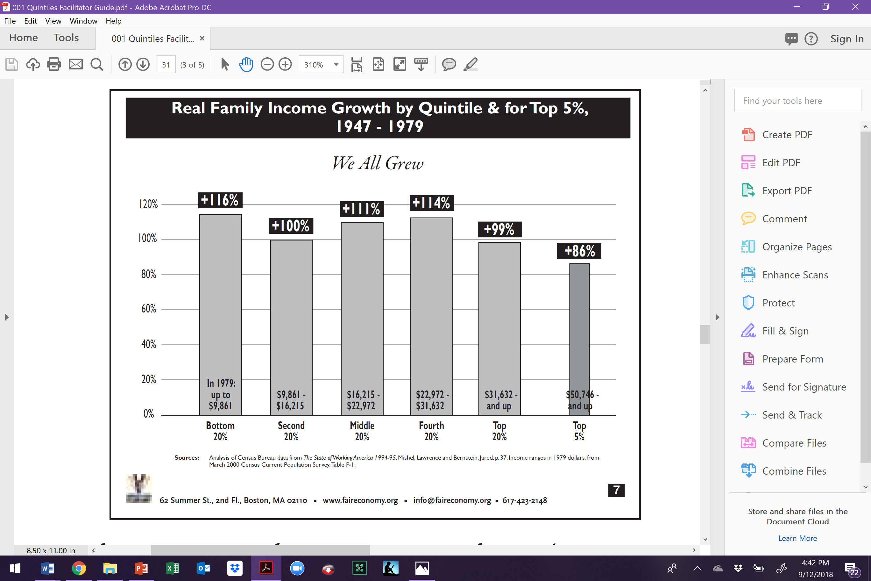

Slide 23
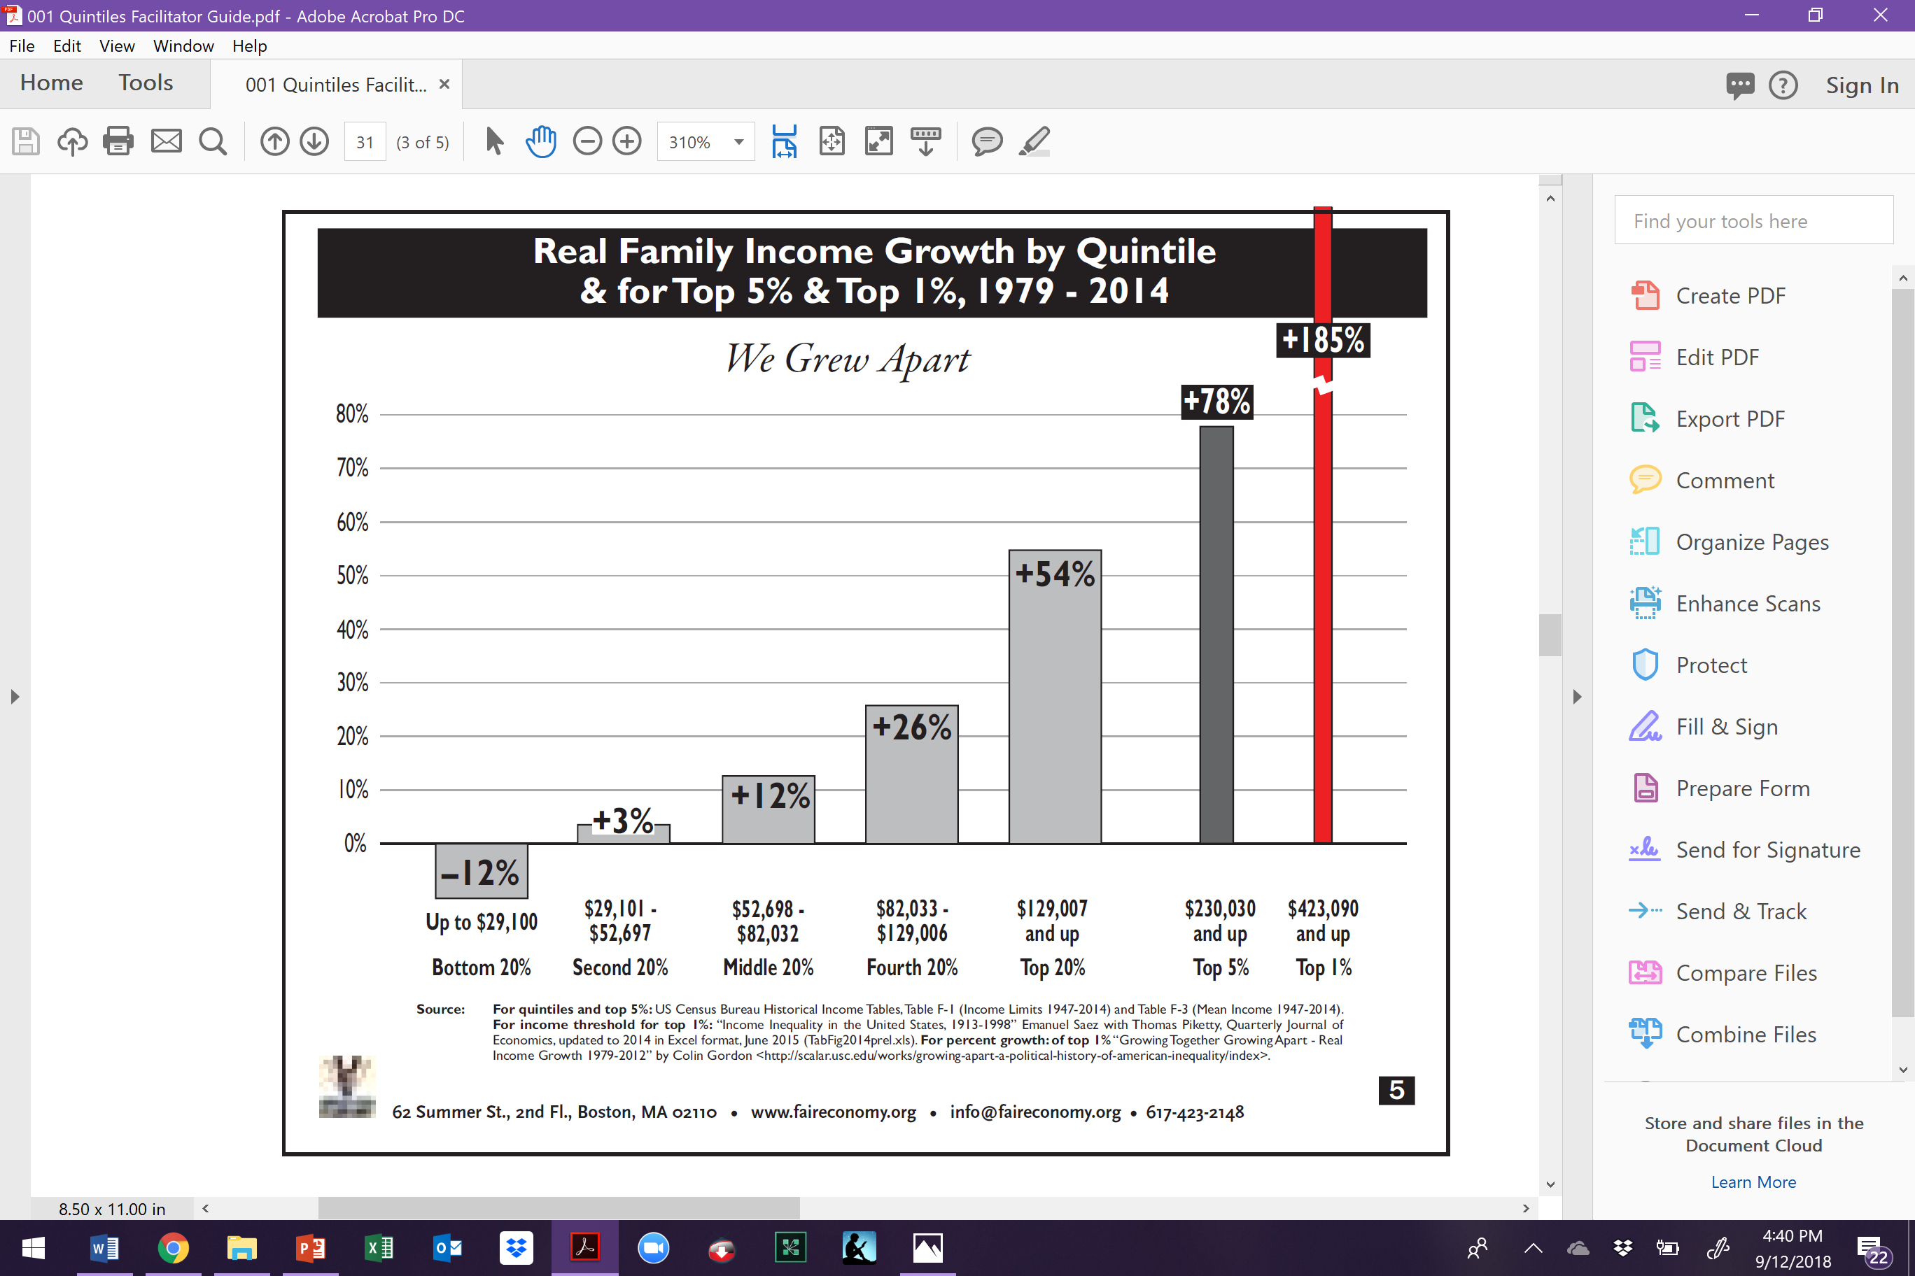

Slide 24
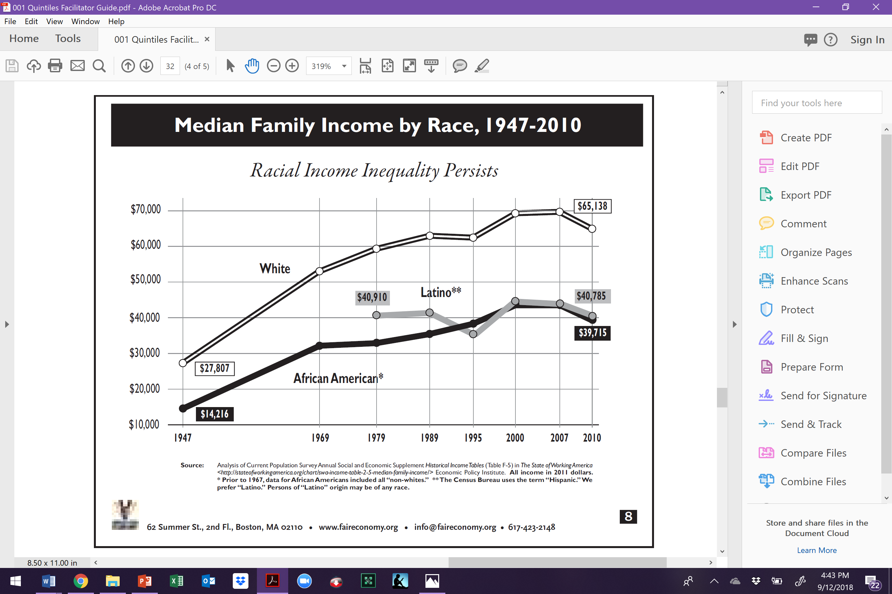

Slide 25
Key Points
The systems of income and wealth have been intentionally built to shift power and opportunity away from those in the lowest economic sectors to those in the top.
This is further compounded when you look at the intersection of race and income.

Slide 26
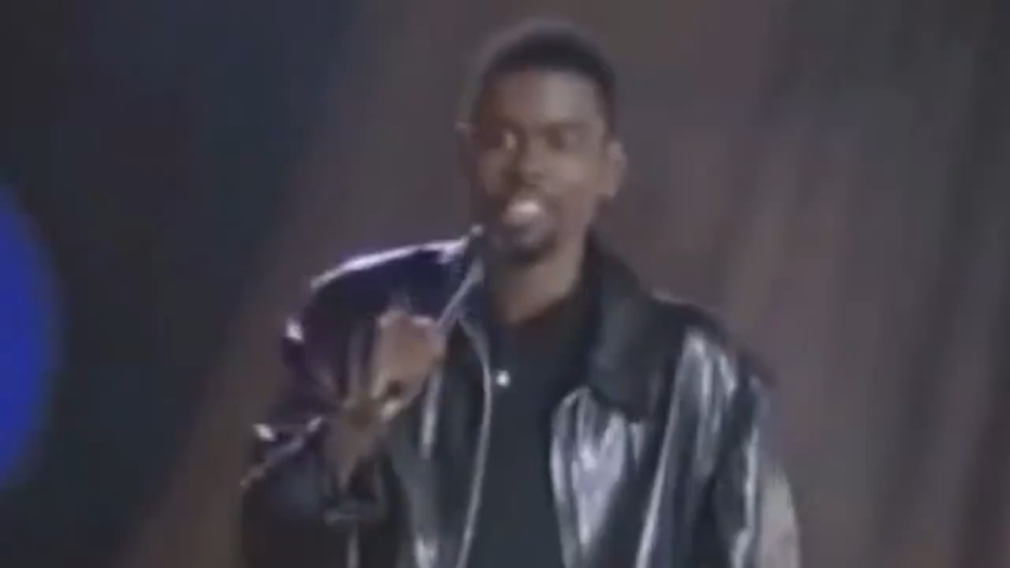
How does a system of structural racism affect school funding?

Slide 27
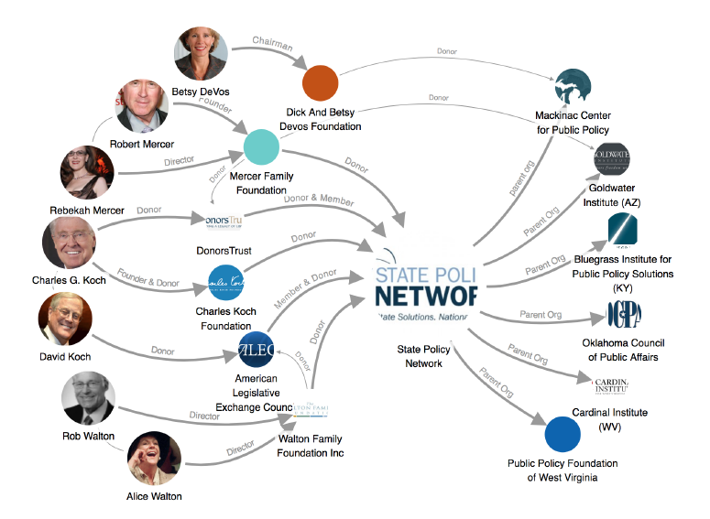

Slide 28
How systems work together to dismantle public schools.
Define High Standards
Design Tests to Measure Standards
Tie Funding to Tests
Cut Funding When Results are not Attained
Repeat Until All Public Schools have Failed
Private Schools, Charter Schools, Vouchers

Slide 29

Privatization

Slide 30

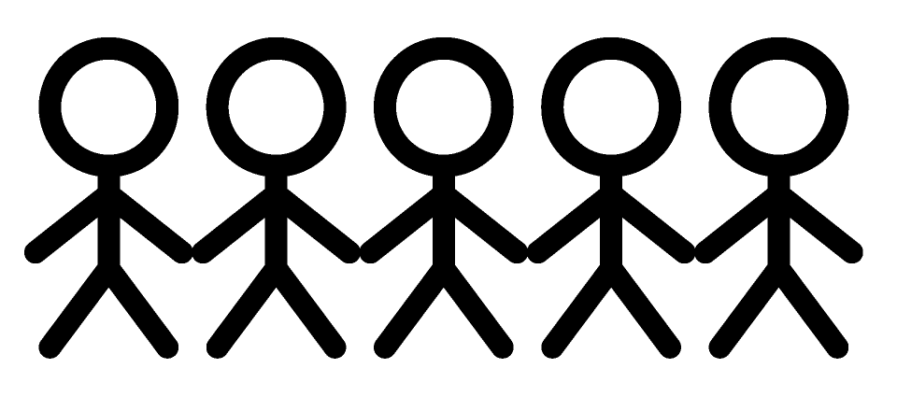
POWER
The ability to create, control, and prevent change.
ORGANIZED PEOPLE + ORGANIZED MONEY

Slide 31
What is THE staff role?
What are the types of work staff people must engage in that support and cultivate the types of leaders and structures that cultivate power-ful Social Justice Unionism?
What changes in your work/expectations would you (and your leader/manager) need to make room for in order to cultivate social justice unionism as presented in this book?

Slide 32
What is THE staff role?
What are the types of work staff people must engage in that support and cultivate the types of leaders and structures that cultivate power-ful Social Justice Unionism?

Slide 33
Key Points
Power comes from organized money or organized people.
It is only by members organizing members, with support from staff, that we can work to combat the systems seeking to dismantle public education and the public good.

Slide 34
Bringing it All Together
A Summary of How We Win

Slide 35
Session 1

Slide 36
7 Components of Social Justice Unionism
Defend the rights of its members while fighting for the rights and needs of the broader community and students.
Recognize that the parents and neighbors of our students are key allies, and build strategic alliances with parents, labor unions, and community groups.
Education unions should also work to unite all staff members at a school. They should build ongoing alliances with a wide range of groups, from other public service unions to the broader labor movement, churches, community and social organizations, advocacy groups, and business and political groups that support public schools.
Put teachers and others who work in classrooms at the center of school reform agendas, ensuring that they take ownership of reform initiatives.
Encourage those who work with children to use methods of instruction and curricula that will promote racial and gender equity, combat racism and prejudice, encourage critical thinking about our society’s problems, and nurture an active, reflective citizenry that is committed to real democracy and social and economic justice.
Forcefully advocate for a radical restructuring of American education.
Aggressively educate and mobilize its membership to fight for social justice in all areas of society.

Slide 37
Session 2

Slide 38
Leaders we Need
Leaders – Trusted and respected by their colleagues in ways that cut across communities of workers- is connected by values and influential relationships with mobilizers, activists, and those not yet part of the work. Get people to move their thinking and take action.
Mobilizers – Connected to communities of workers in ways that are influential – can convene their community. Get people excited to act.
Activists – Supportive and willing to act if invited

Slide 39

Why do we run Common Good Campaigns?
Builds Power through Leaders and Structures from the bottom up
This is the best way for us to WIN more for all!
Unions and community groups share a common powerful opposition, and we need each other in order to win
Unions win more and community groups win bigger and broader campaigns when we work together in this way
Notes:
Two concrete examples--we will go into more depth throughout this program….

Slide 40
Session 3

Slide 41
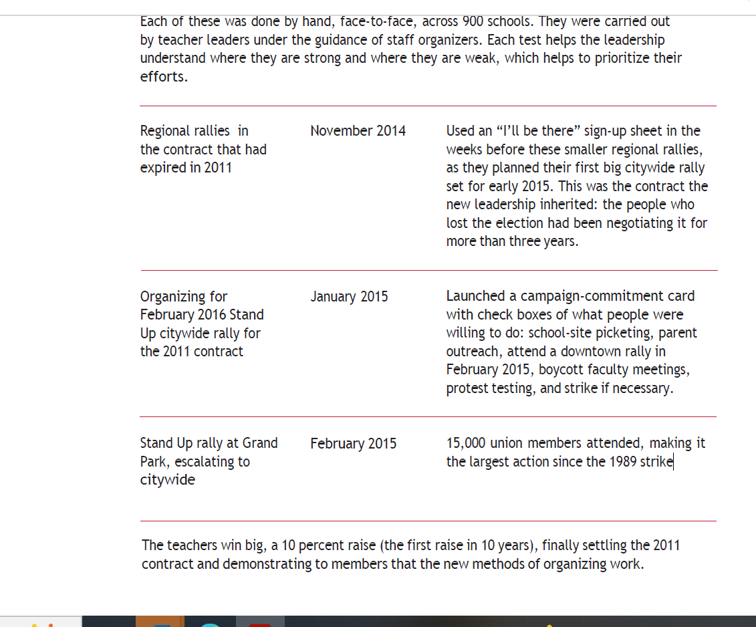
Structure test
p.423 in book

Slide 42
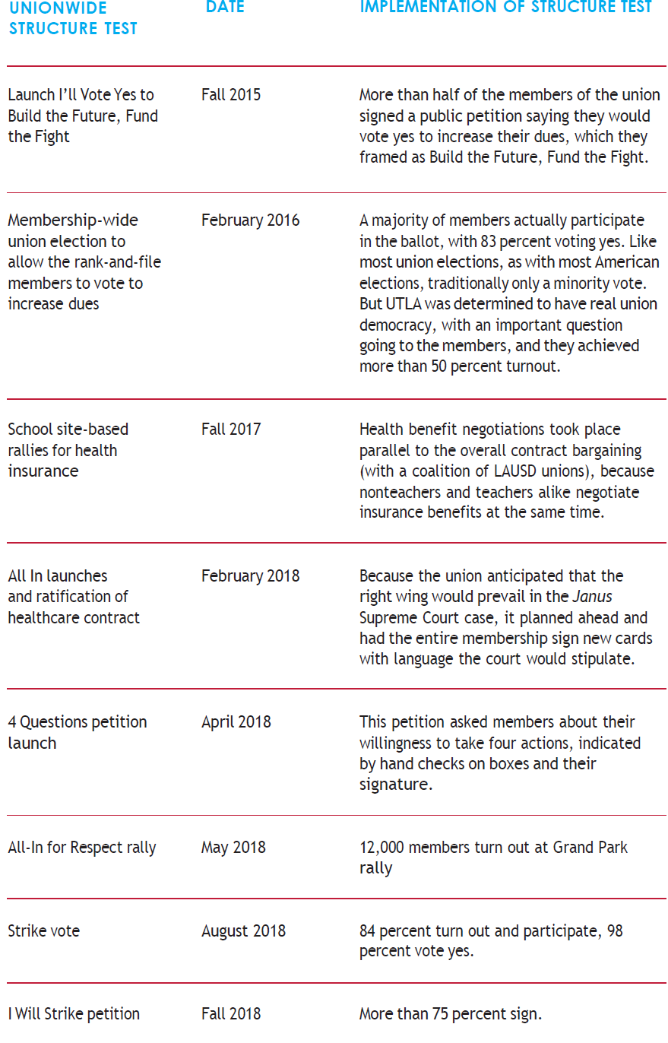

Slide 43
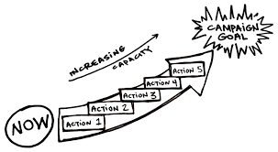
Lessons Learned
The workers, their energy, and their leadership must be at the front of the campaign
Official union leadership and staff must be willing to work with rank and file members AND allow them to have meaningful roles in campaigns
Must make space for rank and file to develop as leaders (training, chance to take risks, space to prove)
Community-centric approach
Democratic organizing (Marshall Ganz and Ella Baker)
Gradual escalation of tactics
Workers have power

Slide 44

Bill Fletcher – 34-41
Public Sector Unions play 3 roles:
1. They defend the interests of their members
2. They must look out for the interests of the community (Fletcher indicates that this has almost become cliché)
3. They must defend the public sector (This is readily understood by unions in other nations but not here)

Slide 45
Bill Fletcher – 34-41
This third role is critical right now. Public sector unions need to articulate a coherent and credible defense of the public sector - to explain the role of the public sector and show why any kind of civilized society must have a public sector. I don't think public sector unions do that very well. As a result, they tend to come across as merely defending the interests of their members.

Slide 46
Clubs Don’t Do Social Justice Unionism
RG p. 12
Unorganized
Club
Union
Fighting Union

Slide 47
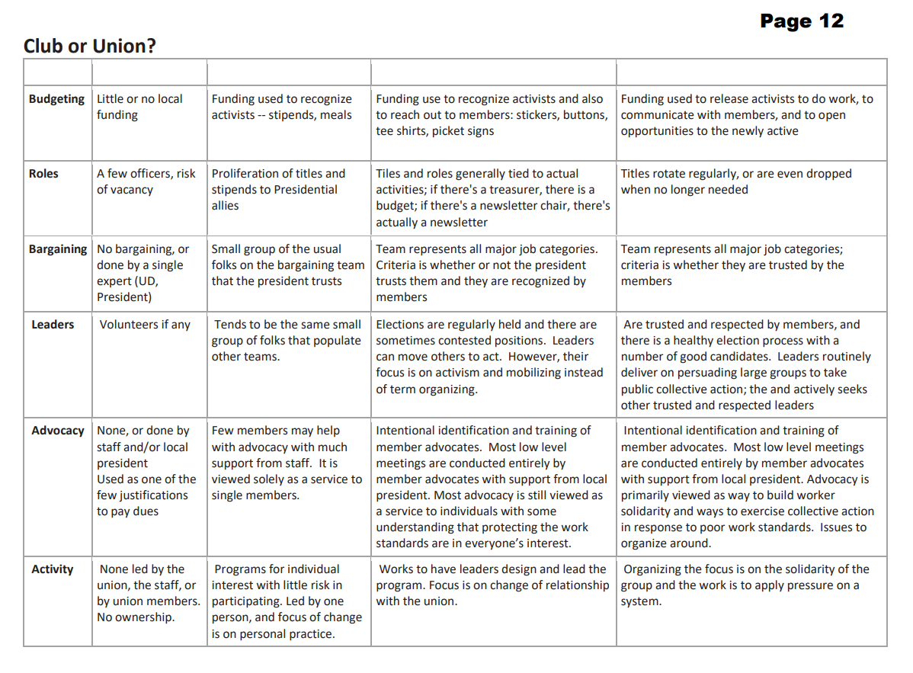
How might you guide a conversation with a leader(s) on:
1. how to fill this out with "realness;" and
2. what next-steps to take after completing?
Zoom Chat

Slide 48
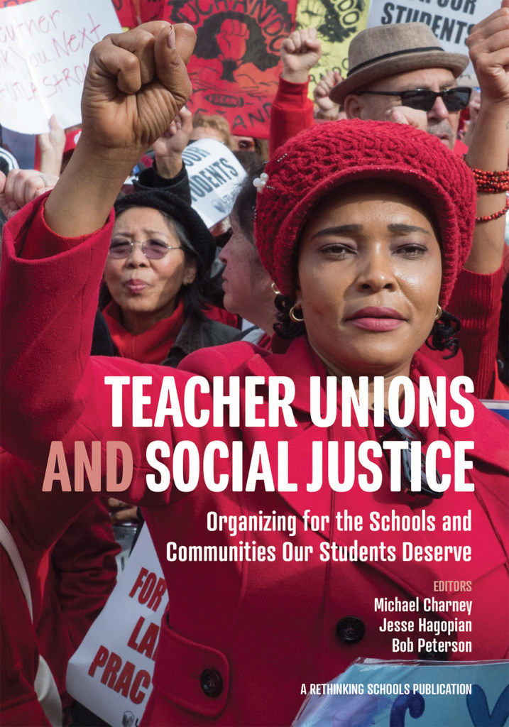
Get Your Copy of the Book:
Teacher Unions and Social Justice
Send an Email: Shephardallent@ohea.org
Include:
  Name
  State Affiliate
  Address
  How do you plan to use this resource in your work?

Slide 49
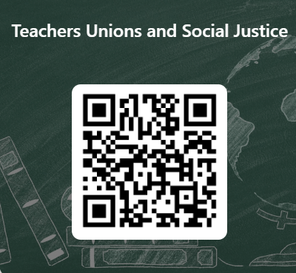
Teacher Unions and Social Justice
This learning event was designed to provide a foundational experience of the key concepts and methods needed to move members towards organizing around social justice issues and bargaining for the common good. The purpose of the four-session series is to both model a way to begin this work and build an urgency within you to continue this work.
Please let us know how we did.

Slide 50
Taking you Home
PDF of slideshows via email:
jessica.minguez@neaalaska.org
Book kerfluffles:
kmedina@nea.org
More opportunities:
nea.org/UD-Org-Support

