Slide 1
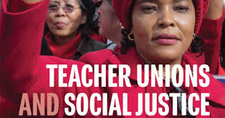

DAY 1

Slide 2
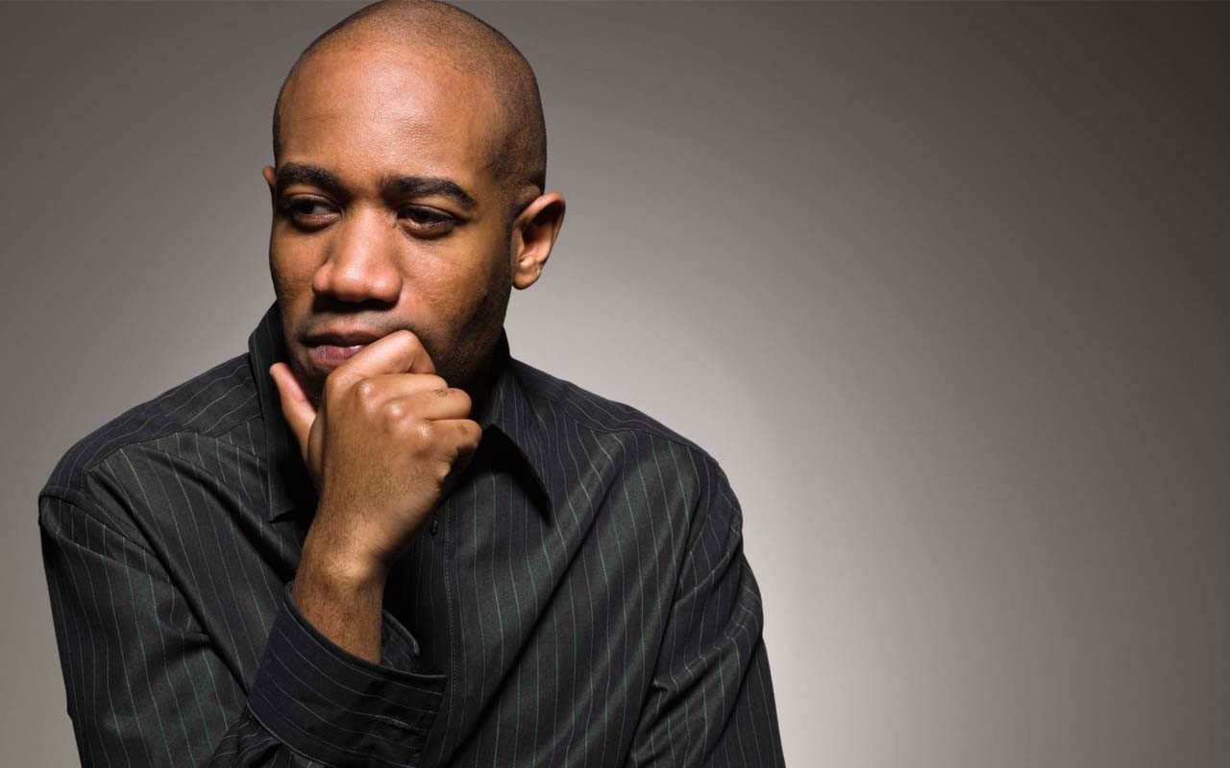
Entry Activity
What do you think Social Justice Unionism looks like?
- Use Sticky Notes and Post on Wall -

Slide 3

Honoring This Space
We begin by acknowledging that through a history of colonization and brutality, we currently reside on and are connecting from the traditional lands stewarded by generations of indigenous people.
We honor these indigenous people, all elders, past, present, and emerging. We are called to learn and share these learnings about this tribal history, culture, and contributions that have been suppressed in the telling of the story of what we now call the United States of America.

Slide 4

3 Day Agenda
Days 1 and 2
7:30-8:30 Breakfast
8:30 Convene
10:15-10:30 Break
12:00- 1:00 LUNCH
2:15-2:30 Break
4:30-5:00 Choice Networking
5:00 Adjourn
Day 3
7:30-8:30 Breakfast
8:30 Convene
11:00-11:15 Break
1:00 Boxed Lunch
1:00-2:00 Choice Networking
2:00 Adjourn

Slide 5

Today’s Outcomes
What is Social Justice Unionism?
What would it take to move to that?
Who are the leaders we need?
What makes a successful campaign?
What is my role as a staff person?

Slide 6

Community Agreements p. 2
Using Self-Awareness and Self-Knowledge
Listening for Understanding
Being Gracious
Staying Engaged
Being Open and Suspend Judgment
Saying “I”- tell your truth
Seeking Discomfort
Reaching Empathy
Expecting Non-Resolution and Non-Closure
*Adapted from “Embracing equity and inclusion”, Annie E. Casey Foundation
Notes:
Community Agreements for Our Time
Awareness and Self-Knowledge
This requires self-knowledge and self-awareness. Self-knowledge allows you to see what causes you pain and conflict and enables you to embrace your contradictions and inconsistencies. It allows the space to work on things about yourself that you are not happy with. In turn, self-knowledge helps to prevent you from projecting your negative aspects onto other people. Bringing your best self also requires that you have a positive attitude, are willing to deeply explore your perspectives and remain open to the perspectives and experiences of others.
Listening for Understanding
Be an active listener. Active listening involves paying full and careful attention to the other person, looking him or her in the eye, avoiding interruptions, reflecting your understanding, clarifying information, summarizing the other person’s perspectives and sharing your own. Remember that most people need time to open up and might not be willing to immediately share their personal stories, hopes, fears and/or concerns.
Being Gracious
Being kind is a vital way of bringing meaning to our own lives, as well as the lives of others. Kindness is about caring genuinely for others around you, wanting the best for them and recognizing in them the same wants, needs, aspirations and even fears that you may have. Being kind and generous allows us to communicate better with others, to be more self-compassionate and to be a positive force in other people’s lives. This includes following the COVID protocols that are in place to protect the health of this learning community.
Stay Engaged
Staying engaged requires you to be morally, emotionally, intellectually and socially involved in the conversation. Staying engaged means that you are listening with curiosity and willing to deepen your understanding. Staying engaged might also require you to sustain the conversation even when it gets uncomfortable or diverted. This also means a commitment to keeping your electronic communications to a minimum with folks not present in this learning community.
Be Open and Suspend Judgment
Listening with an open mind includes being receptive to the influence of others. You can suspend judgment by becoming aware of preconceived notions and listening to everything someone has to say before jumping to conclusions. Most importantly, suspending judgment also means listening to what the speaker has to say for understanding, not just to determine whether the speaker is right or wrong.
Say “I”- tell your truth
Speaking your truth in authentic and courageous conversations about race requires a willingness to take risks. It means that you will be absolutely honest and candid about your own thoughts, feelings, experiences and opinions and not just saying what you perceive others want to hear. Speaking your truth will require you to speak from the “first person” and use “I” statements.
Seek Discomfort
Leaning in to discomfort will require you to let go of racial understandings and stereotypes that you may be holding onto in order to move forward. Leaning in means that you will avoid judgment, assume positive intent and be open to the kernel of wisdom in each individual’s experiences. Leaning in to discomfort will require you to sit through moments of embarrassment, confusion, anxiety and/or fear.
Reaching Empathy
Empathy and compassion allow you to understand the other person’s point of view. When you are empathetic, you are more understanding, patient and kind. Expanding your capacity to feel empathy will also allow others to enter your circle of human concern.
Resolution and Closure
Expect and accept that there may not be closure. It is not likely that you will resolve your personal understanding about race or another person’s racial experience in a single conversation. The more you talk about race with another person, the more you learn and the more they will learn. Authentic and productive conversations about race are continuous and always evolving.
*Adapted from “Embracing equity and inclusion”, Annie E. Casey Foundation

Slide 7

The Basics
Name Tents
Handouts
Logistics

Slide 8
One Revolution Around the Room
Name
Required Pronoun
Native Land if You Know it

Slide 9
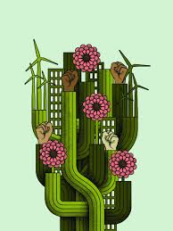
Today’s Agenda
Jessica
Imagine if your union…

Slide 10
Imagine If
13 "Imagine if" statements
In Pairs and Trios gather around 1 statement
With those that have gathered:
Introduce yourself
Share your reaction to the statement you are gathered at
Our Debrief:
“What is something someone said that stuck with you?” (Also, please read your "Imagine if" statement first.)

Slide 11
7 Components of Social Justice Unionism p. 75
Defend the rights of its members while fighting for the rights and needs of the broader community and students.
Recognize that the parents and neighbors of our students are key allies, and build strategic alliances with parents, labor unions, and community groups.
Education unions should also work to unite all staff members at a school. They should build ongoing alliances with a wide range of groups, from other public service unions to the broader labor movement, churches, community and social organizations, advocacy groups, and business and political groups that support public schools.
Put teachers and others who work in classrooms at the center of school reform agendas, ensuring that they take ownership of reform initiatives.
Encourage those who work with children to use methods of instruction and curricula that will promote racial and gender equity, combat racism and prejudice, encourage critical thinking about our society’s problems, and nurture an active, reflective citizenry that is committed to real democracy and social and economic justice.
Forcefully advocate for a radical restructuring of American education.
Aggressively educate and mobilize its membership to fight for social justice in all areas of society.

Slide 12
How Near and How Far?
Near
Far
Component 1

Slide 13
How Near and How Far? Debrief Conversation
Thinking of your context and the Seven Components of Social Justice Unionism, which component would you consider the most “ripe” for movement? The most entrenched?

Slide 14

Key Points
It matters what your locals think more than you.
Not every local is ready for social justice work in this moment.
The successful social justice campaigns outlined in this text were not staff driven.

Slide 15


Slide 16

Shelly
Why do we need Social Justice Unionism?

Slide 17
Why do we need Social Justice?
“Two tensions have been specifically pivotal for teacher unionists. Although advocates of social justice in education sometimes seem to expect teachers to foreswear any self-interest or dedication to the children they teach, unionism sees teachers as agents and beneficiaries of social justices. At issue is how teachers have understood the relationship of their self-interest (sometimes represented as business or bread and butter unionism) to broader political concerns (sometimes described as social justice or social movement unionism).
A second tension involves teachers simultaneously making demands upon the state while serving it… Questions involving the relationship of self-interest to social justice and the relationship of working people to the state have shaped the history of teacher unions and their participation in movements for social change.” (pg.43)
“Teacher unions have at times challenged the inequalities of American life, and foster broader demands for the public good. At other moments, they have allied themselves with the state to place teachers’ immediate interests and privileges above more expansive ideas. At times teachers have been served reasonably well by such visions, even if their more disadvantaged students have not been. But teachers are also harmed by theories that lead them to ally themselves with class, gender, and racial privilege. In order to protect both material self-interest and the joy of their work, public school teachers must, in the long run, protect the public interest.“ (pg. 51)

Slide 18
How do you answer?
Zinn – 25-30 (27-30)
Fletcher – 34-41 (37-38)
Are these the two tensions that keep our
unions agitated, “Is it self-interest or broader
political/social concerns?”
Is this the Theory of Change we need? - “ In order to protect both material and self-interest and the joy of their work, public school educators must, in the long run, protect the public interest.”
How does your role as a staff person change within these tensions and theory of change?
Be ready to present and discuss your answers as a whole group.

Slide 19
Key Points
All work is dignified, and all workers deserve to thrive.
Our job is to get public school employees to understand that they are all workers.
Learning Conditions are Working Conditions.
There is a historical basis for why we are in the struggle we are currently in.

Slide 20
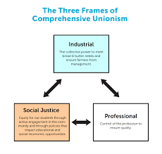
Three Models of Teacher Unionism
Sara & Albert
Three Models of Teacher Unionism

Slide 21
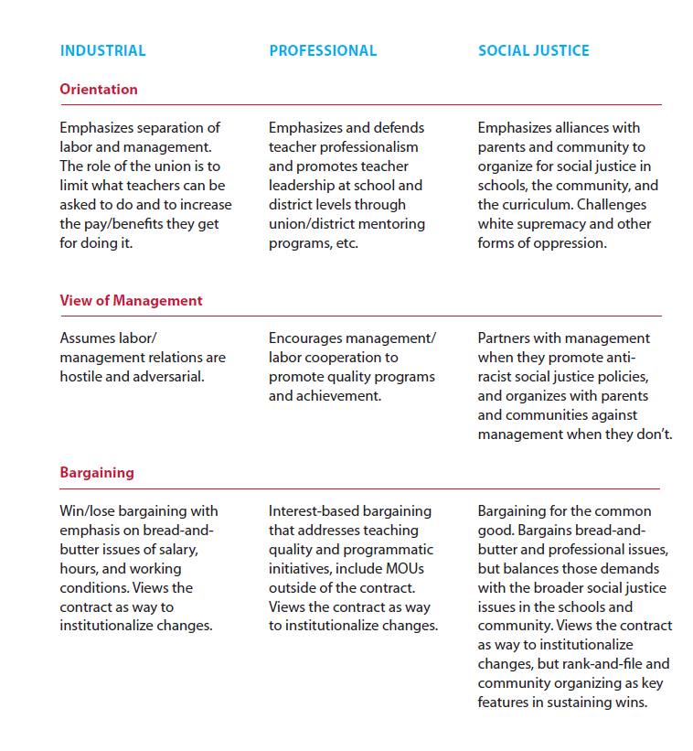
Three Models of Teacher Unionism

Slide 22
Three Models of Teacher Unionism Debrief
Do you think your local leaders would assess themselves as you have?
What shifts in your work with this local would you make to move them from where they are to a more social justice focused union?
How would/do you use this tool?

Slide 23
Key Points
This is not a linear process.
Context matters.
This is a framework to help organize thinking and work.

Slide 24


Slide 25
Toney
Who are the people we need?

Slide 26
Who are the leaders and structures we need?
“The terms “social justice” and “social justice unionism” can be watered down or co-opted. Some activists and leaders believe that passing resolutions in solidarity with different struggles (often a positive thing) makes a union a “social justice union.” Others label programs “social justice,” but because of top-down leadership and a lack of membership involvement, such programs are less effective than they might be. A new leader or leadership team can’t just declare that by virtue of their politics they are now a social justice union. It’s hard work. Real transformation of a union encompasses change in many areas: internal decision-making processes, vision, campaigns, addressing race and gender issues, relationships with parents and communities, and much more.” (Gunderson, pg. 175)

Slide 27
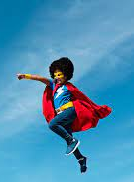
What is THE staff role?
What are the types of work Staff people are engaged in that support and cultivate the types of leaders this statement is referring to?
What changes in your work/expectations would you (and your leader/manager) need to make room for in order to cultivate social justice unionism as presented in these cases?

Slide 28
Definitions for Today
Leaders – Trusted and respected by their colleagues in ways that cut across communities of workers- are connected by values and influential relationships with mobilizers, activists, and those not yet part of the work. Get people to move their thinking and take action.
Mobilizers – Are already convinced members, who are already willing to take action. They are connected to the other already convinced.
Activists – Supportive and willing to act if invited but not able to move others.

Slide 29
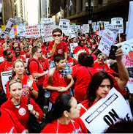


Leaders, Mobilizers, and Activists – Scenarios

Slide 30
Leaders, Mobilizers, and Activists
Who is a leader, a mobilizer, and an activist? How do you know?
In what order would you want to invite them into your cause and why?

Slide 31
Assessing Your Current Worksites (Ellen)
How many people have been identified as trusted and respected by a number of people in the worksite?
How many people are actively working in support of the union and have a group of folks that they influence?
How many people are ready to take pro-union action?

Slide 32
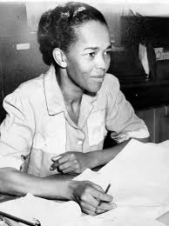
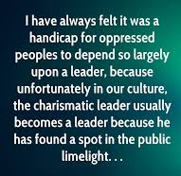
Ella Baker

Slide 33
Ella on Leadership - Handout
What do you think about Ella Baker’s style of leadership? What positives do you see? Are there any potential negatives you can think of? Explain your position.
Ella Baker believed that everyday people should be empowered to lead their own struggles against issues that directly affect them. Do you think this idea is relevant today? If so, how?
Think about the changes you think we need to see in this society. Do you think this change will be brought about only if great leaders emerge to make it happen?

Slide 34
Ella Baker Debrief

Slide 35
Key Points
The title does not indicate the leader
Our primary job is to identify leaders who can share power, responsibility and authority
We support members and leaders by helping them identify structures that distribute power, responsibility and authority
We can’t MAKE Social Justice Leaders

Slide 37
Yvie
What is your role?

Slide 38

Advocacy, Mobilizing, Organizing Pg 248-251
Advocate
Mobilizer
Organizer
Notes:
Ellen
20 Mins Entry activity – 4 Corners of Union Work
How do you think your locals primarily view your role with them? Social Justice Advocate, Contract Manager and Problem Solver, Leadership Coach and Developer, Campaign/Organizing Leader –
Prompts -Once at your charts, what are the opportunities that this view could have for moving towards a win and what are the challenges that this view could have?
Where is our power?
Contract Negotiation, Grievances, Member Engagement, Staff Led Programs
10 MIN debrief – so now what?

Slide 39
What do we mean? Pgs. 248-251 in the book
Advocacy
“Advocacy is the work of creating change through the actions of professionals or technical experts—lobbyists, pollsters, lawyers, communication specialists, researchers. Advocacy relies on the expertise, status, and know-how of these groups of people to make change. Advocacy usually happens in a closed-door room; ordinary people play a small to nonexistent role in its efficacy. Advocacy has become a dominant strategy for unions and liberals.”
Mobilizing
“Mobilizing, by contrast, activates an already-convinced membership. Mobilizing encourages those who already support a cause or a mission to take action to defend their belief—for example, by attending a protest, wearing a button, or signing a petition.”
Organizing
“To organize is to build mass support and strength among ordinary people. Organizing draws its power from working people’s biggest strength: our numbers... The work of organizing is systematic and rigorous: It requires connecting with every single worker in a shop, every educator in a building, every building in a district. At its core, it asks people to understand their own agency and to make choices about how they will exercise it.”

Slide 40
Corner Discussion – Use Pg. 251 or 49 in RG
Select the compass point that best answers where you are for each of the following questions -
1. What role do your leaders see you in currently? Why?
2. What role does your manager expect you to be in most often? Why?
3. What would your role look like if you were working with a SJ local? Why?
Notes:
Ellen

Slide 41
What does it all mean?
Discuss the tensions that exist and discuss your why.
How do you deal with these tensions?
Notes:
Ellen

Slide 42
Key Points
We may see our roles differently than our managers and our members.
Your compass helps you define the direction of the work.

Slide 43
Ellen
Leaders and Structures

Slide 44
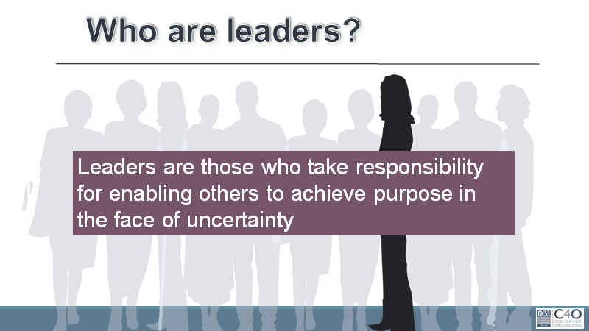

Slide 45
Organizing is…
…identifying leaders and coordinating them into leadership teams, building community and commitment around common goals, building power from the resources of that community, using that power strategically to make concrete change in the world,
THEN

Slide 46
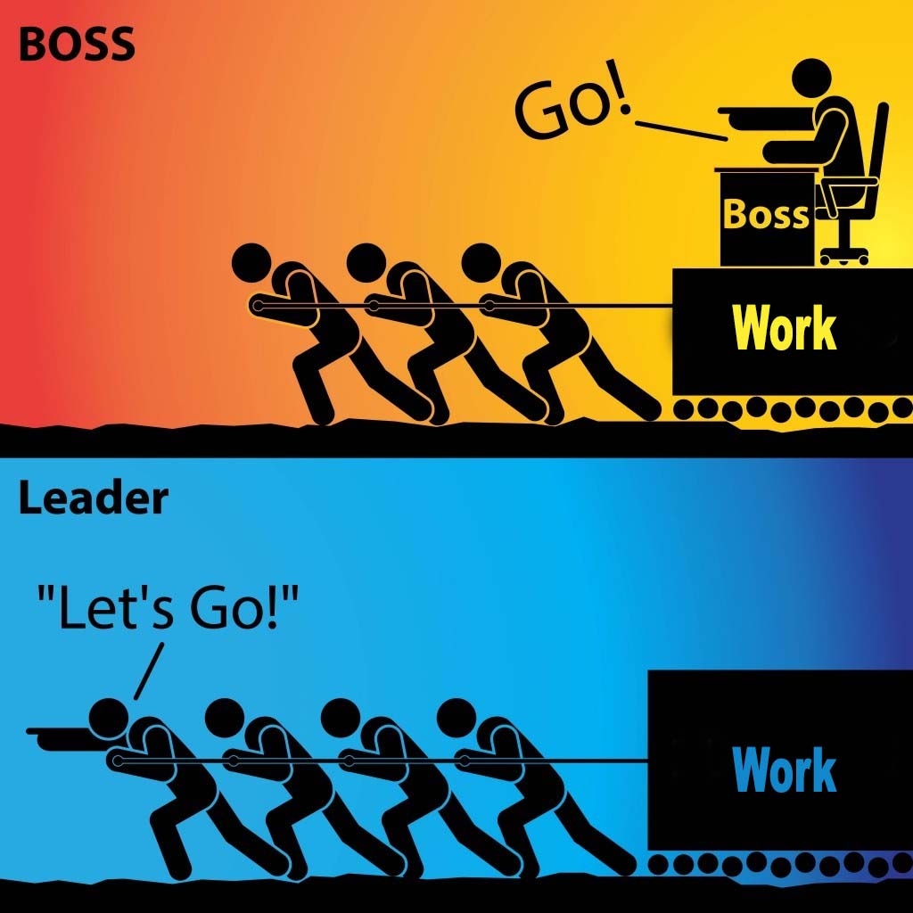
Leadership in organizing is…
…taking responsibility for enabling others to achieve shared purpose in the face of uncertainty.
The members who can lead most successfully are those who already have followers, i.e. people who trust and respect them.

Slide 47
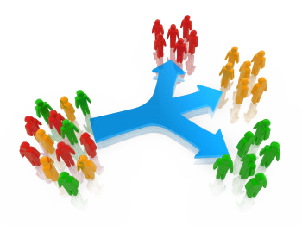
They do this through structures…
Structures allow for the distribution of power and responsibility and prioritizes leadership development. Structures are how people use their agency in support of the issues they feel are important. Because we think about organizing as a leadership practice that enables people to turn the resources, they have into the power to make the change they want… structures are typically “groups of people” organized around a common purpose or value, using their agency to take action. Teams, committees, networks, boards, coalitions … etc.

Slide 48

Natural Leader ID Review – Pg 274-282
“Who here is trusted and respected?”

Slide 49
Izaak
What is Required in Social Justice Campaigns

Slide 50
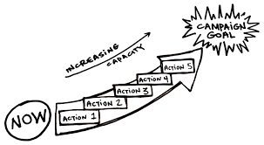
8 Cases of Social Justice Wins

Slide 51
Cases
A. 113 Teacher Community Unionism
B. 120 Cincinnati Teacher-Led School
C. 138 Improving Our Practice: Parent Teacher Home Visits
D. 148 Community Schools, Teacher Unions, and Black Lives Matter
E. 158 "You Have to Stop. You Have to Create Space."
F. 165 Teacher Strikes Boost Fight for Racial Justice in Schools
G.189 You Need Rank and File to Win
H. 227 "It’s Not Magic. It’s Organizing!"

Slide 52
Social Justice Wins
What are the key issues that this story “wins”?
What are the small steps along the way (tactics) that were put in place?
What was the overall narrative of this story? (Example – those closest to the work should lead the work, so let’s fight for site-based leadership teams)
What do you think are the specific roles that staff played in this story?

Slide 53
Lessons Learned
The workers, their energy, and their leadership must be at the front of the campaign
Official union leadership and staff must be willing to work with rank-and-file members AND allow them to have meaningful roles in campaigns
Must make space for rank and file to develop as leaders (training, chance to take risks, space to prove)
Community-centric approach
Democratic organizing (Marshall Ganz and Ella Baker)
Gradual escalation of tactics
Workers have power

Slide 54

Revitalized Union Movement – pg. 239-240
“Social Justice Unionism is an organizing model that calls for the radical boost in internal union democracy and increased member participation. This contrasts to a business model that is so dependent on staff providing services that it disempowers members and concentrates power in the hands of a small group of elected leaders and/or paid staff. An organizing model , while still providing service to members, focuses on building union power at the school level in alliance with parents, community groups, and other social movements.
Three components of social justice unionism are like the legs of a stool. Unions need all three to be balanced and strong:
  We organize around bread-and-butter issues.
  We organize around teaching and learning issues to reclaim our profession and our classrooms.
  We organize for social justice in our community and our curriculum." (Peterson)

Slide 55
For Further Thought (Ellen)
Consider the following “requirements” for the Social Justice Unionism Organizing Model:
    Internal Union Democracy
    Increased Member Participation
    Building Power at the School Site Level in Alliance with Parents, Community Groups, and Social Movements
What do each of those look like and what are the implications for you as you do your work?
To what extent do these exist in the locals you work with?

Slide 56
As we debrief – Lessons from the UTLA Strike pg. 255
“As word of our new mission spread, we attracted top-notch staff with organizing and campaign experience to work at UTLA. At the same time, we undertook the very difficult process of letting go of staff members who could not buy in to our new union vision. While this process was sometimes painful, we learned from allies around the country willing to share their experiences, that it would be a mistake not to clean house from the start. The talent and skills of our new staff have been a tremendous asset in building our union’s capacity and power.” (Inouye)

Slide 57
What is THE staff role?
What are the types of work Staff people are engaged in that support and cultivate the types of leaders and structures outlined in these cases.
What changes in your work/expectations would you (and your leader/manager) need to make room for in order to cultivate social justice unionism as presented in these cases?

Slide 58

Ending it Right
Choice Networking
Housekeeping
Feedback via email

Slide 59

Choice Network Time

