Slide 1
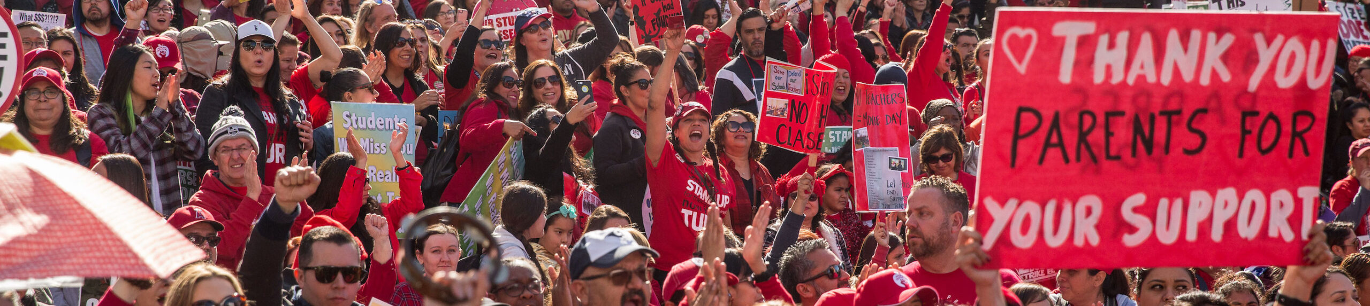

FLIPPING SCHOOL BOARD ELECTIONS
ORGANIZER SUPPORT PROGRAM
In the chat, tell us your:
Name
State
Pronouns
Something fun here?

Slide 2
HONORING THIS SPACE
We are all connecting from lands inhabited by indigenous people past and present. We begin by acknowledging that through a history of colonization and brutality.
We honor these indigenous people, all elders, past, present, and emerging. We are called to learn and share these learnings about this tribal history, culture, and contributions that have been suppressed in the telling of the story of what we now call the United States of America.

Slide 3
TODAY’S FACILITATORS
ELLEN
HOLMES
NEA C4OAS
BEKAH
SAXON
VIRGINIA
KATIE
BISHOP
WASHINGTON
MELISSA
DAN
FLORIDA
& SPECIAL GUESTS
AMBER
HOLLAND
NEA C&E
ALLIE
GORDON
NEA C&E
MEIGHAN
DAVIS
NEA C&E
JOIA CLEVINGER
MARYLAND
MATT
MOSER
ALASKA

Slide 4
COMMUNITY AGREEMENTS
Using Self-Awareness and Self-Knowledge
Listening for Understanding
Being Gracious
Staying Engaged
Being Open and Suspend Judgment
Saying “I”- tell your truth
Seeking Discomfort
Reaching Empathy
Expecting Non-Resolution and Non-Closure
*Adapted from “Embracing equity and inclusion”, Annie E. Casey Foundation

Slide 5
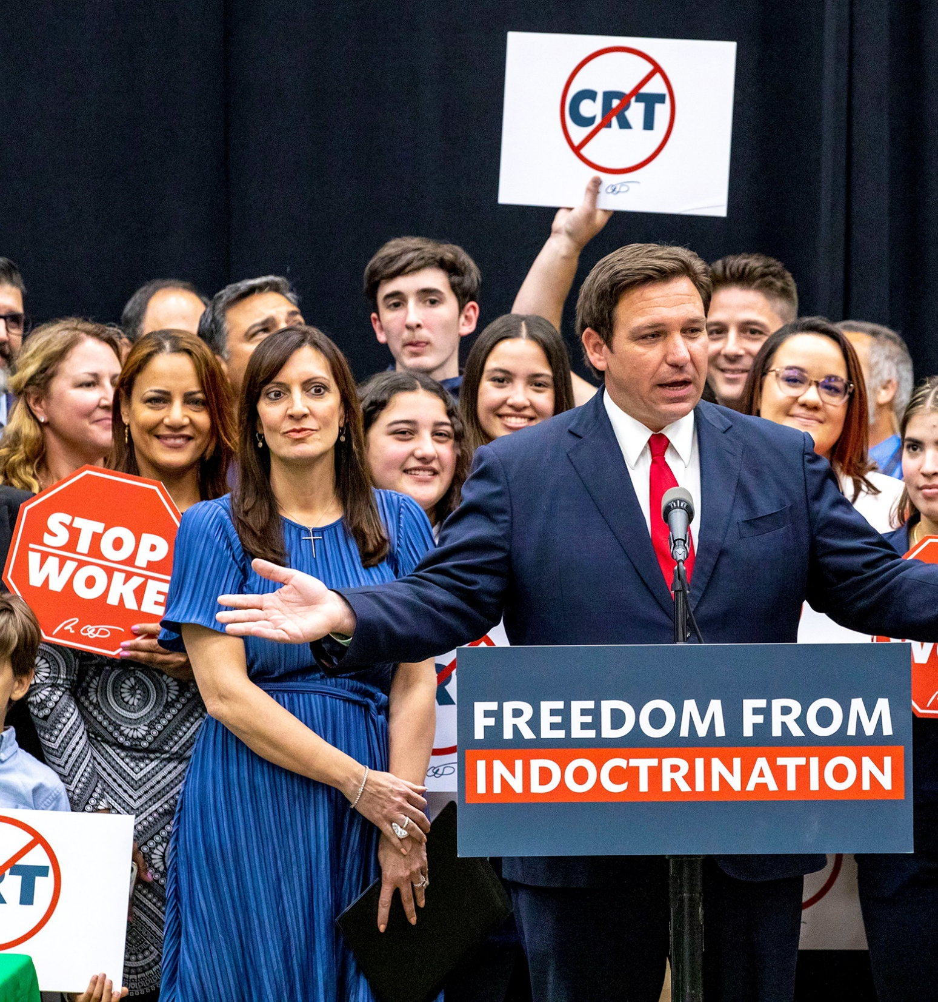
WHY ARE WE HERE?
Put in the chat:
What are all the ways the boss screws our members over?
What can we change in our members’ lives by electing champions who keep their campaign promises?

Slide 6

ASSOCIATION READINESS
KNOW THE LAW
KNOW YOUR BYLAWS
ENGAGED LEADERS
MEMBER COMMUNICATION
ORGANIZATION CAPACITY
ORGANIZATION CAPACITY
Notes:
Meighan

Slide 7
WHAT IT WILL TAKE TO WIN
STEP 1: PROJECTED TURNOUT %
YEAR | TURNOUT | REGISTRATION | TURNOUT %
2020 | 5,314 | 20,567 | Turnout/Registration 26%
2016 | 7,896 | 18,345 | 43%
2012 | 6,123 | 17,253 | 35%
Average these=
35%
STEP 2: PROJECTED VOTER TURNOUT
35% x 25,867 =
9,053
PROJECTED TURNOUT % MULTIPLIED BY CURRENT REGISTRATION
STEP 3: VOTE GOAL
TWO CANDIDATES: PROJECTED VOTER TURNOUT MULTIPLIED .52
THREE CANDIDATES: PROJECTED VOTER TURNOUT/3 +1
*
VIABLE CANDIDATES
Notes:
Amber

Slide 8
MEMBER AND VOTER LISTS
MEMBERS
VOTERS
Get updated lists from School District
Know your members’
interests & capacity
Find a tracking system that
works for your local (if allowed)
Get creative & brainstorm overcoming obstacles with others
Get access to VAN My Voters tab
Work through your candidates
(they can usually get VAN
access through party)
Buy your own voter list
from Board of Elections
Notes:
Allie

Slide 9
BREAKOUT
List the common “shutdowns” you hear from members (or staff) in your locals when you try to suggest a new approach to elections, recommendation process, or volunteer recruitment
2. What are the ways you can pushback to those shutdowns to overcome the resistance?

Slide 10
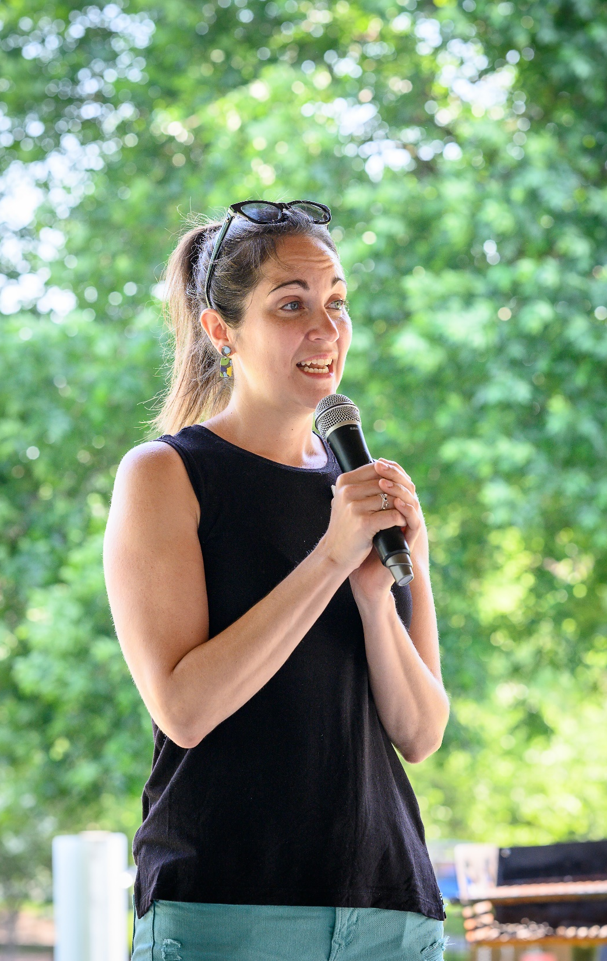
ENGAGING MEMBERS AS LEADERS
Who is trusted & respected in your building when it comes to politics?
Fit the volunteer, not the position
Train them well
Create community
Make everyone a recruiter
Give the job away to a member if you can
Make them feel special
ORGANIZATION CAPACITY
Notes:
Meighan

Slide 11
CASE STUDY BREAKOUTS
Maryland’s transparent recommendation process that builds ownership
How to beat the bad guys in a southern state
How we won in Fairbanks, Alaska with labor and coalition partners

Slide 12
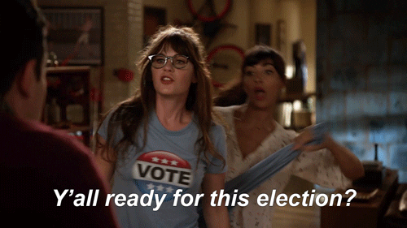
NEA RESOURCES & WRAP
Don’t get in trouble, follow your chain of command
Local/state/staff training
See Educators Run
School Board Toolkit
Year Round Organizing Toolkit
Handouts/PDFs
Evaluation link: bit.ly/here
Questions?
ELLEN HOLMES eholmes@nea.org
KATIE BISHOP kbishop@washingtonea.org
MELISSA DAN melissa.dan@floridaea.org
BEKAH SAXON bsaxon@veanea.org
ALLIE GORDON agordon@nea.org
AMBER HOLLAND aholland@nea.org
MEIGHAN DAVIS mdavis@nea.org
JOIA CLEVINGER joclevinger@mseanea.org
MATT MOSER matthew.moser@neaalaska.org
Notes:
Allie

Slide 13
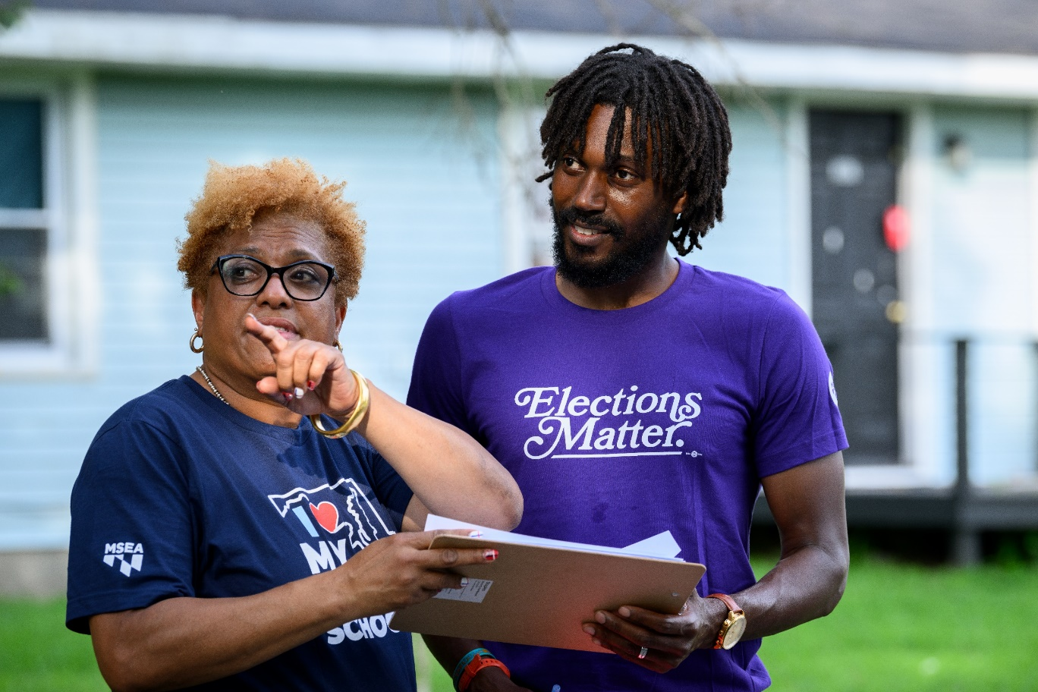
ENGAGING MEMBERS AS VOLUNTEERS
Don’t forget to have organizing conversations
Use the Ladder of Engagement
Make it a good experience
Delegate roles for ownership & turnout
Have a tight turnout plan
ORGANIZATION CAPACITY
Notes:
Amber

