Slide 1
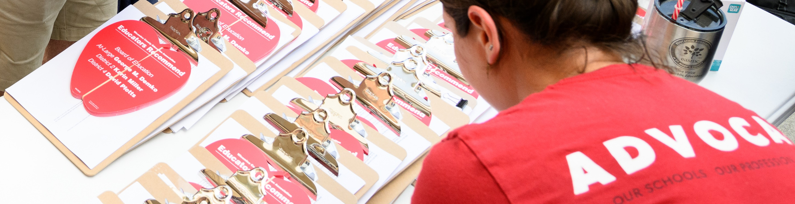

WINNING SCHOOL BOARD ELECTIONS
ORGANIZER SUPPORT PROGRAM
MED
Change your name to include
State
Pronouns [example: Melissa, FL (she/her)]
In the chat, tell us your:
What is your favorite (or least favorite campaign activity?)

Slide 2

LAND ACKNOWLEDGEMENT
MED
Every community owes its existence and vitality to generations from around the world who contributed their hopes, dreams, and energy to making the history that led to this moment. Some were brought here against their will, some were drawn to leave their distant homes in hope of a better life, and some have lived on this land for more generations than can be counted. Truth and acknowledgment are critical to building mutual respect and connection across all barriers of heritage and difference. We begin this effort to acknowledge what has been buried by honoring the truth. We pay respects to their elders past and present. Please take a moment to consider the many legacies of violence, displacement, migration, and settlement that bring us together here today.

Slide 3

TODAY’S AGENDA
MED
What we need to run strong campaigns
Breakout Room Introductions
Association Readiness
Mapping
Vote goals & data
Organizing Member
Organizing Voters
Breakout discussions on PAC, candidate recruitment, & member engagement
NEA Resources

Slide 4
COMMUNITY AGREEMENTS
MED
Using Self-Awareness and Self-Knowledge
Listening for Understanding
Being Gracious
Staying Engaged
Being Open and Suspend Judgment
Saying “I”- tell your truth
Seeking Discomfort
Reaching Empathy
Expecting Non-Resolution and Non-Closure
*Adapted from “Embracing equity and inclusion”, Annie E. Casey Foundation

Slide 5
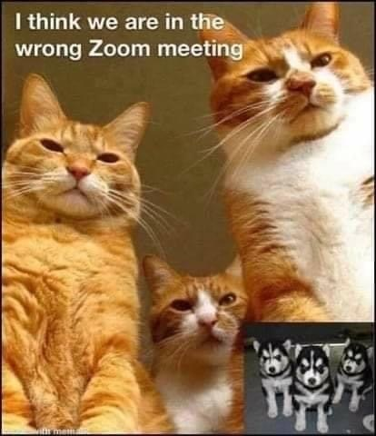
WHO IS IN THE ZOOM?
NE
WHY ARE WE HERE?
In your breakout room, share:
What does your local do really well in your school board election work?
What does your local need help on?
What are the biggest barriers you’re facing?
*Designate note-taker to report out.
You have 15 minutes.
Notes:
We really want to use our time together to be as interactive as possible.
We always hear what folks love the most about our trainings is the connections they make to staff in other states and hearing what they are doing.

Slide 6


STRONG CAMPAIGNS STAY READY
MED
Pre-Election Association Readiness Checklist
Know your election & fundraising laws
Know your constitution and bylaws
Have a plan to get your leadership engaged
Know your communications infrastructure
Evaluate your capacity
ORGANIZATION CAPACITY

Slide 7
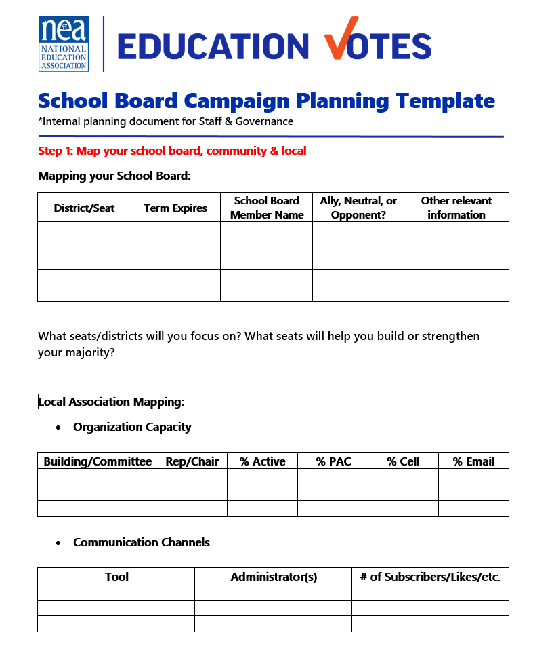
STRONG CAMPAIGNS HAVE
CAMPAIGN PLANS
MED
Mapping
Goals
Strategies & Tactics
Message
Budget
Accountability/task tracker
Timeline
Evaluation & wrap-up

Slide 8
STRONG CAMPAIGNS DO THEIR RESEARCH
BR
NE
Start with a simple chart of current office holders & assessments.
Be careful what words you use, how this is stored, & how this is shared.
 | TERM EXPIRES | SCHOOL BOARD MEMBER | ALLY, NEUTRAL, OPPONENT | NOTES
Seat A
Seat B
Seat C
Seat D
Seat E
Seat F
Seat G

Slide 9
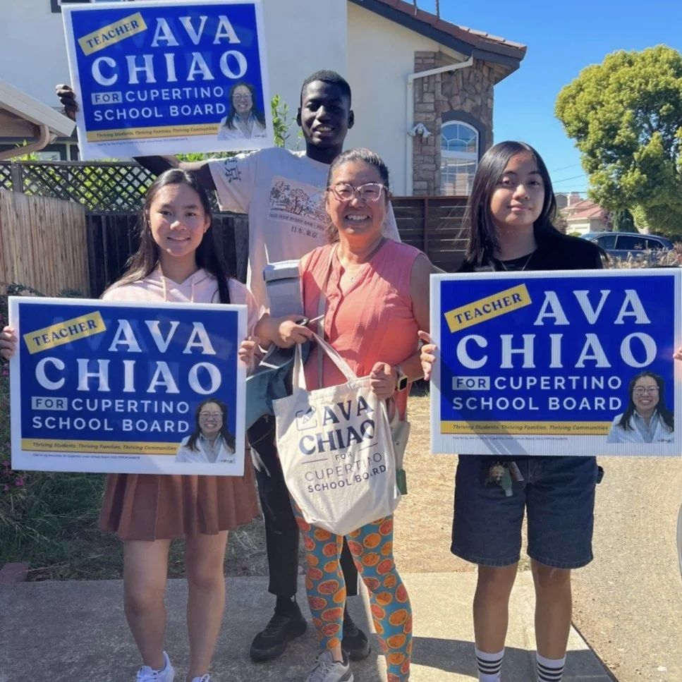
ASSESSING SCHOOL BOARD MEMBERS
NE
Willing to listen
Relationship with members
Experience in public education
Strong candidate or campaigner
Community support
Member of coalition or allied group?
Potential for improved relationship
Is this seat winnable?

Slide 10
MAPPING YOUR SCHOOL BOARD EXAMPLE
NE
 | TERM EXPIRES | SCHOOL BOARD MEMBER | ALLY, NEUTRAL, OPPONENT | NOTES
Seat A | 2026 | President Jane Jones | Ally | Parent of member
Seat B | 2024 | Vice-President Billy James | Neutral | Basketball coach
Seat C | 2026 | Dolores Smith | Neutral
Seat D | 2025 | Randy Jerk | Opponent | Tried to take dues deduction away
Seat E | 2024 | Gladys Grumps | Opponent | Repeatedly dismissive of concerns
Seat F | 2024 | Jean Garcia | Ally
Seat G | 2025 | Frida Lemon | Neutral

Slide 11
MAPPING YOUR COMMUNITY
NE
More Power to Elect Candidates
Against Us
With Us
Less Power to Elect Candidates

Slide 12
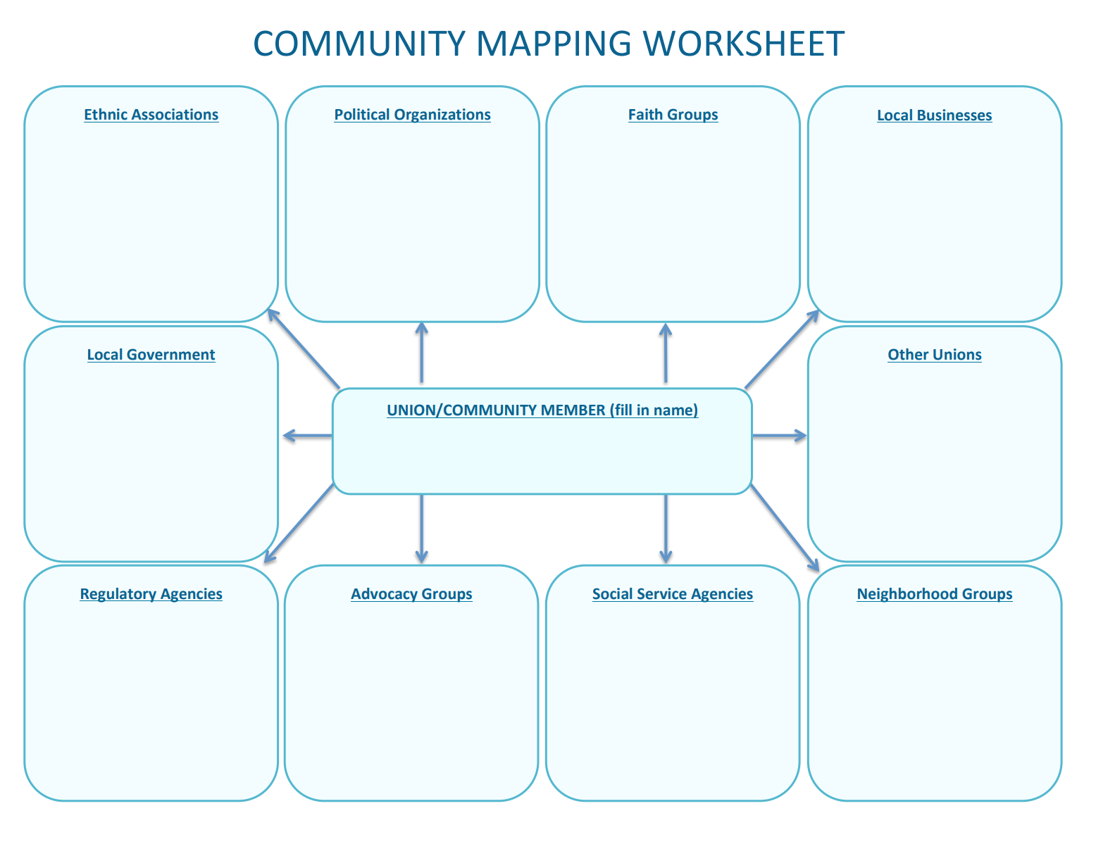
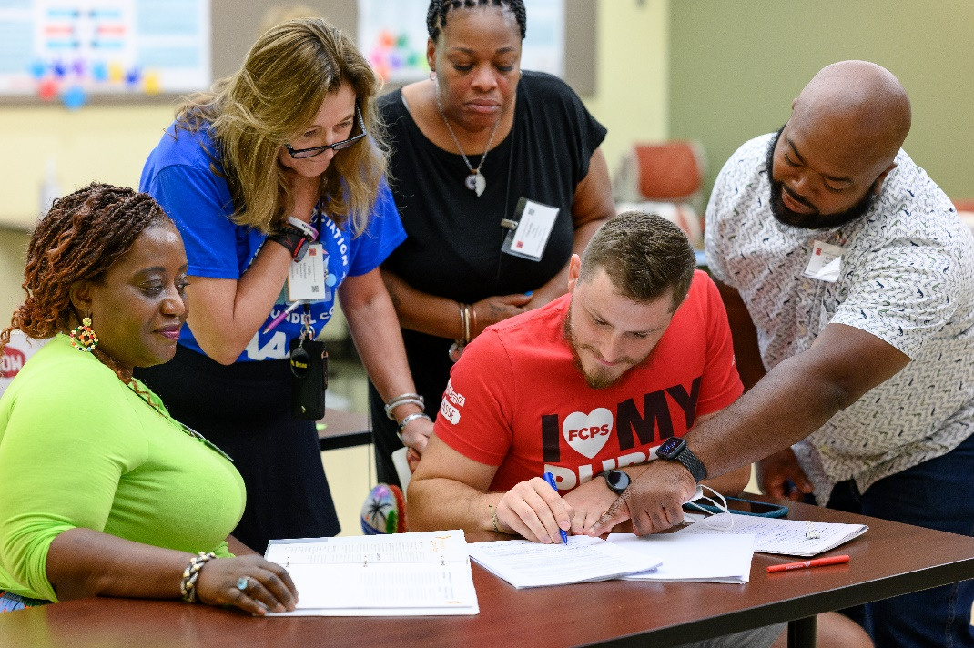
MAPPING: YOUR MEMBERS
NE

Slide 13
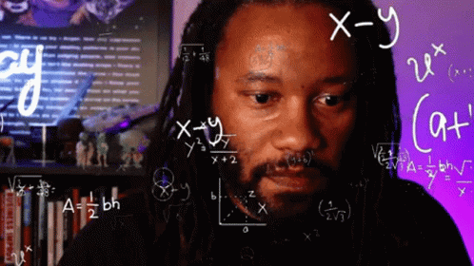
MJD
WHAT IS A WIN NUMBER & VOTE GOAL?
A win number is the minimum number of votes you need to win the election
A vote goal is your win number with some extra cushion
Every election starts with calculating your win number & vote goal
This number is the objective of your whole campaign

Slide 14
MJD
CALCULATING YOUR VOTE GOAL
STEP 1: PROJECTED TURNOUT %
YEAR | TURNOUT | REGISTRATION | TURNOUT %
2020 | 5,314 | 20,567 | Turnout/Registration 26%
2016 | 7,896 | 18,345 | 43%
2012 | 6,123 | 17,253 | 35%
Average these
= 35%
STEP 2: PROJECTED VOTER TURNOUT
35% x 25,867 =
9,053
PROJECTED TURNOUT % (35%) MULTIPLIED BY CURRENT REGISTRATION (25,867)
STEP 3: VOTE GOAL
TWO CANDIDATES: PROJECTED VOTER TURNOUT MULTIPLIED .52
*THREE CANDIDATES: PROJECTED VOTER TURNOUT/3 +1 & ADD CUSHION
RANK CHOICE VOTING RECOMMENDATION IS TO USE 52%

Slide 15
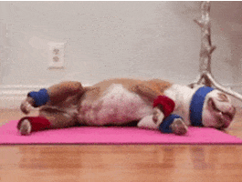
MJD
VOTE GOAL EXERCISE
Calculate vote goal for the district below for a two-person race
Here are the past voting results:
There are currently 66,908 registered voters in the district
Year | Turnout | Registration
2020 | 42,630 | 62,897
2016 | 38,976 | 58,907
2012 | 30,876 | 55,876

Slide 16
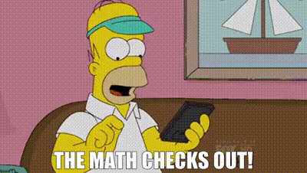
MJD
EXERCISE BREAKDOWN
Year | Turnout | Registration | %
2020 | 42,630 | 62,897 | 68%
2016 | 38,976 | 58,907 | 66%
2012 | 30,876 | 55,876 | 55%
(68+66+55)/3 = 63% is projected turnout %
66,908 registered voters x 63% = 42,152 is the projected voter turnout
2 candidate race: 42,152 x 52% = 21,919

Slide 17
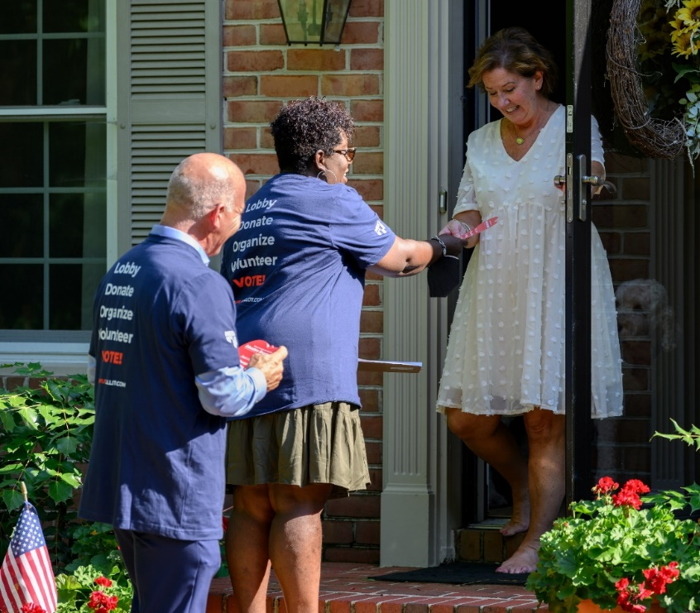
HOW TO USE VOTE GOAL
MJD
Ask candidate if they have vote goal, they will need a measureable goal to reach for their voters: How many calls, conversations, mailing universe size do they need?
Give your candidate strategic field knowledge
Help the local realize the numbers they can deliver for the candidate

Slide 18
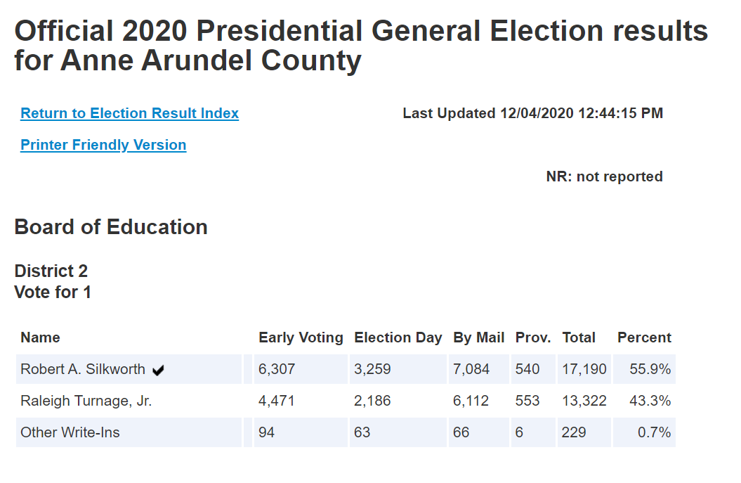
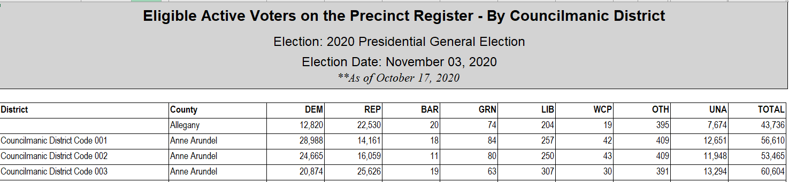
WHERE TO FIND THE ELECTION DATA
MJD
Local Supervisor of Elections Office or Board of Elections website
VAN
Coalition and partner support

Slide 19
MEMBER AND VOTER LISTS
MJD
MEMBER AND VOTER LISTS
MEMBERS
VOTERS
Get updated lists from School District
Know your members’
interests & capacity
Find a tracking system that
works for your local (if allowed)
Get creative & brainstorm overcoming obstacles with others
Get access to VAN My Voters tab
Work through your candidates
(they can usually get VAN
access through party)
Buy your own voter list
from Board of Elections
Email mdavis@nea.org

Slide 20
MED
WHY ARE MEMBERS SO IMPORTANT
IN YOUR SCHOOL BOARD RACE?

Slide 21
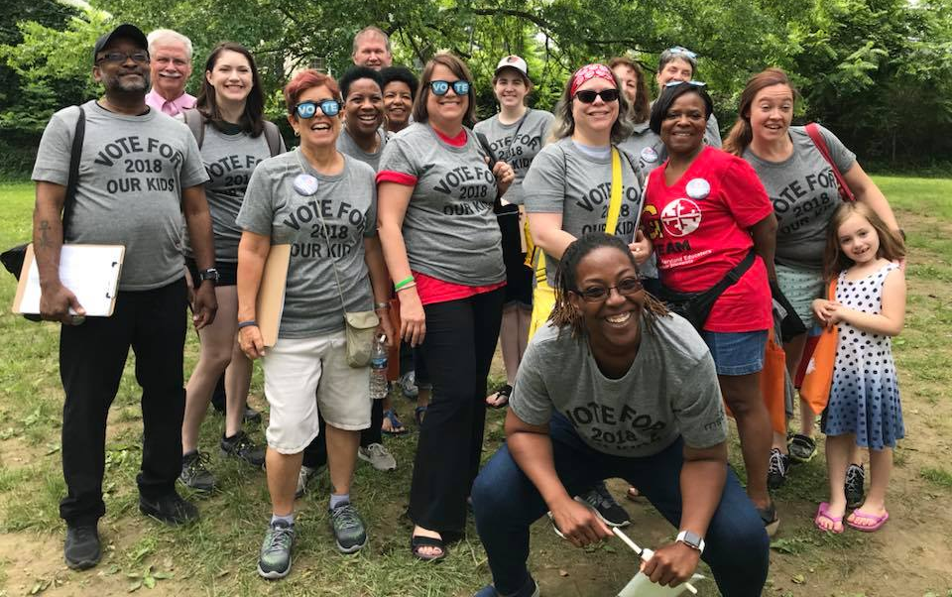
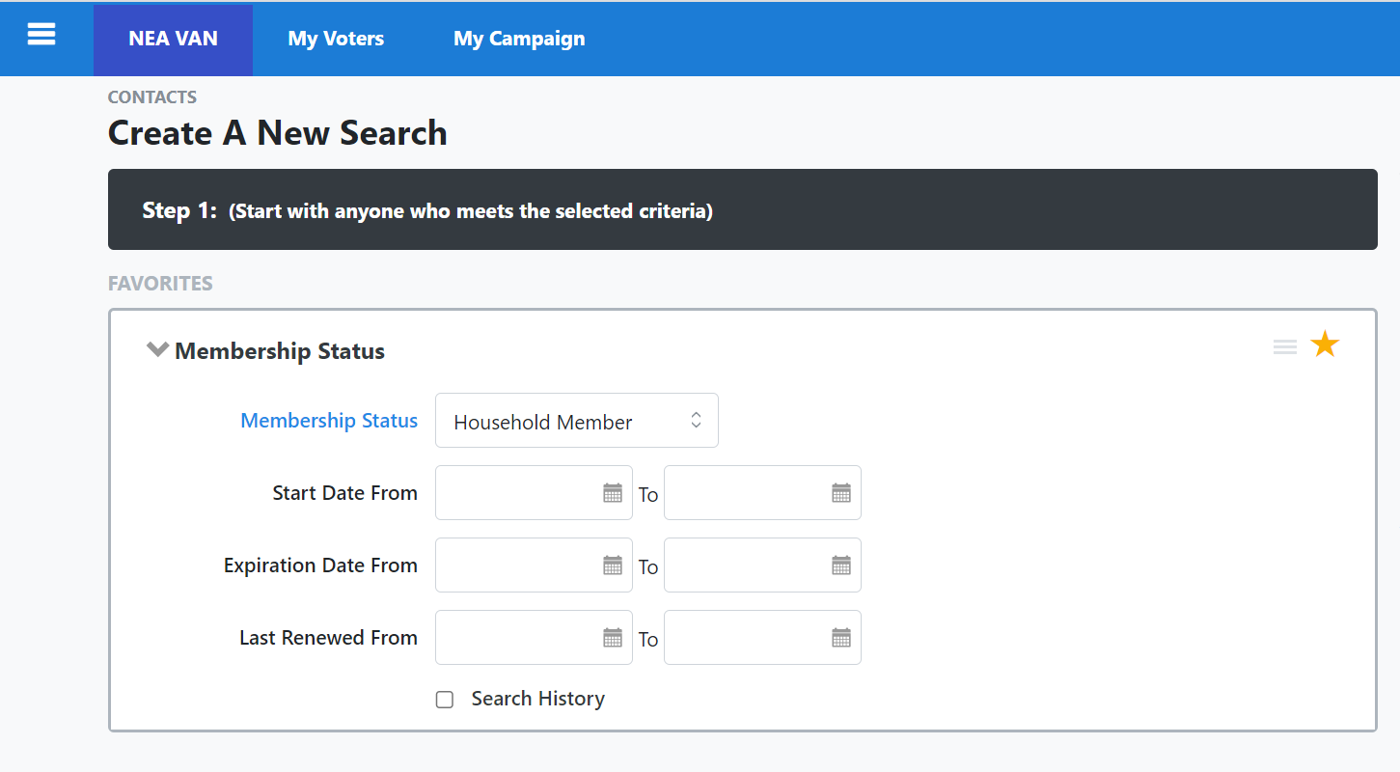
MED
WINNING WITH MEMBERS
Reaching your vote goal requires:​
Delivering members to vote​
Delivering members to volunteer​
Tapping members’ households & personal networks for both​
​
Members = base support​
Members = volunteer army
Members = avenues to more supporters/volunteers

Slide 22

MED
LADDER OF ENGAGMENT
Higher Risk
Don’t start w/high risk activities
Training gives confidence if they are hesitant to say yes
Celebrate them after they accomplish goal
Mix up activities you are asking volunteers to take
Lower Risk

Slide 23
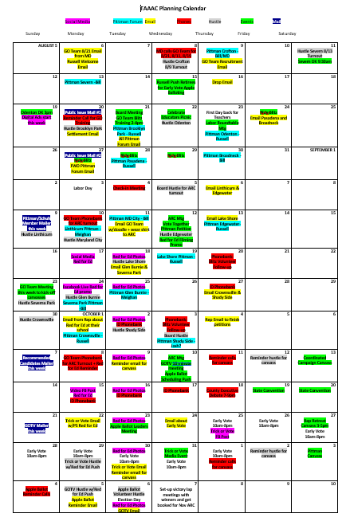
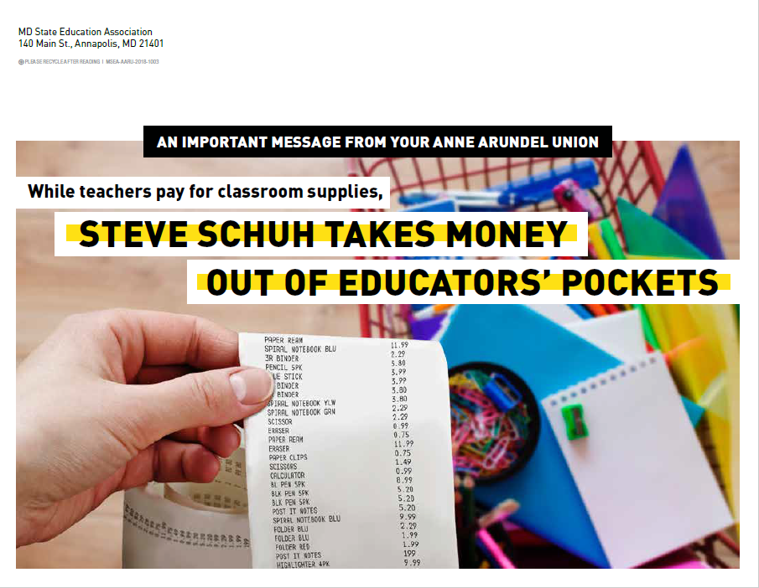
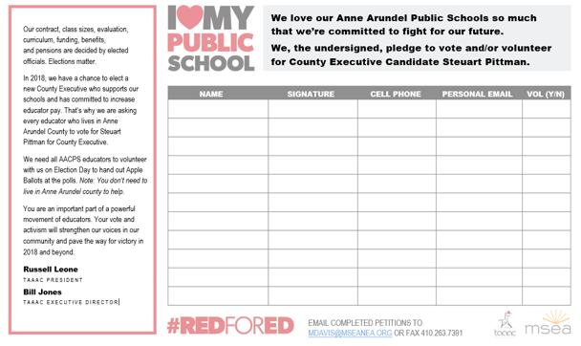
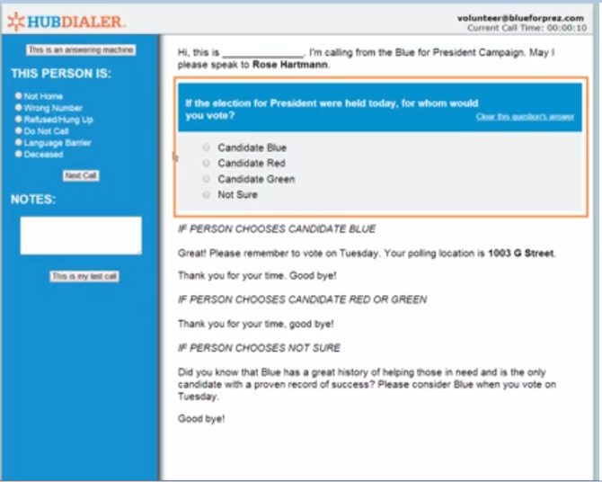

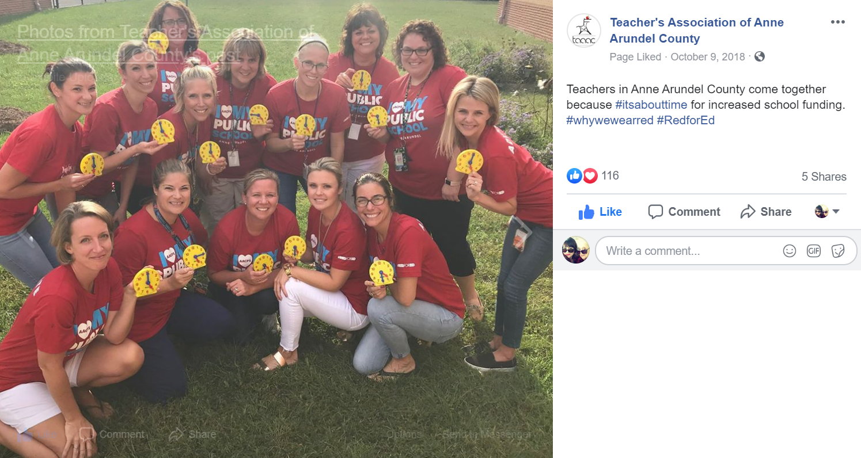
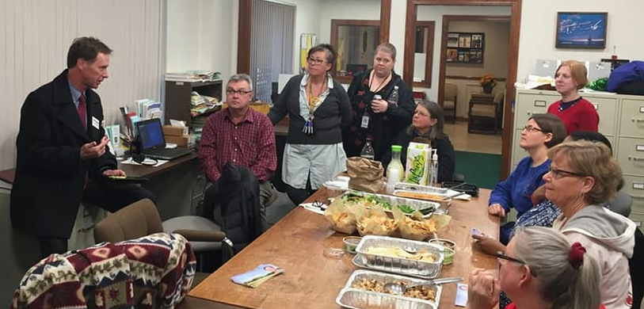
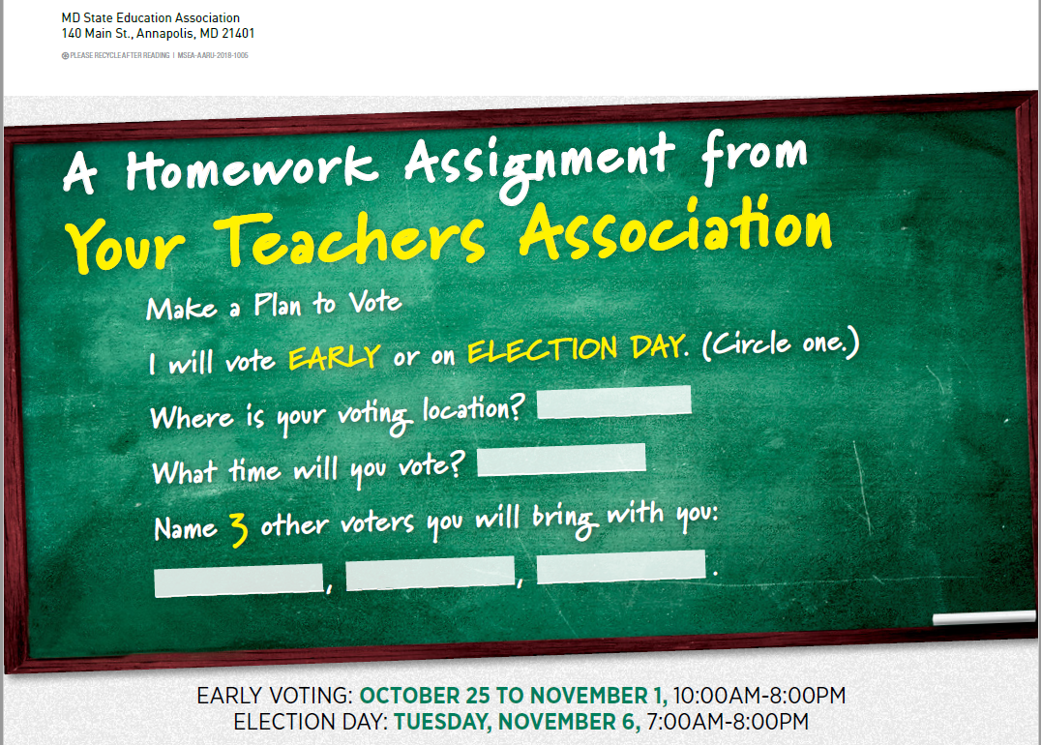
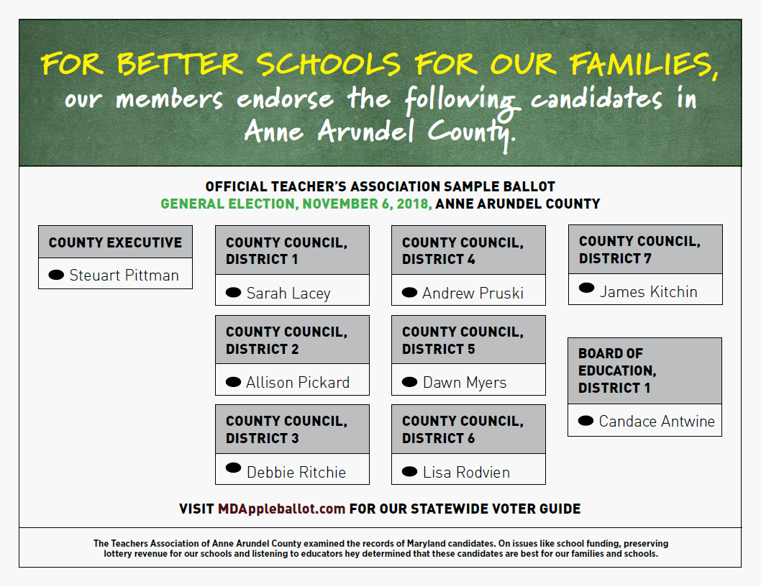
LAYERED MEMBER CONTACT PLAN
MED

Slide 24
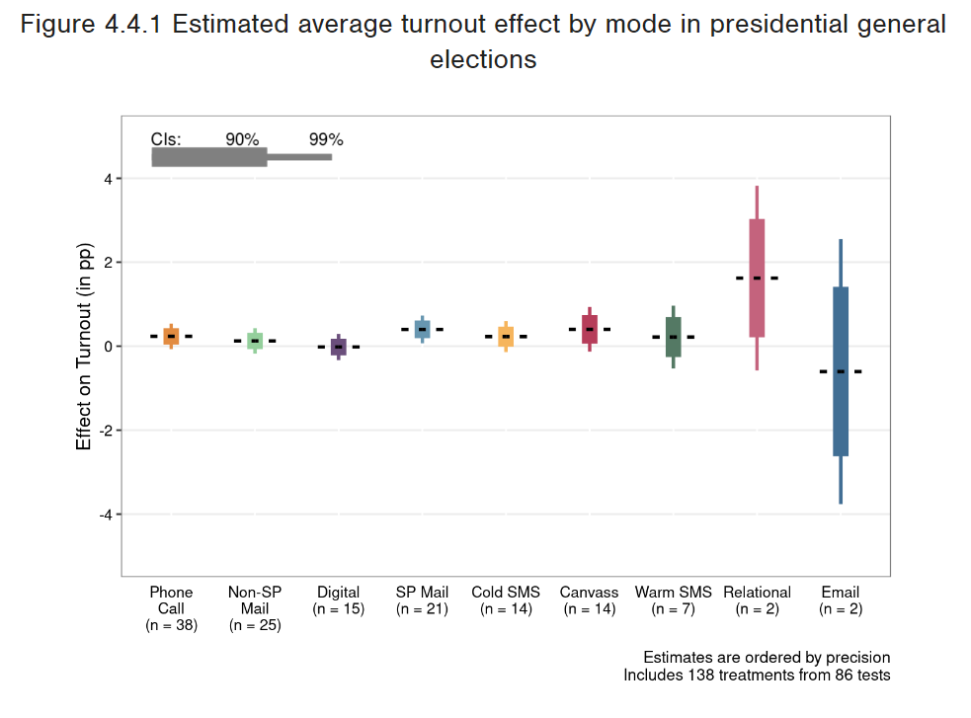

NE
VOTER
CONTACT
MODE
EFFECTIVENESS

Slide 25
DIRECT VOTER CONTACT MATH
NE
CANVASSING
PHONES
TEXT
Average knocks are 15 – 20 doors per hour
If 1620 is your vote goal / 15 doors per hour = 108 hours
108 hours/ 2 hour shifts = 54 volunteer shifts
Volunteers average 10 phone contacts per hour
If 1620 is your vote goal / 10 contacts per hour = 162 hours
162 hours / 2 hour shifts = 81 volunteer shifts
300-400 texts assigned to volunteer
Emphasize making time (90 min) to reply to messages/not just sending

Slide 26
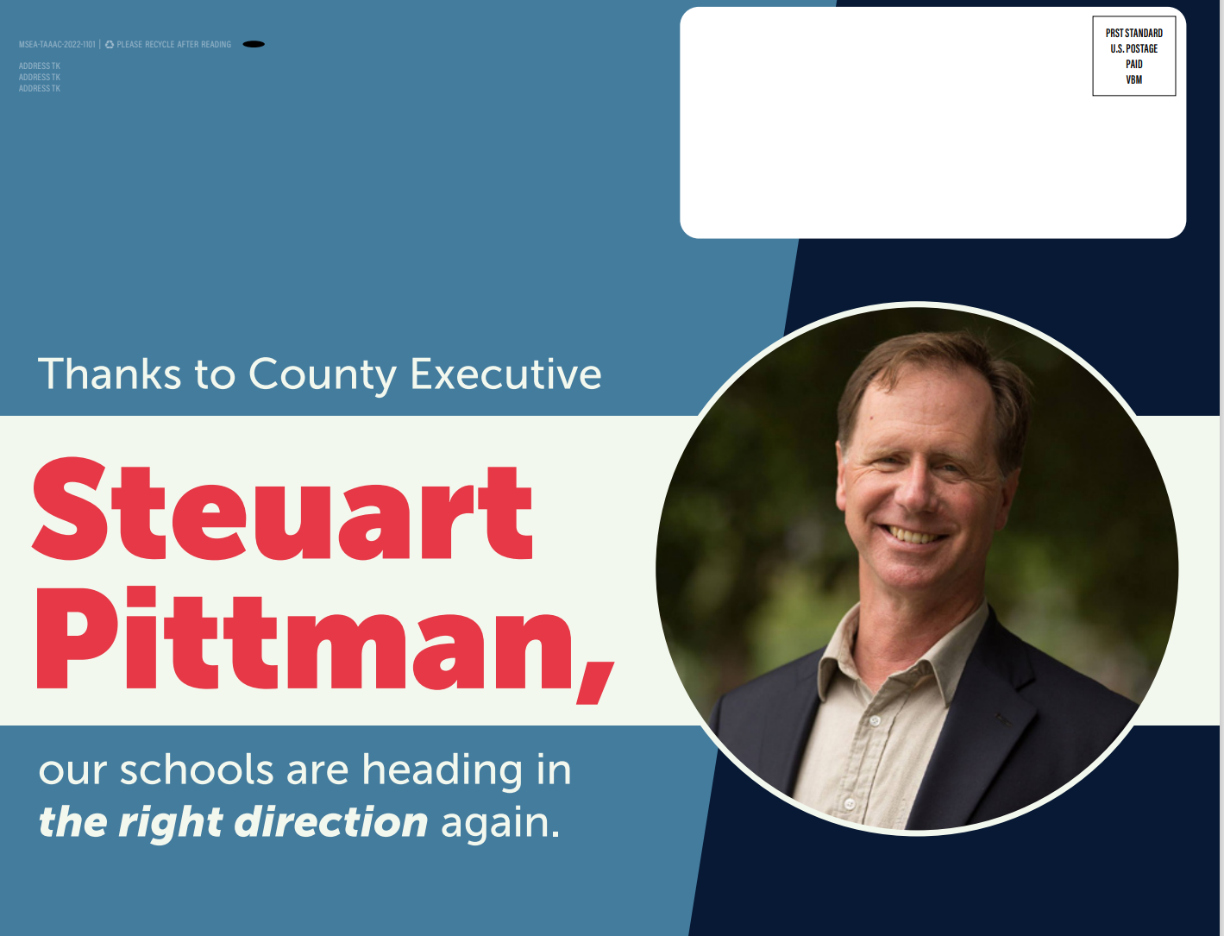

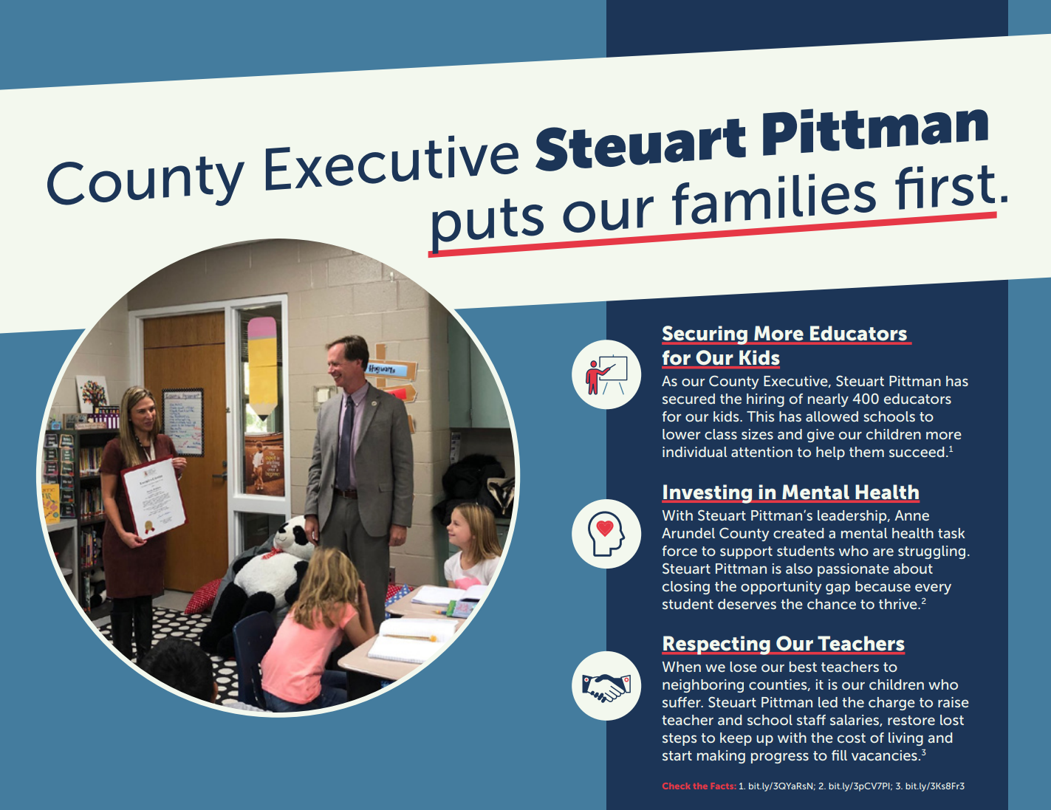
NE

Slide 27
BREAKOUT
MED
1. Mapping (Target, Community, Members)
  How many races are you going to target/priorities?
  Do you have partner organizations?
  Are you going to map member relationships?
2. Vote Goal/Data
  Do you have access to this data?
  If not, how are you going to get it?
3. Member Engagement
  How will you communicate with your members as voters?
  How will you recruit volunteers?
4. Voter Contact
  What voter contact methods will you focus on?

Slide 28


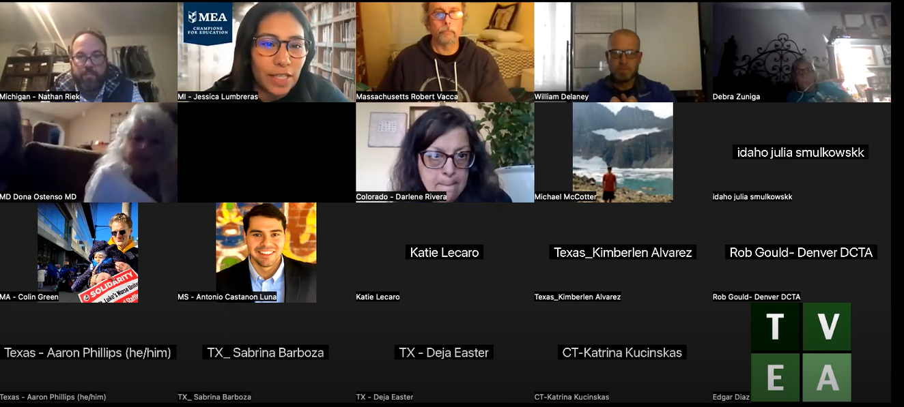
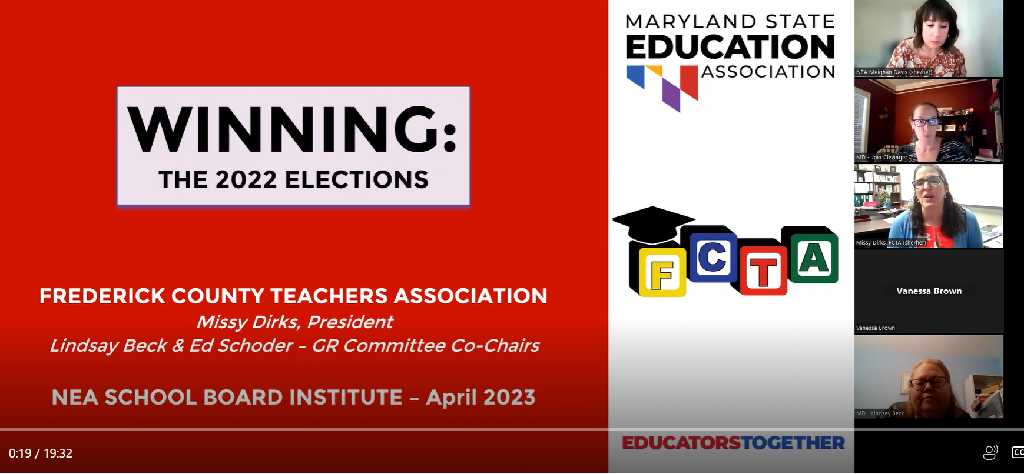


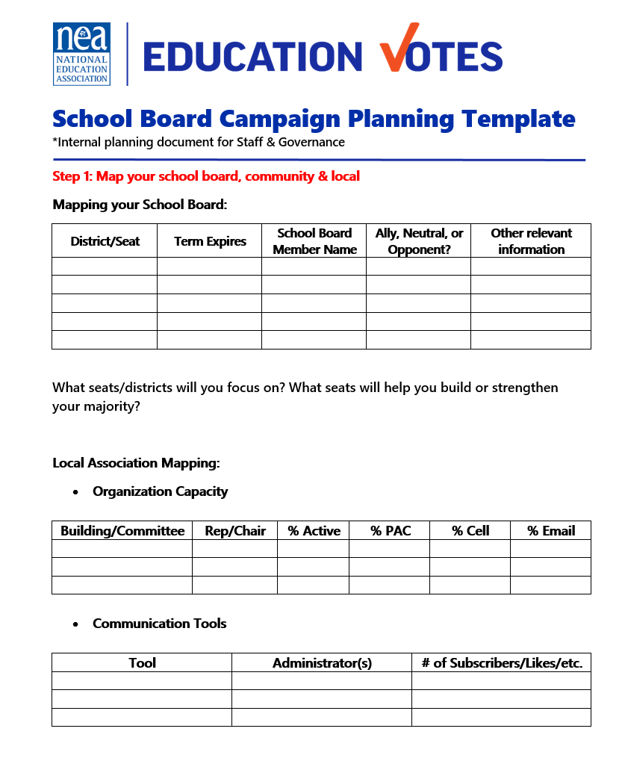
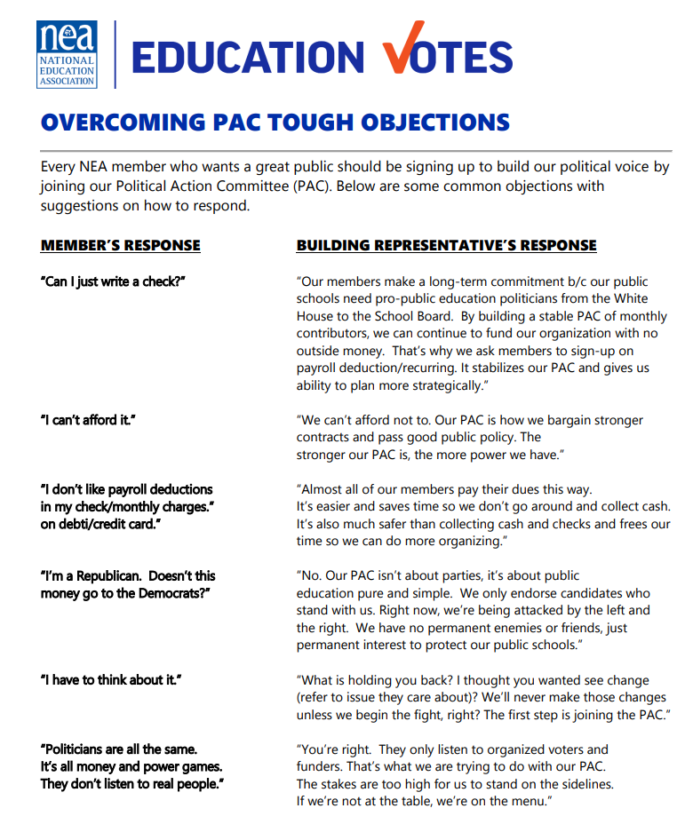
https://NEASCHOOLBOARD.ORG
MJD

Slide 29
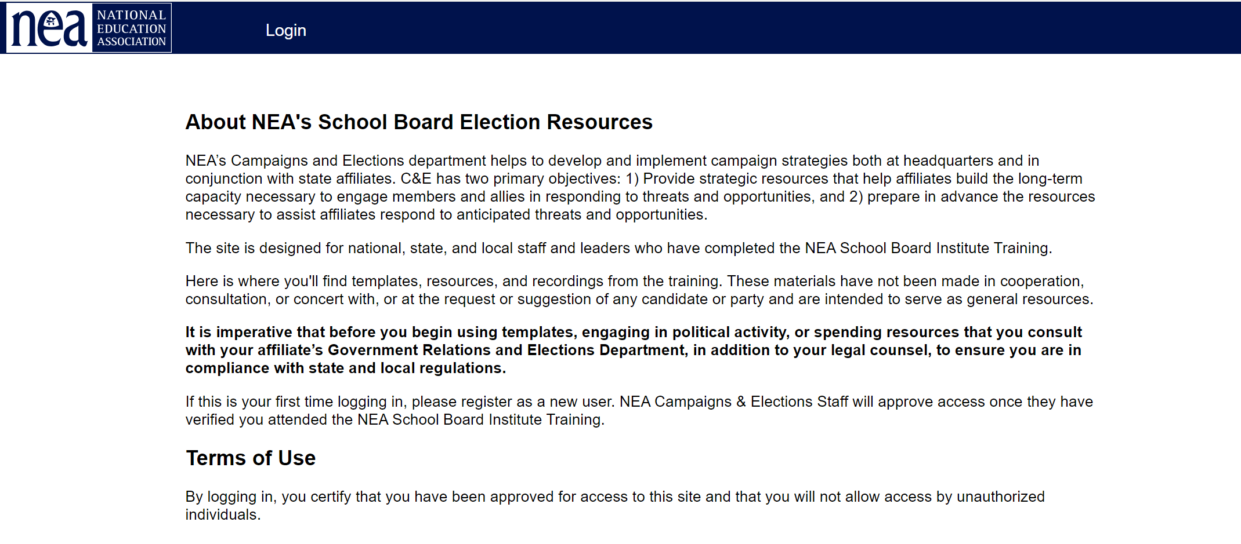
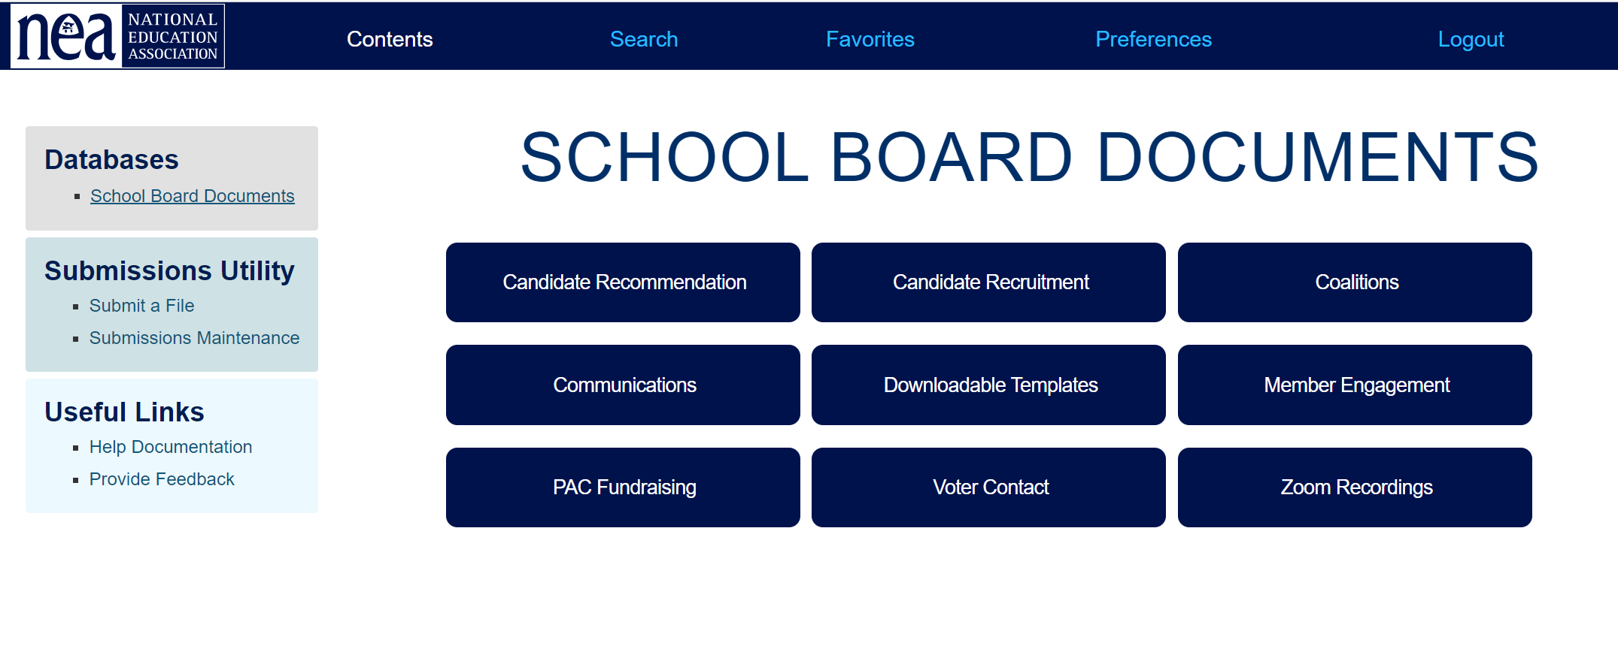
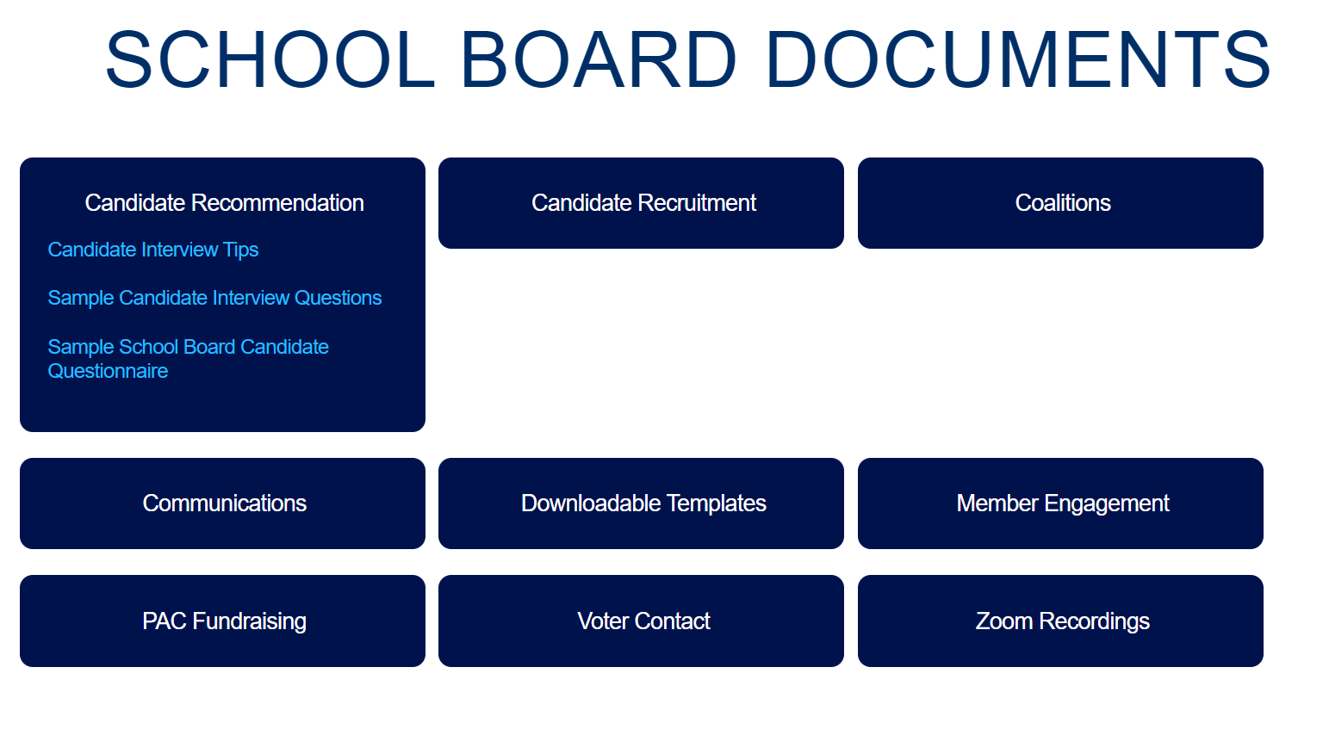
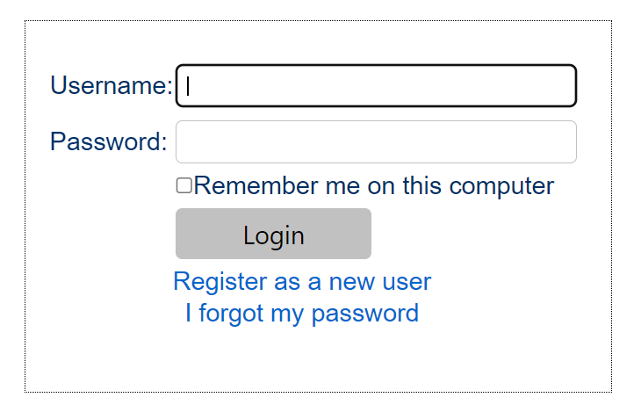
https://NEASCHOOLBOARD.ORG
MJD

Slide 30
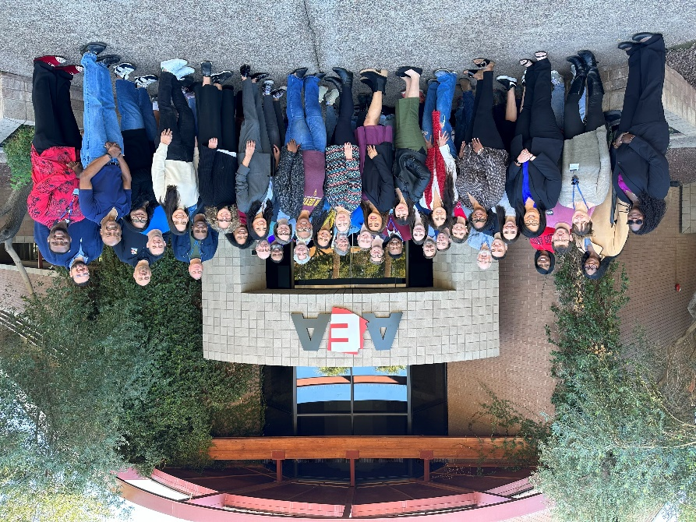
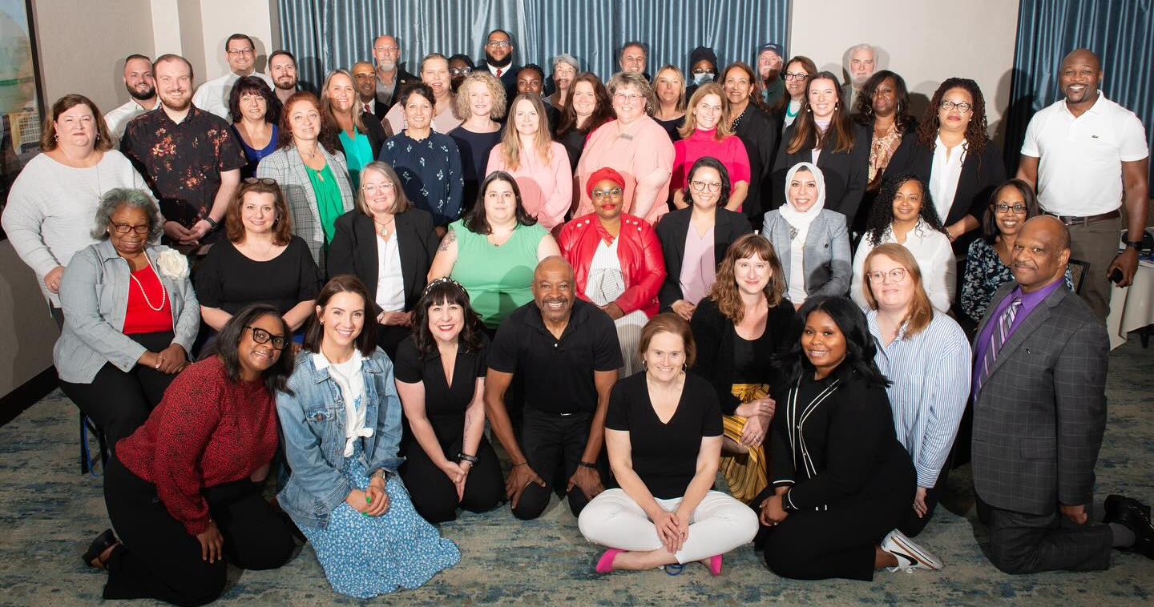
SEE EDUCATORS RUN
MJD
2025 Training Calendar
  April 4-6, 2025 Philadelphia
  June 20 – 22, 2025 Des Moines
  Aug 1-3, 2025 Denver
Members apply at nea.org/SER
Presidents, Executive Directors, and Government Relations Directors approve applicants. State affiliates pay for travel, NEA covers all other expenses.

Slide 31

END OF THE ROAD
MJD
Meighan: mdavis@nea.org

