Slide 1
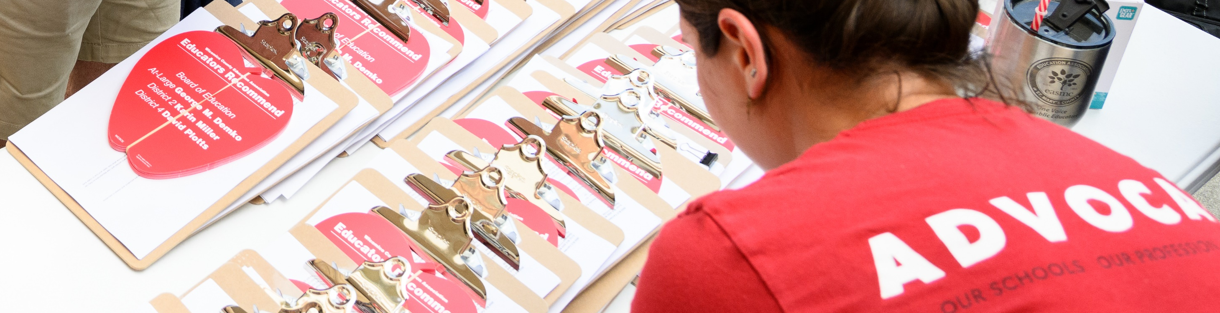

FLIPPING SCHOOL BOARD ELECTIONS
ORGANIZER SUPPORT PROGRAM
In the chat, tell us your:
Name
State
Pronouns
What is one thing you want to learn today?
Notes:
JULI

Slide 2
HONORING THIS SPACE
We are all connecting from lands inhabited by indigenous people past and present. We begin by acknowledging that through a history of colonization and brutality.
We honor these indigenous people, all elders, past, present, and emerging. We are called to learn and share these learnings about this tribal history, culture, and contributions that have been suppressed in the telling of the story of what we now call the United States of America.
Notes:
JULI

Slide 3
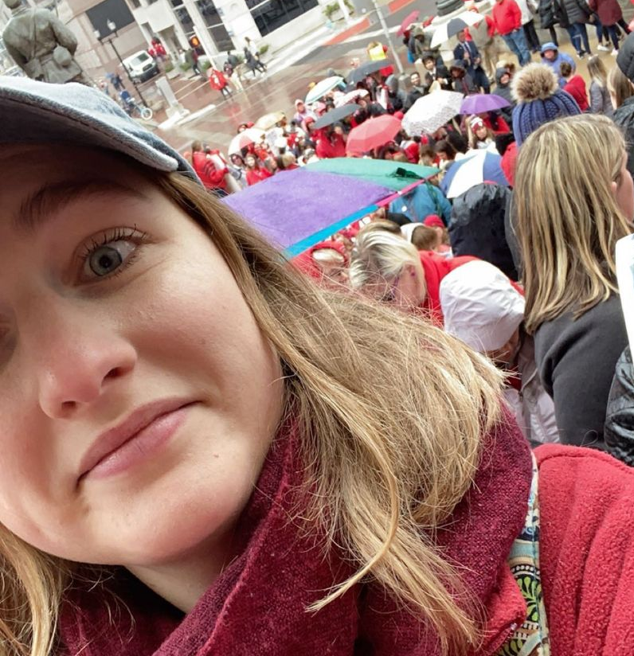
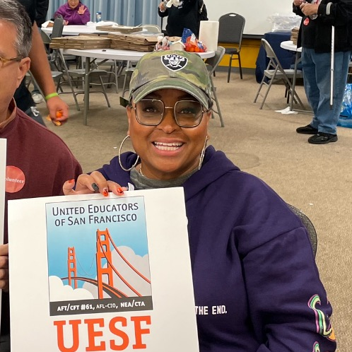
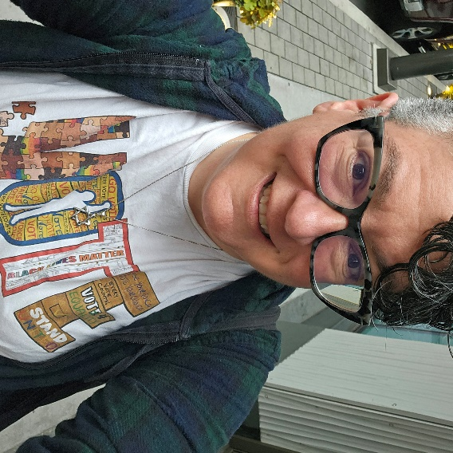
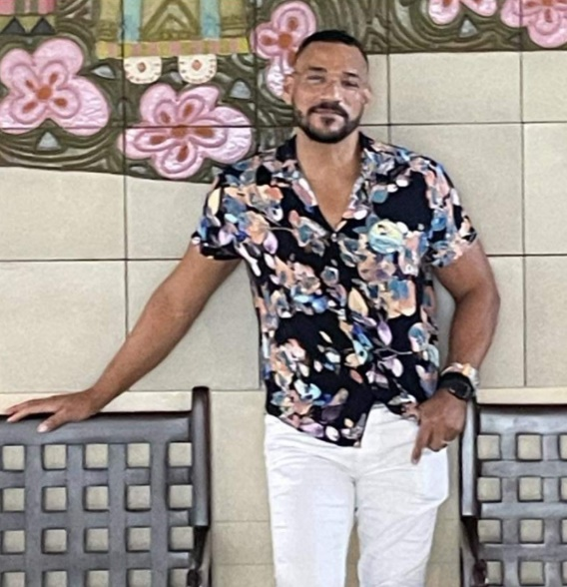
TODAY’S FACILITATORS
JULI
DAVIS
INDIANA
HALIMAH
MEKKI
CALIFORNIA
BEKAH
SAXON
CONNECTICUT
CHAD
WILLIAMS
MICHIGAN
Notes:
JULI

Slide 4
COMMUNITY AGREEMENTS
Using Self-Awareness and Self-Knowledge
Listening for Understanding
Being Gracious
Staying Engaged
Being Open and Suspend Judgment
Saying “I”- tell your truth
Seeking Discomfort
Reaching Empathy
Expecting Non-Resolution and Non-Closure
*Adapted from “Embracing equity and inclusion”, Annie E. Casey Foundation
Notes:
10 MIN TOTAL JULI

Slide 5
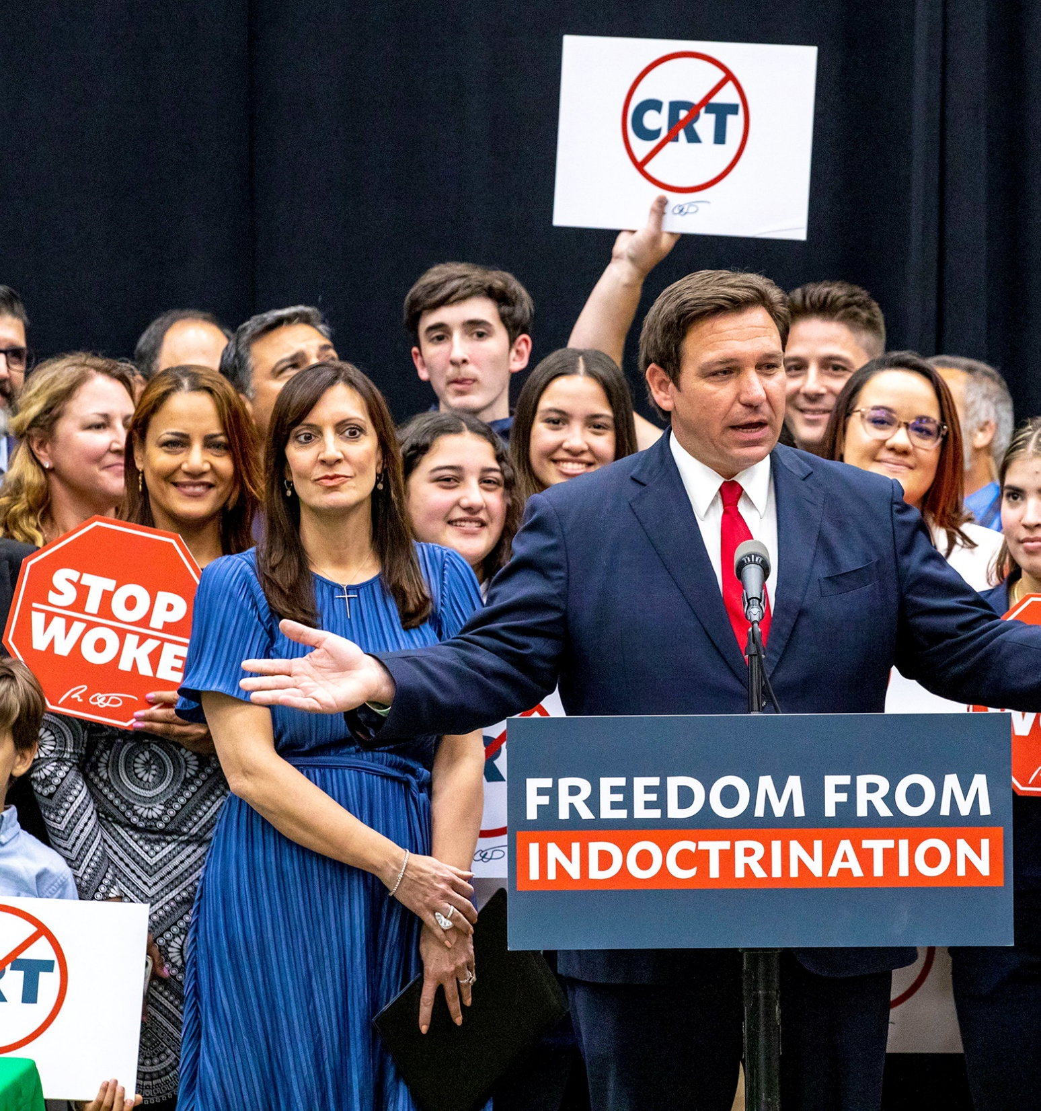
WHY ARE WE HERE?
WHY ARE WE HERE?
Put in the chat:
What are all the ways the boss screws our members over?
What can we change in our members’ lives by electing champions who keep their campaign promises?
Notes:
Bekah

Slide 6



ASSOCIATION READINESS
ASSOCIATION READINESS
BUILD A STRONG
CAMPAIGN FOUNDATION
KNOW THE ELECTION LAWS
KNOW YOUR CONSTITUTION & BYLAWS
GET YOUR LEADERS ENGAGED
KNOW HOW TO TALK W/MEMBERS
EVALUATE ORGANIZATION CAPACITY
ORGANIZATION CAPACITY
Notes:
Bekah

Slide 7
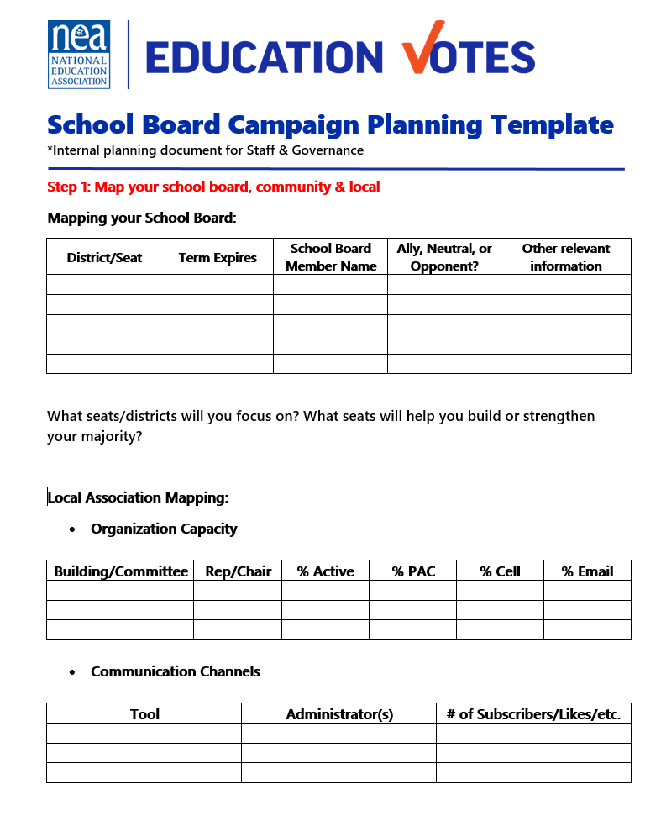

CAMPAIGN PLAN
Mapping
Goals
Strategies & Tactics
Message
Budget
Accountability/task tracker
Timeline
Evaluation & wrap-up
Notes:
Bekah
Mapping – this is getting the lay of the land. Some campaign plans might refer to this section as research.
Goals – these are external goals like winning an election, and our internal goals about increasing PAC participation, recruiting x number of volunteers etc.
Our strategy is our overall plan and our tactics are those individual actions to get us there, for example we know having our members vote in big numbers is part of our strategy and doing building meetings is the tactic to help us achieve that strategy.
Message – We have a message that we will be repeating to external audiences like voters, and what we will be saying to our members to motivate them to vote.
Budget/Fundraising - Elections are expensive and we have outside money trying to influence our elections so it’s critical that we have our own independent political action committee’s to support our campaigns and a budget for our spending priorities.
Accountability/Task tracker –We know stuff doesn’t get done unless there is a name and deadline attached to it.
Timeline – Our last step is putting it on a calendar that will work for you

Slide 8
MAPPING: SCHOOL BOARD
Key Principles: Build majority, keeping friends is priority, beating incumbents is hard, think long term – not just this cycle
 | TERM EXPIRES | SCHOOL BOARD MEMBER | GOOD, NEUTRAL, OR BAD | OTHER
Seat A | 2027 | President Jane Jones | Good | Parent of member
Seat B | 2026 | Vice-President Billy James | Neutral | Basketball coach
Seat C | 2026 | Dolores Smith | Neutral
Seat D | 2024 | Randy Jerk | Bad | As of now, no declared opponent
Seat E | 2025 | Gladys Grumps | Bad | Repeatedly dismissive of concerns
Seat F | 2024 | Jean Garcia | Good | Will face challenger from Moms4Liberty
Seat G | 2025 | Frida Lemon | Neutral | In 3rd term, probably won’t run again
Notes:
Bekah
the first thing we want to map to prepare for the election is that school board
Chart – we want to start with a chart so we can start figuring out how many allies we have and how many races/seats we need to target. We can’t always win everything, so it’s important that we know how to tier these races out based on winning a majority and playing in races we have the most likelihood to win.
Considerations on Assessment of School Board – here are some helpful considerations as you start making your assessments on which races you are going to target.
Key Lessons when deciding electoral priorities
Once you have your chart filled out, as you are making decisions on who is going to receive your financial and volunteer support - make sure you are protecting friends and keep in mind that incumbents are hard to beat. That doesn’t mean don’t try to take them out, but you may not be able to win all those races against established candidates.

Slide 9
MAPPING: YOUR LOCAL
Rules: different rules govern elections & union engagement in elections work
Association rules, examples
Endorsement Process
Approval of Money & Contributions
Elections Rules, examples:
Candidates
Political contributions
Election Activities
Union participation
Money: sources and how can use; Early money is critical for your candidates
Local Dues/General Fund Dollars
can be used for educating, communicating with & supporting your members
Political Dollars/PAC funding
can be used for direct contributions to a candidate
doing a specific activity on behalf of a candidate or in-kind contributions
Notes:
Bekah
once we’ve taken stock of what we need to win, then we need to look internally
Organizing Capacity - our two biggest resources are our organized people and money. We need to know what we have and make sure we have contact info to build more volunteers and PAC.
Communications Tools – we need to know what tools we have access to and be clear who those administrators are.
Leadership engagement – as we start looking at ourselves, we need to make sure we are thinking through how we can get our leaders invested. Maybe that means doing one-on-one policy discussions with candidates. We also need to be thinking through what team we currently have, what strengths we have and what we need to build on.
Constitutions & Bylaws around electoral work – many locals have how you recommend candidates and maybe how money is decided. If it’s not, it’s an important conversation to have with Governance and Executive Boards ASAP.
Rules – knowing the rules for the local, coordinating with candidates, and how you can spend money is crucial. Your GR Director is a good person to start with if you have no idea or want to talk through how you might be able to get creative with campaign spending.

Slide 10
BREAKOUT
List the common “shutdowns” you hear from members (or staff) in your locals when you try to suggest a new approach to elections, recommendation process, or volunteer recruitment. What are the ways you can push back on those shutdowns and overcome the resistance?
Two common problems during elections are no long-term planning to prepare and no member involvement, requiring staff to do the work. What are some processes/structures to put in place to resolve these issues?
Notes:
10 MIN Chad

Slide 11
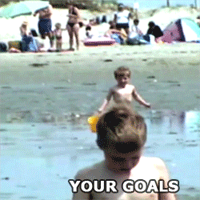
GOAL SETTING
GOAL SETTING
Internal Goals
How will we grow during this election?
  Members voting
  Volunteers active
  PAC participation
Vote Goal
How many voters do we need to win?
Notes:
We have two types of goals. External & Internal.
Our internal goals are about how we plan to build the union, like new PAC donors, volunteers etc.
Our external goals are about how many voters we want to contact, what races we want to win etc.
The most important external goal we need is our vote goal. This is how many voters we need to turn out.
To calculate your vote goal you need to gather information for the past three elections that look like the one you are working on. If it’s in a presidential year, look at the information for that district for the past three presidential elections. Depending on your state, this may be super easy to find on the State Board of Elections website or your clerk’s website.
You will average the turnout for these past three elections. This is your projected turnout %.
You also need to look up how many registered voters there are in this district. Take the percentage from step 1 and multiply that percentage with registered voters. This is your projected voter turnout.
If this is a two-person race, you take that number and multiply .52. If you have more than 2 candidates, you’ll divide it by number of serious viable candidates and add 1. It’s also smart to add cushion on top of that

Slide 12
WHAT IT WILL TAKE TO WIN
STEP 1: PROJECTED TURNOUT %
YEAR | TURNOUT | REGISTRATION | TURNOUT %
2020 | 5,314 | 20,567 | 26%
2016 | 7,896 | 18,345 | 43%
2012 | 6,123 | 17,253 | 35%
Average these=
35%
STEP 2: PROJECTED VOTER TURNOUT
35% x 25,867
=9,053
PROJECTED TURNOUT % MULTIPLIED BY CURRENT REGISTRATION
STEP 3: VOTE GOAL
9,053 x .52 =4708
TWO CANDIDATES: PROJECTED VOTER TURNOUT MULTIPLIED .52
*THREE CANDIDATES: PROJECTED VOTER TURNOUT/3 +1
*VIABLE CANDIDATES
Notes:
Chad

Slide 13
MAPPING: YOUR COMMUNITY
More Power to Elect Candidates
Against Us
With Us
Less Power to Elect Candidates
Notes:
Chad11-13 ONE BLOCK 10 MINUTES
Mapping Community (5 minutes) - The last thing you want to map is your community. You need to know who may be potential allies and who will be your opposition
First step is to brainstorm all the organizations that care about education/work on elections
Plot them on XY axis
Prioritize your outreach to potential coalition partners with more power
Don’t forget to research member involvement, we have a great worksheet you can start using with building reps or and GR committee so you can research what groups our members are already a part of.

Slide 14
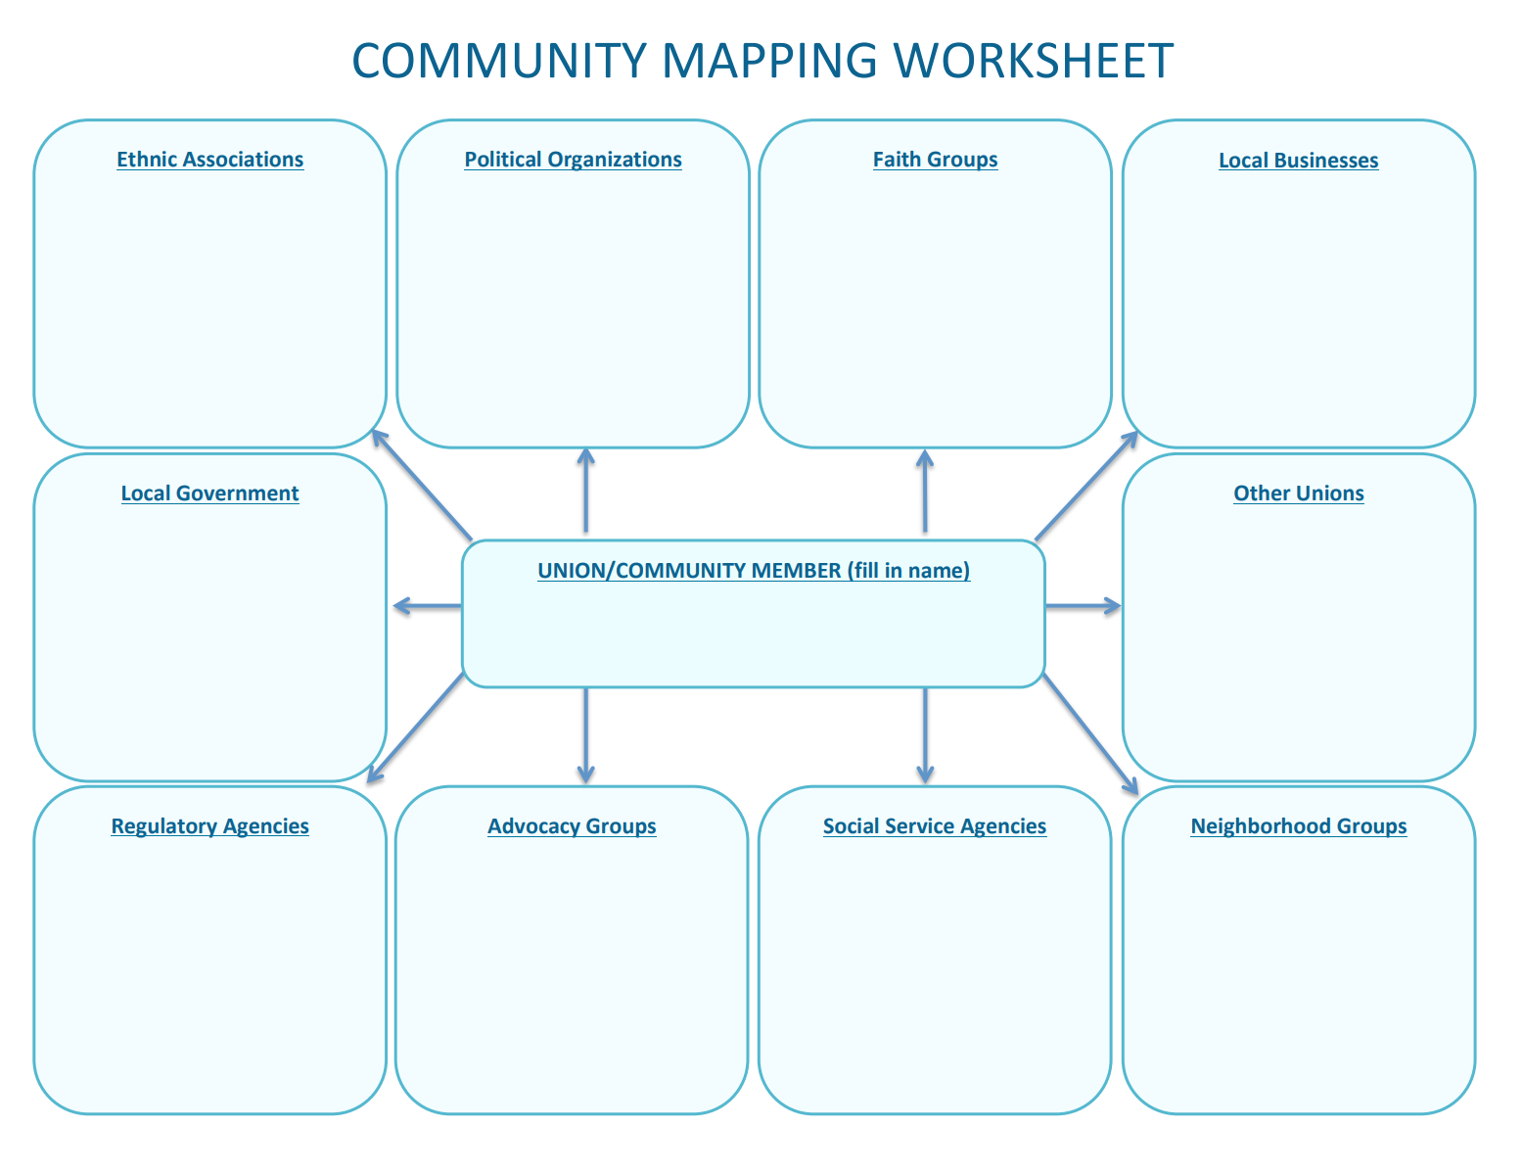
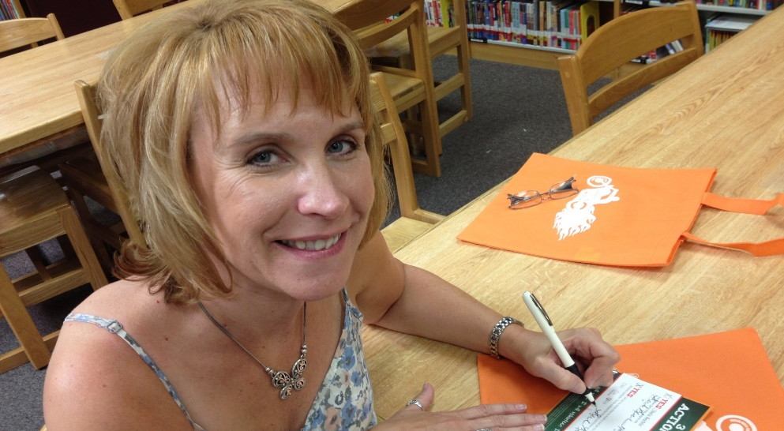
MAPPING: YOUR MEMBERS
Notes:
Halimah
We want to know who is connected to the community organizations, groups, agencies that are with us and will vote for our candidates
This is an opportunity to surface engaged members and activists
This is an activity that can be done months prior to the election season
It can be something added to a new teacher meeting, rep meeting or site visit to learn more about members and what they are interested in
You can create a online form to email to members so that the information can be integrated into a spreadsheet
The members with connections are the ones we should consider recruiting first as they are already connected to the community

Slide 15
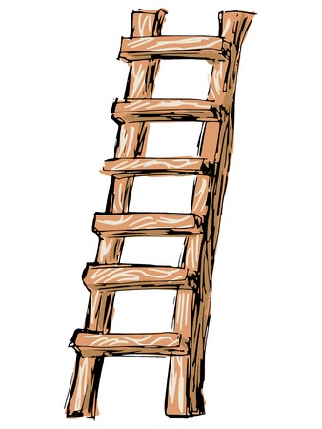
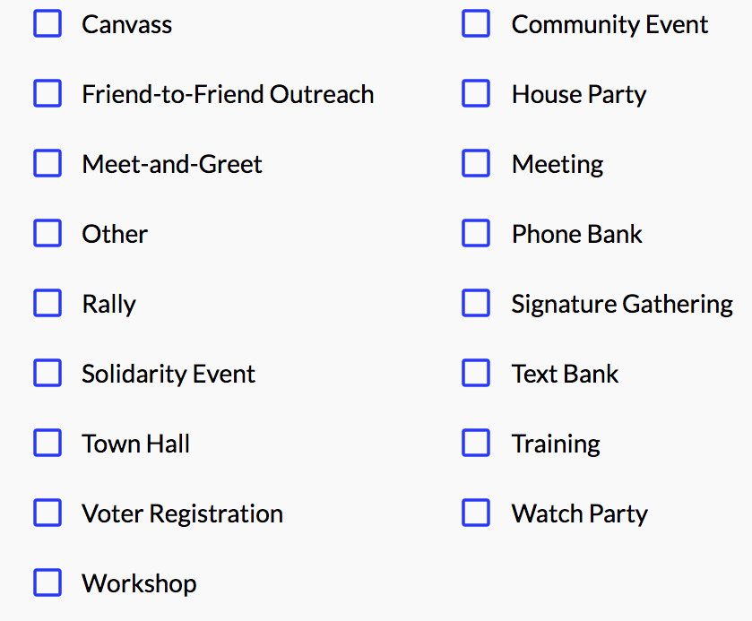
LADDER OF ENGAGEMENT
LADDER OF ENGAGEMENT
Higher:
Risk
Commitment
Skill
Power
Lower:
Risk
Commitment
Skill
Power
Notes:
Halimah
Members tend to want to engage in lower risk engagement, they may need a little push, some training, to build their confidence to engage in higher levels of engagement
Meet them where they are and build in ongoing training as rep meeting and at sites
Encourage members to take risks and engage in activities that are out of their comfort zone
Celebrate when they engage ina high level activity and remind them of what they have achieved when it’s time to plan for the next campaign
Select a variety of engagements for both in person and text/virtual opportunities
Keep track of who is showing up

Slide 16
MEMBER AND VOTER LISTS
MEMBER AND VOTER LISTS
MEMBERS
VOTERS
Get updated lists from School District
Know your members’
interests & capacity
Find a tracking system that
works for your local (if allowed)
Get creative & brainstorm overcoming obstacles with others
Get access to VAN My Voters tab
Work through your candidates
(they can usually get VAN
access through party)
Buy your own voter list
from Board of Elections
Notes:
Halimah
Must have good lists
Request lists from the School District twice a year
Train reps and leaders to engage in one on one conversations (and record responses on members interests and capacity
Survey members to make sure you have attempted to connect with the entire unit
Use tracking systems members can access and maintain (because if not, it will be on staff to keep this up)
Train members on the tools you will use to maintain and update data
Request data early and have member activists review and understand how to use data

Slide 17
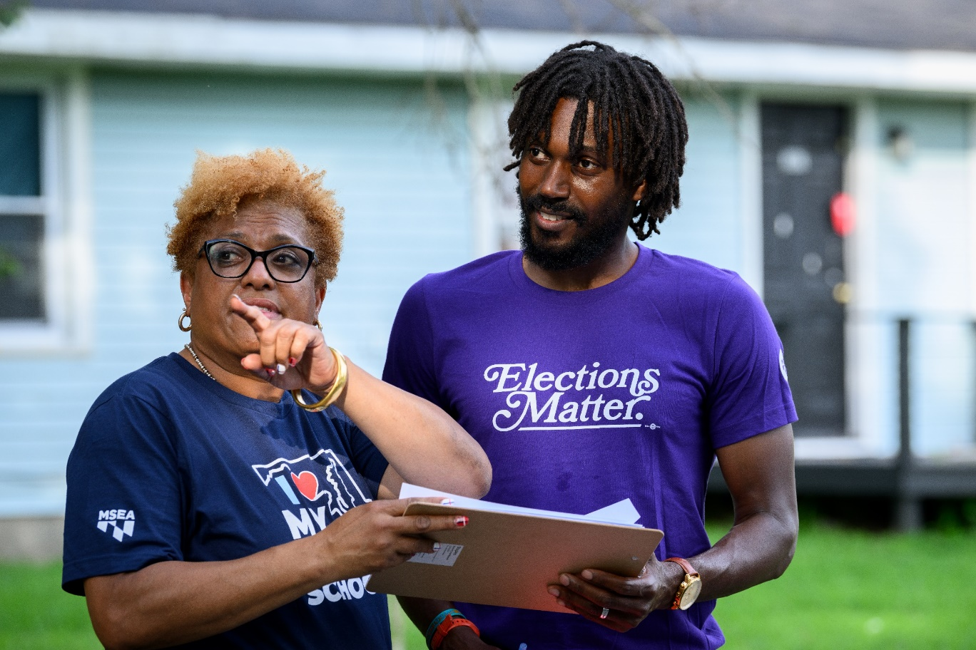
ENGAGING MEMBERS AS ACTIVISTS
ENGAGING MEMBERS AS VOLUNTEERS
Don’t forget to have organizing conversations
Keep building your list
Use the Ladder of Engagement
Make it a good experience
Delegate roles for ownership & turnout
Have a tight turnout plan
Notes:
Halimah 14-17 ONE BLOCK 15 MINUTES
Summary slide
Coach members to do this work
Make it fun!
Create opportunities to build community
Think beyond pizza
Have members set goals, take ownership of success

Slide 18
PRACTICE PLANNING
Assume you all work in the targeted local as members or staff. In your breakout room, plan a campaign to flip the school board as presented.
1. who is your target for 2024?
2. who is your target for 2025?
3. Map the community using your knowledge of your actual community
4. how will you identify potential candidates for recruitment against Randy Jerk?
5. BONUS: how can your work in 2024 set you up for 2025?
Notes:
20 MIN halimah

Slide 19
REFLECTIONS
What were you missing?
How would you get it for your own campaigns?
Notes:
20 MIN halimah

Slide 20
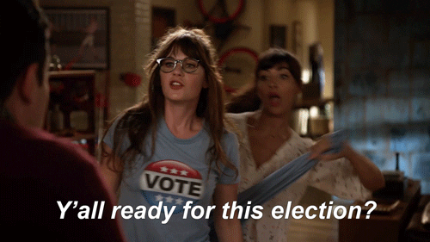
RESOURCES & WRAP
Don’t get in trouble, follow your chain of command
educationvotes.nea.org
  App for digital organizing
  Virtual trainings
  Social media graphics
PDF of Handouts
Evaluation link in the chat
Questions?
ELLEN HOLMES eholmes@nea.org
JULI DAVIS jdavis@ista-in.org
HALIMAH MEKKI hmekki@cta.org
BEKAH SAXON bekahs@cea.org
CHAD WILLIAMS cwilliams@mea.org
Notes:
5 MIN JULI

