Slide 1


Welcome to Advanced Site Based Representation

Slide 2
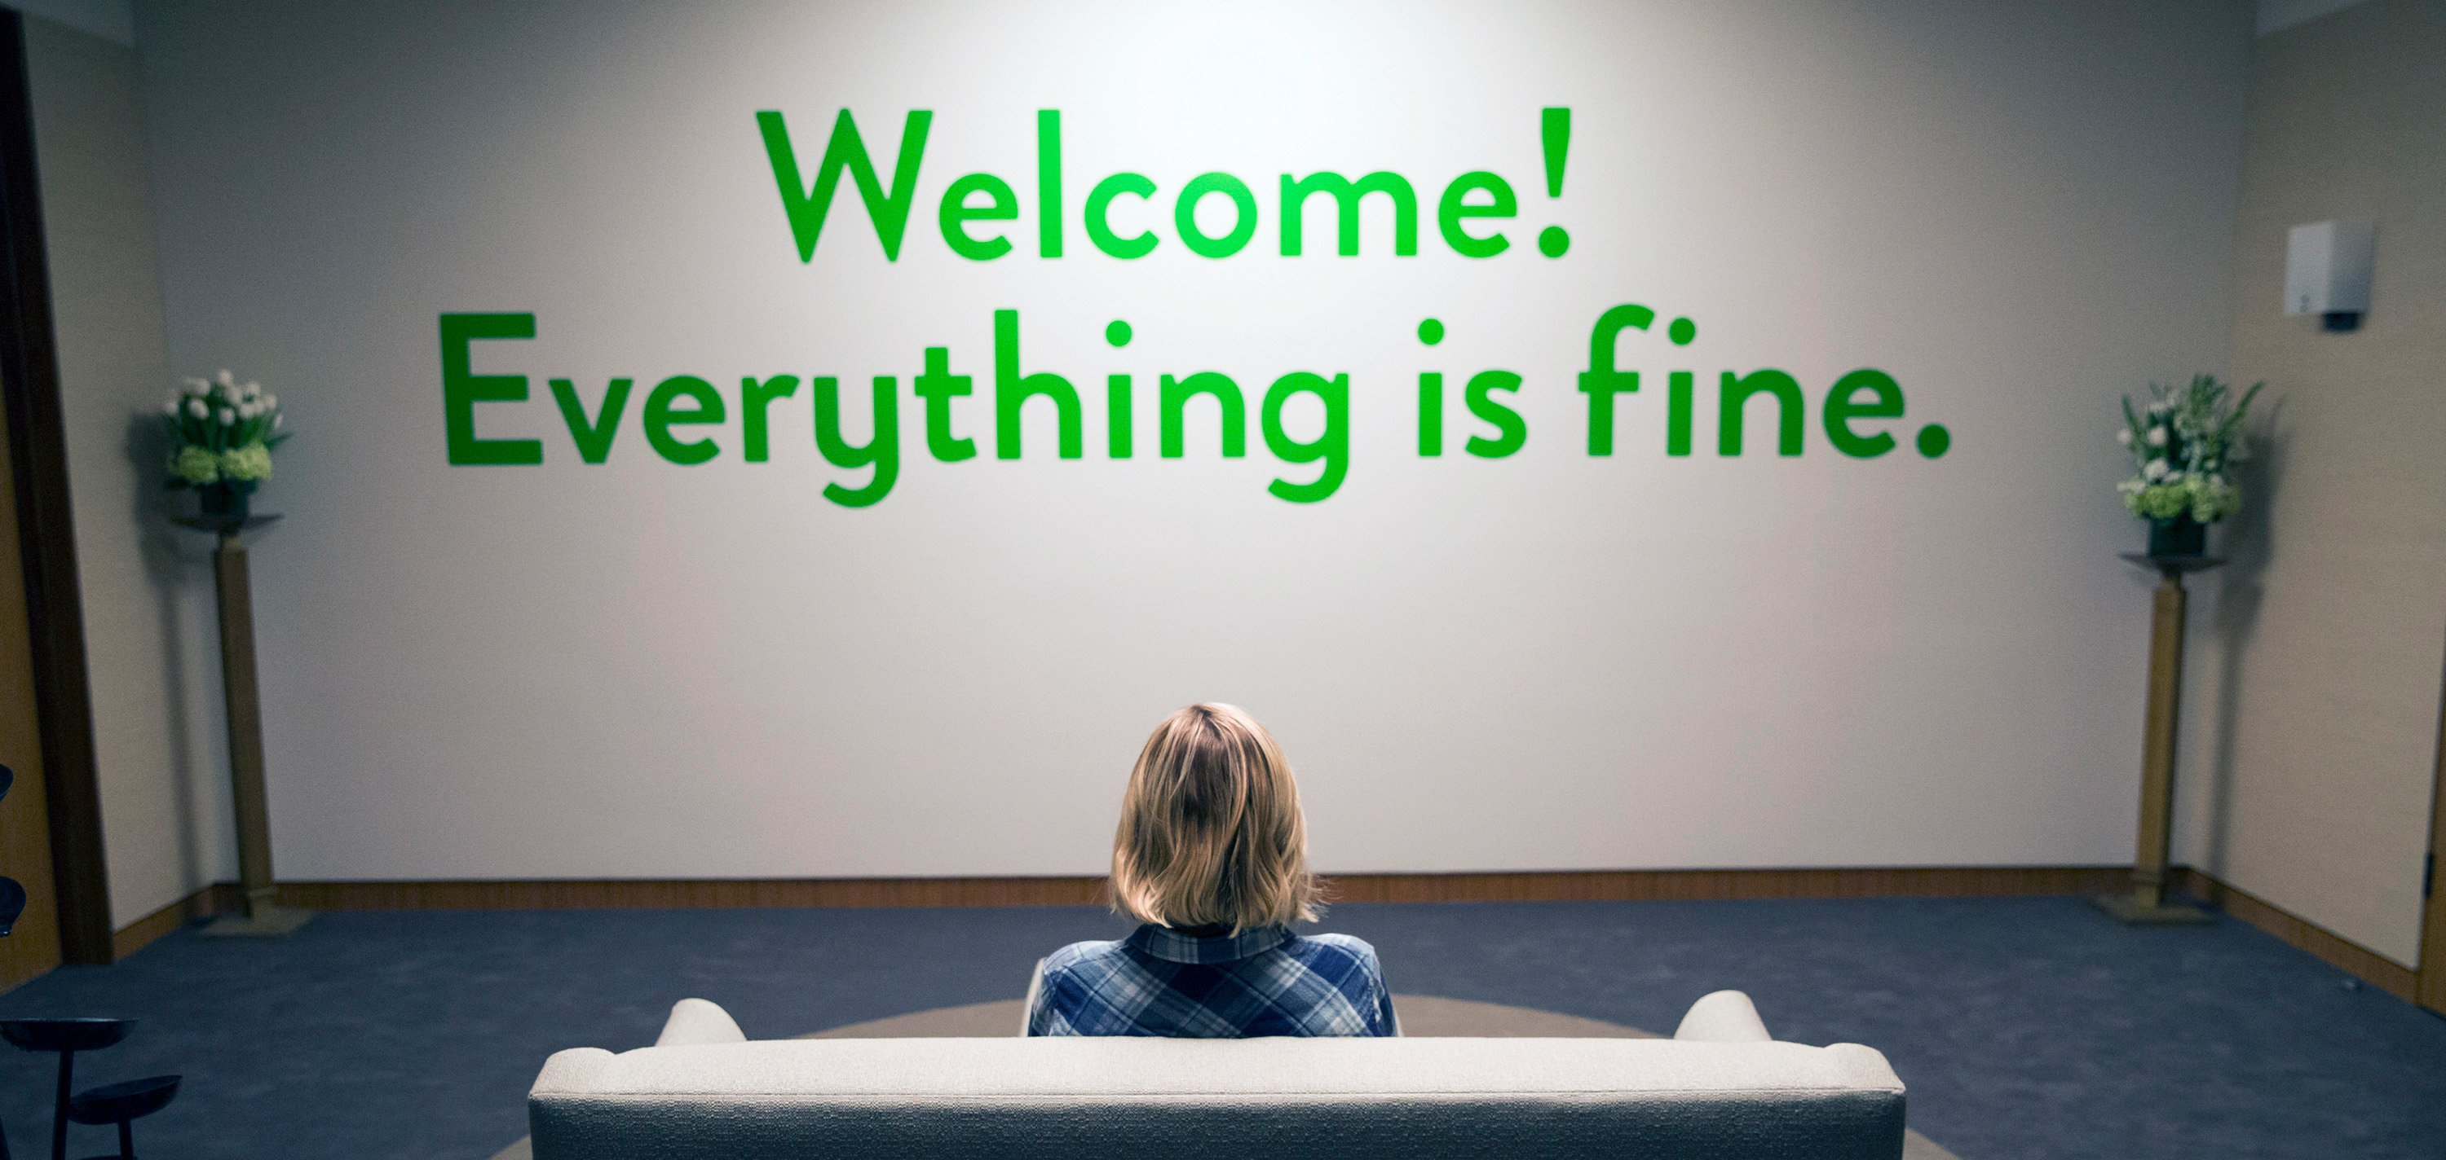
Getting To Know You
Your name, your position, and local
What experience do you have representing members or issues?
What goal do you have as a leader for this upcoming year?

Slide 3
Ground Rules and Classroom Expectations
Using Self-Awareness and Self-Knowledge
Step Forward/Step Back
Listening for Understanding
Being Gracious
Staying Engaged
Being Open and Suspend Judgment
Expecting Non-Resolution and Non-Closure

Slide 4


The Parking Lot
ELMO

Slide 5
Understanding Your Contract
The contract is the document that governs the workplace.
-Negotiated by both sides
-Binding and enforceable.
What are some of the topics that are covered in the contract?

Slide 6
Understanding Your Contract
Knowing You Contract Activity

Slide 7
Timelines!
Timelines are very important. Missing a deadline will usually end a case immediately.

Slide 8
Not all work issues are contract violations.
  -Other violations of policy, past practice, law.
  -Non-contractual issues
  What can be done about these types of issues?

Slide 9
Is This a Contract Violation? Activity

Slide 10
End of Day 1
-Questions?
-For tomorrow
-Have fun!

Slide 11
Day 2
WELCOME BACK!
AS YOU COME IN THIS MORNING, TAKE A MOMENT TO ADD TO THE CHART PAPER:
WHAT 3 THINGS DO YOU BELIEVE ARE IMPORTANT IN YOUR ROLE AS A REPRESENTATIVE OF THE UNION?

Slide 12
Interacting with Members
Overview of Role as Representative
Interviewing Members
Dealing with Challenging Members

Slide 13

What is Representation?
Speaking for the organization, not as an individual
Speaking on behalf of someone else's interest
Standing up to those in power

Slide 14
As a Union Representative in your Building, you are the backbone of your union
It is your job to develop relationships and trust with your colleagues
The BEST way to do this is through Transparency and Competence

Slide 15
Transparency
NEVER meet with building administration in secret
Start a weekly/monthly newsletter with relevant union and building updates
Give clear updates on your activities at Rep Assembly/Council meetings
Speak with members regularly one-on-one
What else?

Slide 16
Competence
Know the basics of your contract to answer questions
Know where to go to get answers
Follow through on your word, both with members and with administration
Lead by example though setting regular meetings and challenging administration when necessary
What else?

Slide 17
Toady
Firebrand
Leader
Buddy-buddy with principal
Gossips about members
Talks about how members need to be "reasonable"
Makes excuses for management
Always skeptical of administration
Complains but won't lead change
Often loudest voice in room
Polarizing
Trusted by management and members
Focuses on solutions, not personalities
Moves others to take action – not a solo actor
Consensus builder

Slide 18
Confidentiality
As a Union Representative, you occupy space as BOTH a colleague and a formal position in the Union
Navigating this space can be tricky
Golden Rule: Assume what members disclose to you is confidential unless told otherwise
Likewise: NEVER agree to confidentiality with management
Notes:
Tip: tell folks, "Unless you tell me otherwise, everything you tell me is confidential".

Slide 19
Best Practices for Confidentiality
Use personal emails whenever possible
When discussing problems in a wider group, do not use names unless given permission
Use anonymous surveys when gathering input from members
Do not single out individuals when bringing concerns to management

Slide 20
When do I Represent?
Types of Representational Meetings
Level 1 or Informal Grievance Hearing
'Fact-Finding' meeting during disciplinary investigation
Problem Solving Meeting
What other spaces do we "represent" our members?
Notes:
Ask folks to look in contract for retaliation protections

Slide 21
In all of these meetings you want to interview members because:
Want to get the facts from multiple perspectives
Identify how widespread a problem is
Prepare for confrontations with management
Clear notes if case escalates to a UniServ
Why else?

Slide 22
Grievance/Problem Interview
What you want to find out:
Nature of complaint (contract violation, non-contract problem, personal gripe?)
When did problem start?
What attempts have been made to solve problem?
How many members does this impact?
Does member understand the contract language?
What solution does the member want? Are they open to alternatives?
Is management aware? What is their response?
Notes:
Ask folks to look in contract for retaliation protections

Slide 23
Meeting with Managment Interview
What you want to find out:
Is the meeting disciplinary?
What are the specific allegations?
What is the member's recollection of events?
Are any other union members involved?
What were the interactions between member and management prior on this issue?
Get a timeline of events if possible
Notes:
Ask folks to look in contract for retaliation protections

Slide 24
Interviewing Dos and Don'ts
DO
Don't
Ask open-ended questions
Dig into details
Review contract with member
Emphasize your formal role
Reassure member against retaliation
Confirm understanding of events
Make assumptions
Interrupt member
Use jargon
Disclose confidential information
Highlight personal conflicts
Make promises you can't keep
Notes:
Ask folks to look in contract for retaliation protections

Slide 25

Interviewing Activity

Slide 26
Challenging Members
As a Union Representative, you are the first line of defense and first point of contact for members when they need help.
Members will come to you in a variety of stressful emotional states: angry, scared, confused, overwhelmed, etc.
It is your job to meet members where they are and do your best to assist them. This takes diplomatic skill and practice.

Slide 27
Members often react in one of three ways:
Timid/scared or hesitant
Angry and Upset
Stubborn "know it all"

Slide 28

Timid Members
Identify why they are scared:
Fear of retaliation?
Guilt over 'making waves'?
Confusion on what their option are?
Lack of knowledge of the grievance process?
Why else would our members be scared to take action?
Notes:
Ask folks to look in contract for retaliation protections

Slide 29

Timid Members
Best practices when interacting:
Focus on the "bureaucratic" nature of your role as BR (i.e., "I'm just here to talk with you about what happened")
Assert confidence through clear knowledge of rights and contract
Emphasize that any decision to act is theirs, but you're here to support them
Clarify member's rights against retaliation and 'inoculate' on what discipline process looks like
Notes:
Ask folks to look in contract for retaliation protections

Slide 30
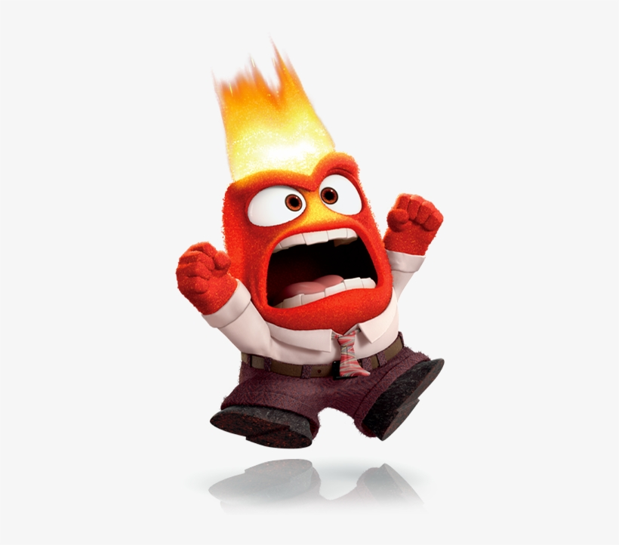
Angry Members
Identify why they are angry:
Personal beef with admin?
Unjustified accusations?
Defense mechanism?
Lack of control?
History with union?
Why else would our members be angry?
Notes:
Ask folks to look in contract for retaliation protections

Slide 31

Angry Members
Best practices when interacting:
Maintain calm and steady emotions – do NOT escalate
Lay out options objectively
Express sympathy, but be direct in your assessment
Focus on the shared goal and outcome (solving the problem)
Don't allow yourself to be brow-beaten or accept abuse
Notes:
Ask folks to look in contract for retaliation protections

Slide 32
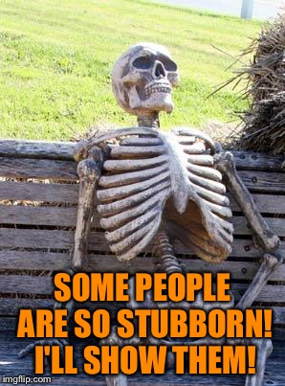
Stubborn Members
Identify why they are so resistant:
Past history with union?
Personal agenda?
Beef with admin?
Refuse to acknowledge any fault?
Why else would our members be stubborn?
Notes:
Ask folks to look in contract for retaliation protections

Slide 33
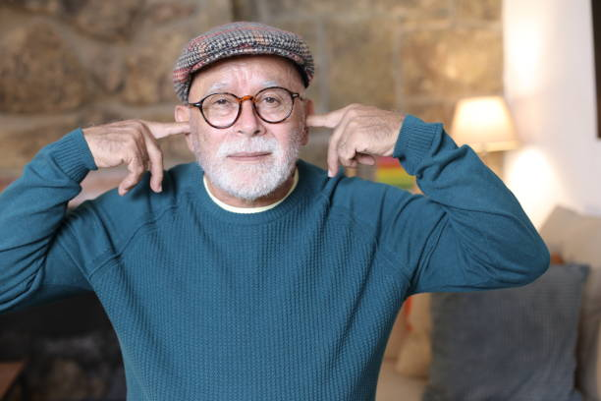
Stubborn Members
Best practices when interacting:
Remind them of your role as BR to support and help
Directly lay out consequences for action/inactions
Set clear expectations of what they can expect from you and union
Do not make promises you cannot keep
Consider sending a follow up message detailing what you've agreed to
Notes:
Ask folks to look in contract for retaliation protections

Slide 34
Challenging Members Activity

Slide 35
Day 3
Welcome back!

Slide 36
Day 3 AM: The Law
Weingarten Rights
Maryland Specific Appeals
Grievance and Arbitration

Slide 37
Solidarity Activity Conversation
What did we learn?
What went well?
What was a challenge?

Slide 38
Weingarten Rights
"If this discussion could lead to my being disciplined or terminated,
I request that my union representative be present at the meeting."

Slide 39
Weingarten Rights
Established in the private sector by the Supreme Ct. in NLRB vs. Weingarten.
State employees have won similar rights through state law, state labor board decisions, or union contracts.
Union contracts typically use the same language as the Weingarten decision; union interpret their contracts to provide the strongest rights guaranteed to the private sector under Weingarten.

Slide 40
When do Weingarten Rights Apply?
Supervisor makes attendeance mandatory.
Meeting is (or becomes) part of an investigation.
Employee reasonably believes discipline could result.
Employee requests prepresentation.

Slide 41
When do Weingarten Rights Not Apply?
Employee has asked for the meeting.
Meeting is for routine supervisory purposes.
Supervisor has assured employee that discussion is not part of a disciplinary investigation.
Meeting is disciplinary, but employee did not request union representation.

Slide 42
Weingarten Rights
Reasonable belief depends on circumstances:
Has supervisor issued prior warnings?
Have others been disciplined for similar conduct?
Has the employee been under scrutiny?

Slide 43
Weingarten Rights
Unsure whether it's a disciplinary meeting? Then ask!
Regardless of whether the meeting is found to be disciplinary, you cannot be disciplined for asking for a union rep.

Slide 44
Rep's role during investigatory meetings
Consult with the employee before the meeting.
Review pertinent documents.
Ask clarifying questions.
Encourage employee to be calm.
Caucus during meeting if necessary.
Be a credible witness and take good notes; you may be asked to testify later.

Slide 45
Check out page 2.18 and R.7 in your Rep Handbook for more info about Duty of Fair Representation
Duty of Fair Representation:
"[The] union has the duty to represent all employees - whether members of the union or not - fairly, in good faith, and without discrimination. This duty applies to virtually every action that a union may take in dealing with an employer as your representative, including collective bargaining, handling grievances, and operating exclusive hiring halls." (NLRB)
As a Building Representative – this means YOU!

Slide 46
Duty of Fair Representation:
As a legal representative of your Union, you need to exercise good judgment to help prevent a DFR claim.
Always, always, always document representative interactions with members
Build trust with your members and create reputation for impartiality
Treat members in similar situations similarly
This does NOT mean you have to file a grievance every time a member wants one, but it does mean you need to be able to show good and fair reasons for refusing to do so
When in doubt – CALL YOUR UD!

Slide 47
Seven Tests of Just Cause
Used by hearing officers and arbitrators to ensure fundamental fairness
Most decision-makers will apply the tests holistically—taking the "big picture" rather than focusing on technical deficiencies

Slide 48
Test One—Reasonable Rule or Work Order
Is the rule or order reasonably related to the orderly, efficient, and safe operation of the business? Is the rule or instruction straightforward and stated in language that is easy to understand? Has it been applied consistently?
Consider "reasonableness" not just from the adminstration's viewpoint, but from the employee's viewpoint, too.

Slide 49
Test Two—Notice
Did the employee receive adequate notice of the work rule or performance standard and the possible consequences of failure to comply?
Is it up-to-date and relevant to operational needs?
How was the method for informing the employee appropriate for the seriousness of the rule?
Was it discussed in staff meetings or prior oral or written communications?
What evidence shows the employee was aware of it and understands it?

Slide 50
Test Three—Sufficient Investigation
What caused the belief that a violation occurred?
Did the investigator ask the employee for a written statement or other written confirmation of the employee’s version of the alleged infraction?
Were others with knowledge of or involvement in the issue interviewed and were their answers recorded and confirmed?
Is there equipment that the supervisor or experts should have examined?

Slide 51
Test Four—Fair Investigation
Was the investigation fair and objective?
Did the investigator have a preconceived belief that an infraction occurred?
Was the investigator too close to the matter to be objective, or influenced by factors irrelevant to the alleged infraction?

Slide 52
Test Five—Proof
What evidence supports the conclusion?
Did the investigator discard allegations that he or she could not validate?
What solid—not flimsy or slight—evidence formed the basis for taking disciplinary action?

Slide 53
Test Six—Equal Treatment
Has the employer dealt with employees equally and without discrimination?
Was the rule applied consistently with similarly situated employees?
What is the employer’s record for disciplinary action for this type of infraction?

Slide 54
Test Seven—Appropriate Discipline
Is the discipline reasonably related to the magnitude of the problem that the alleged violation caused?
For instance, did it create danger or a severe workflow disruption?
Is it reasonably associated with the employee’s length of service and overall performance?
Is the violation part of a pattern?
Is it based on a minor infraction, which does not merit harsh discipline unless it is a repeat occurrence?

Slide 55
Appeals, Grievances, and Arbitrations
Which process applies and under what circumstances?
CBA, or COMAR §4-205, §6-202
COMAR = Code of Maryland Regulations
Can select either the CBA grievance process or an adminstrative appeal, not both!
Note: MSEA does not represent non-members in administrative appeals.

Slide 56
The Administrative Appeal Process under §4-205 Appeals is available to certificated and non-certificated employees. The CBA's grievance process is available to certificated employees and in some counties to non-certificated employees. Challengeable actions:
Discipline (i.e. Warnings, Reprimands; NOT Suspensions or Dismissal/Termination)
Evaluation (Only whether the proper process was followed, not the final assessment of performance)
Being put on a Performance Improvement Plan only if it arises from discipline

Slide 57
§4-205 – Individual elects administrative appeal process
Local superintendent may hold a hearing (it is not required) and issues a decision.
Superintendent’s decision may be appealed by individual to county board. Hearing may be held (it is rarely required) and county board issues a decision.
Since hearing is unlikely, submit affidavits and arguments in writing.
County board’s decision may be appealed by individual to State Board. State Board’s review is limited in scope and does not require a hearing. State Board issues a decision.

Slide 58
If the employee chooses the CBA:
Grievance process moves forward per CBA. May be resolved at any step.
If issue is not satisfactorily resolved at lower steps of grievance process, the local may decide to file for arbitration.
If filed for arbitration, a hearing is held, and the arbitrator issues a decision. This is the last step unless otherwise indicated in the CBA.

Slide 59
Challenging a Suspension or Termination (certificated staff)
§6-202 Appeals are available to certificated employees
Request hearing before local BOE within 10 days of decision; BOE or hearing examiner holds hearing and issues decision; may appeal to state BOE within 30 days. State BOE holds hearing and issues decision.
OR
Request hearing before an arbitrator within 10 days of decision; Hearing is held before an arbitrator and arbitrator issues decision. Arbitrator determines whether the county board had "sufficient cause" to suspend or terminate. A request may be made for judicial review by a circuit court. Circuit court review is limited to legality (no substantive review) and issues a decision.

Slide 60
§6-202 of the Maryland Education Article- Suspensions and Terminations of Certificated Employees (Excerpts)
(a)(1) On the recommendation of the county superintendent, a county board may suspend or dismiss a teacher, principal, supervisor, assistant superintendent, or other professional assistant for:
(i) Immorality;
(ii) Misconduct in office, including knowingly failing to report suspected child abuse in violation of § 5-704 of the Family Law Article;
(iii) Insubordination;
(iv) Incompetency; or
(v) Willful neglect of duty.

Slide 61
Day 3 PM: Meeting with the Principal
A team role play activity to put into practice what we have learned at SLC.

Slide 62
Interacting with Members - Summary
As an Association Representative, you are the frontline of your Union and will be called upon to represent your colleagues with management
These meetings will often take the form of a low-level grievance, discipline meeting, or problem-solving
In all these scenarios, you want to interview the member and any relevant witnesses to get as much information as possible
Our jobs are stressful, and anything involving their union can lead to strong emotional reactions from our members
Part of your job is meeting members where they are and helping them work through those emotional states to solve the problem
In all of this, you need to maintain a posture of fairness and impartiality as a legal representative of your union
Notes:
Ask folks to look in contract for retaliation protections

Slide 63

YOUR RIGHTS AS A REP
YOU ARE PROTECTED FROM RETALIATION
CODE OF MARYLAND REGULATIONS (COMAR)
6-402: Public school employees may form, join, and participate in the activities of employee organizations of their own choice for the purpose of being represented on all matters that related to salaries, wages, hours, and other working conditions
6-409 A public school employer and employee organization may not interfere with, intimidate, restrain, coerce, or discriminate against any public school employee because of the exercise of their rights under 6-402, etc.
WHERE ELSE CAN WE LOOK FOR PROTECTION?
Notes:
Ask folks to look in contract for retaliation protections

Slide 64
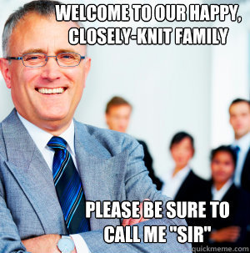
YOUR RIGHTS AS A REP
When you speak to your administration on a union issue as a Rep, you are not in a subordinate position.
You are equals.
(see 2.17 in AR Handbook for tips talking to admin)

Slide 65
THINGS THAT ARE (LIKELY) NOT RETALIATION
COMAR 6-201:
The county superintendent shall assign [staff] to their positions in schools; transfer them as the needs of the schools require
Didn't get promotion or position you applied for
Grade level or subject change

Slide 66
CASE STUDY
Basic Facts of Case
After school Union Faculty Advisory Council (FAC) with principal
Principal states Union member was part of a committee
Union member stands up, pounds fist on table, yells that it isn't true
Principal apologizes but later "verbally counseled" the member for his "insubordination"
In May, principal initiated a request to transfer the union member because of the "strained relationship" and that he "constantly files grievances claiming they are on behalf of the FAC" and he has impacted the "collegial atmosphere among colleagues"
Is this retaliation?
Notes:
Aribitration Case: Prince George's County- 2021: Teacher was Rep and member of FAC. At meeting with principal, pounded fist, yelled. Principal transferred teacher stating that he was preventing her from forming a "collegial atmosphere among the colleagues of the FAC" and he was "constantly filing grievances". The arbitrator sided with the union. The principal transferred the teacher in retaliation of his union activities and the transfer was overturned.

Slide 67

Case Study: Arbitrator's Decision
" I do not agree with the Board that the Grievant's conduct on February 22 was uncivil and therefore actionable, particularly where, as here, the Grievant was engaged in clear-cut protected union activity and was doing nothing more than engaging in "robust debate" about a misstatement made... The real reason Principal initiated the transfer action was to get rid of the Grievant so as to convert the labor-relations environment from contentious to collegial, her preferred way to conduct labor-management at her school".

Slide 68
TYPES OF REPRESENTATION MEETINGS
Discipline
Problem Solving
Contract Violation
IMPORTANT: YOU SHOULD NOT FILE A GRIEVANCE; YOU ARE TRYING TO RESOLVE AT THE LOWEST LEVEL POSSIBLE WHICH IS AT THE WORK SITE.
KEEP YOUR UNISERV DIRECTOR INFORMED OF WHAT'S OCCURING.

Slide 69
TIPS
Stay calm; you're seeking to resolve the situation, not escalate
Don't be afraid to caucus, or take a break, with the member
Take good notes; try to capture what is discussed; capture important dates, comments, and details
Ask clarifying questions
Keep in communication with your UD
Check out pages 2.23 and 2.24 in your AR Handbook for more great TIPs!

Slide 70

When to Turn it Over to the UD
Discipline that could result in termination
CPS Investigation
IMMEDIATELY!
Evaluation Issue

Slide 71
Types of Bosses
COLLABORATIVE LEADER
RULE FOLLOWER
KNOW YOUR AUDIENCE AND PLAN YOUR ARGUMENT ACCORDINGLY
UNIFORMED
CONFUSED
FEARFUL
AGGRESSIVE
Notes:
Ask folks to look in contract for retaliation protections
Aggressive: Liz
Airhead: Mike
Rule follower: Mike

Slide 72
Role Play
Remember Ms. Smith?
It's time to meet her principal.
Your job as rep is to present your case to the principal.

Slide 73
Presenting an Effective Case
Start with the Contract
Composure
Stick to the facts
Remember you are an equal to admin in your role as a Rep
Seek to find solutions
Avoid losing your temper
Contract Violation(s)
Have the language ready to show admin
Is there a school policy/procedure that applies?
Make sure you have dates and are aware of any timelines for grievances
TAKE CLEAR NOTES IN THE MEETING AND ALWAYS GO INTO A MEETING WITH A PLAN!
Notes:
Check out 2.20 for an example of a case intake form

Slide 74
Problem Solving and Building Power
WHY ARE FACULTY ADVISORY COUNCILS AN EFFECTIVE TOOL FOR A BUILDING WIDE ISSUE?
FACULTY ADVISORY COUNCILS
DOES YOUR CONTRACT HAVE ONE?
Notes:
Ask folks to look in contract for FACs

Slide 75
Whova Evaluation
Please take a few minutes to fill out an evaluation for today's class. Your feedback is important to us!

Slide 76
Problem Solving and Building Power
WHAT IF YOUR CONTRACT DOESN'T HAVE A FACULTY ADVISORY COUNCIL? HOW ELSE CAN YOU BUILD POWER IN YOUR BUILDING?
WITH A PARTNER, USE CHART PAPER TO BRAINSTORM SOME WAYS TO BUILD POWER REGARDING A BUILDING WIDE ISSUE
Notes:
Want more on this? Take Organizing next year!

Slide 77
REMEMBER YOUR POWER
RELATIONSHIPS WITH ADMIN AND MEMBERS
THE CONTRACT
FACULTY ADVISORY COUNCIL
ORGANIZING MEMBER POWER

Slide 78
USING THE CASE STUDY DETAILS YOU WERE PROVIDED, DEVELOP A PLAN TO TRY AND RESOLVE THE ISSUE AT THE LOWEST LEVEL POSSIBLE.
CASE STUDIES
DEVELOP MEETING PLAN
ARE THERE CONTRACT VIOLATIONS?
MEMBER INTERVIEWS
CAN YOU USE A FACULTY ADVISORY COUNCIL?
OTHER WAYS TO BUILD POWER WITH MEMBERS?
Notes:
Ask folks to look in contract for retaliation protections

Slide 79
PRESENTING CASE STUDIES

Slide 80
WHOVA EVALUATION
Please take some time to fill out the evaluation for this course. Your feedback is important to us and we will use it to improve the course for next year's participants.

