Slide 1







Slide 2


Final Day!
As you enter today, write on the chart paper what you believe is important about your role as an association/building representative

Slide 3


How can I best advocate at my worksite?
Today we will:
Roleplay advocacy scenarios
Assess opportunities for site-based advocacy
Develop a plan for site-based advocacy moving forward

Slide 4
What is Representation?
Speaking for the organization, not as an individual
Speaking on behalf of someone else's interest
Standing up to those in power

Slide 5
As a Union Representative in your Building, you are the backbone of your union
It is your job to develop relationships and trust with your colleagues
The BEST way to do this is through Transparency and Competence

Slide 6
Transparency
NEVER meet with building administration in secret
Start a weekly/monthly newsletter with relevant union and building updates
Give clear updates on your activities at Rep Assembly/Council meetings
Speak with members regularly one-on-one
What else?

Slide 7
Competence
Know the basics of your contract to answer questions
Know where to go to get answers
Follow through on your word, both with members and with administration
Lead by example though setting regular meetings and challenging administration when necessary
What else?

Slide 8
Toady
Firebrand
Leader
Buddy-buddy with principal
Gossips about members
Talks about how members need to be "reasonable"
Makes excuses for management
Always skeptical of administration
Complains but won't lead change
Often loudest voice in room
Polarizing
Trusted by management and members
Focuses on solutions, not personalities
Moves others to take action – not a solo actor
Consensus builder

Slide 9
Confidentiality
As a Union Representative, you occupy space as BOTH a colleague and a formal position in the Union
Navigating this space can be tricky
Golden Rule: Assume what members disclose to you is confidential unless told otherwise
Likewise: NEVER agree to confidentiality with management
Notes:
Tip: tell folks, "Unless you tell me otherwise, everything you tell me is confidential".

Slide 10
Best Practices for Confidentiality
Use personal emails whenever possible
When discussing problems in a wider group, do not use names unless given permission
Use anonymous surveys when gathering input from members
Do not single out individuals when bringing concerns to management

Slide 11
When do I Represent?
Types of Representational Meetings
Level 1 or Informal Grievance Hearing
'Fact-Finding' meeting during disciplinary investigation
Problem Solving Meeting
In what other spaces do we "represent" our members?
Notes:
Ask folks to look in contract for retaliation protections

Slide 12
What could representation look like?
Insert Video Here

Slide 13
What did you notice?
What do you wonder?

Slide 14
In all of these meetings you want to interview members because:
Want to get the facts from multiple perspectives
Identify how widespread a problem is
Prepare for confrontations with management
Clear notes if case escalates to a UniServ
Why else?

Slide 15
Grievance/Problem Interview
What you want to find out:
Nature of complaint (contract violation, non-contract problem, personal gripe?)
When did problem start?
What attempts have been made to solve problem?
How many members does this impact?
Does member understand the contract language?
What solution does the member want? Are they open to alternatives?
Is management aware? What is their response?
Notes:
Ask folks to look in contract for retaliation protections

Slide 16
Meeting with Management Interview
What you want to find out:
Is the meeting disciplinary?
What are the specific allegations?
What is the member's recollection of events?
Are any other union members involved?
What were the interactions between member and management prior on this issue?
Get a timeline of events if possible
Notes:
Ask folks to look in contract for retaliation protections

Slide 17
Interviewing Dos and Don'ts
DO
DON’T
Ask open-ended questions
Dig into details
Review contract with member
Emphasize your formal role
Reassure member against retaliation
Confirm understanding of events
Make assumptions
Interrupt member
Use jargon
Disclose confidential information
Highlight personal conflicts
Make promises you can't keep
Notes:
Ask folks to look in contract for retaliation protections

Slide 18


Interviewing Activity

Slide 19
YOUR RIGHTS AS A REP
YOU ARE PROTECTED FROM RETALIATION
CODE OF MARYLAND REGULATIONS (COMAR)
6-402: Public school employees may form, join, and participate in the activities of employee organizations of their own choice for the purpose of being represented on all matters that related to salaries, wages, hours, and other working conditions
6-409 A public school employer and employee organization may not interfere with, intimidate, restrain, coerce, or discriminate against any public school employee because of the exercise of their rights under 6-402, etc.
WHERE ELSE CAN WE LOOK FOR PROTECTION?
Notes:
Ask folks to look in contract for retaliation protections

Slide 20
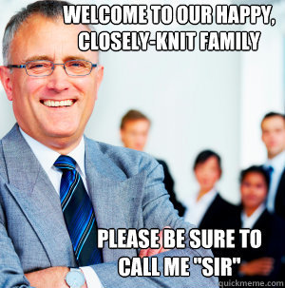
Your Rights as a Rep
When you speak to your administration on a union issue as a Rep, you are not in a subordinate position.
You are equals.

Slide 21
THINGS THAT ARE (LIKELY) NOT RETALIATION
COMAR 6-201:
The county superintendent shall assign [staff] to their positions in schools; transfer them as the needs of the schools require
Didn't get promotion or position you applied for
Grade level or subject change

Slide 22
CASE STUDY
Basic Facts of Case
After school Union Faculty Advisory Council (FAC) with principal
Principal states Union member was part of a committee
Union member stands up, pounds fist on table, yells that it isn't true
Principal apologizes but later "verbally counseled" the member for his "insubordination"
In May, principal initiated a request to transfer the union member because of the "strained relationship" and that he "constantly files grievances claiming they are on behalf of the FAC" and he has impacted the "collegial atmosphere among colleagues“. Employee was transferred, union grieved.
The case went to an arbitrator.
Is this retaliation?
Notes:
Aribitration Case: Prince George's County- 2021: Teacher was Rep and member of FAC. At meeting with principal, pounded fist, yelled. Principal transferred teacher stating that he was preventing her from forming a "collegial atmosphere among the colleagues of the FAC" and he was "constantly filing grievances". The arbitrator sided with the union. The principal transferred the teacher in retaliation of his union activities and the transfer was overturned.

Slide 23
Case Study: Arbitrator's Decision
" I do not agree with the Board that the Grievant's conduct on [date] was uncivil and therefore actionable, particularly where, as here, the Grievant was engaged in clear-cut protected union activity and was doing nothing more than engaging in "robust debate" about a misstatement made... The real reason Principal initiated the transfer action was to get rid of the Grievant so as to convert the labor-relations environment from contentious to collegial, her preferred way to conduct labor-management at her school".

Slide 24
Types of Representation Meetings
Discipline
Problem Solving
Contract Violation
IMPORTANT: YOU SHOULD NOT FILE A GRIEVANCE; YOU ARE TRYING TO RESOLVE AT THE LOWEST LEVEL POSSIBLE WHICH IS AT THE WORK SITE.
KEEP YOUR UNISERV DIRECTOR INFORMED OF WHAT'S OCCURING.

Slide 25

When to Turn it Over to Your UD
Discipline that could result in termination
CPS Investigation
IMMEDIATELY!
Evaluation Issue

Slide 26
Weingarten Rights
"If this discussion could lead to my being disciplined or terminated,
I request that my union representative be present at the meeting."

Slide 27
Weingarten Rights
Established in the private sector by the Supreme Ct. in NLRB vs. Weingarten.
State employees have won similar rights through state law, state labor board decisions, or union contracts.
Union contracts typically use the same language as the Weingarten decision; unions interpret their contracts to provide the strongest rights guaranteed to the private sector under Weingarten.

Slide 28
When do Weingarten Rights Apply?
Supervisor makes attendence mandatory.
Meeting is (or becomes) part of an investigation.
Employee reasonably believes discipline could result.
Employee requests representation.

Slide 29
When do Weingarten Rights Not Apply?
Employee has asked for the meeting.
Meeting is for routine supervisory purposes.
Supervisor has assured employee that discussion is not part of a disciplinary investigation.
Meeting is disciplinary, but employee did not request union representation.

Slide 30
Weingarten Rights
Reasonable belief depends on circumstances:
Has supervisor issued prior warnings?
Have others been disciplined for similar conduct?
Has the employee been under scrutiny?

Slide 31
Weingarten Rights
Unsure whether it's a disciplinary meeting? Then ask!
Regardless of whether the meeting is found to be disciplinary, you cannot be disciplined for asking for a union rep.

Slide 32
Rep's role during investigatory meetings
Consult with the employee before the meeting.
Review pertinent documents.
Ask clarifying questions.
Encourage employee to be calm.
Caucus during meeting if necessary.
Take good notes.

Slide 33
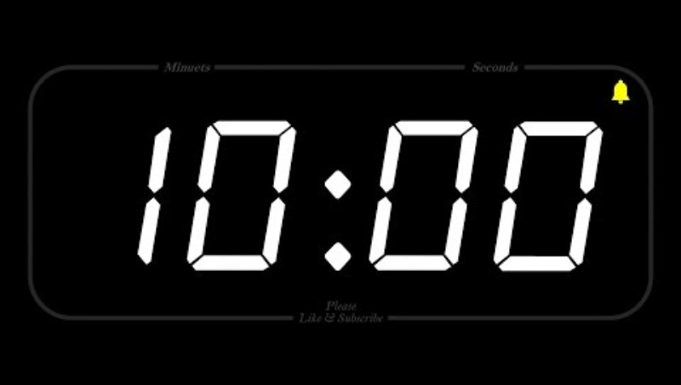
Small Group Discussions:
Weingarten Scenarios

Slide 34

Colleagues
Campaigns

Slide 35

Basics:
  Armor class: an opponent must roll above that number to cause “damage”
  Hit points: each time a roll successfully “hits”, you lose one point
  Your weapon: what you are using to convince your colleague
  Your weakness: the one weapon that wipes out ALL of your hit points at once if it “hits”
  Your immunity: even if one of these weapons “hits”, you don’t lose any hit points
Some people have multiple weapons. Some weapons are stronger than others. Some people have multiple immunities. How is this like organizing in real life?

Slide 36

The Scene
Notes:
The bell rings to start the school day at Generic High School. Our five building reps (from here on out known as "heroes") enter the building. <Have each hero introduce themselves.> Tonight is the County Executive's budget hearing, and programs, jobs, and salaries are all on the line as the County Executive is loathe to give the district any of his hoard of tax money. The heroes know the only way to be successful at the board meeting is to recruit at least three other members to join them. There are five such members in the faculty lounge right now, using their first period planning to caffeinate and ready for the day. <Each member introduces themselves and the game begins.>

Slide 37


Slide 38
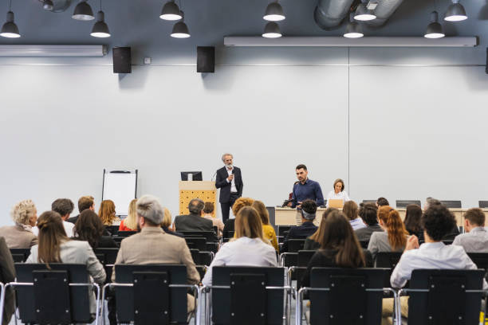
Notes:
*This is an optional slide to use if we have a lot of people participating*
You heroes proudly walk into Generic District's meeting room, taking up the first two rows of seats. You look strong, powerful. Before you sits the school board. <Allow school board members to introduce themselves.> You know the only way to get to the County Executive is to get a majority of this school board on your side. With an ominous rumble (that you assume is thunder, because there are no windows in this room), public comment begins. <Initiate gameplay.>

Slide 39


Notes:
A low rumble comes from behind the podium. The floor beneath you begins to swell and shake. The portraits of long-past superintendents rattle on the walls. A growl thunders through the room - "Who dares ask me for coin?? Smells like... educators... Did I not give you coin last year? Are you not GRATEFUL??" You now know the speaker is the County Executive, an enormous dragon, sitting atop a massive pile of gold. His scales glint in the dim florescent light, but strike you as greasy rather than shiny. Greed has shrunk his wings while increasing his waist. You don't know how long you can stand to be in the room with such a vile creature. <initiate combat>

Slide 40
Debrief

Slide 41


