Slide 1
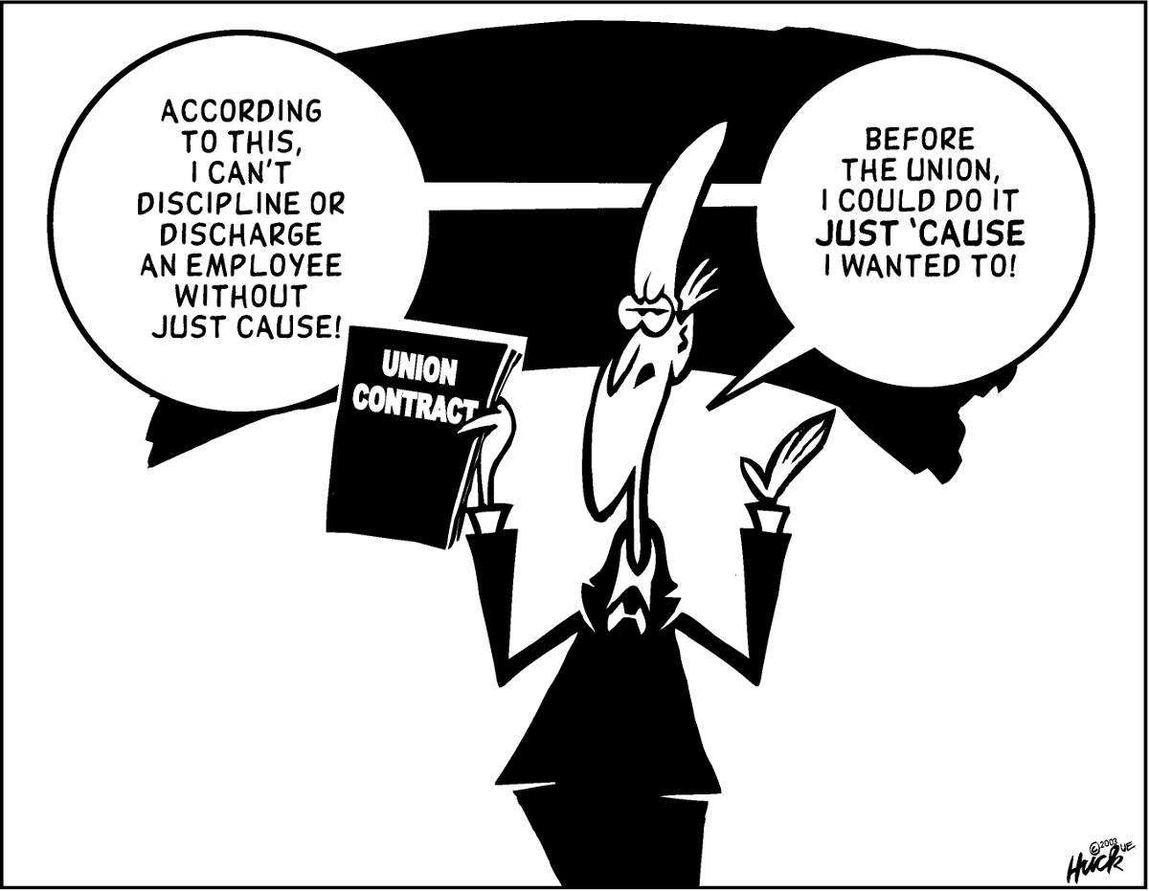
Just Cause
Why do MNEA leaders need to know this?

Slide 2
Index cards on the tables: write down
What you know about just cause or progressive discipline?
AND/OR
WHY is just cause/progressive discipline is important?

Slide 3
What is just cause?
One of the main reasons workers join unions is to gain protection against unfair and unjust discipline that employers hand out.
“Our main contractual weapon is often summed up in one short sentence, “Employees shall be disciplined or discharged only for just cause.”’
What is egregious?
Notes:
Madelaine

Slide 4
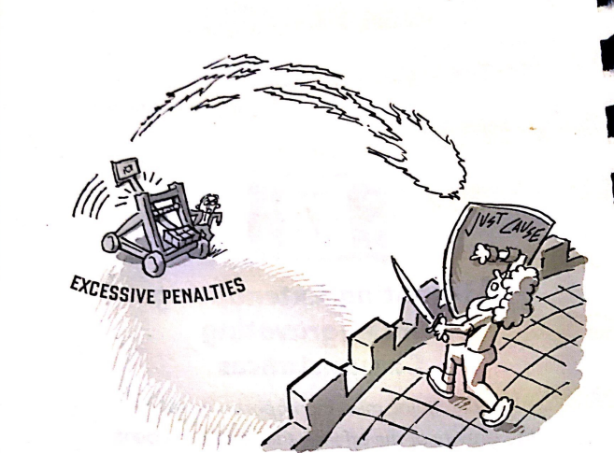
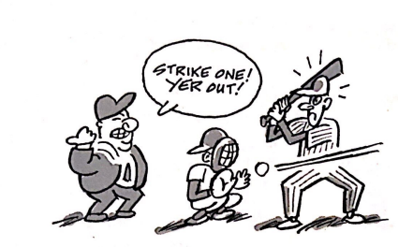
History of Just cause & the NLRA
In 1964, labor arbitrator Carroll Daugherty introduced “The seven tests of just cause” in the form of seven questions.
Notes:
Alice

Slide 5
Why Does just cause matter for ESPs?
Missouri DOES NOT have labor laws that provide specific protections for public sector employees.
Without a law, the only way to be protected from random or discriminatory discrimination is to get it into a CBA.
At will vs just cause
Not officially a right unless it is in a contract
Without just cause language in a CBA or policy, employees can be written up or fired for anything. JUST BECAUSE.
Teacher Tenure law and just cause
  Tenure law has a process and parts of just cause

Slide 6
7 tests of just cause
Fair Notice of Rules
Prior Enforcement
Due Process during investigations
Substantial Evidence
Equal Treatment Compared to other employees
Progressive Discipline
Mitigating and Extenuating Circumstances

Slide 7
Relevant District Policy: Termination of Professional Staff Members or Termination of Support Staff Members
CBA language: Add to Employee Rights sections of CBAs in employee discipline or due process sections.
The district shall use progressive discipline to improve, correct, and prevent recurrent Board policy violations by an employee. Progressive discipline shall include at least the following steps: an informal discussion, formal discussion with written documentation, written reprimand, and disciplinary action following the outcome of an investigation. The district shall not discharge any employee except upon just cause. Except in the cases of the most serious violations of board policy, a single act shall not subject an employee to discharge. The district shall utilize the hearing process required by Board policy and law for the termination of tenured teachers, prior to termination of any bargaining unit member covered by this Agreement. Violations of this (article/section/procedure) shall be subject to the grievance procedure. For the purposes of this agreement, just cause means:
prior notice of specific rule/consequence,
reasonable relation to orderly, efficient and safe operation of the District,
due process,
fair and objective investigation,
substantial evidence of misconduct,
equal application of rules,
order and penalties to all employees, and
evaluation of seriousness of offense with the record of service of employee.
AF

