Slide 1

Kirkwood NEA
BUILDING REP TRAINING

Slide 2
Most important skills
*meeting with principal, problem solving
*draft action sheet
*repping member with admin
*building organizing meetings

Slide 3
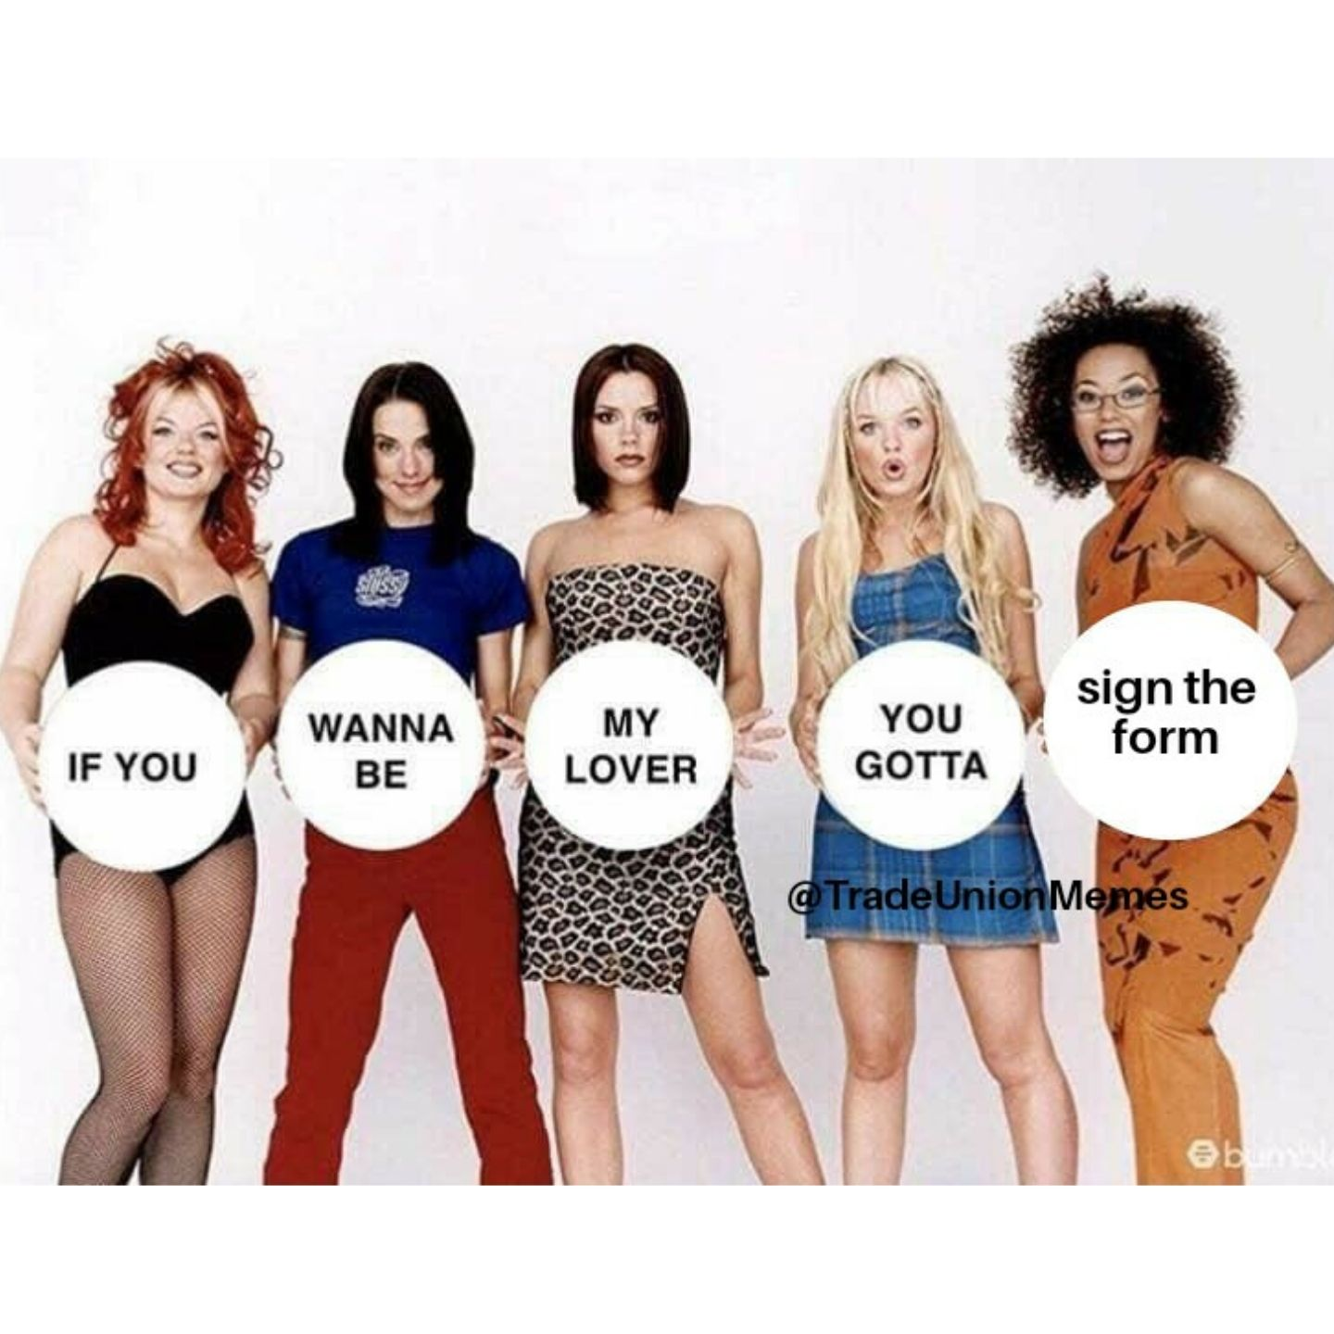
KNEA works because you do!
Powerful role of building reps
You are the leadership of NEA in your school.
CONNECTOR: Update your co-workers on important NEA items that affect them.
RECRUITER: Ask all certified staff in your school to be NEA members.
CONFIDANTE: Listen to your co-workers’ concerns. They trust you and expect confidentiality.
PROBLEM SOLVER: Help your coworkers have tough conversations and navigate the chain of command.

Slide 4
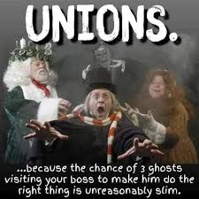
Brainstorm the wins!
Because of your strength as KNEA, you were able to win….

Slide 5
A Few Negotiable Topics
in the Collective Bargaining Agreement
Union Rep in Admin Meetings
Building Level Problem Solving Meetings with Admin
Fair Educator Discipline process (due process & progressive discipline)
Limits on after school meetings
Plan time protections
Union representation at district-wide committees

Slide 6
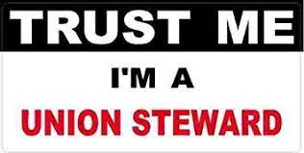
Rights of Union Reps
Keep your nose clean at work: school work during contracted time and union work during lunch/ off contracted hours.
When you are representing KNEA in a meeting, you are putting on your UNION REP hat.
You are speaking to admin as an equal.

Slide 7
A coworker brought me a big problem.
New teachers in your department are required stay after school for 90 minutes every other week for a book study until February.
What are my options?

Slide 8
Options to handle an issue
  Member vents and gets over the issue.
  Member talks to the principal with a rep present and asks for a solution.
  Rep asks the principal for a solution.
  Organize a group of coworkers to handle an issue that affects many people.
  Member writes a formal grievance complaint with help from MNEA UniServ Director. This includes issues violations of the collective bargaining agreement, school board policy, discrimination, harassment and retaliation.

Slide 9
Right to Union Representation
in meetings with Admin
Why does this benefit educators?

Slide 10
Role of the rep in meetings
Take notes.
Make sure the allegations are made clear by asking clarifying questions.
If the investigator/principal seems to be badgering the member, interject and remind them that questioning should be done respectfully
Ask about timelines: when they will get a final outcome.

Slide 11
What do you do?
Sadie, a non-KNEA teacher comes to you for help.
She says that the principal wants to meet with her at plan time in 10 min. She doesn’t know what the meeting is about but she’s scared.

Slide 12
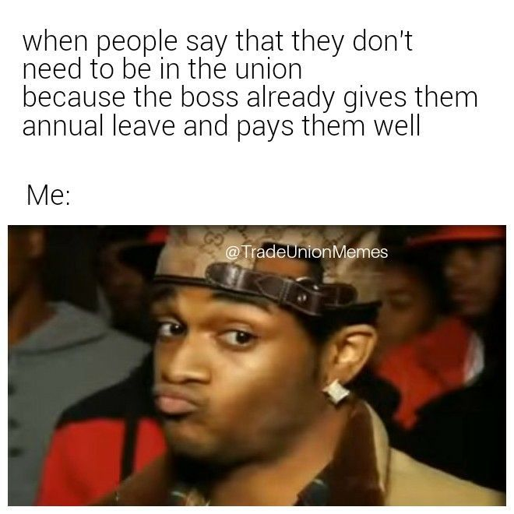
Do I have to rep non-members in meetings with admin?
Yes. You won the exclusive bargaining representative election.

Slide 13

Step 1: Learn the Nature of the Meeting
Member should ask prior to the meeting:
  What’s the meeting about?
  Who will be there?
  Can we reschedule so I can find
a rep?
‹#›

Slide 14
Educator Due Process Rights in Kirkwood
DUE PROCESS per page 3 of the KSD Updated 2024-25* Employee Handbook
*We will communicate any changes from the 25-26 Handbook when we get it.
Complaints made against an employee must be called to the attention of the employee. The employee may provide a written response to the complaint. Complaints not called to the attention of the employee may not be used as the basis for disciplinary action. The Kirkwood School District practices progressive discipline for employees, which includes verbal warning; written warning; suspension with/without pay and discharge. Disciplinary action shall be appropriate to the behavior, which precipitates the action. The District reserves the right not to follow the practice of progressive discipline in instances when, in the judgment of the District, consideration for the health and safety of the employee, other employees, and or students, or the effective operation of the District would dictate prompt action requiring removal of the employee from his/her work situation. An employee may have a representative present, if they so choose, when the District is contemplating suspension or discharge of the employee.

Slide 15
Typical Progressive Discipline Process
for Certified Staff –We will define this in the CBA.
This is for routine concerns. Egregious concerns such as stealing or drinking on the job do not follow progressive discipline.
Informal Verbal discussion (Hey, Alice, you have been late two times this year.)
Formal Verbal Discussion (You’ve been late 3 times this year. If this continues, again, I’ll need to write you up and inform HR.)
Written documentation (This email is a summary of our past 2 conversations on 9/1 and 9/10 about your lateness. I am concerned. )
4. Written reprimand (You have violated the staff conduct policy multiple times. Sign this memo and we’ll put it in your personnel file.)
5. Improvement Plan (You must clock in and out daily for 6 wks. Last chance.)
Notes:
Why does this matter? Last year, at least 3 people were denied this. For example, someone was given a written reprimand which skipped over steps 1-3. When she asked where previous documentation was, she was told it exists but they don’t know where.

Slide 16
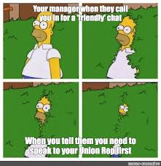
What should a member do if they
are already in the meeting and
they realize that they want a rep?

Slide 17

REPRESENTATION!
“At this time, I am requesting union representation. Can we reschedule this meeting? ”
Written Statements:
If the District asks for a written statement, the member should request at least 24 hours to provide such statement and have a Building Rep or UniServ Director look over the statement before submission .
‹#›
Notes:
Remind member to ask what the meeting is about if they aren’t sure. If they get into a meeting and realize it’s disciplinary, they can stop the meeting at any time to reschedule with PR&R.

Slide 18
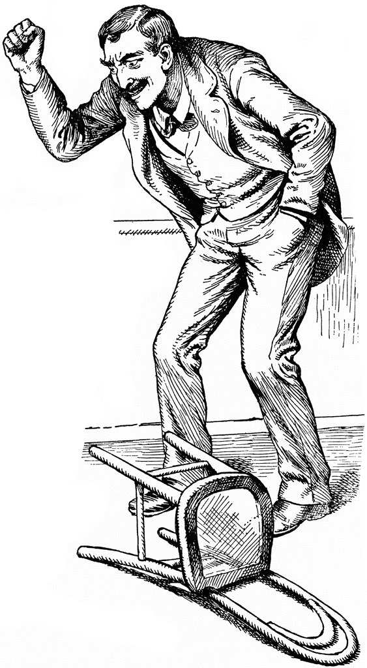
Does an administrator have to provide time to meet with the member prior to the meeting?
The administration is under no obligation to offer time to consult with a member before the meeting.
Be proactive–ask for a minute to step about and talk to the person.
  The decision to provide time prior to a meeting will usually be based on whether or not the district perceives that an infraction affects the safety and security of students and staff.
‹#›

Slide 19
Consult Privately With the Member Before the Meeting
Do not use work email.
Remind the member that the information they share with you will be kept confidential.
Ask the member to honestly tell you what they know. Listen carefully without judgement.
  Sometimes the member is embarrassed and may not give you all the details.
Give the member a briefing on how to best conduct themselves in the meeting and practice answering questions.
If uncomfortable with the situation, call your MNEA UniServ Director
‹#›
Notes:
Tell narrative in chronological order. You can use personal email to send those communications. Affirm their concern, answer the question, redirect to a solution or another topic. Ex. affirm - I understand I should sign out when leaving building, answer - I was in a rush and forgot, redirect - I will always sign out from now, I know it must be difficult for you to be responsible for so many people.

Slide 20

What if there’s no time?
As soon as the meeting begins, determine the purpose before the member answers any questions.
Request a short break (caucus) to meet with the member in private. If the meeting looks very serious, request more time so that the MNEA UniServ Director can be included.
The district can ask a member to sign a document even if the details are in dispute. In those situations, advise the member to add, ‘My signature signifies receipt, not agreement’.
‹#›
Notes:
Be careful of insubordination and unknowingly admitting guilt. If request is denied, try only to take notes and ask clarifying questions.

Slide 21
What would you do?
At the meeting, Sadie is told that she’s being
written up with a formal disciplinary reprimand (Step
4) because she ended a meeting by telling her principal
that he was “being extra” in January of last school
year. This is the first she is hearing about it.

Slide 22
To bring up in meeting with admin
We’d like to step outside for a minute and review this reprimand letter.
Why wasn’t the concern brought up earlier if admin wanted to address it? The observation feedback form has NO notes about this. The evaluation policy talks about timely feedback. Bringing up something from 6 months ago is not fair.
Can you explain why this is a written discipline warning? It’s a first offense. Can we consider this a verbal warning instead?

Slide 23
BEST PRACTICE TO USE EVERY MEETING:
Ask the administrator for a break if you see your coworker shut down, cry, get loud, or become agitated. Leave the room with your coworker. If they are very upset, ask admin to reschedule the meeting.

Slide 24

Taking Notes
Take careful notes and check your comprehension.
  Highlight main ideas.
  Paraphrase key points.
  Ask the speaker to clarify or to slow down in order for you to take accurate notes..
‹#›
Notes:
Note taking: Date, location, attendees (initials after listing), you do not have to copy everything that is said. Administrators will be more careful about what they say and how.
Notes may be used at a later grievance or board hearing.
If you must do some of the talking in the meeting, ask the member to take notes.
Use black pen in case your notes must be copied. Avoid pencil to avoid smudging.

Slide 25
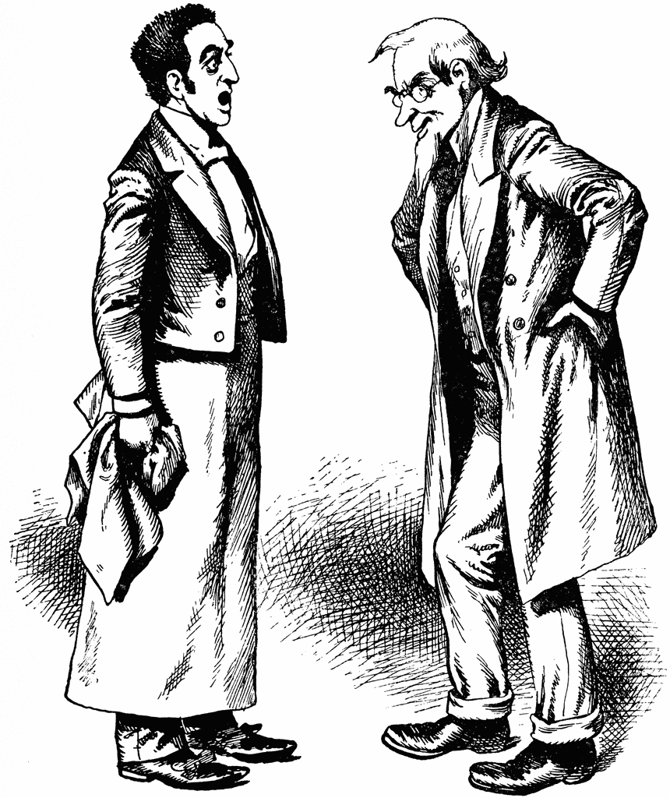
Strategize
The initial meeting may not be the time for the “fight”, you could just be there to hear out the admin’s reason for calling the meeting. You can also take a break from the meeting to reconsider/review/collaborate wording of a letter going into member’s file.
If disciplinary action is imminent, ask for the action to be delayed until you can review the information and consult with your UniServ Director.
‹#›
Notes:
The initial meeting may not be the time for the “fight”, you could just be there to hear out the admin’s reason for calling the meeting. You can also take a break from the meeting to reconsider/review/collaborate wording of artifact going into member’s file. Write out key points before meeting.
Ask that information/answers be repeated if necessary so it can be recorded accurately.
Get direct quotes whenever possible and indicate by using quotation marks.
Review your notes yourself and with the member as soon as possible after the meeting and fill in any gaps.
After the meeting, type up or rewrite your notes so someone else can understand them. Do not throw out your original notes. *Mark actions/to do’s to review at the end of the meeting.

Slide 26
What would you do?
Admin is insisting on the formal write up but will give
your coworker the weekend to review it before
signing it. She doesn’t think the write up is fair and
wants it to go away.

Slide 27
Contact your local president and UniServ Director.
We’ll help review the write up, including:
ideas about if the write up is fair or needs to be grieved
ideas for revisions to the write up
ideas for the rebuttal to staple to the write up

Slide 28
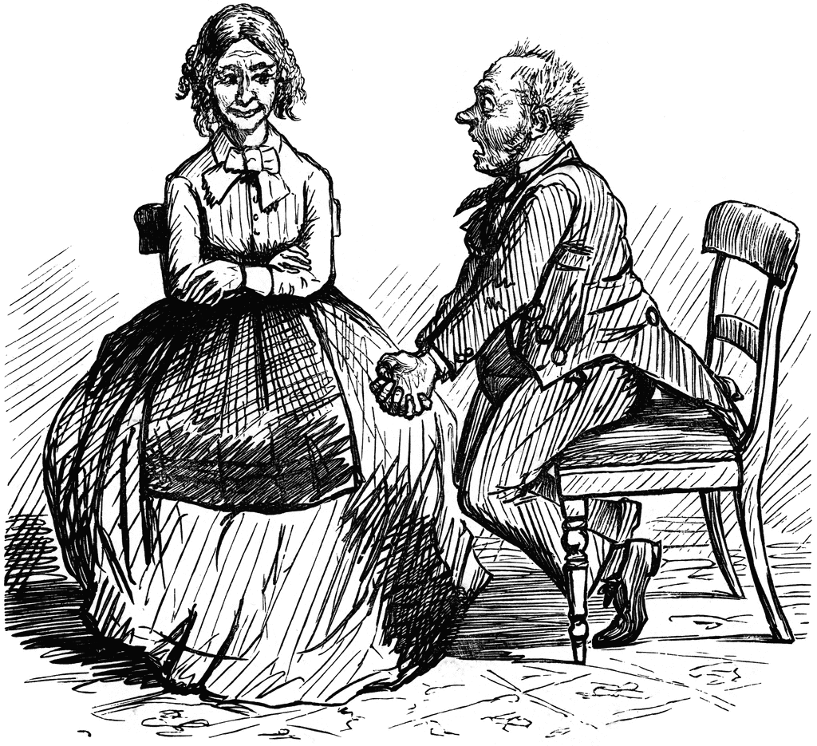
Step 5: After the Meeting Debrief with the Member
Spend some time with the member debriefing. Make sure the member is OK.
Caution the member not to share the details of the meeting with others until the matter is resolved.
Determine if what the next steps are or if any are needed. Is this a grievance?
Provide meeting notes to the member.We do not give our complete meeting notes to admin.
‹#›

Slide 29
Grievance Policy Process
Deals with broken policies or violations of the collective bargaining agreement. ·
Handled by concerned educator, building rep and MNEA UniServ Director
Formal, cannot be anonymous ·
Involves meeting with the superintendent and the school board.
Summary steps to filing
1) Write the grievance and compile evidence documents.
2) Meet with principal
3) Meet with Superintendent or Designee
4) Meet with School Board

Slide 30
Technology Rights and Responsibilities
Central Office can see anything on your computer and your emails. They are not private.
Almost any email sent from a school computer can be released to the public. Be careful what you put in writing.
Be careful about posting photos of you and alcoholic beverages.
Please do not follow students on social media (Tiktok, Snapchat, Facebook, Instagram) or comment on their pages.
Please do not talk about your school or your students on social media. Also, try to stay away from conversation about the school district on social media.

Slide 31
Marijuana
Please know that even with the new law on recreational marijuana, school employees still need to be very cautious about marijuana consumption. These rules apply even with a medical marijuana license.
1. Districts typically have 2 relevant policies: GBEBB: employee drug and alcohol testing and GBEBA: Drug free workplace.
2. No cannabis products on campus or in your car on school property, per the Drug Free School and Communities Act. No cannabis products in your car or with you at an off-campus district approved activity, including professional conferences.
4. Cannabis smokers should be careful of smoking in their cars in general or wearing clothes they smoked in recently to school. All the district needs is “reasonable suspicion” aka smelling like weed, to drug test you.
5. Do not talk to admin about a medical marijuana license UNLESS you have had an injury at work which often triggers a drug test. Don’t volunteer information of any kind in this situation. Teachers should call Alice Floros as their MNEA rep before telling the admin about their medical marijuana license.
6. Educators should be careful about cannabis jokes or references with kids or at work—full stop. An area employee was disciplined for a joke in the past, so the districts tend to be a bit conservative.

Slide 32
Illegal Discrimination: Both harassment and hostile work environment are forms of discrimination.
The negative behavior must be motivated by one of these classes:
Protected Classes:
Race
Color
Religion
National Origin
Age
Sex
Pregnancy
Citizenship
Disability Status
Veteran status
Genetic information

Slide 33
It is not illegal to be a JERK!
There are a wide variety of intolerable working conditions that would not qualify as harassment and are not legally actionable.
Example:
If you are singled out by a supervisor because of a personal disagreement.
Being mean
Yelling, screaming
Belittling
Other complaints may be filed under Policy GBCB-Staff Conduct

Slide 34
When does discrimination become harassment for a complaint per Policy AC?
In order to make a claim:
The discrimination must be ‘severe and pervasive’. Examples:
  Pattern of explicit derogatory conduct- such as statements that a person can’t do their work because of their race or gender.
  If certain work rules only apply to individuals of a specific religion, race, age..

Slide 35
What to do if you are subjected to discriminatory harassment.
Contact MNEA rep Alice Floros
File a complaint with the District
Equal Employment Opportunity Commission (EEOC) or Missouri Commission of Human Rights (MCHR)
Important Time Limits
EEOC or MCHR complaints must be filed within 180 days of the last discriminatory action.

Slide 36
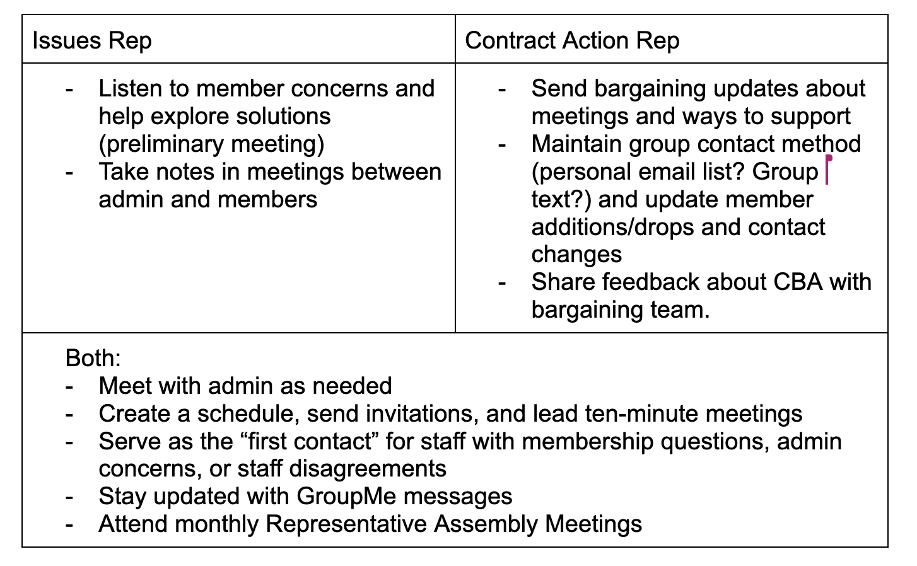
New this year: BAR roles
Notes:
Consider having the more veteran BARs be the “issues rep”

Slide 37
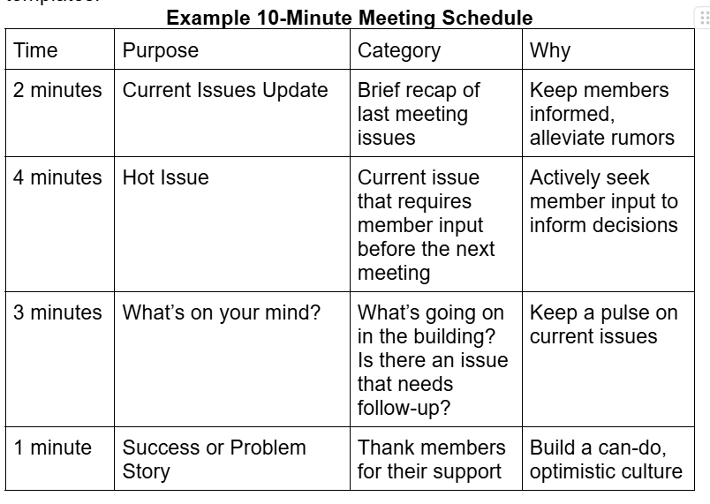
10 Minute Meetings

Slide 38
Admin Meetings
-At least quarterly/as things come up.
Maria story about recess duty.
-Giving structure…note taking (Google Form).

