Slide 1

Meramec Valley NEA
BUILDING REP TRAINING
Notes:
Bingo topics:

Slide 2
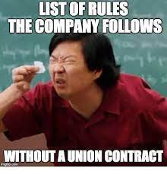
Pair-Share
Which wins in the MVNEA collective bargaining agreement have improved life at your school?

Slide 3
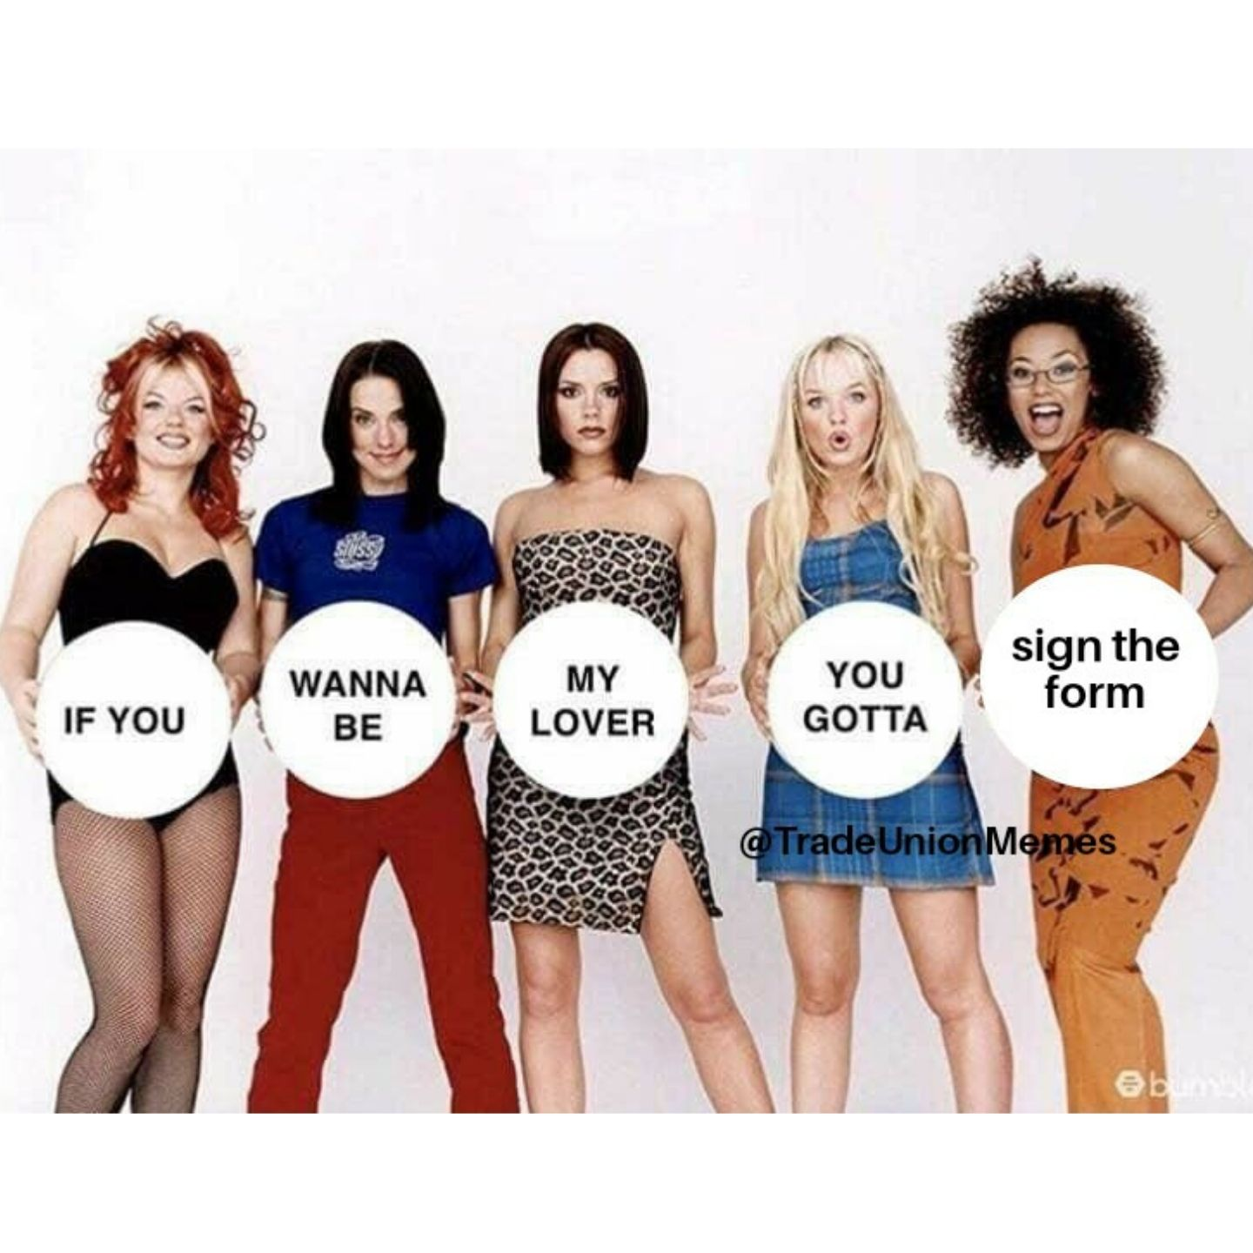
MNEA WORKS BECAUSE YOU DO!
Powerful role of building reps
You are the leadership of NEA in your school.
CONNECTOR: Update your co-workers on important NEA items that affect them.
RECRUITER: Ask all certified staff in your school to be NEA members.
CONFIDANTE: Listen to your co-workers’ concerns. They trust you and expect confidentiality.
PROBLEM SOLVER: Help your coworkers have tough conversations and navigate the chain of command.
Building reps meet with the principals monthly or as needed.
Building reps hold once a month meetings, within a week after our building rep meeting.

Slide 4
A coworker brought me a big problem. What are my options?
Ask the person what they want to do about the problem. Are they just venting a little bit? Do they want to know what can be done?
Options to handle an issue
Member puts summarizes the concern in an email and includes the MVNEA building rep.
Member talks to the principal with a rep present and asks for a solution.
Rep asks the principal for a solution.
Member writes a formal grievance complaint with help from MVNEA leadership. This includes issues violations of the MVNEA collective bargaining agreement, school board policy, discrimination, harassment and retaliation.

Slide 5
Know Your Rights Bingo
Article 4.6
MVNEA appoints how many members to serve on the policy review committee?

Slide 6
4 MVNEA appointed members
on policy review committee

Slide 7
Know Your Rights Bingo
Article 5.7
Unused sick/personal leave days will be paid out at a maximum of ______ per day with resignation in December.

Slide 8
$95/day if submitted by December

Slide 9
Know Your Rights Bingo
Article 8.3
After school faculty meetings are limited to ____ minutes per month, except in emergencies.

Slide 10
BINGO ANSWER:
Article 8.3: 60 minutes
DISCUSSION:
What is an emergency?
What is NOT an emergency?

Slide 11
ARTICLE 9.1 Plan Time
“An average of five (5) periods per week of self-directed planning time will be allotted to all secondary teachers, and an average of _____ minutes of self-directed planning time will be allotted to all elementary teachers. Assignments to a study hall shall be considered a teaching period in the secondary schools. Duty time, including but not limited to, the supervision of students before and after school, passing time, staff lunch time, and travel time will not count toward plan time minutes. If all members of a PLC or committee agree to meet during plan time they may.”

Slide 12
Bingo answer: 250 minutes.
What do we do if we do not get 250 minutes of self-directed plan time?

Slide 13
Know Your Rights Bingo
Article 10.1 Student Discipline
Can student discipline information recorded by a certified staff member be removed or altered without notice to you?

Slide 14
Answer: No removal without notification
No student discipline information recorded by a Bargaining Unit employee may be removed or altered without notification to the Bargaining Unit employee.

Slide 15
Know Your Rights Bingo
Article 5.7 Right to Representation
A principal asks to talk to a teacher during plan time about a concern from a student. What should the teacher do?
Just go find out what the deal is.
Tell her principal that she wants an MVNEA rep there with her and asks to reschedule the meeting.

Slide 16
Bingo answer: reschedule, get MVNEA rep
2 minute practice time!

Slide 17
Article 11.2: Due process
Brian’s principal sees him in the hallway and says that he needs a written statement about a fight in the hallway yesterday. What should Brian do? He has 3 hours to write a statement.
Refuse to write a statement. Brian didn’t see anything and just wants to do his job.
Reach out to his MVNEA rep to review his statement draft
Use up the whole plan time to write a long five paragraph essay in detail about what happened and any opinions about the students and co-workers who were around.

Slide 18
Article 11.2 Due Process
Bingo Answer:
Reach out to MVNEA rep for help with the written statement

Slide 19
Jordan’s principal says that they can’t teach a book anymore because its too controversial.
Where would Jordan look in the collective bargaining agreement to learn more about their rights?

Slide 20
Article 11.5
Professional Autonomy
“The District and Bargaining Unit employees acknowledge the need for educators to be free from restraint that would prohibit them from fairly presenting all sides of issues in their teaching functions as specifically set forth in and aligned with District learning and curricular standards.”
Tips: follow written district curriculum, use written DESE standards

Slide 21
Article 7.9 Sick Pool
What are the limits to the sick day pool?

Slide 22
Article 7.9 Sick Pool
50 day limit for 3 years, then 30 additional days.
FMLA paperwork must be filled out

Slide 23
Article 11.4 Communication
Do you have to respond to routine phone calls and emails on weeknights and weekends?
  Yes, this is my job. I always have to be available.
  No, I don’t have to respond to routine messages or check my email at night. If my principal texts me, I’ll ask if its an emergency or if I can just handle it when I get back to school.

Slide 24
Article 11.4 Communication
Bingo answer: No after hours requirement
DISCUSSION: What’s an emergency?

Slide 25
Part 2: Repping Members in Meetings

Slide 26
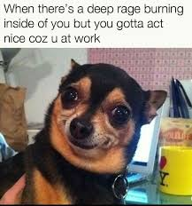
Right to Union Representation
in meetings with Admin
Why does this benefit educators?

Slide 27
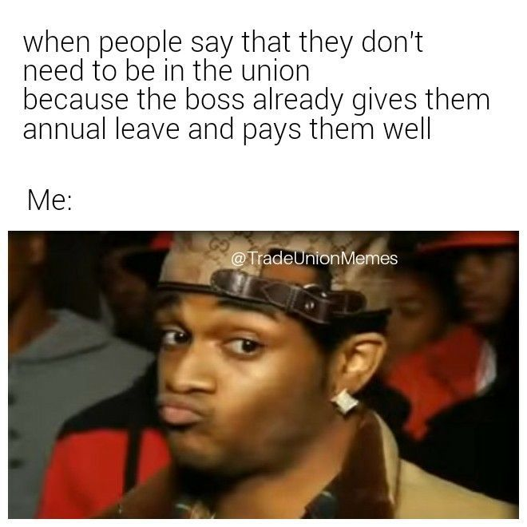
Do I have to rep non-members?

Slide 28
Do I have to rep non-members?
YES—If you have a collective bargaining agreement (union contract) because your local is the exclusive union representative for all certified staff, regardless of membership status.
Please do attend meetings with them and take notes. If they have a possible grievance, please talk to your local exec board and UniServ Director about the grievance. Please do give them a membership form.
Please do not tell a non-member to talk to their MSTA rep or that they’d get better help if they were a member.

Slide 29
Do we have to rep support staff?
If they are members, yes.
If they are not members, no. MVNEA does not have a collective bargaining agreement for support staff.

Slide 30
Article 11.2 Due Process
Can anonymous complaints be used against teachers?

Slide 31
Article 11. 2 Due Process
“Anonymous complaints/concerns will not be used as the basis for disciplinary action without verification of a violation through an investigation by an agency outside of the district or a district investigation that includes documented evidence of a violation. Employees will be presented with the anonymous documentation of the investigation upon request, unless such disclosure would compromise or impede investigations as set forth herein.”

Slide 32
Steps to Follow
First of all, stay calm!
Try to keep the member calm also.
  Often when members are in disciplinary meetings, their emotions can get the best of them.
  Take breaks from the meeting.
Step 1: Learn the nature and purpose of the meeting
Step 2: Check your resources. Review applicable policies and other relevant information in building handbook.
Step 3: Meet with the member prior to the meeting; hear their story, pick a strategy and coach them on how to answer questions that may come up in the meeting.
Step 4: Attend the meeting and act as note taker and advocate
Step 5: Debrief with the member and discuss next steps
32
Notes:
Be genuine. Perhaps break the tension by establishing a personal rapport with the member. Consider using humor, a personal anecdote, or some other natural strategy to break the tension.

Slide 33

Step 1: Questions
Member should ask prior to the meeting:
  What’s the meeting agenda?
  Who will be there?
33

Slide 34
2. Ask for REPRESENTATION!
“Can we reschedule this meeting? I want to have a rep.”
^ Use before the meeting
OR
upon realizing that the meeting could become disciplinary
34
Notes:
Remind member to ask what the meeting is about if they aren’t sure. If they get into a meeting and realize it’s disciplinary, they can stop the meeting at any time to reschedule with PR&R.

Slide 35
Does an administrator have to provide time to meet with the member prior to the meeting?
No, but…
The administration should honor this request but does not have to provide time for the association to do a full investigation.
  The decision to provide time prior to a meeting will usually be based on whether or not the district perceives that an infraction affects the safety and security of students and staff.
35

Slide 36

What if there’s no time?
As soon as the meeting begins, determine the purpose before the member answers any questions.
Request a short break (caucus) to meet with the member in private. If the meeting looks very serious, request more time so that the MNEA UniServ Director can be included.
The district can ask a member to sign a document even if the details are in dispute. In those situations, advise the member to add, ‘My signature signifies receipt, not agreement’.
36
Notes:
Be careful of insubordination and unknowingly admitting guilt. If request is denied, try only to take notes and ask clarifying questions.

Slide 37
What do you do?
Sadie, a non-MVNEA teacher comes to you for help.
She says that the principal wants to meet with her at plan time in 10 min.
She doesn’t know what its about but she’s scared.

Slide 38
Sadie comes back to you.
The principal agrees to postpone the meeting so Sadie can get a rep.
The meeting is with the principal and AP. They want to hear Sadie’s side of the story about some concerns about using bad language in front of the kids 6 months ago.
What would you do now?

Slide 39
Article 11.2 Due Process
Bargaining Unit employees will be made aware of complaint(s)/concern(s) within ten (10) working days of an administrator’s knowledge if the complaint(s)/concern(s) are likely to be used as the basis of disciplinary action.

Slide 40

Written Statements:
If the District requires a written statement from an employee in a personnel matter following an incident involving such employee, the Bargaining Unit employee shall have at least three (3) hours to provide such statement except in cases of extraordinary circumstances impacting student safety.

Slide 41
Step 2: Check Your Resources
Board Policies
  GBCB - Staff Conduct
  GBH- Staff /Student Relations
  GBCC: Staff Use of Communication Devices
  GCN - Evaluation of Professional Staff
  GBM- Staff Grievances
  GCPD - Suspension of Professional Staff Members
  GCPE - Termination of Professional Staff Members
Building Handbook. Note that not all buildings have this.
41
Notes:
In this order check: MOU > Board Policy > Building Handbook. Board Policy CBCB is most commonly referenced. All buildings are supposed to be keeping handbooks (CHCA).

Slide 42
Step 3: Consult Privately With the Member Before the Meeting
Remind the member that the information they share with you will be kept confidential.
Obtain member consent from the member if you’re taking action on their behalf.
Ask the member to honestly tell you what they know. Listen carefully without judgement.
  Sometimes the member is embarrassed and may not give you all the details.
Give the member a briefing on how to best conduct themselves in the meeting and practice answering questions.
  Affirm, Answer, and Redirect
If uncomfortable with the situation, call your MNEA UniServ Director
42
Notes:
Tell narrative in chronological order. You can use personal email to send those communications. Affirm their concern, answer the question, redirect to a solution or another topic. Ex. affirm - I understand I should sign out when leaving building, answer - I was in a rush and forgot, redirect - I will always sign out from now, I know it must be difficult for you to be responsible for so many people.

Slide 43

Establish Guidelines Prior to Meeting
Establish non-verbal signals for use to indicate that the member should stop talking, or that a caucus is needed.
Advise the member to be honest, but to answer only what is asked.
Caution against providing additional information, or explanations.
Tell the member to signal for a caucus if they want to provide additional information that may be favorable to their case.
Emotional Ask the administrator for a break if you see your coworker shut down, cry, get loud, or become agitated.
43
Notes:
NOTE: You cannot tell a member to refuse to answer a question or give false information (this can cause further disciplinary action). Ex. Do you have a watch? Answer: Yes. (You don’t tell them what time it is.) Practice some question answering before the meeting.

Slide 44

More Guidelines
Advise the member not to argue with the administration or you.
You will be the scribe and will document all concerns that will be addressed and answered.
  Provide the member with pen and paper for taking notes or writing messages to you.
Put the member at ease by assuring them that as the NEA building representative, your job is to assist with a fair and transparent meeting.
44

Slide 45
Step 4: In the Meeting
BEST PRACTICE TO USE EVERY MEETING:
Ask the administrator for a break if you see your coworker shut down, cry, get loud, or become agitated. Leave the room with your coworker. If needed, do this multiple times. If they are very upset, ask admin to reschedule the meeting.
Please do not let your coworker cry or get loud in front of the boss.

Slide 46

Clarifying questions
•Just to clarify so we are all on the same page, can you share more examples of how you think the teacher broke a rule?
•Just so I understand, can you explain when this teacher was trained or told what to do in this situation? I’m just trying to understand when the expectation was clearly stated.
•Just so we are clear, can you repeat again what was reported to you?

Slide 47
Typical Disciplinary Process
for Certified Staff
This is for routine concerns. Egregious concerns such as stealing or drinking on the job do not follow progressive discipline.
Informal Verbal discussion (Hey, Alice, you have been late two times this year.)
Formal Verbal Discussion (You’ve been late 3 times this year. If this continues, again, I’ll need to write you up and inform HR.)
Written documentation (This email is a summary of our past 2 conversations on 9/1 and 9/10 about your lateness. I am concerned. )
4. Written reprimand (You have violated the staff conduct policy multiple times. Sign this memo and we’ll put it in your personnel file.)
5. Improvement Plan (You must clock in and out daily for 6 wks. Last chance.)

Slide 48

Step 4: In the Meeting
Be quiet.
  You can’t listen closely when you’re talking, interrupting, or thinking about what you’ll say next.
Listen for main ideas.
  Don’t get caught up or sidetracked by examples, stories, statistics, etc.
Take careful notes and check your comprehension.
  Highlight main ideas.
  Paraphrase key points.
  Ask the speaker to clarify or to slow down in order for you to take accurate notes..
48
Notes:
Note taking: Date, location, attendees (initials after listing), you do not have to copy everything that is said. Administrators will be more careful about what they say and how.
Notes may be used at a later grievance or board hearing.
If you must do some of the talking in the meeting, ask the member to take notes.
Use black pen in case your notes must be copied. Avoid pencil to avoid smudging.

Slide 49
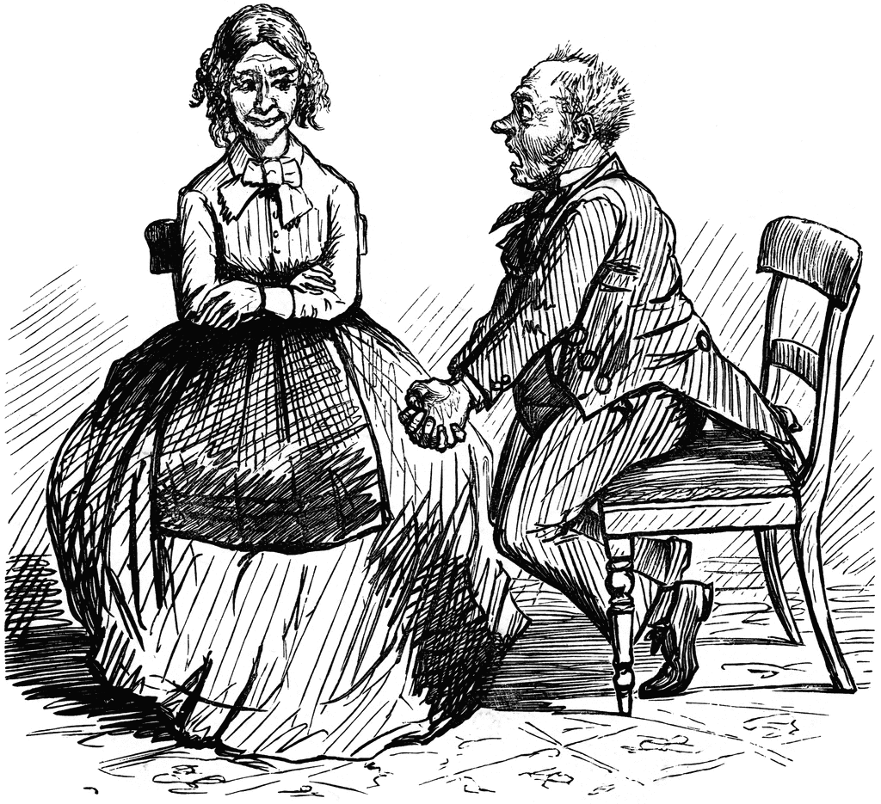
Step 5: After the Meeting Debrief with the Member
Spend some time with the member debriefing. Make sure the member is OK.
Caution the member not to share the details of the meeting with others until the matter is resolved.
If necessary, conduct investigation for further information.
Determine if what the next steps are or if any are needed. Is this a grievance?
Provide meeting notes to the member.
49

Slide 50

Grievance Process
Deals with broken policies or violations of the collective bargaining agreement. ·
Handled by concerned educator, building rep and MNEA UniServ Director
Formal, cannot be anonymous ·
Involves meeting with the superintendent and the school board.
Summary steps to filing
1) Write the grievance and compile evidence documents.
2) Meet with principal
3) Meet with Superintendent or Designee
4) Meet with School Board

Slide 51
Rights and Responsibilities
Technology
Central Office can see anything on your computer and your emails. They are not private.
Almost any email sent from a school computer can be released to the public. Be careful what you put in writing.
Be careful about posting photos of you and alcoholic beverages.
Please do not follow students on social media (Tiktok, Snapchat, Facebook, Instagram) or comment on their pages.
Please do not talk about your school or your students on social media. Also, try to stay away from conversation about the school district on social media.

Slide 52
Both harassment and hostile work environment are forms of discrimination.
The negative behavior must be motivated by one of these classes:
Protected Classes:
Race
Color
Religion
National Origin
Age
Sex
Pregnancy
Citizenship
Disability Status
Veteran status
Genetic information

Slide 53
It is not illegal to be a JERK!
There are a wide variety of intolerable working conditions that would not qualify as harassment and are not legally actionable.
Example:
If you are singled out by a supervisor because of a personal disagreement.
Being mean
Yelling, screaming
Belittling
Other complaints may be filed under Policy GBCB-Staff Conduct

Slide 54
When Does discrimination
become harassment?
In order to make a claim:
The discrimination must be ‘severe and pervasive’. Examples:
  Pattern of explicit derogatory conduct- such as statements that a person can’t do their work because of their race or gender.
  If certain work rules only apply to individuals of a specific religion, race, age..

Slide 55
ACTION STEPS
Contact MNEA rep Alice Floros
File a complaint with the District
Equal Emplyment Opportunity Commission (EEOC) or Missouri Commission of Human Rights (MCHR)
Important Time Limits
EEOC or MCHR complaints must be filed within 180 days of the last discriminatory action.

Slide 56
File a Complaint with the District under Policy AC
Policy AC: “Discrimination, harassment or retaliation against employees, students or others on the basis of race, color, religion, sex, national origin, sexual orientation, ancestry, disability, veteran status, age, genetic information or any other characteristic protected by law is strictly prohibited in accordance with law.”
Needed information:
a.) Date of filing your concerns.
b.) Discrimination category. (e.g. sex, national origin etc.)
c.) Names of person(s) involved including possible witnesses. (full names and position titles.)
d.) Facts alleged to have happened (include dates, locations, and any other factual information that would provide clarity regarding your concerns).
e.) A statement of why the facts constitute a violation of Policy AC.
f.) A suggestion of the remedy desired.
g.) A description of any informal adjustment attempts or progress within the complainant’s

