Slide 1

Sammamish Uniserv Council Building Rep Training
Presenters:
Katie bishop, ELIZABETH PREMO & Michael ruiz

Slide 2
Welcome
Name
Local Education Association
Worksite name
What is your role within your school disitrict?
Why did you become a Buidling Rep?

Slide 3
Why Did Join Your
Local Union?
Popcorn out: Why do people join their local associations?
Notes:
Popcorn out why some folks have shared they are members of their local association.
Then ask folks to reflect and write down why they became a member of their local association. Hold onto that why for now- we will circle back to it a little later today.

Slide 4
Why unions?
In 2022, the average union educator made $282 more a week ($1128 a month) than non-union educators. (Bureau of Labor Statistics)
Washington state is currently 4th in educator pay, due to collective political action at the state and local levels. (National Education Association Rankings) (increase from 6th to 4th in the previous two years).
High Membership equals more resources to sit as equals with the district leaders.
Unionized educators have safer work conditions and protections.
Union members report a higher life satisfaction rating than non-union members. (NY Time poll).

Slide 5
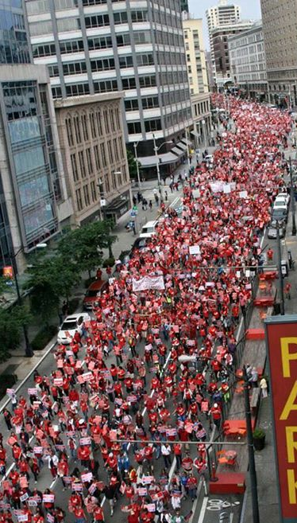
Strong United Membership
Ability to Achieve Purpose
Notes:
Grab a sticky note. Write down WHY you are a union member. Lets post it down and then we will come back together.

Slide 6
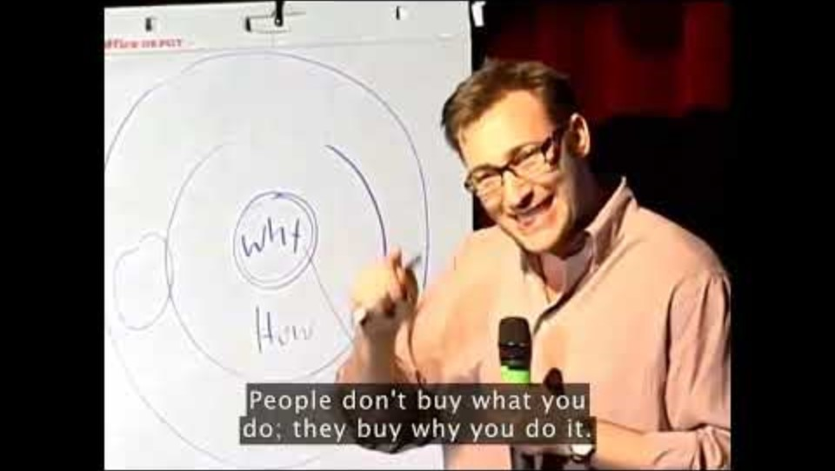
Start with WHY by Simon Sinek
Notes:
https://www.youtube.com/watch?v=tK4HNPCVt2k

Slide 7
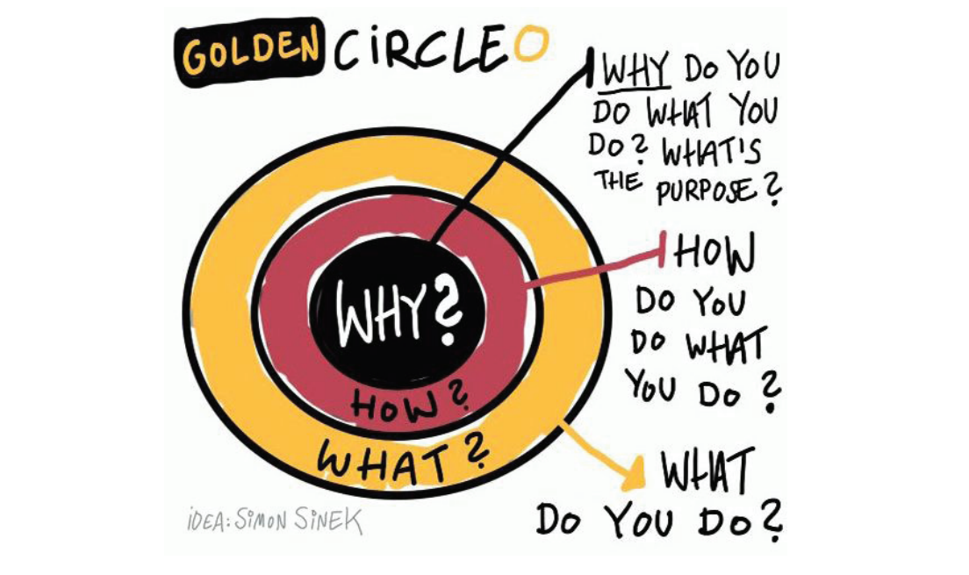
Start with Why.
  What is my why?
  Why did I become an educator?
  Why am I a member of my union?
  What is my union’s why?

Slide 8

Know your Why.
It’s not enough to know what and how you do things, but you should also know why you do them.
Notes:
Action happens when we connect people to their values and a plan to win.
Listening and connecting is how we connect their issues to a solution.
The union is the solution to the issue in front of them.

Slide 9

How to ask someone to join the union…
Listen
Educate
ask
Notes:
On a scale of 1-10 how comfortable are you asking someone to join the union?

Slide 10
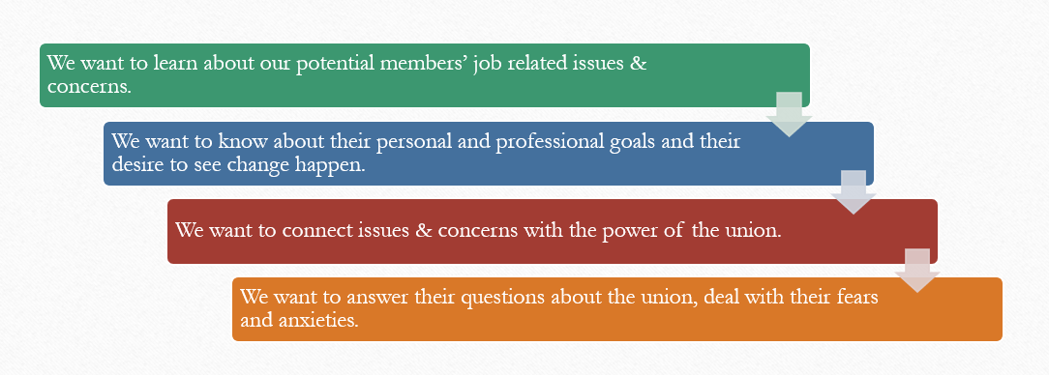
Listen
Notes:
As you know the key to listening is creating space for a person to speak. Asking open-ended questions is important in creating this space. Open-ended questioning indicates that you are there to listen and that you care about your colleagues concerns and issues. Keep in mind, we want to ask questions that elicit workplace concerns and issues. Understanding these workplace issues and concerns is important for connecting our colleagues with the power of the union to address such issues and concerns.
Open: What do you like about working in schools?
Closed: Are things going well for you in the classroom?
The beginning of the school year can be daunting, especially for New Educators. Ask general questions to learn what your colleague cares about: y
What are you most excited about?
What are you most anxious about?
Why did you choose to work at your school?

Slide 11

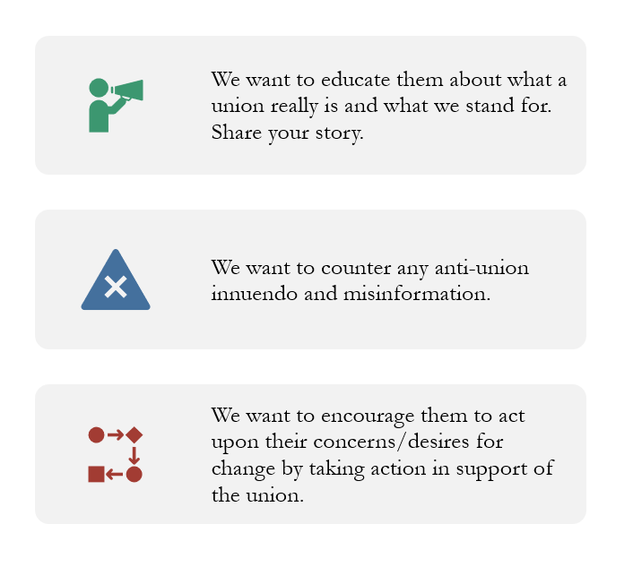
Educate sharing your story & answering tough questions
Notes:
Our union is essential for securing better wages and benefits, and ensures that we have a voice on the job. It is important that our colleagues in our building understand why the union is important, and that we provide information for important questions that arise when having discussions.
Educating members is key for getting our union story out there, before the opposition tells our story for us. Throughout our discussions with colleagues we will encounter tough questions and objections relating to dues, politics and worksite issues. It is important that we do our best to provide members and potential members with the clear and concise information. However, it is not required that you know the answer to every question, in fact not knowing answers to specific questions provides an opportunity to follow up later. It is ok to tell potential members, “I don’t know, let me get more information about that for you, and get back to you.”

Slide 12

Ask
Bringing it all together and making the membership ask
Being an educator is one of the hardest jobs in the world and it's never been harder than right now. With more members like you, we'll have a stronger collective voice that improves our daily lives so we can give students our best.
Will you join _______ as a member?
Notes:
Alright folks, you’ve done a lot of listening to, and educating of members. It’s time for the Ask, this is where the rubber meets the road. You’ve talked about the benefits of being a member and now it’s time to invite them to join. It’s the only way to know if they will become a dues paying member. It’s important that you actually do the ask. It can be as simple as, “Will you join your union?”
ASK THEM TO JOIN THEIR LOCAL ASSOCIATION • Being an educator is one of the hardest jobs in the world and it’s never been more challenging than right now. With more members like you, we’ll have a stronger collective voice that improves our daily lives so we can give students our best. Will you join ______________________________ as a member?
Paper Form, Be prepared to wait and have some awkward silence when they fill it out.
Other examples include:
“We’ve discussed some important issues today, as you can see our union is important for ensuring our voice on the job. Will you join the union in solidarity with myself and our colleagues here in the building?”
“I have a membership app so will you take a minute to fill it out?”
There are some basics to keep in mind. <review slide>

Slide 13
AFFIRM, ANSWER, REDIRECT
Affirm
You make an expression that shows understanding or empathy with the objection
Answer
You give a factual answer that doesn’t skirt the issue
Redirect
You refocus the conversation on the issues that were already discussed
Notes:
Affirm: Let them know you’re listening, you understand, and their feelings are valid. Don’t get mad at them—validate and educate them.
Answer: Give a truthful, concise answer to the question. If you don’t know the answer, don’t guess. Tell them you’ll find out and get back to them.
Redirect: Once you’ve answered the question, bring the conversation back to your message.

Slide 14
Typical Objections/
Tough Questions
How much are dues? What do my dues pay for?
I can’t afford to pay dues.
I don’t support my union’s politics.
I have a cousin that was in a union and they didn’t do anything for her.
I support my local but I don’t want my dues money going to the WEA and NEA.

Slide 15
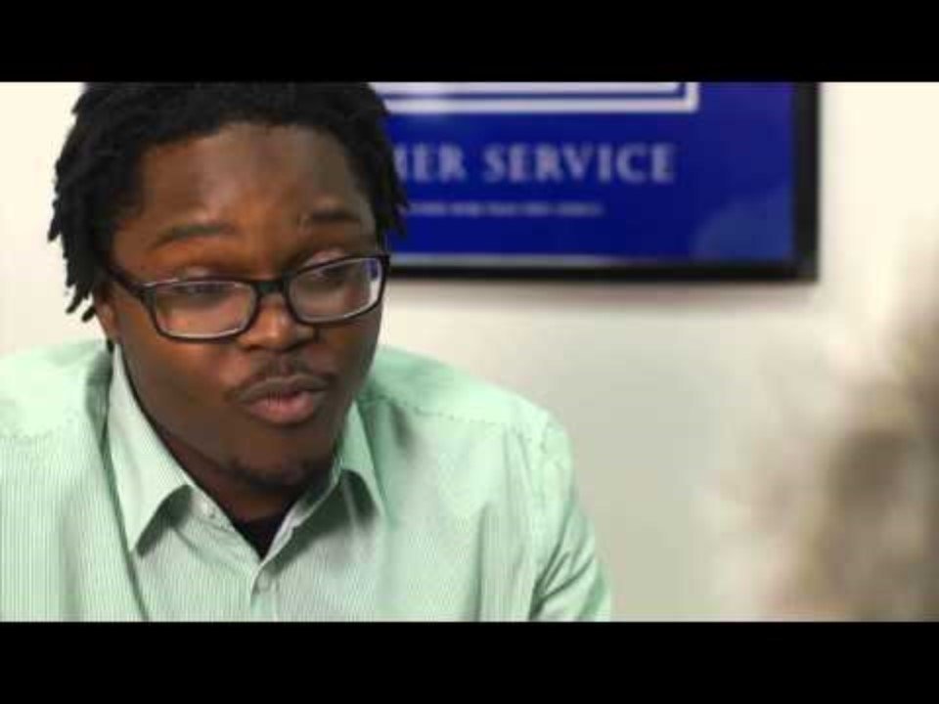
Model on how to have these conversations
Notes:
Note-
Good opening- connecting.
Good summarizing of the issues she expresses. Not trying to solve, just listens.
Hears objection- won’t listen to us. Affirms (not denies what she says), answers that might be the case now, but redirects to the solution is unity and standing together, choice about doing nothing.
CLEAR ASK- not waivers and does not fill the void.
https://www.youtube.com/watch?v=JcQbfnyPg1E

Slide 16

Practice the ask and answering tough questions…
Notes:
We have an exercise for you now, we’d like you pair up again and work through the scenarios provided in your workbook. These scenarios will walk you through a complete conversation and challenge you to utilize all the skills we’ve discussed today in order to get to an effective ask. Let's spend the next 30 minutes working through these scenarios and then host a couple of mock interviews here in the front of the room.
5 or 10 Minutes to play rep, switch roles. Total 10 or 20 minutes
5 or 10 Minutes to debrief

Slide 17
Practice Session
Break into 3’s
One person plays the building rep
Another plays the potential member (pull an objection from our earlier conversation)
Observer
You have 7 minutes then switch roles.

Slide 18

Reflections

Slide 19
BREAK

Slide 20

First friend – Best friend
A “first friend” program makes the union relevant for the variety of ways in which it assists the newly hired to get acclimated and become successful on the job.
The most important time you can spend is the time you spend reaching out to new hires, based on their needs.
Sustained, personal contact over time is the key.
Make sure you say the words, “Your success is a priority of our union and your support is a commitment I make to you as a union leader.”

Slide 21

Building / Department Meetings
Frequency
Location
Duration
Notes:
Engagement
Not just sit and get
Allow for conversations
What’s going well, what’s not going well?
What do you need for things to improve or continue?

Slide 22
Meeting with an Administrator
Frequency
Standing Items
First level for problem solving

Slide 23
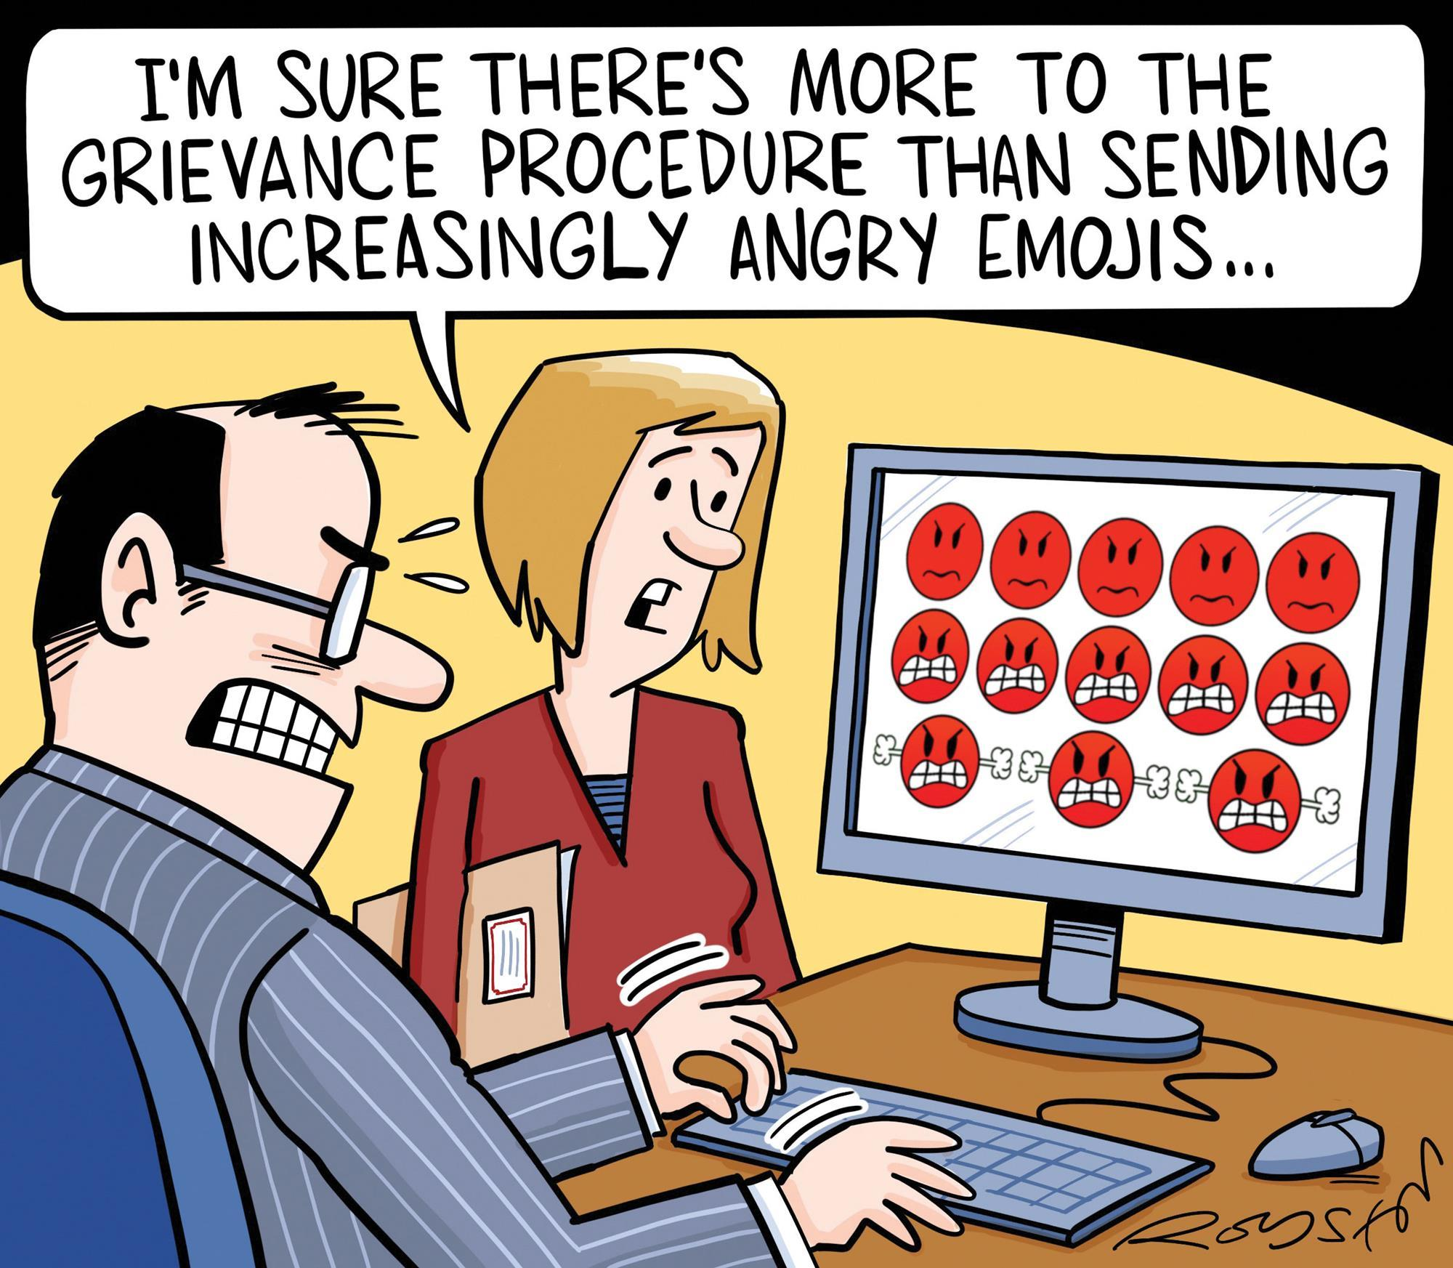
Gripe (Grumble) or Grievance

Slide 24

What does your contract say about the grievance process, timelines, etc?

Slide 25
Core Reminders as Building Reps
Gather
Gather all the facts, have the impacted educator help you write up a timeline.
Contract
Read or look through the contract first.
Apply
Apply the facts to the relevant contract language, if any.
Contact
Contact your association president about the issue

Slide 26
Reminders…
Please always listen to members and review the contract.
How we handle conflicts reflects how people end up feeling about their union. Remind them that their building rep (AKA YOU) is one of the most important resources they get.
Although there may not be a clear violation, we still advocate for our members and work toward solutions.

Slide 27
Gripe, Grievance, Organize Scenarios -
A supervisor is scheduling meetings during lunch time and is saying attendance is optional.
You volunteered to be on a committee and now they are scheduling meetings outside the duty day.
On January 15, an educator is moved to comprehensive evaluation.
Because of a tight budget, the District will be asking educators to perform lunch duty during their lunch time on a rotating basis.
An employee receives a letter of reprimand the first time she is two minutes late after a break.

Slide 28
“Weingarten” Rights
Employees have the right to union representation at investigatory interviews which the employee reasonably believes may result in disciplinary action.
“Weingarten Rights” has become the common term for this because the US Supreme Court upheld the right in NLRB vs. Weingarten, Inc. 420 U.S. 251 (1975)
While we encourage administrators to remind employees of this, it is ultimately the employee’s responsibility to request representation during an investigatory interview.
Note: If an administrator advises a member that they can bring a union rep with them to a meeting, they should bring a union rep with them to the meeting!
Notes:
– Ask questions; bring out additional facts; counsel employee; provide information re: past practices – However:
“Representative present is not limited to being a passive or silent observer, but the representative does not speak in place or for the employee who is being interviewed.”

Slide 29

Weingarten &
Potential Discipline
Investigatory Interview:
  A meeting at which a supervisor seeks information from employee (any meeting – any administrator – even “friendly talks”) which may lead to discipline.
Reasonable belief of potential discipline
  When a supervisor asks an employee for information which might provide a “basis” for discipline.
  Important Notes:
  Evaluation is not disciplinary and Weingarten Rights do not apply.
  However, having a strong, positive Building Labor/Management Relationship may make an administrator more comfortable allowing a Rep to attend evaluation-related meetings.
Notes:
Would a reasonable person expect this could lead to discipline.
Have a right to rights in email, via phone call or text message.
Advise the member to ask him or herself this question; if the member answers yes, he or she should ask for representation:
Could this meeting/these questions lead to any disciplinary action?
Have you been advised to bring a union representative? (This is a sign that you need one!)
Advise the member to insist on having a union representative present unless the administrator clearly and unequivocally informs the member that the meeting will NOT result in discipline. If there is doubt on the purpose of the meeting and whether discipline may result, the SVEA rep should attend the meeting.
The member has the right to reschedule the meeting so a union rep CAN attend.
Members should take advantage of this right!
There is not a “day” limit for rescheduling the meeting. That is, there is no rule that the meeting must be rescheduled in, e.g., 2 days or in 4 days.
The member and Rep just can’t intentionally stall or delay the meeting.
Before the Meeting
Ask, in advance, what the meeting is about and who will be attending. Be persistent if you receive a vague answer.
Give the administration a courtesy notice that a representative will be attending the meeting.
If no union representative can attend at the date and time given by the administrator, reschedule the meeting for a date and time when an association rep can be present. This is the member’s right, so long as this is not just a delay tactic
Meet with the employee prior to the meeting.

Slide 30
BREAK

Slide 31

How to Represent a bargaining unit member
FAQ’s on representation
Notes:
Refer to the FAQ’s on representing a member: Read through the document.
Questions or experiences to share?

Slide 32
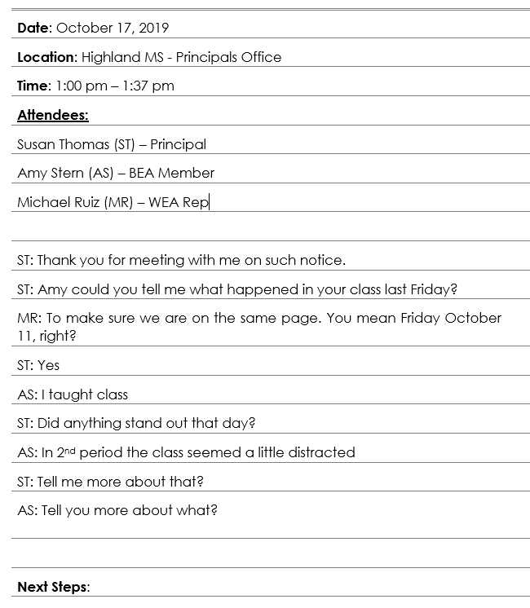
Note Taking
Notes:
Note the date, location, time, and attendees.
When writing down topics- note the speaker by initials, not verbatim, but the core pieces of what someone said.
What if admin want to take notes? You can let them know that until you see them, you are not in agreement with what was said. It is best to keep your own notes.
What should you do with notes? Put them in shared drive. Do not share them widely with people. Ensure your president has access to the notes.

Slide 33
Best Practices
Pre/post meeting
Type of Meeting
  Disciplinary
  Investigation
  Performance
Timeline
To caucus or not
Your role
Notes:
Pre Meeting- try to get 5-10 minutes to talk to the member prior to the meeting.
Post Meeting- give the member a chance to debrief or discuss next steps.
Your Role is different depending on the meeting. (refer to different type of meetings).
Investigation: Promote Fair Process
Disciplinary/Concern: Check for Reasonable, clarify expectations
Performance Feedback: Clarify concerns and confirming support
Caucus- typically it is best to see the meeting through and help the member get through it. However if the member is so upset, its best to take a break to collect themselves.

Slide 34
Popcorn!
What type of Meeting and Your role?
Parent complaint via email
Tardiness to work routinely
Not instructing and shopping online during class
Principal watched you call a student a big meanie and the parent contacted your principal.
Showing up to work under the influence
Violations of the schools' candy policy, colleague put up a sign offering free candy
Notes:
Quick popcorn out:
What kind of meeting is this?
Parent complaint via email
Investigation: Promote Fair Process
Tardiness to work routinely
Investigation: Promote Fair Process
Not instructing and shopping online during class
Investigation: Promote Fair Process
Principal watched you call a student a big meanie and the parent contacted your principal.
Disciplinary/Concern: Check for Reasonable, clarify expectations
Showing up to work under the influence
Trick question: please call your Uniserv Director
Violations of the schools' candy policy, Colleague put up a sign offering free candy
Disciplinary/Concern: Check for Reasonable, clarify expectations

Slide 35

FishBowl Practice
Time to Rep your colleague
Notes:
Move chairs to focus on the rep meeting.
You will play the representative in this meeting.
UD will play the admin and member in trouble.
One participant will start the meeting, about 90 seconds to 2 minutes, we will say pause. Ask the group, what went well what could we have done differently?
Then popcorn another person in to pick up where another person left off. (Repeat until a reasonable ending point and most participants have tried the scenario).

Slide 36
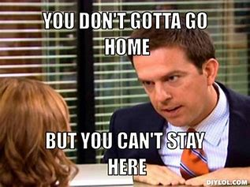
Closing
Time

