Slide 1
Advanced
Site Rep & Grievance Training
San Jose PCS
Fall 2023

Slide 2
The Core Responsibilities
The
Facilitator
The Communicator
The
Advocate
The
Unionist

Slide 3
Union Code of Conduct
I will not criticize any union colleague except to the individual directly.
If any union colleague is being criticized in my presence, I will confront the criticism and ask that it stop.
I will not participate in any conversations with management that criticizes, or negativity speculates about any union colleague.
I will settle my differences with colleagues within the union.
I will engage in debate, offer others every opportunity for debate and respect the minority viewpoints, but I will observe and support the majority mandate of the union.
Notes:
BRUCE

Slide 4

Update and refresh your membership lists
Reconcile membership lists, reporting errors, name changes, new transfers in or out and get the corrections to the Membership Chair immediately
Collect non-work emails of all union members
Create phone/texting tree
Engage site in regular 10-minute meetings
Involve members in union actions (BAT)
Attend monthly Rep Council meetings
Encourage attendance at union events and activities
Encourage local chapter engagement

Slide 5

Social Media Tips for Educators
Your social media and technology use is governed by school board policy, state law, technology use agreements and your CBA
Never “friend” students
Overshare the professional, under share the personal and never share the private
Do share the awesome (no kids’ faces in photos please)
You are what you like and re-tweet
If you are on the district server, they can see what you see
If you wouldn’t want your boss to see it, don’t post it

Slide 6

Your role in the membership process
Potential drops - what’s your responsibility?
Non- members = Potential members
Benefits of local union
Create talking points around your local’s success
Ask them to join
Access to CTA360
Local dashboard
Search individuals
Update individual contact information
Leadership roles and CTA support info
SIGN UP new members
Notes:
LISA/DEB

Slide 7
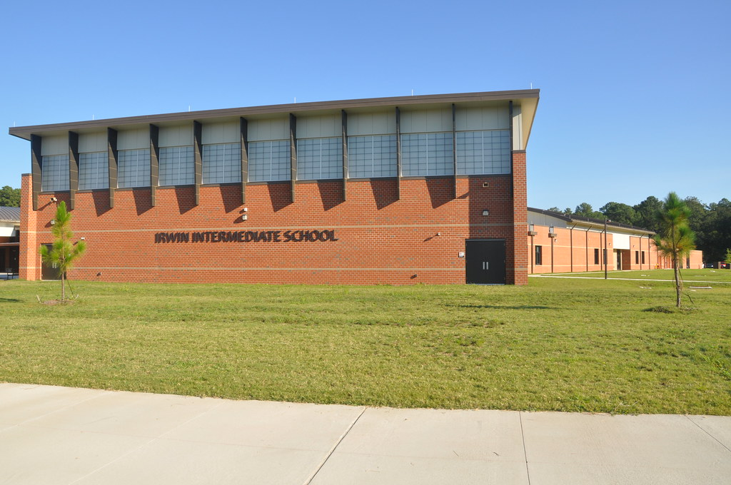
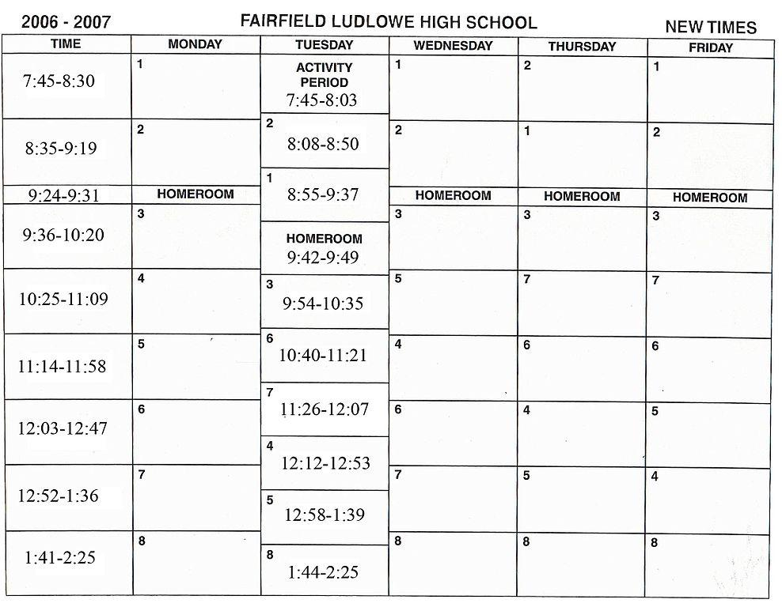
Site Mapping and Data Collection
If you can’t count it, it doesn’t count!
Notes:
NATE
Data collection- systematic approach to keeping a pulse on all members
Different level of intensity and importance

Slide 8
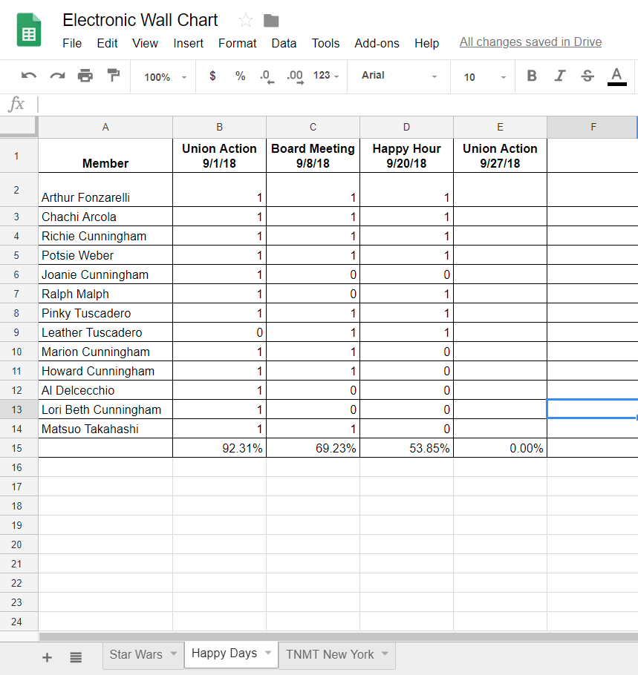
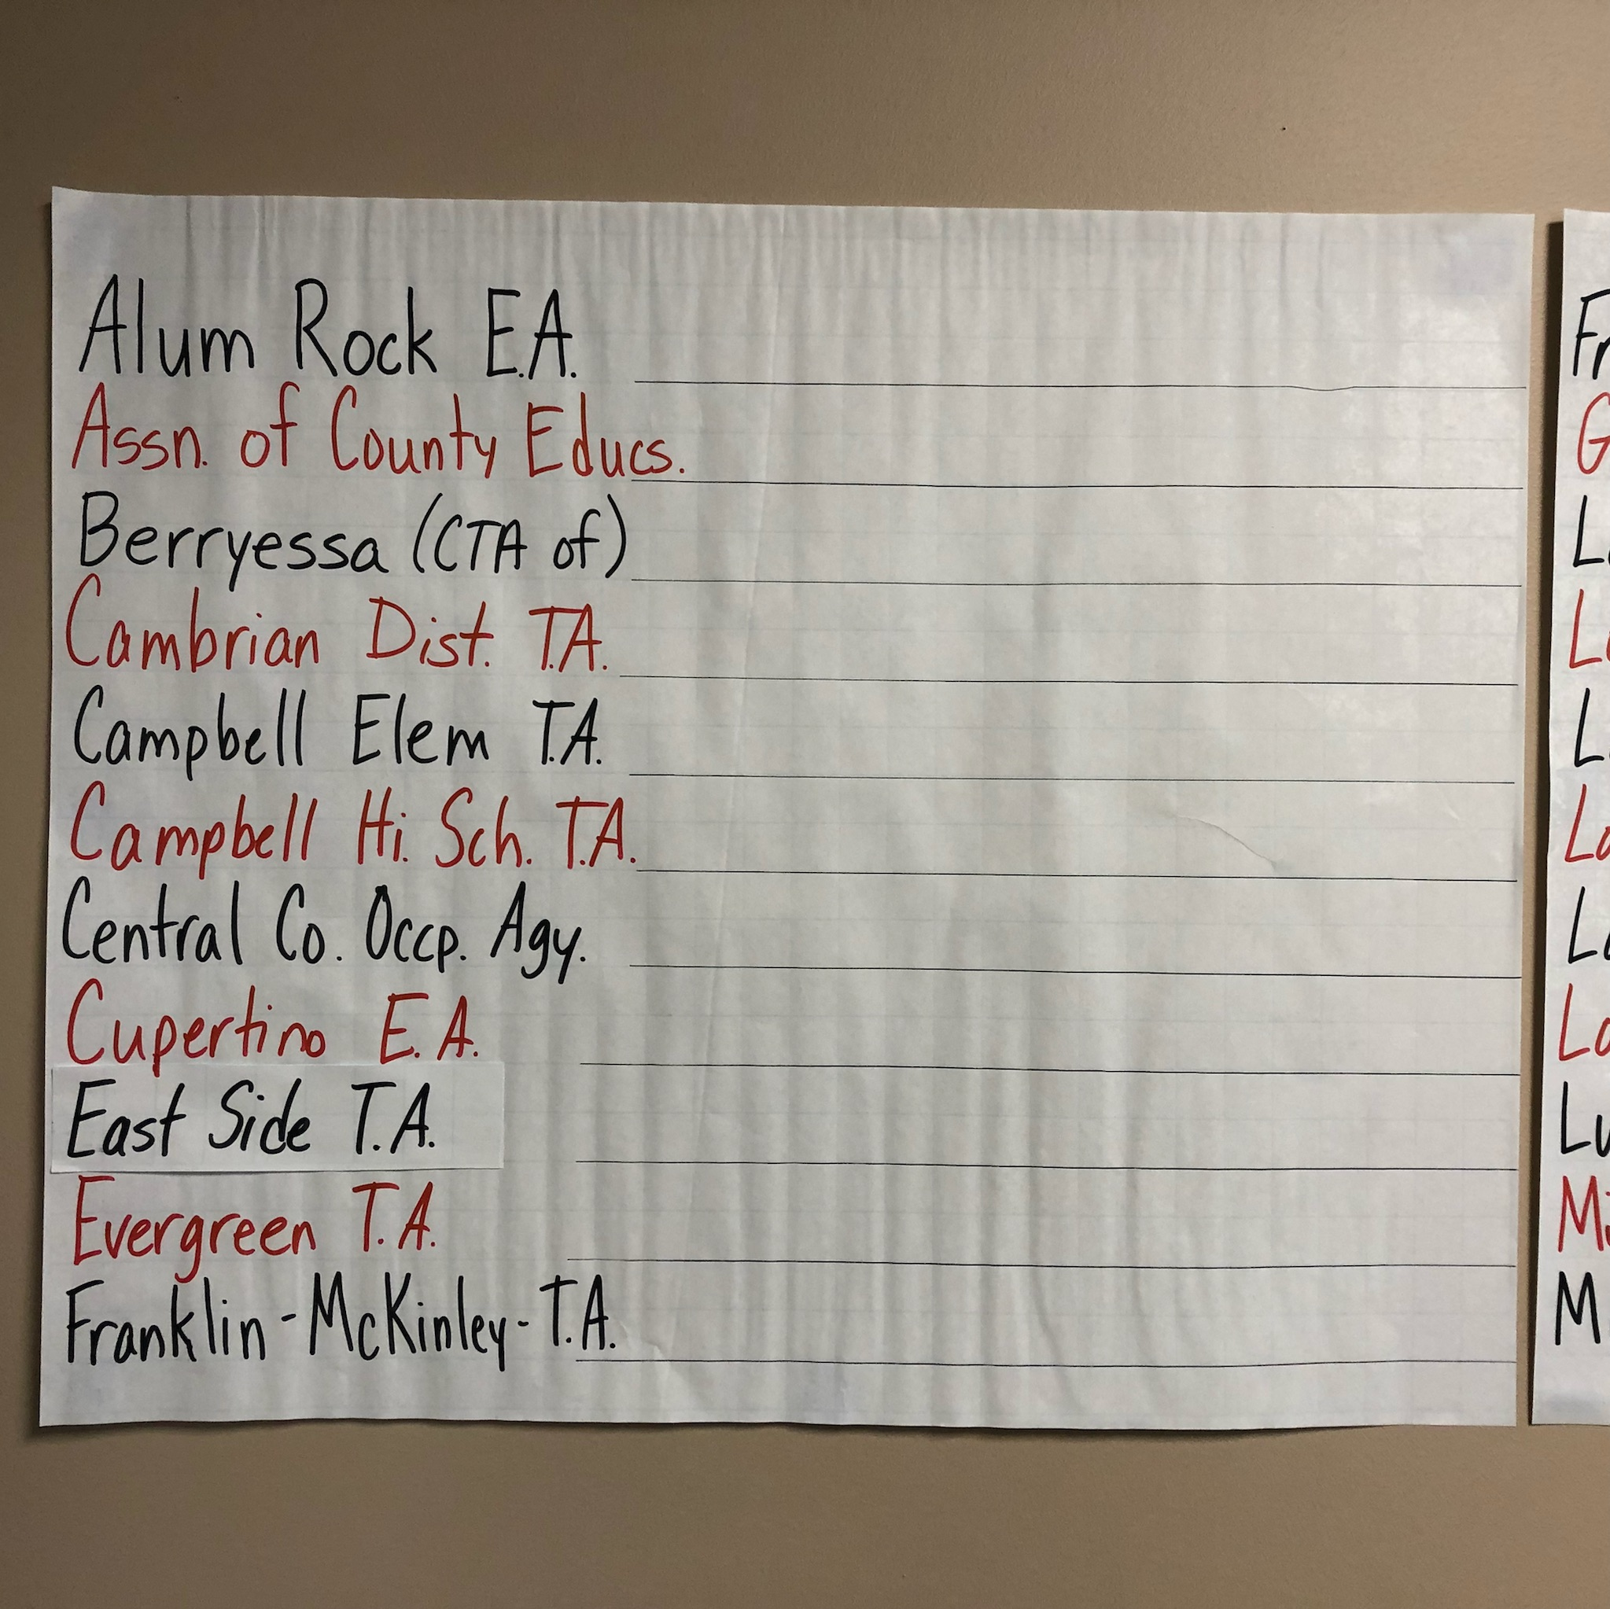
GOOGLE SPREEDSHEETS WALL CHARTS
Notes:
NATE

Slide 9
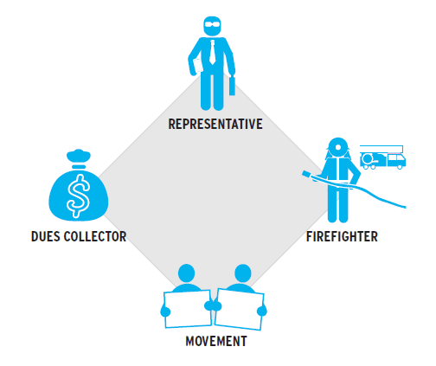
How do your members view your Association?
Representative
Dues Collector
Movement
Firefighter
Notes:
Lisa Activity: moving around to corners, discussion, flip charts

Slide 10

Membership Engagement tools already in place in your local
VP of Membership or Membership Chair
Site Reps aka Membership Captains at each school site
New Teacher Programing (beyond NTO)
Member /Community Engagement Grants
Notes:
LISA- Have participants talk to each other and share out
Do you have…. Questions
President support, coversation

Slide 11

Campaign 2024
Santa Clara County Board of Education Races
Local School Board Races
State Assembly Races
State Senate Races
County Supervisor Races
US Senate
POTUS
Notes:
ADIA
1:1 political convos- how to hold them without being abrasive
10-minute meeting

Slide 12
The Advocate
Handles lower level informal grievances
Maintains contact with CTA PCS regarding concerns
Indentifies worksite problems
Involves members in professional issues

Slide 13
Traits of the Advocate—you are someone who:
Adheres to the Union Code of Conduct
Steers member to member issues to CTA for possible mediation—not through grievances
Is trustworthy
Is thoughtful
Is organized
Is able to keep a secret
Is someone looked up to by your peers
Is someone who can see beyond your own experience

Slide 14
Advocate: The “right” to representation--
EERA (where we get our collective bargaining rights in California) states:
  A unit member has the right to representation at any meeting with an administrator that is disciplinary or could result in disciplinary action
I say:
  Any meeting with an administrator at which you feel uncomfortable because of what you believe to be “unfair” judgments or behavior from the administration in the past.
Let the administration say “no” first to representation, then contact staff

Slide 15
What does “represent a member in a disciplinary meeting” look like?
First: put your PARITY hat on
    Find out what the agenda is (before the meeting, in case you need to ask your member questions)
    Investigative—administration will have lots of questions: What happened? Who was there? What was said? Did anyone touch anyone else? What is the history?
  BEFORE answering the questions, the administration needs to state the reason for the questions, e.g. “there was an allegation made that…”, “a student reported to a parent that…”, “I saw or heard this and need to know…”

Slide 16
Representation continued…
Second: meet with your member
      Once you know the reason for the questions, consider whether you need to talk with the member BEFORE he/she answers the administration
    NO—you don’t need to talk if the member has already told you of the incident, and, it is either untrue, or your member is just a witness and not the object of the investigation
    YES—you do need to talk if you don’t know what happened and can’t determine if the member will be in trouble

Slide 17
Knowing when you aren’t the “right” person
Third: meeting with administration
  You have the right to end the meeting (even if the administration throws a fit) if you believe that the member may be guilty of a serious allegation
    Criminal? You are not the right representative
    Could it result in serious discipline (suspension)? You probably aren’t the right person
    Will it result in a verbal warning, written warning? Yes, you MAY be the right person
  Understanding parity is also understanding your position/role
  If you aren’t the right person, call the appropriate party immediately (Chapter President and/or CTA PCS)

Slide 18
Representation continued…
Fourth: When you are the right person
  Keep the administration on task by asking clarifying questions to ascertain the scope of the allegation and/or issue
  Take notes as applicable (not verbatim unless a statement is startling or concerning)
  Keep the member on task. If your member starts to ramble, giving information that isn’t helpful or begins tattling on others, get his/her attention and give the “stop” sign (pre-arrange what that sign is)

Slide 19
Representation continued…
Fifth: the close
  Ask what the follow-up will be (another meeting, additional investigation, a written summary, a written reprimand, nothing)
  Thank the administration and leave
  Let the appropriate person (Chapter President or CTA PCS) know of the outcome to establish whether there is follow-up needed
  IMPORTANT: Maintain confidentiality

Slide 20
PART 2:
Complaint or Grievance?
“Our labor unions are not narrow, self-seeking groups. They have raised wages, shortened hours, and provided supplemental benefits. Through collective bargaining and grievance procedures, they have brought justice and democracy to the shop floor.” ~John F. Kennedy

Slide 21
What is a Grievance?
A grievance is a violation, misapplication or misinterpretation of any provision of your collective bargaining agreement or of a policy of the Board of School Trustees which affects the terms and conditions of your employment.

Slide 22
What is a complaint?
Everything else or other concerns that are not addressed by your Collective Bargaining Agreement (CBA) or contract.

Slide 23
Is it a complaint or a grievance?
“I am not getting my 10 sick days.”
Grievance
“My principal is bullying me and being a jerk.”
Complaint or possible DFEH violation
“The timeline was not followed on my evaluation.”
Grievance
“My classes are too large”
Grievance
“I was only observed once.”
Grievance
“I don’t want a particular student in my class.”
Complaint
“A fellow colleague is bad mouthing me around campus”
Complaint and CTA mediation recommended

Slide 24
Brainstorm T/P/S
Take some time to think about your experiences from the past school year with grievances and complaints
(5 min )

Slide 25
Report Out

Slide 26
The Grievance Process
Step 1: Investigate & Document
Step 2: File Informal Grievance
Step 3: Formal Grievance/Class Action
Step 4: Mediation/Arbitration

Slide 27
You have a grievance. What should you do?
Investigate
Speak to all affected employees
Take anecdotal notes

Slide 28
How to Investigate a Grievance
Interview the grievant and write down dates, facts, and witnesses.
Ask questions for clarification and additional information.
Interview the involved supervisor and witnesses. Keep a written record.
Examine all records that have a bearing on the incident.
Separate the facts from opinions and allegations.
Determine which facts are relevant to the matter in dispute.
Initiate informal grievance and know your timelines

Slide 29
Presenting a Grievance
Work towards resolution, not persecution
Focus on facts – what happened, what rule was broken
Stay united in front of management
Keep the grievant (and your grievance chair/chapter president) informed throughout the process

Slide 30
What About Complaints?
Board Policy enforced by Uniform Complaint
Unsafe/unsanitary conditions for students by board complaint or COE complaint (Williams Act)
Education Code enforced by writ to superior court (GLS)
Labor law enforced by unfair practice charge (ULP)
Curriculum addressed by consulting
Notes:
BP – board complaint
EC – writ
Labor – unfair
Curriculum - consulting

Slide 31
How to deal with a complaint?
Employee or Staff Member
Site Representative
Rep Council/Exec. Board
CTA Primary Contact Staff

Slide 32
Policy
Policy refers to those written procedures established by management in areas of the work relationship not covered by the CBA (e.g. School Board Policy, Administrative Regulations, Principal’s Memo).

Slide 33
Past Practice
Any longstanding, unbroken practice that is accepted and known by both union and management. Bona fide past practices are considered part of the contract.
Example: The District Office charges your sick leave on a pro-rata basis, although the contract is silent about leaves that are less than a full day.

Slide 34
Remember, even though the you have one of the toughest contracts in the country, no contract is worth the paper it’s printed on unless it’s enforced.

Slide 35

In all cases—grievance or complaint
The BEST solution happens at the lowest level. You are integral to achieving this for your local.

Slide 36
Questions
&
Answers

