Slide 1

Writing & Tracking Grievances​
"When they work well, Unions are the voices of all the workers in negotiations with management, and can leverage worker solidarity to not only prevent management from treating workers poorly, but to force management to create a safer, equitable and more joyous workplace" ​
Jane McAlevey (Oct 12, 1964- July 7, 2024)
October 23, 2025 Adia Hoag
Notes:
2/90 minutes
Josh: What this workshop is not: not working through your own highly specific grievances, not second-guessing your own PCS ("Josh and Adia said it's a good grievance")

Slide 2
What is a grievance?
A grievance is a violation, misapplication, or misinterpretation of any provision of this agreement or of a policy of the Board of School Commissioners which affects the terms and conditions of employment.
Notes:
2/88 Minutes
Adia

Slide 3
What is a complaint?
Anything that is not a grievance.
Notes:
2/86 Minutes
Adia

Slide 4
Gripe or grievance?
“I am not getting my 10 sick days.”
Grievance
“My principal is bullying me and being a jerk.”
Gripe or possible CRD complaint
“The timeline was not followed on my evaluation.”
Grievance
“My classes are too large!”
Grievance (if you have language)
“I was only observed once and got an unsat evaluation.”
Grievance
“I don’t want a particular student in my class.”
Gripe or possible safety complaint
“A colleague is bad mouthing me around campus.”
Gripe and mediation recommended
“My para is always showing up late or calling out sick.”
Gripe, possible IEP violation or CDE Compliant
Notes:
10/84 minutes
Adia

Slide 5

How to deal with a complaint?
Employee or Staff Member, talk to the person directly
Site Representative
Rep Council/Exec. Board
Member or consult CTA Staff
    Uniform Complaint
    Williams Act Complaint (3Ts)
    California Civil Rights Department (CRD)
    CDE Special Education Complaint
Organize, organize, organize!
Notes:
10/74 minutes
Adia

Slide 6
What does your CBA say?
Look up your grievance article in your CBA.
What is your timeline?
How many days between each grievance step? Workdays or calendar days?
Do you have to conduct an informal meeting with admin prior to filing a formal grievance?
Is there an exception for class action grievances to file directly at Level 2?
Does your CBA include binding arbitration?
What agency does your local need to request a list arbitrators from? SMCS or AAA?
Notes:
10/64 minutes
Josh: 10 minutes

Slide 7
The Grievance Process
(Depends on your CBA)
Step 1: School Site or Office (informal and formal)
Step 2: Superintendent/HR Director or Designee
Step 3: Mediation (some districts)
Step 4: Arbitration
Notes:
4/54 minutes
Josh

Slide 8
Recipe for Writing a Grievance
Notes:
2/50 minutes
Adia

Slide 9
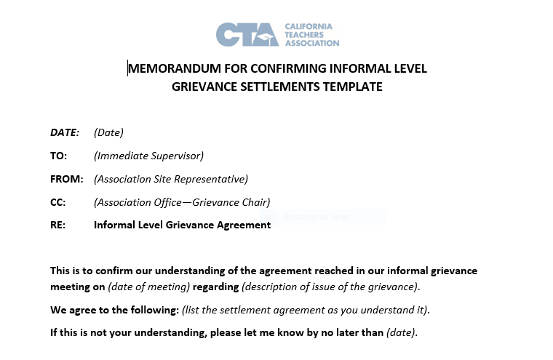
Basics of writing a persuasive & clear grievance
Handout #1Grievance Template
Handout #2 Recipe for Writing a Grievance
Handout #3 Grievance Form
Handout #4 Scenario & OEA CBA Language
Handout #5 Tracking Form
Handout #6 Grievance Fact Collection Sheet
Notes:
2/48 minutes
Josh

Slide 10
Write a grievance:
Take some time to think about the scenario and the contract language provided, using the Recipe for Writing a Grievance please write up a draft for a Level 1 grievance.
(10 min )
Notes:
12/46 minutes
Josh: check remaining time left… hopefully 45 minutes left…

Slide 11
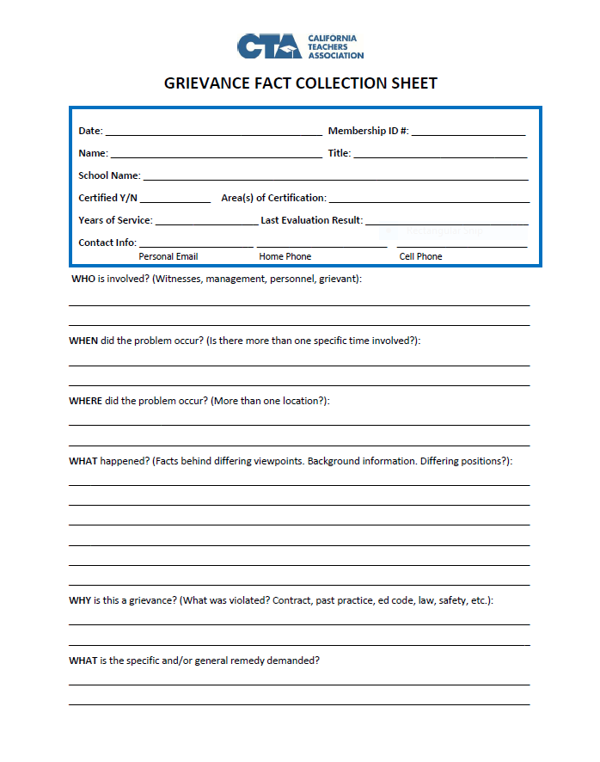
Grievance Fact Collection Sheet
Record keeping and documentation are so important:
  Who is involved?
  What happened?
  When did the problem occur?
  Where did this problem occur?
  Why is this a grievance?
  Information request needed?
  Remedy? BE SPECIFIC
Notes:
4/34 minutes
Adia

Slide 12
You have a grievance. What should you do?
Investigate
Speak to all affected employees
Take anecdotal notes
Send an information request
Document, document, document
Notes:
5/30 minutes
Josh: When should you be vague and when should you be specific? “Who is impacted” should be part of your information request? And you need to do your own research and organizing. Site Reps can be used to survey members at their work sites to see who is impacted by the class grievance and should benefit from the remedy or relief. Examples: yard duty, Keenan trainings, unpaid assessments, class size overages (hard caps vs. soft caps). Beware of taking shortcuts.

Slide 13
How to Investigate a Grievance
Interview the grievant and write down dates, facts, and witnesses.
Ask questions for clarification and additional information.
Interview the involved supervisor and witnesses. Keep a written record.
Examine all records that have a bearing on the incident.
Separate the facts from opinions and allegations.
Determine which facts are relevant to the matter in dispute.
Fill out the grievance form in full and have the grievant sign it.
Notes:
10/25 minutes
Adia: members can lie, talk to all people involved even admin, sometimes admin will tell on themselves or district personnel

Slide 14
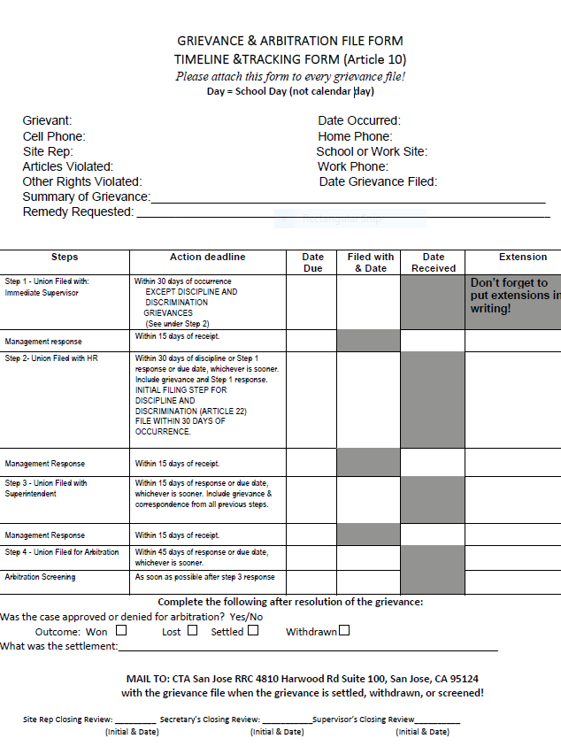
Tracking Grievances
Use to locate improve the CBA during the next round of negotiations
Identify patterns and problem areas in your CBA
Keep records organized
Avoid a DFR by not missing important timelines
Analyze trends:
  Is new language needed
  Strengthen, clarify, or rewrite existing language
Notes:
2/15 minutes
Adia: Ask what they can use the tracker for?

Slide 15
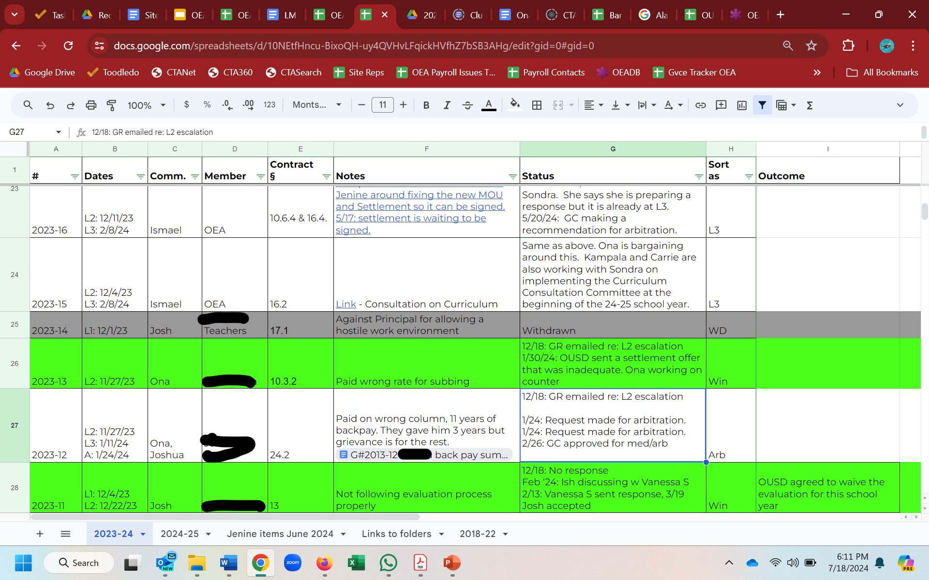
OEA Tracker
Notes:
3/13 minutes
Josh

Slide 16
Site Reps’ Ten Tenets
Don’t shortcut the grievance procedure.
Don’t lose your temper.
Don’t argue with the grievant in front of the management.
Don’t bluff or threaten.
Don’t permit stalling.
Don’t “horsetrade” grievances.
Do stick to the facts.
Do talk less and listen more.
Do attempt to settle at the lowest level.
Do keep the grievant informed about the grievance.
Notes:
2/10 minutes
Adia

Slide 17
Organizing Around a Grievance
All for one and one for all
Organizing campaigns assist in winning at the grievance table
Be creative and have fun!
Consult your PCS for ideas and assistance
Your power is your membership!
Notes:
2/8 minutes
Josh

Slide 18
Contract Enforcement
As was once said, “The best representation that workers have ever received has been provided by persons with little formal education, but a well-thumbed copy of the contract and a strong sense of justice and fair-play.”
Notes:
1/6 minutes
Adia

Slide 19

Questions
&
Answers
Notes:
5 minutes left

