Slide 1

Building Union Power through SITE REPS!
Facilitated by
Dawn Cova & Kei Swensen, CTA Staff
Presented By:
California Teachers Association

Slide 2
Intro to Training Method
Small group discussions and activities
Role plays
Participants work together
Learn by doing
Question for the group: Where do our workplace rights come from?​
Notes:
Where do our workplace rights come from?​
The law
The Union Contract
The Power of Solidarity
Worker solidarity is so powerful that even without the law or the contract, we can win.

Slide 3

Basic Premise of Unionism
An Injury to ONE is an Injury to ALL!
Balance of Power - Parity
Improving Peoples' Lives
Notes:
We will come back to Parity later in the presentation.
If employees in a workplace act individually, all employees lose power.

Slide 4
Union Code of Conduct
Criticism directly to the individual only
Settling differences
Debate, but support the majority

Slide 5

UNION POWER
WITHIN
TO
WITH
Notes:
Dimensions of Power:
Basic premise of unionism – solidarity
In a workplace there is an imbalance of power. Employer has POWER OVER, but IN UNION members have power WITH, WITHIN, and TO (take action with others)
See handbook

Slide 6
What’s the difference & which one builds UNION POWER?
Advocacy
Mobilizing
Organizing
Notes:
Advocacy is the lowest form of worker participation. It doesn’t involve ordinary people in any real way; lawyers, pollsters, researchers, and communications firms are engaged to wage the battle. Mobilizing does bring significant numbers of people into the fight, but they are, generally the already committed activists, not the mass of the workforce and community.
Ordinary people need to see themselves as the key agents of change; staff should support them.
Most unions do Advocacy & Mobilizing
Organizing is expanding the base from which you mobilize. Worker agency is what makes change.

Slide 7

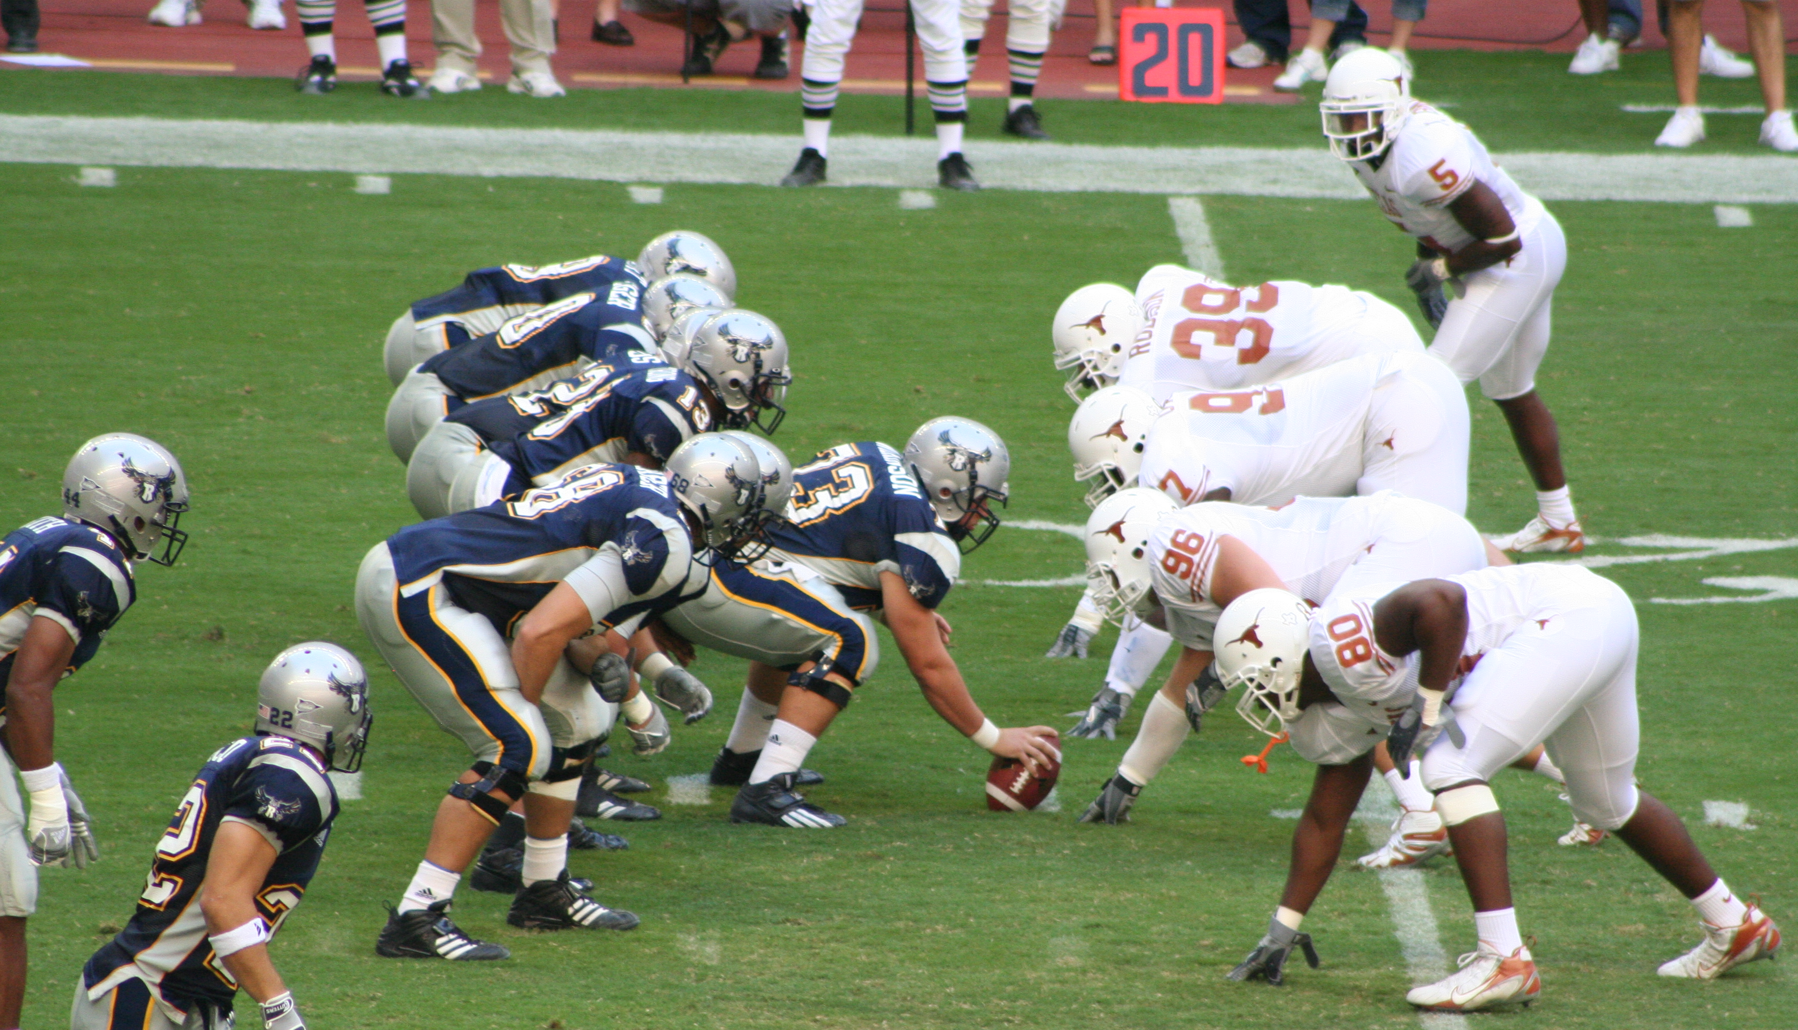

4 Union “Tools” To WIN!
1. Offense
Organizing for Power
2. Defense
Grievances/Complaints/Litigation
3. Collective Bargaining
Scoreboard: Measures Progress
Narrative: OUR WHY?
Framing & Messaging
Notes:
Where do reps fit in to union tools context?
What do most members want to do when there’s an issue? (DEFENSE!)
Reps are a VITAL part of our union offense! (Think like an Organizer.)

Slide 8
Taking Action:
2 Models of a Union
Servicing
  Member takes issue to the Site Rep
  Site Rep talks to the boss alone
  Grievance is filed
  Who holds the power here?
Organizing
  Member has an issue
  Other members get involved and talk to the boss collectively
  Grievance is filed by many members at the site collectively
  Who holds the power here?

Slide 9
Member Centered Union
Members
  See themselves as the Union
  Run the Union
  Talk to each other regularly
  Are proactive
  Set goals and strategy
  Know the contract
Notes:
Example: Fair and Open Elections

Slide 10
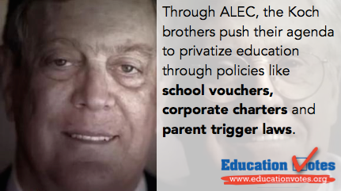
Why are union site reps crucial?
  Our opponents’ agenda:
Elimination of Fair Share
Weaken collective power of labor unions
Eliminate collective bargaining
Privatize public education by vouchers & charters
Total control of US Govt. by corporate America
Notes:
Our opponents have been successful at achieving first objective.
We need to STOP them from achieving more of their objectives!

Slide 11
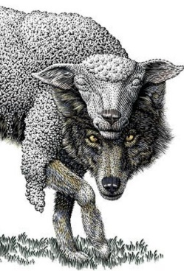
The Wolves Always Wear Sheep’s Clothing
The “Wolves” Drop campaigns: ​
  Emails, phone calls, letters​, even face-to-face
Consistent messaging: ​
  Freedom​
  Choice
  Party Politics
The “Wolves” DECEPTIVE empty promises: ​
  Representation​
  Liability insurance​
  Cheaper ​
Third Party “the Union”
Notes:
The Wolves know our collective power comes from membership.
The Wolves’ Messaging:
The Wolves will claim they offer you freedom and choice, but as union members we have the freedom to negotiate a fair return on our work, to ensure we have time to care for our loved ones, and to achieve the quality public education our students deserve.
What they’re really trying to do is weaken our ability to achieve improvements for our students and our profession.
How is DIVIDING our union, our members going to help us achieve more?
Come back to POWER EQUALITY we build when we have the FREEDOM to come together in Union.
For example:
Mackinac Center – “MyPayMySay”
Opt Out today
American Legislative Exchange Council
So-called “Freedom Foundation”
Charles and David Koch
Right to Work Foundation
Liberty Justice Center
Center for Individual Rights

Slide 12
The Role of Leaders to Overcome Inaction
Admin Relies On… | Leaders… | Co-Workers Find…
Fear | Righteous Indignation | Courage
Futility | Plan to Win | Hope
Division | Identify Common Ground | Unity
Confusion | Interpret and Share Info | Clarity

Slide 13

SITE REPS ARE
Union Organizers & Member Advocates
Our union is as strong as our sites
Our sites are as strong as our reps
Strong reps are union organizers and member advocates!

Slide 14
Union Organizers strive to create power through:
Union Democracy - Members own their UNION
Worker Agency - Members acting together are the agents of change
Structure Based Organizing – Members create and work their plan to win!
Super-majority Participation - Members are engaged
Strong Internal & External Communication - Members control the narrative & use student-centered message frame with discipline

Slide 15


Members Own Their UNION – Union Democracy
Members speak for themselves
Leaders listen to their members
Members drive negotiations through their actions
Site charts are shared with all members
If you can’t count it, it doesn’t count!
Power is in the hands of the members (employer alliance does not build power)
Notes:
Transparency = No backroom deals
Members control their union
Leaders listen to their members
Do not answer questions or speak for members. (For example, don’t ASSUME what members are willing or not willing to do; or what they want or don’t want; leaders have to LISTEN to what they say)
No secret organizing (power is in the hands of the workers)
Negotiations are open and transparent. Members drive negotiations through their actions. Every member considers himself/herself a bargainer/negotiator.
Site wall charts (indicating participation) are kept current and shared with members. Assessments are NOT judgements. Know the data and make smart and strategic decisions around investing resources; and to know exactly where members are on an issue (widely/deeply felt?)
If you can’t count it, it doesn’t count.
Members understand that Winning Life-Altering improvements in Local Chapter contracts take SUPER-MAJORITIES of member activists.

Slide 16
Members Acting Together Are the Agents of Change – Worker Agency
Members own grievances and complaints (through direct action)
01
Members working together will improve working conditions and will secure the future of all members
02
Leaders and members use structure tests to assess how widely and deeply felt an issue is.
03
Notes:
Members acting together are the agents of change (Worker Agency/Direct Action)
Workers together are the agents of change, including improving their work sites, improving their work lives and securing their future. Collective action creates a great work place.
Every member is a bargainer and understands this. The members win or lose the best bargains.
Use structure tests to assess how widely and deeply felt an issue is.
Members own grievances & complaints. (i.e. through direct action)
Members own “Demand to Bargain” and/or “Cease and Desist” notices/letters through direct action. (Refer to handbook; highlight examples from locals that have done this.)
No backroom deals

Slide 17
A Good Organizing Issue
Is Widely Felt
Is Deeply Felt
Is Winnable
Builds the Union and Leaders
Has a Connection to Students and to the Public

Slide 18
What Makes a Good Action?
Simple
Visible
Something you know people will do
Timed for effect
Builds on past actions
Unifies
Targets the person(s) with the power
to meet your demands

Slide 19
DIRECT ACTION for POWER
4 Reasons to Take Direct Action to Solve Issues at Work
Organizing actions with our co-workers helps us win resolution quicker
Not every issue at work is a grievance, organizing with our co-workers is the only way to resolve some worksite issues
Organizing around our issues builds workers’ power. It builds solidarity and union visibility. It sends a strong message to the boss that our rights must be respected. When we come together as a union, a group of people acting together, we feel better about ourselves, our Union and our jobs.
Workers own the issue, take responsibility for solving worksite problems stop 3rd partying of the Union
Notes:
Grievances only build power, if they’re paired with direct-action
Direct action.
Direct action is crucial to building capacities and relationships. The same goes for directly confronting management in the workplace over grievances rather than confining responses to legalistic forms.
(hand-out available)

Slide 20
Elements of An Organized Worksite
Union presence is visible daily to management
Members defend standards and enforce contract
Members own their Union
Site assessments are completed
Site Capacity Rubric is implemented

Slide 21
Members create their Plan to Win!
Structure-Based Organizing
Use Site Capacity rubric/assessment to determine membership power at school site
Site Mapping
Conduct one-on-one (relational and organizing) conversations to strengthen membership and increase participation
Help connect-the-dots for members (membership + participation = power)
Individual assessments (based on what members DO, not what they SAY)
Assist Building Action Team (as liaison)
Track participation data on Wall Chart
CTA 360

Slide 22
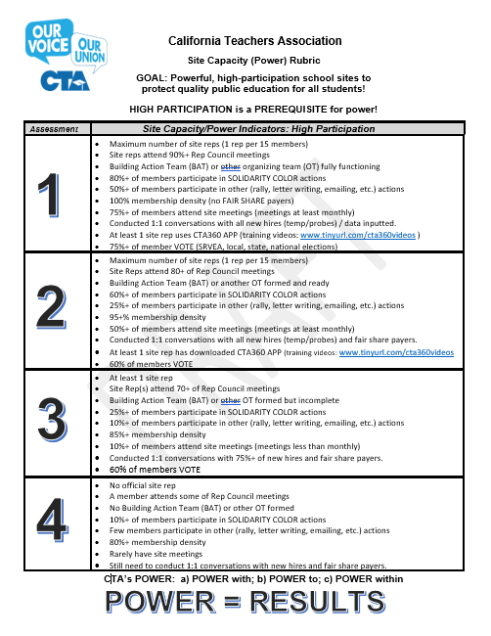
Create Powerful, High Participation Work Sites!
What percent of your chapter’s sites are “1s”?

Slide 23
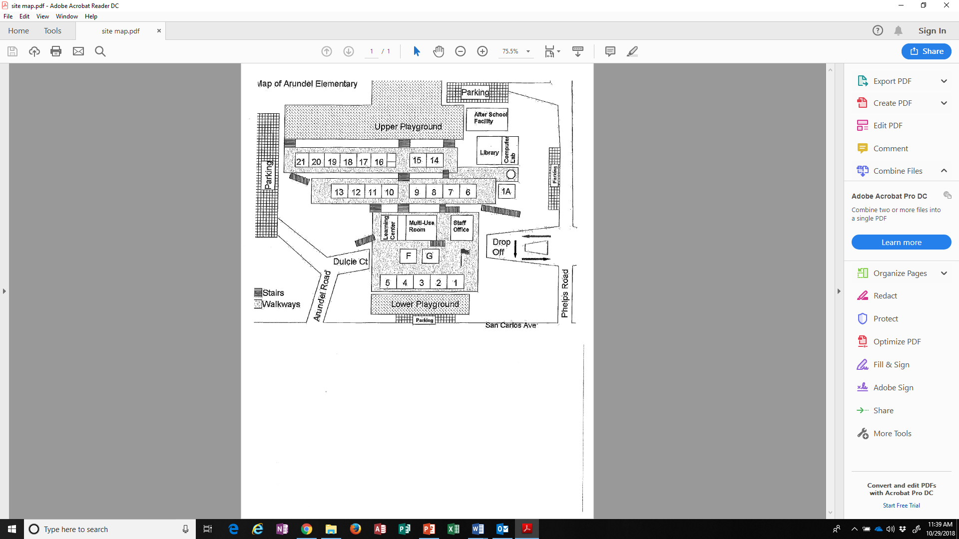
Site Mapping
Grapevines
Bottlenecks
Work Groups
Relationships
Social Groups
Group Concerns
Water Coolers
Broom Closets
Hangouts
Prep Time

Slide 24
Assess Members
Best things about the work site?
Least favorite things about the work site?
Can we count on you to join us around this issue?
Who else cares about this issue?
When can we get colleagues together to create a plan to win?
Notes:
This could be a time to do an activity in small groups where members can “map” using the provided member data and school map

Slide 25
How Do We Keep Track of Conversations?
The Wall Chart
CTA360
Notes:
You should track new conversations, ongoing conversations and conversations with objections
Track all intentional conversations that lead to the union goals and objectives.
For example, if you are in bargaining, track conversations related to bargaining.
If you are organizing a rally, track commitments made to participate to the event (How do you assess if you don’t count it!)

Slide 26
Wall Charts
Record what is and what is not happening
Allow for positive and helpful conversations over facts
Help us to analyze problems and assess issues
It is not judgment, it is assessment, which only helps anything and everything…
Help us to remember our tasks
Give us a visual for celebration when the wall chart is “green”

Slide 27
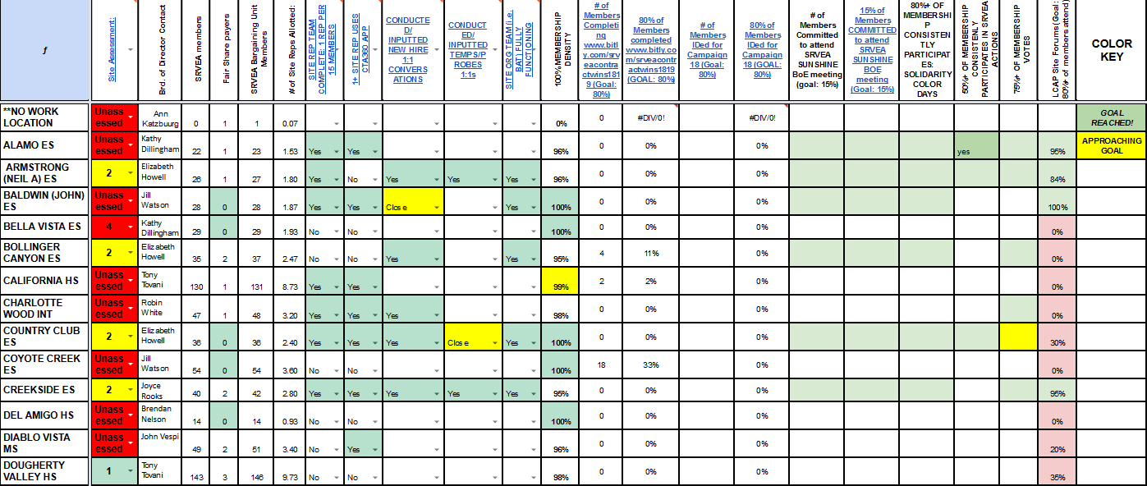
Notes:
Site Wall Chart
The Wall Chart gives you a quick glance and assessment of where your members are and the participation of the worksite. This quick assessment helps you target those site get more members involved. Wall Charts are good to use with Site Reps to validate them and provide them with more guidance or support. The goal is to make the Chapter a “High Participating” Chapter

Slide 28
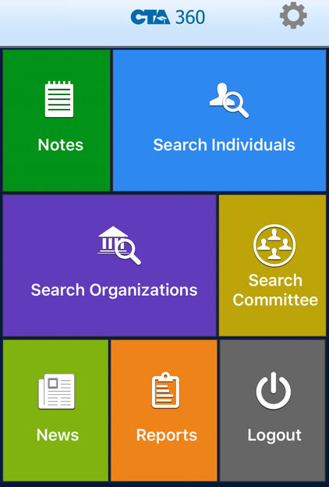
CTA 360
Using CTA 360 as a tool
  Search individuals or committees
  Mass email and text
  Member status by site

Slide 29

Listening Is Important!
Avoid distractions
Slow down
Empathize
Keep an open mind
Find common ground
Leave emotions behind
Ask questions
Smile!

Slide 30

Relational Conversations
Introduce yourself. Ask questions that will help surface members’ values and/or motivations. (For example, “How did you get into teaching? What do you like best about your job?”)
Message can be as simple as “Hi, together we are local/CTA. We all support each other and work together to solve problems and provide the best public education for our kids.”
The goal is to build a relationship based on shared values. Connect members to our shared values of standing together in union: to advocate for public education, our students, and colleagues.
Notes:
Leadership should have an objective of having one one-on-one conversation with 80+ of members annually (adjust as appropriate)
Reps should have conversations with100% of new members in the first 3 months

Slide 31
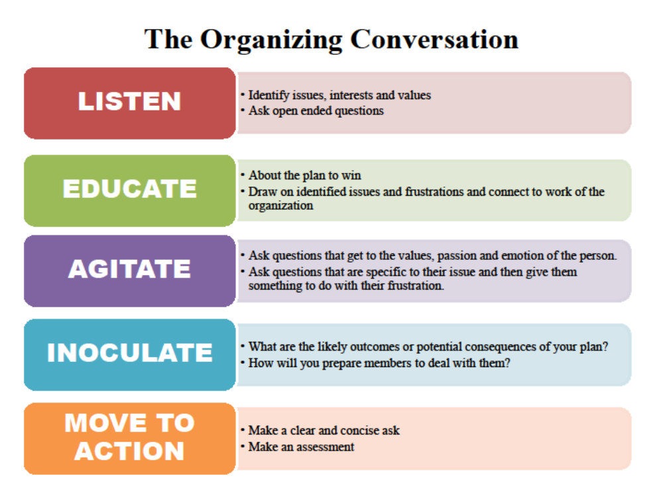

Slide 32
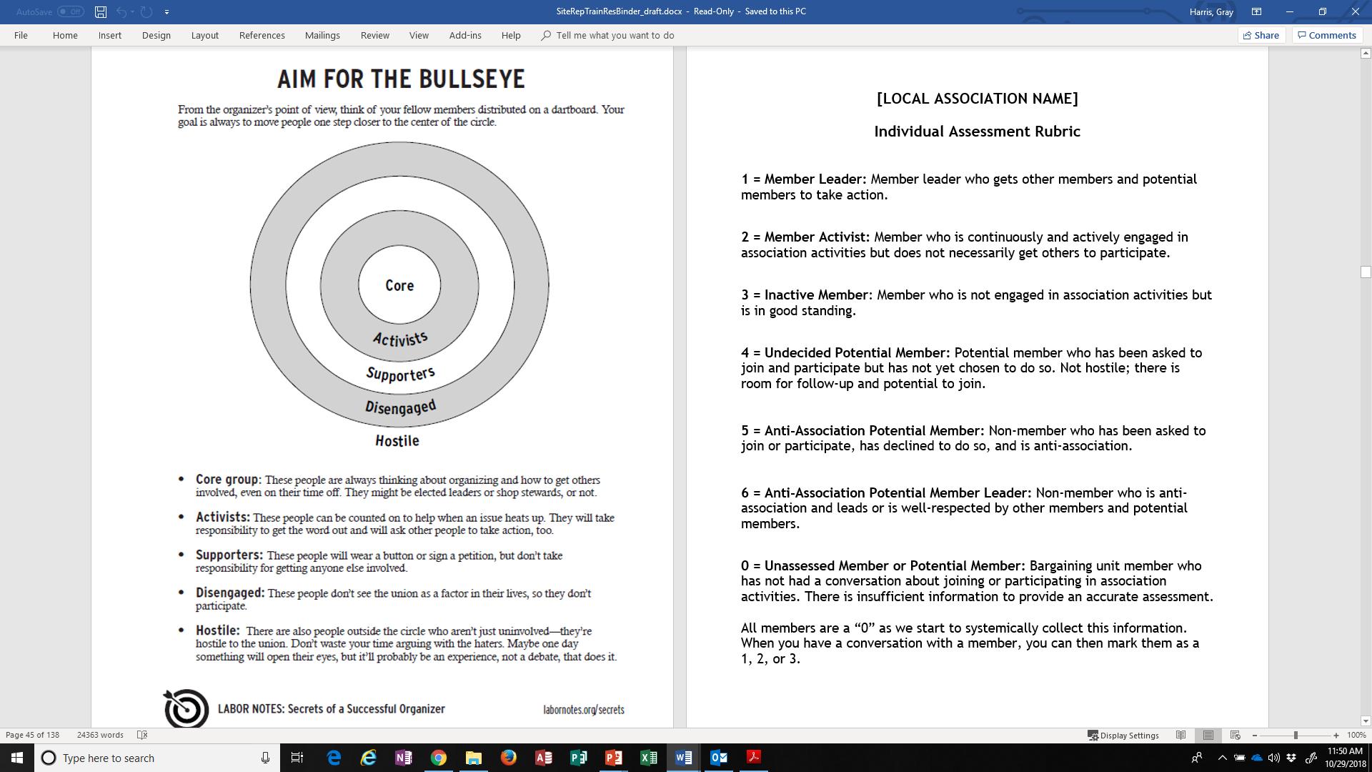

Slide 33


You are not alone!
BAT teams are networks of union members at a school (or worksite).
BAT leaders will have networks of union members who they see regularly.
BAT leaders (with the support of site reps, union staff, and other union leaders) will organize colleagues in their network to stay informed, maintain union membership, and to get engaged in addressing site issues and winning a strong contract.
Notes:
There may already be organic leaders who can be recruited (Think about: grade level? department? who eats lunch together? etc.)

Slide 34
Members Are Engaged – Super-majority Participation
Engage all bargaining unit members: promote union membership and recruit new union members
Help members understand their vital role in building union power
Notes:
Know the new bargaining unit members and be helpful to them
Know bargaining unit members’ status: union member or potential member
Be prepared to overcome objections and answer predictable questions
Forward membership forms to your membership chair immediately
Identify organic leaders
Use CTA 360 as a resource
Connect the dots between Membership + Collective Action/High Participation including elections and electoral campaigns
Seek out and develop organic leaders
Assist members in identifying “organizational cost” for negotiations or district-wide issues – what is it going to take to get what you want?

Slide 35
Build Power through super-majority participation
Identify organic leaders (at least one at every worksite)
Members are active in their organizing committees, building action teams or contract action teams
Site Reps are meeting and dialoguing regularly with members at their sites
Members are asked, “What is it going to take to win what you want?” “Are you and your members willing to do what it will take to win?”
Membership is high at each site. Reps are having conversations with non-members and overcoming objections
Membership, collective action/high participation equal UNION POWER

Slide 36

Why did you join (or choose to remain) part of your union?
How will you overcome objections from potential members??
Remember, people join WHY, not what you do.
Notes:
Give participants time to reflect and share with neighbor

Slide 37
Handling member drop requests
If a member wants to drop:
Ask why?
Use the RAP and Freedom Frame
If member insists:
We will have 10 days to talk to the member again at the site to encourage them to remain part of their union before the drop is processed.
Contact Local Union President
Organizing Conversation
All requests to drop membership must be given as a hard copy (no emails) to the chapter president.

Slide 38
POSE the CHOICE:
Every action and every non-action sends a message, and makes an impact
Doing _________(this)
means ___________(this):
You support ___________________
NOT doing ___________(this)
means ________(this):
You support what the district is doing and are okay with it. (Because that is the message you are sending and that is how they will interpret it)
Example:
Joining as a member
means
we have more collective power to win on issues that affect our students and our profession.
It tells our district we support each other.
NOT joining as a member
means
we LOSE more power to win on issues that affect our students and our profession.
It tells our district we don’t support our coworkers and we agree with all of the decisions made by the district.
Notes:
If an organic leader remains undecided, the recruiting organizer, because of the urgency that always exists in high-risk union fights where the employer’s war is either imminent or already in motion, takes the next step: “framing the hard choice.” The process begins with understanding an individual organic leader’s self-interest and helping the leader come to his or her own understanding, through face-to-face discussions, that this self-interest can only be realized through collective—not individual—action
Framing the Choice is what parents do with children they are trying to get to bed. It’s what political campaigns do all the time. The difference here is that Framing the Choice in a union context is not about trying to trick anyone, but is about being as honest as possible, it’s about telling the absolute truth. Our job is to tell the truth about the consequences of action or non-action. Everything has an impact, and not becoming a member is NOT a passive action, but a harmful one.

Slide 39
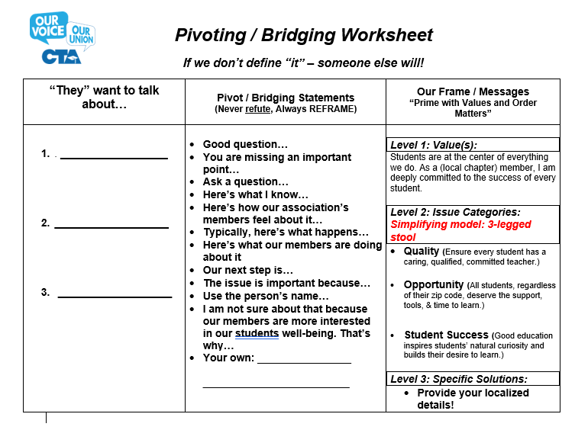
Notes:
Never REFUTE!
Pick ONE bridge/pivot statement and always restated our frame

Slide 40
Benefits of Union Membership
For Public Education
For Your Career
For Your Rights
For Your Wallet

Slide 41
Messaging is Critical

Slide 42
Union Communication: Members control the narrative
Use appropriate union message frame(s) in all internal & external communication
Attend monthly union rep council meetings
Hold regular union site meetings
Manage member surveys
Collect member cell #s and personal email addresses
Keep union bulletin board up-to-date
Encourage members to use cta.org and nea.org websites
Notes:
Bring membership concerns to the rep council/officers
Actively listen to members
Be aware of “hot” issues
Deliver union correspondence to members
Model & encourage message frame discipline

Slide 43
Messaging: Students are the center of everything we do. As a (local chapter) member, I am deeply committed to the success of every student.
We work together to ensure:
Quality
Opportunity
Student Success
Notes:
Student-centered frame (external)

Slide 44
Messaging: Our Union Guarantees Our Freedom!
Freedom to achieve the public education our students deserve.
Freedom to negotiate a fair return for our hard work.
Freedom to negotiate time and resources to care for our loved ones.
Notes:
Union Freedom frame (internal)

Slide 45
Messaging: Our Dues Dollars are a Collective Investment in Our Students, Our Freedom and Our Future!
Secure funding and resources for our students and neighborhood schools
Our secure profession
Our secure retirement

Slide 46
Union Communications
Surfacing Issues
Connecting People
Follow Up
Background information
Knowing your rights
Soliciting member responses

Slide 47
10 Minute Meetings
2 Minutes: Current Issues Update
4 Minutes: Our Hot Issue
3 Minutes: What’s on Your Mind?
1 Minute: A Success or a Problem

Slide 48



Membership Advocate
Contract Enforcer
Member Rep
Notes:
Defense

Slide 49
What is a grievance?
A grievance is a violation, misapplication or misinterpretation of any provision of this agreement or of a policy of the Board of School Commissioners which affects the terms and conditions of employment.

Slide 50
Advocacy
You are there to defend the process, not the member
Don’t judge, defend!

Slide 51
PARITY
When acting in your role as a union representative, you have parity with admin. Parity or the "Equality Rule" makes you a "legal equal" to the boss. But, it’s in effect only when you are doing your job as a union representative, not when you’re acting as an individual employee. You’re acting officially when you investigate and argue grievances, request information and otherwise defend members.

Slide 52
Duty of Fair Representation
"The employee organization recognized or certified as the exclusive representative for the purpose of meeting and negotiating shall fairly represent each and every employee in the appropriate unit.“
-Educational Employment Relations Act
Covered by DFR | Not Covered by DFR
Bargaining wages, hours and working conditions Enforcing the Collective Bargaining Agreement (CBA) | Providing representation in statutory claims e.g. Education Code, Civil Rights laws etc.

Slide 53
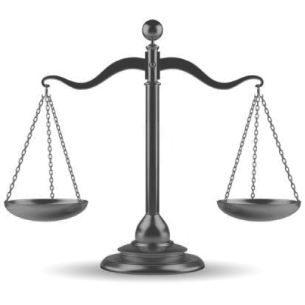
GRIEVANCES ARE DEFENSE
VIOLATIONS OF CBA
Grievance Considerations:
CBA Grievance Procedure Article
Follow Grievance Article closely including timelines.
Grievance must be based on violation of the CBA article in question.
Ask: “What article/provision of our CBA gives you the authority to do that?”
Who gains power in a grievance?
An invention of management to weaken union power.
Need to include an ORGANIZING for POWER component if possible.
Notes:
Quickly tell the story of how grievances came to be.
1930s direct action / highly effective / mgmt. tool
Now it’s defense
When to file a GRIEVANCE:
Clear violation of the contract
Need to establish a paper trail
Need to protect grievance timelines
Effects only one worker, especially where discipline is involved
Worker is widely unpopular (and it’s unlikely colleagues will participate in action to support them)
Contract interpretation cases where language is clear

Slide 54

Grievant Interview Form
Right place and time for the interview
Encourage the member to talk
Repeat the story back
Help the member think through the problem
Explain the next steps
Give “homework” – Ask for a timeline
Follow up after your investigation

Slide 55
Small Group Grievance
Role play
Interviewing
Preparing to meet with the boss
Writing the grievance
Notes:
Role Plays are included in the Binder

Slide 56
Alternatives to Grievance
Ed Code
Fair Employment and Housing/EEOC
Family Medical Leave Act
Labor Code
Americans with Disabilities Act
Cal/OSHA
US Department of Labor
Direct Collective Action

Slide 57
Is it a complaint or a grievance?
“I am not getting my 10 sick days.”
Grievance
“My principal is bullying me and being a jerk.”
Complaint or possible EEOC violation
“The timeline was not followed on my evaluation.”
Grievance
“My classes are too large”
Grievance
“I was only observed once.”
Grievance
“I don’t want a particular student in my class.”
Complaint
“A fellow colleague is bad mouthing me around campus”
Complaint and CTA mediation recommended

Slide 58
COMPLAINTS
Complaints Concerning School Personnel
Uniform Complaint Policy Complaints:
Ethical violations
Violations so Board Policies or Administrative Regulations
Usually: BP or AR 1312.1a
Violations of LAW (State or Federal)
Violation of legal regulations (State or Federal)
Appeal to CA Department of Education
Usually: BP or AR 1312.3a
Notes:
Complaints are defense as well. But, can be used like grievances for non-contract violations.

Slide 59

LITIGATION
Violation of LAW
    Educational Employment Relations Act (EERA)
    Public Employment Relations Board (PERB) www.perb.ca.gov
    California Education Code (www.tinyurl.com/ctaedcodeindex)
    Other State and Federal Law
Employment Related Issues
    Call CTA Staff for assessment and possible referral
Non-Employment Related Issues
SLOW AND DRAWN OUT
Notes:
Litigation takes the issue out of our members’ hands and will not get immediate results

Slide 60

INSUBORDINATION
RULE # 1:
The best rule to follow in regards to insubordination is “Don’t be”.
WORK, THEN GRIEVE RULE:
If a worker at your site comes to you and questions a directive issued by the immediate supervisor or principal, advise him or her to discuss the objections with the principal. If the principal insists that the order be obeyed, advise the member to comply unless it is a threat to the health or safety of the staff member or students. Then file a grievance. This is the "Work, then Grieve" rule.

Slide 61
Small Group Discussion About Right to Representation
A principal calls you into the office and hands you a letter of reprimand. Are you entitled to have union representation? Why or why not?
Your Vice Principal schedules a meeting to discuss your evaluation. She has been hostile towards you in the past. Are you entitled to have union representation? Why or why not?
You are in a meeting with your supervisor discussing a student's progress when he suddenly begins asking you in an accusatory manner about some missing supplies. What do you do?

Slide 62
THE
WEINGARTEN RULE
AN EMPLOYEE HAS THE RIGHT TO HAVE A UNION REPRESENTATIVE AT A MEETING WITH THE EMPLOYER IF HE OR SHE HAS A REASONABLE EXPECTATION THAT DISCIPLINE MAY RESULT.
This is a private sector rule that has been made applicable to Public School employees under the EERA. (See Redwood CCD v. PERB (1984) 159 Cal.App.3d 617)

Slide 63
Under the Education Employment Relations Act (EERA), employees have the right to union representation at a meeting with the employer if he or she has a reasonable expectation that discipline may result. The employee must request the representative.
Disciplinary meetings
Investigations of wrongdoing
Complaint representation
Required responses to derogatory material
Other unusual circumstances
All other areas of professional-employment relations

Slide 64
Meetings with Administrators
THE SITE REPRESENTATIVE FILLS IN THE GAPS
Gets the Information
Asks questions and starts with “what is the purpose of this meeting?”
Clarifies facts
Listens
Take notes
Advocates for the Employee
Speaks for the employee when possible
Explains
Points out extenuating circumstances
Argues the employee’s case
Asserts rights under the collective bargaining agreement
Protects the Employee
From verbal abuse
From making a bad decision about their job
From making statements that could be used against them
Supports the Employee
Provides moral support
Provides helpful information and advice

Slide 65
Large Group Discussion
Meeting with Administration
What kinds of meetings have you held with administration?
What sort of preparation do you think is necessary?
What should be done to for the Union to keep control of the meeting?
What sort of follow up should be done after the meeting?

Slide 66
Rep Scenarios
Notes:
In addition to the questions around “What would you do?” and “What would you say?”
Also ask participants “How would you build worker agency in this scenario?”

Slide 67
Thank you for making a difference for your students and your colleagues!
LET’S GO WIN!
Please give us feedback
Notes:
Share out, Closing, Raffle

