Slide 1
New Skills, New Requirements, New Attitude
Advanced Site Rep Training

Slide 2
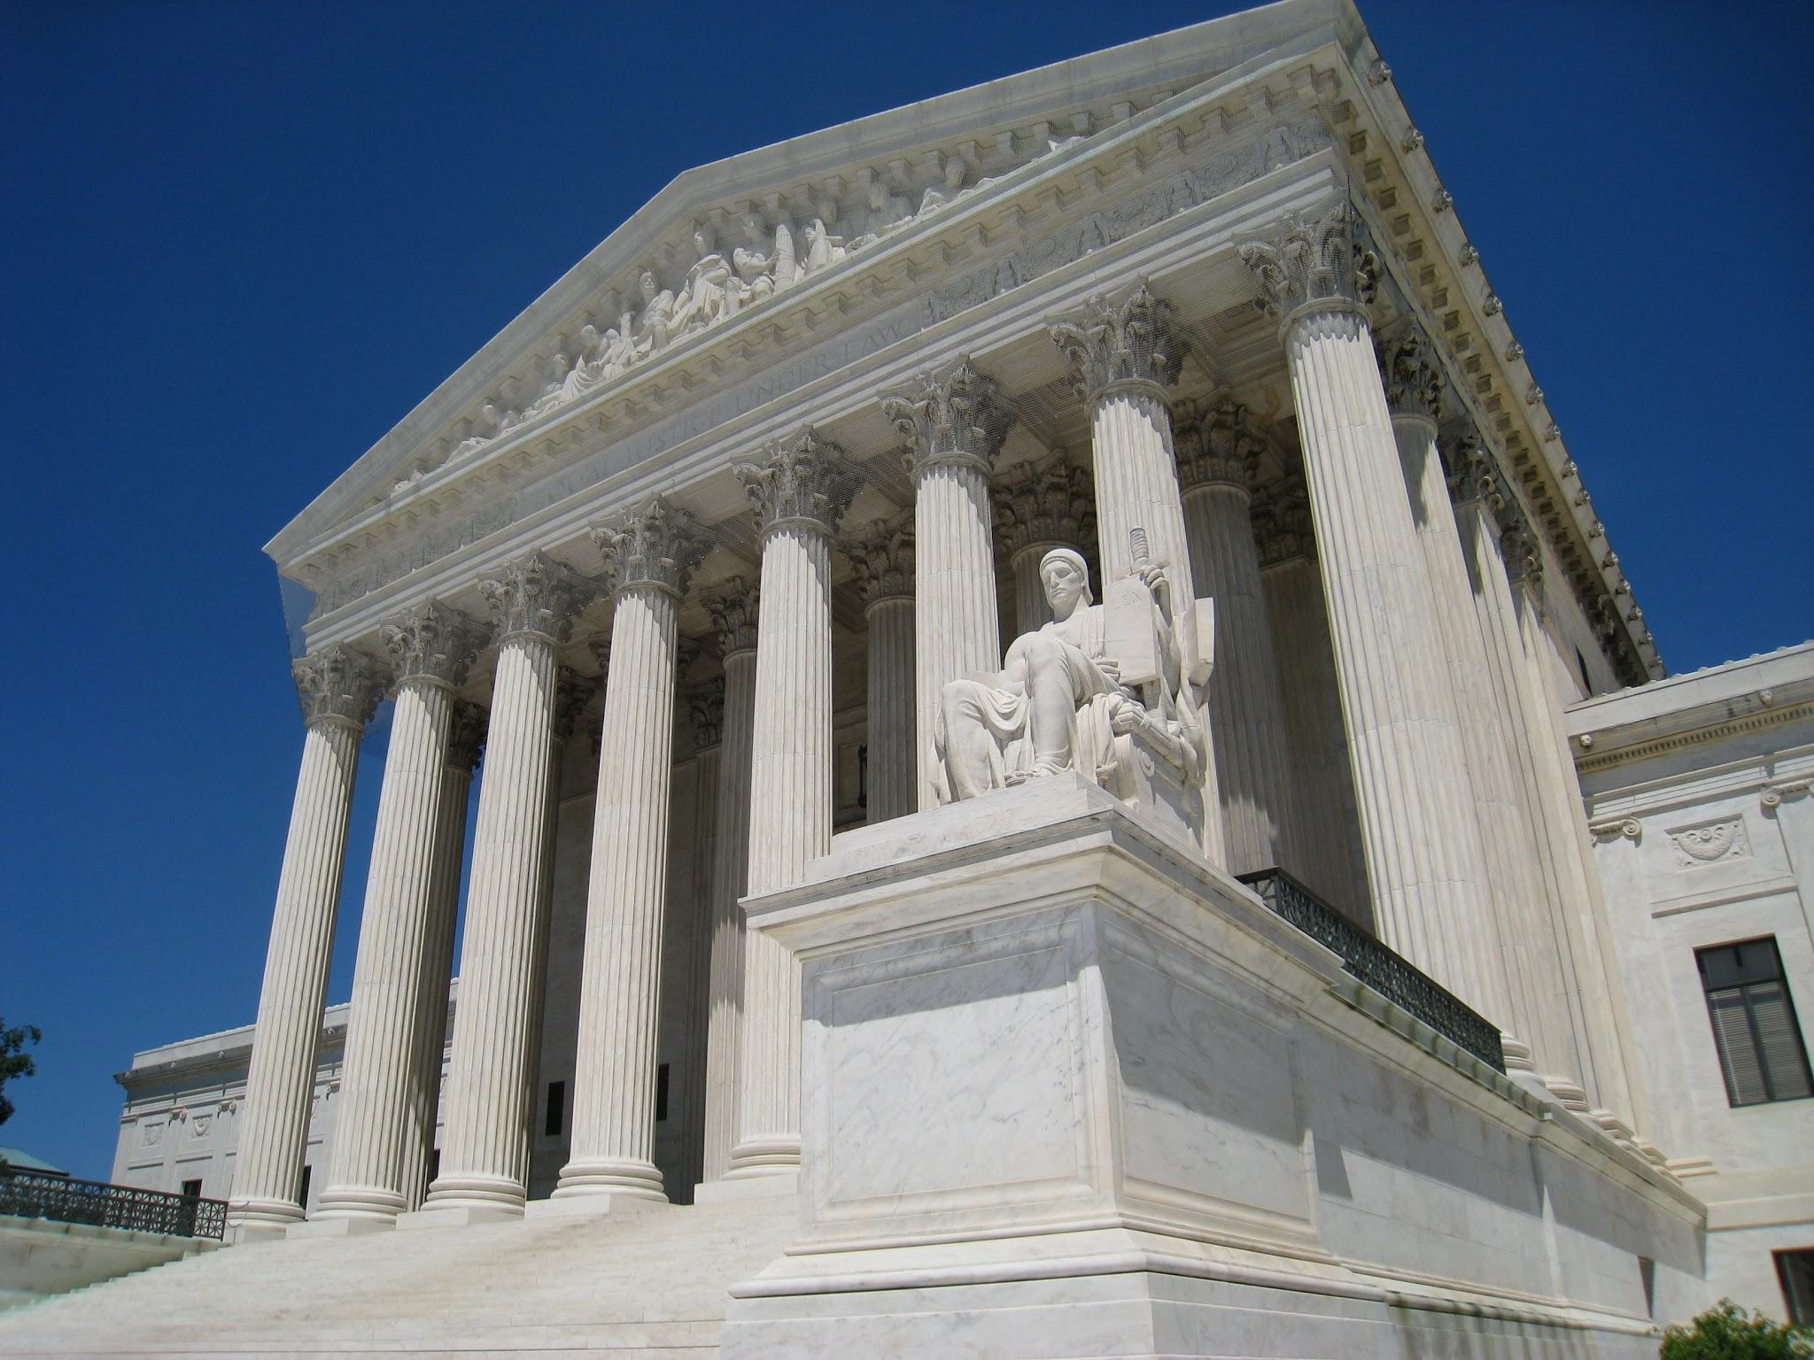
What does the Janus decision mean to your local
Agency Fee Chapters:
No longer collect Fair Share fees (loss of $)
Chapters need to actively recruit members
All chapters
How to talk about the changes
ALL bargaining unit members (members and non-members) are covered by the collective bargaining agreement
Notes:
ADIA
Non- members are potential members

Slide 3

JANUS
Notes:
ADIA

Slide 4
The Core Responsibilities
The
Facilitator
The Communicator
The
Advocate
The
Role Model
Notes:
ADIA
Rubric Self Assessment

Slide 5
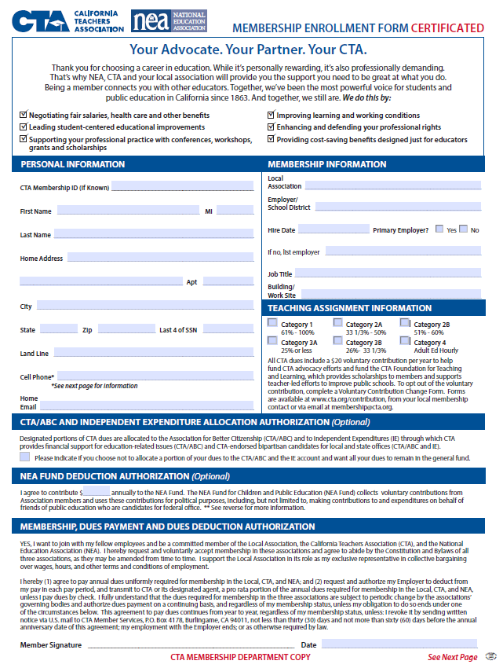
Changes in Membership
New Membership Enrollment forms
  Maintenance of Dues provision
  Member survey
Commitment Cards
Anniversary Dates
Drop Process
Notes:
LISA - Hand out “Your advocate. Your Partner. Your CTA.

Slide 6
Membership Drop: Steps to the Process (part 1)
Initial Interaction
  Member notifies RRC/UniServ/CTA Headquarters/District/Site Rep
  Member informed of drop process
  Drop request/contact logged- EMAIL your staff person
Valid Drop Request Delivered
  Member provides valid drop request to chapter president via U.S. Mail or hand delivered
  Request includes:
    Formal request to drop
    Member’s first and last name,
    Home address
    Name of local
    Date
    Original signature
Notes:
LISA/DEB
Things can no longer rest on the shoulders of the president
A phone call to the president cannot be the only reason someone stays in the union

Slide 7
Membership Drop: Steps to the Process (part 2)
15 Working-Day Process Timeline Begins
  Have Organizing Conversation with the Member
    Identify most compelling person to hold 1:1 conversation
    Listen and try to directly address member's concern and DOCUMENT the reasons
Completing the Request
  Inform CTA Membership Department if the member still wants to drop
  Inform your staff person
You have 15 work-days from when the president receives the request to complete this process.
Notes:
LISA/Deb

Slide 8

Your role in the membership process
Potential drops - what’s your responsibility
Non- members = Potential members
Benefits of local union
Create talking points
Access to CTA 360
Local dashboard
New member survey
Search individuals
Update individual information
Notes:
LISA/DEB

Slide 9
The Facilitator: The 10 Minute Meeting
Keep them relevant, purposeful and worthwhile
Make sure they reflect the opinions of the members
Give advance notice
10 minutes before or after your regularly scheduled faculty meetings
Provide an agenda and key items to be considered
Include a social dimension (like coffee or a light snack)
Allow questions and if you don’t know, say so, and get back to your members with answers
Promote a discussion, adds stimulation and is vital to decision making
After the meeting follow up with non-union members present and make sure they are asked to join
Ask for suggestions from new members and others on topics for the next meeting
Help members relax by providing a relaxed and congenial atmosphere
Make the meeting short and make sure it ends on time
Notes:
BRUCE
Handout for the 10 minute meeting

Slide 10

Ten-Minute Meeting
Short on time, big on message
Schedule 10-minute meetings
Notes:
BRUCE
Kris and Adia share examples

Slide 11

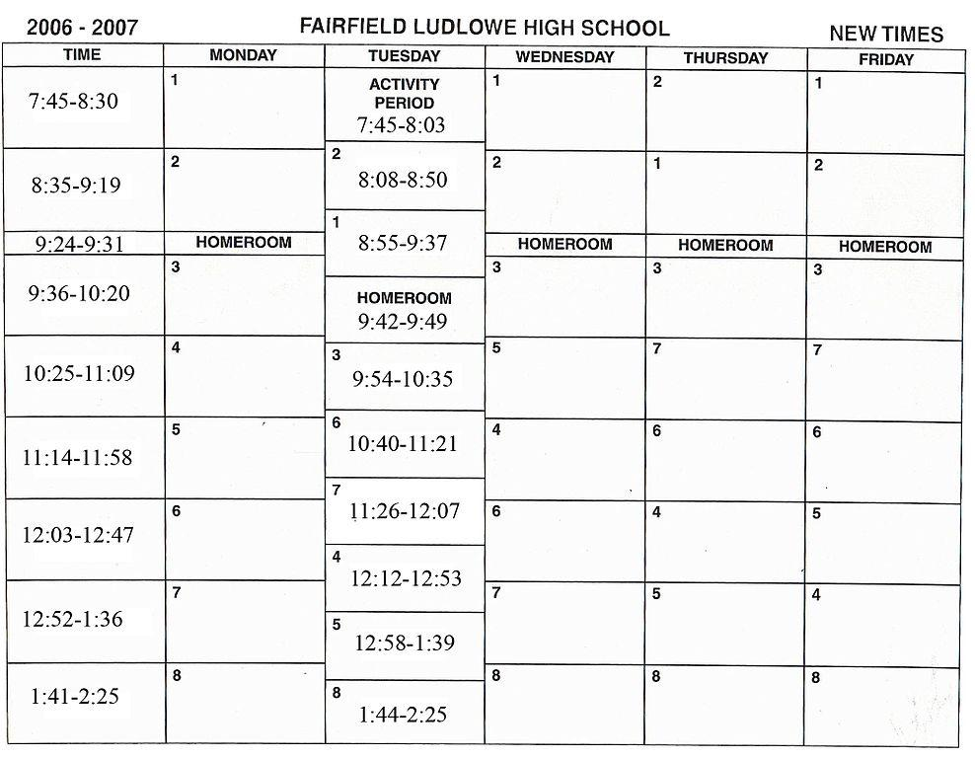
Site Mapping and Data Collection
Notes:
NATE
Data collection- systematic approach to keeping a pulse on all members
Different level of intensity and importance

Slide 12
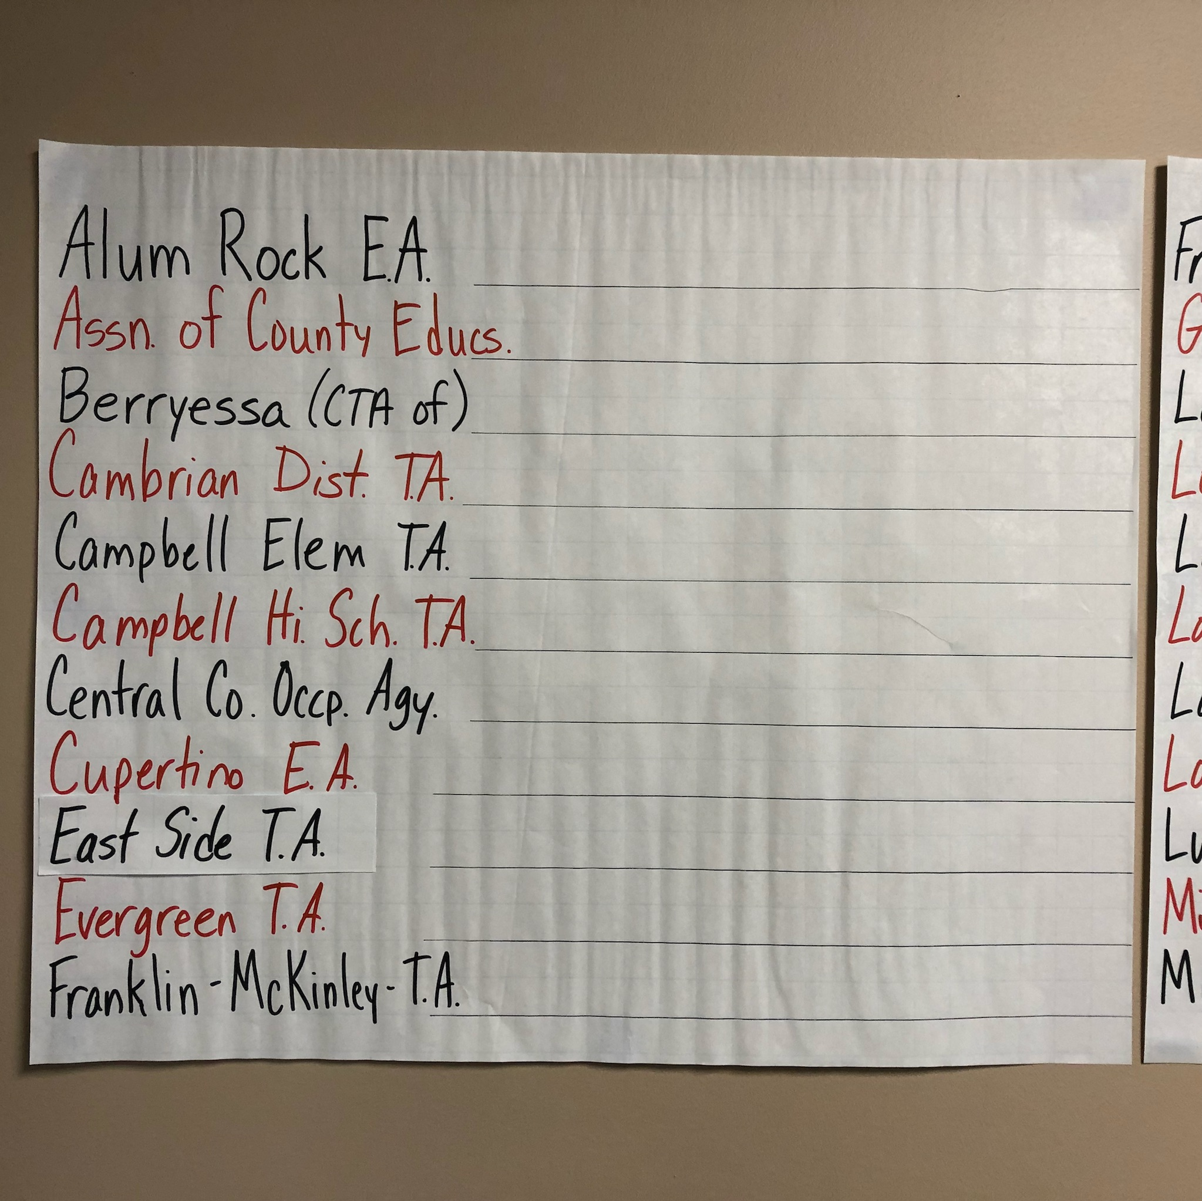
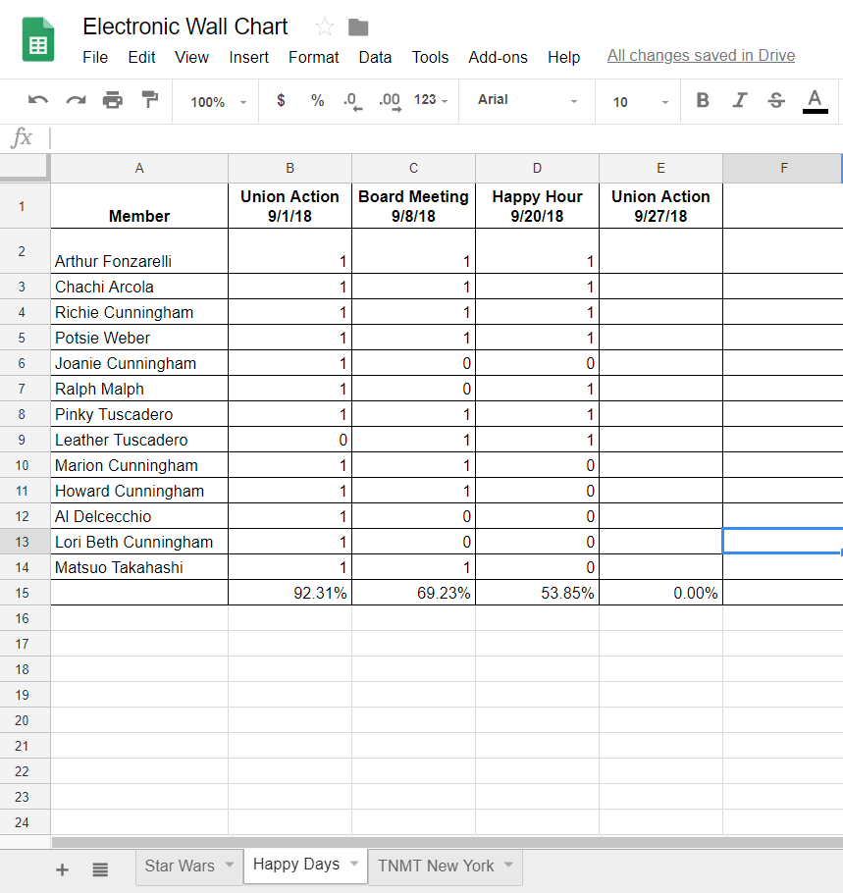
Wall Charts
Paper Wall Charts at Office
Electronic Wall Charts (Google Spreadsheets)
Notes:
NATE

Slide 13
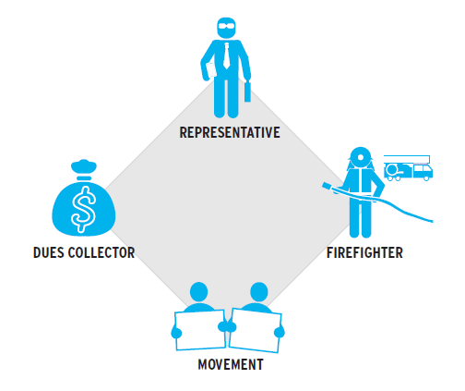
How do your members view your Association?
Representative
Dues Collector
Movement
Firefighter
Notes:
Lisa Activity: moving around to corners, discussion, flip charts

Slide 14

Membership Engagement tools already in place in your local
VP of Membership or Membership Chair
Site Reps aka Membership Captains at each school site
New Teacher Programing (beyond orientation)
Member /community engagement plans
Notes:
LISA- Have participants talk to each other and share out
Do you have…. Questions
President support, coversation

Slide 15
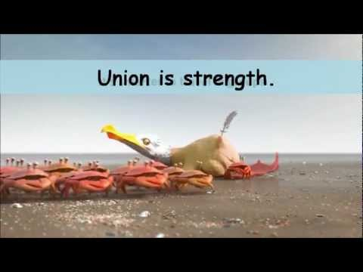
Stronger Together: Union is strength
Notes:
NATE

Slide 16
Union Code of Conduct
I will not criticize any union colleague except to the individual directly.
If any union colleague is being criticized in my presence, I will confront the criticism and ask that it stop.
I will not participate in any conversations with management that criticize, or negativity speculate about any union colleague.
I will settle my differences with colleagues within the union.
I will engage in debate, offer others every opportunity for debate and respect the minority viewpoints, but I will observe and support the majority mandate of the union.
Notes:
BRUCE

Slide 17

Campaign 2018
Santa Clara County Board of Education Races
Local School Board Races
Statewide Races
Gavin Newsom for Governor
Tony Thurmond for Superintendent of Public Instruction
Ed Hernandez for Lieutenant Governor
Xavier Becerra for Attorney General
Alex Padilla for Secretary of State
Betty Yee for State Controller
Ricardo Lara for Insurance Commissioner
Fiona Ma for State Treasurer
Notes:
ADIA
1:1 political convos- how to hold them without being abrasive
10-minute meeting

Slide 18

Tony Thurmond for SPI
Notes:
ADIA

Slide 19
FRAME:
“Students are the center of everything we do.”
MESSAGE: Tony Thurmond is the best candidate to help California’s students.
TALKING POINTS:
  Thurmond supports transparency & accountability for all public schools, including charters
  Thurmond supports quality teachers in all public schools
  Thurmond supports affordable housing, so our students can have access to the best teachers
Notes:
ADIA

Slide 20
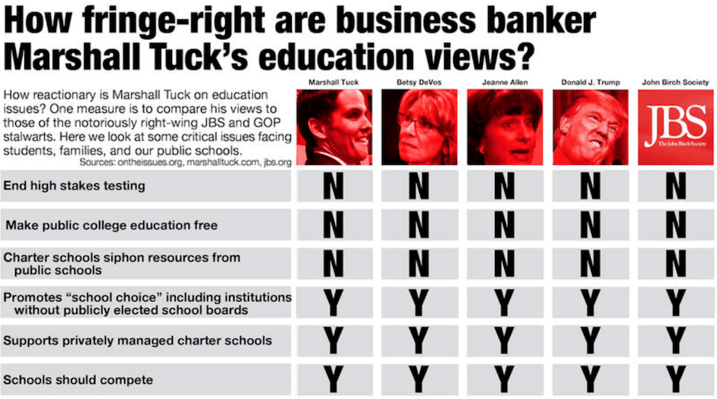
Notes:
ADIA

Slide 21
Questions & Answers
“Our labor unions are not narrow, self-seeking groups. They have raised wages, shortened hours, and provided supplemental benefits. Through collective bargaining and grievance procedures, they have brought justice and democracy to the shop floor.” John F. Kennedy
Notes:
ADIA

