Slide 1

Site Rep &
Grievance Training
Presented by Adia Hoag, CTA PCS
Lisa Vieler, C4OB
August 31, 2021

Slide 2
The Core Responsibilities
The
Facilitator
The Communicator
The
Advocate
The
Role Model

Slide 3
Your motivations and hesitations
Why did you become a rep for your site?
What do you want to learn today?
What are your top concerns about being a site rep or union leader?

Slide 4
Union Code of Conduct
I will not criticize any union colleague except to the individual directly.
If any union colleague is being criticized in my presence, I will confront the criticism and ask that it stop.
I will not participate in any conversations with management (administration) that criticize, or negatively speculate about, any union colleague.
I will settle my differences with colleagues within my union.
I will engage in debate, offer others every opportunity for debate and respect minority viewpoints, but I will observe and support the majority mandate of my union.
Notes:
Tab 2 – pg. 5

Slide 5
The Communicator
Distributes newsletters and flyers
Maintains a bulletin board
Collects literature & bulletins from opposition
Activates a building telephone tree or email list
Conducts surveys
Informs faculty of policy decisions
Reports back information to members

Slide 6
How do I help my work site gain parity?
Site Reps act as the conduit between the member and the Association
  Share perspective, concerns, victories, injustice, and looming issues
  Share the unique culture of your site/cluster
  Help the Association understand your administration
  Assess what your site or cluster “needs” in order to gain parity
  Help create a plan for increasing parity

Slide 7
How do I help my work site gain parity?
Site Reps act as the conduit between the Association and the membership
  Help your members understand the battle for parity with the District
  Engage your members in conversations seeking their input around District and Membership issues
  Attend meetings

Slide 8
How do I help my work site gain parity?
  Site Reps act as the conduit between the membership (union) and your administration
    Support the member in disciplinary (potentially disciplinary) actions
    Act as the voice of the membership in conveying preferences, concerns, ideas
    Be available to the administration to hear ideas and concerns
    Act as a problem-solver when that is appropriate
    Act as a barrier when that is appropriate.

Slide 9






The Facilitator
A visible representative of the union at the work site
Holds regular worksite meetings
Encourages members to serve on union committees
Welcomes all new employees
Discusses important issues
Represents the work site at Rep Council meetings

Slide 10
The Facilitator: The 10 Minute Meeting
Keep them relevant, purposeful and worthwhile
Make sure they reflect the opinions of the members
Give advanced notice
10 minutes before or after your regularly scheduled faculty meetings
Provide an agenda and key items to be considered
Include a social dimension (like coffee or a light snack)
Allow questions and if you don’t know, say so, and get back to your members with answers
Promote a discussion, adds stimulation and is vital to decision making
After the meeting follow up with non-union members present and make sure they are asked to join
Ask for suggestions from new members and others on topics for the next meeting
Help members relax by providing a relaxed and congenial atmosphere
Make the meeting short and make sure it ends on time
Notes:
Handout for the 10 minute meeting

Slide 11
Meeting with Administrators
Regular meetings help formulate school policy and contribute to the prevention of grievances
This is a valuable tool in getting members’ voices heard on school matters
The Site Rep and the Principal sit down as equals to discuss school issues
Be prepared with an agenda and a strategy before you meet with your Principal
Establish and maintain a good rapport
Propose and discuss solutions that are practical
Over time your Principal will be convinced that your cooperation in solving problems at the site level is an asset
Don’t forget to inform staff members of the results of each meeting, celebrate your victories
Never give up! ORGANIZE

Slide 12
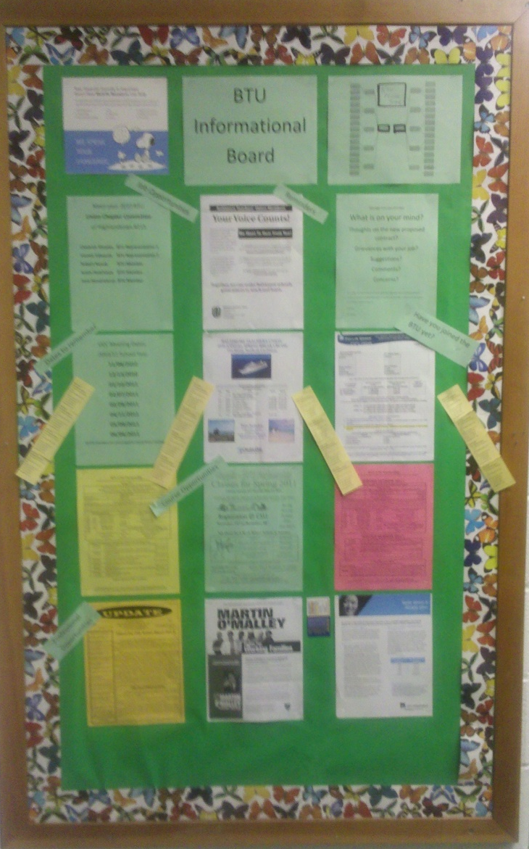
Bulletin Boards
For current chapter information and important announcements
Keep your bulletin board attractive and up-to-date
Old poster and messages should be removed promptly
All material should be kept fresh
A quick glance by a colleague will show them that CTA is fighting for them!

Slide 13
Introducing Unionism to
New Staff Members
Share past successful actions or issues dealt with by your local chapter
Site Reps should use
CTA 360 to enroll new members
If you don’t ask, they won’t join!
You may wish to invite a CTA PCS to talk with your total staff or individual non-members
Mobilize: Site Rep asks for the participation of every person at school site

Slide 14
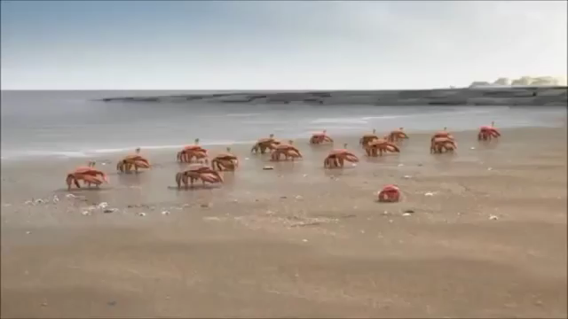
Unionism: Strength in Numbers

Slide 15

Lay the Groundwork
Collect non-work emails of all union members
CTA 360
Have regular union school site meetings
Involve all members in union actions and organizing
Attend all monthly Site Rep Council meetings
Encourage attendance at every union school meetings
Encourage local chapter engagement

Slide 16

Social Media Tips for Educators
Your social media and technology use is governed by school board policy, state law, technology use agreements, and your contract
Never “friend” students
Overshare the professional, under share the personal and never share the private
Do share the awesome (no kids faces in photos please)
You are what you like and re-tweet
If you are on the district server they can see, what you see
If you wouldn’t want your boss to see it, don’t post it

Slide 17
The Advocate
Handles lower-level informal grievances
Maintains contact with CTA PCS regarding concerns
Identifies school site problems
Involves members in professional issues

Slide 18
Role Model: Traits of the Advocate
Remember the Union Code of Conduct
Member to member issues are mediated by CTA
Trustworthy
Thoughtful
Organized
Able to keep a secret
Someone looked up to by his/her peers
Someone who can see beyond his/her own experience

Slide 19
Advocate: The “right” to representation
EERA (where we get our collective bargaining rights in California) states: A unit member has the right to representation at any meeting with an administrator that is disciplinary or could result in disciplinary action
I say: Any meeting with an administrator at which you feel uncomfortable because of what you believe to be “unfair” judgments or behavior from the administration in the past.
Let the administration say “no” first to representation, then contact staff

Slide 20
What does “represent a member in a disciplinary meeting” look like?
First: put your PARITY hat on
    Find out what the agenda is (before the meeting, in case you need to ask your member questions)
    Investigative—administration will have lots of questions: What happened? Who was there? What was said? Did anyone touch anyone else? What is the history?
  BEFORE answering the questions, the administration needs to state the reason for the questions, e.g., “there was an allegation made that…”, “a student reported to a parent that…”, “I saw or heard this and need to know…”

Slide 21
Representation continued…
Second: meet with your member
      Once you know the reason for the questions, consider whether you need to talk with the member BEFORE he/she answers the administration
      NO— you don’t need to talk if the member has already told you of the incident, and, it is either untrue, or your member is just a witness and not the object of the investigation
      YES— you do need to talk if you don’t know what happened and can’t determine if the member will be in trouble

Slide 22
Knowing when you aren’t the “right” person
Third: meeting with administration
  You have the right to end the meeting (even if the administration throws a fit) if you believe that the member may be guilty of a serious allegation
    Criminal? You are not the right representative
    Could it result in serious discipline (suspension)? You probably aren’t the right person
    Will it result in a verbal warning, written warning? Yes, you MAY be the rep
  Understanding parity is also understanding your position/role
  If you aren’t the right person, call the appropriate party immediately (ACE President and/or CTA PCS)

Slide 23
Representation continued…
Fourth: When you are the right person
  Keep the administration on task by asking clarifying questions to ascertain the scope of the allegation and/or issue
  Take notes as applicable (not verbatim unless a statement is startling or concerning)
  Keep the member on task. If your member starts to ramble, give information that isn’t helpful, or begins tattling on others, get his/her attention and give the “stop” sign (see Union Code of Conduct)

Slide 24
Representation continued
Fifth: the close
  Ask what the follow-up will be (another meeting, additional investigation, a written summary, a written reprimand, nothing)
  Thank the administration and leave
  Let the appropriate person (ACE President or CTA PCS) know of the outcome to establish whether there is follow-up needed
  IMPORTANT: Maintain confidentiality

Slide 25

5 MINUTE
Bio Break

Slide 26
PART 2:
Complaint or Grievance?
“Our labor unions are not narrow, self-seeking groups. They have raised wages, shortened hours, and provided supplemental benefits. Through collective bargaining and grievance procedures, they have brought justice and democracy to the shop floor.” ~John F. Kennedy

Slide 27
What is a Grievance?
A grievance is a violation, misapplication or misinterpretation of any provision of your collective bargaining agreement or of a policy of the Board of School Commissioners which affects the terms and conditions of your employment.

Slide 28
What is a complaint?
Everything else or other concerns that are not addressed by your Collective Bargaining Agreement (CBA) or contract.

Slide 29
Brainstorm
Think, Pair, Share
Take some time to think about your experiences from the past school year with grievances and complaints
(3 min )

Slide 30
Report Out

Slide 31
Is it a complaint or a grievance?
“I am not getting my 10 sick days.”
Grievance
“My principal is bullying me and being a jerk.”
Complaint or possible DFEH violation
“The timeline was not followed on my evaluation.”
Grievance
“My classes are too large”
Grievance
“I was only observed once.”
Grievance
“I don’t want a particular student in my class.”
Complaint
“A fellow colleague is bad mouthing me around campus”
Complaint and CTA mediation recommended

Slide 32
The Grievance Process
Step 1: File Level 1, Investigate & Document
Step 2: Formal or Informal Resolution
Step 3: Level 2 & 3 Written Appeals
Step 4: Arbitration

Slide 33
You have a grievance. What should you do?
Investigate
Speak to all affected employees
Take anecdotal notes

Slide 34
How to Investigate a Grievance
Interview
Interview the grievant and write down dates, facts, and witnesses.
Ask
Ask questions for clarification and additional information.
Interview
Interview the involved supervisor and witnesses. Keep a written record.
Examine
Examine all records that have a bearing on the incident.
Separate
Separate the facts from opinions and allegations.
Determine
Determine which facts are relevant to the matter in dispute.
Initiate
Initiate informal grievance

Slide 35
Presenting a Grievance
Work towards resolution, not persecution
Focus on facts – what happened, what rule was broken
Stay united in front of management
Keep the grievant (and your grievance chair/chapter president) informed throughout the process

Slide 36
What About Complaints?
Board Policy enforced by board complaints and/or uniform complaints
Unsafe/unsanitary conditions for students by board complaint or Williams Act Complaint
Education Code enforced by writ to superior court
Labor law enforced by unfair practice charge
Curriculum addressed by consulting
Notes:
BP – board complaint
EC – writ
Labor – unfair
Curriculum - consulting

Slide 37
Who deals with a complaint?
Employee or Staff Member
Site Representative
Rep Council/Exec. Board
CTA Primary Contact Staff

Slide 38
Policy
Policy refers to those written procedures established by management in areas of the work relationship not covered by the CBA (e.g., School Board Policy, Administrative Regulations, Principal’s Memo, District Memo).

Slide 39
Past Practice
Any longstanding, frequent practice that is accepted and known by both union and management. Bona fide past practices are considered part of the contract.
Example: The District Office charges your sick leave on a pro-rata basis, although the contract is silent about leaves that are less than a full day.

Slide 40
Remember, even though the you have one of the toughest contracts in the country, no contract is worth the paper it’s printed on unless it’s enforced.

Slide 41

Questions
&
Answers

