Slide 1
Site Representative 101:
Roles and Responsibilities
CTA PCS

Slide 2
The Core Responsibilities
The Work Site Leader
The Communicator
The Problem Solver
The Union Builder

Slide 3






The Worksite Leader
Is a visible representative of the union
Holds worksite meetings
Gets union members to serve on committees
Welcomes new employees
Discusses important issues
Represents the school at site representative council meetings

Slide 4
The Communicator
Distributes newsletters and flyers
Maintains a bulletin board
Collects literature & bulletins from opposition
Activates a building telephone tree or email list
Conducts surveys
Informs faculty of policy decisions
Reports back information to members

Slide 5
The Problem Solver
Handles lower level informal grievances
Maintains contact with CTA PCS regarding concerns
Indentifies worksite problems
Involves members in professional issues

Slide 6
What is a Grievance?
A grievance is a violation, misapplication or misinterpretation of any provision of this agreement or of a policy of the Board of School Commissioners which affects the terms and conditions of employment.

Slide 7
School Site Meetings
Keep them relevant, purposeful and worthwhile
Make sure they reflect the opinions of the members
Give advanced notice
10 minutes before or after your regularly scheduled faculty meetings (CBA 2.3)
Provide an agenda and key items to be considered
Include a social dimension (like coffee or a light snack)
Allow questions and if you don’t know, say so, and get back to your members with answers
Promote a discussion, adds stimulation and is vital to decision making
After the meeting follow up with non-union members present and make sure they are asked to join
Ask for suggestions from new members and others on topics for the next meeting
Help members relax by providing a relaxed and congenial atmosphere
Make the meeting short and make sure it ends on time
Notes:
Handout for the 10 minute meeting

Slide 8
Meeting with Administrators
Regular meetings help formulate school policy and contribute to the prevention of grievances
This is a valuable tool in getting members’ voices heard on school matters
The Site Rep and the principal sit down as equals to discuss school issues
Be prepared with an agenda and a strategy before you meet with your principal
Establish and maintain a good rapport
Propose and discuss solutions that are practical
Over time your principal should be convinced that your cooperation in solving problems at the school level will be an asset
IMPORTANT! Inform staff members of the results of each meeting
Do not give up!

Slide 9
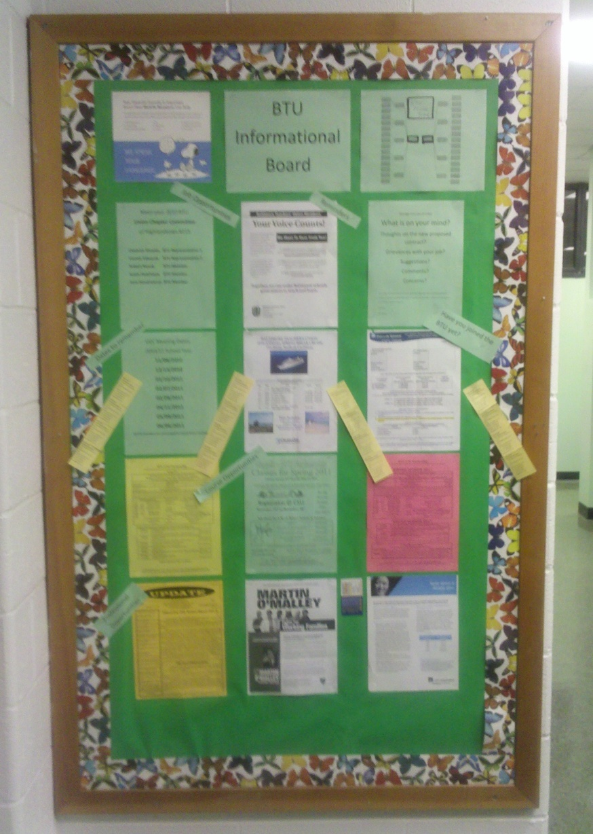
Bulletin Boards
For current chapter information and important announcements
Keep your bulletin board attractive and up-to-date
Old poster and messages should be removed promptly
All material should be kept fresh
A quick glance by a colleague will show them that BTU is fighting for them!

Slide 10
Introducing CTA to New Faculty Members
Cite past successful actions or issues dealt with by your local chapter
Site Reps should keep a supply of Membership Cards on hand or use CTA 360
If you don’t ask, they won’t join!
You may wish to invite a CTA PCS to talk with your total staff or individual non-members
Mass Action Approach: Site Rep must actively seek the participation of every person at school

Slide 11

Lay the Groundwork
Collect non-work emails of all union members
Phone tree
Have regular union school meetings
Involve all members in union actions
Attend all monthly Site Rep Council meetings
Encourage attendance at every union school meetings
Encourage local chapter engagement

Slide 12
Remember, even though the you have one of the toughest contracts in the country, no contract is worth the paper it’s printed on unless it’s enforced.

