Slide 1
Our Welcome Activity …
Please complete the following on the wall prior to sitting …
I am … [first name]
I serve as … [professional position]
I reside in … [home state]
I am attending because … [your why]
My email …

Slide 2
Strength and Power Building:
Clubs to Fighting Unions
2025 LGBTQ+ Caucus Organizing Track

Slide 3
Anthony

Slide 4
NEA Members and External Audiences
This presentation and its contents are confidential and may not be further distributed or passed on to any other person or published or reproduced, in whole or in part, by any medium or in any form for any purpose. Audio/video recording, copying of slides, and the use of AI note-taking tools are prohibited without the written consent. Violation of these terms may result in legal action.
Notes:
This slide should be inserted at the beginning, middle, and end of the presentation to provide notice to those who join after the introduction.

Slide 5
Honoring This Space
We begin by acknowledging that through a history of colonization and brutality, we are currently on the traditional lands stewarded by generations of indigenous people.
We honor these indigenous people, all elders, past, present, and emerging. We are called to learn and share these learnings about this tribal history, culture, and contributions that have been suppressed in the telling of the story of what we now call the United States of America.

Slide 6

Shout Out Around the Room
Name
Pronoun
Work Location

Slide 7

April 12
Sessions 1-3
1. 10:15-11:45
2. 1:45- 3:15
3. 3:30- 5:00

Slide 8
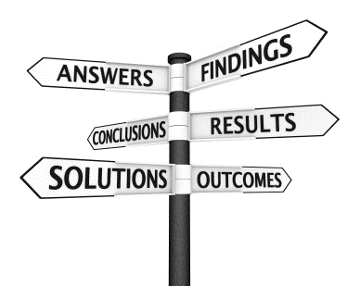
Session OUtcomes
We will leave this training with a campaign and leadership plan that works for you.
In the process we will discuss:
Identifying Leaders to Build Power
Building Structures to Distribute Leadership
Building Power through Organizing
Centering Race, Class, and Gender

Slide 9

Logistics to Remember
Questions to Ask
Bathroom
Materials
Food
Room Temperature

Slide 10

Community Agreements Page (2 in the handouts)
Using Self-Awareness and Self-Knowledge
Listening for Understanding
Being Gracious
Staying Engaged
Being Open and Suspend Judgment
Saying “I”- tell your truth
Lean into Discomfort
Reaching Empathy
Expecting Non-Resolution and Non-Closure
*Adapted from “Embracing equity and inclusion”, Annie E. Casey Foundation
Notes:
Community Agreements for Our Time
Awareness and Self-Knowledge
This requires self-knowledge and self-awareness. Self-knowledge allows you to see what causes you pain and conflict and enables you to embrace your contradictions and inconsistencies. It allows the space to work on things about yourself that you are not happy with. In turn, self-knowledge helps to prevent you from projecting your negative aspects onto other people. Bringing your best self also requires that you have a positive attitude, are willing to deeply explore your perspectives and remain open to the perspectives and experiences of others.
Listening for Understanding
Be an active listener. Active listening involves paying full and careful attention to the other person, looking him or her in the eye, avoiding interruptions, reflecting your understanding, clarifying information, summarizing the other person’s perspectives and sharing your own. Remember that most people need time to open up and might not be willing to immediately share their personal stories, hopes, fears and/or concerns.
Being Gracious
Being kind is a vital way of bringing meaning to our own lives, as well as the lives of others. Kindness is about caring genuinely for others around you, wanting the best for them and recognizing in them the same wants, needs, aspirations and even fears that you may have. Being kind and generous allows us to communicate better with others, to be more self-compassionate and to be a positive force in other people’s lives. This includes following the COVID protocols that are in place to protect the health of this learning community.
Stay Engaged
Staying engaged requires you to be morally, emotionally, intellectually and socially involved in the conversation. Staying engaged means that you are listening with curiosity and willing to deepen your understanding. Staying engaged might also require you to sustain the conversation even when it gets uncomfortable or diverted. This also means a commitment to keeping your electronic communications to a minimum with folks not present in this learning community.
Be Open and Suspend Judgment
Listening with an open mind includes being receptive to the influence of others. You can suspend judgment by becoming aware of preconceived notions and listening to everything someone has to say before jumping to conclusions. Most importantly, suspending judgment also means listening to what the speaker has to say for understanding, not just to determine whether the speaker is right or wrong.
Say “I”- tell your truth
Speaking your truth in authentic and courageous conversations about race requires a willingness to take risks. It means that you will be absolutely honest and candid about your own thoughts, feelings, experiences and opinions and not just saying what you perceive others want to hear. Speaking your truth will require you to speak from the “first person” and use “I” statements.
Seek Discomfort
Leaning in to discomfort will require you to let go of racial understandings and stereotypes that you may be holding onto in order to move forward. Leaning in means that you will avoid judgment, assume positive intent and be open to the kernel of wisdom in each individual’s experiences. Leaning in to discomfort will require you to sit through moments of embarrassment, confusion, anxiety and/or fear.
Reaching Empathy
Empathy and compassion allow you to understand the other person’s point of view. When you are empathetic, you are more understanding, patient and kind. Expanding your capacity to feel empathy will also allow others to enter your circle of human concern.
Resolution and Closure
Expect and accept that there may not be closure. It is not likely that you will resolve your personal understanding about race or another person’s racial experience in a single conversation. The more you talk about race with another person, the more you learn and the more they will learn. Authentic and productive conversations about race are continuous and always evolving.
*Adapted from “Embracing equity and inclusion”, Annie E. Casey Foundation

Slide 11
Your World as It Is and Your Highest Hopes

Slide 12
Ellen

Slide 13
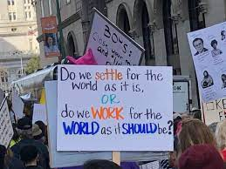
What are your three biggest problems?
IF you had all the power you needed, how would you solve them?

Slide 14


Slide 15
Organizing, Power, and Campaigns

Slide 16
Albert

Slide 17
What is organizing? - p. 4
Organizing is identifying leaders and coordinating them into leadership teams
Building community and commitment around common goals
Building power from the resources of that community
Using that power strategically to make concrete change in the world

Slide 18



Slide 19

Who is powerful?
What makes them powerful?

Slide 20
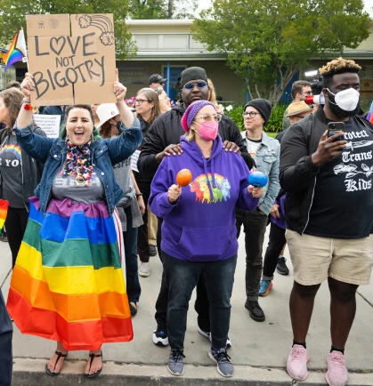

DEFINING POWER
Power is the ability to control, create, and prevent change.
Power is organized people and organized resources (money).
Power is not static, it is either waning or growing.

Slide 21

UNDERSTANDING POWER
Power is neutral
Our values affect the way we use power

Slide 22

TRUTHS ABOUT BUILDING POWER
Power has to be consistently built or it is waning
Not everyone wants us to have power and actively work to take our power away
Public actions through shared vision, shared purpose, shared resources, shared risk, and unity is how we build power
The bigger the win you want– the more power you need
Building power requires leadership

Slide 23
Definition for Campaigns
An issue campaign is the process through which the people organize around leaders and structures to use their resources in accomplishing goals that achieve the change they need and want. It is public. It involves risk. It results in the story being about the workers.
From Marshall Ganz

Slide 24
Strength AND Growth
Achievement of public actions and campaign demands are a show of our strength.
Issue campaigns ALSO grow membership, engagement, and leadership experience. This is a measure of our growth
We support local leader teams in making campaign plans to ensure these experiences are successful and grow unifying relationships through public, positive actions for members and leaders.

Slide 25
Key Ideas
Issue Campaigns, designed well, result in the ability to achieve wins that make a positive, concrete difference in the lives of people.
Getting and keeping membership is necessary but not sufficient. (GROWTH)
Power is built and used when you do the necessary work of long term campaigns (STRENGTH)

Slide 26
Three Theories of Change

Slide 27
Grat

Slide 28
3 Theories of Change – pgs. 5-8
Advocacy
“Advocacy is the work of creating change through the actions of professionals or technical experts—lobbyists, pollsters, lawyers, communication specialists, researchers. Advocacy relies on the expertise, status, and know-how of these groups of people to make change. Advocacy usually happens in a closed-door room; ordinary people play a small to nonexistent role in its efficacy. Advocacy has become a dominant strategy for unions and liberals.”
Mobilizing
“Mobilizing, by contrast, activates an already-convinced membership. Mobilizing encourages those who already support a cause or a mission to take action to defend their belief—for example, by attending a protest, wearing a button, or signing a petition.”
Organizing
“To organize is to build mass support and strength among ordinary people. Organizing draws its power from working people’s biggest strength: our numbers. The work of organizing is systematic and rigorous: It requires connecting with every single worker in a shop, every educator in a building, every building in a district. At its core, it asks people to understand their own agency and to make choices about how they will exercise it.”

Slide 29

As you watch the following videos which is closest to the way you currently do union work?

Slide 30
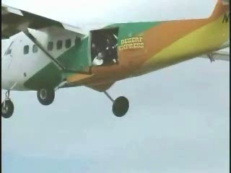
Advocacy
Ellen
Notes:
Burning Parachute

Slide 31

Mobilizing

Slide 32
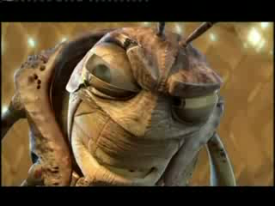
Organizing
Ellen

Slide 33
Team Talk
Which of these theories do we mostly work in?
Which of these theories generates the power you need to win the changes you want ?

Slide 34
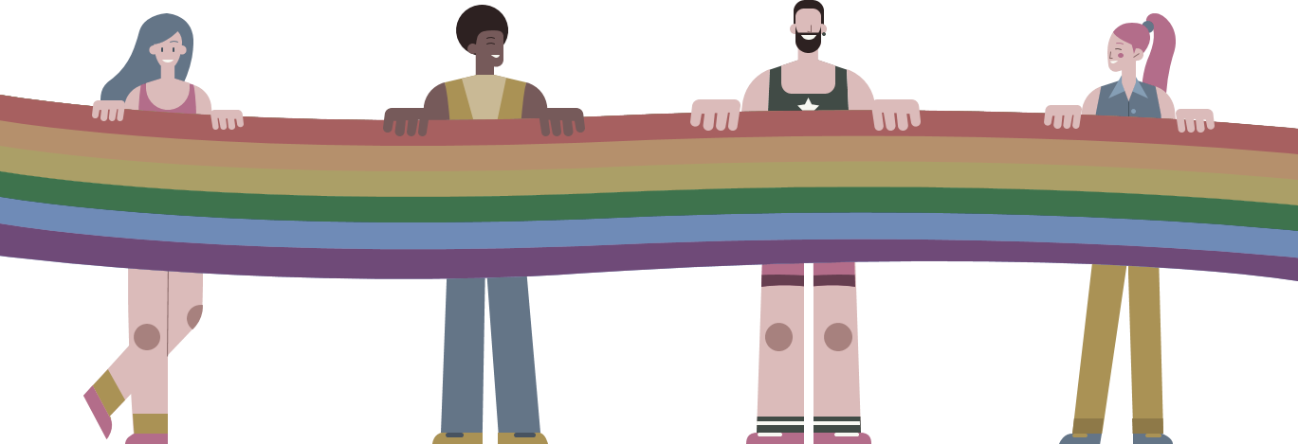
The Right Leadership Begins with You
Leaders are those who take responsibility for enabling others to achieve shared purpose in the face of uncertainty

Slide 35

Leaders Across these Theories Page 4, 10-12

Slide 36
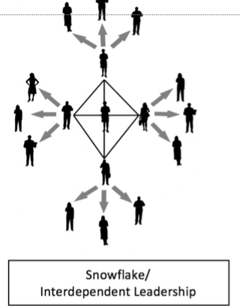
In each of these models, who holds the accountability and responsibility is different.
Remember, we build the most power when the members are accountable to one another and are responsible for the actions necessary to build that power.
If we hold the responsibility and are the only ones held accountable, the members are not building power to address the issues that are important.

Slide 37
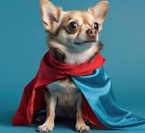
Organizing Basic Skills
Curious about others issues
Asks Good Questions does not Tell Solutions
Listen 80%- Talk 20%
Be in a positive, public relationship with 75% of the members in your unit

Slide 38
Organizing Basic Methods
One on One’s
Worksite Mapping
Worksite Lists with leaders identified
Data Collection about who are the leaders
Team Coaching that allows others to lead

Slide 39
Key Ideas
The skills and methods of organizing are the foundation of an issue campaign.
To move across these theories of change requires a shift in your ownership and leadership of the work in their union.
Issue campaigns build leaders and structures focused on using power.

Slide 40
END OF SESSION 1

Slide 42
Recognizing Leadership

Slide 43
Jeny

Slide 44
Who are leaders that build power?
In the face of uncertainty – they are confronting the person in power – risky!
Risk builds leadership – AND it requires you allow that risk and support it – NOT DO IT.

Slide 45
Definitions for Today – Pgs. 9-27
Leaders – Trusted and respected by their colleagues in ways that cut across communities of workers- are connected by values and influential relationships with mobilizers, activists, and those not yet part of the work. Get people to move their thinking and take action.
Mobilizers – Are already convinced members, who are already willing to take action. They are connected to the other already convinced.
Activists – Supportive and willing to act if invited but not able to move others.

Slide 46
IF Organizing is…
identifying leaders and coordinating them into leadership teams,
  building community and commitment around common goals,
building power from the resources of that community, and
using that power strategically to make concrete change in the world,
THEN

Slide 47
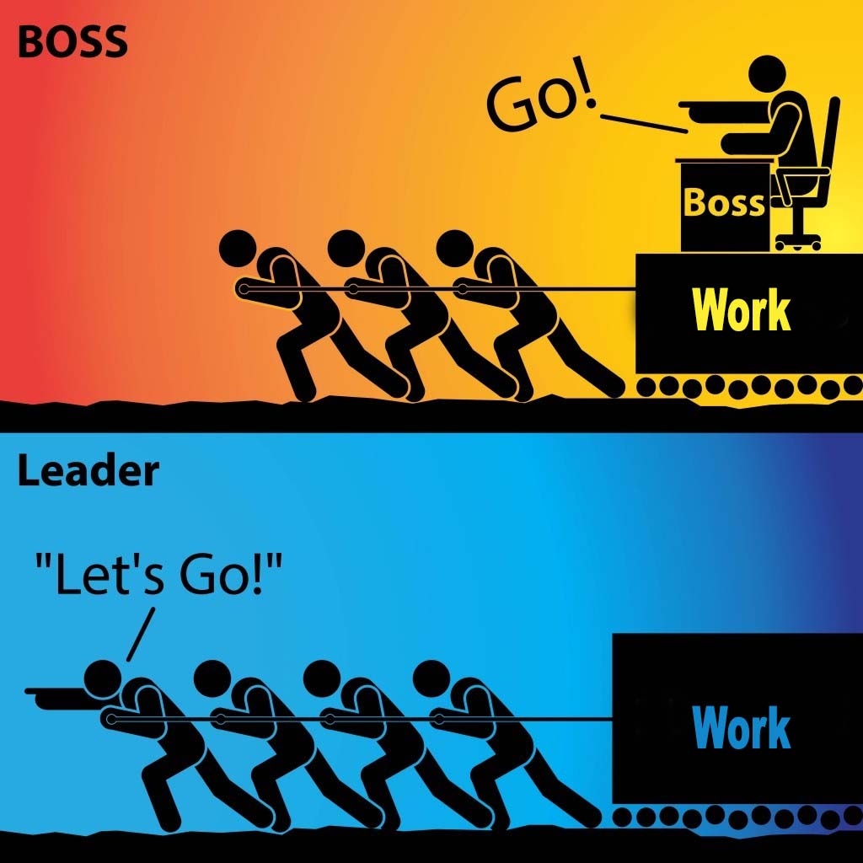
Leadership that builds power is…
…taking responsibility for enabling others to achieve shared purpose in the face of uncertainty.
The members who can lead most successfully are those who already have followers, i.e. people who trust and respect them.

Slide 48
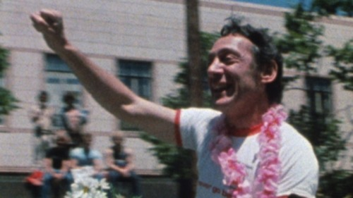
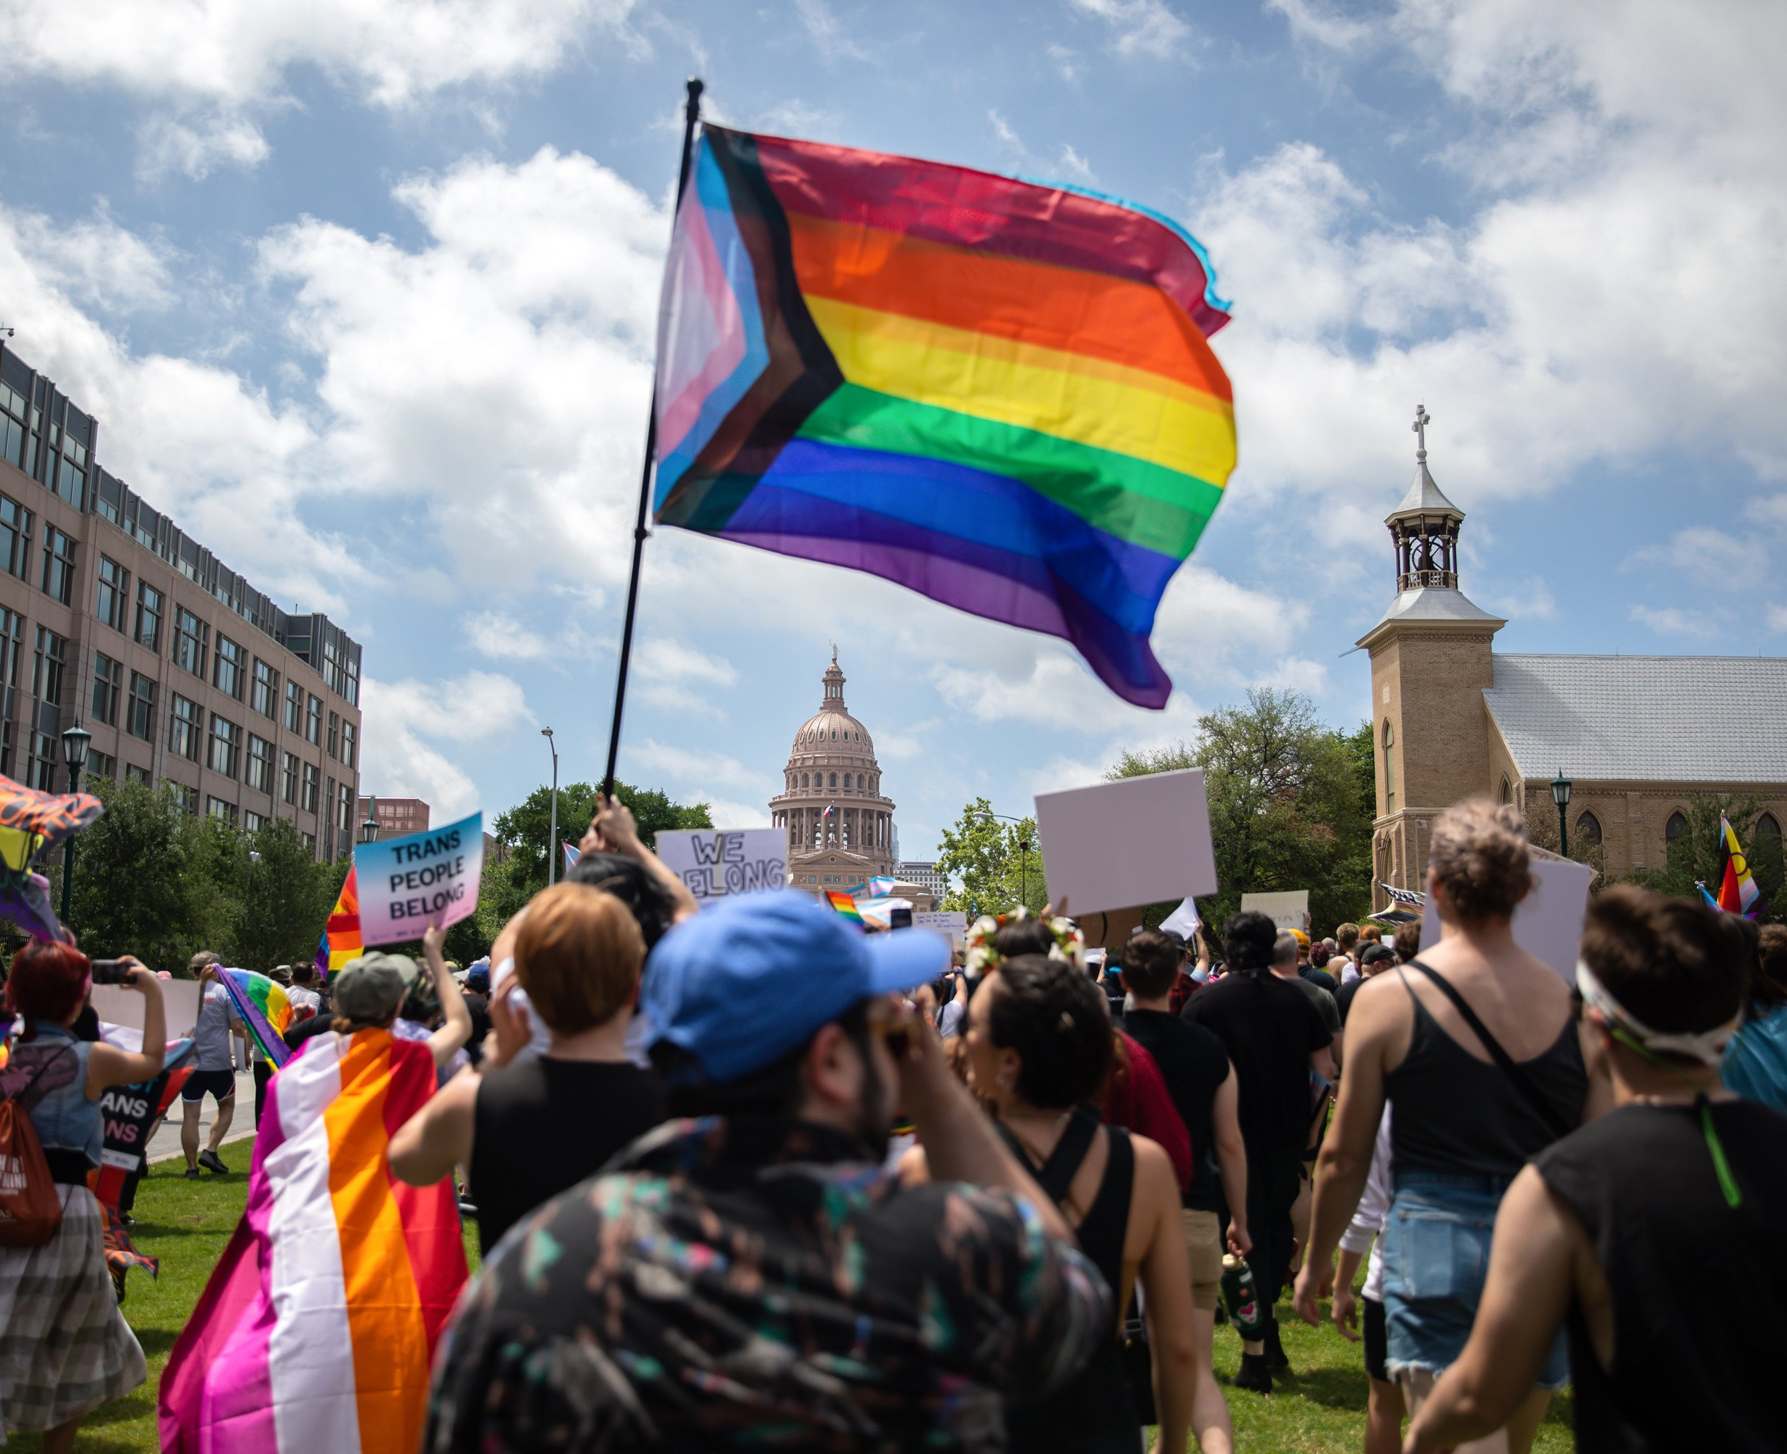
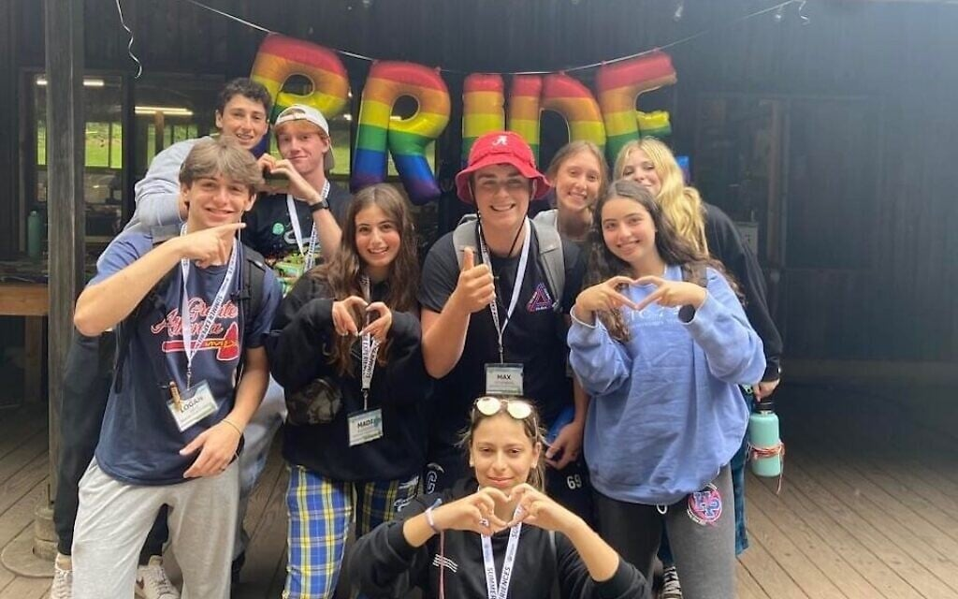
Leaders, Mobilizers, and Activists – Scenarios (pgs. 26-27)

Slide 49

Leaders, Mobilizers, and Activists (pgs. 26-27)
Who is a leader, a mobilizer, and an activist? How do you know?
In what order would you want to invite them into your cause and why?

Slide 50
We don’t make leaders, we find them by visiting worksites consistently and asking who is Trusted and Respected.

Slide 51
Key Ideas
Leaders are identified by their colleagues not us.
Leaders have followers and can move people.
Our role is to coach activists into relationship with leaders and other colleagues
Our role is to coach mobilizers into taking more risk and leading actions
Our goal is to support our leaders with resources.

Slide 52
Assessing our Structure

Slide 53
Eric J.

Slide 54

How are we positioned for building and using power?

Slide 55
Club or Union? Pg. 28 Table Talk
Which of these columns best describes the constituency you’re focusing on?
What indicators stand out to you?
Unorganized
Club
Union
Fighting Union

Slide 56
Levels of Organizing - Pgs. 29-31
Advanced
Members Lead
Basic
Member and Staff Partners
Staff Coach and Build Leader Capacity
Beginning
Staff Lead
Staff Focus on Engagement and Leader ID
Survival
Staff Lead
Staff Advise and Coach
Focus on Recruitment and Engagement

Slide 57
Whole Room Idea Sharing
Advanced
Basic
Beginning
Survival
Share strategies for moving the work from staff led to member led to advance your organizing.
Unorganized
Club
Union
Fighting Union

Slide 58
Key Ideas
Clubs are fixed, are not growing, and do not have enough resources to achieve the wins they want or to move the community to act.
The best way to transform a community into a constituency is to listen for the shared issues and values in order to invite them to take action for a shared purpose.
When WE do the work, lead the work, make the change happen – we take the opportunity for growth away from a leader.

Slide 59
Building a Campaign

Slide 60
Eric S.

Slide 61
How do you build a Campaign? Pg. 90
An action plan with a beginning, middle, and end, working towards a specific demand
  •Involves a series of escalating actions (or tactics) that combine to solve a particular issue
  •Increases pressure on decision-makers to give what will solve that issue
  •Builds power by increasing engagement, developing leaders, and building capacity around the values and shared pain of the common issue.
  •Throughout the campaign we identify milestones that indicate we have enough power to try something more and something bigger and win!

Slide 62
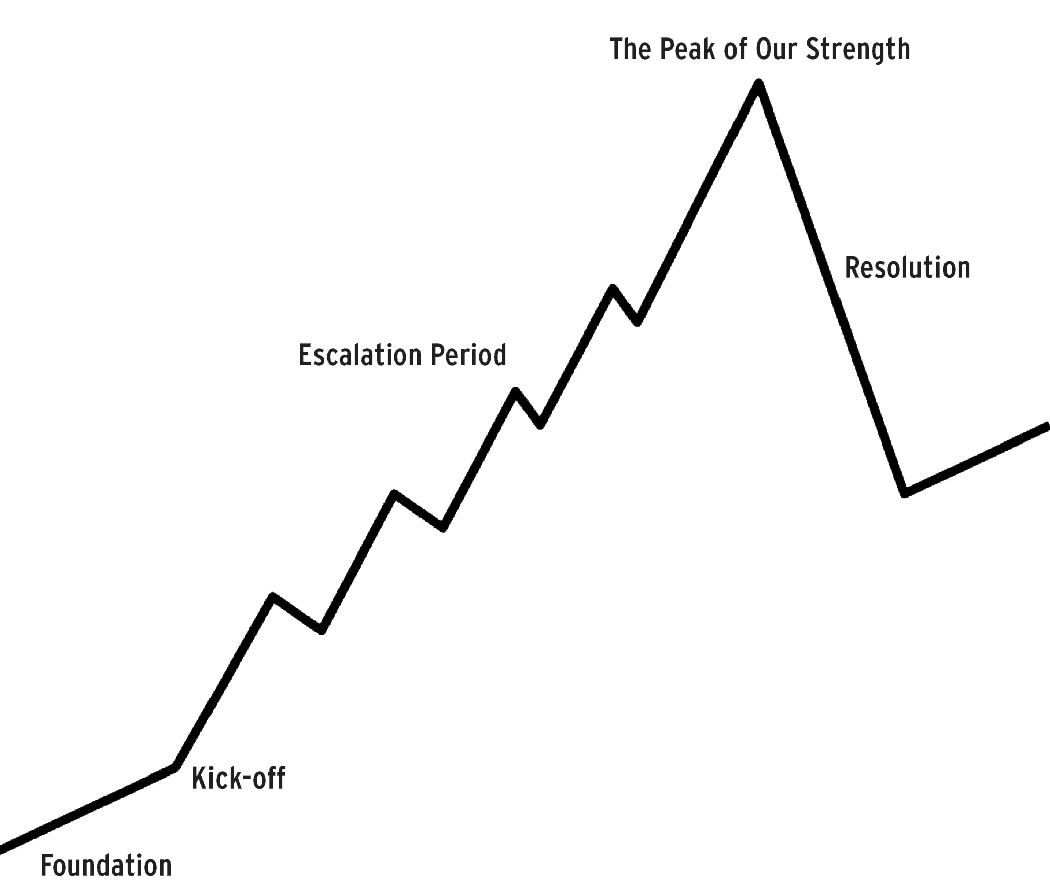
Key Parts of an Issue Campaign Pg. 91
Problem and Issue
Power Analysis
Target
Demand
Strategy and Tactics
Escalation

Slide 63
Campaigns are Strategic - pg. 103
Strategy involves asking:
  Who are my people (constituency)?
  What change do they need?
  How could they use their resources to build the power they need to achieve that change ?
Strategy is how to turn what you have” into “what you need” to get “what you want” - how to turn resources into power.
Strategy is an intentional plan

Slide 64
Key Ideas
Campaigns involve a large diverse group of people, are member led, and increase power and visibility of their union

Slide 65
END OF SESSION 2

Slide 66
Centering Race, Class, and Gender

Slide 67
Salina

Slide 68

TEAMWORK
Make a list of LBGTQ+ problems workers face in our schools.
What will it take to achieve equity for the people who work and learn in our schools?

Slide 69
How does a union build and transform their power?
Campaigns (fighting unions)
Public Action and Demands
Strategic and Ongoing
Continues to Add
  Base – Mobilizers - Leaders
  Allies – Partners - Coalitions
  Requires Risk
  Supported by Staff
  Leaders Build and Use Power
Programs (club culture)
Build Presence
Episodic
Member Recruitment
Committee/Program Leaders
Low Risk
Often Staff Led
Power in Policy

Slide 70
Centering Race, Class, and Gender Justice – pg. 40
Race, class, and gender justice is the systematic fair treatment of people resulting in equitable opportunities and outcomes for all.
It is not just the absence of discrimination and inequities, but also the presence of deliberate systems and supports to achieve and sustain race, class, and gender equity through proactive and preventative measures.

Slide 71
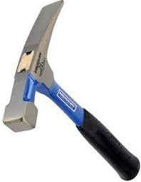
Race, Class, Gender Equity Tools – pgs. 41-43
What they do:
Proactively seek to both eliminate systemic barriers and advance equity
Identify clear goals, objectives and measurable outcomes
Develop mechanisms for successful implementation
What they are:
A set of questions used to anticipate, assess, and prevent potential adverse consequences of proposed actions on different race, class, or gender groups.

Slide 72
Key Points about Equity Tool Success
Buy in from the organization and its leaders
Routine and ongoing use of the RET
Data- driven assessment
A commitment to making changes
Tenacity – A commitment to overcoming obstacles to making changes
WE HAVE TO DECIDE TO DO THINGS DIFFERENTLY AND STICK WITH IT

Slide 73
For each of the answers in step 1, ask these 4 questions.
For each problem ask these questions:
​Who is most directly impacted?
Who has been left out?
How can they be directly engaged?
How do our demands advance race, class, or gender justice?

Slide 74
Key
Points
Intentional campaigns, not programs build power.
Centering race, class, and gender justice in our campaigns increases the people engaged, the number of leaders involved, and the amount of resources we have to win the change we want.
Power is only built through people with a shared vision, making public commitments to act, to risk their collective resources, for the meaningful change they want.
If your campaign is not designed from the beginning to include those with the least amount of power, the least amount of privilege, the least amount of resources – there is no way to retool a campaign to include them.

Slide 75
STEP 1:
Problem and Issue

Slide 76
Grat

Slide 77
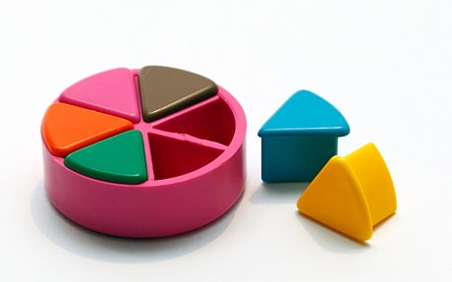
PROBLEM vs. ISSUE pg. 93
A problem is the whole pie. Problems are vast, complex, and entrenched.
When we try to tackle a problem, we reinforce the hopelessness of the situation. We are trying to take on the full pie all at once.
Issues are the pieces of the pie. It’s a small chunk of the larger problem that we can make progress on, and in turn we are slowly taking on the full problem over time.
Notes:
What are some “red flags” to look out for when identifying the issue?

Slide 78
Issue
An issue is a slice of the larger problem that is manageable and solvable.

Slide 79

PROBLEM vs. ISSUE

Slide 80
EXAMPLES- Problems to Issues + Values
VALUES – Public Schools should be safe, equitable, and inclusive learning and working environments for all people.
PROBLEM -Our school is hostile to LGBTQ+ staff and students
  ◦ Issue Cut – There are no gender inclusive bathrooms and/or transgender students are forced to use the wrong restroom.
PROBLEM - Our school reinforces racism and the school to prison pipeline
  ◦ Issue Cut– We need to stop armed security guards from arresting students for minor infractions in our schools.

Slide 81
Key Ideas
Problems are big conditions of injustice
Issues are the smaller member identified components that make up the problem
Issues indicate a path to action
Values build a relatable why across people experiencing the pain of the problem
We intentionally work to connect members around issues and values to build Solidarity

Slide 82
TEAMWORK – Problems into Issues
Example Problem – We want quality health care for everyone
Values behind wanting to fix this – equity, fairness, dignity
Possible Issues –
Not enough health providers in our rural system
Values – access and equity
Drugs are not affordable
Values – fairness and access
No coverage for home health options
Values – equity and dignity
Cut your problems into issues on your charts.

Slide 83
Assessing Our Issues – Pg. 94
Widely felt and/or deeply felt.
  The pain can be felt by just one, but the injustice of that pain is shared by many.
  The pain AND the injustice of that pain is felt by many.
Winnable.
Builds the union and builds leaders.
Has a connection to students and the public.
Secrets of a Successful Organizer “A Good Organizing Issue” handout

Slide 84

Issue Criteria Checklist
pg. 95

Slide 85
TEAMWORK – Assessing our Issues
TIME: 10 Minutes
In your group, spend 10 minutes evaluating an issue you identified from the scenario

Slide 86
STEP 2:
Power Analysis

Slide 87
Albert and Eric J.

Slide 88
REMEMBER POWER
Power is the ability to control, create, and prevent change.
Power is organized people and organized resources (money).

Slide 89
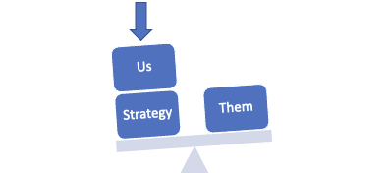
Purpose of Power Analysis
Understand how (& by who) power is exercised to cause and maintain the problems & conditions that we seek to change
Develop effective strategies for:
  Permanently altering power relationships in favor of the people suffering from the problems & conditions that we seek to change
  Grassroots organizing to build power
  Issue campaigns that BOTH help to build power AND win change
  Connecting short term activities to LONG TERM goals

Slide 90
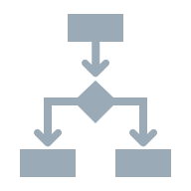


Process of Power Analysis
1. Issue Background
2. System Landscape
3. Identify & Analyze Target(s)

Slide 91
Key Ideas
Understanding our own power, or lack thereof, is a necessary starting point
Understanding who has the power to fix the issue is crucial to building a successful campaign

Slide 92

Spectrum of Allies Part 1 Pg. 33
  Active allies: people who agree with you & are organizing alongside you
  Passive allies: people who agree but aren't doing anything about it (yet!)
  Neutrals: people who aren't sure, or are unengaged (they might just not know about you yet)
  Passive opponents: people who disagree, but aren't trying to stop you
  Active opponents: people who have done something to prevent you from reaching your goal

Slide 93

Share Out Spectrum of Allies

Slide 94
Focusing your tactics matters
Only the Opposition – cynicism
Only the Active Allies – stagnation
Generalizations about Slices – missed opportunities
DO FOCUS ON THE PASSIVE ALLIES
  These are folks who know or care about what you’re up to, but aren’t doing anything about it! Give them a chance to participate and build power with you.
THE GOOD NEWS
  It is only necessary to move some or all of the pie wedges one step in your direction. If we shift each wedge one step, we are likely to win, even if the hardliners on the opponent’s side don’t budge.

Slide 95
Team Share of Spectrum of Allies

Slide 96
Key POINTs
It is only necessary to move some or all of the pie wedges one step in your direction.
If we shift each wedge one step, we are likely to win, even if the hardliners on the opponent’s side don’t budge.

Slide 97
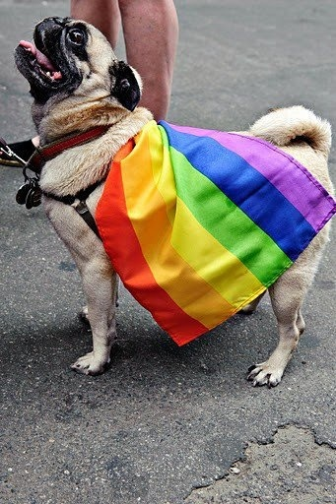
What will you take with you into your future work?
Closing our time together…

Slide 99
What follows are slides and content that we don’t have time for

Slide 100
Who are Our People?

Slide 101
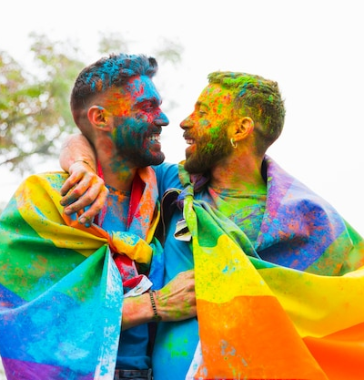
Give One Idea and Get One Idea
Your name
Where you are from
Who are your people that you will need to work with you on your campaign.
Track any “people” that you did not think of as needing, but might be useful. AND WHY on your worksheet

Slide 102
Our people are those
Who share our beliefs and interests.

Slide 103

People are the base of our power

Slide 104

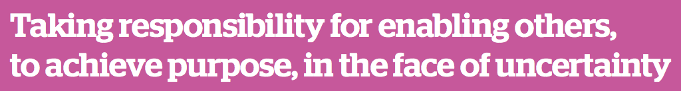
How do we find our people?
We have to ask the people

Slide 105
Key Points
Our People are BOTH leaders and followers.
We have to be in relationship with them to figure that out.

Slide 106
One on One Conversations
Notes:
Establishment of HBCU's, Tribal Colleges, HSI, Asian Pacific Islanders Institutions - REHE-A-Status-Report-Chapter-9.xlsx (live.com)
Tribal Colleges Resources/Data
Location of TCUs - Race and Ethnicity in Higher Education (equityinhighered.org)
TCU Exploration Guide by American Indian college fund.pdf
NativeAmericanFactSheet-October-2021-FINAL.pdf (pnpi.org)
Creating-Visibility-and-Healthy-Learning-Environments-for-Natives-in-Higher-Education_web.pdf (collegefund.org)
Tribal colleges empower Native students with an affordable, culturally relevant education – but need more funding (theconversation.com)
REHE-2020-Chapter-2-individual.pdf (equityinhighered.org)
Tribal Colleges & Universities – American Indian Higher Education Consortium (aihec.org)
Tribal Colleges and Universities: An Introduction | American Indian College Fund
Indigenous Peoples' Day Resources - Zinn Education Project (zinnedproject.org)
Resources for Teaching About Indigenous Peoples | NEA
TCU White Paper.pdf
Hispanic Serving Institutions Resources/Data
Hispanic-Serving Institutions (HSIs) Infographic: 2020-21 | Excelencia in Education (edexcelencia.org)
A Closer Look at Hispanic-Serving Institutions - Higher Education Today (higheredtoday.org)

Slide 107
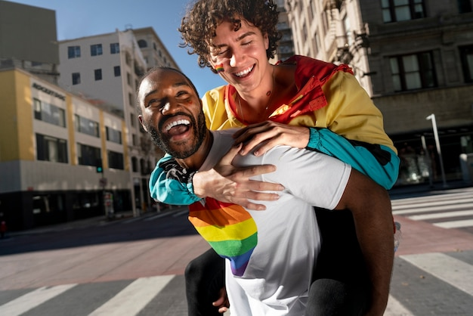
One on One Conversations
Organizing starts and builds through organizing or one on one (1:1) conversations with workers
3 Type of 1:1s
  Recruitment
  Escalation
  Maintenance
  On p. of your participant handout, you will find a resource that provides information on building relationships through 1:1 conversation along with definitions with each type of 1:1

Slide 108
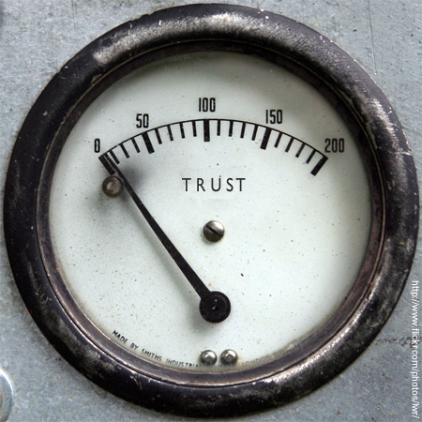
One on One Conversations
While the types of 1:1 conversations may overlap they are all rooted in:
  Shared Values
  Commitment
  Consistency
Conversations, are about being:
  Curious
  Leaning into potential and interests
  Probing for shared experiences
  Connecting on values
  You may not get a hard commitment for action or engagement because trust and respect is a precursor to action.

Slide 109
One on One Conversation Practice
Count off 1-5
The number corresponds to vignettes that each group is assigned
Groups will role play a 1:1 conversation with the following roles:
  Organizer: Individual facilitating the 1:1 conversation
  Worker: Assuming the role of the person in the vignette
  Observer/Coach: Listening attentively and providing the feedback after the 1:1 ends
  In a perfect world, there will enough time for a facilitator prompted cue to switch roles once.

Slide 110
Debrief
What emotions did you notice in yourself and your role-play partner(s)?
Were there any moments where you felt stuck or unsure of how to proceed?
How did you ensure respect and awareness of the historical and cultural significance of the institution?
Did you arrive at any shared values during your conversation? If so, what were they?
Based on what you heard, what would be your next steps?

Slide 111
Key Ideas
Recruitment, Escalation, and Maintenance 1:1s are essential for fostering strong, value-based relationships with workers, which are foundational to any organizing effort.
When organizing on higher ed campuses, emphasize curiosity, shared experiences, and values over immediate commitment, as trust and respect precede action.

Slide 112
Leaders

Slide 113
What is organizing?
Organizing is identifying leaders and coordinating them into leadership teams; Building community and commitment around common goals; Building power from the resources of that community; Using that power strategically to make concrete change in the world.

Slide 114
Who are leaders?

Slide 115
Who are leaders?
Leaders are those who take responsibility for enabling others to achieve shared purpose in the face of uncertainty

Slide 116
If leadership is…
Taking responsibility for enabling others to achieve shared purpose in the face of uncertainty
Notes:
For the purpose of our working together today, let’s use this definition, “Leadership is taking responsibility for enabling others to achieve purpose, in the face of uncertainty”

Slide 117
Then leaders…
Have followers

Slide 118
How do we find Leaders?

Slide 119
How do UniServ Directors find the leaders?
We have to ask our people…

Slide 120
Who here is trusted and respected?

Slide 121
Key Points
Leaders have followers.
There are probably multiple leaders, with different followers.
You have to talk to a lot of people to find out who the leaders are, and to learn about how the workplace is organized.
The leader of one group might not be respected by another group, and might even be alienating to some.
Just because someone is already in favor of the campaign doesn’t make them any more of a leader than someone who is unsure or even hostile to the union.

Slide 122
What kind of leadership do we need?

Slide 123
What is organizing?
Organizing is identifying leaders and coordinating them into leadership teams; Building community and commitment around common goals; Building power from the resources of that community; Using that power strategically to make concrete change in the world.

Slide 124
Structures are how we connect collective use of personal agency.

Slide 125
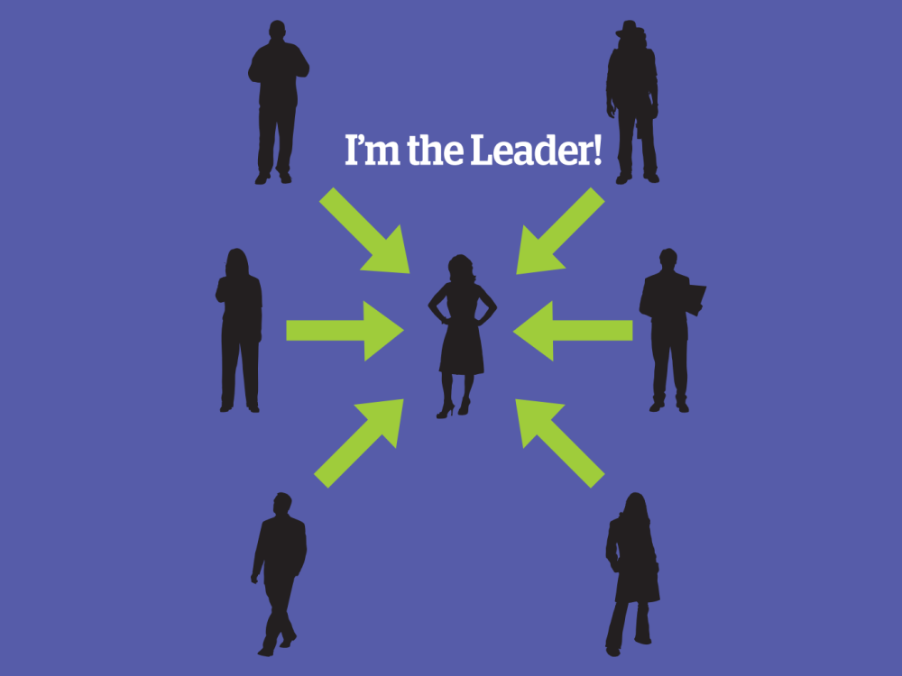
What to look for -
In the next three slides you will see a version of this “barbell”
The line portion of the shape represents relationship and resources
The ends represent leadership and accountability OVER relationships and resources
Pay attention to WHERE the ends are pointed.

Slide 126
Notes:
Has anyone been a part of this model of leadership? What’s in like to be the dot in the middle? What’s it like to be someone on the outside trying to get in?
Why, if this is so frustrating, is this model of leadership so commonly practiced?

Slide 127
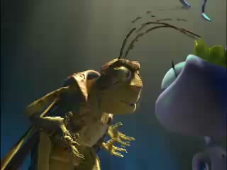
If you are the only leader…
Notes:
Flaming Parachute Guy

Slide 128
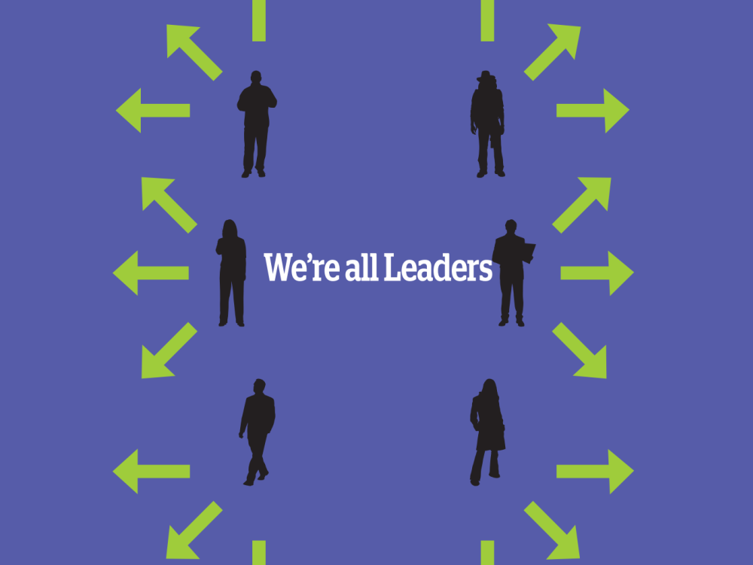

Slide 130
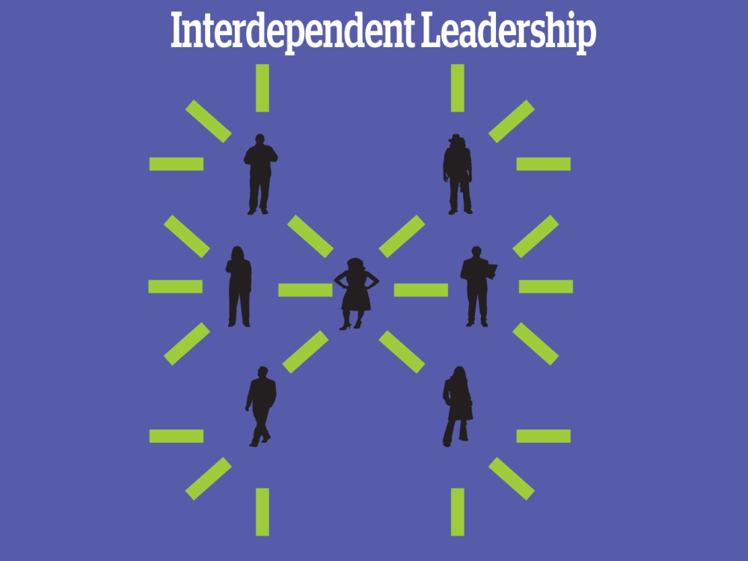

Slide 131

Remember interdependent leadership…

Slide 132
Leadership is a PRACTICE
not a position

Slide 133
If leadership is…
Taking responsibility for enabling others to achieve purpose in the face of uncertainty
Notes:
For the purpose of our working together today, let’s use this definition, “Leadership is taking responsibility for enabling others to achieve purpose, in the face of uncertainty”

Slide 134
Then leaders…
Have followers

Slide 135
We are coaching towards the Interdependent Structure – Leadership and Ownership Rich

Slide 136
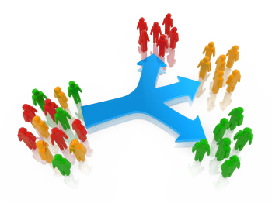
They do this through structures…
Structures allow for the distribution of power and responsibility and prioritizes leadership development. Structures are how people use their agency in support of the issues they feel are important. Because we think about organizing as a leadership practice that enables people to turn the resources, they have into the power to make the change they want… structures are typically “groups of people” organized around a common purpose or value, using their agency to take action. Teams, committees, networks, boards, coalitions … etc.

Slide 137
Key Points
Our primary job is to identify leaders who can share power, responsibility, and authority
We support members and leaders by helping them identify structures that distribute power, responsibility and authority
We are not the leaders – we are a resource/coach
Pre-identified leaders and Pre-developed structures are necessary for strong worksites with high union visibility.
You alone are not enough.

Slide 138
Assessing our Readiness to Center Social Justice

Slide 139
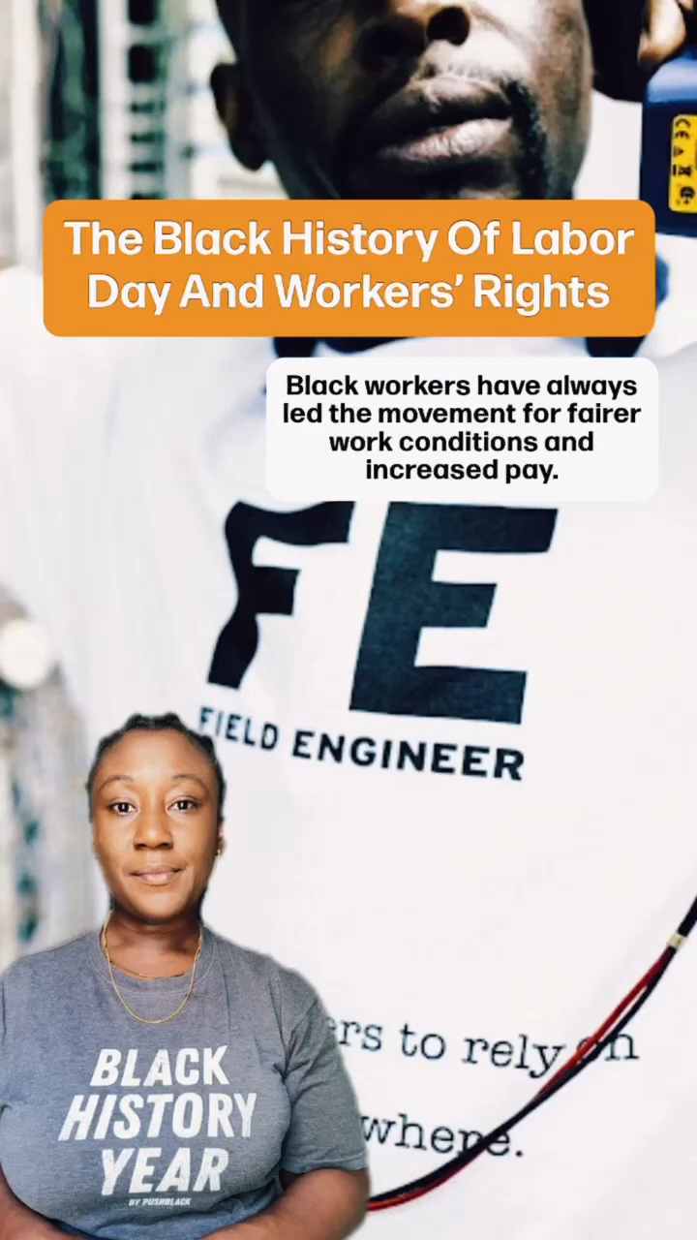
Black Workers Values Shape Unions

Slide 140
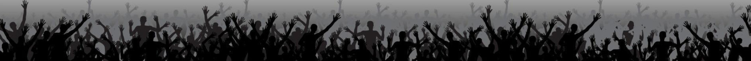
Core Values
Core values are the fundamental beliefs of a person or an organization. These guiding principles dictate behavior and can help people understand the difference between right and wrong. These can often be expressed in one or two words. We are taking a moment to consider our core values because they can provide a basis for solidarity in the midst of struggles.

Slide 141
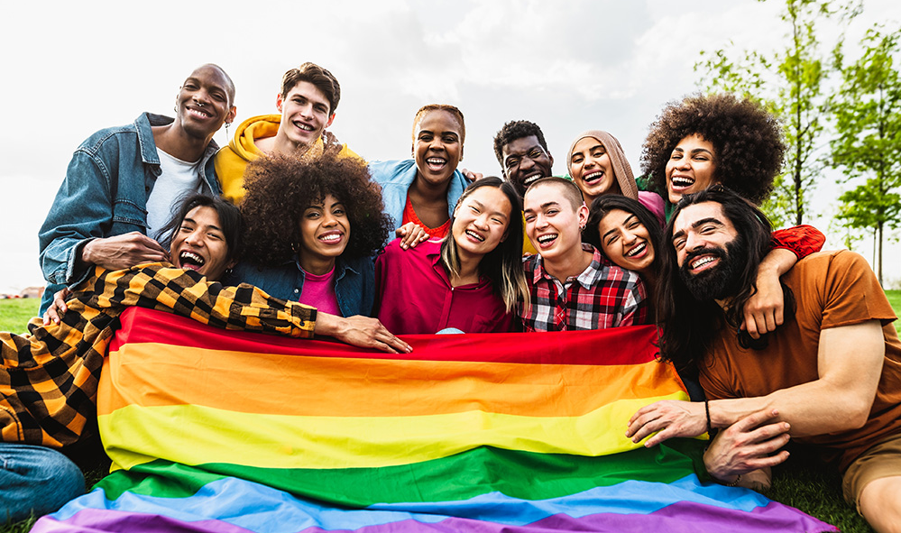
What are the core values of your union?

Slide 142
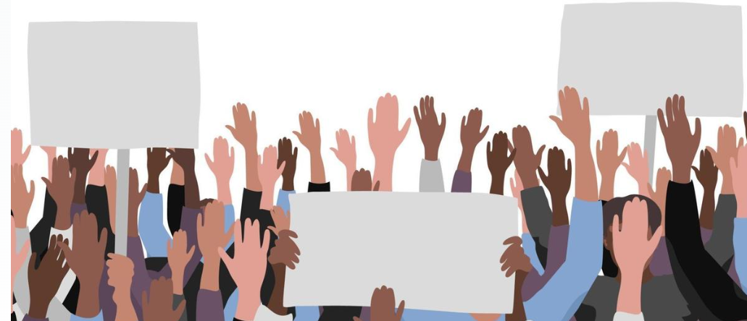
Report Out
Each table shares list of values.
Listen as tables share out and only add new values to the list.
What do you notice?

Slide 143
Union Values
Fairness, honesty/integrity, responsibility, compassion/empathy, safety, health, generosity, hard work/responsibility, community, freedom, democracy, binding contracts, equality, opportunity, respect, stability/security, unity, quality work, justice, collective action, dignity/respect, charity/community service, and due process.

Slide 144
Key Points
Ideally - Unions advance the welfare of all workers. They are based on the idea of justice, progress, and betterment of self and of society. They embody the universal ideal of human rights and the need to aspire to become more complete human beings. By becoming an active participant in the labor movement, members become part of something larger than themselves.
However, without INTENTIONAL APPLICATION of our stated values to dismantling systems of oppression we make no forward movement movement.

Slide 145
Walk the Line Activity
There will be six rounds
Listen to the union value statement, a description, and a short statement.
Based on how you have seen your affiliate live into this stated value, you will move on the line toward “Strongly Agree” or Strongly Disagree”
Keep in mind, this is a reflection activity. People may feel very differently about the values and how they see our work. The variety of perspectives is important.

Slide 146
Walk the Line Activity – Round 1
Calling People In Not Out
Calling people in means trying to create a culture and community that people actually want to be a part of. Calling people in means we don’t shame or blame. It requires direct, specific and compassionate communication with one another. We all have space to grow, and calling people in is how we support one another through growth.
STATEMENT: Our affiliate calls one another in when we need to communicate within our affiliate and with other white people.

Slide 147
Walk the Line Activity – Round 2
Accountability through Collective Action
Collective actions means that we look to build a movement of millions of people. Individual transformation is not enough. This is done through building accountability relationships with people of color who are doing racial justice work in the movement and who are accountable to a group of people. We don’t wait to be asked to take action to organize white people.
STATEMENT: Our affiliate is taking accountable collective action on a regular basis.

Slide 148
Walk the Line Activity – Round 3
Taking risks, making mistakes, learn, and keep going.
Making mistakes is part of life, and we know we have to be outside of our comfort zones in order to make change. Even when we take on real risk, we know that the risk is always greater for people of color. When we make mistakes, we want to reflect and stay in motion. We cannot let making mistakes prevent us from continuing our work. When others make mistakes, we do not shame, blame or exile.
STATEMENT: Our affiliate stays in the process of taking action, receiving feedback and staying in motion. We support one another through our mistakes.

Slide 149
Walk the Line Activity – Round 4
Mutual Interest
Racial justice isn’t something we help people of color with. The system of white supremacy harms all of us—including white people, though in very different ways than people of color. We need to get clear with ourselves about what we have to gain through this fight.
STATEMENT: Our affiliate and members are clear on our mutual interest. We’ve spent time getting clear on what’s at stake for us as individuals and as a group

Slide 150
Walk the Line Activity – Round 5
Enough for All
There are enough resources in the world for everyone's basic needs to be met— for folks to have decent housing, enough food, safety, etc. The problem isn’t that we don’t have enough stuff—it’s that it’s distributed unfairly. White supremacy tells us we need to compete with everyone, even other people doing this work.
STATEMENT: We organize from a place of abundance and cooperation.

Slide 151
Walk the Line Activity – Round 6
Growing is good
We need millions of white people to join the movement for racial justice, and in order for this to happen our groups need to keep growing. We need to constantly bring in new voices and leaders. This means more than inviting people to come to meetings. It means finding new and exciting ways to bring people into the work based on their skills.
STATEMENT: Our group is open to growth. We bring in new members and engage with them as leaders.

Slide 152
Debrief the Line
What are you taking away from that activity?
Is there anything that surprised you?
Where are we doing really well?
Where do we need to grow?

Slide 153
Key Points
Our unions CAN be critical in the dismantling of systems of oppression – BUT
Organizations that adopt racial justice principles must ensure that they also invest in sustained forms of leadership, staff, and member development to create a shared understanding of race and racism (and gender or class for that matter).

Slide 154
Steps 3 and 4
Target and Demand

Slide 155

A Target Is
The person with the power to give you what you are demanding.
This person
Has a name
Has a face
Has an address

Slide 156
TEAMWORK
Return to Your Issue Charts
Who are the Potential Targets for Each of the Problems?
Remember our Definition

Slide 157
Demand:
“Hey TARGET,
we demand ACTION
because HARM or IMPACT!”

Slide 158
Demand:
Hey Dean Sam: We demand gender affirming bathrooms in every building because all students and faculty need to feel safe and included in our schools. ”

Slide 159
REVIEW
Issue: A slice of a workplace problem that is deeply/widely felt, winnable, and will build our power.
Power: The ability to control, create and prevent change. Power is organized people and organized resources (money).
Target: Is the person with the power to give you what you are demanding.
Demand: the outcome that addresses the issue that you are making directed at a target.

Slide 160
TEAM WORK – Demand
Use your Issue and Target.
Draft at least one demand of your Target that resolves your issue and linked to YOUR VALUES

Slide 161
A different analysis is required.
Problems
Causes
Solutions
History
Strategies
Leadership
What race, class, or gender inequities are you noticing or experiencing? What are the impacts on different racial groups? Who benefits most and who is hurt most?
What institutions, policies, or practices are causing or contributing to the inequities? What social norms, popular myths, or cultural biases may be contributing?
How did things get this way and are things worsening or improving?
What solutions could address the root causes and eliminate the inequities? How would different racial groups be impacted by the proposed solutions?
What strategies and actions could be used to advance the solutions?
Who are the stakeholders most affected by the inequities? Are they involved in naming the issues and solutions? What kinds of active leadership roles could they take to advance the proposed solution?

Slide 162
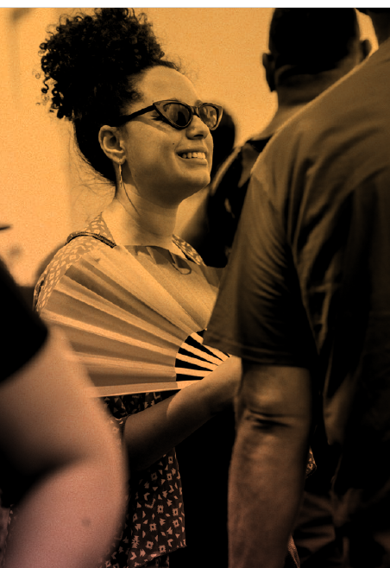
Applying Your Learning
Return to your issue and demands chart
With your group practice applying questions from the Equity Analysis Tool I just shared.
If your team did not create a set of issues and demands that you want to use for this, then you can use the ones on the following slide.

Slide 163

Your Thoughts?
What did your group learn using this analysis tool?
What did your group struggle with?
How can you use this in your own work?

Slide 164
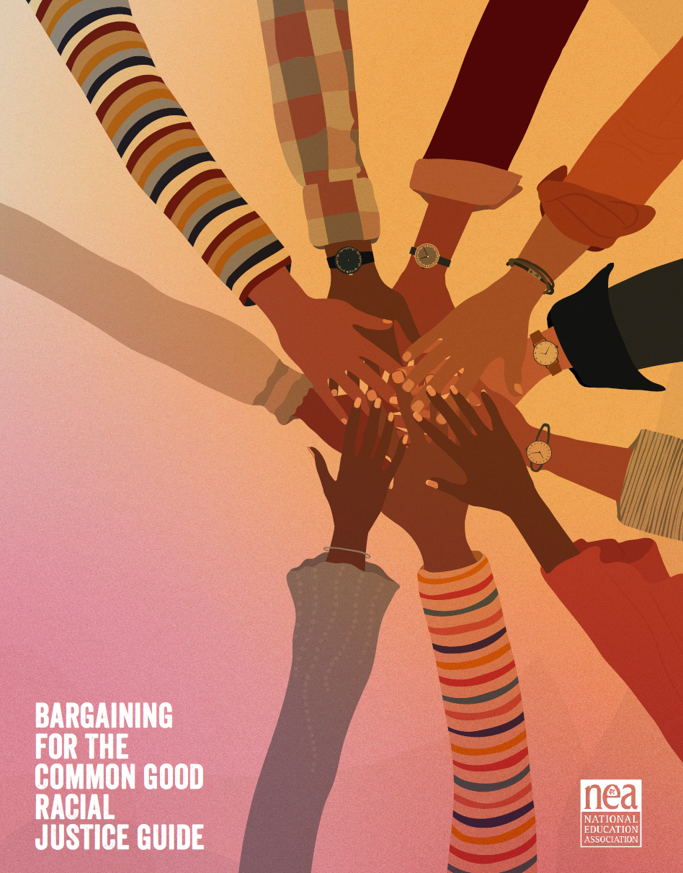
Resources
Center for Racial and Social Justice Guide
Racial Equity Tool.

Slide 165
Key Ideas
A powerful demand makes clear who has the power to make the change that’s needed
We can only build a powerful demand when we have taken the steps to accurately identify the issue and determine who has the power to create change

Slide 166
STEP 5 and 6
Strategy, Tactics, and Escalation

Slide 167
What do you think is the difference between a strategy and a tactic?

Slide 168
Strategy
Strategy: The way we use our power to win our demand. It is a series of tactics aimed at putting pressure on the target to meet our demand.

Slide 169
What makes good tactics?

Slide 170
Tactics
Tactic: Actions we take as a part of an escalation plan that increases pressure on the target to win our demand.

Slide 171
Tactics Must:
Put pressure on your Target
(puts them out of their comfort zone)
Build your Power
(develops leaders, brings more people in, etc.)
Be Strategic

Slide 172
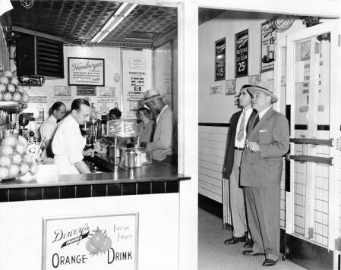
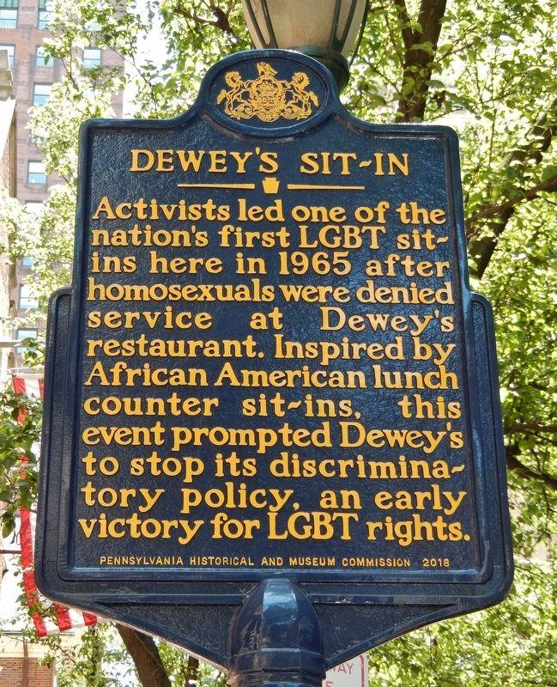
Historic LGBTQ+ Tactics

Slide 173
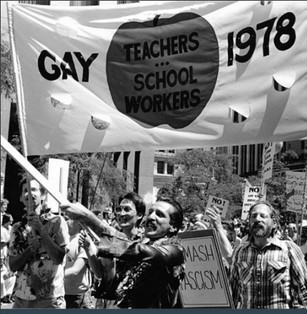
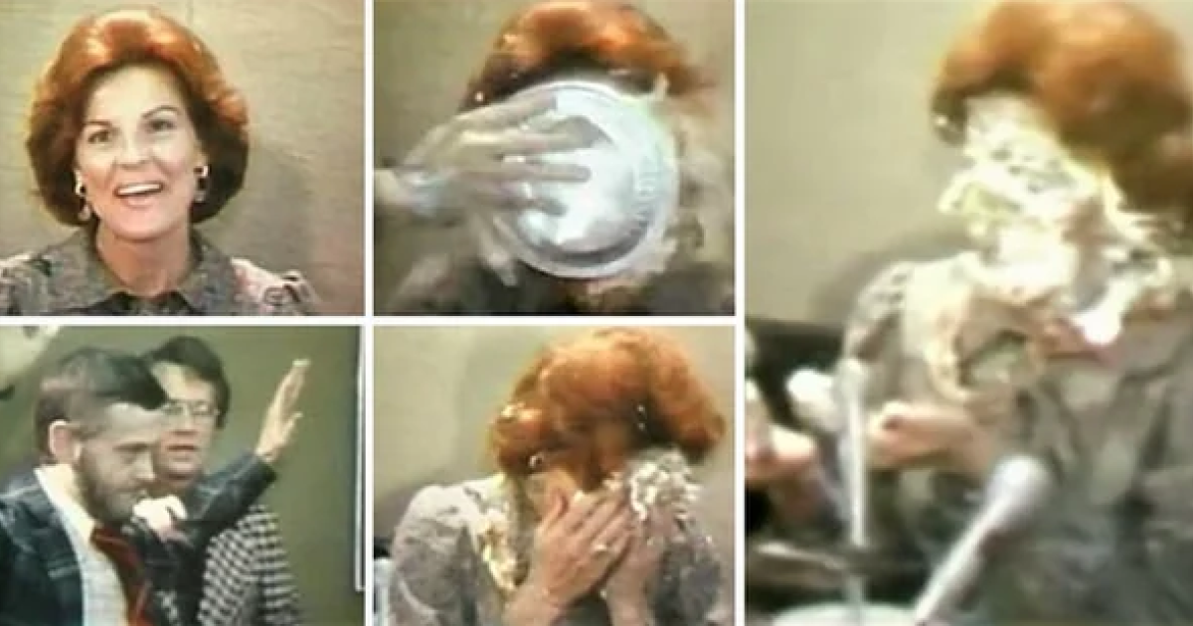
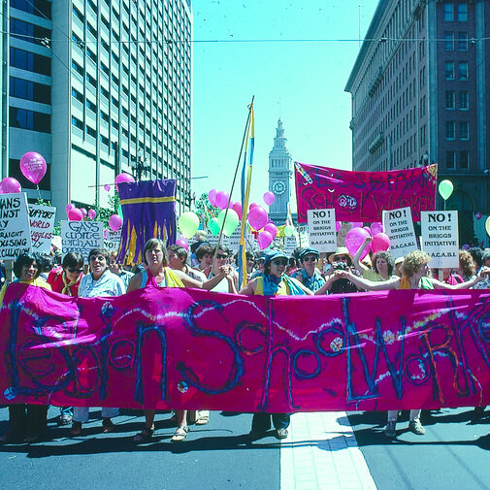
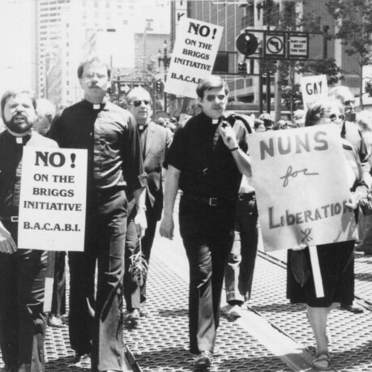
Historic LGBTQ+ Tactics

Slide 174
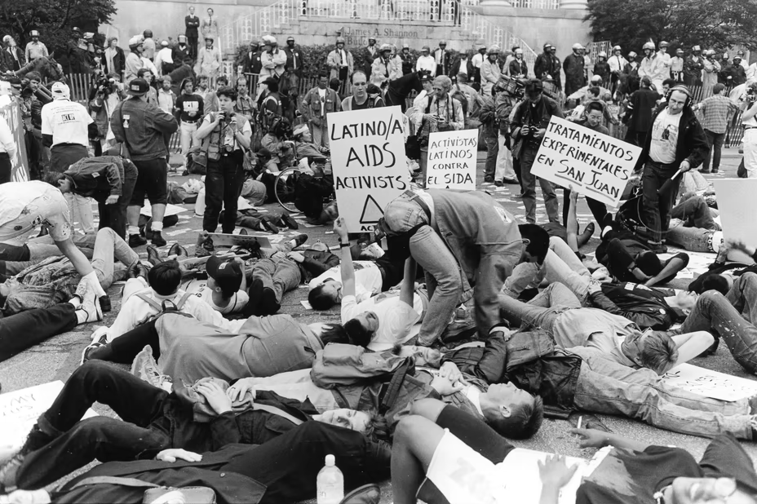

Historic LGBTQ+ Tactics
ACT UP!

Slide 175
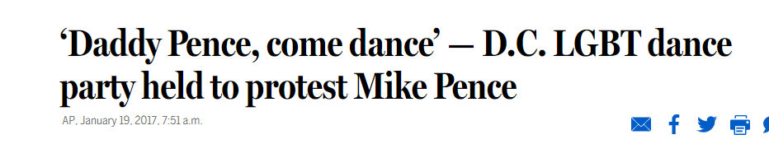
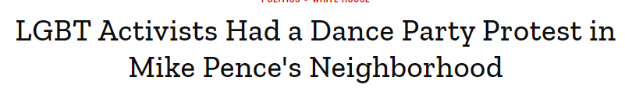
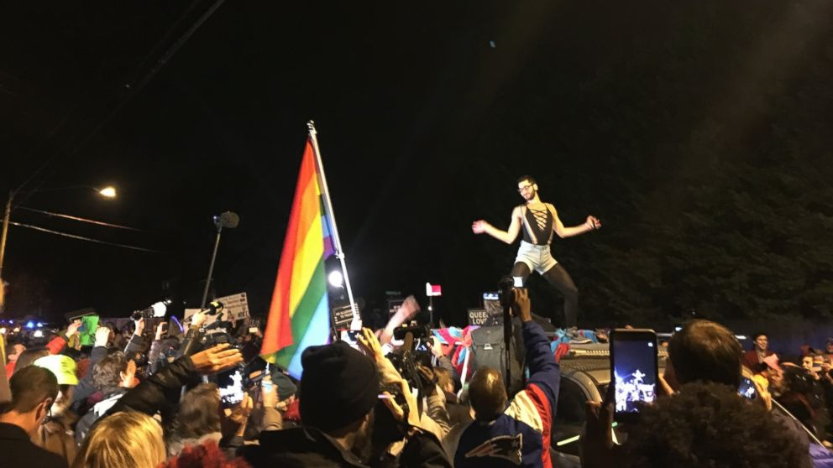
Historic LGBTQ+ Tactics

Slide 176
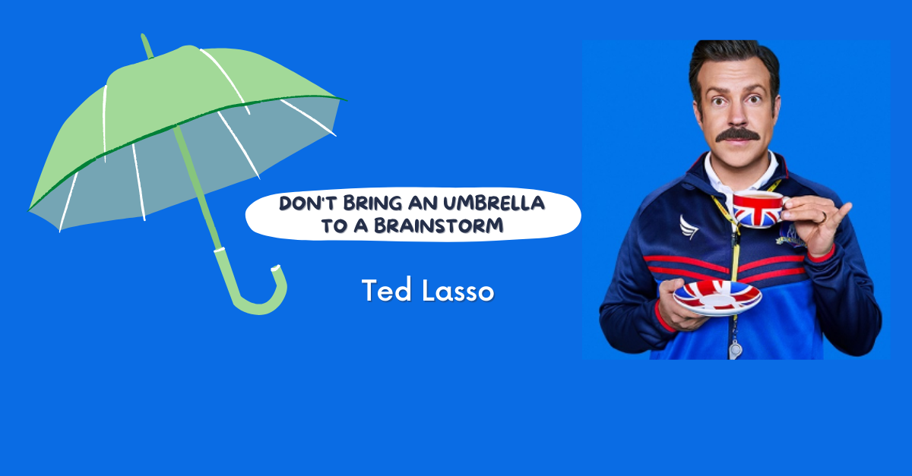
TEAM WORK – 5 Minute Tactic Brainstorm
+YOU HAVE 5 MINUTES!+
Brainstorm AS MANY tactics as you can on 1 chart.
•Be creative!
•You are NOT evaluating right now! Everything goes on the board!

Slide 177
Team Work
TIME: 15 Minutes
Evaluate your tactics
Decide which tactics that you came up with are strategic based on the evaluation criteria
CIRCLE the tactics you decide are strategic
CROSS OUT the tactics you decide are not strategic

Slide 178
Evaluating Tactics
Put pressure on your Target.
Build your Power.
Be Strategic.

Slide 179
Key Ideas
Tactics allow workers to:
Share Resources, Values, and Commitment
Take risks together and achieve shared wins
Build trust in their own agency and the collective effectiveness of their union

Slide 180

Campaign Mountain

Slide 181

Why do you think tactics escalate gradually?

Slide 182
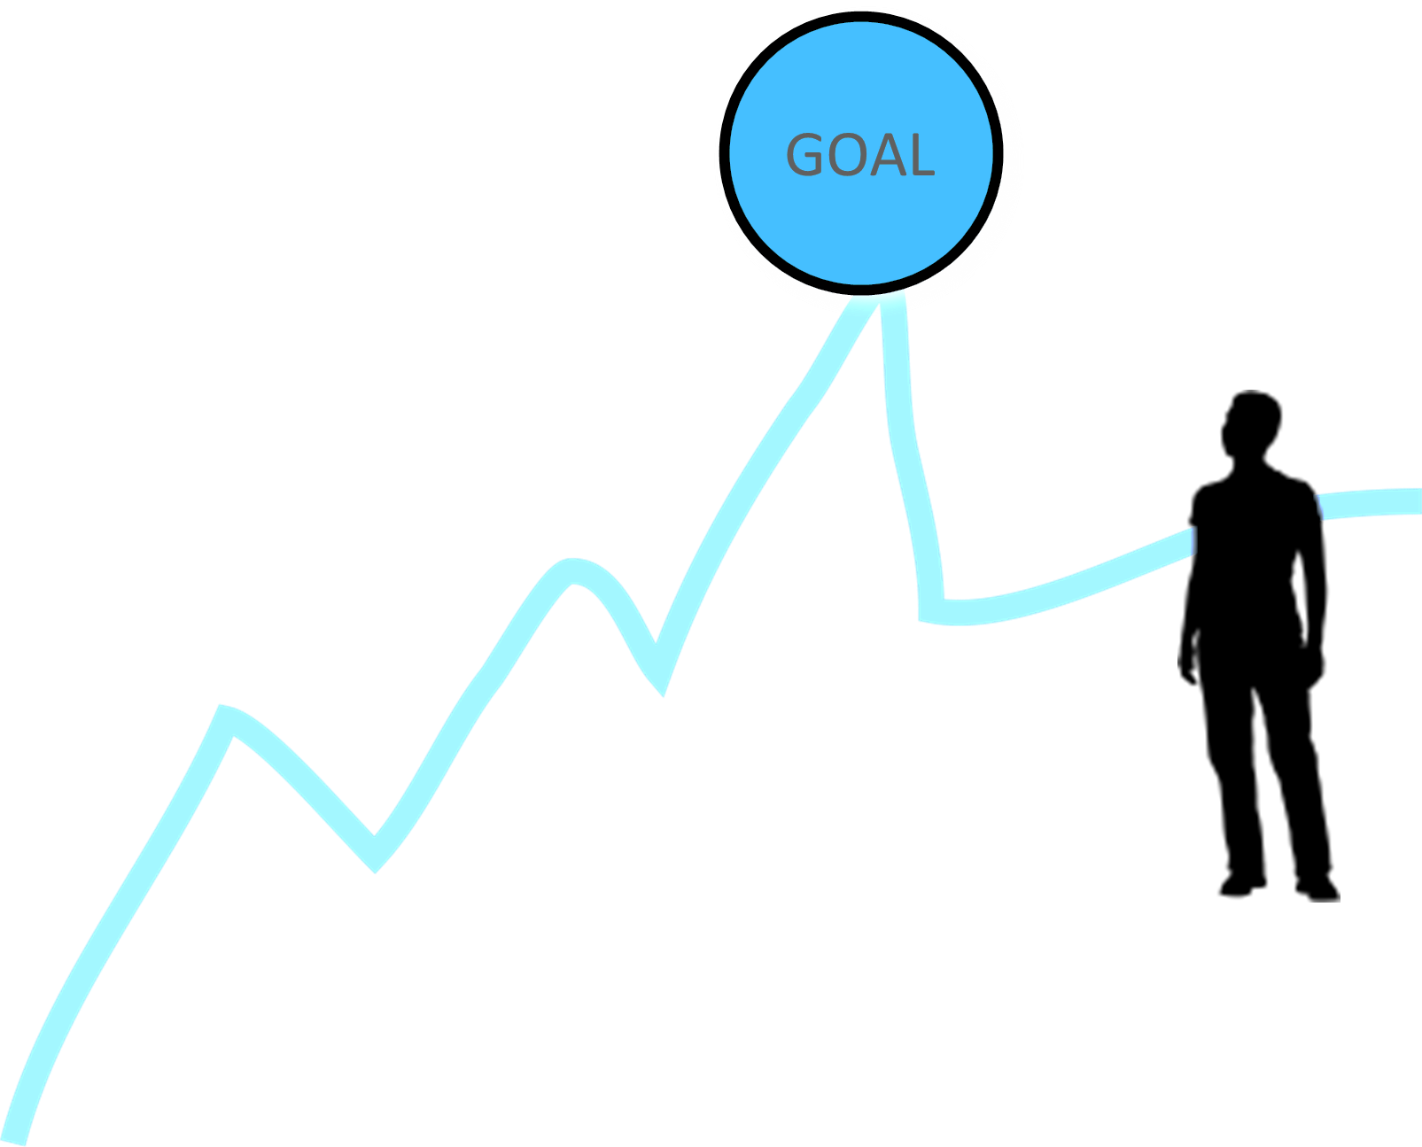
Less escalated actions prepare our people for more escalated actions
Gives us information about our readiness for the next step and how much pressure your target is able to sustain
Give the target the opportunity to do the right thing before things escalate
The threat of escalation can be as powerful as actual escalation

Slide 183
TEAM WORK – Escalation of Tactics
Return to your tactics chart
Arrange them in an order that has your least visible, least risky tactic to highest visibility highest risk

Slide 184
Key Ideas
An escalating campaign is held together by a set of values and shared commitment to a demand.
Escalating tactics are how we develop leaders, identify new leaders, move more people into our base.
If we are organizing, we are always climbing campaign mountain

