Slide 1

Centering Race, Class and Gender in Your Campaigns

Slide 2
Our Agenda:
Explore
Explore Identity, Intersectionality, and Allyship and where that can be used in your plan
Use
Use a framework for analyzing problems and resources in order to apply that analysis to the issues and goals (demands) in your plans
Apply
Apply our learning to scenarios and crafting demands in order to turn your goals into demands of your targets.

Slide 3


Slide 4
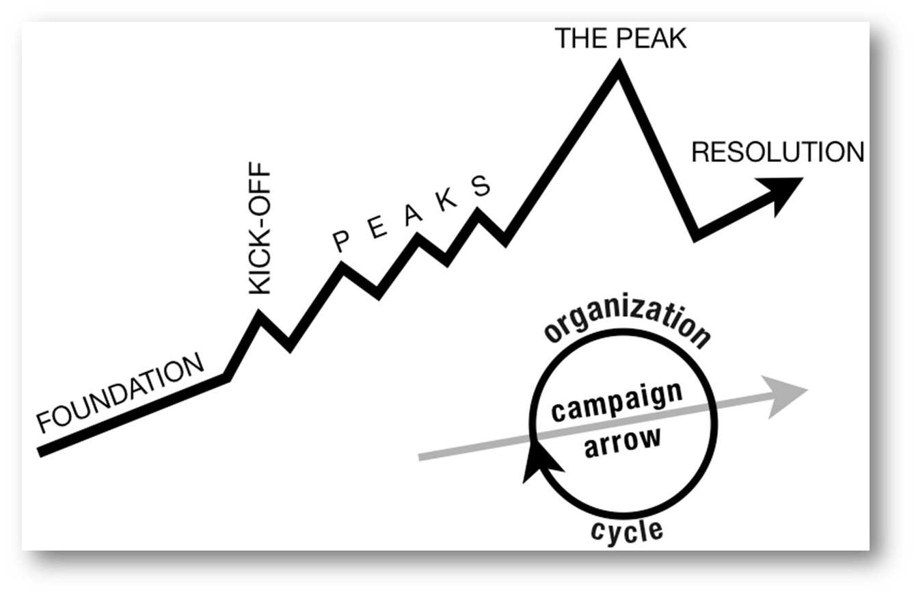
Structure of a Campaign
WIN
Notes:
Hedy
Tactic scramble!

Slide 5
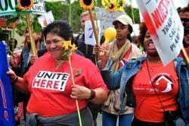
Growth – Base Building
Nationally, across all membership categories, we have to recruit 250,000 new members a year just to maintain current levels of union density. (Necessary)
BUT
Maintenance does not build.
(Not Sufficient)

Slide 6
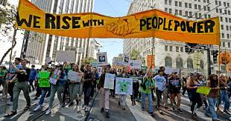
Strength – Organizing and Realizing Change
Increased membership and density isn't just about numbers, it's about the power to make systemic change through working together.
BUT it not only about the wins -
In order to control the changes we win, we have to continually push to a super majority member density. (Over 75%)

Slide 7
An organizing leader asks:
Who are my people?
What are their issues?
What do they demand?
What are they willing to risk in order to win that demand?

Slide 8
Centering Race, Class, and Gender in requires intention.
At each point ask:
​Who is most directly impacted?
Who has been left out?
How can they be directly enagaged?
How do our demands advance race, class, or gender justice?

Slide 9
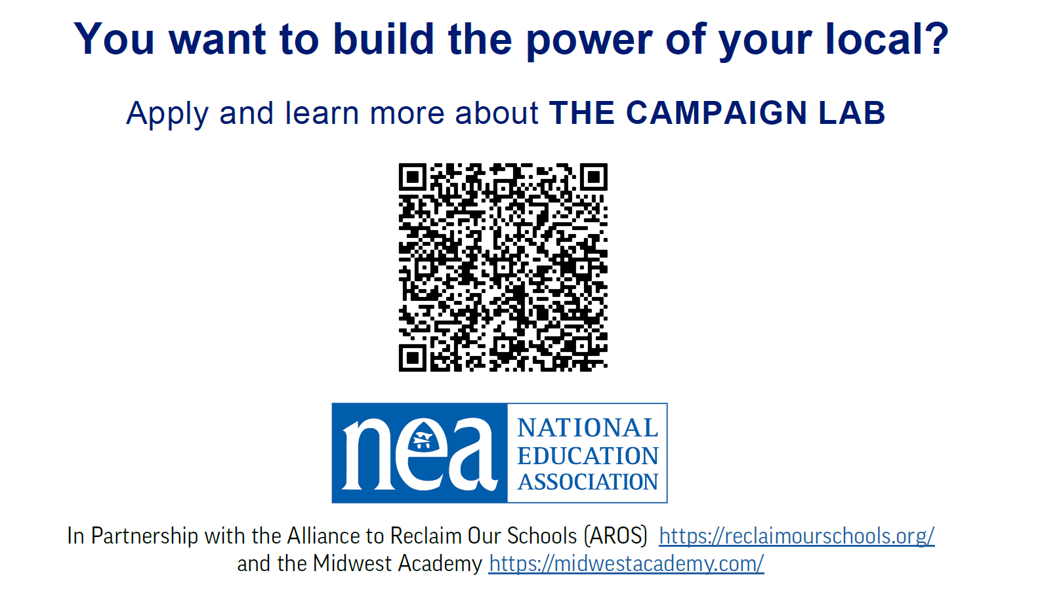

Slide 10

Disclaimer
The content we are going to explore may bring up strong feelings. Throughout our time together, we will explore examples of racism, ableism, heterosexism, and sexism.
These oppressive ideas and assumptions are offensive, problematic, and false. Yet, over time, they have become as pervasive and invisible as the air we breathe. We need to examine them so that we can understand, challenge, and ultimately eliminate them.
*Modified from ADL

Slide 11
People in Campaigns – Identity and Allyship
Monet

Slide 12
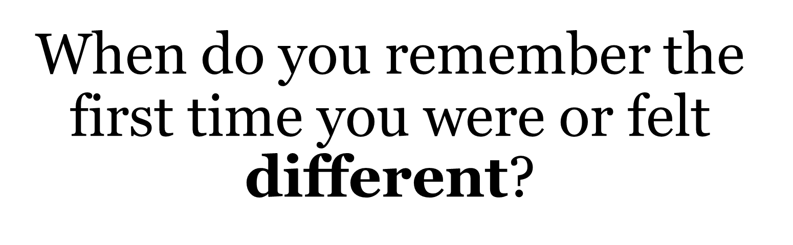

Slide 13
Your Identities Activity
Class
Age
Race
Gender Identity
Physical/Mental Ability
Religion
Nationality
Let’s Move –
Notice the stations around the room correlated to the different identities listed here.
Which identity of yours do you think about the most?
Move to that station, discuss your reasons why, and report out.

Slide 14
Your Identities Activity
Class
Age
Race
Gender Identity
Physical/Mental Ability
Religion
Nationality
Let's Talk
Which identity of yours do you think about least?
Move to that station and discuss:
Why don’t you have to think about it as much?
What could that mean in terms of your identity?
How can you leverage that power/privilege for marginalized people in your scope of influence?

Slide 15
ALLY
A member of the "dominant" or "majority" group that:
Questions or rejects dominant ideology
Works against oppression through support of and is an advocate with or for the oppressed population

Slide 16
ALLY
A member of the "dominant" or "majority" group that

Slide 17
ALLY
A member of the "dominant" or "majority" group that:
Questions or rejects dominant ideology

Slide 18
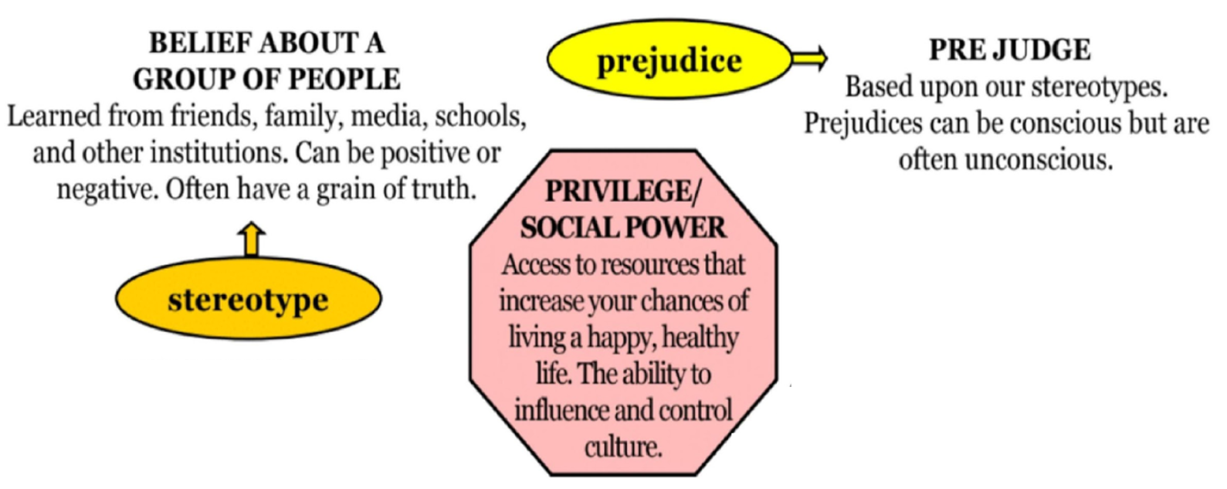
Cycle of Oppression

Slide 19
ALLY
A member of the "dominant" or "majority" group that:
Works against oppression through support of and is an advocate with or for the oppressed population

Slide 20
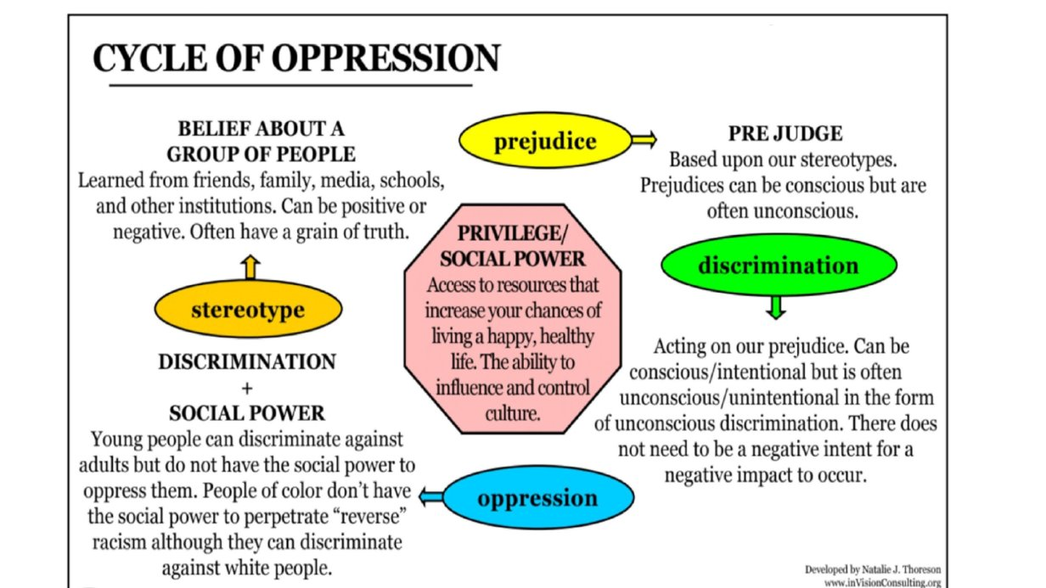
Cycle of Oppression

Slide 21

Key Points
An ally is someone from a privileged group advocating for someone in an oppressed group.
There are intentionally built systems that privilege some and oppress others.
We each have an identity that allows us to be privileged, and each has been oppressed due to an identity.
We have the ability to use our agency to act and unify to create and use power.
We need to constantly look for who’s missing

Slide 22
Matching Resources to Injustices –
Levels of Expression of Oppression
Katie
Notes:
Monet

Slide 23

Intersectionality

Slide 24

Intersectionality
Intersectionality is a framework for understanding a person, group of people, or social problem as affected by a number of discriminations and disadvantages. It takes into account people's overlapping identities and experiences in order to understand the complexity of prejudices they face.​

Slide 25
Levels of Expressions of Oppressions
I n d i v i d u a l | Internalized Oppression lies within individuals. These are our private beliefs and biases about others, influenced by our culture, that reside inside our minds. | S y s t e m i c | Institutional Oppression occurs within institutions and systems of power. It is the norms, policies and practices that are structured into political, societal and economic institutions that have the net effect of imposing oppressive conditions, denying rights, opportunity, and equality to identifiable groups.
 | Interpersonal Oppression occurs between individuals. Once we bring our private beliefs into our interactions with others, we are now in the interpersonal realm. |  | Structural Oppression is bias across institutions and society. It’s the cumulative and compounded effects of an array of factors that systematically privilege some and disadvantage others.
Notes:
Katie
3:45pm

Slide 26
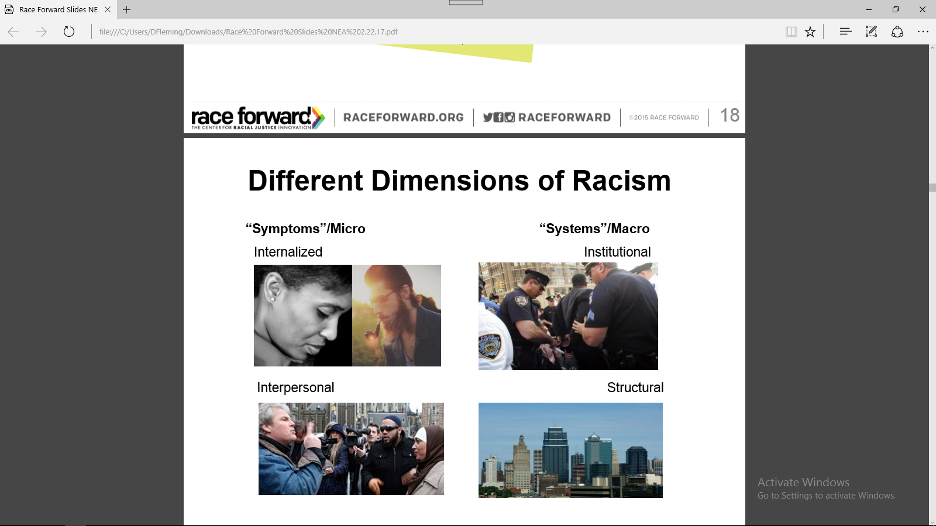
Internalized Oppression
Internalized expressions of oppression lies within individuals. These are private beliefs about race that reside inside our minds.
Examples: prejudice, xenophobia, internalized oppression and privilege, and biases (conscious and unconscious) about race influenced by the dominant culture.
Notes:
Internalized racism
All the prejudice, bias and blind spots you have within yourself as an individual

Slide 27
Interpersonal Oppression
Interpersonal expressions of oppression occurs between individuals. Once we bring our private beliefs about race into our interactions with others, we are now in the interpersonal realm.
Examples: public expressions of prejudice, hate, bias and bigotry between individuals.
Source: Race Forward 2022
Notes:
Interpersonal Racism
What happens when you act out those blind spots and bias on each other
This symptoms are recognized day to day, we talk about them most, and it’s easy to focus here

Slide 28
Institutional Oppression
Institutional expressions of oppression occurs within institutions. It involves discriminatory treatment, unfair policies and practices, and inequitable opportunities and impacts, based on race, class, gender.
Examples: A school system that concentrates people of color in the most overcrowded, under-funded schools with the least experienced teachers
Source: Race Forward 2022
Notes:
Institutional Racism occurs within institutions and systems of power. It is the norms, policies and practices that are structured into political, societal and economic institutions that have the net effect of imposing oppressive conditions and denying rights, opportunity, and equality to identifiable groups based upon race or ethnicity.
Resolution I new business item refers to the institutional racism
(white supremacy is structural)
We have worked on this, however, we focused on the personal and interpersonal versus focusing on the structural/institutional- make point.

Slide 29
Structural Oppression
Structural expression of oppression is bias across institutions and society. It’s the cumulative and compounded effects of an array of factors that systematically privilege some people and disadvantage others.
Examples: The “racial wealth divide”(where whites have many times the wealth of people of color) results from generations of discrimination and racial inequality.
Source: Race Forward 2018
Notes:
Structural Racism is racial bias across institutions and society. It’s the cumulative and compounded effects of an array of factors that systematically privilege white people and disadvantage people of color.

Slide 30
Key Points
1. There are no hard and fast lines between the levels – and changing one can affect another. ​
​
While we believe that the individual is ​
responsible for exploring personal bias …​
​2. The way to effect change is by addressing institutionalized and structural oppression – this is where injustice lives.

Slide 31
Hedy

Slide 32
Expressions of Oppression Exercise
We are going count off by 10’s
There are 10 Scenarios
Identify which level of expression of oppression your scenario is.
Your team will be responsible for providing a two-sentence summary of the scenario, identifying the level of expression of racism – and providing “why” you came to this conclusion (total of 3 minutes).
Notes:
There are 8 Scenarios. You will work in small groups to identify the level of racism in your scenario. Count off by 8. Find your new groups. Take your booklet along with a pen/pencil.
Assign group their Scenario
Each group will discuss and identify the level of racism in your scenario

Slide 33
Report and Debrief
3 Minute Report Outs
Please share…
    Two sentence summary
    What level did your group determine your scenario was at?
    Why did your group choose this level?
Notes:
Briefly describe the scenario to the larger group, we don’t have time to read them all. What level did your group determine your scenario was at and why? What did you struggle with? What was Clear to You? Let’s revisit our key point - there are not hard and fast lines between the levels – and changing one can affect another. While we believe that the individual is responsible for exploring personal bias – the way to effect change is by addressing institutionalized and structural racism – this is where injustice lives.
Remind them that they will return to this group again, so remember their assigned group number.

Slide 34

Oppression in Medicine Scenario #1
Transgender and gender non-conforming people face rampant discrimination in health care settings, are regularly denied needed care, and experience a range of health risks because they are transgender or gender non-conforming, according to a report of more than 6,450 transgender and gender non-conforming people. The National Transgender Discrimination Survey: Report on Health and Health Care was released nationally today by the National Gay and Lesbian Task Force and the National Center for Transgender Equality.
Key findings include:
Nearly 1 in 5 (19 percent) reported being refused care outright because they were transgender or gender non-conforming.
Survey participants reported very high levels of postponing medical care when sick or injured due to discrimination and disrespect (28 percent).
Harrassment: 28 percent of respondents were subjected to harassment in medical settings.

Slide 35

Financial Services Scenario #2
Members of the LGBTQIA+ community are still struggling, in some instances, to access financial services that would help them manage their money.
Some 30% of LGBTQIA+ adults have experienced bias, discrimination or exclusion in the financial services sector, either from individuals or organizations, a survey from the National Endowment for Financial Education found. The online survey of more than 1,000 adults in the LGBTQ+ community took place from May 6 to May 17.
Of those who experienced such barriers to accessing financial services, many noted that age and orientation were the top reasons they felt led to the experience. In addition, transgender respondents face the most discrimination, the survey found.

Slide 36
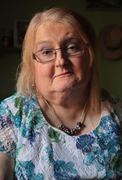
Workplace Gender Change Scenario #3
It took Aimee Stephens several months to write a letter to her boss explaining that she was a transgender woman and planned to start coming to work as her true self.
She had been working as a funeral director and embalmer for RG & GR Harris Funeral Homes in Garden City, Michigan, for almost six years. She loved her job, but didn’t want to hide who she was anymore.
She agonized over what to say in the letter, wrote several drafts and sought input from her therapist. Finally satisfied, she handed the letter to her boss in the summer of 2013.
“He read it, he folded it up and put it in his pocket,” Stephens recalled in an interview with CNN. “And basically stood up and walked away.”
She was fired two weeks later. Stephens filed a complaint with the Equal Employment Opportunity Commission, which then sued the funeral home claiming that firing Stephens for being transgender was unlawful sex discrimination based on her employer’s sex- or gender-based expectations.
“I was proposing to go from being a man in a suit to a woman in a dress and they couldn’t handle that part,” Stephens said.
Her boss stated that he fired Stephens because she “was no longer going to represent himself as a man” and “wanted to dress as a woman,”

Slide 37
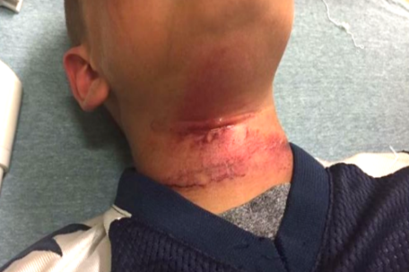
Scenario #4: Biracial Boy Pushed Off Tape
Teenagers in New Hampshire taunted an 8-year-old biracial boy with racial slurs and then pushed him off a picnic table with a rope around his neck, injuring him, the boy’s family said.
The child was treated at a hospital for cuts to his neck following the near-hanging Aug. 28 in Claremont, the boy’s grandmother, Lorrie Slattery, told the Valley News of West Lebanon, N.H. He has since been released and has returned to school in Claremont…
… An expert on abuse who spoke to the boy at the hospital said he swung from his neck three times before being able to remove the rope, Slattery said. None of the teens came to his aid, she said.
What is the expression of racism?

Slide 38
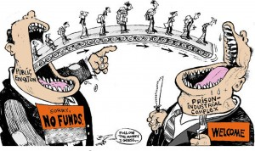
The School to Prison Pipeline: Scenario #5
A significant number of Chicago students are pushed into the path of juvenile and adult prisons as a result of harsh disciplinary policies and high stakes testing. By harsh disciplinary policies, we mean excessive security procedures and police involvement as well as the overuse of suspensions and expulsion for minor infractions. These policies feed the “School to Prison Pipeline”, sometimes also called the “Schoolhouse to Jailhouse Track”.
Research suggests that students of color, in particular African American students, are disproportionately impacted by these punitive policies…These zero tolerance policies involve the police in minor incidents and often lead to arrests, juvenile detention referrals, and even criminal charges and incarceration.
What is the expression of racism?

Slide 39
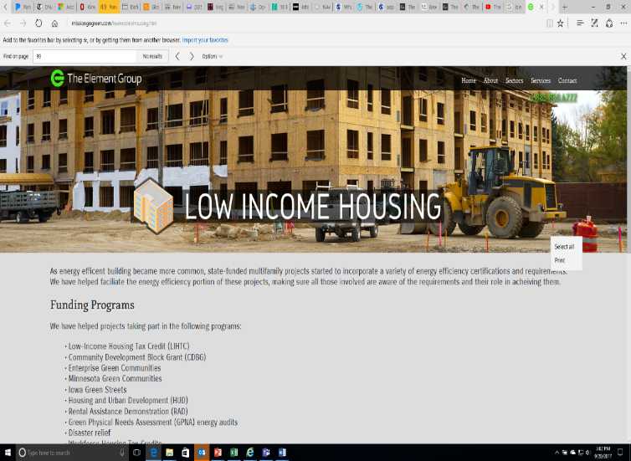
Scenario #6: Doorway to a Better Life
A state government agency decides that low-income housing must be built, which will house low-income Blacks and Latinos. The agency fails to look for locations near jobs and important infrastructures, like schools, decent public transportation, and other services. In fact, it is built in a poor, mostly Black and Latino part of town. Often times the government locates the housing where it will have the least opposition. White neighborhoods tend to oppose public and affordable housing. Resources, whether public or private, often follow whites who flee urban problems for white suburbs
When the housing is built, the school district, already under-funded, has new residents too poor to contribute to its tax base. The local government spends its limited resources on transportation to connect largely white, well-to-do suburban commuters to their downtown jobs.
The public housing residents are left isolated, in under-funded schools, with no transportation to job centers. Whole communities of people of color lose opportunities for a good education, quality housing, living wage jobs, services and support-systems.
In this town, no one individual stands in front of the doorway to a better life and says, “No Blacks/Latinos/ Native Americans/Asians allowed.” Race, however, is the unspoken motivator behind a series of actions which lead to decisions about where to place the walls.
What is the expression of racism?

Slide 40
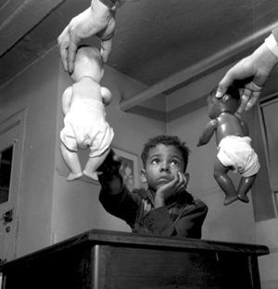
Scenario #3: The Doll Case
In the 1940s, psychologists Kenneth and Mamie Clark designed and conducted a series of experiments known colloquially as “the doll tests” to study the psychological effects of segregation on African-American children.
Drs. Clark used four dolls, identical except for color, to test children’s racial perceptions. Their subjects, children between the ages of three to seven, were asked to identify both the race of the dolls and which color doll they prefer. Most of the children preferred the white doll and assigned positive characteristics to it. The Clarks concluded that “prejudice, discrimination, and segregation” created a feeling of inferiority among African-American children and damaged their self-esteem.
What is the expression of racism?

Slide 41
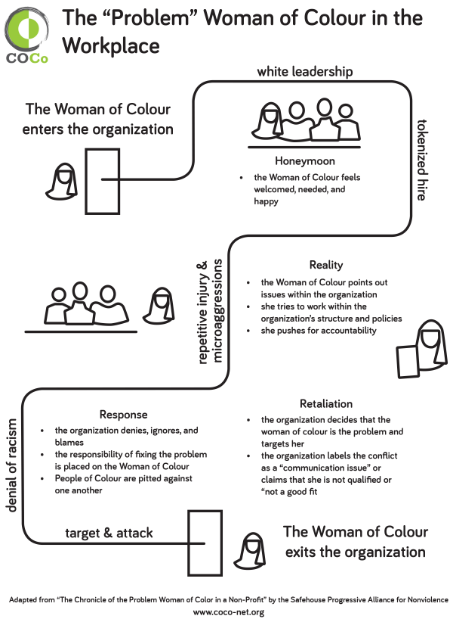
Scenario #8: The 'problem' Women of Color in the Workplace

Slide 42
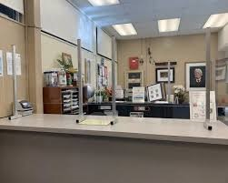
Scenario #9: Office Professionals Back to Work During a Pandemic
In October 2020, the office professionals in the Lakeview School district are required to return to work in person during the pandemic. The district has offered a high level of personal protective equipment (PPE) in gloves, face shields, and masks, but the district can only put up shield guards in the front office and encourage staff to work 6 (six) feet apart. There is no change in the ventilation system where they office professionals work or ability to move their work stations from where they prior to the pandemic.
The building office professionals are required to handle their day to day tasks (payroll, managing sick leave entries, student attendance, purchasing, etc.) as well as the additional requirements, which includes print for the teaching staff who are teaching remotely. They also must process all the additional payroll for the stipends that the teaching staff receive when they have additional workload associated with working remotely. The district refuses to offer a pay differential to the office professionals for working in person or offer additional sick leave for working in person. Administration can opt to work remotely and rarely come into the building and the office professionals in the district office can work remotely.

Slide 43
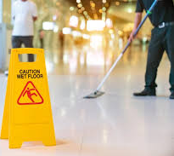
Scenario #10: Custodial Schedules
In recent years The Seaside School District has hired a number of teachers that are on J1 Visas. When they moved to the community, some of these teachers brought their families. They enrolled their children in the schools and their spouses and other family members applied for jobs in the school. The cost of coming to the US was great, many of these families are in dept to an agency that helped them find their jobs. Much of the money they earn is given to the agency or sent back to their families in the Philippines.
Dick Summerville is the Facilities manager for the Seaside School District. Dick is responsible for overseeing all the facilities in the District, which includes hiring and managing all the custodial and maintenance staff. Some of the spouses and family members of the teachers were hired by Dick to work in the Facilities Services Department. For many of these new employees English is a second language, and they do not read English well or at all.
This group is affiliated with the Teacher's Union. The Union supports four negotiated agreements, one being the agreement that covers the custodians and maintenance workers. This agreement outlines pay, benefits, leave, and other workings conditions such as breaks and lunches. The new employees were not provided with a copy of the contract or told about then Union when they were hired. The Union has not been provided a list of the new employees hired in the district, nor have they asked. The Union Executive Board is made up mostly of teachers or paraprofessionals.
Dick makes all the building and maintenance schedules. He schedules one full-time custodian during the day at most buildings and schedules multiple part-time evening custodians. The day custodians tend to be people that have worked for the District many years and are from the community. The evening custodians tend to be the spouses and family members of the J1 visa holders. He does not schedule breaks or lunches into this schedule. He schedules all of his employees 30 hours (part time) a week so they do not qualify for insurance. He refuses to allow overtime and thus the buildings are understaffed and impossible to clean and maintain in the time allowed by the schedule. He stops by the sites unannounced on a regular basis and does spots checks unscheduled evaluations. The employees live in fear of being written up and losing their job.

Slide 44

What did you struggle with?
What was clear to you?
Debriefing the Levels of Expressions of Oppression

Slide 45
Key Points
There are no hard and fast lines between the levels.
Each level is supported by the other levels.
Changing one can affect another.
​
​

Slide 46


POWER
The ability to create, control, and prevent change.
ORGANIZED PEOPLE + ORGANIZED MONEY

Slide 47

Mobilization = Power
Campaigning maximises the motivation of the audience, not their knowledge. Try using education to campaign, and you will end up circling and exploring your issue but not changing it.
All campaigns have some 'educational' effect but it is education by doing, through experience, not through being given information. Moreover, information is not power until it leads to mobilization.
Membership grows because of participation in active, visible issue campaigns not because of education and communication efforts.
Notes:
taken from Chicago Training Strategic campaigns
By placing workers in the center of the “fight” we give them the tools, practice and organization to give them the power to tackle the issue today and the issues of tomorrow.
We can beat back apathy through a course of collective action that demonstrates their power. Mobilization is the practice of power.

Slide 48
Campaigns Build Power and Unions
Well-structured, issue campaigns result in more people, more leaders, and more resources over time.
This provides more and more power to create, control, or prevent change.
WIN
Notes:
Hedy
Tactic scramble!

Slide 49
Centering race, class, and gender justice in our campaigns increases the people engaged, the leaders involved, and the resources we have to win the demands we want.

Slide 50
Key Points
Power is built through organizing people and resources.
The amount of power you have determines the scope of change you can achieve. ​
For lasting change, you have to dismantle the systems of oppression.
​

Slide 51

Let us know how we did!!

Slide 52
EXTRAS FOLLOW THIS

Slide 53
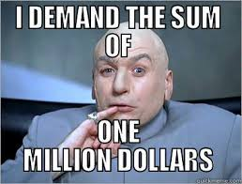
Now you try…
  What is a demand you could make related to your campaign that takes on race, class, or gender.
Notes:
Hedy

Slide 54
Problem
Issue Cut
Widely Felt Deeply Felt Winnable
Connected to Public Support
PROBLEM -Our school is hostile to LGBTQ+ staff and students
Issue Cut – There are no gender inclusive bathrooms and/or transgender staff and students are forced to use the wrong restroom
PROBLEM - Our school reinforces racism and the school to prison pipeline
Issue Cut– We need to stop armed security guards from arresting students for minor infractions in our schools.

Slide 55
When making a demand …
  A demand is the change you want as a result of your campaign.
  Meaningful
  Measurable
  Achievable
Notes:
Hedy

Slide 56

Target:
Has the power to give you what you are demanding
A person:
- a name, face, & address
Notes:
Hedy

