Slide 1
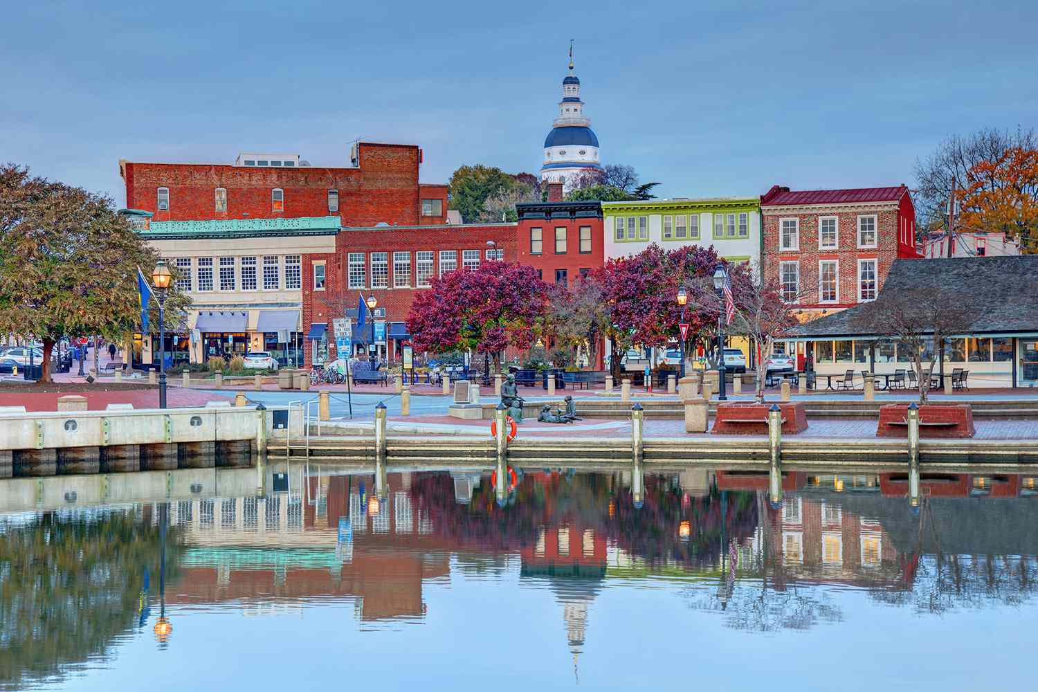

Zone 1 Organizing Institute
July 9-12, 2024
Westin Annapolis
Annapolis, MD
Issue Organizing
Monet Reilly & Mike Magee

Slide 2

Zone 1 Organizing Institute
Annapolis, MD
Objectives:
Understand difference between “problems” and “issues”
2. Understand what a good “Organizing Issue” is and how to identify one
3. Learn to identify key decision makers/targets
4. Walk away with a specific issue and plan start

Slide 3
WHAT’S YOUR PROBLEM?
ACTIVITY A- 5 MINUTES
STEP 1- OPEN THE YELLOW FOLDER ON YOUR TABLE
STEP 2- DISCUSS WITH YOUR TABLE WHAT YOUR GROUP THINKS ABOUT THE QUESTION PRESENTED.
Zone 1 Organizing Institute
Annapolis, MD

Slide 4


Activity A
Discuss with you table your thoughts on the question.
Zone 1 Organizing Institute
Annapolis, MD
Notes:
10 Min Mark

Slide 5

BEAT THE CLOCK
WHAT DID YOU GROUP DECIDE?
Zone 1 Organizing Institute
Annapolis, MD
Notes:
10 Min Mark

Slide 6


WHAT’S YOUR PROBLEM?
Prompt 1
Should teachers provide class coverages?
Prompt 2
How can class coverages be equitably done?
Zone 1 Organizing Institute
Annapolis, MD

Slide 7

Problem: Something causing educators to suffer.
Issue: A solution to the problem.
Zone 1 Organizing Institute
Annapolis, MD
Notes:
Your issue is your how
i.e., stagnating salaries, low planning time, bad administrator, anti-teacher Board of Ed, etc.
i.e., educator salary increases, increased planning time, replacing principal, pro-teacher BoE members, etc.

Slide 8
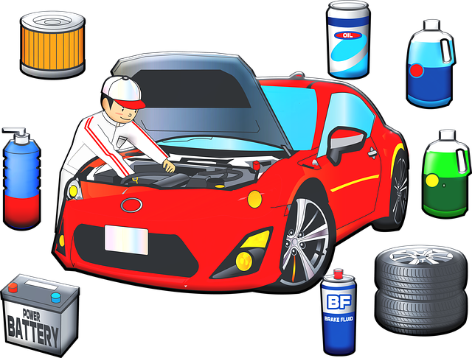
Organizing Issues defined
An Organizing Issue is a specific, tangible improvement in the lives of educators that in some way addresses or solves a Problem.
Zone 1 Organizing Institute
Annapolis, MD
Notes:
We often confuse problems and goals for Issues

Slide 9
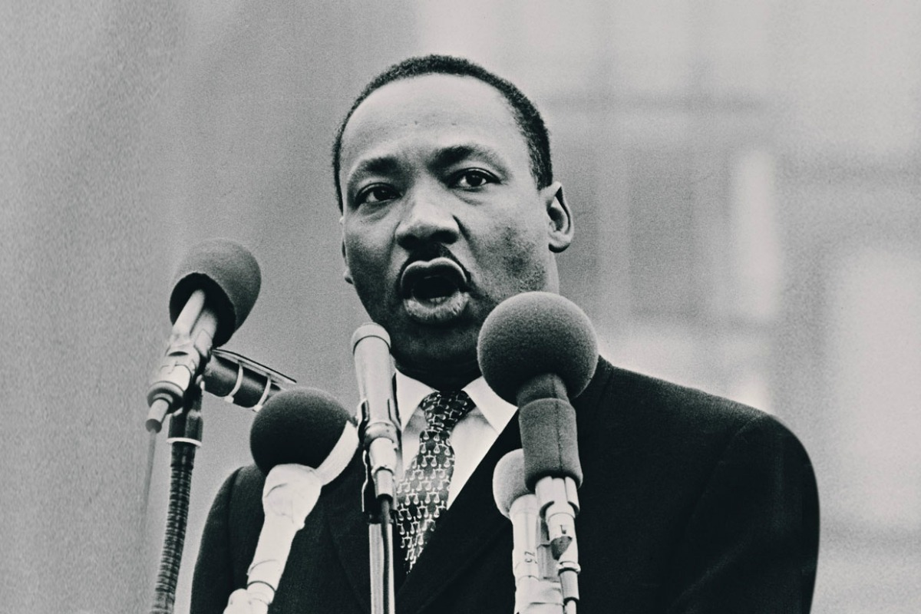
THINK BACK TO NOT TOO LONG AGO
Problem: Racism in America (big, abstract, hard to tackle)
Subsidiary Problem: Segregation in the South and disenfranchisement of Black voters
Solution/Issue: Outlaw (legal) segregation and racial voting restrictions
Campaign Outcome: Civil Rights Act of 1964 & Voting Rights Act of 1965
Zone 1 Organizing Institute
Annapolis, MD
This Photo by Unknown Author is licensed under CC BY

Slide 10
Smaller Scale Problem to Issue
L. D. Middle School
Problem: teachers feeling coverage fatigue
Solution/Issue: hire more staff! rotate staff who are covering vacant positions and request support from central office
L. D. Middle School
Problem: teachers do not feel supported with violent student behaviors
Solution/Issue: ensure Student Behavior Advocates are always available to respond to calls instead of covering vacant classes
Zone 1 Organizing Institute
Annapolis, MD

Slide 11

Specific ways to identify a Problem
One-on-One organizing Conversations
Member Climate Survey
Union townhalls
The problem chooses you (sometimes)
Or a combination of these!
Zone 1 Organizing Institute
Annapolis, MD

Slide 12
Where is the pain point?
What is the problem?
Where to start?
Zone 1 Organizing Institute
Annapolis, MD

Slide 13
What’s the biggest problem in public education?
ACTIVITY B- HAND UP/PAIR UP
Step 1- On your piece of cardstock in the folder, write down your answer. DO NOT SHARE IT.
1
Step 2- Ask as many people as possible in 5 minutes what their biggest problem is.
2
Step 3- Tally mark every time someone has the same problem as yours, move on if they don’t.
3
Zone 1 Organizing Institute
Annapolis, MD

Slide 14
Activity B
Tally mark every time someone has the same problem as yours, if they do not, then move on!
Zone 1 Organizing Institute
Annapolis, MD
Notes:
10 Min Mark

Slide 15
Problem: Something causing members to suffer.
Issue: A solution to the problem.
An Organizing Issue is a specific, tangible improvement in the lives of members that in some way addresses or solves a Problem.
Zone 1 Organizing Institute
Annapolis, MD
Notes:
Your issue is your how
i.e., stagnating salaries, low planning time, bad administrator, anti-teacher Board of Ed, etc.
i.e., educator salary increases, increased planning time, replacing principal, pro-teacher BoE members, etc.

Slide 16

WHAT IS A GOOD ISSUE?
There are nearly limitless possible issues you could tackle
But only SOME of those are *good* organizing issues
Zone 1 Organizing Institute
Annapolis, MD
Notes:
So what makes a *good* organizing issue, and how do you decide between competing priorities?

Slide 17

Criteria for a Good organizing Issue
widely felt
deeply felt
clear decision maker
real improvement
build organized power
Change relations of power
non-divisive
develop leadership
Groundwork for next campaign
winnable
Zone 1 Organizing Institute
Annapolis, MD

Slide 18
Coverage
Problem: so many vacant positions causing coverage fatigue
Issue: Consistent/ regular updates and transparency around vacancies/ absences
Issue 2.0: Staff emailed a daily list of absences & coverages and weekly update of vacant positions with action steps from admin to reduce coverage fatigue
Zone 1 Organizing Institute
Annapolis, MD

Slide 19
Toileting students
Problem: ESPs pressured into toileting students without training or safety equipment
Issue: Extra pay and training for ESPs who volunteer to toilet students
Issue 2.0: $1000 annual stipend, PPE provided, and four hours of paid safety training
Zone 1 Organizing Institute
Annapolis, MD

Slide 20
Bargaining Campaign
Problem: Series of weak contract settlements
REAL problem: Constrictive bargaining rules isolate members from process
Possible Issue: Introduce proposals for transparent bargaining process and frame your contract campaign around those
Zone 1 Organizing Institute
Annapolis, MD

Slide 21
Membership Density
Problem: Low membership density
REAL problem: Long history of concessions to management, bully superintendent, burnt-out union leadership
Find Your Issue: Identify a widely/deeply felt problem members care about and fight for an improvement!
Zone 1 Organizing Institute
Annapolis, MD

Slide 22
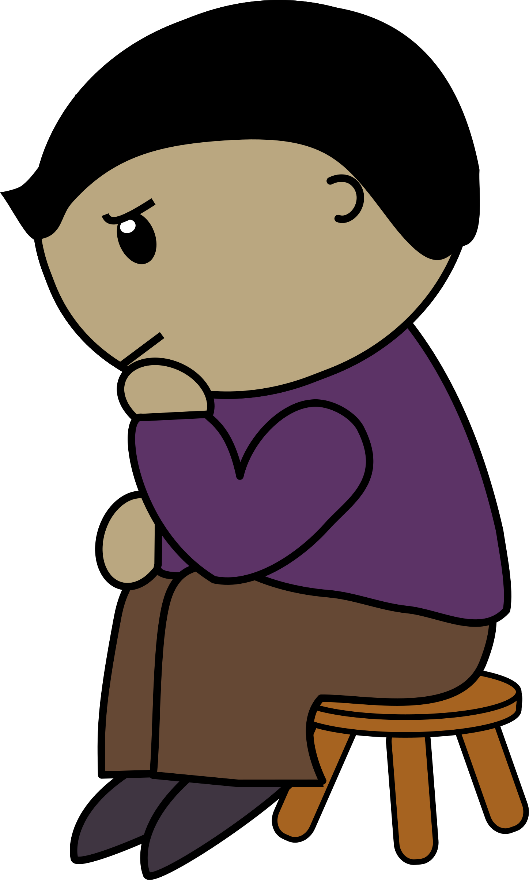
Issue Identification
ACTIVITY C
Your group has 10 minutes to:
Step 1- Review your problem
Step 2- Brainstorm possible solutions
Step 3- Identify ONE solution as the BEST organizing issue
Zone 1 Organizing Institute
Annapolis, MD
Notes:
In your local teams you are now going to refine your chosen organizing Issue.
You are going to assess the strength of your issue and make changes based on what we’ve covered this morning.

Slide 23

Activity C
widely felt
deeply felt
clear decision maker
non-divisive
develop leadership
groundwork for next campaign
winnable
Zone 1 Organizing Institute
Annapolis, MD

Slide 24

Identifying The Decision Maker(s)
There is a person, or small group, who could give us the solution to our problem if they wanted
Our job is to apply sufficient pressure through the union so that they give us what we want
This person is thus the “target” of our campaign
We pressure this person through strategic direct actions, or “tactics” in the language of organizing, that escalate in intensity over time
Zone 1 Organizing Institute
Annapolis, MD
Notes:
The decision maker(s) needs to be a person(s) with a name(s)
This person(s) holds the power to decide to give us what we want
They are influenced by other people, and we should pressure them as well
Do a simple “power map” of the target to determine points of leverage

Slide 25

Identifying decision maker(s)
The issue determines who our decision maker is!
Some common targets in Education are:
Building Principal
Chair of the School Board
Superintendent
Regional Superintendent
A specific legislator, or legislative committee
County Executive
Zone 1 Organizing Institute
Annapolis, MD

Slide 26
Excessive Coverages– Decision Maker
Building Principal
Teachers doing coverage
Assistant principals overseeing grade levels
Financial secretary coordinating coverage
Teachers missing staff members at collaborative planning
Department chairs coordinating plans for vacant positions
All roads point to… PRINCIPAL
Who else?
  Regional superintendent
  HR department
  Superintendent
Zone 1 Organizing Institute
Annapolis, MD

Slide 27
WHO IS YOUR TARGET?
ACTIVITY D- 5 MINUTES
STEP 1- List who you believe is your primary target.
STEP 2- List 3 reasons why you believe they have the power to give you what you want.
*You will share your target and your why in final activity.
Zone 1 Organizing Institute
Annapolis, MD

Slide 28
Activity D
List your target and 3 reasons why you believe they have the power.
Zone 1 Organizing Institute
Annapolis, MD

Slide 29

GOALS
Remember earlier? Goals are NOT issues. But they are important.
Goals are specific things we achieve in the course of, or as a result of, our campaign.
Goals can take two forms: internal and external
Zone 1 Organizing Institute
Annapolis, MD

Slide 30
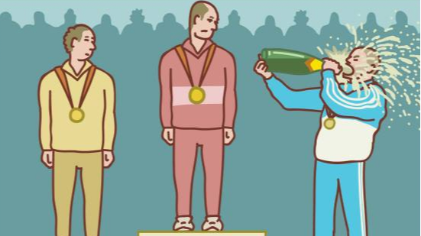
Why Goals Matter
Without them, we don’t know if we’ve succeeded or not
They discipline our plan campaign
We view the health and strength of our local as an important aspect of the campaign, not just winning THE THING ™
Zone 1 Organizing Institute
Annapolis, MD

Slide 31

INTERNAL GOALS
These are goals oriented internally to your local.
Zone 1 Organizing Institute
Annapolis, MD
Notes:
Increasing membership by a specific amount
Recruiting a specific number of new building reps or officers
Rebuilding dormant committees

Slide 32

EXTERNAL GOALS
These are goals oriented outwardly to your community and larger context
Zone 1 Organizing Institute
Annapolis, MD
Notes:
Examples include:
Assigning a consistent liaison to your local Parent’s organization
A joint work group with your local progressive religious organization
Regular lunch meetings with the County Executive

Slide 33

Coverage Issue example
Internal Goals:
  Increase membership to 90%
  Recruit 25 new building reps
External Goals:
  Liaisons assigned to attend every meeting of local civil rights organization
  5 positive news articles during campaign
Zone 1 Organizing Institute
Annapolis, MD

Slide 34

WHAT ARE YOUR GOALS?
ACTIVITY E- 7 MINUTES
STEP 1- Identify 2 internal goals
STEP 2- Identify 2 external goals
Zone 1 Organizing Institute
Annapolis, MD
Notes:
Okay, we’re almost there!
You have your issue, you have your target, now let’s figure out some goals.
You may come up with more, and that’s okay, but try to identify the 2 most important.

Slide 35
Activity E
Identify 2 internal and 2 external goals
Zone 1 Organizing Institute
Annapolis, MD

Slide 36
Final Activity!
STEP 1- Gather your team, and find another team at a table near you
STEP 2- Present your Campaign so far: Issue, Decision Maker, and 2 internal/external goals.
STEP 3- Provide feedback: Is the issue specific enough? Is it widely and deeply felt? Is the decision maker a specific person who we can influence? Are the goals clear and achievable?
3 minutes to Present / 2 minutes for feedback (SWITCH at 5!)
ACTIVITY F
Zone 1 Organizing Institute
Annapolis, MD
Notes:
Be brief! Team A has 2 minutes to present, Team B has 3 minutes to provide feedback
At 5 minutes SWITCH!

Slide 37
Activity F
Provide feedback:
Is the issue specific enough?
Is it widely and deeply felt?
Is the decision maker a specific person who we can influence?
Are the goals clear and achievable?
Zone 1 Organizing Institute
Annapolis, MD

Slide 38
Zone 1 Organizing Institute
July 9-12, 2024
Westin Annapolis
Annapolis, MD
Thank you!
Monet Reilly & Mike Magee

