Slide 1
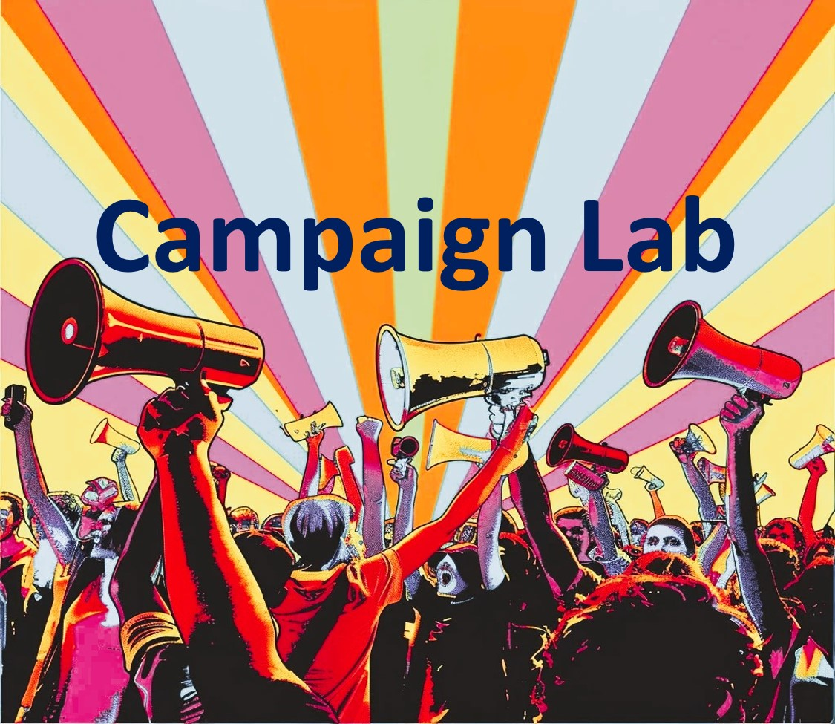
Foundations of Organizing and Winning Campaigns
NEA MEMBERS AND SUPPORTERS
By attending this training, you confirm that you are a NEA affiliate staff member. The information you receive here is only for your use in your capacity as an NEA affiliate staff member.
This presentation and its contents are confidential and may not be further distributed or passed on to any other person or published or reproduced, in whole or in part, by any medium or in any form, for any purpose. Audio/video recording, copying of slides, and the use of AI note-taking tools are prohibited without the written consent from Ellen Holmes. Violation of these terms may result in legal action.

Slide 2

NEA Standards of Conduct
NEA has adopted a Standard of Conduct Policy to ensure that all of our gatherings are welcoming to and free from discriminatory, harassing, or otherwise unacceptable behavior. Discrimination or harassment based on race, color, ethnicity, religion, sex, age, national origin, sexual orientation, disability, gender identity, or expression, or any other characteristic protected by law will not be tolerated. If you have experience any discriminatory or harassing behavior, please report the incident. Thank you for your commitment to ensuring a positive event for all.

Slide 3
Honoring This Space
We begin by acknowledging that through a history of colonization and brutality, we are currently on the traditional lands stewarded by generations of indigenous people.
We honor these indigenous people, all elders, past, present, and emerging. We are called to learn and share these learnings about this tribal history, culture, and contributions that have been suppressed in the telling of the story of what we now call the United States of America.

Slide 4
Session OUtcomes
We will leave this training with a campaign plan that works for you.
In the process we will discuss:
Key Issues and Problems
Designing Strategic Actions
Building Power through Organizing
Developing Structures to Win

Slide 5

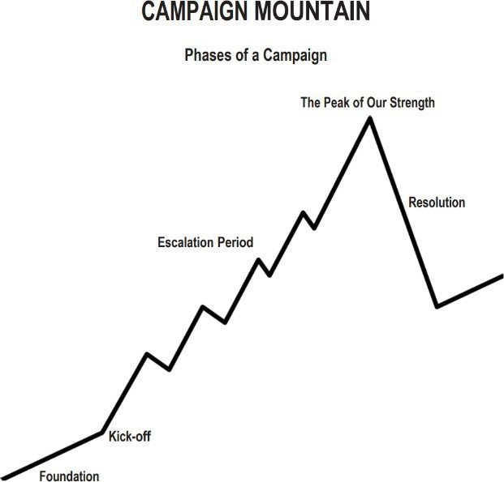
Key Parts of an IssuE Campaign
Centering Equity
Problem and Issue
Power Analysis
Target
Demand
Strategy and Tactics
Escalation
Timeline
Tactics (in order) of escalation
Benchmarks for each tactic
Timeline
Tactics (in order) of escalation
Benchmarks for each tactic

Slide 6
Key Practices of Campaign Planning
  •Involves a series of escalating actions (or tactics) that combine to solve a particular issue, that combine to win a demand
  •Increases pressure on decision-makers to give what will solve that issue
  •Builds power by increasing engagement, developing leaders, and building capacity around the values and shared pain of the common issue.
  •Identifies milestones that indicate we have enough power to take on larger actions and win!

Slide 7
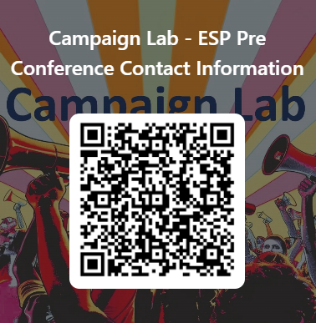
Campaign Lab Courses

Slide 8

Information and Application

Slide 9

Apply to be a Campaign Lab Coach
Possess an organizing and leadership mindset
Engages in peer problem solving and coaching
Campaign Coach
Holds coaching calls, with team 2 times a month
Coaches 1–2 local teams
Attends campaign coach training
Works with a mentor coach

Slide 10
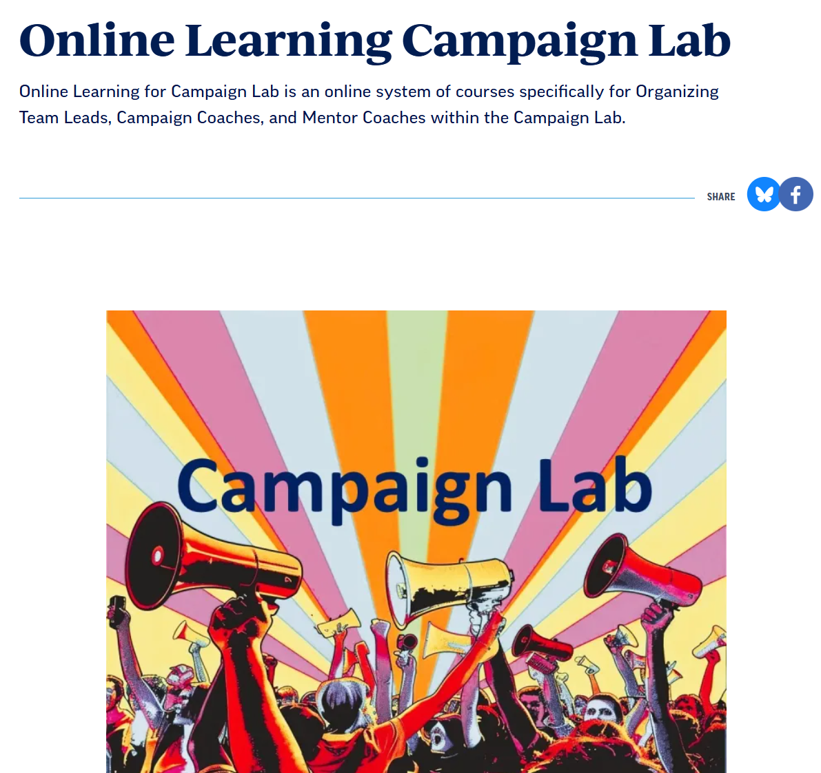
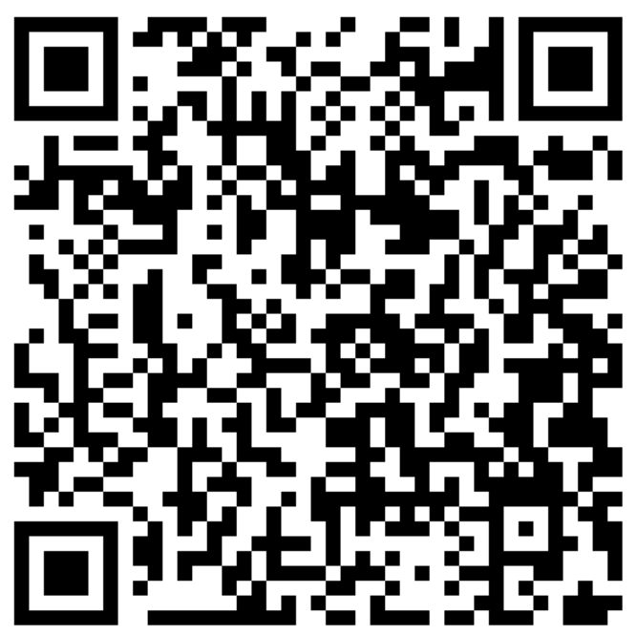
Online Learning Opportunities

Slide 11
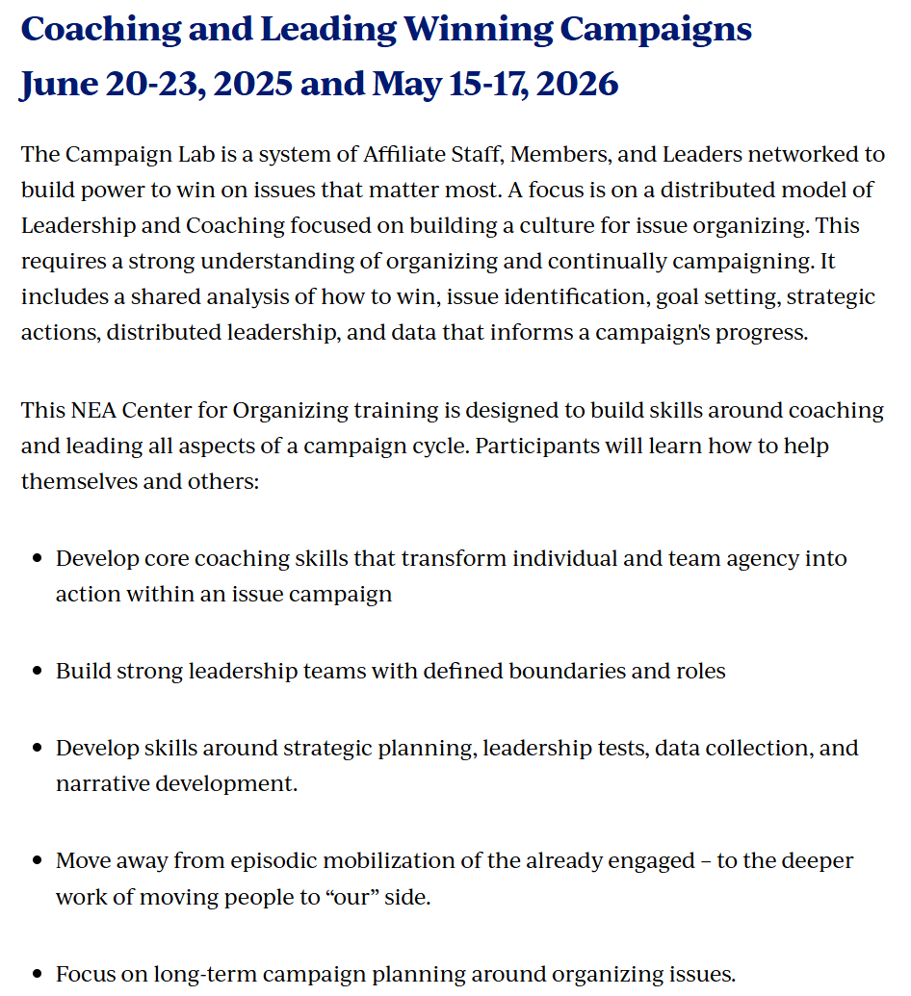
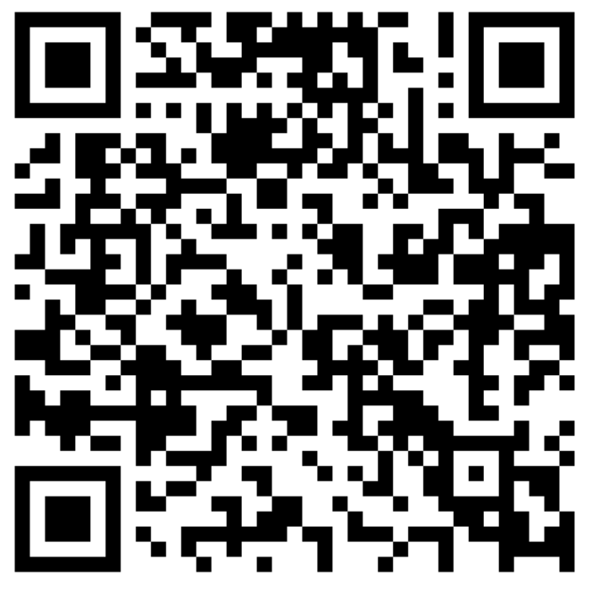


In Person Opportunities

Slide 12

Logistics to Remember
Questions to Ask
Bathroom
Materials
Food
Room Temperature

Slide 13

Community Agreements
Using Self-Awareness and Self-Knowledge
Listening for Understanding
Being Gracious
Staying Engaged
Being Open and Suspend Judgment
Saying “I”- tell your truth
Lean into Discomfort
Reaching Empathy
Expecting Non-Resolution and Non-Closure
*Adapted from “Embracing equity and inclusion”, Annie E. Casey Foundation
Notes:
Community Agreements for Our Time
Awareness and Self-Knowledge
This requires self-knowledge and self-awareness. Self-knowledge allows you to see what causes you pain and conflict and enables you to embrace your contradictions and inconsistencies. It allows the space to work on things about yourself that you are not happy with. In turn, self-knowledge helps to prevent you from projecting your negative aspects onto other people. Bringing your best self also requires that you have a positive attitude, are willing to deeply explore your perspectives and remain open to the perspectives and experiences of others.
Listening for Understanding
Be an active listener. Active listening involves paying full and careful attention to the other person, looking him or her in the eye, avoiding interruptions, reflecting your understanding, clarifying information, summarizing the other person’s perspectives and sharing your own. Remember that most people need time to open up and might not be willing to immediately share their personal stories, hopes, fears and/or concerns.
Being Gracious
Being kind is a vital way of bringing meaning to our own lives, as well as the lives of others. Kindness is about caring genuinely for others around you, wanting the best for them and recognizing in them the same wants, needs, aspirations and even fears that you may have. Being kind and generous allows us to communicate better with others, to be more self-compassionate and to be a positive force in other people’s lives. This includes following the COVID protocols that are in place to protect the health of this learning community.
Stay Engaged
Staying engaged requires you to be morally, emotionally, intellectually and socially involved in the conversation. Staying engaged means that you are listening with curiosity and willing to deepen your understanding. Staying engaged might also require you to sustain the conversation even when it gets uncomfortable or diverted. This also means a commitment to keeping your electronic communications to a minimum with folks not present in this learning community.
Be Open and Suspend Judgment
Listening with an open mind includes being receptive to the influence of others. You can suspend judgment by becoming aware of preconceived notions and listening to everything someone has to say before jumping to conclusions. Most importantly, suspending judgment also means listening to what the speaker has to say for understanding, not just to determine whether the speaker is right or wrong.
Say “I”- tell your truth
Speaking your truth in authentic and courageous conversations about race requires a willingness to take risks. It means that you will be absolutely honest and candid about your own thoughts, feelings, experiences and opinions and not just saying what you perceive others want to hear. Speaking your truth will require you to speak from the “first person” and use “I” statements.
Seek Discomfort
Leaning in to discomfort will require you to let go of racial understandings and stereotypes that you may be holding onto in order to move forward. Leaning in means that you will avoid judgment, assume positive intent and be open to the kernel of wisdom in each individual’s experiences. Leaning in to discomfort will require you to sit through moments of embarrassment, confusion, anxiety and/or fear.
Reaching Empathy
Empathy and compassion allow you to understand the other person’s point of view. When you are empathetic, you are more understanding, patient and kind. Expanding your capacity to feel empathy will also allow others to enter your circle of human concern.
Resolution and Closure
Expect and accept that there may not be closure. It is not likely that you will resolve your personal understanding about race or another person’s racial experience in a single conversation. The more you talk about race with another person, the more you learn and the more they will learn. Authentic and productive conversations about race are continuous and always evolving.
*Adapted from “Embracing equity and inclusion”, Annie E. Casey Foundation

Slide 14

Shout Out from Your Team
Name
Pronoun
Work Location

Slide 15
Highest Hopes
Ellen

Slide 16

If you had all the power you needed, what is the world you and your union would create?

Slide 17
Three Theories of Change
Kathy

Slide 18
3 Theories of Change Pages 4-7
Advocacy
“Advocacy is the work of creating change through the actions of professionals or technical experts—lobbyists, pollsters, lawyers, communication specialists, researchers. Advocacy relies on the expertise, status, and know-how of these groups of people to make change. Advocacy usually happens in a closed-door room; ordinary people play a small to nonexistent role in its efficacy. Advocacy has become a dominant strategy for unions and liberals.”
Mobilizing
“Mobilizing, by contrast, activates an already-convinced membership. Mobilizing encourages those who already support a cause or a mission to take action to defend their belief—for example, by attending a protest, wearing a button, or signing a petition.”
Organizing
“To organize is to build mass support and strength among ordinary people. Organizing draws its power from working people’s biggest strength: our numbers. The work of organizing is systematic and rigorous: It requires connecting with every single worker in a shop, every educator in a building, every building in a district. At its core, it asks people to understand their own agency and to make choices about how they will exercise it.”

Slide 19
Team Talk Pg. 7
Which of these theories do we mostly work in?
Which of these theories will build the power we need to achieve the BIG dreams we have?

Slide 20
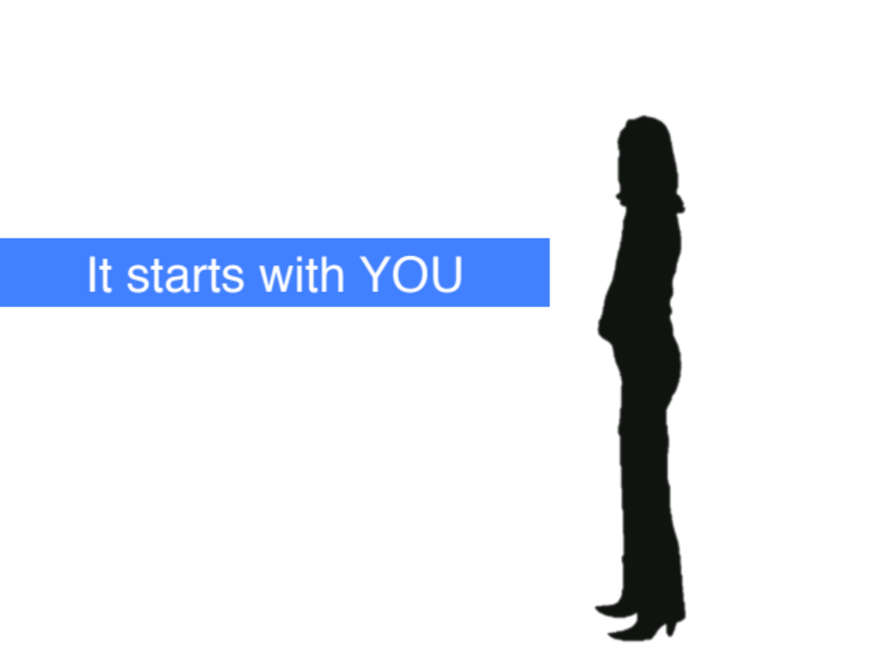
Moving towards Organizing Starts With YOU

Slide 21
Leaders Across these Theories
In the next slide, you will see three illustrations of leadership structures.
The lines represent relationship, resources, communication, and connectivity.
The circles represent people with accountability, responsibility, and knowledge.
Pay attention to WHERE the connections flow and fail, and where it is critical.

Slide 22
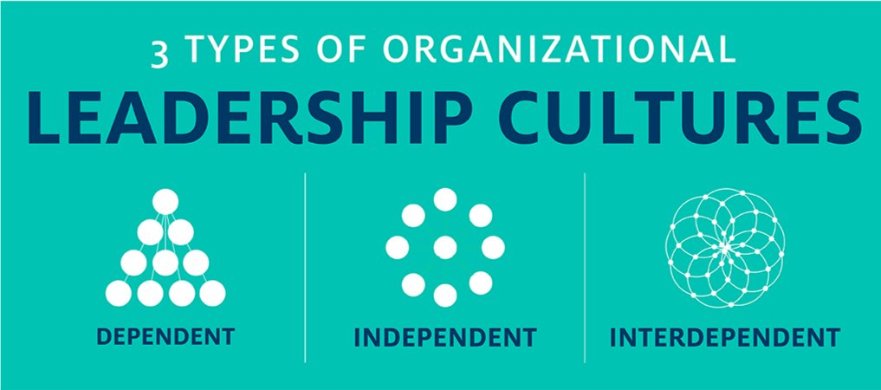
Leaders Across these Theories

Slide 23

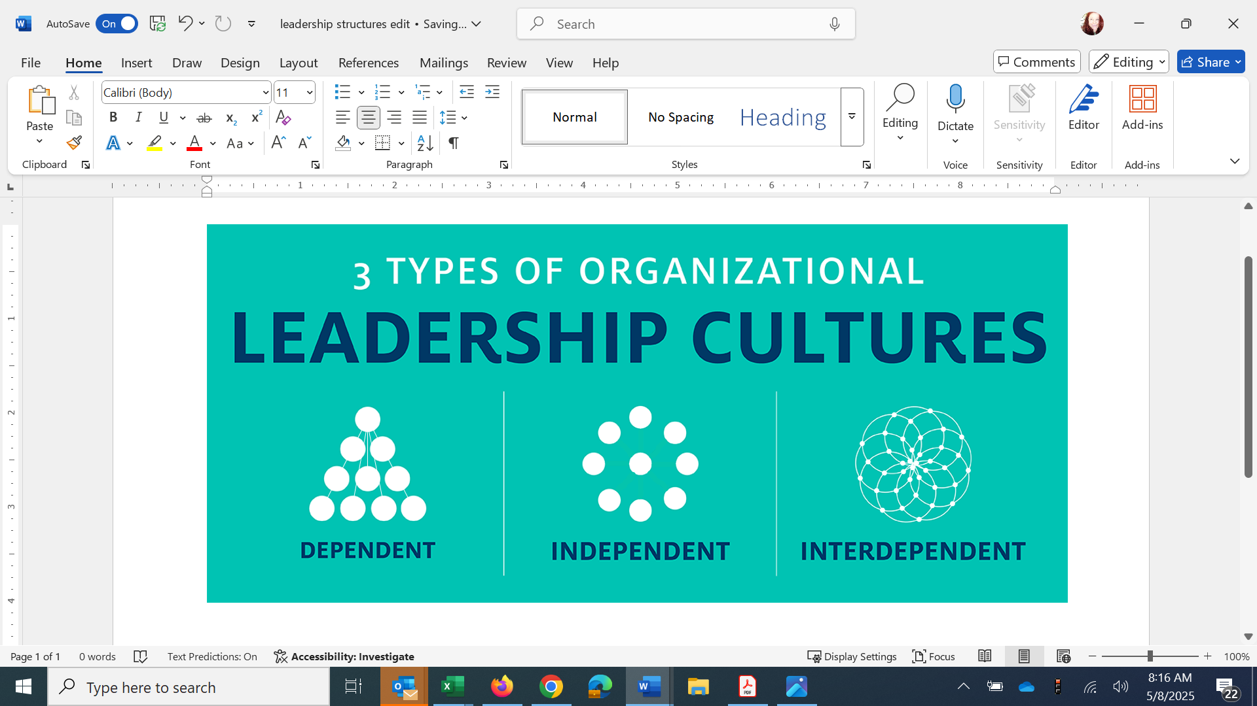
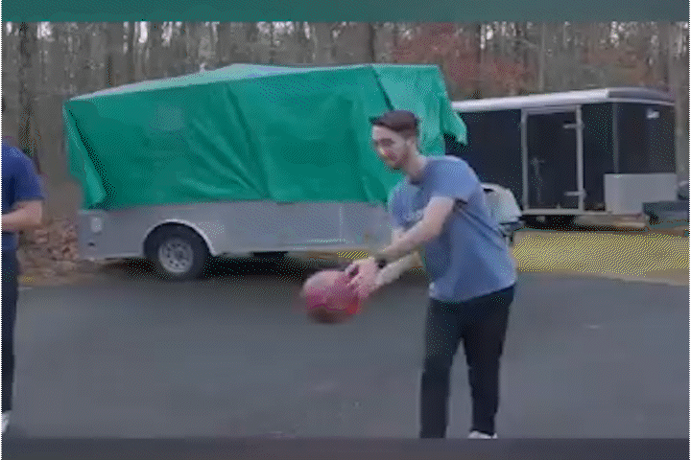
Leaders Across these Theories
If you are the only leader…

Slide 24

Leaders Across these Theories
If we are all leaders…

Slide 25
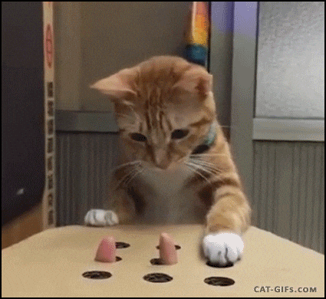
Leaders Across these Theories
If we are all leaders…

Slide 26
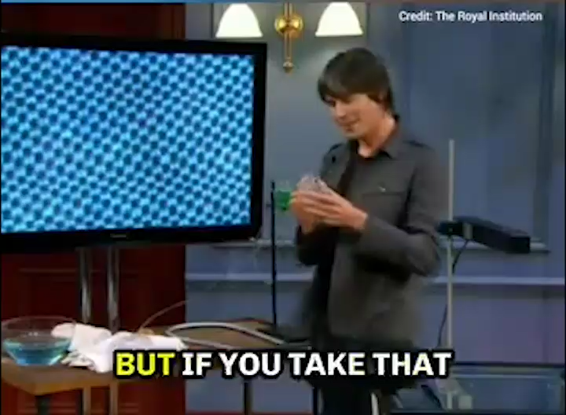
Leaders Across these Theories
Leaders Across these Theories

Slide 27
In each of these models, who holds the accountability and responsibility is different.
Remember, we build the most power when the members are accountable to one another and are responsible for the actions necessary to build that power.
If we hold the responsibility and are the only ones held accountable, the members are not building power to address the issues that are important.

Slide 28
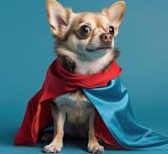
The Organizing ESP’s Basic Skills
Curious about others' issues
Asks Good Questions does not Tell Solutions
Listen 80%- Talk 20%
Be in a positive, public relationship with 75% of the members in your unit

Slide 29

The Organizing ESP's Basic Methods
One on One’s
Member Mapping
Member Lists
Data Collection
Team Coaching

Slide 30

Key Ideas
The skills, methods, and dispositions of organizing are the foundation of an issue campaign.
To move across these theories of change requires a shift in your ownership and leadership of the work in their union.

Slide 31
Organizing, Power, and Campaigns
Natasha and Jariza
Notes:
Jariza

Slide 32
What is organizing?
Organizing is identifying leaders and coordinating them into leadership teams
Building community and commitment around common goals
Building power from the resources of that community
Using that power strategically to make concrete change in the world
Notes:
Jariza

Slide 33


Ellen
Notes:
Natasha 15 minutes

Slide 34

Who is powerful?
What makes them powerful?

Slide 35
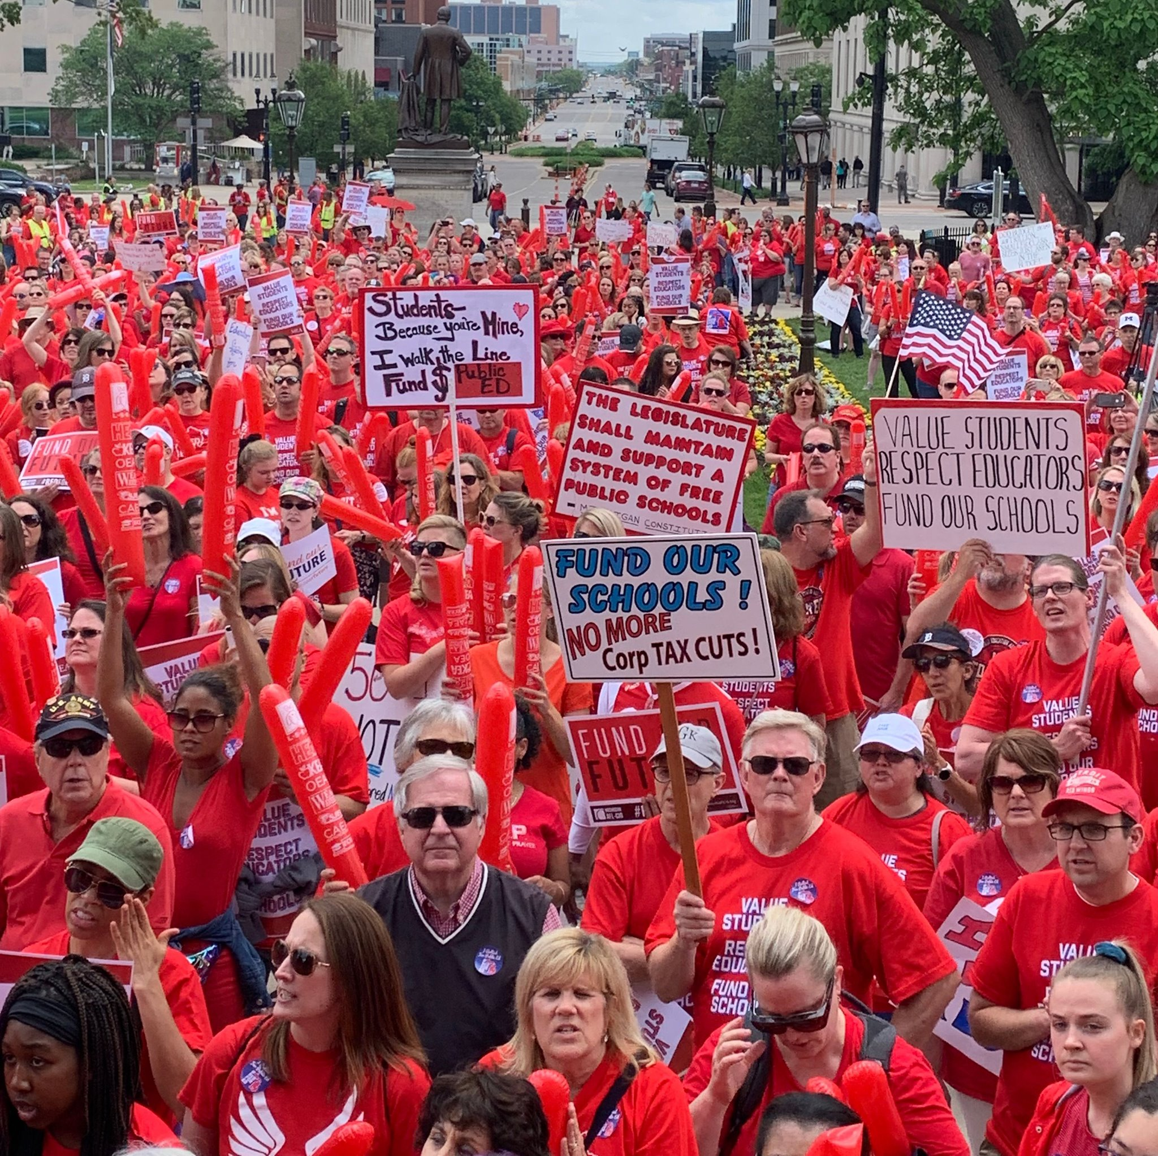

DEFINING POWER
Power is the ability to control, create, and prevent change.
Power is organized people and organized resources (money).
Power is not static, it is either waning or growing.

Slide 36

UNDERSTANDING POWER
Power is neutral
Our values affect the way we use power

Slide 37

TRUTHS ABOUT BUILDING POWER
Power has to be consistently built or it is waning
Not everyone wants us to have power and actively work to take our power away
Public actions through shared vision, shared purpose, shared resources, shared risk, and unity is how we build power
The bigger the win you want– the more power you need
Building power requires leadership

Slide 38
MEASURING OUR POWER
We measure power by our ability to wage and win campaigns that bring concrete improvements to people’s lives and lead to social, racial, and economic justice.

Slide 39
What do you think a campaign is?
Notes:
Jariza

Slide 40
From Marshall Ganz
An issue campaign is the process through which the workers organize around leaders and structures to use their resources in accomplishing goals that achieve the change they need and want. It is public. It involves risk. It results in the story being about the workers.

Slide 41
So how do we assess if an issue campaign has built our power?

Slide 42
Strength AND Growth

Slide 43
Strength AND Growth
Achievement of public actions and campaign demands are a show of our strength.
Issue campaigns ALSO grow membership, engagement, and leadership experience. This is a measure of our growth
We support local leader teams in making campaign plans to ensure these experiences are successful and grow unifying relationships through public, positive actions for members and leaders.

Slide 44
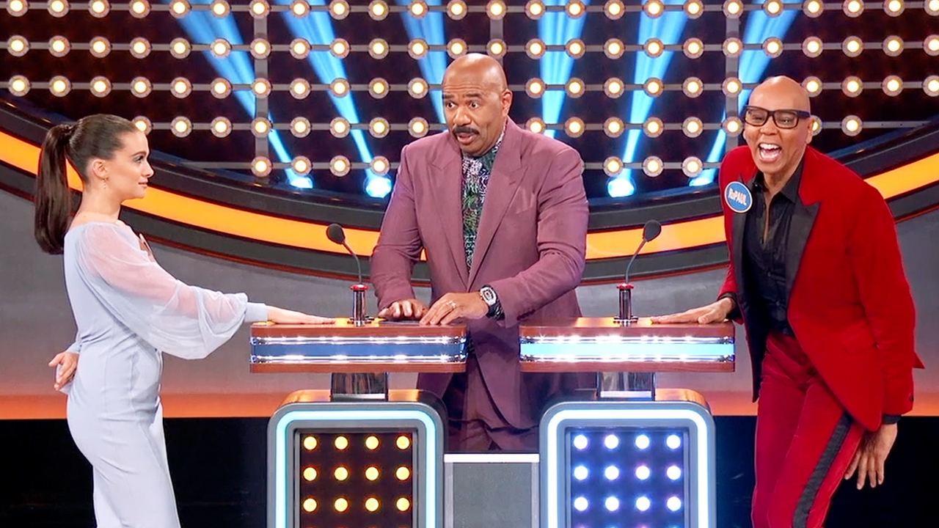
Is it an issue campaign?

Slide 45
Key Ideas
Issue Campaigns, designed well, result in the ability to achieve wins that make a positive, concrete difference in the lives of workers.
Issue Campaigns, Designed well, result in the growth of members, leaders, engagement, trust, unity, and all the nice things we want in a labor movement.
We measure both Strength and Growth

Slide 46
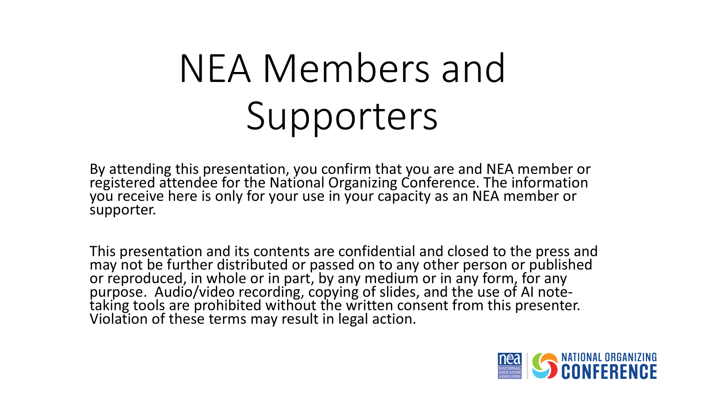

Slide 47
Building a Campaign
Ellen

Slide 49
Key Parts of an Issue Campaign p. 9
Problem and Issue
Power Analysis
Target
Demand
Strategy and Tactics
Escalation

Slide 50
How do you build a Campaign?
An action plan with a beginning, middle, and end, working towards a specific demand
  Involves a series of escalating actions (or tactics) that combine to solve a particular issue
  Increases pressure on decision-makers to give what will solve that issue
  Builds power by increasing engagement, developing leaders, and building capacity around the values and shared pain of the common issue.
  Throughout the campaign we identify milestones that indicate we have enough power to try something more and something bigger and win!

Slide 51
Campaigns are Strategic
Strategy involves asking:
  Who are my people (constituency)?
  What change do they need?
  How could they use their resources to build the power they need to achieve that change ?
Strategy is how to turn what you have” into “what you need” to get “what you want” - how to turn resources into power.
Strategy is an intentional plan

Slide 52

Key Idea
Campaigns involve a large diverse group of people, are member led, and increase power and visibility of their union

Slide 53
BREAK

Slide 54
Problem and Issue
Jeny and Kathy

Slide 55
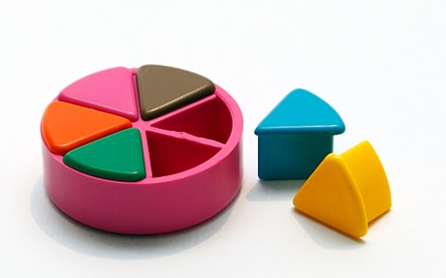
PROBLEM vs. ISSUE
A problem is the whole pie. Problems are vast, complex, and entrenched.
When we try to tackle a problem, we reinforce the hopelessness of the situation. We are trying to take on the full pie all at once.
Issues are the pieces of the pie. It’s a small chunk of the larger problem that we can make progress on, and in turn we are slowly taking on the full problem over time.
Notes:
What are some “red flags” to look out for when identifying the issue?

Slide 56
Issue
An issue is a slice of the larger problem that is manageable and solvable.

Slide 57

PROBLEM vs. ISSUE

Slide 58
Values
Values are fundamental beliefs that dictate behavior
Ideally, Unions advance the welfare of all members.
They are based on the universal ideal of human rights, the idea of justice, progress, and betterment of self and of society.
Through shared values, members build solidarity and commit to active participation in the labor movement.
Shared values transform individual members into part of something larger than themselves.

Slide 59
How to Link Issues and Values
Investigating member issues is necessary but not sufficient – we also need to identify workers’ SHARED values –
WHY is this an issue?
WHY do you want to fix this?

Slide 60
Some Union Values
Fairness, honesty/integrity, responsibility, compassion/empathy, safety, health, generosity, hard work/responsibility, community, freedom, democracy, binding contracts, equality, opportunity, respect, stability/security, unity, quality work, justice, collective action, dignity/respect, charity/community service, and due process.

Slide 61
EXAMPLES- Problems to Issues + Values
VALUES – Public Schools should be safe, equitable, and inclusive learning and working environments for all people.
PROBLEM -Our school is hostile to LGBTQ+ staff and students
  ◦ Issue Cut – There are no gender inclusive bathrooms and/or transgender students and staff are forced to use the wrong restroom.
PROBLEM - Our school reinforces racism and devalues the experiences of marginalized populations
◦ Issue Cut– Books are being banned.

Slide 62
Key Ideas
Problems are big conditions of injustice
Issues are the smaller member identified components that make up the problem
Issues indicate a path to action
Values build a relatable why across people experiencing the pain of the problem
We intentionally work to connect members around issues and values to build Solidarity

Slide 63
TEAM WORK – The Problems Pg 12-13
List the problems that you and your members want to improve – these are BIG
For each of the problems you identify – try to think what the values are that are behind WHY you see this as a problem.
Example Problem – We want quality health care for everyone
Values behind wanting to fix this – equity, fairness, dignity
List your problems and values on your charts.

Slide 64
Key Ideas
We listen for the values as we talk about problems.
This is how we build solidarity.

Slide 65
TEAM WORK – Problems into Issues Pg 12-13
Example Problem – We want quality health care for everyone
Values behind wanting to fix this – equity, fairness, dignity
Possible Issues –
Not enough providers in our rural system
Values – access and equity
Drugs are not affordable
Values – fairness and access
No coverage for home health options
Values – equity and dignity
Cut your problems into issues on your charts.

Slide 66
Assessing Our Issues
Widely felt and/or deeply felt.
  The pain can be felt by just one, but the injustice of that pain is shared by many.
  The pain AND the injustice of that pain is felt by many.
Winnable.
Builds the union and builds leaders.
Has a connection to students and the public.
Secrets of a Successful Organizer “A Good Organizing Issue” handout

Slide 67
TEAM WORK – Problems into Issues
In your group, spend a few minutes evaluating an issue you identified from the scenario

Slide 68
Target and Demand
Natasha

Slide 69
Target

Slide 70

A Target Is
The person with the power to give you what you are demanding.
This person
Has a name
Has a face
Has an address

Slide 71
Targets also have VALUES
Values:
What are the target’s values?
What causes them to act?
What is behind their WHY?

Slide 72
Targets also have RELATIONSHIPS
Relationships:
What relationships does the target have?
Who influences the target?
Who are the target’s allies and opponents?

Slide 73
Targets also have SELF INTEREST
Self Interest:
Remember, self-interest is how the values look like in the world. What are the ways that the target wants to make their values real in the world?
What are the target’s goals?
What does the target care about?
What motivates the target to act?
Possible examples: maximize profits, cut costs, weaken unions, have good public image, get re-elected, etc.

Slide 74
Targets also have POWER
Power:
What power does the target have and where does their power derive from?
How do they organize people?
How do they organize money and resources?

Slide 75
TEAM WORK – Target and Analysis p.14
You identified an issue, now, identify the TARGET who has the power to fix this.
Name them and then build a chart that answers the following about the TARGET:
  Values
  Relationships
  Self Interests
  Power

Slide 76
Key Ideas
Everyone has values, each one of us, our members, our organizations, our allies, our opponents, and our targets.
Understanding the values of the members, of our Target, and our allies is critical in order to build an effective campaign.

Slide 77
Demand

Slide 78
Demand:
“Hey TARGET,
we demand ACTION
because HARM or IMPACT!”

Slide 79
Demand:
Hey Superintendent Sam: We demand gender affirming bathrooms in every school because all students and staff need to feel safe and included in our schools. ”

Slide 80
REVIEW
Issue: A slice of a workplace problem that is deeply/widely felt, winnable, and will build our power.
Power: The ability to control, create and prevent change. Power is organized people and organized resources (money).
Target: Is the person with the power to give you what you are demanding.
Demand: the outcome that addresses the issue that you are making directed at a target.

Slide 81
TEAM WORK – Demand p.13
Use your Issue and Target.
Draft at least one demand of your Target that resolves your issue and linked to YOUR VALUES

Slide 82
Key Ideas
A powerful demand makes clear who has the power to make the change that’s needed
We can only build a powerful demand when we have taken the steps to accurately identify the issue and determine who has the power to create change

Slide 83
Spectrum of Allies
Ellen and Jariza

Slide 84

Spectrum of Allies Part 1
  Active allies: people who agree with you & are organizing alongside you
  Passive allies: people who agree but aren't doing anything about it (yet!)
  Neutrals: people who aren't sure, or are unengaged (they might just not know about you yet)
  Passive opponents: people who disagree, but aren't trying to stop you
  Active opponents: people who have done something to prevent you from reaching your goal

Slide 85

Share Out Spectrum of Allies

Slide 86
Focusing your tactics matters
Only the Opposition – cynicism
Only the Active Allies – stagnation
Generalizations about Slices – missed opportunities
DO FOCUS ON THE PASSIVE ALLIES
  These are folks who know or care about what you’re up to, but aren’t doing anything about it! Give them a chance to participate and build power with you.
THE GOOD NEWS
  It is only necessary to move some or all of the pie wedges one step in your direction. If we shift each wedge one step, we are likely to win, even if the hardliners on the opponent’s side don’t budge.

Slide 87
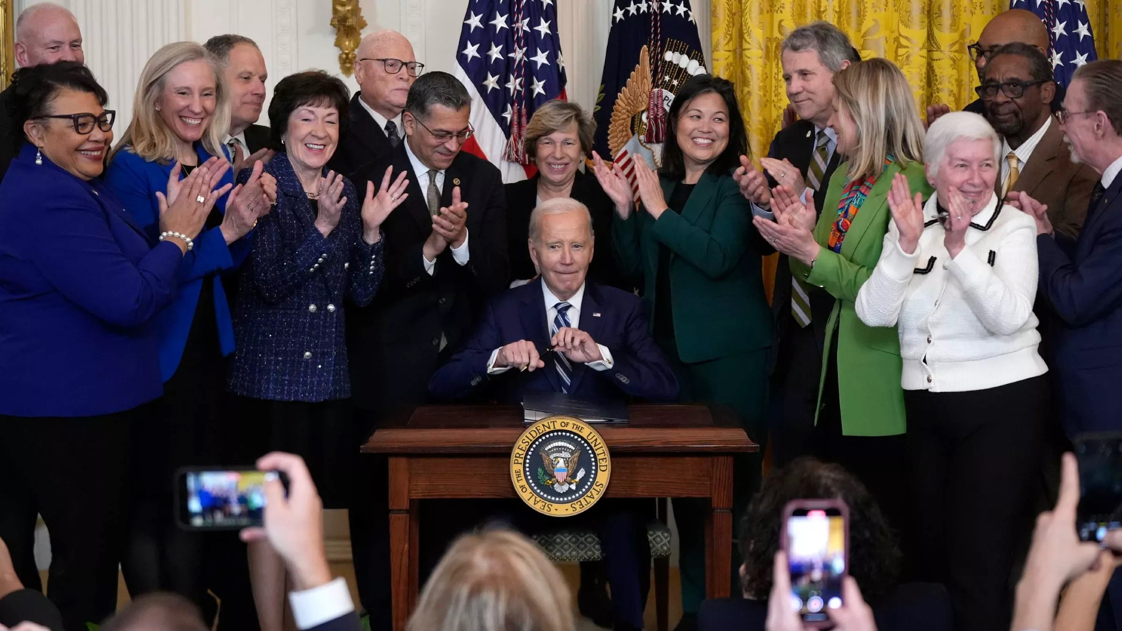
Current example – Social Security Fairness Act Passes.

Slide 88
Spectrum of Allies Part 2
Develop a convincing argument or values-based narrative that will appeal to each wedge.
2. Design one small achievable ask to engage one individual from that wedge to move closer to you.

Slide 89
Team Pair Share of Spectrum of Allies

Slide 90
Spectrum of Allies Debrief – Whole Group
How did it feel to present your arguments for how to move your wedges?
What is something new you learned from this or from another team?
What do you think you could apply to your current work?

Slide 91
Key Ideas
It is only necessary to move some or all of the pie wedges one step in your direction.
If we shift each wedge one step, we are likely to win, even if the hardliners on the opponent’s side don’t budge.

Slide 92
Strategy and Tactics
Jeny

Slide 93
What do you think is the difference between a strategy and a tactic?

Slide 94
Strategy
Strategy: The way we use our power to win our demand. It is a series of tactics aimed at putting pressure on the target to meet our demand.

Slide 95
Tactics
Tactic: Actions we take as a part of an escalation plan that increases pressure on the target to win our demand.

Slide 96
What makes good tactics?

Slide 97
Tactics Must:
Put pressure on your Target
(puts them out of their comfort zone)
Build your Power
(develops leaders, brings more people in, etc.)
Be Strategic

Slide 98
Key Ideas
Tactics allow workers to:
Share Resources, Values, and Commitment
Take risks together and achieve shared wins
Build trust in their own agency and the collective effectiveness of their union

Slide 99
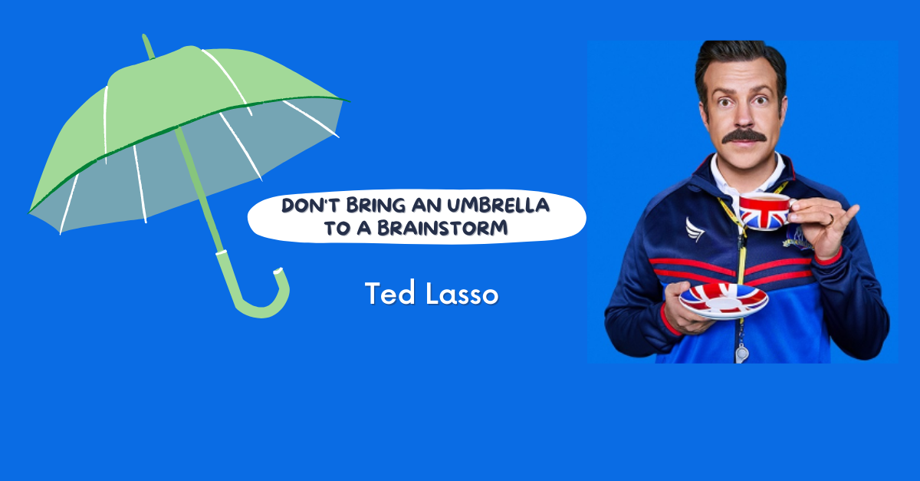
TEAM WORK – Tactic Brainstorm
Brainstorm AS MANY tactics as you can on 1 chart.
•Be creative!
•You are NOT evaluating right now! Everything goes on the board!

Slide 100
Team Work
Evaluate your tactics
Decide which tactics that you came up with are strategic based on the evaluation criteria
CIRCLE the tactics you decide are strategic
CROSS OUT the tactics you decide are not strategic

Slide 101
Evaluating Tactics
Put pressure on your Target.
Build your Power.
Be Strategic.
Notes:
Chart paper around room with brief dircetions

Slide 102
Evaluating Tactics
Does the action relate to your issue?
Does it align with your values?
Will it increase the pressure on the decision-maker?
Is it visible?
Is it timed for effect?
Is it new and different—or tried and true?
Are enough people ready to do it?
Will it unify people?
How will management react?
Does it violate the law? (If so, are we prepared for the consequences?)
Will it be fun?

Slide 103
Compression Points &
Escalation
Jariza and Kathy

Slide 104


Slide 105
Compression Points
Points on the calendar where you celebrate short term wins or escalate your tactics.
◦Naturally occurring deadlines- Breaks, Board Meetings
◦Artificial deadlines-target has till day X to act
◦Help us build urgency and crisis

Slide 106

Why do you think tactics escalate gradually?

Slide 107
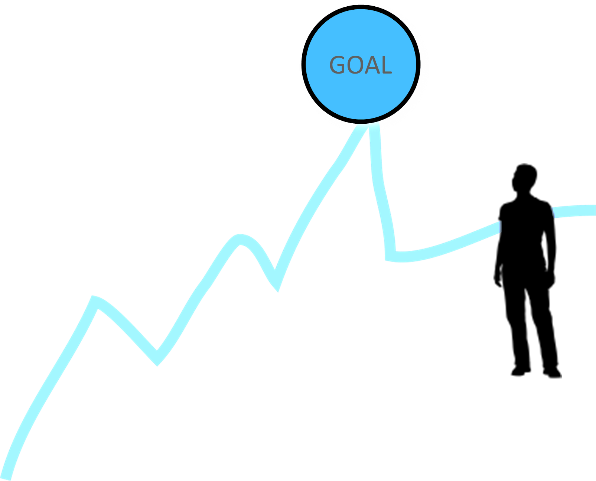
Less escalated actions prepare our people for more escalated actions
Gives us information about our readiness for the next step and how much pressure your target is able to sustain
Give the target the opportunity to do the right thing before things escalate
The threat of escalation can be as powerful as actual escalation

Slide 108
TEAM WORK – Escalation of Tactics
Return to the tactics chart you just made
Arrange them in an order that has the least visible, least risky tactic to highest visibility highest risk

Slide 109
Key Ideas
An escalating campaign is held together by a set of values and shared commitment to a demand.
Escalating tactics are how we develop leaders, identify new leaders, move more people into our base.
If we are organizing, we are always climbing campaign mountain

Slide 110

What will you take with you into your future work?
Closing our time together…

Slide 111
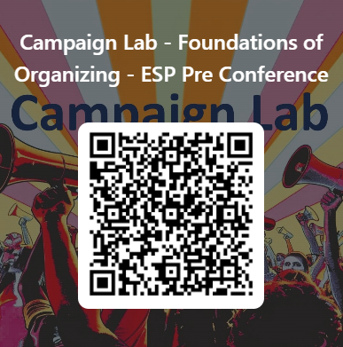
Feedback time
Goal – 100%Participation​
6 Short Questions​
We use what you give us

Slide 112
