Slide 1
Campaign Academy:
Coaching and Leading Winning Campaigns
Baltimore, 2025

Slide 2

Campaign Academy
By attending this training, you confirm that you are either an NEA affiliate staff person or NEA member in good standing. The information you receive here is only for your use in your capacity as an NEA affiliate staff person or NEA member.
This presentation and its contents are confidential and may not be further distributed or passed on to any other person or published or reproduced, in whole or in part, by any medium or in any form, for any purpose unless written consent has been provided by Ellen Holmes. Audio/video recording, copying of slides, and the use of AI note-taking tools are prohibited without the written consent from Kyle Serrette. Violation of these terms may result in legal action.

Slide 3
Honoring This Space
We begin by acknowledging that through a history of colonization and brutality, we are currently on the traditional lands stewarded by generations of indigenous people.
We honor these indigenous people, all elders, past, present, and emerging. We are called to learn and share these learnings about this tribal history, culture, and contributions that have been suppressed in the telling of the story of what we now call the United States of America.

Slide 4

Key OUtcomes
Participants will understand: Why the Campaign Lab exists How the Campaign Lab operates to support and network local campaigns What is expected for participation in winning Campaigns

Slide 5
Overall Agenda
Friday (Coaches, Mentor Coaches)
  5:00-8:00 Meeting
Saturday (Coaches, Mentor Coaches)
  7:30-8:30 Breakfast
  8:30-Noon Meeting
  12:00-1:00 Lunch
  1:00-4:30 Meeting
  4:30-5:00 Networking and Adjourn
Sunday (Everyone)
  7:30-8:30 Breakfast
  8:30-Noon Meeting
  12:00-1:00 Lunch
  1:00-4:30 Meeting
  4:30-5:00 Networking and Adjourn
Monday (Everyone)
  7:30-8:30 Breakfast
  8:30-1:00 Meeting
  1:00 Adjourn, Lunch on your own

Slide 6
Tonight’s Agenda and Outcomes
5:00-6:30 Welcome’s and Why
6:30-8:00 Basics of a Coaching Framework
Coaches and Mentor Coaches will understand why the Campaign Lab is needed in this moment and how Coaching supports our theory for supporting and networking winning campaigns.

Slide 7
Logistics to Remember
Questions to Ask
Bathroom
Materials
Food
Room Temperature
PEPs Portal

Slide 8
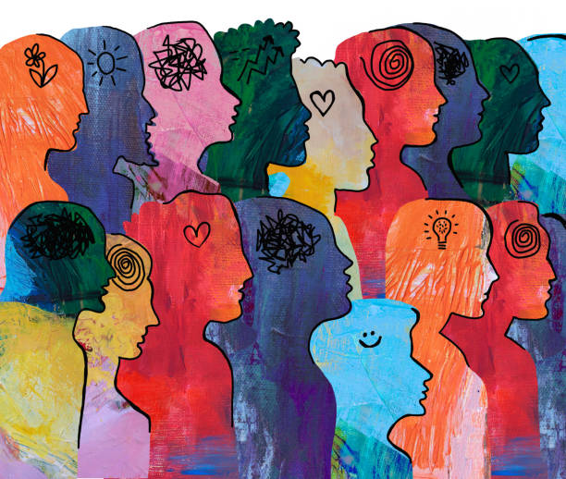
Shout Out from Your Team and Around the Room
Name
Pronouns
Work Location

Slide 9

Community Agreements
Using Self-Awareness and Self-Knowledge
Listening for Understanding
Being Gracious
Staying Engaged
Being Open and Suspend Judgment
Saying “I”- tell your truth
Lean into Discomfort
Reaching Empathy
Expecting Non-Resolution and Non-Closure
*Adapted from “Embracing equity and inclusion”, Annie E. Casey Foundation
Notes:
Community Agreements for Our Time
Awareness and Self-Knowledge
This requires self-knowledge and self-awareness. Self-knowledge allows you to see what causes you pain and conflict and enables you to embrace your contradictions and inconsistencies. It allows the space to work on things about yourself that you are not happy with. In turn, self-knowledge helps to prevent you from projecting your negative aspects onto other people. Bringing your best self also requires that you have a positive attitude, are willing to deeply explore your perspectives and remain open to the perspectives and experiences of others.
Listening for Understanding
Be an active listener. Active listening involves paying full and careful attention to the other person, looking him or her in the eye, avoiding interruptions, reflecting your understanding, clarifying information, summarizing the other person’s perspectives and sharing your own. Remember that most people need time to open up and might not be willing to immediately share their personal stories, hopes, fears and/or concerns.
Being Gracious
Being kind is a vital way of bringing meaning to our own lives, as well as the lives of others. Kindness is about caring genuinely for others around you, wanting the best for them and recognizing in them the same wants, needs, aspirations and even fears that you may have. Being kind and generous allows us to communicate better with others, to be more self-compassionate and to be a positive force in other people’s lives. This includes following the COVID protocols that are in place to protect the health of this learning community.
Stay Engaged
Staying engaged requires you to be morally, emotionally, intellectually and socially involved in the conversation. Staying engaged means that you are listening with curiosity and willing to deepen your understanding. Staying engaged might also require you to sustain the conversation even when it gets uncomfortable or diverted. This also means a commitment to keeping your electronic communications to a minimum with folks not present in this learning community.
Be Open and Suspend Judgment
Listening with an open mind includes being receptive to the influence of others. You can suspend judgment by becoming aware of preconceived notions and listening to everything someone has to say before jumping to conclusions. Most importantly, suspending judgment also means listening to what the speaker has to say for understanding, not just to determine whether the speaker is right or wrong.
Say “I”- tell your truth
Speaking your truth in authentic and courageous conversations about race requires a willingness to take risks. It means that you will be absolutely honest and candid about your own thoughts, feelings, experiences and opinions and not just saying what you perceive others want to hear. Speaking your truth will require you to speak from the “first person” and use “I” statements.
Seek Discomfort
Leaning in to discomfort will require you to let go of racial understandings and stereotypes that you may be holding onto in order to move forward. Leaning in means that you will avoid judgment, assume positive intent and be open to the kernel of wisdom in each individual’s experiences. Leaning in to discomfort will require you to sit through moments of embarrassment, confusion, anxiety and/or fear.
Reaching Empathy
Empathy and compassion allow you to understand the other person’s point of view. When you are empathetic, you are more understanding, patient and kind. Expanding your capacity to feel empathy will also allow others to enter your circle of human concern.
Resolution and Closure
Expect and accept that there may not be closure. It is not likely that you will resolve your personal understanding about race or another person’s racial experience in a single conversation. The more you talk about race with another person, the more you learn and the more they will learn. Authentic and productive conversations about race are continuous and always evolving.
*Adapted from “Embracing equity and inclusion”, Annie E. Casey Foundation

Slide 10

What does a Loving Community or School look like?

Slide 11
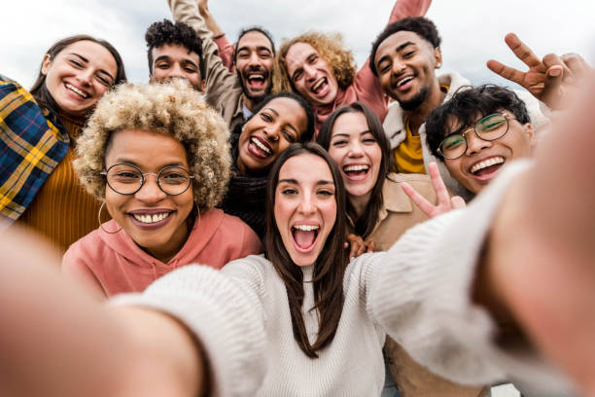
Picturing a Future
Open your phone and a picture that represents what you think a school or community built on love looks like.
We will be repeating at least 3 rounds of the following:
  For each round you and ONE partner THAT YOU DON’T ALREADY KNOW will have three minutes TOTAL, 90 seconds each, to share:
        Your name
        Where you are from
        WHY you selected this picture

Slide 12
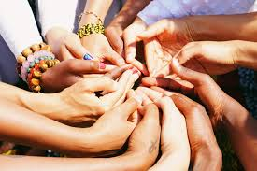
What did your picture look like?
How did you feel when you were presenting or listening ?
What are some common themes that you heard across the introductions?
How do we achieve this?
Can we do this alone?

Slide 13
Why the Campaign Lab?
Carrie and Amanda

Slide 14

Our conversation right now in Campaign Lab
Where are we now? ​
Where are we trying to get to? ​
How will we get there?

Slide 15
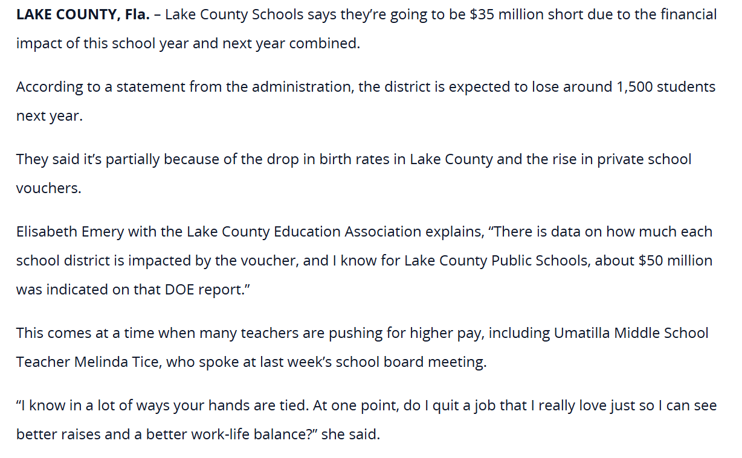
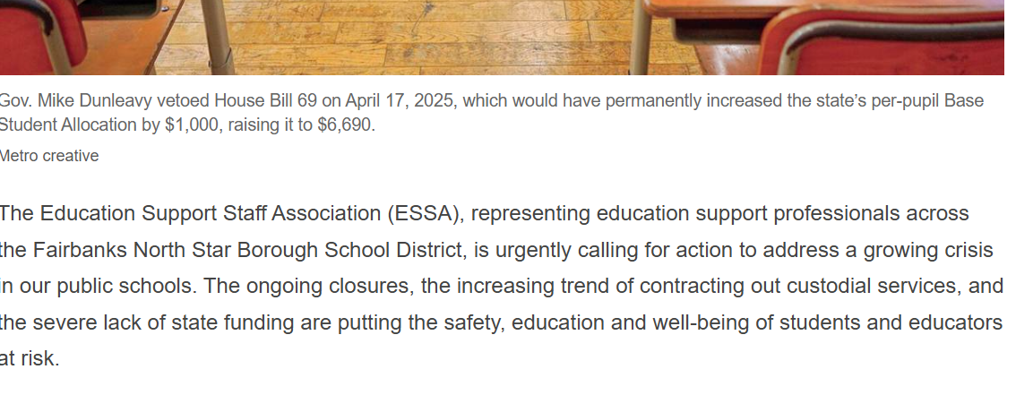
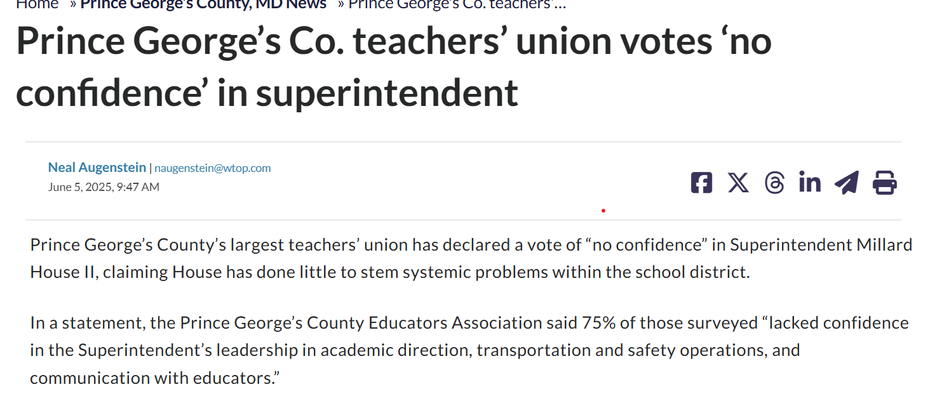
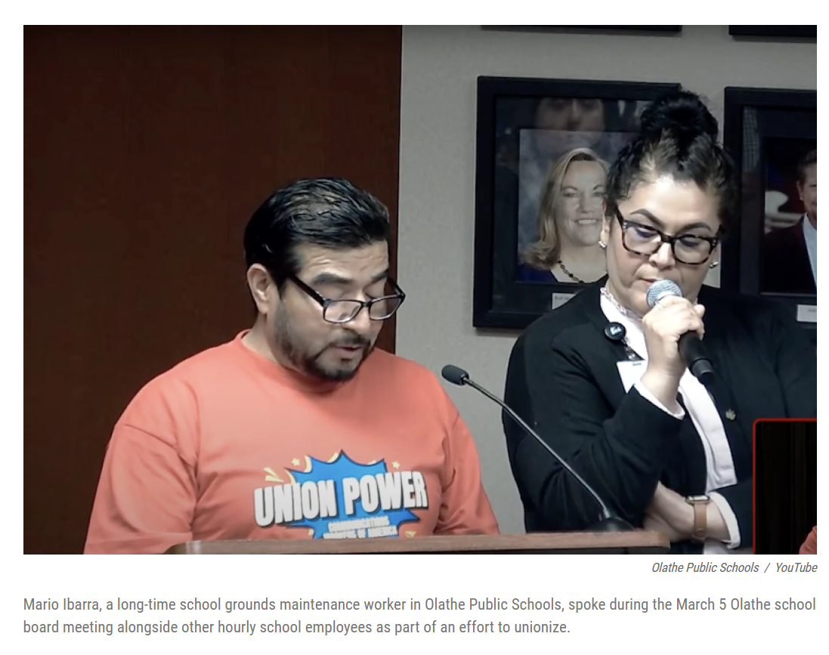
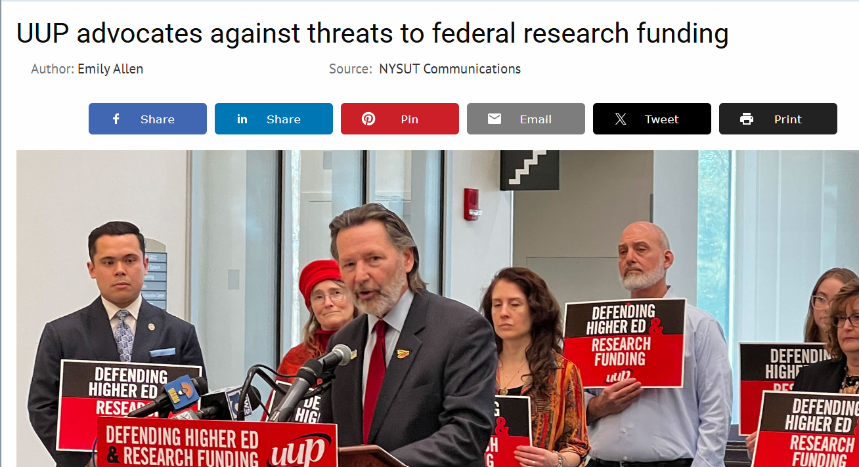
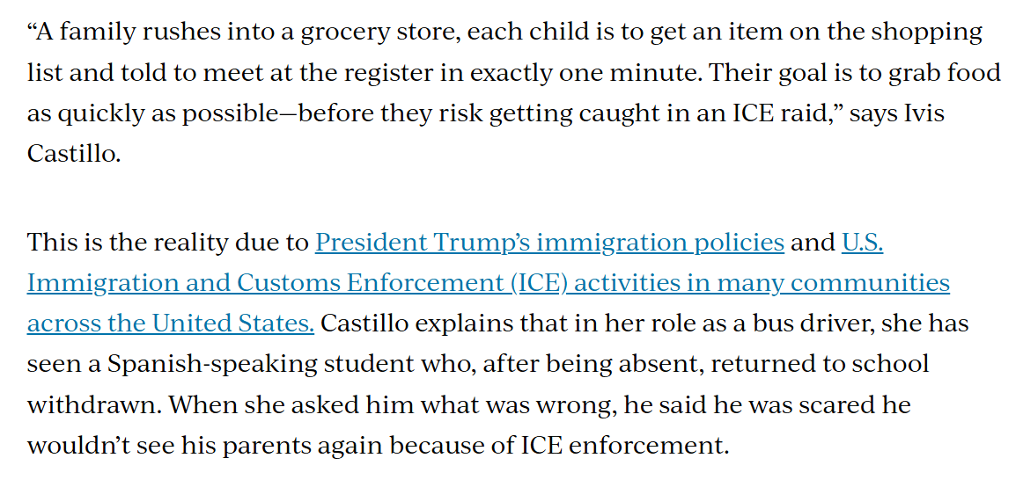
What and who are you up against?

Slide 16

What are the impacts on
your coworkers?
your students?
your community?

Slide 17

Why?
Why is this happening? What is the root cause?
Who is benefiting from what's happening ?
What is their vision for our public schools and higher education?
Notes:
12 min. Let's take a moment. How have the attacks impacted our schools and our communities? 6 min. Find someone to pair with to share. 6 min Group discussion
15 min. By small groups: Each table discusses one of these questions. (Facilitators can pop in for guidance as needed.)
Shared analysis -

Slide 18
What's at stake and how do we talk about it?
    What's at stake for public education?
    Public school workers?
    Public school students?
    Families and communities that public schools serve?
    Our regions and country?

Slide 19

What are you being called upon to do?
And how can you build the power needed to win your vision through Campaign Lab?

Slide 20
Centering Equity
Albert and Ellen

Slide 21
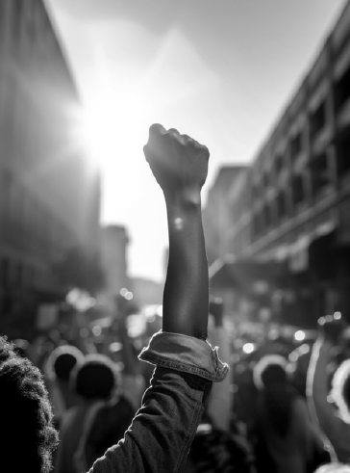
You shared pictures that embodied a loving school and leaned into why Campaign Lab exists.
Who is needed to solve these problems?
Name PEOPLE, not organizations

Slide 22
What type of union builds power?
Campaigns
Public Action and Demands
Strategic and Ongoing
Continues to Add
  Base – Mobilizers - Leaders
  Allies – Partners - Coalitions
  Requires Risk
  Supported by Staff
  Leaders Build and Use Power
Programs
Build Presence
Episodic
Member Recruitment
Committee/Program Leaders
Low Risk
Often Staff Led
Power in Policy

Slide 23
Centering Race, Class, and Gender Justice
Race, class, and gender justice is the systematic fair treatment of people resulting in equitable opportunities and outcomes for all.
It is not just the absence of discrimination and inequities, but also the presence of deliberate systems and supports to achieve and sustain race, class, and gender equity through proactive and preventative measures.

Slide 24

Centering Equity in your Campaigns Tool
What they do:
Proactively seek to both eliminate systemic barriers and advance equity
Identify clear goals, objectives and measurable outcomes
Develop mechanisms for successful implementation
What they are:
A set of questions used to anticipate, assess, and prevent potential adverse consequences of proposed actions on different race, class, or gender groups.

Slide 25
Would the campaign(s) your coaching have answers to these questions or be able to say most components of these tools are a part of their campaign?
What is something you noticed that could support your coaching?

Slide 26
Factors that Support the Centering Equity in your Campaigns Tool
Buy in from the organization and its leaders
Routine and ongoing use of the RET
Data- driven assessment
A commitment to making changes
Tenacity – A commitment to overcoming obstacles to making changes
WE HAVE TO DECIDE TO DO THINGS DIFFERENTLY AND STICK WITH IT

Slide 27

Key
Points
Intentional campaigns, not programs build power.
Centering race, class, and gender justice in our campaigns increases the people engaged, the number of leaders involved, and the amount of resources we have to win the change we want.
Power is only built through people with a shared vision, making public commitments to act, to risk their collective resources, for the meaningful change they want.

Slide 28
Why Coaching?
Albert and Ellen

Slide 29
From our reading... Three Theories
“To organize is to build mass support and strength among ordinary people. Organizing draws its power from working people’s biggest strength: our numbers. Working people may or may not see themselves as activists or politically active or even in political agreement, but through organizing, they come together to act in common cause. The work of organizing is systematic and rigorous: It requires connecting with every single worker in a shop, every educator in a building, every building in a district. At its core, it asks people to understand their own agency and to make choices about how they will exercise it. The work of organizing is difficult; ordinary people are seldom confronted by their own agency nor asked to make choices that recognize their own power.”

Slide 30

Time to Talk
Given this what is the role of coaches in the Campaign Lab?

Slide 31
Coaching enables others to understand their own agency and make decisions about how to act in the face of uncertain outcomes.

Slide 32
From our reading... The Taking Stock Report
“In order to generate the power needed to rise to the occasion, labor unions and community organizations will need to come together in partnership. The union movement is one of the few forces capable of mobilizing working families en masse to prevent the US from succumbing to MAGA authoritarianism. Education unions are uniquely positioned because they already have a workplace presence in most neighborhoods across the country. Organized communities have ears to the ground on how to build power at the local level and mobilize communities across different neighborhoods. Together they can build power to not only protect, but to strengthen our democracy for future generations.”

Slide 33

Power is
  The ability to act (use agency collectively)
  The possession of control, authority, or influence over others preventing or causing action.

Slide 34
Community to Constituency
Community
Common Values and Interests
Constituency
Commit to Act to Achieve Common Goal

Slide 35
Time to Talk
Given this what is the role of coaches in the Campaign Lab?

Slide 36
Coaching helps campaigners transform communities into constituencies.
Coaching transforms actors into leaders.

Slide 37
From our Reading... Ella Baker on Leadership
“Baker represented a different leadership tradition altogether. She combined the generic concept of leadership— “a process of social influence in which a person can enlist the aid and support of others in the accomplishment of a common task”—and a confidence in the wisdom of ordinary people to define their problems and imagine solutions. Baker helped everyday people channel and congeal their collective power to resist oppression and fight for sustainable, transformative change…
That collective effort required leaders who were accountable to one another and were not singular. There were many organizers in groups such as SNCC who modeled Baker’s brand of what sociologist Charles Payne has called “group-centered leadership.” Rather than someone with a fancy title standing at a podium speaking for or to the people, group-centered leaders are at the center of many concentric circles. They strengthen the group, forge consensus and negotiate a way forward. That kind of leadership is impactful, democratic, and, I would argue, more radical and sustainable, than the alternatives.”

Slide 38

Leadership is …
accepting responsibility(self) for enabling others (others) to achieve shared purpose in the face of uncertainty (action). Leadership requires a decision, a choice, to accept responsibility. It is a form of social interaction, of relationship. It is about achieving “shared” purpose. And its domain is the uncertain.

Slide 39
Time to Talk
Given this what is the role of coaches in the Campaign Lab?

Slide 40
When we coach we build leaders who understand they are interdependent in both responsibility and accountability.

Slide 41
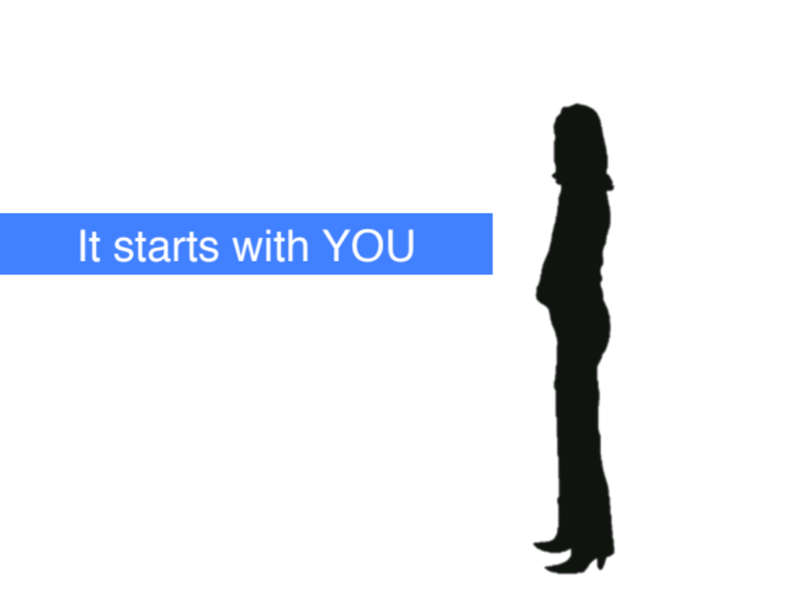
To Coach we Center Their Agency
When we direct others in action and determine their goals – we are only growing OUR agency.
We center their agency when we ask them to identify what is preventing their action, and ask what they are willing to do to overcome the barriers. (Coach)
When someone defines their goal and uses THEIR agency to move towards it – their confidence, power, skills, and trust grow.

Slide 42
To Coach We Have to Believe that Campaigners Can
Read a political landscape
Assess their potential allies and opponents
“Cut an issue” from a big problem to a set a of winnable (local) demands
Pick fights that will build their base and develop new leaders
Use a tactic sequence to create a crisis for our targets

Slide 43
Campaign Coaching: What It Is & Isn’t
What It Is | What It Isn’t
Helping organizers become strategists and lead powerful local campaigns | Making key strategy decisions for a local group
Supporting strong containers for collective action and shared power | “Answering questions that come up” as an external consultant
Balancing the need to learn and develop skills with running a “live” campaign | Having “catch up calls” without preparing questions to support the group through challenges

Slide 44
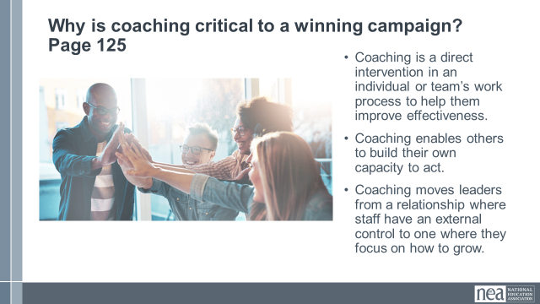
Why is coaching critical to a winning campaign?
Coaching is a direct intervention in an individual or team’s work process to help them improve effectiveness.
Coaching enables others to recognize their own capacity and decide hot they will act.
Coaching transforms leaders from a relationship where "experts" have an external control to one where they focus on their own their determinations for how to grow.

Slide 45

Key Point
Coaching is the way we walk our talk.

Slide 46

Closing the Day
What is becoming clearer?
What remains murky?
Housekeeping

Slide 47
Additional Unused Slides Follow

Slide 48
Campaign Lab Overview
Carrie and Amanda

Slide 49
Basic Structure of Campaign Lab
250
500
Coach
Team Lead
Team Lead
Coach
Team Lead
Team Lead
Coach
Team Lead
Team Lead
Campaign Lab Coordinators
50
Tech
Logistics and Grants
Payments
Mentor Coach
7
7
Notes:
The commitment for the local team lead is that they meet twice a month with a campaign coach to discuss their progress and receive just in time problem solving, advice, and coaching towards next steps. They also agree to attend an all call meeting once month to hear from others across the country that are also doing this work. Once a coach and a mentor coach agree that the Team Lead and local have a plan, have a team, and are ready to begin taking actions according to an actual escalating plan, they receive a seed grant of $2500.
Coaches, high capacity, campaign minded, leaders can serve as coaches and will receive training and support to do this. They agree to coach locals, up to two — and receive an annual stipend of up to $1800. They commit to meet with one to two teams, twice a month and attend the monthly all call meeting.
Mentor coaches are typically staff, who have a record of leading campaigns or growing locals through organizing. They do not receive a stipend. They have no more than 5 coaches that they meet with once a month and attend the all call meetings.
The Campaign Lab Coordinators, Amanda, Carrie, and Ellen, are managed by Kyle. Kyle is primarily focused on building the alignments with our outside partners and moves the Campaign Lab strategically into other aspects of the NEA enterprise. Amanda, Carrie, and Ellen work together they keep the system connected, convene the people in the system, build capacity across the system, manage and monitor applications of teams and coaches, and develop a strategic intent for the work across the campaign lab. They are supported by Dommie, Shola, and Karla. Dommie provides technology and data support, Shola coordinates the payment of coaches, Karla pulls team applications from the grant system and provides all travel logistics.

