Slide 1
Campaign Academy:
Coaching and Leading Winning Campaigns
Baltimore, 2025

Slide 2
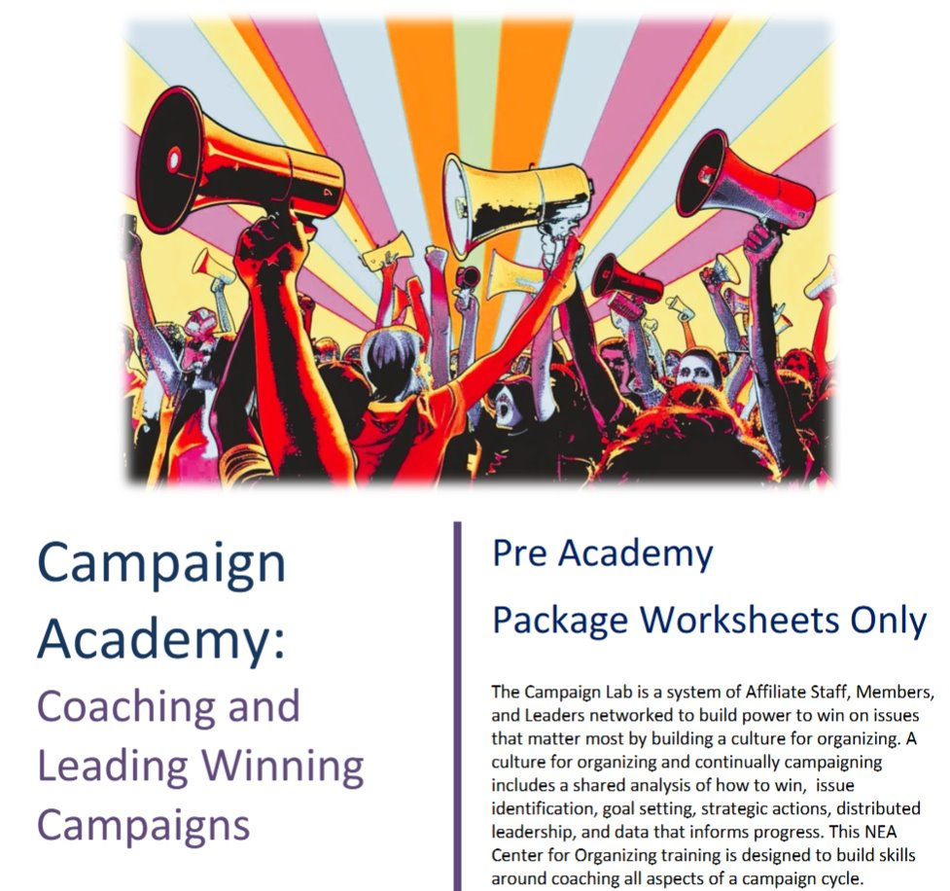
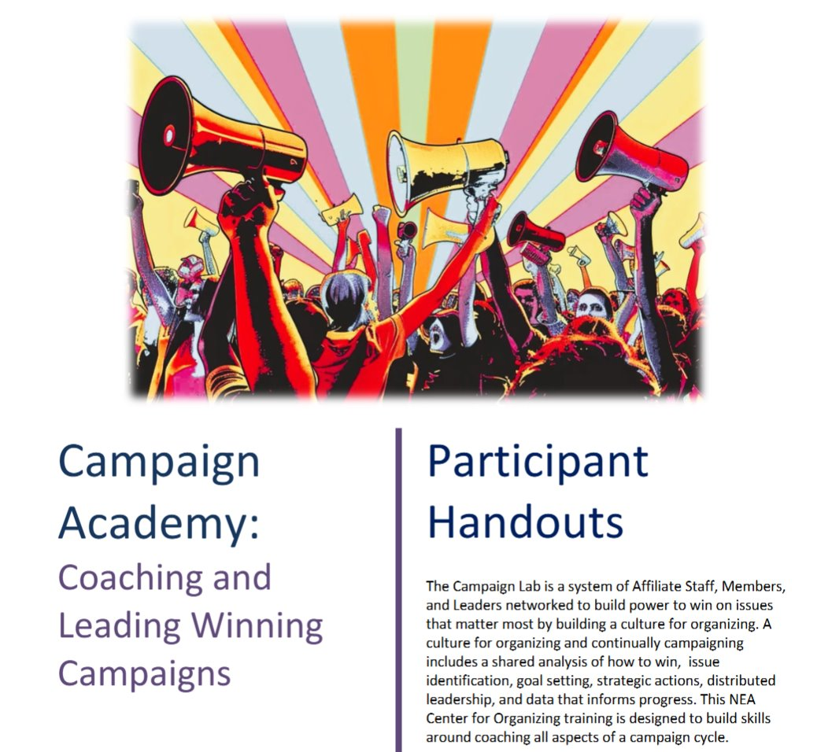
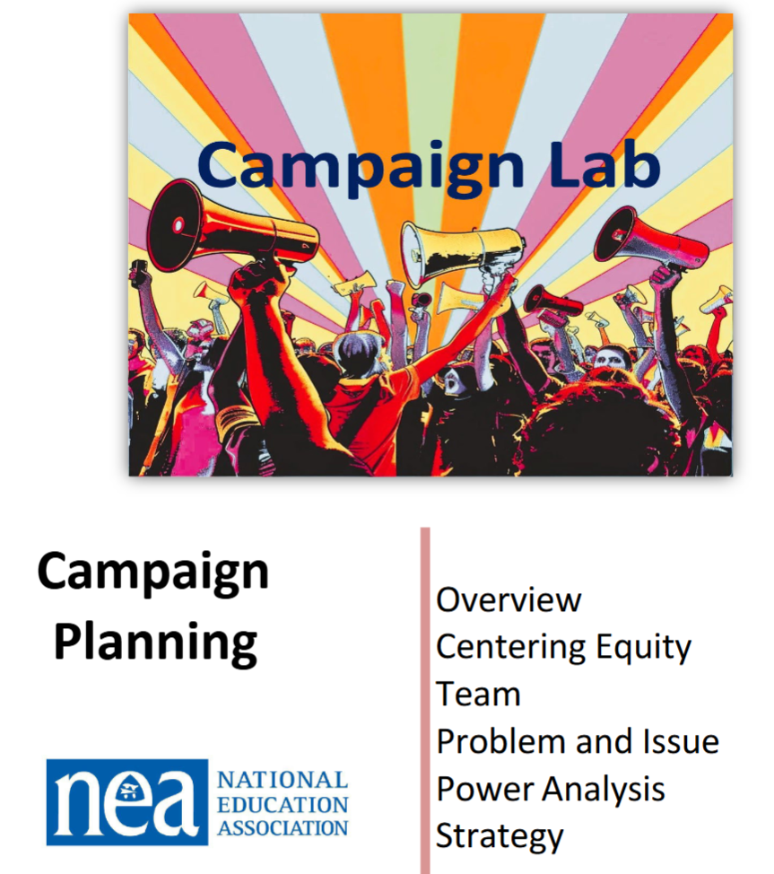
Documents you Will Need Today
Pre Academy Module – Pre Academy Worksheets Only
  Community Agreements and Three Theories Article Reflections
Participant Handouts Module – Participant Handouts
Campaign Planning Module - Campaign Planning Guide

Slide 3

Campaign Academy
By attending this training, you confirm that you are either an NEA affiliate staff person or NEA member in good standing. The information you receive here is only for your use in your capacity as an NEA affiliate staff person or NEA member.
This presentation and its contents are confidential and may not be further distributed or passed on to any other person or published or reproduced, in whole or in part, by any medium or in any form, for any purpose unless written consent has been provided by Ellen Holmes. Audio/video recording, copying of slides, and the use of AI note-taking tools are prohibited without the written consent from Kyle Serrette. Violation of these terms may result in legal action.

Slide 4
Honoring This Space
We begin by acknowledging that through a history of colonization and brutality, we are currently on the traditional lands stewarded by generations of indigenous people.
We honor these indigenous people, all elders, past, present, and emerging. We are called to learn and share these learnings about this tribal history, culture, and contributions that have been suppressed in the telling of the story of what we now call the United States of America.

Slide 5

Key OUtcomes
Participants will understand: Why the Campaign Lab exists How the Campaign Lab operates to support and network local campaigns What is expected for participation in winning Campaigns

Slide 6
Overall Agenda
Sunday (Everyone)
  7:30-8:30 Breakfast
  8:30-Noon Meeting
  12:00-1:00 Lunch
  1:00-4:30 Meeting
  4:30-5:00 Networking and Adjourn
Monday (Everyone)
  7:30-8:30 Breakfast
  8:30-1:00 Meeting
  1:00 Adjourn, Lunch on your own

Slide 7
ToDay’s Agenda and Outcomes
  7:30-8:30 Breakfast
  8:30-Noon Coaching and Teams
  12:00-1:00 Lunch
  1:00-4:30 Campaign
  4:30-5:00 Networking and Adjourn
Participants will understand the Basics of the Campaign Lab, the Structures for Support, and the stages of a Campaign Cycle

Slide 8
Logistics to Remember
Questions to Ask
Bathroom
Materials
Food
Room Temperature
PEPs Portal

Slide 9

Shout Out from Your Team and Around the Room
Name
Pronouns
Work Location

Slide 10

Community Agreements
Using Self-Awareness and Self-Knowledge
Listening for Understanding
Being Gracious
Staying Engaged
Being Open and Suspend Judgment
Saying “I”- tell your truth
Lean into Discomfort
Reaching Empathy
Expecting Non-Resolution and Non-Closure
*Adapted from “Embracing equity and inclusion”, Annie E. Casey Foundation
Notes:
Community Agreements for Our Time
Awareness and Self-Knowledge
This requires self-knowledge and self-awareness. Self-knowledge allows you to see what causes you pain and conflict and enables you to embrace your contradictions and inconsistencies. It allows the space to work on things about yourself that you are not happy with. In turn, self-knowledge helps to prevent you from projecting your negative aspects onto other people. Bringing your best self also requires that you have a positive attitude, are willing to deeply explore your perspectives and remain open to the perspectives and experiences of others.
Listening for Understanding
Be an active listener. Active listening involves paying full and careful attention to the other person, looking him or her in the eye, avoiding interruptions, reflecting your understanding, clarifying information, summarizing the other person’s perspectives and sharing your own. Remember that most people need time to open up and might not be willing to immediately share their personal stories, hopes, fears and/or concerns.
Being Gracious
Being kind is a vital way of bringing meaning to our own lives, as well as the lives of others. Kindness is about caring genuinely for others around you, wanting the best for them and recognizing in them the same wants, needs, aspirations and even fears that you may have. Being kind and generous allows us to communicate better with others, to be more self-compassionate and to be a positive force in other people’s lives. This includes following the COVID protocols that are in place to protect the health of this learning community.
Stay Engaged
Staying engaged requires you to be morally, emotionally, intellectually and socially involved in the conversation. Staying engaged means that you are listening with curiosity and willing to deepen your understanding. Staying engaged might also require you to sustain the conversation even when it gets uncomfortable or diverted. This also means a commitment to keeping your electronic communications to a minimum with folks not present in this learning community.
Be Open and Suspend Judgment
Listening with an open mind includes being receptive to the influence of others. You can suspend judgment by becoming aware of preconceived notions and listening to everything someone has to say before jumping to conclusions. Most importantly, suspending judgment also means listening to what the speaker has to say for understanding, not just to determine whether the speaker is right or wrong.
Say “I”- tell your truth
Speaking your truth in authentic and courageous conversations about race requires a willingness to take risks. It means that you will be absolutely honest and candid about your own thoughts, feelings, experiences and opinions and not just saying what you perceive others want to hear. Speaking your truth will require you to speak from the “first person” and use “I” statements.
Seek Discomfort
Leaning in to discomfort will require you to let go of racial understandings and stereotypes that you may be holding onto in order to move forward. Leaning in means that you will avoid judgment, assume positive intent and be open to the kernel of wisdom in each individual’s experiences. Leaning in to discomfort will require you to sit through moments of embarrassment, confusion, anxiety and/or fear.
Reaching Empathy
Empathy and compassion allow you to understand the other person’s point of view. When you are empathetic, you are more understanding, patient and kind. Expanding your capacity to feel empathy will also allow others to enter your circle of human concern.
Resolution and Closure
Expect and accept that there may not be closure. It is not likely that you will resolve your personal understanding about race or another person’s racial experience in a single conversation. The more you talk about race with another person, the more you learn and the more they will learn. Authentic and productive conversations about race are continuous and always evolving.
*Adapted from “Embracing equity and inclusion”, Annie E. Casey Foundation

Slide 11
So what is different about the Campaign Lab?

Slide 12
3 Prevalent Theories of Change
Advocacy
“Advocacy is the work of creating change through the actions of professionals or technical experts—lobbyists, pollsters, lawyers, communication specialists, researchers. Advocacy relies on the expertise, status, and know-how of these groups of people to make change. Advocacy usually happens in a closed-door room; ordinary people play a small to nonexistent role in its efficacy. Advocacy has become a dominant strategy for unions and liberals.”
Mobilizing
“Mobilizing, by contrast, activates an already-convinced membership. Mobilizing encourages those who already support a cause or a mission to take action to defend their belief—for example, by attending a protest, wearing a button, or signing a petition.”
Organizing
“To organize is to build mass support and strength among ordinary people. Organizing draws its power from working people’s biggest strength: our numbers. The work of organizing is systematic and rigorous: It requires connecting with every single worker in a shop, every educator in a building, every building in a district. At its core, it asks people to understand their own agency and to make choices about how they will exercise it.”

Slide 13

Time to Talk
Which of these theories do we mostly work in?
Which of these theories generates the power you need to win the changes you want ?

Slide 14
Advocacy is about – using expertise.
Mobilizing is about – engaging the already committed.
These are necessary, but not sufficient to build the power we need.

Slide 15


Slide 16
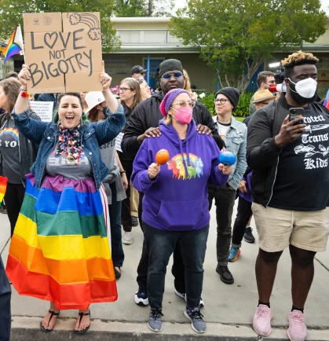

DEFINING POWER
Power is the ability to control, create, and prevent change.
Power is organized people and organized resources (money).
Power is not static, it is either waning or growing.

Slide 17

UNDERSTANDING POWER
Power is neutral
Our values affect the way we use power

Slide 18

TRUTHS ABOUT BUILDING POWER
Power has to be consistently built or it is waning
Not everyone wants us to have power and actively work to take our power away
Public actions through shared vision, shared purpose, shared resources, shared risk, and unity is how we build power
The bigger the win you want– the more power you need
Building power requires leadership

Slide 19

The Right Leadership Begins with You
Leaders are those who take responsibility for enabling others to achieve shared purpose in the face of uncertainty

Slide 20

Leaders Across these Three Theories

Slide 21
Campaigns are not Programs
An issue campaign is the process through which the people organize around leaders and structures to use their resources in accomplishing goals that achieve the change they need and want. It is public. It involves risk. It results in the story being about the workers.
From Marshall Ganz

Slide 22
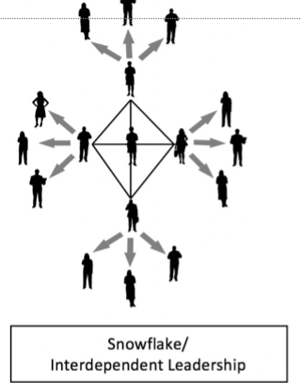
In most “Programs” the responsibility and accountability is centralized, members don’t broadly own the program, aren’t risking much to participate, and aren’t typically invested in shareing any benefits of the program. Little power is built to address the issues that are important.
We build the most power when the members are accountable to one another and are responsible for the actions necessary to build that power. Leadership is interdependent and distributed.
In the Campaign Lab we are intentionally creating an ever expanding structure of leadership.

Slide 23
And that is what is different about Campaign Lab.
This is an intentionally created and networked leadership structure focused on building and using power within and across issue campaigns.

Slide 24

Key
Points
Intentional campaigns, not programs, build power.
The power to win is only built through people with a shared vision, making public commitments to act, to risk their collective resources, for the big meaningful changes they want.
The kind of power we needs depends a distributed and interdependent leadership structure.

Slide 25
Meeting This Moment
Carrie and Amanda

Slide 26
Let's meet each other!
Who has shown the power of their union to their school board or trustees? This could be a vote, a strike, a rally, a petition.
Who has brought the issues of the community or students into their union work?
Who has advocated for change as a union or coalition with elected officials?

Slide 27
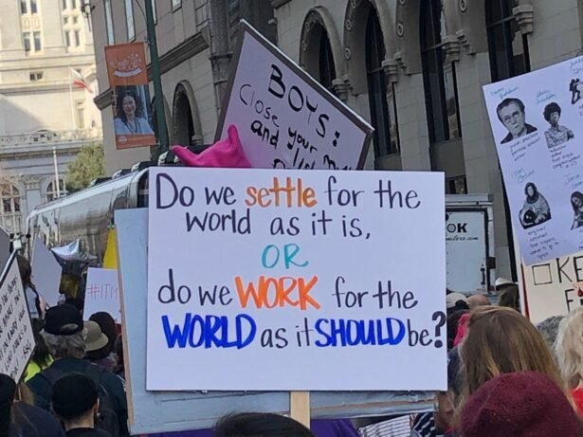
If your school community could have three things right now what they be?

Slide 28
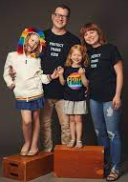
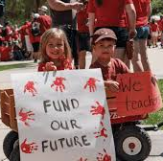
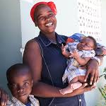


Funded, fed, inclusive, safe, cared for…
This IS ALL union work in the
Campaign Lab

Slide 29
HOW DOES CAMPAIGN LAB WORK?
COACHING
PEER LEARNING
TRAINING
NETWORKING
COLLABORATION
POWER-BUILDING
Notes:
WHAT IS CAMPAIGN LAB?
Context on this moment and what’s needed from our union. Helpful narrative context for us internally:
"Almost all strategic narratives demand change from the organization and/or the broader world. Establishing a sense of urgency for the change required, by authentically setting out the current reality of where the organization is and the challenges it faces. This current reality also provides the dramatic tension the narrative needs in order to capture its audience’s attention. Don’t restrict the narrative to just good news,
A good strategic narrative should link together why the organization is – or needs to go – on a journey, what the direction and destination of that journey is, and how it is going to get there.

Slide 30
Basic Structure of Campaign Lab
Team Lead
Team Lead
Coach
Coach
Coach
Campaign Lab Coordinators
Tech
Logistics and Grants
Payments
Team Lead
Team Lead
Mentor Coach
Team Lead
Team Lead
7
Notes:
The commitment for the local team lead is that they meet twice a month with a campaign coach to discuss their progress and receive just in time problem solving, advice, and coaching towards next steps. They also agree to attend an all call meeting once month to hear from others across the country that are also doing this work. Once a coach and a mentor coach agree that the Team Lead and local have a plan, have a team, and are ready to begin taking actions according to an actual escalating plan, they receive a seed grant of $2500.
Coaches, high capacity, campaign minded, leaders can serve as coaches and will receive training and support to do this. They agree to coach locals, up to two — and receive an annual stipend of up to $1800. They commit to meet with one to two teams, twice a month and attend the monthly all call meeting.
Mentor coaches are typically staff, who have a record of leading campaigns or growing locals through organizing. They do not receive a stipend. They have no more than 5 coaches that they meet with once a month and attend the all call meetings.
The Campaign Lab Coordinators, Amanda, Carrie, and Ellen, are managed by Kyle. Kyle is primarily focused on building the alignments with our outside partners and moves the Campaign Lab strategically into other aspects of the NEA enterprise. Amanda, Carrie, and Ellen work together they keep the system connected, convene the people in the system, build capacity across the system, manage and monitor applications of teams and coaches, and develop a strategic intent for the work across the campaign lab. They are supported by Dommie, Shola, and Karla. Dommie provides technology and data support, Shola coordinates the payment of coaches, Karla pulls team applications from the grant system and provides all travel logistics.

Slide 31
Learning and Growing Together
Peer Learning: What are the organizing, campaign or advocacy skills, vision, commitment and/or experience you bring with you to Campaign Lab that you feel you could teach others?
Networking through Campaign Lab:
What people do you want to connect with, learn from and organize with?
Notes:
Campaign Lab has growing capacity and vision for what we can build together.
Two butcher paper: for each question, different colored post it. Ask ppl to write down and put their name on it.
Facilitators group post-its by themes. We discuss themes and cohort opportunities as group
What are the organizing, campaign or advocacy skills, vision, commitment and/or experience you bring with you to CampaignLab that you feel you could teach others?
Networking through Campaign Lab:
What people do you want to connect with, learn from and organize with? We don't mean names – but rather types of folks. Could be people from the south, folks doing school board elections, people who want to figure out a kind of strategy – like protecting LGBTQ or immigrant students – or how to prepare for a strike?

Slide 32
Power Together
We are building power in our locals and communities.
What more can we do together?
What else might be possible?
Notes:
Organizing Leadership + Membership
How we win change? Strikes, Direct Action, Contracts, School Boards, Budgets, Local Elections, Ballot Measures, Legislation
Issue we are fighting on:
Improving Wages and Working Conditions
Stopping public funds for private schools
Stopping school closures
Fighting racial discrimination
Protecting culturally inclusive and responsible education
Protecting immigrant and LGBTQ students

Slide 33
Key
Points
The peer network is what makes Campaign Lab work.
All of you are here to learn; All of you have something to share.
We are up against a bigger fight than any of us can face on our own, so we need each other.
To sustain movements across time, we have to continually support and grow with each other.

Slide 34
Centering Equity pg. 30 in Participant Handouts and pg. 3 in the Campaign Cycle Planning Tool
Ellen and Albert

Slide 35
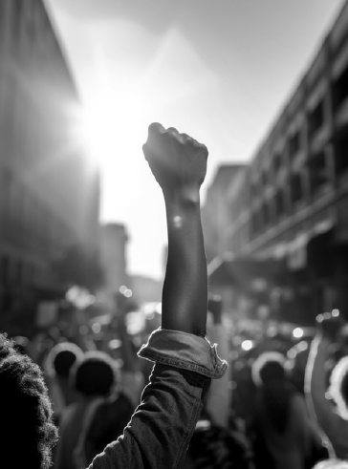
What will it take to achieve equity for the people who work and learn on our campuses/worksites?

Slide 36
What type of union builds power?
Campaigns
Public Action and Demands
Strategic and Ongoing
Continues to Add
  Base – Mobilizers - Leaders
  Allies – Partners - Coalitions
  Requires Risk
  Supported by Staff
  Leaders Build and Use Power
Programs
Build Presence
Episodic
Member Recruitment
Committee/Program Leaders
Low Risk
Often Staff Led
Power in Policy

Slide 37
What about Race, Class, and Gender Justice?
Many of us value justice and equity, so we must apply a Race, Class, and Gender Justice lens to our work
This lens involves both personal and institutional commitment to advancing equity
It means proactively eliminating systemic barriers and setting clear, measurable equity goals
Use it to develop equity-focused campaigns and anticipate harm across race, class, and gender lines
It’s more than avoiding discrimination, it’s about creating systems that sustain equity

Slide 38
Centering Equity
Causes: What institutions, policies, or practices are causing or contributing to the inequities? What social norms, popular myths, or cultural biases may be contributing?
History: How did things get this way and are things worsening or improving?
Strategies: What strategies and actions could be used to advance the solutions?
Problems: What inequities are you noticing or experiencing? What are the impacts on different racial groups? Who benefits most and who is hurt most?
Solutions: What solutions could address the root causes and eliminate the inequities? How would different racial groups be impacted by the proposed solutions?
Leadership: Who are the stakeholders most affected by the inequities? Are they involved in naming the issues and solutions? What kinds of active leadership roles could they take to advance the proposed solution?
Additional Equity Tools: Who is most directly impacted? Who has been left out? How can they be directly engaged? How do our demands center race, class, and gender justice?

Slide 39
Debrief
What did you learn about using this analysis tool?
What did your group struggle with?
How do you think you could use this in your own work?

Slide 40
Key
Points
Intentional campaigns, not programs, build power.
Centering race, class, and gender justice in our campaigns increases the number of people engaged, the number of leaders involved, and the amount of resources we have to win the change we want.
Power is only built through people with a shared vision, making public commitments to act, to risk their collective resources, for the meaningful change they want

Slide 41
Organizing Around Issues pg. 42-45 Participant Handouts and pg. 11-12 Campaign Cycle Planning Tool
Amanda and Zac

Slide 42
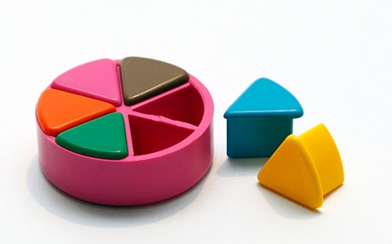
PROBLEM vs. ISSUE
A problem is the whole pie. Problems are vast, complex, and entrenched.
When we try to tackle a problem, we reinforce the hopelessness of the situation. We are trying to take on the full pie all at once.
Issues are the pieces of the pie. It’s a small chunk of the larger problem that we can make progress on, and in turn we are slowly taking on the full problem over time.
Notes:
What are some “red flags” to look out for when identifying the issue?

Slide 43
Issue
An issue is a slice of the larger problem that is manageable and solvable.

Slide 44

PROBLEM vs. ISSUE

Slide 45
Values
Values are fundamental beliefs that dictate behavior
Ideally, Unions advance the welfare of all members.
They are based on the universal ideal of human rights, the idea of justice, progress, and betterment of self and of society.
Through shared values, members build solidarity and commit to active participation in the labor movement.
Shared values transform individual members into part of something larger than themselves.

Slide 46
Some Union Values
Fairness, honesty/integrity, responsibility, compassion/empathy, safety, health, generosity, hard work/responsibility, community, freedom, democracy, binding contracts, equality, opportunity, respect, stability/security, unity, quality work, justice, collective action, dignity/respect, charity/community service, and due process.

Slide 47
How to Link Issues and Values
Investigating member issues is necessary but not sufficient – we also need to identify workers’ SHARED values –
WHY is this an issue?
WHY do you want to fix this?

Slide 48
EXAMPLES- Problems to Issues + Values
VALUES – Public Schools should be safe, equitable, and inclusive learning and working environments for all people.
PROBLEM -Our school is hostile to LGBTQ+ staff and students
  ◦ Issue Cut – There are no gender inclusive bathrooms and/or transgender students and staff are forced to use the wrong restroom.
PROBLEM - Our school reinforces racism by silencing protestors
  ◦ Issue Cut– We need to stop law enforcement from arresting students and staff for exercising their Constitutional rights.

Slide 49

Key Points
Problems are big conditions of injustice
Issues are the smaller member identified components that make up the problem
Issues indicate a path to action
Values build a relatable why across people experiencing the pain of the problem
We intentionally work to connect members around issues and values to build Solidarity

Slide 50
TEAM WORK – The Problems
List the problems that you and your members want to improve – these are BIG
For each of the problems you identify – try to think what the values are that are behind WHY you see this as a problem.
Example Problem – We want quality health care for everyone
Values behind wanting to fix this – equity, fairness, dignity
List your problems and values on your charts.

Slide 51
Key Points
We listen for the values as talk about these problems.
This is how we build solidarity.

Slide 52
TEAM WORK – Problems into Issues
Example Problem – We want quality health care for everyone
Values behind wanting to fix this – equity, fairness, dignity
Possible Issues –
Not enough providers in our rural system
Values – access and equity
Drugs are not affordable
Values – fairness and access
No coverage for home health options
Values – equity and dignity
Pick ONE problem and cut into issues on your charts.

Slide 53
Assessing Our Issues
Widely felt and/or deeply felt.
  The pain can be felt by just one, but the injustice of that pain is shared by many.
  The pain AND the injustice of that pain is felt by many.
Winnable.
Builds the union and builds leaders.
Has a connection to students and the public.
Secrets of a Successful Organizer “A Good Organizing Issue” handout

Slide 54

Issue Criteria Checklist
(as a resource)

Slide 55
Problems are big conditions of injustice
Issues are the smaller member identified components that make up the problem
Issues indicate a path to action
Values build a relatable why across people experiencing the pain of the problem
We intentionally work to connect members around issues and values to build Solidarity
Not Every Issue is an Organizing Issue
Key Points

Slide 56
Leadership Team Development pg. 31-41 Participant Handout and pg. 4-10 Campaign Cycle Planning Tool
Ellen and Halimah

Slide 57
EFFECTIVE TEAMS
EFFECTIVE TEAMS
STEPS
STEPS
MEASURES
CONDITIONS
MEASURES
CONDITIONS
Bounded
Purpose
Goals
Stable
Community Agreements
Capacity
(Team)
Diverse
Roles
Learning
(Individual)
Notes:
- When looking at effective teams, we should be paying attention to the conditions that make a great team, the steps to get there, and the measures that help us know we got there (30 sec)
- There is some research around this. Richard Hackman, Marshall Ganz, Ruth Wageman, out of Harvard University studied teams throughout the world, governments, sports, the military and their research is the basis for some of this thinking. Purpose assigned vs. Purpose developed collectively
Let’s start with the measures of an effective team
This work was done with Cabin Crews in airplanes (where they had been problems with crashes and miscommunications), Symphony Orchestras (where they were frustrated, being cogs in a wheel; Orpheus Orchestra where there’s no conductor, all led by leadership teams)
MEASURES
GOALS: A good team has goals AND takes action together to achieve the goal and effect the change they want to see.
CAPACITY: An effective team also builds capacity. Learns how to work together and how to develop new leadership to replace them when their gone.
LEARNING: Lastly, an effective team also includes a learning component. One way to know if your team is effective is if you walk away with a new skill or perspective on how to do the work.
CONDITIONS
Your team is bounded. You can name the people on it; they don’t come and go, whoever shows up doesn’t have the automatic right to participate in the team.
Your team is stable. It meets regularly. It’s not a different, random group of people every time. Membership of the team remains constant long enough that the team learns to work together better and better; each member is fully committed to be on the team and commits consistent time and effort to it.
Your team is interdependent. As on an athletic team, a string quartet, or an airplane cabin crew, the contribution that each person makes is critical to the success of the whole. Team members have a vital interest in each other’s success, looking for ways to offer support.
Finally, there are 3 Steps to reach these measures.
Crafting a SHARED PURPOSE.
Developing SHARED NORMS/COMMUNITY AGREEMENTS.
And establishing INTERDEPENDENT ROLES.

Slide 58
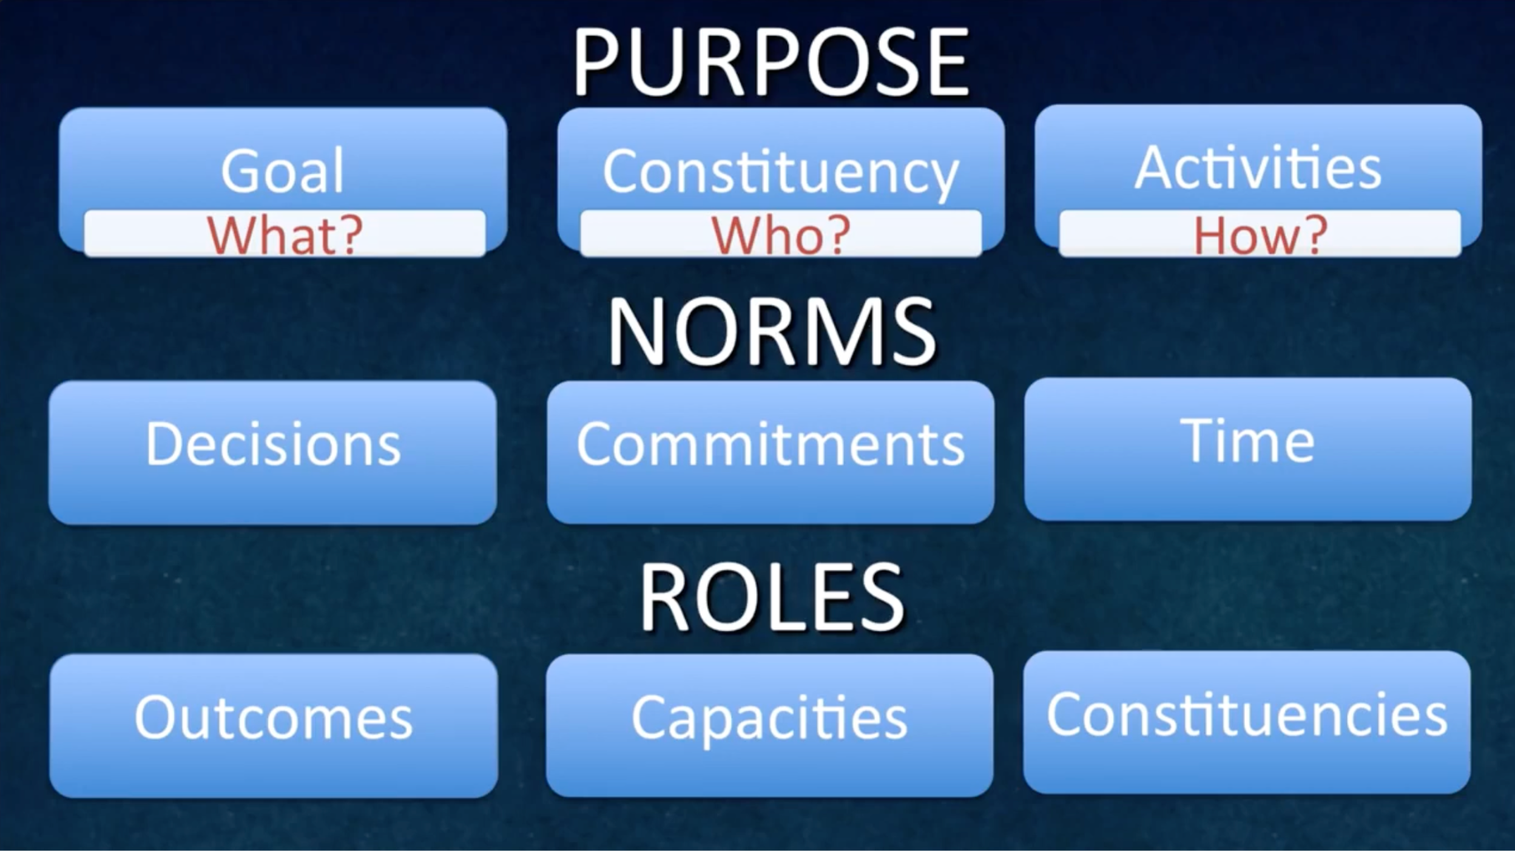
COMMUNITY AGREEMENTS

Slide 59
DEVELOPING A SHARED PURPOSE
OUR PEOPLE ARE...
OUR TEAM’S PURPOSE IS TO…
WE’LL ACHIEVE OUR PURPOSE BY...
WHO?
WHAT?
HOW?
Notes:
The first step is developing a shared purpose.
How many of you have had an experience trying to create a purpose statement for a team or organization you’ve been a part of?
Was that like a walk in the park? No. Once you got there, did it give your team clarity about the goals you were working towards?
So definitely worthwhile. In breakouts, you’ll have a chance to try this out. We’ll develop a statement using the What, How, and Who. Focusing on the shared purpose – why we’re together doing the work, how we want to achieve that purpose together, and who our people are.
Purpose is an interaction between these three things
Who – Who are we engaging to do this work with? How can we be specific in naming our people?
What — what is our north star? What broadly must occur in our world for it to look a little more like what we want? What part of that work are we taking on as a team? This should feel motivational to you as a team.
How – What kinds of activities will engage them in?
(organizing activities) – in an organizing language, what kinds of activities allow for our group to achieve the purpose we’ve set forth.

Slide 60
TEAMS - SHARED PURPOSE
STEP 1 - first draft (individual work) — 3 min
STEP 2 - (group work) — (8 min)
Include what your team is striving for, who you will organize, and how you’ll do it - the kinds of organizing activities you will engage in
NAME | WHO? Your constituency’s characteristics | WHAT? Your team’s reason for coming together | HOW? Specific organizing activities

Slide 61
STEP 3 - SHARED PURPOSE - second draft (individual work) (3 mins)
Include what your team is striving for, who you will organize, and how you’ll do it - the kinds of organizing activities you will engage in
Team Member: Team Member: Team Member: Team Member:

Slide 62
STEP 4 - SHARED PURPOSE - final draft purpose sentence (group work) (5 mins)
Include what your team is striving for, who you will organize, and how you’ll do it - the kinds of organizing activities you will engage in

Slide 63
Decision-making: What is the process by which we will make decisions?
Majority rules: Whatever gets the most votes wins. Consensus: Everyone must agree. Delegation: Nominate one or two people on your team to be the ultimate decision-makers. Coin flip: Leave the decision to fate! Fist to Five: Show a number of fingers to indicate whether you are in favor (five) or opposed (fist) to the proposal at hand. Other:
Discussion and Decision-making: How we will discuss options and reach decisions as a team to ensure vigorous input and debate?
Always Do Engage in open, honest debate Ask open-ended questions Balance advocacy with inquiry | Never Do Engage in personal attacks Fail to listen to what others say Jump to conclusions
Meeting Management: How will we manage meetings to respect each other’s time?
Always Do Start on time; stay on time Be fully present throughout the meeting Listen attentively | Never Do Come to meetings unprepared Answer mobiles or do email
Accountability: How we will delegate responsibilities for actions and activities? How will we follow through on commitments?
Always Do Provide follow-up on action items (have a goal checklist) Ask for/offer support when there is a need Weekly check-in | Never Do Assume you have agreement Assume tasks are getting done Commit to a task that you know you won’t do
Accountability Agreement:
**Regular meeting time:

Slide 64
Role | Responsibilities | You would be good for this role if you . . .Criteria? | Interested Team members & Related Skills/Talents
Team Coordinator
Understanding Team Roles (10 min.): Review the Team Coordinator role below as an example of what roles might look like in your individual campaigns. Thinking about how you should organize your constituency, discuss how your roles would fit together to create an interdependent leadership team that supports one another in your project. What would each role have to be good at? Based on the discussion about the roles, go around the circle and ask each person to tell others: 1) what experience and talents they have that might contribute to the leadership team and 2) what specifically they want to learn in more detail (30 seconds each). How might these talents match up to particular roles? Are there any clear “fits”?
Note: These team roles should not be seen as permanent. For the team to be strong, all leaders should have to earn leadership by carrying out responsibilities relevant to the role they seek.

Slide 65
Leadership Teams Are
Structures for working together interdependently.
Strategic capacity that produce more vibrant, engaging strategy than any individual could create alone
Intentionally created around shared purpose, shared commitments, and accountable through shared agreements
Key Points

Slide 66
Relationships and Roles
Albert and Ellen

Slide 67
Role Clarity
For this work to be equitable, we must have intentional structure, not guesswork
Misalignment leads to burnout, duplication, or dropped tasks
Clear roles help teams build power and leadership at every level

Slide 68
Three Core Roles in Campaign Lab
Mentor Coaches = Support for Coaches
Campaign Coaches = Support for Local Teams
Team Leads = Support and Coordinate the Team

Slide 69
Mentor Coach
Mostly staff-based
Monthly meetings with assigned Campaign Coaches and whole network
Campaign Coach
Holds coaching calls, documents progress
Team Lead
Coordinates team operations
Support Campaign Coaches problem solving and thought partnership
Coaches 1–2 local teams
Engages in peer problem solving and coaching
Upholds team norms and shared commitments
Organizes regular meetings and roles
Focus on output, capacity building, and leadership development
Clarifies team membership and purpose

Slide 70
Reflection
What are 1–2 actions you can take to clarify your role?

Slide 71
Role clarity enables power-building and sustainability
Each role supports equity through intentionality and reflection
You don’t have to do everything, just your piece, well
Key Points

Slide 72
Target and Demand pg. 51-68 in Participant Handout and pg. 14-15 in Campaign Cycle Planning Tool
Zac and Amanda

Slide 73

A Target Is
The person with the power to give you what you are demanding.
This person
Has a name
Has a face
Has an address

Slide 74
TEAMWORK
Return to Your Problem and Issue Charts
Who are the Potential Targets for the PROBLEM and your Issues?
Remember our Definition of Target

Slide 75
TEAM WORK – Demand
This should be an agitational phrase that creates a moral crisis (connected to values) for the listener and demands action

Slide 76
Demand
“Hey TARGET,
we demand ACTION
because HARM or IMPACT!”

Slide 77
Demand:
Superintendent Sam: We demand gender affirming bathrooms in every building because all students and faculty need to feel safe and included in our schools!

Slide 78
TEAM WORK - Demand
Use your Issue and Target
Draft at least one demand of your Target that resolves your issue and linked to YOUR VALUES

Slide 79

Key Ideas
A powerful demand makes clear who has the power to make the change that’s needed
We can only build a powerful demand when we have taken the steps to accurately identify the issue and determine who has the power to create change

Slide 80
Power Analysis pg. 46-47 Participant Handouts and pg. 11-13 Campaign Cycle Planning Tool
Zac and Amanda

Slide 81
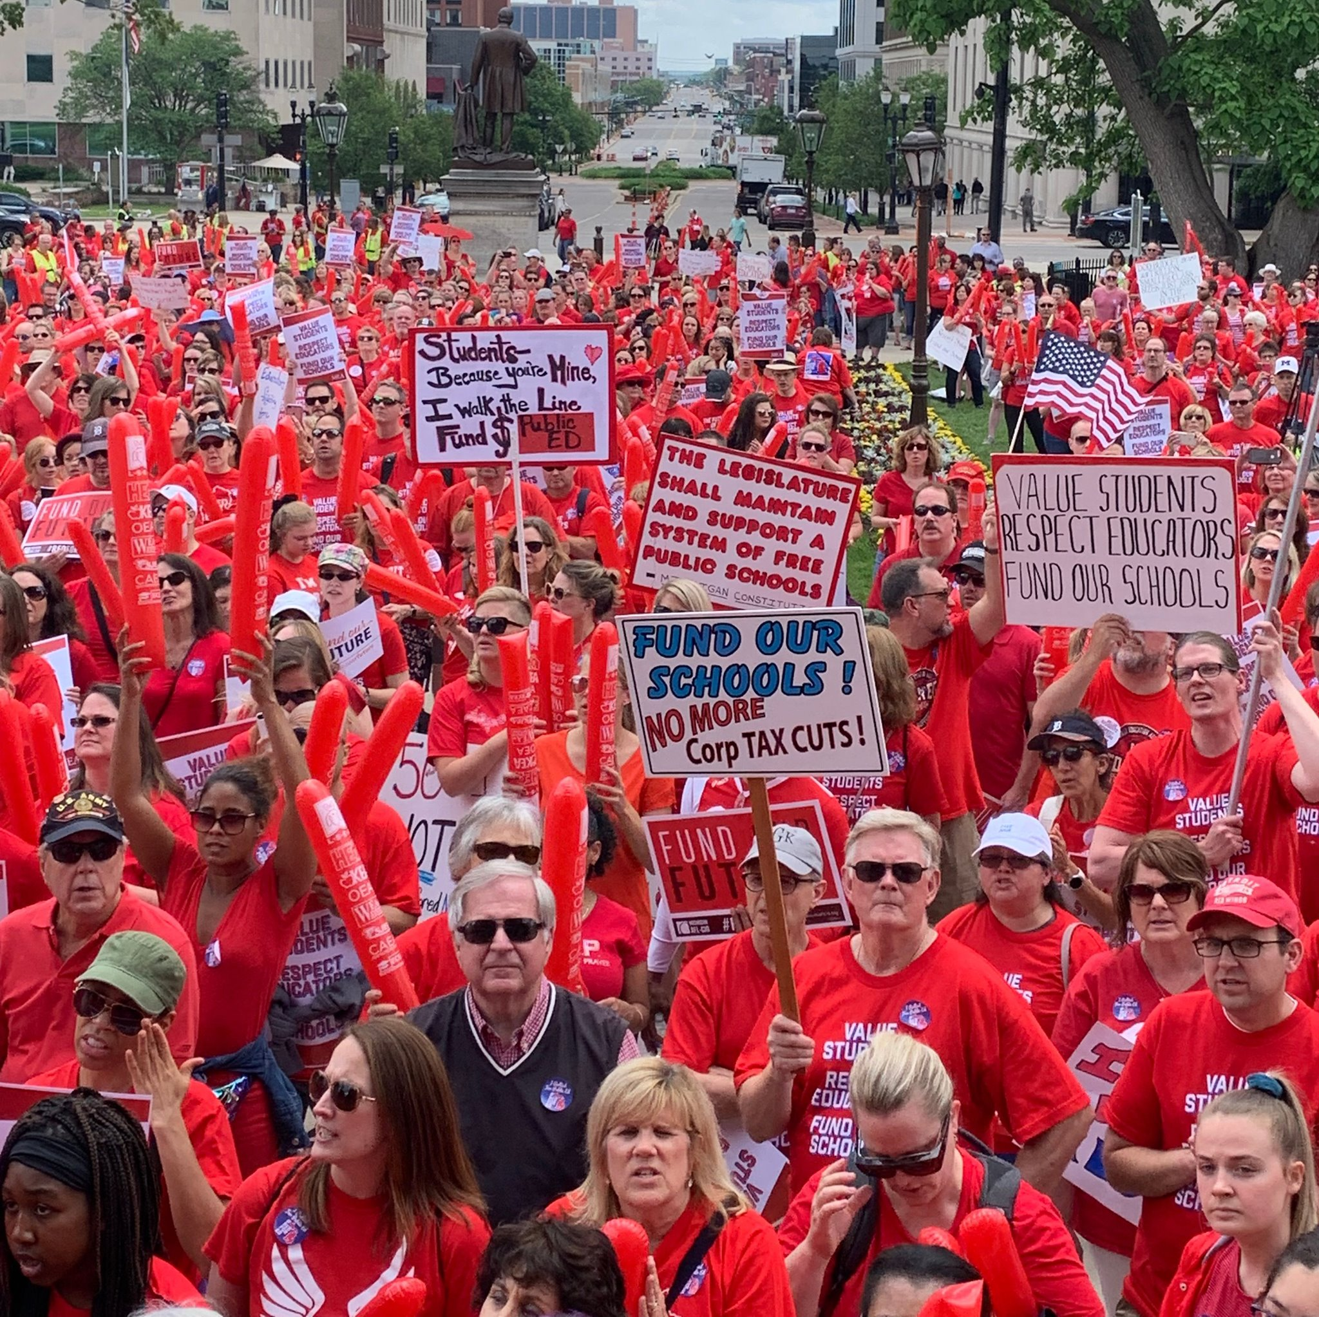
REMEMBER POWER
Power is the ability to control, create, and prevent change.
Power is organized people and organized resources (money).

Slide 82
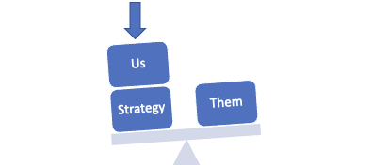
Purpose of Power Analysis
Understand how (& by who) power is exercised to cause and maintain the problems & conditions that we seek to change
Develop effective strategies for:
  Permanently altering power relationships in favor of the people suffering from the problems & conditions that we seek to change
  Grassroots organizing to build power
  Issue campaigns that BOTH help to build power AND win change
  Connecting short term activities to LONG TERM goals

Slide 83



Process of Power Analysis
1. Issue Background
2. System Landscape
3. Identify & Analyze Target(s)

Slide 84
Key Ideas
Understanding our own power, or lack thereof, is a necessary starting point
Understanding who has the power to fix the issue is crucial to building a successful campaign

Slide 85

Process of Power Analysis
1. Issue Background
2. System Landscape
3. Identify & Analyze Target(s)
Notes:
Yvie J
Now we’ll move into Part 3 of the Power Analysis, identifying and analyzing the Target(s). Who has an idea of what we mean by a target in the context of a campaign?

Slide 86
A Target Is
The person with the power to give you what you are demanding.
This person
Has a name
Has a face
Has an address
Notes:
Yvie J
A target is the person who can make the decision to give you what you want. The target is the person who can meet your demands. We need to be very specific in identifying the target. A target is not an organization or a committee. A target is a person with a face, name, and an address.
Once you have done the system landscape and understand the decision making process, you will be able to identify the Target.

Slide 87
Values Triangle
Consider questions on pg. 15 of Campaign Cycle Workbook
Self-Interest
Power
alues
Relationships
Notes:
Zac J
First, we need to understand our own power. There is a helpful tool for power analysis that we call the Values Triangle. The triangle works from the bottom up and the inside out. At the bottom of the triangle, we have relationships. Everything starts with relationships because everything we do happens in, through, with and because of who we know and how we trust them. Inside the triangle is where we have values. Do you remember how we defined values this morning? Values are deeply-held beliefs that shape who you are. We are our best possible selves when we have clarity on our values. The world we want to see and how we define ourselves are based on our values. A person who is clear on their values knows who they are and what they believe in.
On the left of the triangle, we have self-interest. Self-interest is what our values look like in the world, the tangible manifestation of our values. When you understand your values you can discover your self-interest. Your self-interest is what you’re willing to fight for. For example, if one of your values is people over profits, one of your self-interests could include stronger unions, living wage policies, hazard pay for essential workers, and more. On the right side of the triangle is Power. Who remembers our definition of Power? Power is the ability to create, control, and prevent change. Power is made up of organized people and organized resources. Bringing it all together, we build relationships, so that we can agitate people to live up to their values and get clear on their self-interest so that we can build the power we need to make the world reflect our values. Understanding this triangle is key to your work and to making change. Every person and organization has one of these.

Slide 88
Values Triangle
Self-Interest
Democracy
Power
Worker Voice
People over profit
Member organizing
Living Wages
Democracy
Dues
Strong Public Schools
alues
Collective Bargaining
Relationships
Members
CWA
IAF
Great Ed CO
America Votes
UNE
Eliza Hamrick
Notes:
Zac J
One helpful tool for completing a power analysis of our own context is called the Values Triangle. The triangle works from the bottom up and the inside out. At the bottom of the triangle, we have relationships. Everything starts with relationships because everything we do happens in, through, with and because of who we know and how we trust them. Inside the triangle is where we have values. Do you remember how we defined values this morning? Values are deeply-held beliefs that shape who you are. We are our best possible selves when we have clarity on our values. The world we want to see and how we define ourselves are based on our values. A person who is clear on their values knows who they are and what they believe in.
On the left of the triangle, we have self-interest. Self-interest is what our values look like in the world, the tangible manifestation of our values. When you understand your values you can discover your self-interest. Your self-interest is what you’re willing to fight for. For example, if one of your values is people over profits, one of your self-interests could include stronger unions, living wage policies, hazard pay for essential workers, and more. On the right side of the triangle is Power. Who remembers our definition of Power? Power is the ability to create, control, and prevent change. Power is made up of organized people and organized resources. Bringing it all together, we build relationships, so that we can agitate people to live up to their values and get clear on their self-interest so that we can build the power we need to make the world reflect our values. Understanding this triangle is key to your work and to making change. Every person and organization has one of these.

Slide 89
Key Ideas
During a campaign, understanding the values, self-interest, and power of those who we need to influence helps to underpin and strengthen our strategy, increasing our likelihood of success.
Notes:
Zac J

Slide 90
Strategy, Tactics, Timeline, and Compression Points pg. 51-68 Participant Handouts and pg. 13-15, 20-22 Campaign Cycle Planning Tool
Amanda and Zac

Slide 91

What do you think is the difference between a strategy and a tactic?

Slide 92
Strategy
Strategy: The way we use our power to win our demand. It is a series of tactics aimed at putting pressure on the target to meet our demand.

Slide 93
Tactics
Tactic: Actions we take as a part of an escalation plan that increases pressure on the target to win our demand.

Slide 94
What makes good tactics?

Slide 95
Tactics Must:
Put pressure on your Target
(puts them out of their comfort zone)
Build your Power
(develops leaders, brings more people in, etc.)

Slide 96
Power is a function of Courage and Unity
Our Ultimate Power
Amount of Effort or Courage to Persist and Act
Unity - Number of People Sharing the Values, Pain, and Actions
Notes:
Katie B
The more the courage and the more people who are acting – the more power we have.

Slide 97
Low level of courage and high number of actors…
Amount of Effort or Courage to Persist and Act
Sign an online Petition
Unity - Number of People Sharing the Values, Pain, and Actions
Notes:
Katie B
high participation, low effort and courage – low power to cause the target to concede the demand

Slide 98
High level of courage and low number of actors…
Storm the Superintendent’s Office
Amount of Effort or Courage to Persist and Act
Unity - Number of People Sharing the Values, Pain, and Actions
Notes:
Katie B
a lot of courage and effort but low participation – low power to cause the target to concede the demand.

Slide 99
Tactics Must:
Put pressure on your Target
(puts them out of their comfort zone)
Build your Power
(develops leaders, brings more people in, etc.)
In other words …. be Strategic.

Slide 100
Tactics Must:
Put pressure on your Target
(puts them out of their comfort zone)
Build your Power
(develops leaders, brings more people in, etc.)
Be Strategic

Slide 101
Key Ideas
Tactics allow workers to:
Share Resources, Values, and Commitment
Take risks together and achieve shared wins
Build trust in their own agency and the collective effectiveness of their union

Slide 102
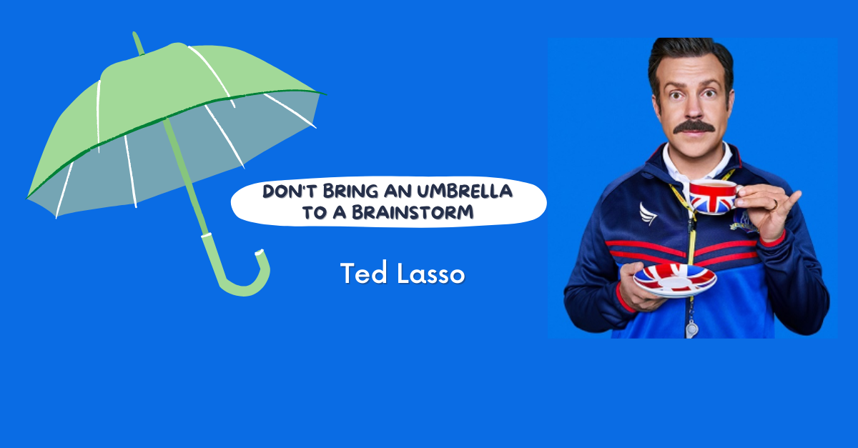
TEAM WORK – 5 Minute Tactic Brainstorm
+YOU HAVE 5 MINUTES!+
Brainstorm AS MANY tactics as you can on 1 chart.
•Be creative!
•You are NOT evaluating right now! Everything goes on the board!

Slide 103
Team Work
TIME: 10 Minutes
Evaluate your tactics
Decide which tactics that you came up with are strategic based on the evaluation criteria
CIRCLE the tactics you decide meet the evaluation criteria
CROSS OUT the tactics you decide are not strategic

Slide 104
Evaluating Tactics Criteria
Put pressure on your Target.
Build your Power.
Be Strategic.

Slide 105
Evaluating Tactics
Does the action relate to your issue?
Does it align with your values?
Will it increase the pressure on the decision-maker?
Is it visible?
Is it timed for effect?
Is it new and different—or tried and true?
Are enough people ready to do it?
Will it unify people?
How will management react?
Does it violate the law? (If so, are we prepared for the consequences?)
Will it be fun?

Slide 106
Key Ideas
Tactics allow workers to:
Share Resources, Values, and Commitment
Take risks together and achieve shared wins
Build trust in their own agency and the collective effectiveness of their union

Slide 107
Timeline, Compression Points, and Escalation pg. 51-68 Participant Handouts and pg. 13-15, 20-22 Campaign Cycle Planning Tool
Amanda and Zac

Slide 108

Timeline
How long can you wait for the demand to be met?
Are you creating a deadline?
Is there and event creating the deadline?
How long will it take to identify the problem, identify the issues, build a leadership team, build a presence, etc. etc. etc.
When do you make the starting point?

Slide 109
Compression Points
Points on the calendar where you celebrate short term wins or escalate your tactics.
◦Naturally occurring deadlines- Breaks, Board Meetings
◦Artificial deadlines-target has till day X to act
◦Help us build urgency and crisis

Slide 110

Why do you think tactics escalate gradually?

Slide 111
Less escalated actions prepare our people for more escalated actions
Give the target a point to do the right thing before things escalate to the next tactic
Use the threat of escalation
Allows more people to join our base

Slide 112
Team Activity Directions
What is the crisis?
How many people, and which people do you need?
What happens if you start at the peak?

Slide 113
Key Ideas
An escalating campaign is held together by a set of values and shared commitment to a demand.
Escalating tactics are how we develop leaders, identify new leaders, move more people into our base.
If we are organizing, we are always climbing campaign mountain

Slide 114
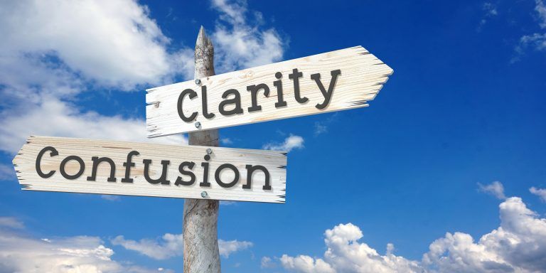
Closing the Day
What is becoming clearer?
What remains murky?
Housekeeping

