Slide 1
Campaign Academy:
Coaching and Leading Winning Campaigns
Baltimore, 2025

Slide 2

Campaign Academy
By attending this training, you confirm that you are either an NEA affiliate staff person or NEA member in good standing. The information you receive here is only for your use in your capacity as an NEA affiliate staff person or NEA member.
This presentation and its contents are confidential and may not be further distributed or passed on to any other person or published or reproduced, in whole or in part, by any medium or in any form, for any purpose unless written consent has been provided by Ellen Holmes. Audio/video recording, copying of slides, and the use of AI note-taking tools are prohibited without the written consent from Kyle Serrette. Violation of these terms may result in legal action.

Slide 3

Community Agreements
Using Self-Awareness and Self-Knowledge
Listening for Understanding
Being Gracious
Staying Engaged
Being Open and Suspend Judgment
Saying “I”- tell your truth
Lean into Discomfort
Reaching Empathy
Expecting Non-Resolution and Non-Closure
*Adapted from “Embracing equity and inclusion”, Annie E. Casey Foundation
Notes:
Community Agreements for Our Time
Awareness and Self-Knowledge
This requires self-knowledge and self-awareness. Self-knowledge allows you to see what causes you pain and conflict and enables you to embrace your contradictions and inconsistencies. It allows the space to work on things about yourself that you are not happy with. In turn, self-knowledge helps to prevent you from projecting your negative aspects onto other people. Bringing your best self also requires that you have a positive attitude, are willing to deeply explore your perspectives and remain open to the perspectives and experiences of others.
Listening for Understanding
Be an active listener. Active listening involves paying full and careful attention to the other person, looking him or her in the eye, avoiding interruptions, reflecting your understanding, clarifying information, summarizing the other person’s perspectives and sharing your own. Remember that most people need time to open up and might not be willing to immediately share their personal stories, hopes, fears and/or concerns.
Being Gracious
Being kind is a vital way of bringing meaning to our own lives, as well as the lives of others. Kindness is about caring genuinely for others around you, wanting the best for them and recognizing in them the same wants, needs, aspirations and even fears that you may have. Being kind and generous allows us to communicate better with others, to be more self-compassionate and to be a positive force in other people’s lives. This includes following the COVID protocols that are in place to protect the health of this learning community.
Stay Engaged
Staying engaged requires you to be morally, emotionally, intellectually and socially involved in the conversation. Staying engaged means that you are listening with curiosity and willing to deepen your understanding. Staying engaged might also require you to sustain the conversation even when it gets uncomfortable or diverted. This also means a commitment to keeping your electronic communications to a minimum with folks not present in this learning community.
Be Open and Suspend Judgment
Listening with an open mind includes being receptive to the influence of others. You can suspend judgment by becoming aware of preconceived notions and listening to everything someone has to say before jumping to conclusions. Most importantly, suspending judgment also means listening to what the speaker has to say for understanding, not just to determine whether the speaker is right or wrong.
Say “I”- tell your truth
Speaking your truth in authentic and courageous conversations about race requires a willingness to take risks. It means that you will be absolutely honest and candid about your own thoughts, feelings, experiences and opinions and not just saying what you perceive others want to hear. Speaking your truth will require you to speak from the “first person” and use “I” statements.
Seek Discomfort
Leaning in to discomfort will require you to let go of racial understandings and stereotypes that you may be holding onto in order to move forward. Leaning in means that you will avoid judgment, assume positive intent and be open to the kernel of wisdom in each individual’s experiences. Leaning in to discomfort will require you to sit through moments of embarrassment, confusion, anxiety and/or fear.
Reaching Empathy
Empathy and compassion allow you to understand the other person’s point of view. When you are empathetic, you are more understanding, patient and kind. Expanding your capacity to feel empathy will also allow others to enter your circle of human concern.
Resolution and Closure
Expect and accept that there may not be closure. It is not likely that you will resolve your personal understanding about race or another person’s racial experience in a single conversation. The more you talk about race with another person, the more you learn and the more they will learn. Authentic and productive conversations about race are continuous and always evolving.
*Adapted from “Embracing equity and inclusion”, Annie E. Casey Foundation

Slide 4

ToDay’s Agenda and Outcomes
  7:30-8:30 Breakfast
  8:30-1:00 Meeting
  1:00 Adjourn, Lunch on your own
Participants will understand the how to build a base and broaden that with coalitions.

Slide 5
Logistics to Remember
Check Out
Travel Home
Stipend

Slide 6
Feedback on Feedback
40% Response rate. Highest ratings for Centering Race, Power Analysis of Targets and Demands, Teams and Issue ID.
Themes – Content is a fit for what is needed, realizations about roles, realizations about Campaign Lab and participation in it
Reminders – More people=More noise=More side convos
Your Words -
"...If you feel you don't belong here, you DO, and the sooner you open yourself up to whatever we throw at you and go on the ride with us, the more you will be able to relax, gather tools and ideas for your toolbox, and get something meaningful out of this time together. If you feel like your goal/campaign doesn't fit with what we are talking about, it is okay. Remember that we are practicing - every campaign looks different - you don't even have your whole team here, so nothing you do in this space is binding, even though you are sharing it with your coach...sometimes you have to go through it, to actually get there, and no amount of pre-loading or support is going to change that."

Slide 7
Who are the People We Need? pg. 78-81 Participant Handout
Amanda and Carrie

Slide 8
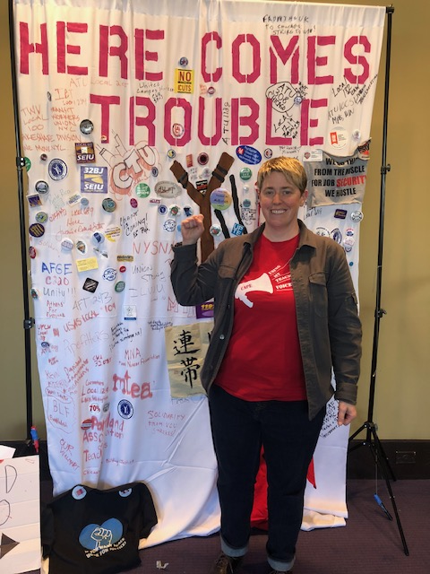
Activists, Mobilizers, and Organizers
What's the difference?
How do leaders fit in?
A story in four slides...

Slide 9
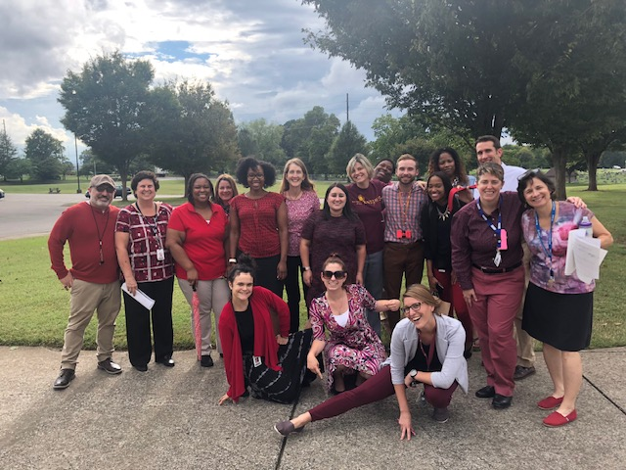


Slide 10
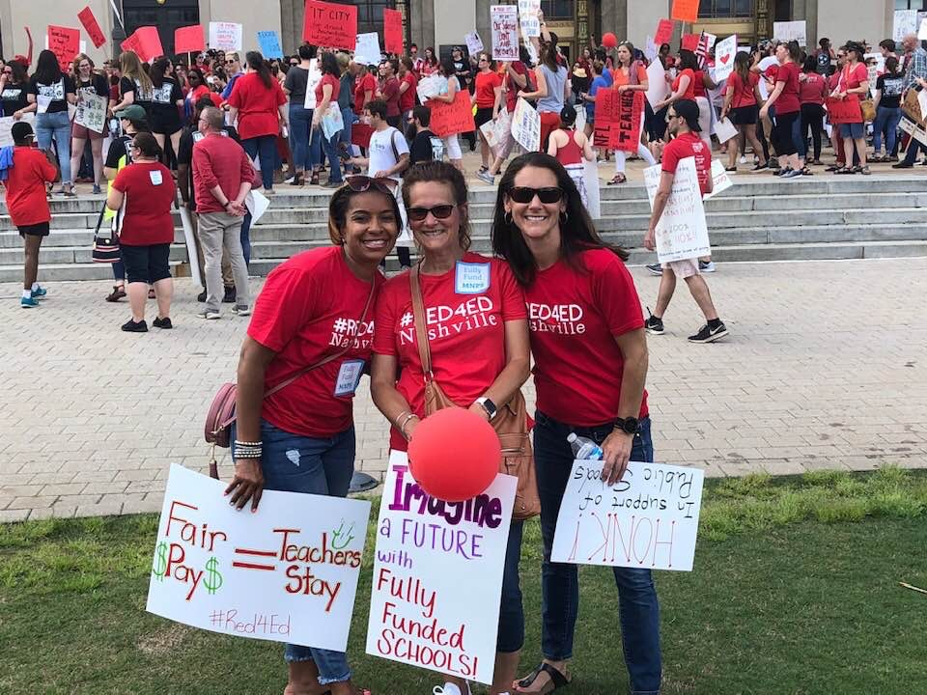

Slide 11
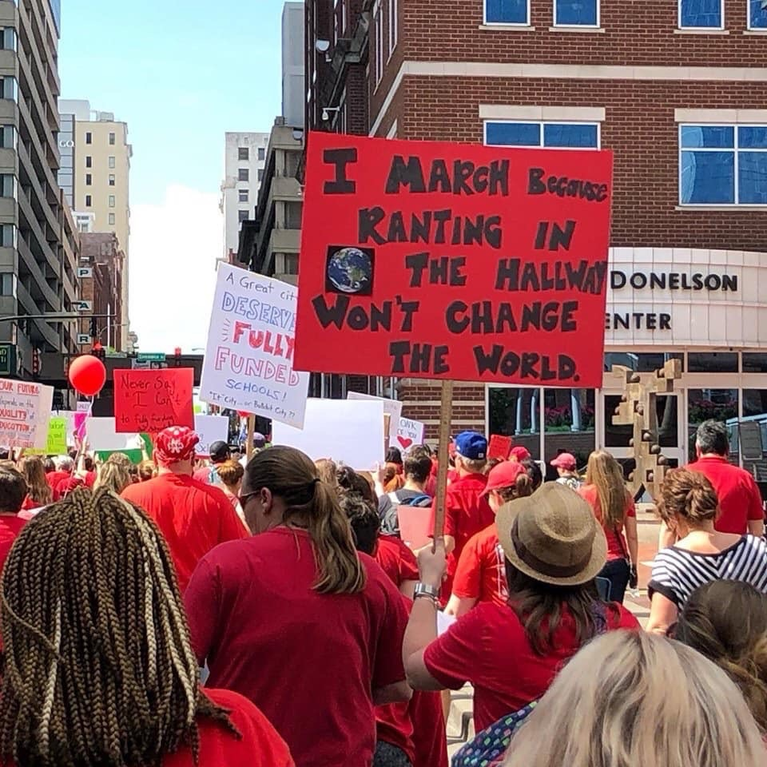

Slide 12
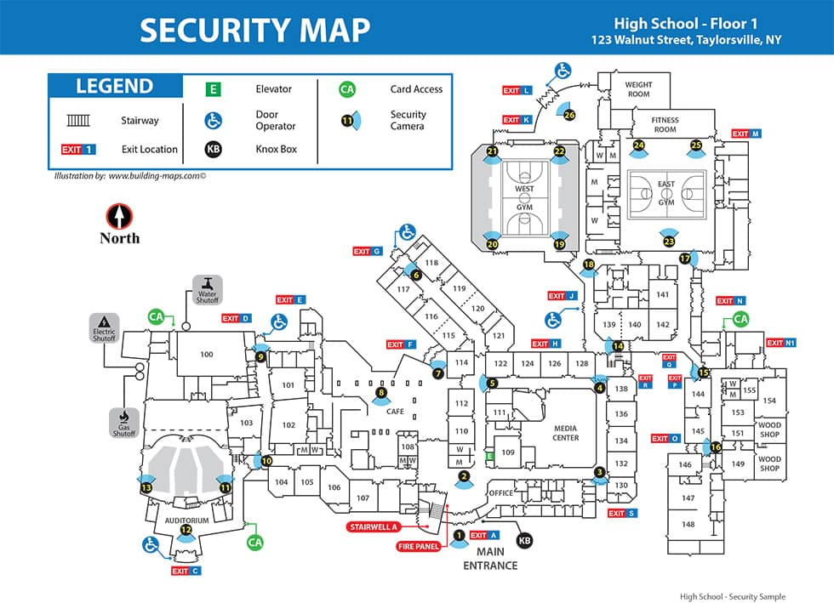
Mapping your worksite
Organizing

Slide 13
Who are the groups in your workplace?
  Department
  Social Groups
    Who carpools together?
    Shares a language or culture?
    Shares political views?
    Are relatives or neighbors?
How do these groups each relate to the school administration? District administration? School board or trustees?
What are the biggest problems facing this group?

Slide 14
Assess the current support for the union.
How many people in your worksite are dues-paying members?
Which groups are less supportive of the union and why?
What will happen if you don’t win the support of each of these groups? Which groups actively influence their peers or community?

Slide 15
Identifying Leaders
Who are the respected, trusted leaders in the groups?
Which groups are your current leaders in?
Which groups have leaders not yet engaged in the union?
How do you identify new leaders in the different groups?

Slide 16


Slide 17
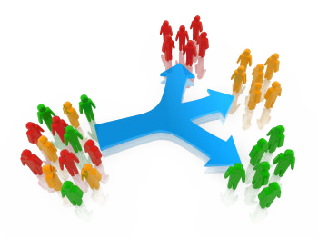
How do you structure organizing?
Structures allow for the distribution of power and responsibility and prioritizes leadership development and agency.
Teams
Committees
Boards
Coalitions
Supporter
Membership

Slide 18
BREAK

Slide 19
Organizer Math pg. 22 Campaign Cycle Planning Tool
Amanda and Carrie

Slide 20
Assessing the Strength of Your Base
Leaders: How many leaders do you have? How many do you need to strengthen your union base?
Mobilizers: Determine how many people are currently working actively for the union and how they influence their peers.
Activists: Identify those among the faculty who are ready to take action in support of union interests when the opportunity arises.
Union Members: Identify which groups your union members are in. Do you have activists who aren't dues-paying members.
Disengaged: How many coworkers are not participating in the union?

Slide 21

Getting to Supermajority
Question
  How do you go from being one person to getting a supermajority of your coworkers to take collective action?

Slide 22
Organizer Math
Figuring out how you are going to meet a goal by breaking it down by worksite and delegating out to worksite leaders

Slide 23
Campaign Lab School Division
You are a rep at your real work site.
What is your density? Total workers/total members.
What is the density of our whole school division?
(total of all our worksite workers/total of all worksite members)

Slide 24
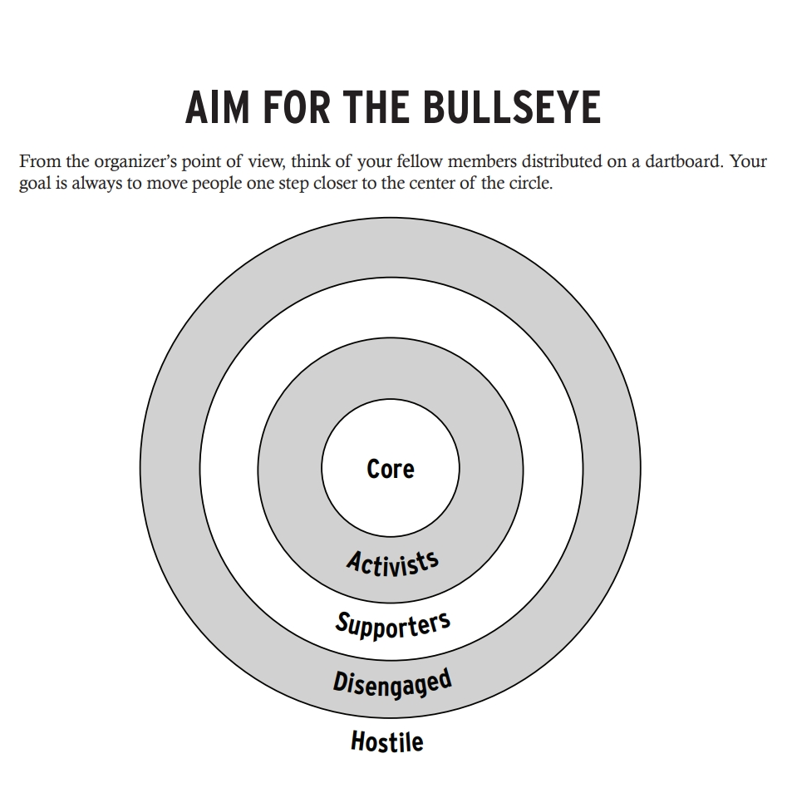
Question
Where would you focus your campaign launch and why?
How many folks can you turn out?

Slide 25
Is this enough?
How could you get more people?

Slide 26

Key Ideas
We build the union through leaders, growing and strengthening the membership.
Our primary job is to identify leaders who are committed, work together, and organize others to get involved in the union.
Campaigns can't build power without leaders and a growing base.

Slide 27

Key
Points
You build the people you need through aligning leaders.
Accountability makes the math work.

Slide 28
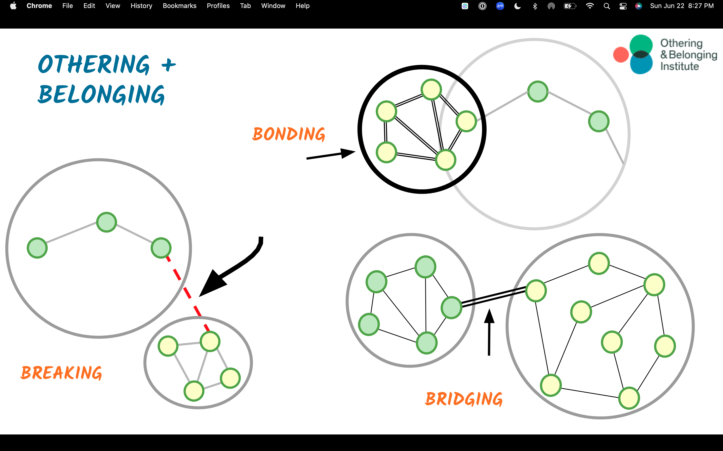

Slide 29
Recruiting Our Leaders
Identify one leader from your organizing map that you know you need to get involved in the union.
Why are they important to organizing? Who are they? What do they care about?
What might be an obstacle in getting them on board? What might be possible if they join.
Take a minute and reflect

Slide 30
LAVA: The Organizing Conversation
Listen
Agitate
Vision
Ask
Notes:
Give folks a hand out of the six parts and have them mark each piece as facilitators model a 1:1

Slide 31
AAR
Affirm
Let them know you’re listening, you understand, and their feelings are valid. Your new colleagues may be scared to speak up or upset by what they’ve heard.
Answer
Give a truthful, concise answer to the question. Do not be evasive or your entire message will be lost.
Redirect
Bring the conversation back to your message.

Slide 32
Bridging and Shared Values
What are the values that ground and guide your organizing?
How will you navigate differences in cultural and political values?
How is racial justice centered in your approach?

Slide 33
Coaches + Leads Time

Slide 34
Coaches and Leads will have time right now to work together.
What are the key take aways for your work?
What are the areas where you need more clarity?
What feels most important as a next step?

Slide 35
Ending it Right

Slide 36

Closing the Day
What is becoming clearer?
What remains murky?
Housekeeping

