Slide 1

Advancing
Racial Justice
Day 1

Slide 2
NEA has adopted a Standard of Conduct Policy to ensure that all of our gatherings are welcoming to and free from discriminatory, harassing, or otherwise unacceptable behavior. Discrimination or harassment based on race, color, ethnicity, religion, sex, age, national origin, sexual orientation, disability, gender identity, or expression, or any other characteristic protected by law will not be tolerated. If you have experience any discriminatory or harassing behavior, please report the incident. Thank you for your commitment to ensuring a positive event for all.

Slide 3
By attending this training, you confirm that you are either an NEA affiliate staff person or NEA member in good standing. The information you receive here is only for your use in your capacity as an NEA affiliate staff person or NEA member.
This presentation and its contents are confidential and may not be further distributed or passed on to any other person or published or reproduced, in whole or in part, by any medium or in any form, for any purpose unless written consent has been provided by Ellen Holmes. Audio/video recording, copying of slides, and the use of AI note--taking tools are prohibited without written consent. Violation of these terms may result in legal action.

Slide 4

Honoring This Space
We begin by acknowledging that through a history of colonization and brutality, we currently reside on Choctaw, Chickasaw, and Quapaw land and are connecting from the traditional lands stewarded by generations of indigenous people.
We honor these indigenous people, all elders, past, present, and emerging. We are called to learn and share these learnings about this tribal history, culture, and contributions that have been suppressed in the telling of the story of what we now call the United States of America.
Notes:
Gina

Slide 5

Acknowledgement
The content we are going to explore may bring up strong feelings. Throughout our time together, we will explore examples of racism, ableism, heterosexism, and sexism. By exploring these together, we can begin the process of unlearning our own internal oppression.
The purpose of unlearning isn’t about forgetting what we know or about being wrong; it’s a conscious act which requires critically examining the ideas and assumptions that influence our expectations, behaviors and beliefs about ourselves and other people. By doing this, we can challenge the cultural and structural norms that perpetuate racism and oppression.
Unlearning is something we can all be committed to because we all have a part to play in dismantling everything that helps maintain racism within society.
Adapted from Transatlantic Notes

Slide 6

Staff and Members in Same
Training
Race Forward Training
All coming from a Different
Space of Privilege and Oppression
How do we Talk about this Space
Additional Info

Slide 7
Why we are here:
NEA’s Framework For Change p. 112
Awareness
Capacity Building
Action
Notes:
Framework for Change:
The National Education Association is uniquely positioned to impact racial justice in education by focusing the work on awareness, capacity building, and action. We will build a union of members who, through their organization, are more aware of racial justice, receive and use racial justice tools, and who, together with other educators and key stakeholders, take action to address racial injustice in schools and related institutions:
If we build awareness about institutional racism and work towards creating racial justice in education, the National Education Association can provide shared knowledge and conceptual clarity in racially aware work;
If we continuously create and disseminate capacity building tools, skills, strategies, and resources to our members, leaders, staff, students and partners, a more racially aware National Education Association can be the leader in publically demanding racial justice in education in more powerful and meaningful ways;
If we support, lift, connect and take action with an intentional focus on movement building, we will create racial equity in our classrooms, worksites, and in our communities.

Slide 8

Logistics to Remember
Questions to Ask
Bathroom
Materials (Not just for here)
Food
Room Temperature
Karla Medina as a Resource
Travel

Slide 9

Agenda
Days 1 & 2
7:30-8:30 AM Breakfast
8:30 AM Convene
10:15-10:30 AM Break
12:00- 1:00 PM LUNCH
2:15-2:30 PM Break
4:30-5:00 PM Choice Networking
5:00 PM Adjourn
2:30 PM Day 2 to Museum

Slide 10
Agenda
Day 3
7:30-8:30 AM Breakfast
8:30 AM Convene
11:00-11:15 AM Break
1:00 PM Boxed LUNCH
1:00-2:00 PM Choice Networking
2:00 PM Adjourn

Slide 11

Overview Of Today’s Learning
Welcome & Introductions
Community Building
Setting the Stage
Talking Race
  Defining Race
  Systems Analysis of Racism
  Shifting Perspectives
  Identifying Racism Types
  Defining Racial Justice
Moving Forward
Closing
Notes:
Lisa

Slide 12
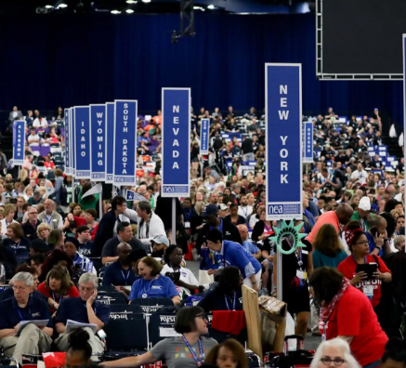
Why is this Our Work?

Slide 13
Bylaw 3-1(g) and Leadership Diversity (2006)
Additional Resources
What do you know about Bylaw 3-1(g)?
Most often thought about in relation to RA membership
Comprehensive measure for encouraging racial/ethnic diversity in leadership
Always intended to be more that meeting an RA quota – to encourage diverse leaders in all aspects of the affiliate’s work.

Slide 14
Resolution I: White Supremacy Culture
Additional Resources
The National Education Association believes that, in order to achieve racial and social justice, educators must acknowledge the existence of White supremacy culture as a primary root cause of institutional racism, structural racism, and White privilege. Additionally, the Association believes that the norms, standards, and organizational structures manifested in White supremacy culture perpetually exploit and oppress people of color and serve as detriments to racial justice.

Slide 15
Resolution I: White Supremacy Culture
Further, the invisible racial benefits of White privilege, which are automatically conferred irrespective of wealth, gender, and other factors, severely limit opportunities for people of color and impede full achievement of racial and social justice. Therefore, the Association will actively advocate for social and educational strategies fostering the eradication of institutional racism and White privilege perpetuated by White supremacy culture.

Slide 16
Honoring Native Lands NBI 64
New Business Item (NBI) 64 proposed:
"At the beginning of all NEA convenings, NEA will acknowledge the native people of whom this land originated."
It passed without opposition.

Slide 17
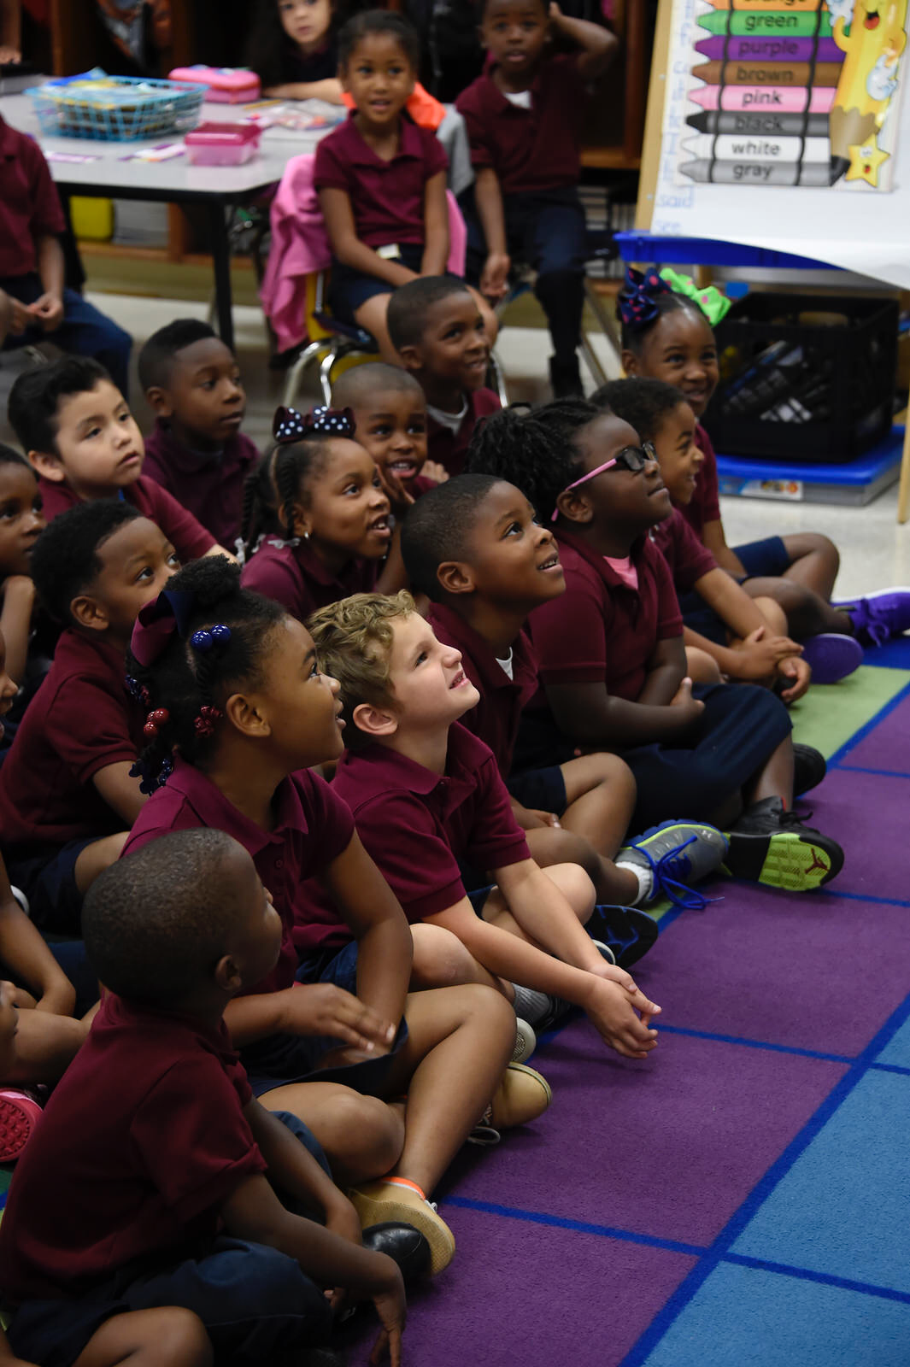
NEA Mission and Vision
Additional Resources
Vision…a great public school for every student.
Mission…advocate for education professionals and to unite our members and the nation to fulfill the promise of public education
Core Values:
  Equal Opportunity
  A Just Society Democracy
  Professionalism
  Partnership
  Collective Action

Slide 18
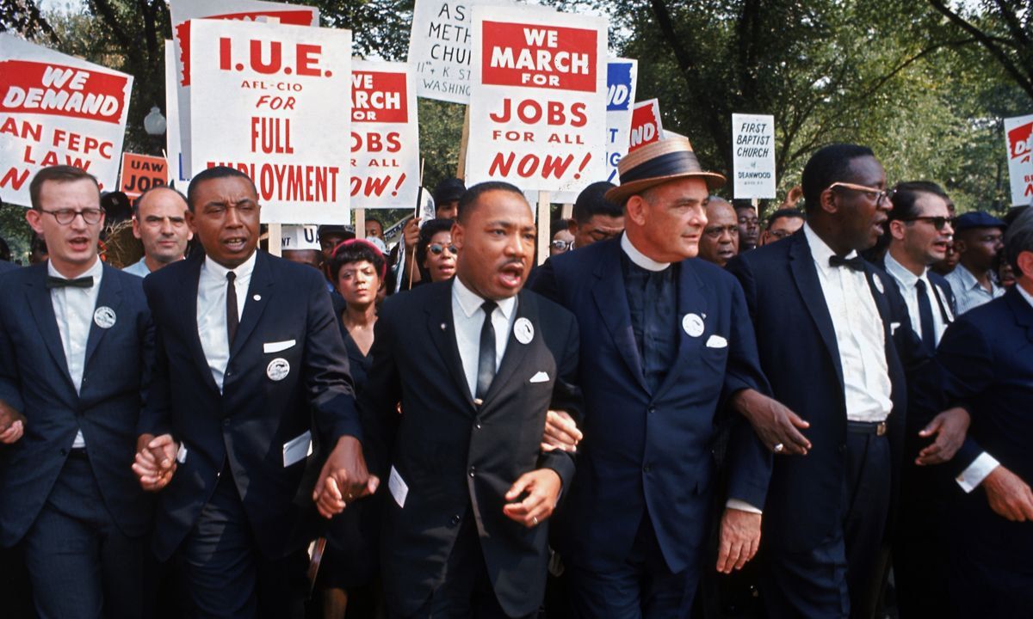
Why it matters to me
“In our glorious fight for civil rights, we must guard against being fooled by false slogans, such as ‘right to work.’ It is a law to rob us of our civil rights and job rights.
Its purpose is to destroy labor unions and the freedom of collective bargaining by which unions have improved wages and working conditions of everyone…Wherever these laws have been passed, wages are lower, job opportunities are fewer and there are no civil rights.”
Martin Luther King

Slide 19

How our work with you is framed
Racial justice is the systematic fair treatment of people of all races, resulting in equitable opportunities and outcomes for all.
To achieve this requires an explicit, though not exclusive, examination of race and ethnicity and a “race and ...” approach that examines how race compounds and intersects with other societal issues.

Slide 20
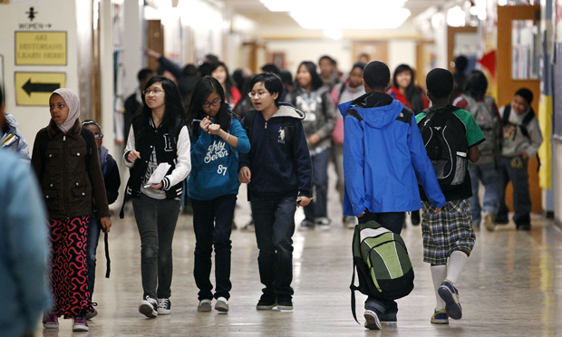
Guiding Question
As participants in this room, what does this mean in your work?

Slide 21
Introductions

Slide 22

Introductions
Community and relationships are important.
Please share
Name
Pronouns
State You Work In
Core Value Leading Your Work
Notes:
Lisa

Slide 23
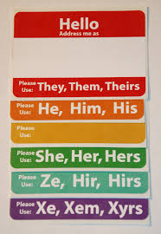
Why share your pronouns?
You can’t just assume by looking.
Asking and correctly using someone's pronouns is the easiest way to show your respect for their gender identity.
Wrong pronoun use can make a person feel disrespected, invalidated, dismissed, alienated, or dysphoric (or, often, all of the above.)
It is a privilege to not have to worry about which pronoun someone is going to use for you.

Slide 24

Core values are the
fundamental beliefs of
a person. These guiding
principles dictate
behavior, choices, and
attitudes.
Our actions may not always reflect our stated core values.

Slide 25

Community Agreements p. 2-3
Awareness & Self-Knowledge
Listen for Understanding
Be Gracious
Stay Engaged
Be Open & Suspend Judgment
Say “I”- tell your truth
Lean into Discomfort
Reach for Empathy
Expect Non-Resolution & Non-Closure

Slide 26
Bekah and Greylor

Slide 27
Move Up

Slide 28
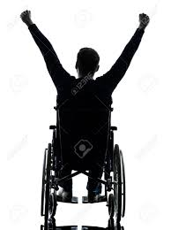
Move Up!
Listen
Listen to the following statements.
Move up
Move up (or remain up) if the statement describes you.
Move down
Move down(or remain down) if the statement does not describe you.
(Adapted from “Stand Up Activity A4.” Lindsey, R., Nuri Robins, K., & Terrell, R. (2009). Cultural proficiency: A manual for school leaders.)

Slide 29
Move Up!
  How did you feel when you heard the statements?
  How did it feel to move into the circle, and how did it feel to be left on the outside?
  Did anything surprise you? Did you notice anything new or different about yourself or the group?
  What have you learned from this activity?
  How does this relate to your work back home?
(Adapted from “Stand Up Activity A4.” Lindsey, R., Nuri Robins, K., & Terrell, R. (2009). Cultural proficiency: A manual for school leaders.)

Slide 30

Key Points
We all have a unique relationship to power and privilege.
Each relationship to power and privilege and the truths associated with that are valid.

Slide 31

Break

Slide 32
Linda and Matt

Slide 33
What is Oppression?

Slide 34
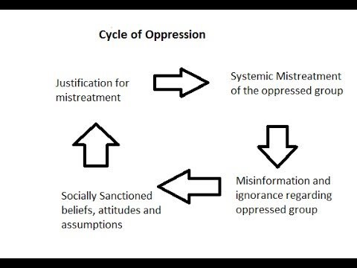
What is Oppression?
Oppression is the experience of repeated, widespread, systemic injustice.
Oppression may be extreme and violent or...
It may be "civilized" or "structural" that is...oppression which is a part of everyday life and built into the laws of society
A group that shares similar characteristics may be oppressed by a more powerful group that does not share those characteristics (race, gender, sexual orientation, ability)

Slide 35
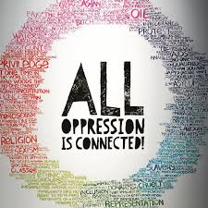
There is no hierarchy of oppressions.
  - Audre Lorde

Slide 36
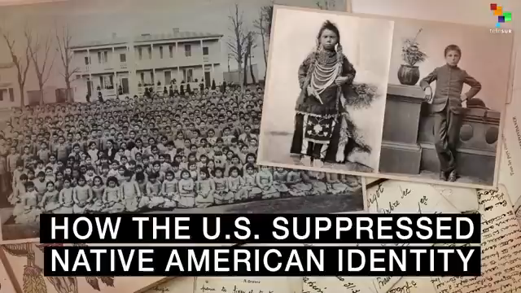

Slide 37
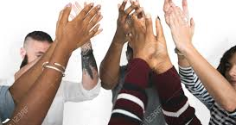
Table Talk
Take the next 10 minutes and discuss your answers to the following questions:
  1. How do you think individuals, institutions and the dominant American society justified this cruel and inhumane treatment?
  2. What kept those who had power and voice (government officials, priests & nuns, teachers, civic leaders, regular citizens) from acknowledging the humanity of these children and preventing this atrocity?

Slide 38
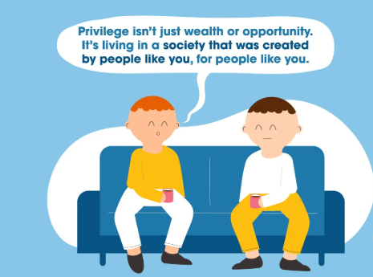
Privilege is...
  An unearned right, favor, or immunity granted to particular individuals or groups and withheld from others
  A key element in perpetuating the power in oppressive systems

Slide 39

Think About Your Life as a Ladder
Reflect on three opportunities you have received that were crucial to your climb.

Slide 40
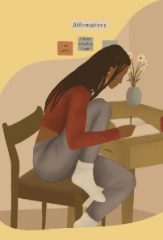
We have reflected...
Now: Share
At your table share one of the opportunities that allowed you to climb your ladder.
Include how that opportunity relates to one of your privileges.

Slide 41

Privilege: Turn to p. 108 of BCG –Racial Justice Guide
A set of advantages systemically conferred on a particular person or group of people.
White people are racially privileged, even when they are economically underprivileged.

Slide 42
Types of Oppression
Matrix of Oppression (pg. 22)
Table Talk
We will assign Oppression Categories for each table.
At your table, discuss how individuals in our organization may (or do) use privilege and power to perpetuate oppression against members in your assigned category
AND how these same individuals might instead intercept that oppression.

Slide 43

Types of Oppression-Activity Debrief
Matrix of Oppression (pg. 21)
What was challenging?
What was easy?
What is going to keep you up at night?

Slide 44
Key Points
Most people do not question why things are considered morally good or evil, rather uncritically, and largely unconsciously, they adopt the "value judgments of good and evil" dominant within their society.
-Nietzsche
Please question. Do not just accept.

Slide 45
Adia and Albert

Slide 46
What words matter?

Slide 47

Defining Race
Race is not biological. Race is a powerful social construct that gives certain people more opportunity and advantages.

Slide 48
Defining Prejudice
According to Merriam-Webster:
Prejudice is injury or damage resulting from some judgment or action of another in disregard of one's rights especially: detriment to one's legal rights or claims.

Slide 49
Defining Racism
RACISM =
PREJUDICE + INSTITUTIONAL POWER
Terms on page 23-24 in Participant Handout and
in the "Additional Participant Resources"

Slide 50


Slide 51
Key Points: Race, Nationality, Ethnicity
Race: A social construct that artificially divides people into distinct groups based on certain characteristics such as physical appearance (particularly skin color) ancestral heritage, cultural affiliation, cultural history, ethnic classification
Nationality: The status of belonging to a particular nation by origin, birth or naturalization
Ethnicity: A social construct that artificially divides people into smaller social groups based on characteristics such as shared sense of group membership, values, behavioral patterns, language, political and economic interests, history, and ancestral geographical base

Slide 52
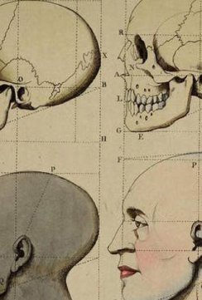
"Race Science"
In the late 1800s the pseudoscience called “race science” developed arguing that race is a biological category. It linked capability to race.
In 1925, using this as the basis, the Central Tube Company (Pittsburgh) created a table claiming to connect race to adaptability to plant work.

Slide 53
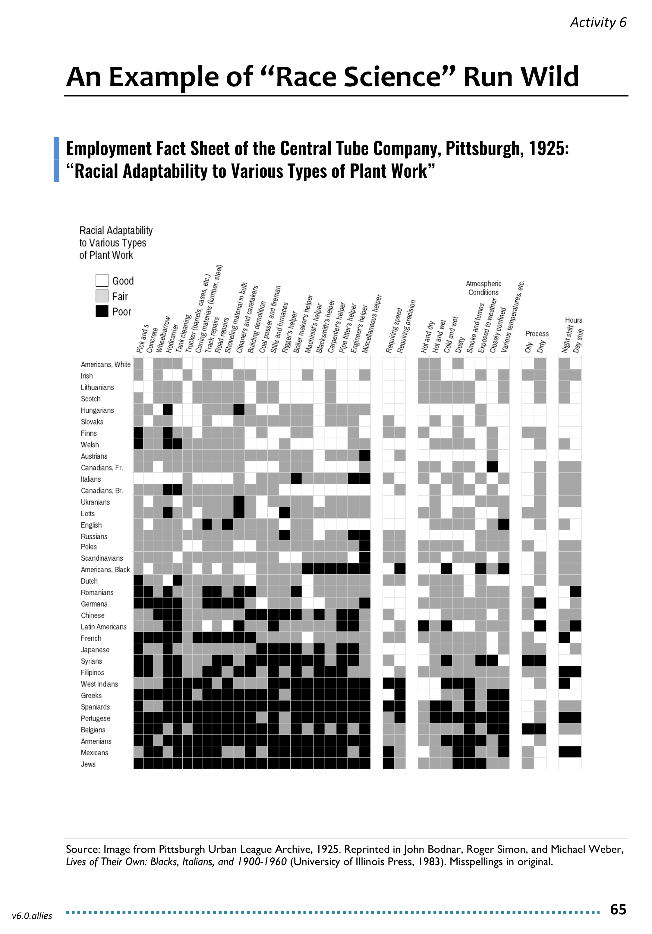
Table Talking
Page 25 of Participant Handout
Look for “White Americans” on the chart. What does this category tell us about who was white in 1925? Who is white today?
Do you see any legacies of this thinking in your work today? If so, how?
Bonus: If you were an organizer during this time, how would you use this data to organize your worksite?

Slide 54
Tell us about your Talking
What did you hear or say that you think needs to be shared out to the larger group?

Slide 55
Key Points
In our society, people have been taught that we should not say the word, “race.”
Race is a construct developed to support oppression within a system of white supremacy.
Once you recognize the existence of oppression and understand how it operates, you can learn how to resist and challenge oppression in all forms.

Slide 56

Lunch

Slide 57
Matt and Greylor

Slide 58
Expressions of Racism

Slide 59

Let’s Add to Our Definition of Racism
An historically-rooted system of power hierarchies based on race
—infused in our institutions, policies, and culture—that benefits white people and hurts people of color.
Racism isn’t limited to individual acts of prejudice. Rather, the most damaging racism is built into systems and institutions that shape our lives.
Most coverage of race and racism is not “systemically aware,” meaning that it either focuses on racism at the level of an individuals’ speech or actions (Central Park birdwatcher incident May 25, 2020), dismisses systemic racism, or refers to racism in the past tense.
*Source: Bargaining for the Common Good Racial Justice Guide

Slide 60
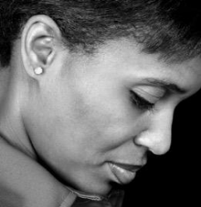

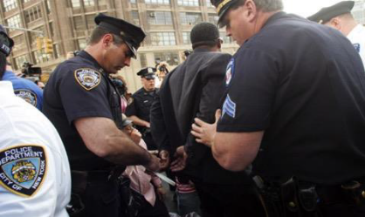
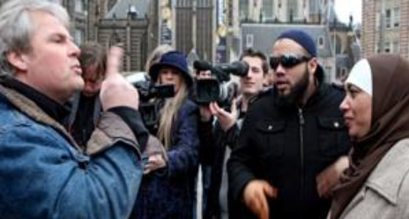
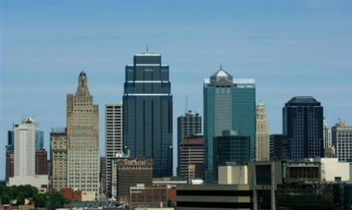
Levels of Racism Participant Handouts p. 6
Individual
Internalized
Interpersonal
Systemic
Institutional
Structural
Notes:
INDIVIDUAL-LEVEL RACISM
INTERNALIZED RACISM lies within individuals. These are our private beliefs and biases about race and racism, influenced by our culture. Forms: racial prejudice toward other people of a different race; internalized oppression, the negative beliefs about oneself by people of color; or internalized privilege, beliefs about superiority or entitlement by white people.
INTERPERSONAL RACISM occurs between individuals. These are biases that occur when individuals interact with others and their private racial beliefs affect their public interactions.
SYSTEMIC-LEVEL RACISM
INSTITUTIONAL RACISM occurs within institutions and systems of power. It is the unfair policies and discriminatory practices of particular institutions (schools, workplaces, etc.) that routinely produce racially inequitable outcomes for people of color and advantages for white people. Individuals within institutions take on the power of the institution when they reinforce racial inequities.
STRUCTURAL RACISM is racial bias among institutions and across society. It involves the cumulative and compounding effects of the interactions of institutions and policies that systematically privilege white people and disadvantage people of color.

Slide 61
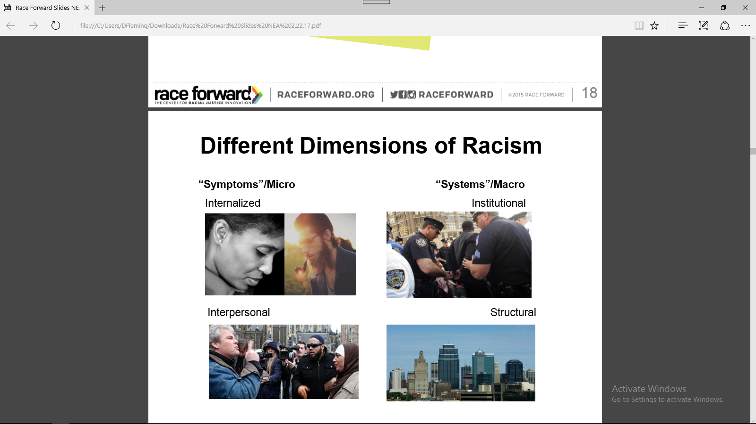
Internalized Racism
Internalized racism lies within individuals. These are private beliefs about race that reside inside our minds.
Examples: prejudice, xenophobia, internalized oppression and privilege, and biases (conscious and unconscious) about race influenced by the dominant culture.
Notes:
Internalized racism
All the prejudice, bias and blind spots you have within yourself as an individual

Slide 62
Interpersonal Racism
Interpersonal racism occurs between individuals. Once we bring our private beliefs about race into our interactions with others, we are now in the interpersonal realm.
Examples: public expressions of prejudice, hate, bias and bigotry between individuals.
Source: Race Forward 2018
Notes:
Interpersonal Racism
What happens when you act out those blind spots and bias on each other
This symptoms are recognized day to day, we talk about them most, and it’s easy to focus here

Slide 63
Institutional Racism
Institutional racism occurs within institutions. It involves discriminatory treatment, unfair policies and practices, and inequitable opportunities and impacts, based on race.
Examples: A school system that concentrates people of color in the most overcrowded, under-funded schools with the least experienced teachers.
Source: Race Forward 2018
Notes:
Institutional Racism occurs within institutions and systems of power. It is the norms, policies and practices that are structured into political, societal and economic institutions that have the net effect of imposing oppressive conditions and denying rights, opportunity, and equality to identifiable groups based upon race or ethnicity.
Resolution I new business item refers to the institutional racism
(white supremacy is structural)
We have worked on this, however, we focused on the personal and interpersonal versus focusing on the structural/institutional- make point.

Slide 64
Structural Racism
Structural racism is racial bias across institutions and society. It’s the cumulative and compounded effects of an array of factors that systematically privilege white people and disadvantage people of color.
Examples: The “racial wealth divide”(where whites have many times the wealth of people of color) results from generations of discrimination and racial inequality.
Source: Race Forward 2018
Notes:
Structural Racism is racial bias across institutions and society. It’s the cumulative and compounded effects of an array of factors that systematically privilege white people and disadvantage people of color.

Slide 65
Key Points
There are no hard and fast lines between the levels – and changing one can affect another.
While we believe that the individual is responsible for exploring personal bias …
The way to effect change is by addressing institutionalized and structural racism – this is where injustice lives.

Slide 66
Expressions of Racism Exercise p. 6-10 of PH
Applying your new knowledge:
We are going count off by 8’s
There are 8 Scenarios
Your team will be responsible for providing a two-sentence summary of the scenario, identifying the level of expression of racism – and providing “why” you came to this conclusion (total of one minute).
Notes:
There are 8 Scenarios. You will work in small groups to identify the level of racism in your scenario. Count off by 8. Find your new groups. Take your booklet along with a pen/pencil.
Assign group their Scenario
Each group will discuss and identify the level of racism in your scenario

Slide 67
Report and Debrief
1 Minute Report Outs
Please share…
    Two sentence summary
    What level did your group determine your scenario was at and why?
Notes:
Briefly describe the scenario to the larger group, we don’t have time to read them all. What level did your group determine your scenario was at and why? What did you struggle with? What was Clear to You? Let’s revisit our key point - there are not hard and fast lines between the levels – and changing one can affect another. While we believe that the individual is responsible for exploring personal bias – the way to effect change is by addressing institutionalized and structural racism – this is where injustice lives.
Remind them that they will return to this group again, so remember their assigned group number.

Slide 68
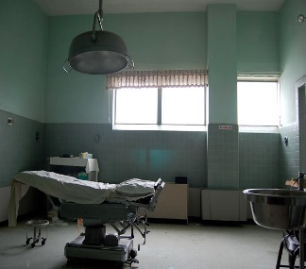
Understanding Expressions of Racism
Scenario #1: Racism in Medicine
Racism has influenced U.S. health care in the past and continues to do so today. The most shameful chapters in American history involve the U.S. government funding studies that allowed poor black men in Alabama to succumb to syphilis or Guatemalan prison inmates, mental health patients and soldiers to be afflicted with the disease and other sexually transmitted infections.
Government agencies also played a role in sterilizing black women in North Carolina, Puerto Rican women and Native American women.
What is the expression of racism?

Slide 69
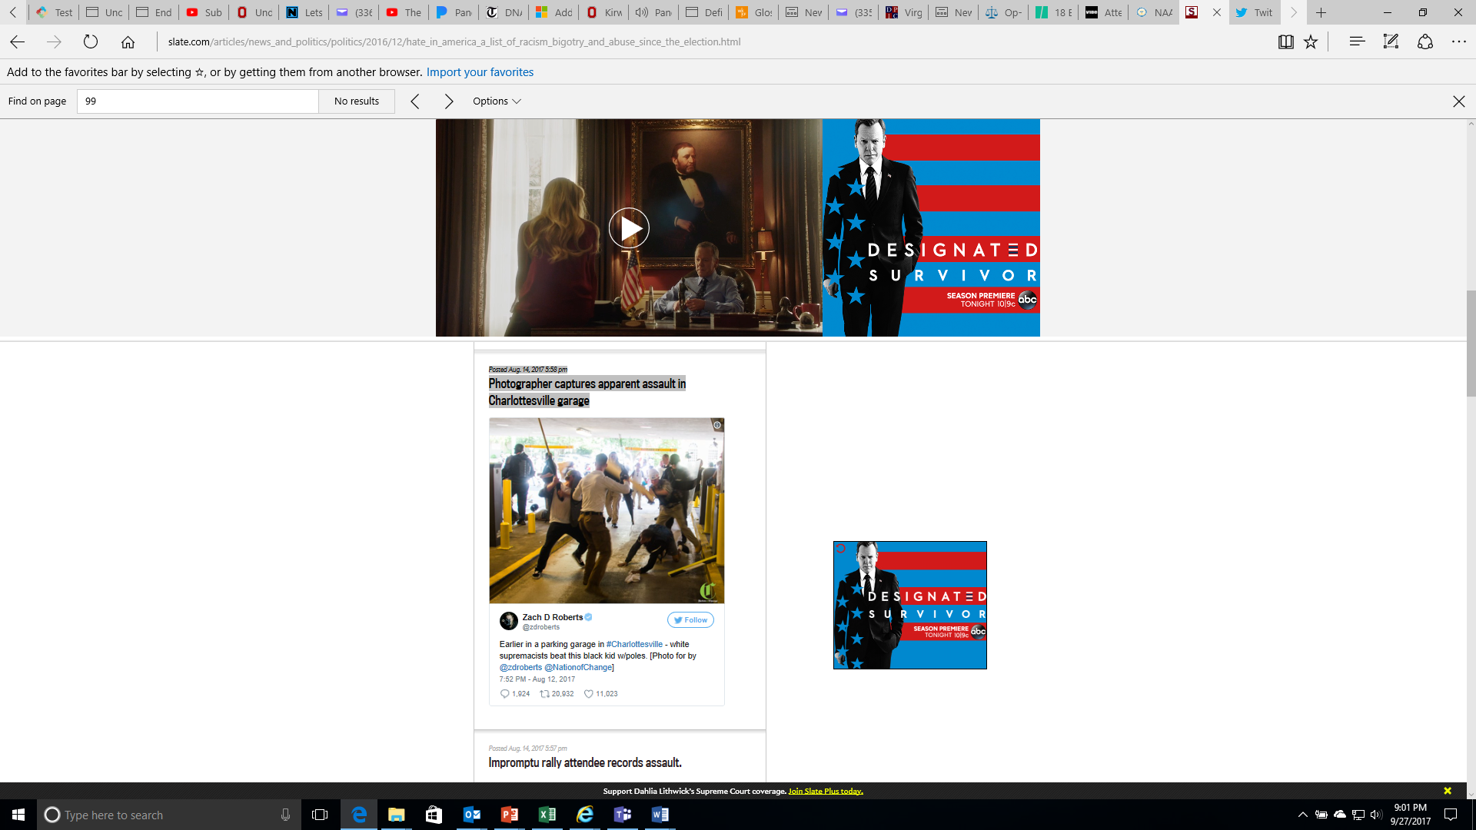
Understanding Expressions of Racism
Scenario #2: Assault in Charlottesville
What is the expression of racism?

Slide 70
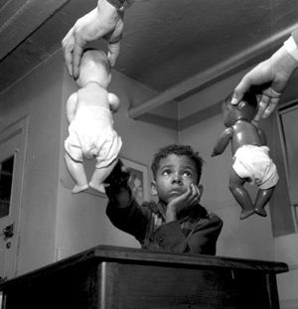
Understanding Expressions
of Racism
Scenario #3: The Doll Test
In the 1940s, psychologists Kenneth and Mamie Clark designed and conducted a series of experiments known colloquially as “the doll tests” to study the psychological effects of segregation on African-American children.
Drs. Clark used four dolls, identical except for color, to test children’s racial perceptions. Their subjects, children between the ages of three to seven, were asked to identify both the race of the dolls and which color doll they prefer. Most of the children preferred the white doll and assigned positive characteristics to it. The Clarks concluded that “prejudice, discrimination, and segregation” created a feeling of inferiority among African-American children and damaged their self-esteem.
What is the expression of racism?

Slide 71
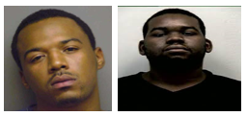
Understanding Expressions of Racism
Scenario #4: Looking Death Worthy
According to a 2006 report, Looking Death Worthy, defendants with the most stereotypically Black facial features (i.e. dark skin, large/full lips, etc.) served up to 8 months longer in prison for felonies than defendants who possessed the least stereotypical features.
In this same study, researchers investigated the role of race in capital sentencing, and in particular, whether the race of the defendant or victim influences the likelihood of a death sentence. The study concludes that in cases involving a White victim, the more stereotypically Black a defendant is perceived to be, the more likely that person is to be sentenced to death.
What is the expression of racism?

Slide 72
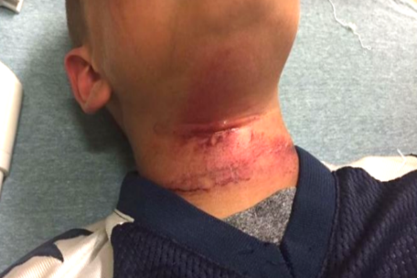
Understanding Expressions of Racism
Scenario #5: Biracial Boy Pushed Off Tape
Teenagers in New Hampshire taunted an 8-year-old biracial boy with racial slurs and then pushed him off a picnic table with a rope around his neck, injuring him, the boy’s family said.
The child was treated at a hospital for cuts to his neck following the near-hanging Aug. 28 in Claremont, the boy’s grandmother, Lorrie Slattery, told the Valley News of West Lebanon, N.H. He has since been released and has returned to school in Claremont…
… An expert on abuse who spoke to the boy at the hospital said he swung from his neck three times before being able to remove the rope, Slattery said. None of the teens came to his aid, she said.
What is the expression of racism?

Slide 73
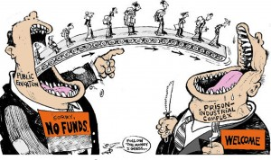
Understanding Expressions of Racism
Scenario #6: The School-To-Prison Pipeline
A significant number of Chicago students are pushed into the path of juvenile and adult prisons as a result of harsh disciplinary policies and high stakes testing. By harsh disciplinary policies, we mean excessive security procedures and police involvement as well as the overuse of suspensions and expulsion for minor infractions. These policies feed the “School to Prison Pipeline”, sometimes also called the “Schoolhouse to Jailhouse Track”.
Research suggests that students of color, in particular African American students, are disproportionately impacted by these punitive policies…These zero tolerance policies involve the police in minor incidents and often lead to arrests, juvenile detention referrals, and even criminal charges and incarceration.
What is the expression of racism?

Slide 74
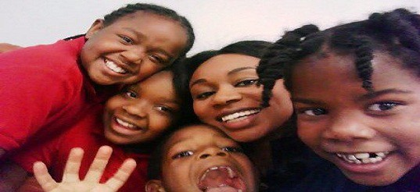
Understanding Expressions of Racism
Scenario #7: Woke Girls
Before school started every morning a 1st-grader student in my class, with very dark skin would visit me so I could apply cocoa butter lotion to his skin. I assumed it was just about the lotion, but when I tried to give him a bottle he could keep in his classroom, he cried and told me I was the only one who thought his skin was beautiful.
Just down the hall in the 3rd-grade ESL class, two Mexican American girls got into a fight. The cause? One girl called the other a “little Mexican girl.”…
…Besides modeling self-love and loving my students, I made an effort to fill my classroom library with books that would support my students to be who they already were. That was quite the challenge.
What is the expression of racism?

Slide 75
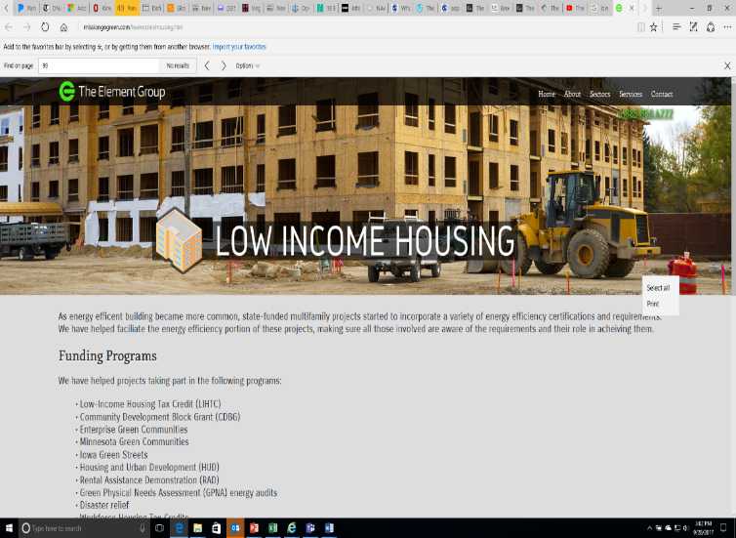
Understanding Expressions of Racism
Scenario #8: Doorway to a Better Life
A state government agency decides that low-income housing must be built, which will house low-income Blacks and Latinos. The agency fails to look for locations near jobs and important infrastructures, like schools, decent public transportation, and other services. In fact, it is built in a poor, mostly Black and Latino part of town. Often times the government locates the housing where it will have the least opposition. White neighborhoods tend to oppose public and affordable housing. Resources, whether public or private, often follow whites who flee urban problems for white suburbs
When the housing is built, the school district, already under-funded, has new residents too poor to contribute to its tax base. The local government spends its limited resources on transportation to connect largely white, well-to-do suburban commuters to their downtown jobs.
The public housing residents are left isolated, in under-funded schools, with no transportation to job centers. Whole communities of people of color lose opportunities for a good education, quality housing, living wage jobs, services and support-systems.
In this town, no one individual stands in front of the doorway to a better life and says, “No Blacks/Latinos/ Native Americans/Asians allowed.” Race, however, is the unspoken motivator behind a series of actions which lead to decisions about where to place the walls.
What is the expression of racism?

Slide 76
Key Points
1. There are no hard and fast lines between the levels – and changing one can affect another.
While we believe that the individual is
responsible for exploring personal bias …
2. The way to effect change is by addressing institutionalized and structural racism – this is where injustice lives.

Slide 77
Adia and Scott

Slide 78
Looking for Expressions of Racism

Slide 79
Everyday Racism in Union Work
Angel’s Story (pg 11-12)
Remain in your current group
Work: (15 minutes)
As you read and discuss, consider whether Angel is thriving in their institutions (school/union).
Each Group will focus on one question from the chart
All Groups will discuss the following:
  As union leaders, what is our role in interrupting the instances of racism that you recognize?
Report out (10 minutes)
What are some examples of Internal Racism? (private beliefs and opinions)? | 3. What are some examples of Institutional Racism (within systems of power)?
2. What are some examples of Interpersonal Racism (between individuals)? | 4. What are some examples of Structural Racism (across systems of power)?

Slide 80
Key Points
Racial Oppression is always there.
We have to be intentional in looking for expressions of racism if we are going to redress them.
We have to recognize that we are likely unintentional contributors to the problem – and we have to choose to be intentional participants in the solution.

Slide 81
Bekah and Scott

Slide 82
Systems of Oppression

Slide 83

Systems of Income and Wealth
Two guiding questions:
Are your members doing better financially than they were 10 years ago? What “signs” would you see that support your answer?
What is the difference between income and wealth?
Notes:
We are going to look at one example of systemic racism that impacts our members and their jobs – income. Take just a moment in your mind and consider the following question – in the last decade, has the income that your members receive been improving? How do you know? We are going to look at the changes in family income during two recent periods of economic growth. First, let’s talk a little about income. What are some examples of income? (wages, salary, savings account interest, social security check, rent from owning real estate, capital gains from selling investments, dividends from stocks, gifts, etc.) Now let’s have five volunteers come to the front of the room. Please stand should to shoulder. Each gets a sign showing the income range — in pre-tax, year 2014 dollars — of the quintile they represent.

Slide 84
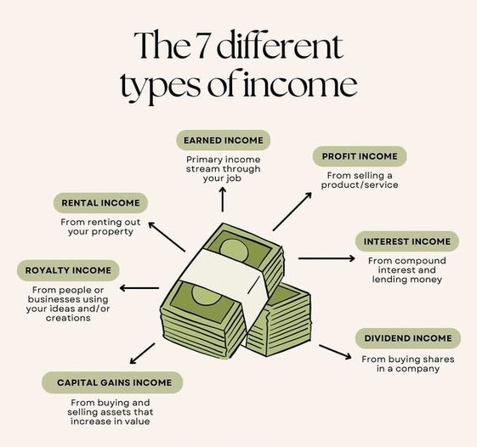
Income
Income is the revenue that a person can bring into their household.
Notes:
We are going to watch how income has changed over quintiles in the population – Economists talk about the U.S. population in “quintiles” or “fifths”. They imagine the entire population of the U.S. lined up in order, from the lowest income to the highest. They then divide that line into five equal parts. This activity looks at what happened to the incomes during two periods of economic growth: 1947-1979 and 1979-2014.
Look at the signs the volunteers are holding – this number represents median Family Income. What jobs would be under each of these categories? What economic challenges would each have? Where are our members (pay attention to job classes and state differences.) Each volunteer, representing a quintile or fifth (20 percent) of the U.S. population, will step forward or back according to whether their income gained or declined. Each step equals a five percent change, so, for example, two steps forward would indicate an income gain of 10%.

Slide 85

Wealth
Wealth is anything that can be liquidated and/or passed from generation to generation - minus debt.
Notes:
We are going to watch how income has changed over quintiles in the population – Economists talk about the U.S. population in “quintiles” or “fifths”. They imagine the entire population of the U.S. lined up in order, from the lowest income to the highest. They then divide that line into five equal parts. This activity looks at what happened to the incomes during two periods of economic growth: 1947-1979 and 1979-2014.
Look at the signs the volunteers are holding – this number represents median Family Income. What jobs would be under each of these categories? What economic challenges would each have? Where are our members (pay attention to job classes and state differences.) Each volunteer, representing a quintile or fifth (20 percent) of the U.S. population, will step forward or back according to whether their income gained or declined. Each step equals a five percent change, so, for example, two steps forward would indicate an income gain of 10%.

Slide 86
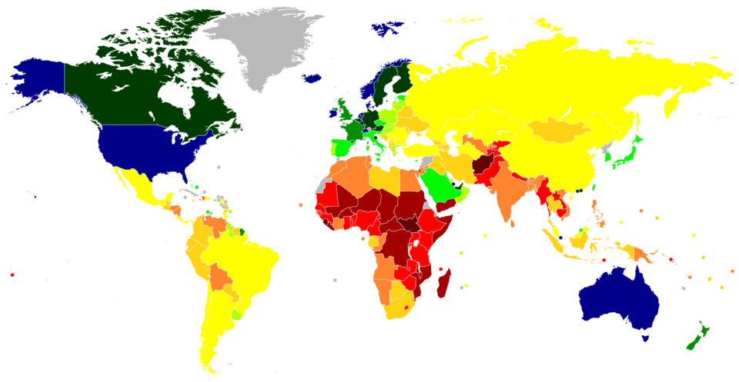
Per Capita Income
Per Capita Income is the average income earned by each person in a specific area, like a country.
What do you think the Per Capita Income is in the US?
  US Per Capita Income 2025

Slide 87
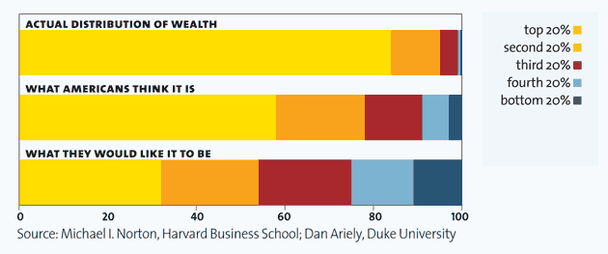
Actual v Perceived Wealth
Actual v Perceived Wealth is a study of what most Americans believe about inequities and wealth, what they actually are, and what they it should be
Wealth Distribution Perceived v Actual

Slide 88
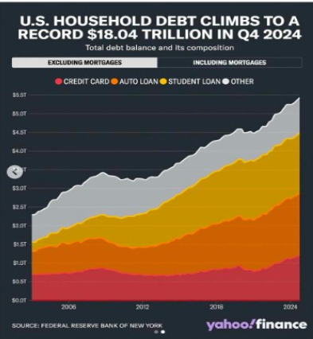
Negative Wealth
Negative Wealth is when you owe more than you own. It is created when your expenses are greater than your income (aka-Debt)
    In 2019: 10% of American have negative net worth.
    In 2024: 31% of Americans have a net worth of $0 or less
      Black/Brown America-1 in 4 have negative wealth
      White America- 1 in 12 have negative wealth

Slide 89
Income Steps Activity
Need 7 Volunteers
Two Periods of Economic Growth (1947-1979) and (1979-2014)
5 will represent each Income Quintile and 2 will represent the top 5% and 1%
Notes:
We are going to look at one example of systemic racism that impacts our members and their jobs – income. Take just a moment in your mind and consider the following question – in the last decade, has the income that your members receive been improving? How do you know? We are going to look at the changes in family income during two recent periods of economic growth. First, let’s talk a little about income. What are some examples of income? (wages, salary, savings account interest, social security check, rent from owning real estate, capital gains from selling investments, dividends from stocks, gifts, etc.) Now let’s have five volunteers come to the front of the room. Please stand should to shoulder. Each gets a sign showing the income range — in pre-tax, year 2014 dollars — of the quintile they represent.

Slide 90
Income Quintiles: 2014
Income Divided into "fifths" of a population from the lowest income to the highest income.
Take a look at the signs the volunteers are holding – this number represents median Family Income.
  What jobs would be in each of these?
  What economic challenges would each have?
  Where are our members?
2014 Income Quintiles
Lowest Quintile: $0-$29,100
2nd Quintile: $29,101-$52,697
3rd Quintile: $52,698-$82,032
4th Quintile: $82,033-129,006
Highes Quintile: $129,007 and Higher

Slide 91
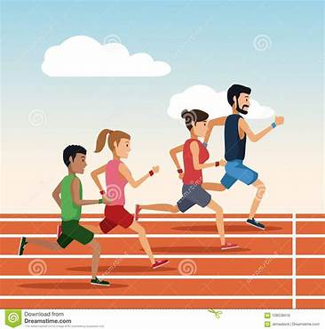
Directions for 1947-1979
Lowest: 23 Steps/Pace Forward (+116%)
Second: 20 Steps/Pace Forward (+100%)
Middle: 22 Steps/Pace Forward (+111%)
Fourth: 22.5 Steps/Pace Forward (+114%)
Highest: 20 Steps/Pace Forward (+99%)
  Top 5%: 17.5 Steps/Pace Forward (+86%)
Notes:
RESET…now let’s look at 1980-2014

Slide 92
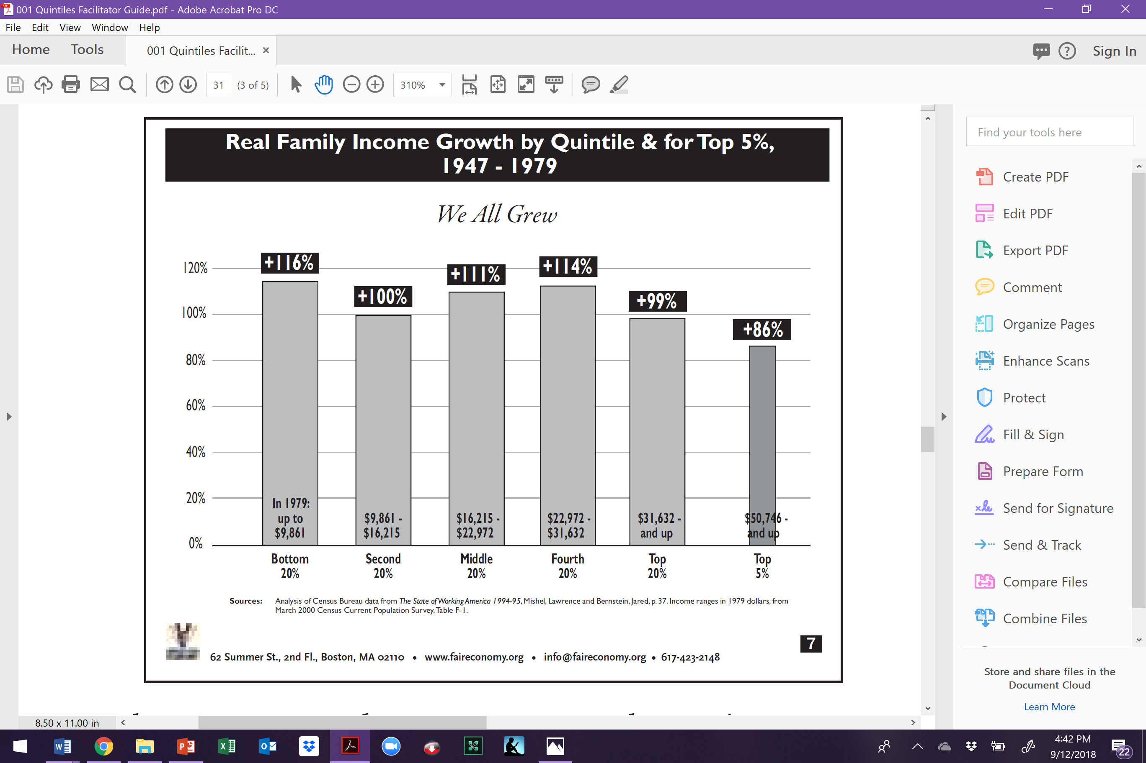
Income: Growth by Quintile 1947-1979
Notes:
During this period, the divide between the top and bottom in America actually narrowed during a period of substantial income growth.
One of the explicit goals of the federal government during early post was period was to build a middle class, people and families who could consume the output of the rapidly growing manufacturing capacity of the U.S programs such as the GI Bill of rights – which enabled hundreds of thousands of returned veterans to go to college and purchase homes – were funded in large part by relatively high taxes on the wealthy. It is important to acknowledge that these programs disproportionately favored white men. For example, the VA and FHA loan programs for housing, both of which utilized racially-restricted underwriting criteria, assured that hardly any of the $120 billion in housing equity loaned from the late 1940s to the early 1960s would go to families of color. These loans helped finance over half of all suburban housing construction in the country during this period, however less than 2% of this housing ended up being lived in by people of color.
In contrast to the post WWII period, the primary goal of economic policy since the 1980s was to let the rich accumulate great capital in the belief that it would trickle down.

Slide 93
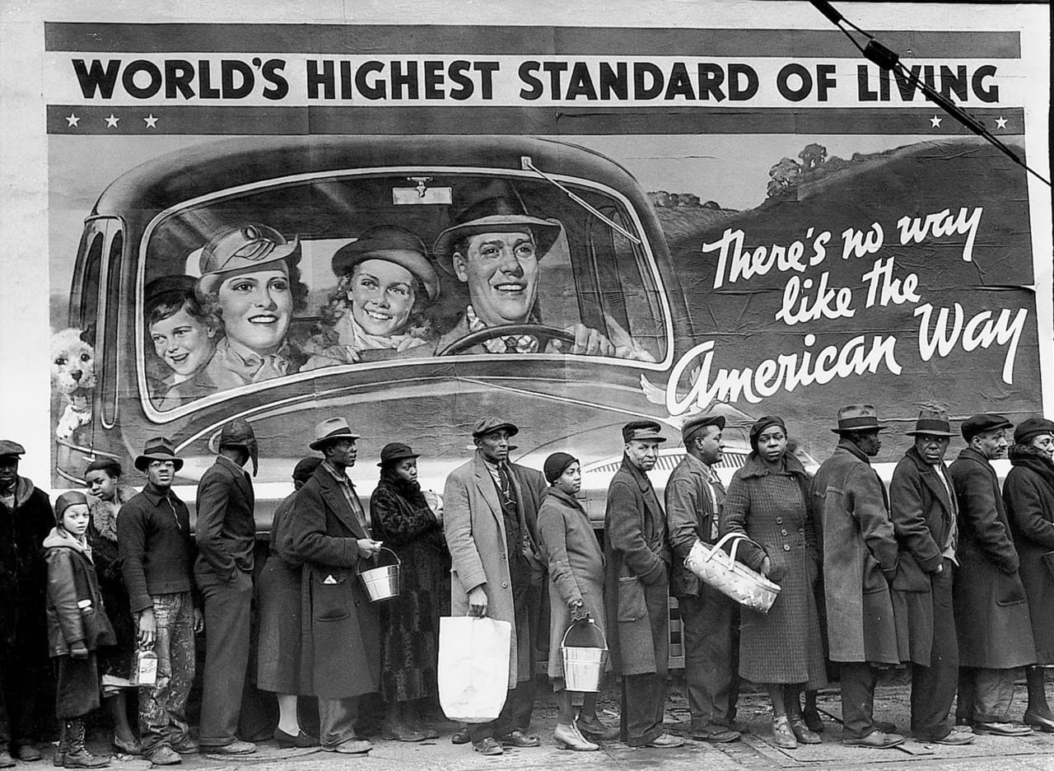
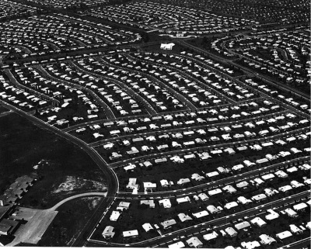
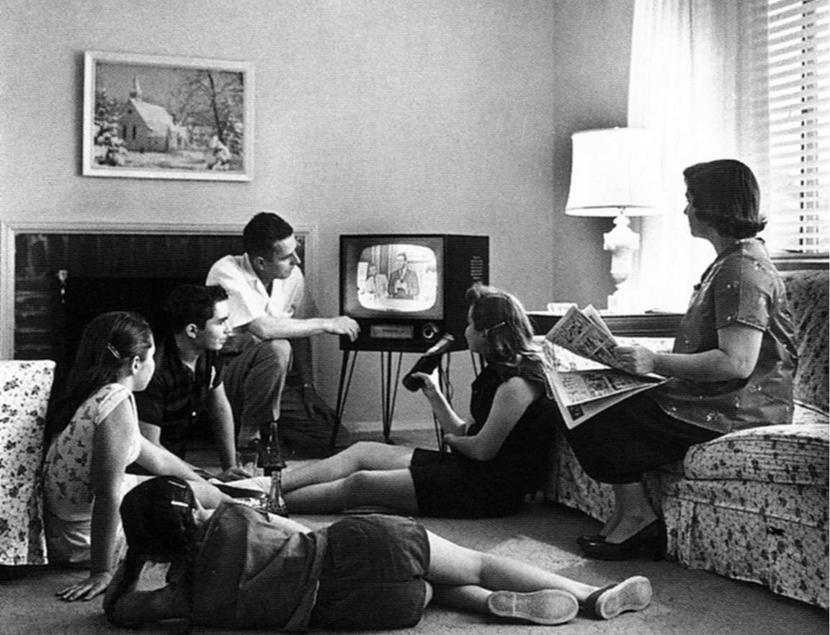
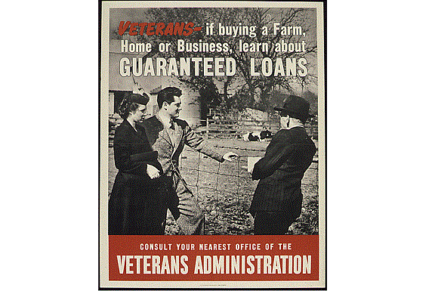
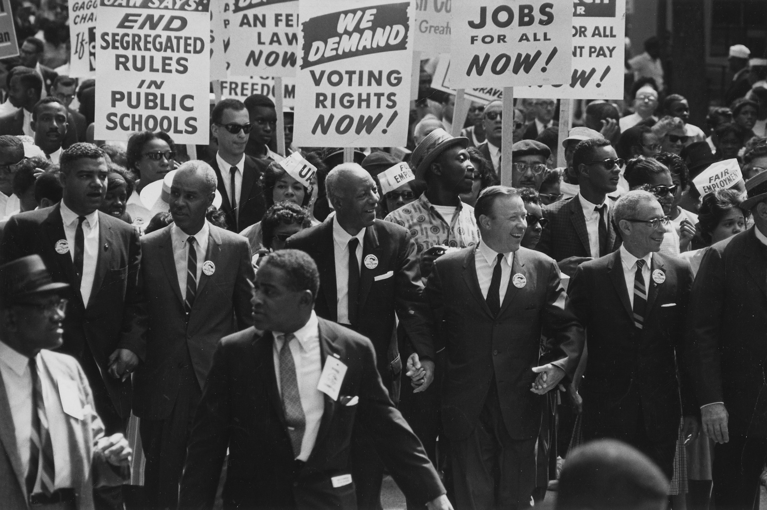
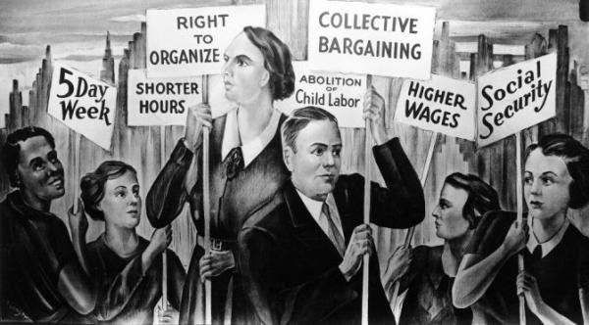
Income and Wealth Exploration
What characterizes this time period in America?
Politics/Historic Events/Unionism
1947-1979
Who was excluded?

Slide 94

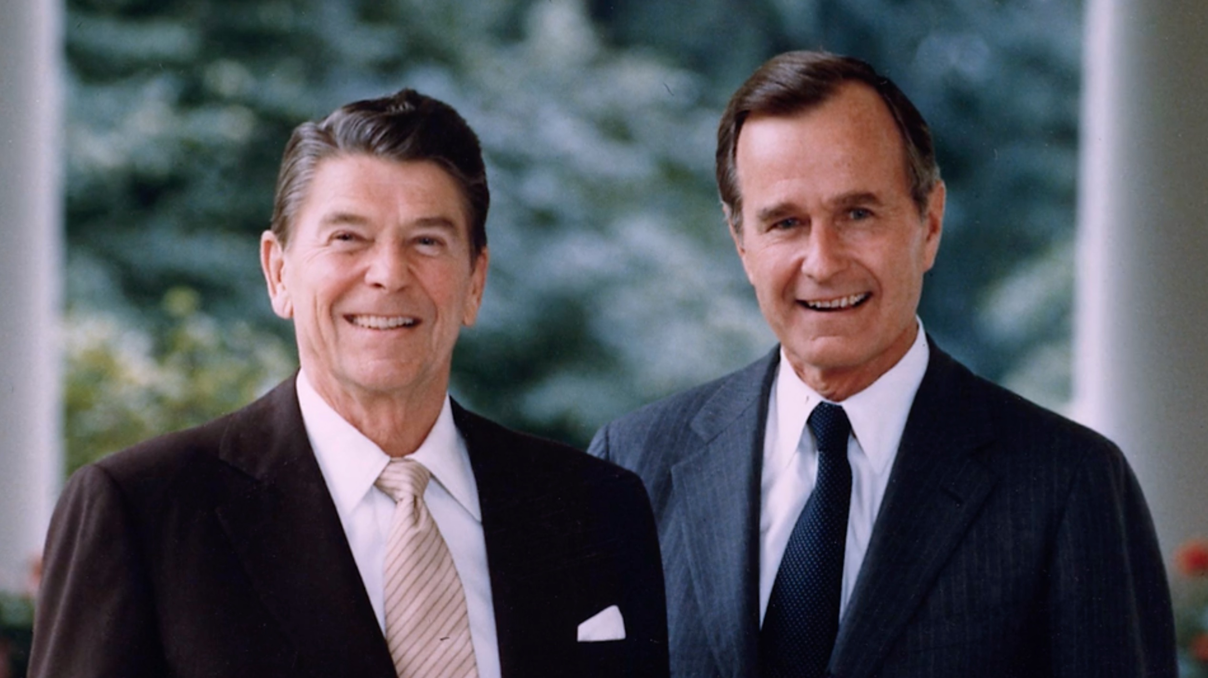
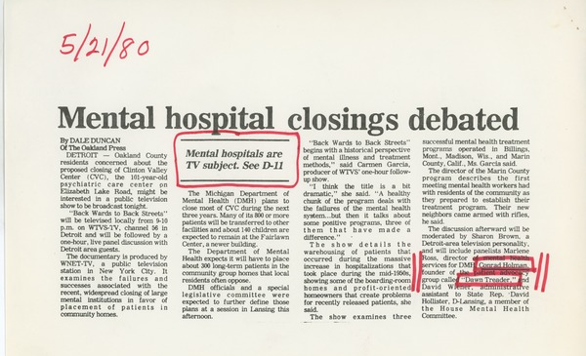
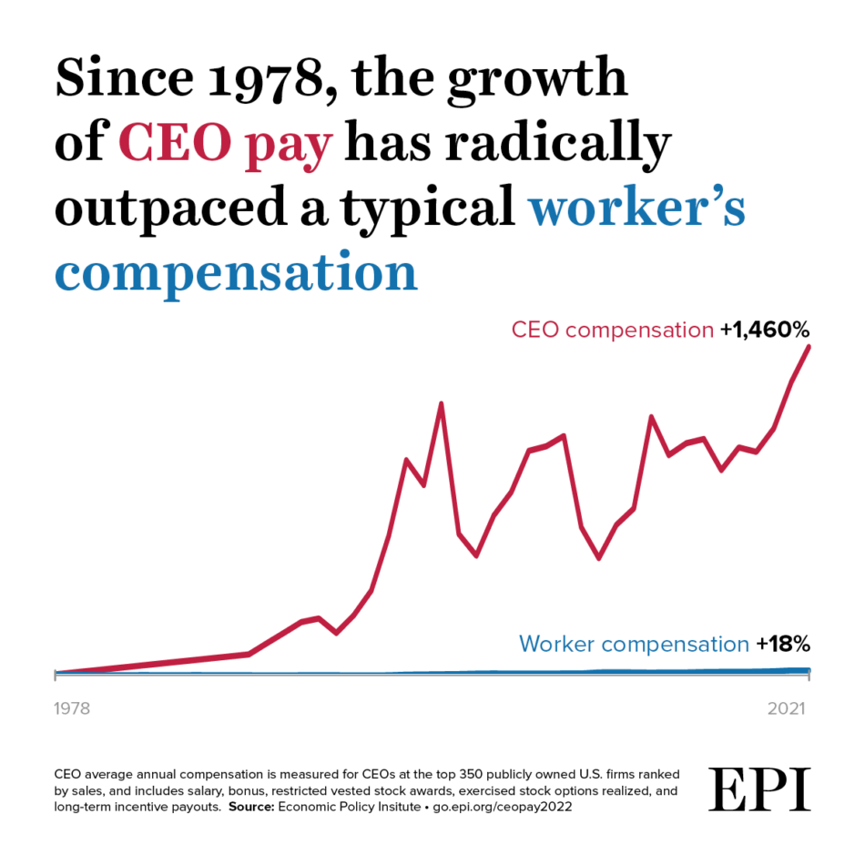
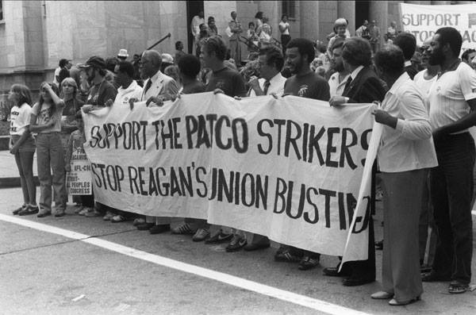
Income and Wealth Exploration
What characterizes this time period in America?
Politics/Historic Events/Unionism
1980-2014

Slide 95
Directions for 1979-2014
Lowest: 2 1/2 steps/paces backward (-12%; $0 - 29,100)
Second: 1/2 step/pace forward (+3%; $29,101 - 52,697)
Middle: 2 steps/paces forward (+12%; $52,698 - 82,032
Fourth: 5 steps/paces forward (+26%; $82,033 - 129,006)
Highest: 10 1/2 steps/paces forward (+54%; $129,007+)
Notes:
Between 1980 and 2014, here’s what happened

Slide 96
Top 5% and Top 1%
Top 5%: 15 1/2 steps/paces forward (+78%) $230,030 and up
Top 1%: 37 steps/paces forward (+185%) $423,090 and up
Notes:
And if we break down the top quintile even further and look at just the top 1%, we see exactly where the greatest income growth went. This small group gained 185%, 37 steps from the starting line.

Slide 97
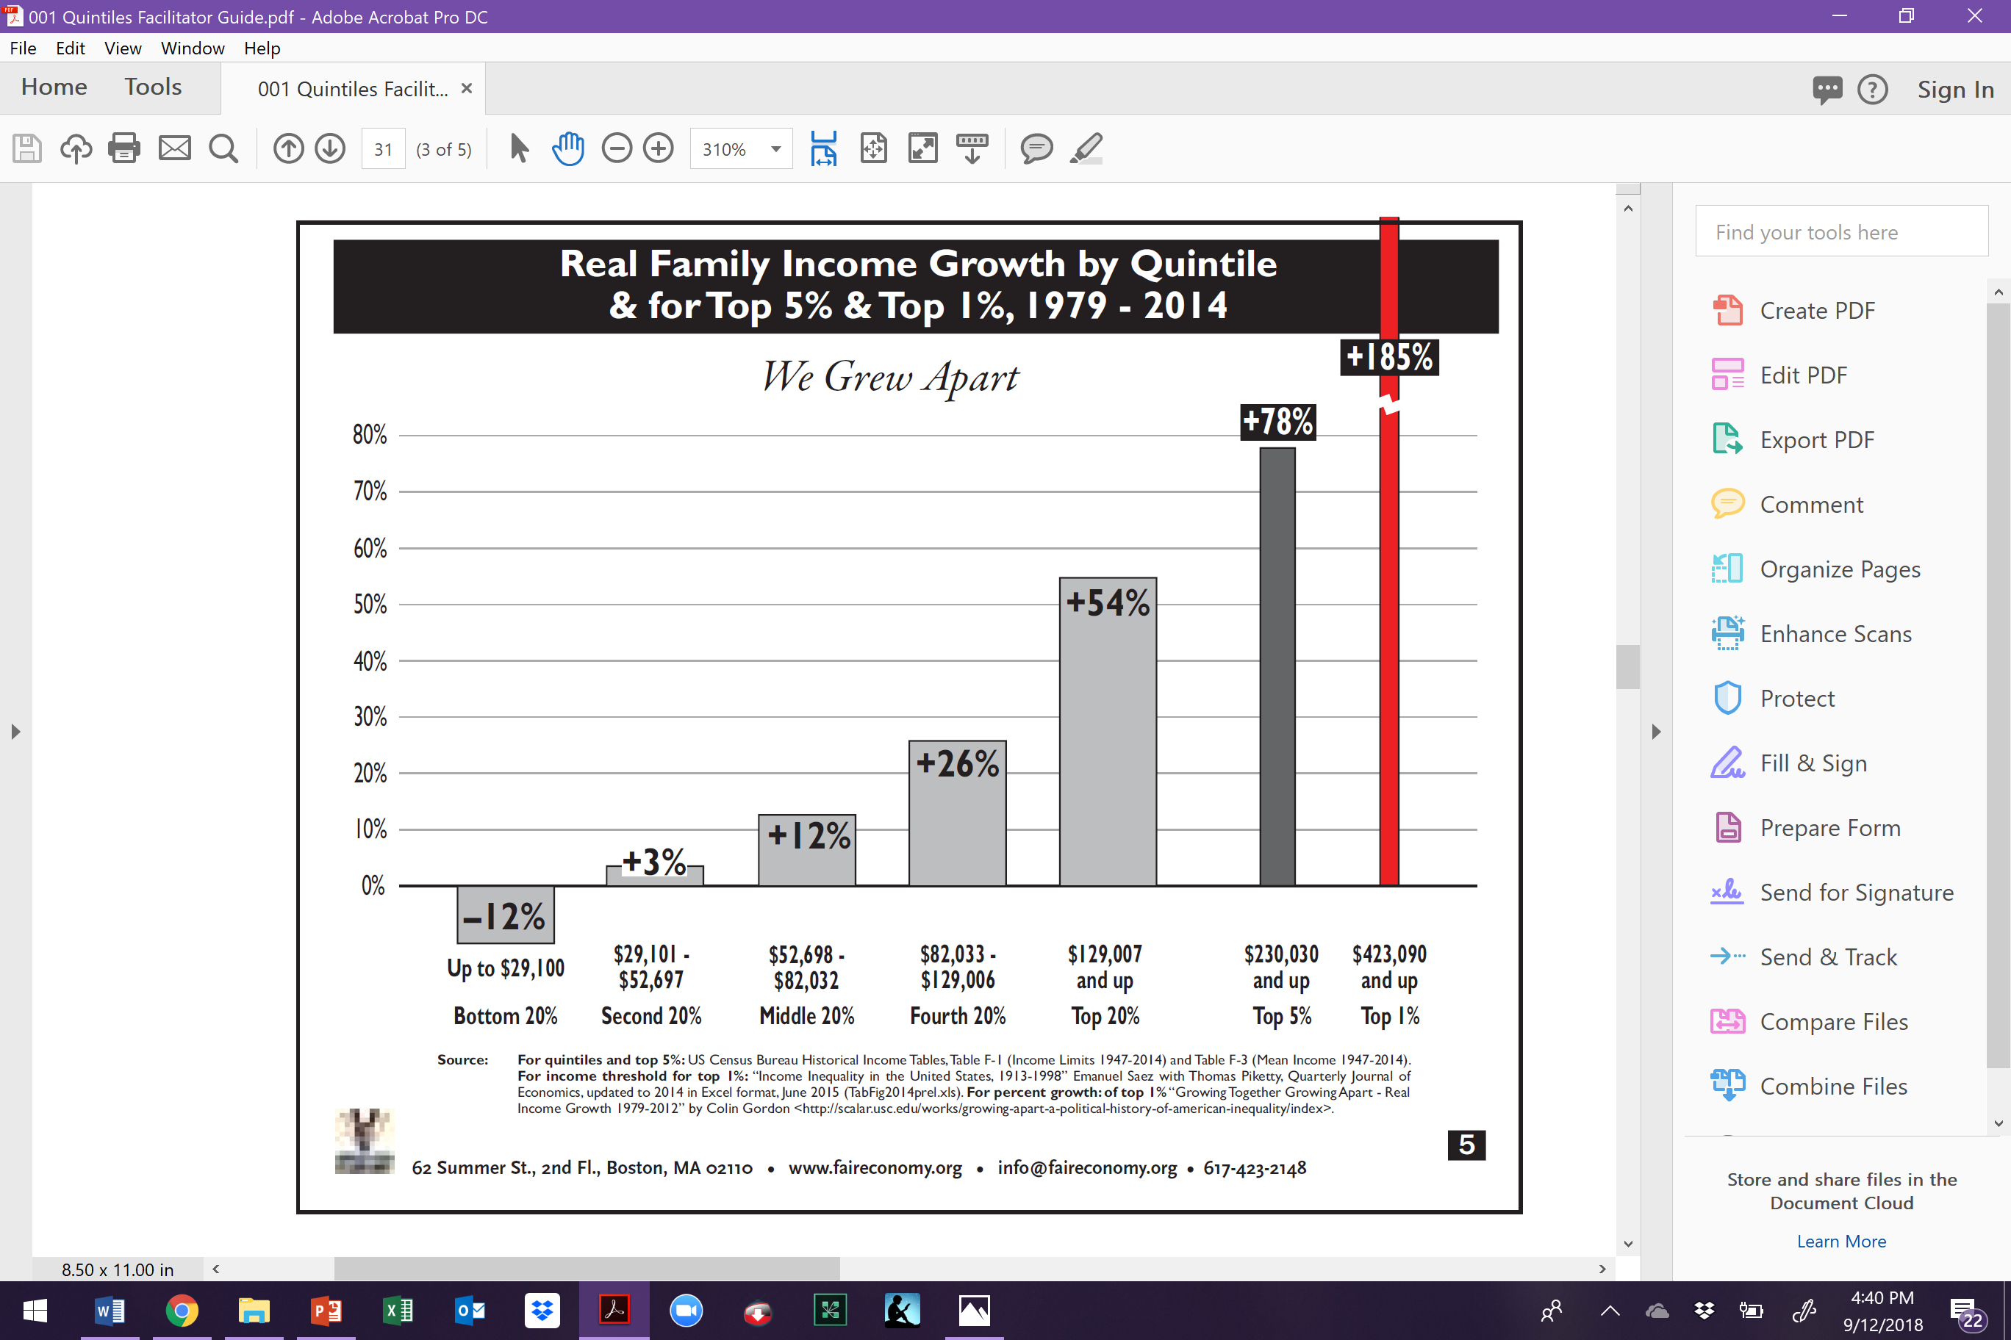
Income: Growth by Quintile 1979-2014
Notes:
During this period, the divide between the top and bottom in America actually narrowed during a period of substantial income growth.
One of the explicit goals of the federal government during early post was period was to build a middle class, people and families who could consume the output of the rapidly growing manufacturing capacity of the U.S programs such as the GI Bill of rights – which enabled hundreds of thousands of returned veterans to go to college and purchase homes – were funded in large part by relatively high taxes on the wealthy. It is important to acknowledge that these programs disproportionately favored white men. For example, the VA and FHA loan programs for housing, both of which utilized racially-restricted underwriting criteria, assured that hardly any of the $120 billion in housing equity loaned from the late 1940s to the early 1960s would go to families of color. These loans helped finance over half of all suburban housing construction in the country during this period, however less than 2% of this housing ended up being lived in by people of color.
In contrast to the post WWII period, the primary goal of economic policy since the 1980s was to let the rich accumulate great capital in the belief that it would trickle down.

Slide 98
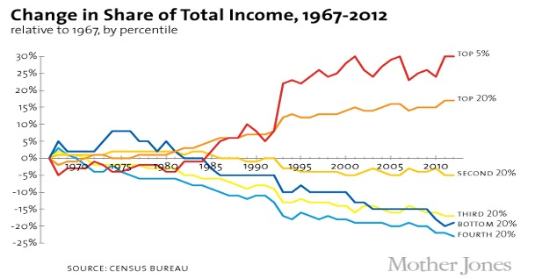
Notes:
During this period, the divide between the top and bottom in America actually narrowed during a period of substantial income growth.
One of the explicit goals of the federal government during early post was period was to build a middle class, people and families who could consume the output of the rapidly growing manufacturing capacity of the U.S programs such as the GI Bill of rights – which enabled hundreds of thousands of returned veterans to go to college and purchase homes – were funded in large part by relatively high taxes on the wealthy. It is important to acknowledge that these programs disproportionately favored white men. For example, the VA and FHA loan programs for housing, both of which utilized racially-restricted underwriting criteria, assured that hardly any of the $120 billion in housing equity loaned from the late 1940s to the early 1960s would go to families of color. These loans helped finance over half of all suburban housing construction in the country during this period, however less than 2% of this housing ended up being lived in by people of color.
In contrast to the post WWII period, the primary goal of economic policy since the 1980s was to let the rich accumulate great capital in the belief that it would trickle down.

Slide 99
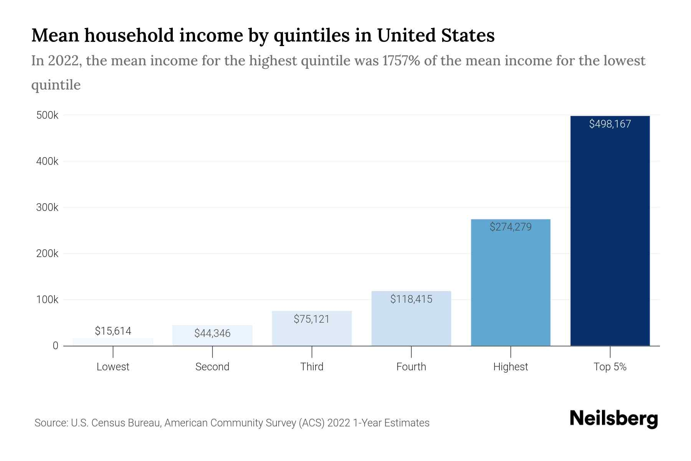
Income Quintiles: 2014 v. 2022
What do you notice?
2014 Income Quintiles
Lowest Quintile: $0-$29,100
2nd Quintile: $29,101-$52,697
3rd Quintile: $52,698-$82,032
4th Quintile: $82,033-129,006
Highest Quintile: $129,007 and Higher
  The top 1% of household have a medium income of $787,712

Slide 100
Questions for Consideration
In which quintile do most of our members live?
In which quintile do you live?
In which quintile do the policy makers live?
And the business owners?

Slide 101
Income andWealth by Race and Gender
What do expect to see?
Examine the following data regarding income and wealth by Race and Gender
Notes:
We are going to look at one example of systemic racism that impacts our members and their jobs – income. Take just a moment in your mind and consider the following question – in the last decade, has the income that your members receive been improving? How do you know? We are going to look at the changes in family income during two recent periods of economic growth. First, let’s talk a little about income. What are some examples of income? (wages, salary, savings account interest, social security check, rent from owning real estate, capital gains from selling investments, dividends from stocks, gifts, etc.) Now let’s have five volunteers come to the front of the room. Please stand should to shoulder. Each gets a sign showing the income range — in pre-tax, year 2014 dollars — of the quintile they represent.

Slide 102
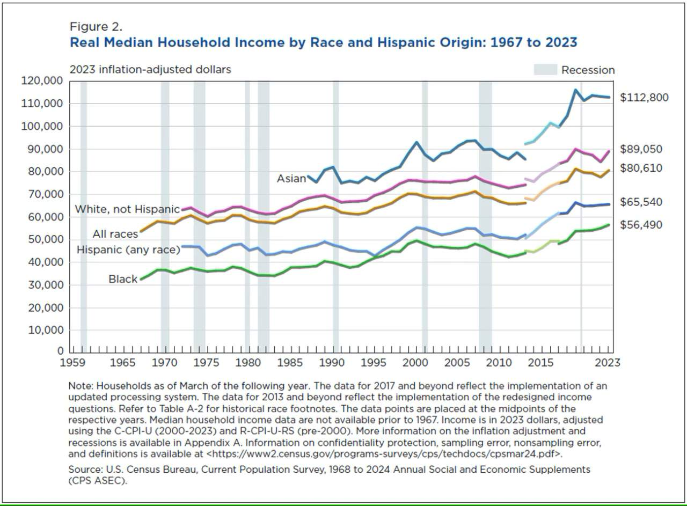
Notes:
In spite of claims made by opponents of affirmative action, there remains a huge chasm among racial groups in terms of income. For example, the income gap between White people one hand and African Americans on the other has actually increased since 1947. Neither of the two periods we looked at in the income quintiles activity were times of increasing racial income equality.

Slide 103
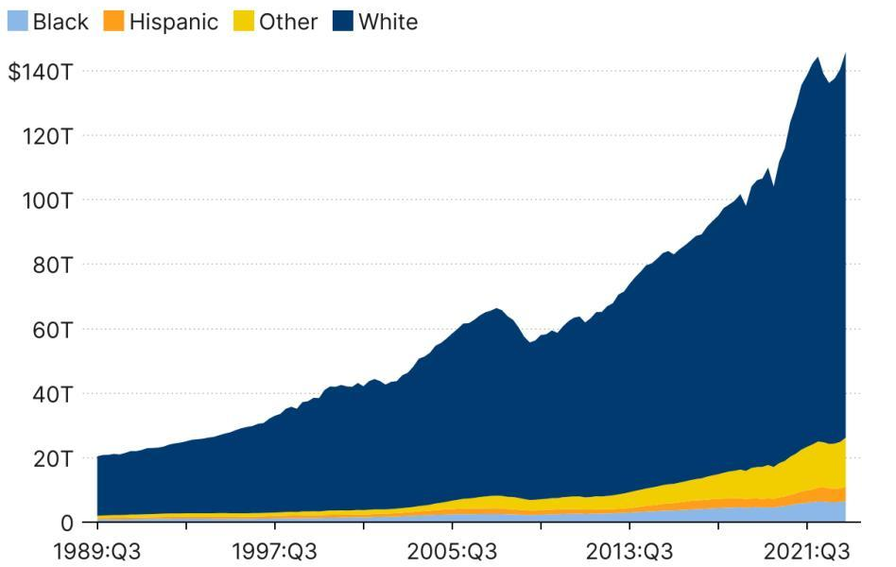

Total household wealth grew in 2022, but white households still hold the vast majority
Source: Brookings Analysis of the Distributional Financial Accounts, 1989-2022
Notes:
During this period, the divide between the top and bottom in America actually narrowed during a period of substantial income growth.
One of the explicit goals of the federal government during early post was period was to build a middle class, people and families who could consume the output of the rapidly growing manufacturing capacity of the U.S programs such as the GI Bill of rights – which enabled hundreds of thousands of returned veterans to go to college and purchase homes – were funded in large part by relatively high taxes on the wealthy. It is important to acknowledge that these programs disproportionately favored white men. For example, the VA and FHA loan programs for housing, both of which utilized racially-restricted underwriting criteria, assured that hardly any of the $120 billion in housing equity loaned from the late 1940s to the early 1960s would go to families of color. These loans helped finance over half of all suburban housing construction in the country during this period, however less than 2% of this housing ended up being lived in by people of color.
In contrast to the post WWII period, the primary goal of economic policy since the 1980s was to let the rich accumulate great capital in the belief that it would trickle down.

Slide 104
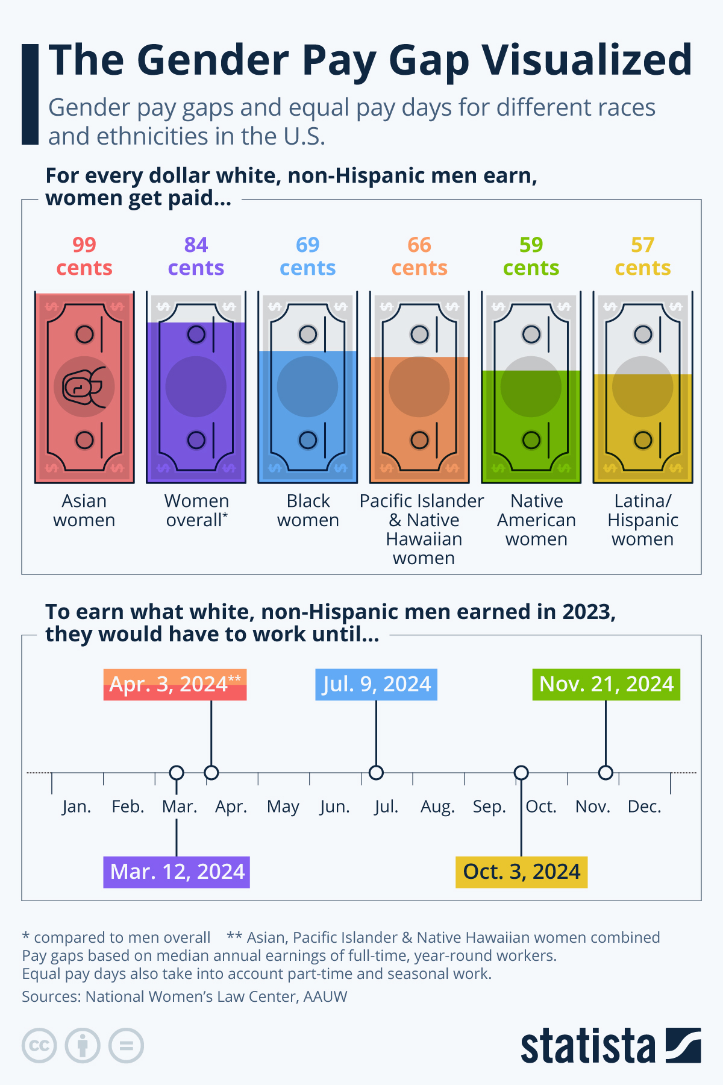

*compared to men overall
**Asian, Pacific Islander & Native Hawaiian women combined
Pay gaps based on median annual earnings of full-time, year-round workers.
Sources: National Women's Law Center, AAUW
Notes:
In spite of claims made by opponents of affirmative action, there remains a huge chasm among racial groups in terms of income. For example, the income gap between White people one hand and African Americans on the other has actually increased since 1947. Neither of the two periods we looked at in the income quintiles activity were times of increasing racial income equality.

Slide 105
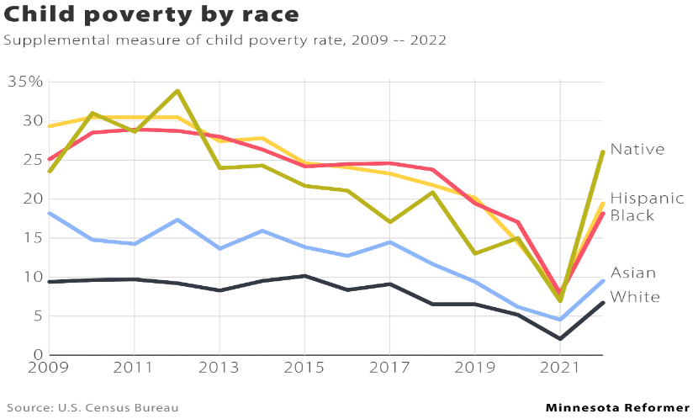
Notes:
During this period, the divide between the top and bottom in America actually narrowed during a period of substantial income growth.
One of the explicit goals of the federal government during early post was period was to build a middle class, people and families who could consume the output of the rapidly growing manufacturing capacity of the U.S programs such as the GI Bill of rights – which enabled hundreds of thousands of returned veterans to go to college and purchase homes – were funded in large part by relatively high taxes on the wealthy. It is important to acknowledge that these programs disproportionately favored white men. For example, the VA and FHA loan programs for housing, both of which utilized racially-restricted underwriting criteria, assured that hardly any of the $120 billion in housing equity loaned from the late 1940s to the early 1960s would go to families of color. These loans helped finance over half of all suburban housing construction in the country during this period, however less than 2% of this housing ended up being lived in by people of color.
In contrast to the post WWII period, the primary goal of economic policy since the 1980s was to let the rich accumulate great capital in the belief that it would trickle down.

Slide 106
Question for Consideration
Why would anyone want to prevent the equitable distribution of wealth?

Slide 107
Key Points
Systems have been intentionally built to shift power, income, wealth, and opportunity away from those in the lowest quintiles toward those in the top quintile.
The impact is further compounded when you look at the intersection of race and income.
Collective action (people power) has led to any number of institutional solutions in the past and could do so again.
Changing Tax and Income Policy is critical to create and sustain wealth for people of color
Notes:
What strikes you about this information? What do you feel is the most significant takeaway?

Slide 108
Albert and Greylor

Slide 109
Shifting Perspectives

Slide 110

Dandelions…
Notes:
5 Mins – Dandelion analogy
Asking Different Questions
We can begin our work on planning to address racial justice by asking different questions that refocus our analysis at the systems level:
FROM: TO:
Blame – Who’s a racist? Causes – What is causing the racial inequity
Intentions – What did they mean? Effects - What were the What was their attitude? actions? What are the impacts?
Prejudice- What beliefs made them Systems – What institutions
do it? are responsible?
Grievances- How can we fix what happened?
Solutions- What are proactive strategies?

Slide 111


NBC and Gucci
Notes:
Gucci
1 – issued an apology
2 – sit down with Dapper Dan (African American designer in Harlem), members of community and other industry leaders
3 – full program of scholarships in major cities (NYC, Nairobi, Tokyo, Beijing, Seoul) to facilitate an increase of different communities within the creative offices
4 – set aside $5 million to invest in community programs in 10 NA cities
5 – formal policy that allows employees to spend company time volunteering in their communities
6 – hired a global director for diversity and inclusion
7 – formed an advisory council that includes Naomi Campbell, racial justice activists, academics and a sprinkling of celebritie

Slide 112
Shifting Perspective p. 19
Traditionally, we have placed more focus on individual and group acts of racism…
Why is it important to intensify our focus on systems (Racial Justice in Education, systemic racism, structural racism)?
Notes:
Validate Individual Racism – do not dismiss or ignore these issues, but pivot to why we need to focus on the systems. Systems give rise to situations that allow for racism and other inequities to flourish.

Slide 113

Asking different questions about the Doll Tests – p. 8

Slide 114
Asking Different Questions p. 19
From: To:
Blame
Who’s a racist?
Causes
What’s causing the racial inequities?
Intentions
What did they mean?
What was their attitude?
Effects
What were the actions?
What are the impacts?
Prejudice
What beliefs made them do it?
Systems
What institutions are responsible?
Grievance
How can we fix what happened?
Solutions
What are proactive strategies and solutions?
Source: Race Forward 2018

Slide 115
Key Points
Advocating for racial justice requires us to shift perspectives and ask a different, much deeper set of questions.
Real change relies upon us spending more time and energy on defining solutions.
Notes:
What strikes you about this information? What do you feel is the most significant takeaway?

Slide 116
Bekah and Linda

Slide 117
Environmental Justice
Notes:
Page 99
Previous pages take a look at other examples of structuralized racism – economy and housing

Slide 118

https://amazeworks.org/environmental-justice-countering-the-effects-of-environmental-racism/

Slide 119

A Couple of Quick Thoughts
What do you think we mean when we say climate justice?
What do you think race has to do with climate justice?

Slide 120

Environmental Racism Explained

Slide 121
Environmental Injustice Defined
When a group bears a disproportionate share of the negative environmental consequences resulting from industrial, municipal, and commercial operations or the execution of federal, state, local, and tribal programs and policies (U.S. EPA, 1998).

Slide 122



What is the best predictor that a person will be disproportionately, negatively impacted by environmental consequences?

Slide 123

Picturing Climate Justice
Take two minutes to look at the pictures around the room, select one that speaks to you the most.
Three participants per picture
Five minutes to explain
Why did you choose the image?
How does your image relate to environmental racism?

Slide 124
Activity –
Types of Environmental Racism
Pg 27
Air Pollution
Lack of access to Clean Water
Climate Migration/Climigration
Extreme Weather
Food Production
Gentrification
Toxins
Question: How does your picture, linked to one of these terms, impact Black, Brown and Indigenous communities in the United States? Think about your home, community, workplace and/or union.
Notes:
PG 23 – types of environmental racism
3 pictures at each table
Ask tables to identify the type of environmental racism pictured and answer the question on butcher paper.

Slide 125
Types of Environmental Racism
Air pollution
People of color and the poor in urban area, who are likely to lack health insurance, are exposed to elevated levels of air pollutants that may lead to greater health impacts from air pollution.
Lack of Access to Clean Water
Due to decrease funding on infrastructure and regulation, many communities of color are exposed to high level of contamination of their water sources. Lack of accountability leads to water pipes on low-income neighborhoods to be outdated and containing harmful substances.

Slide 126


Air and Water—A "new" unholy union
Additionally, data centers required to generate AI tend to be located near poor urban centers; their water requirements and air pollution further strain already stressed areas.
Notes:
Poor indoor air quality impacts learning conditions and working conditions.
1.A study of 100 U.S. schools found a direct association between student academic achievement and classroom ventilation rates, and that measurable progress in math and reading scores were observed when school indoor air quality was improved.
2.Poor IAQ in schools has been linked to cognitive deficits and negative economic impacts in the workplace, including impacts on the number of employee sick days and job retention.
Poor IAQ can trigger asthma attacks and absences. Asthma is a leading cause of school absence, leading to nearly 10.5 million missed school days per year. Research indicates that many students lack an asthma action plan and, particularly in low-income areas, do not have a quick-relief inhaler at school. This leads to unplanned emergency room visits, hospital stays, and missed work and school days putting the greatest financial burden on people with asthma and their families.
Historical policies that resulted in the racial segregation of neighborhoods, workplaces, schools, and health care facilities continue to exacerbate asthma disparities today. Segregation limits resources and opportunities available to certain populations, affects access to health care, increases risk for exposure to environmental triggers, and increases chronic stress in certain populations.

Slide 127
Aging infrastructure is one of the root causes of poor indoor air quality in schools.
Poor IAQ can trigger asthma attacks and absences. Asthma is a leading cause of school absence, leading to nearly 10.5 million missed school days per year.
Research indicates that many students, particularly in low-income areas, do not have a quick-relief inhaler at school, leading to unplanned ER visits, hospital stays, and missed work/school days.
Historical policies that resulted in the racial segregation of neighborhoods, workplaces, schools, and healthcare facilities continue to exacerbate asthma disparities today. Limiting resources and opportunities, access to healthcare, and increasing the risk of exposure to environmental triggers.
Notes:
Poor indoor air quality impacts learning conditions and working conditions.
1.A study of 100 U.S. schools found a direct association between student academic achievement and classroom ventilation rates, and that measurable progress in math and reading scores were observed when school indoor air quality was improved.
2.Poor IAQ in schools has been linked to cognitive deficits and negative economic impacts in the workplace, including impacts on the number of employee sick days and job retention.
Poor IAQ can trigger asthma attacks and absences. Asthma is a leading cause of school absence, leading to nearly 10.5 million missed school days per year. Research indicates that many students lack an asthma action plan and, particularly in low-income areas, do not have a quick-relief inhaler at school. This leads to unplanned emergency room visits, hospital stays, and missed work and school days putting the greatest financial burden on people with asthma and their families.
Historical policies that resulted in the racial segregation of neighborhoods, workplaces, schools, and health care facilities continue to exacerbate asthma disparities today. Segregation limits resources and opportunities available to certain populations, affects access to health care, increases risk for exposure to environmental triggers, and increases chronic stress in certain populations.

Slide 128
Types of Environmental Racism
Climate Migration (Climigration)
As temperature and sea levels have risen due to climate change, governments around the world are facing massive human displacement without any mechanism to address it.
Food Production
Low income families, who tend to be disproportionately people of color, are forced to spend a bigger proportion of their income on food than higher income families. Food chain contamination occurs through introduction of toxic substances into the environment

Slide 129
Food Justice
Food justice is fundamentally about racial justice, because in the United States, race and racism not only structure everyday experiences but also influence the (under) development of neighborhoods and the implementation of policies that disproportionately disenfranchise Black communities... The desire to 'bring good food' to Black communities [as a primary solution]… reinforces the belief that these communities have little or no investment in creating their own place-making strategies toward food self-sufficiency.
Ashante M Reese (2019)
Black Food Geographies: Race, SelfReliance, and Food Access in Washington, D. C.

Slide 130

Food Apartheid

Slide 131
To ACT on Organizing around environmental racism and food apartheid
Ask Different Questions
What are the current environmental justice and food apartheid priorities in your union and/or labor council?
What steps can you take to support these priorities?
What are some projects you want your union and/or labor council to undertake in addressing environmental racism?

Slide 132
Types of Environmental Racism
Extreme Weather
Extreme weather events, such as heatwaves, extreme cold, droughts and floods are expected to increase in frequency and intensity due to climate change. Due to increase in the temperature, there is increased risk in cardiovascular deaths (with risks higher for African Americans). Low-income urban neighborhoods and communities of color are particularly vulnerable to because they are often segregated in the inner city, where dark-colored materials, such as asphalt, used for construction absorb heat and do not allow it to dissipate at the same rate as soil, grass, forests, and other less industrial materials. As heatwaves increase, low income families and people of color are less likely to have access to air-conditioning leading to disproportionate risk of heat-related illness and death.

Slide 133
Types of Environmental Racism
Gentrification
Gentrification describes the movement of wealthier individuals and families (often White) into urban, working class neighborhoods. This results in an increase in property values and rents that often displaces low-income, black and brown inhabitants and businesses who are then forced to move to other neighborhoods where environmental degradation is worse.

Slide 134
Types of Environmental Racism
Toxins in the Community and Workplace
The communities beset by hazardous pollution and toxins tend to be poor and disproportionately black, brown and indigenous communities. Due to entrenched segregation, many hazardous waste and toxic facilities end up in these communities, leading residents to experience health and wellness problems. Research describes the analysis of all permitted industrial facilities across the United States show that polluters, including commercial hazardous waste facilities, disproportionately expose communities of color and low-income populations to chemical releases.

Slide 135
Integrating Racial Justice Solutions
· Without an intentional focus on understanding how race and other social factors play into exacerbating the poor conditions of public schools, we could see a continuation of negative outcomes.
· School districts serving primarily students of color receive less funding than districts serving a majority white student population.
· An aging infrastructure is one of the root causes of poor indoor air quality in schools.
Notes:
Without an intentional focus on understanding how race and other social factors play into exacerbating the poor conditions of public schools, we could see a continuation of negative outcomes in school districts that primarily serve students of color. That is because it is more common for school districts serving primarily Native students or students of color to receive less funding than districts serving a majority white student population.
Districts serving white students living in poverty also tend to receive greater funding than districts serving students of color living in poverty. Those trends hold even when controlling for socioeconomic status. Inequitable financial resources contribute not only to inequitable academic resources such as educators, instructional materials, and technology but also to poor school facilities and critical infrastructure that directly affect student health. Aging infrastructure is one of the root causes of poor indoor air quality (IAQ) in schools, which is critically important for children’s health and academic performance.

Slide 136
To ACT on Organizing around environmental racism and climate change
Ask Different Questions
What are the current environmental justice and climate change priorities in your union and/or labor council?
What steps can you take to support these priorities?
What are some projects you want your union and/or labor council to undertake in addressing environmental racism?

Slide 137
Key Points
Black, brown, and indigenous people and their communities are more vulnerable to climate change because of the gap between the rich and the poor.
Climate change and environmental racism intensifies racial inequalities.
Low-income people are more likely to rent, are less prepared for extreme weather, less likely to be insured and have fewer financial resources to recover after events.

Slide 138
Linda

Slide 139
Day One Closing

Slide 140

Leave One Word Behind
Thinking back to your core value that you shared earlier and today’s experience:
What is one word that describes your spirit right now?

