Slide 1
Name

Slide 2

What words matter?

Slide 3

Important Vocabulary for our Work
5 minutes to Complete when I say begin.
Match each word with the definition in your envelope
Shout out “GO Sports Ball!” when your team is done

Slide 4
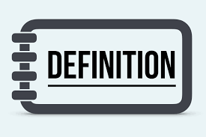
Defining Race
Race is not biological. Race is a powerful social construct that gives certain people more opportunity and advantages.

Slide 5
Defining Prejudice
According to Merriam-Webster: Prejudice is injury or damage resulting from some judgment or action of another in disregard of one's rights
especially : detriment to one's legal rights or claims

Slide 6
Defining Racism
RACISM
IS
PREJUDICE + INSTITUTIONAL POWER

Slide 7
Slide hold for the race, ethnicity, and nationality video

Slide 8

Three Quick Thoughts
How is the definition of race different from nationality and ethnicity?
Why do you think this gets confused?
10 Things about Race p. 15

Slide 9
Race Science
In the late 1800’s the pseudoscience called “race science” developed arguing that race is a biological category. It linked capability to race.
In 1925, using this as the basis, the Central Tube Company (Pittsburgh) created a table claiming to connect race to adaptability to plant work.

Slide 10
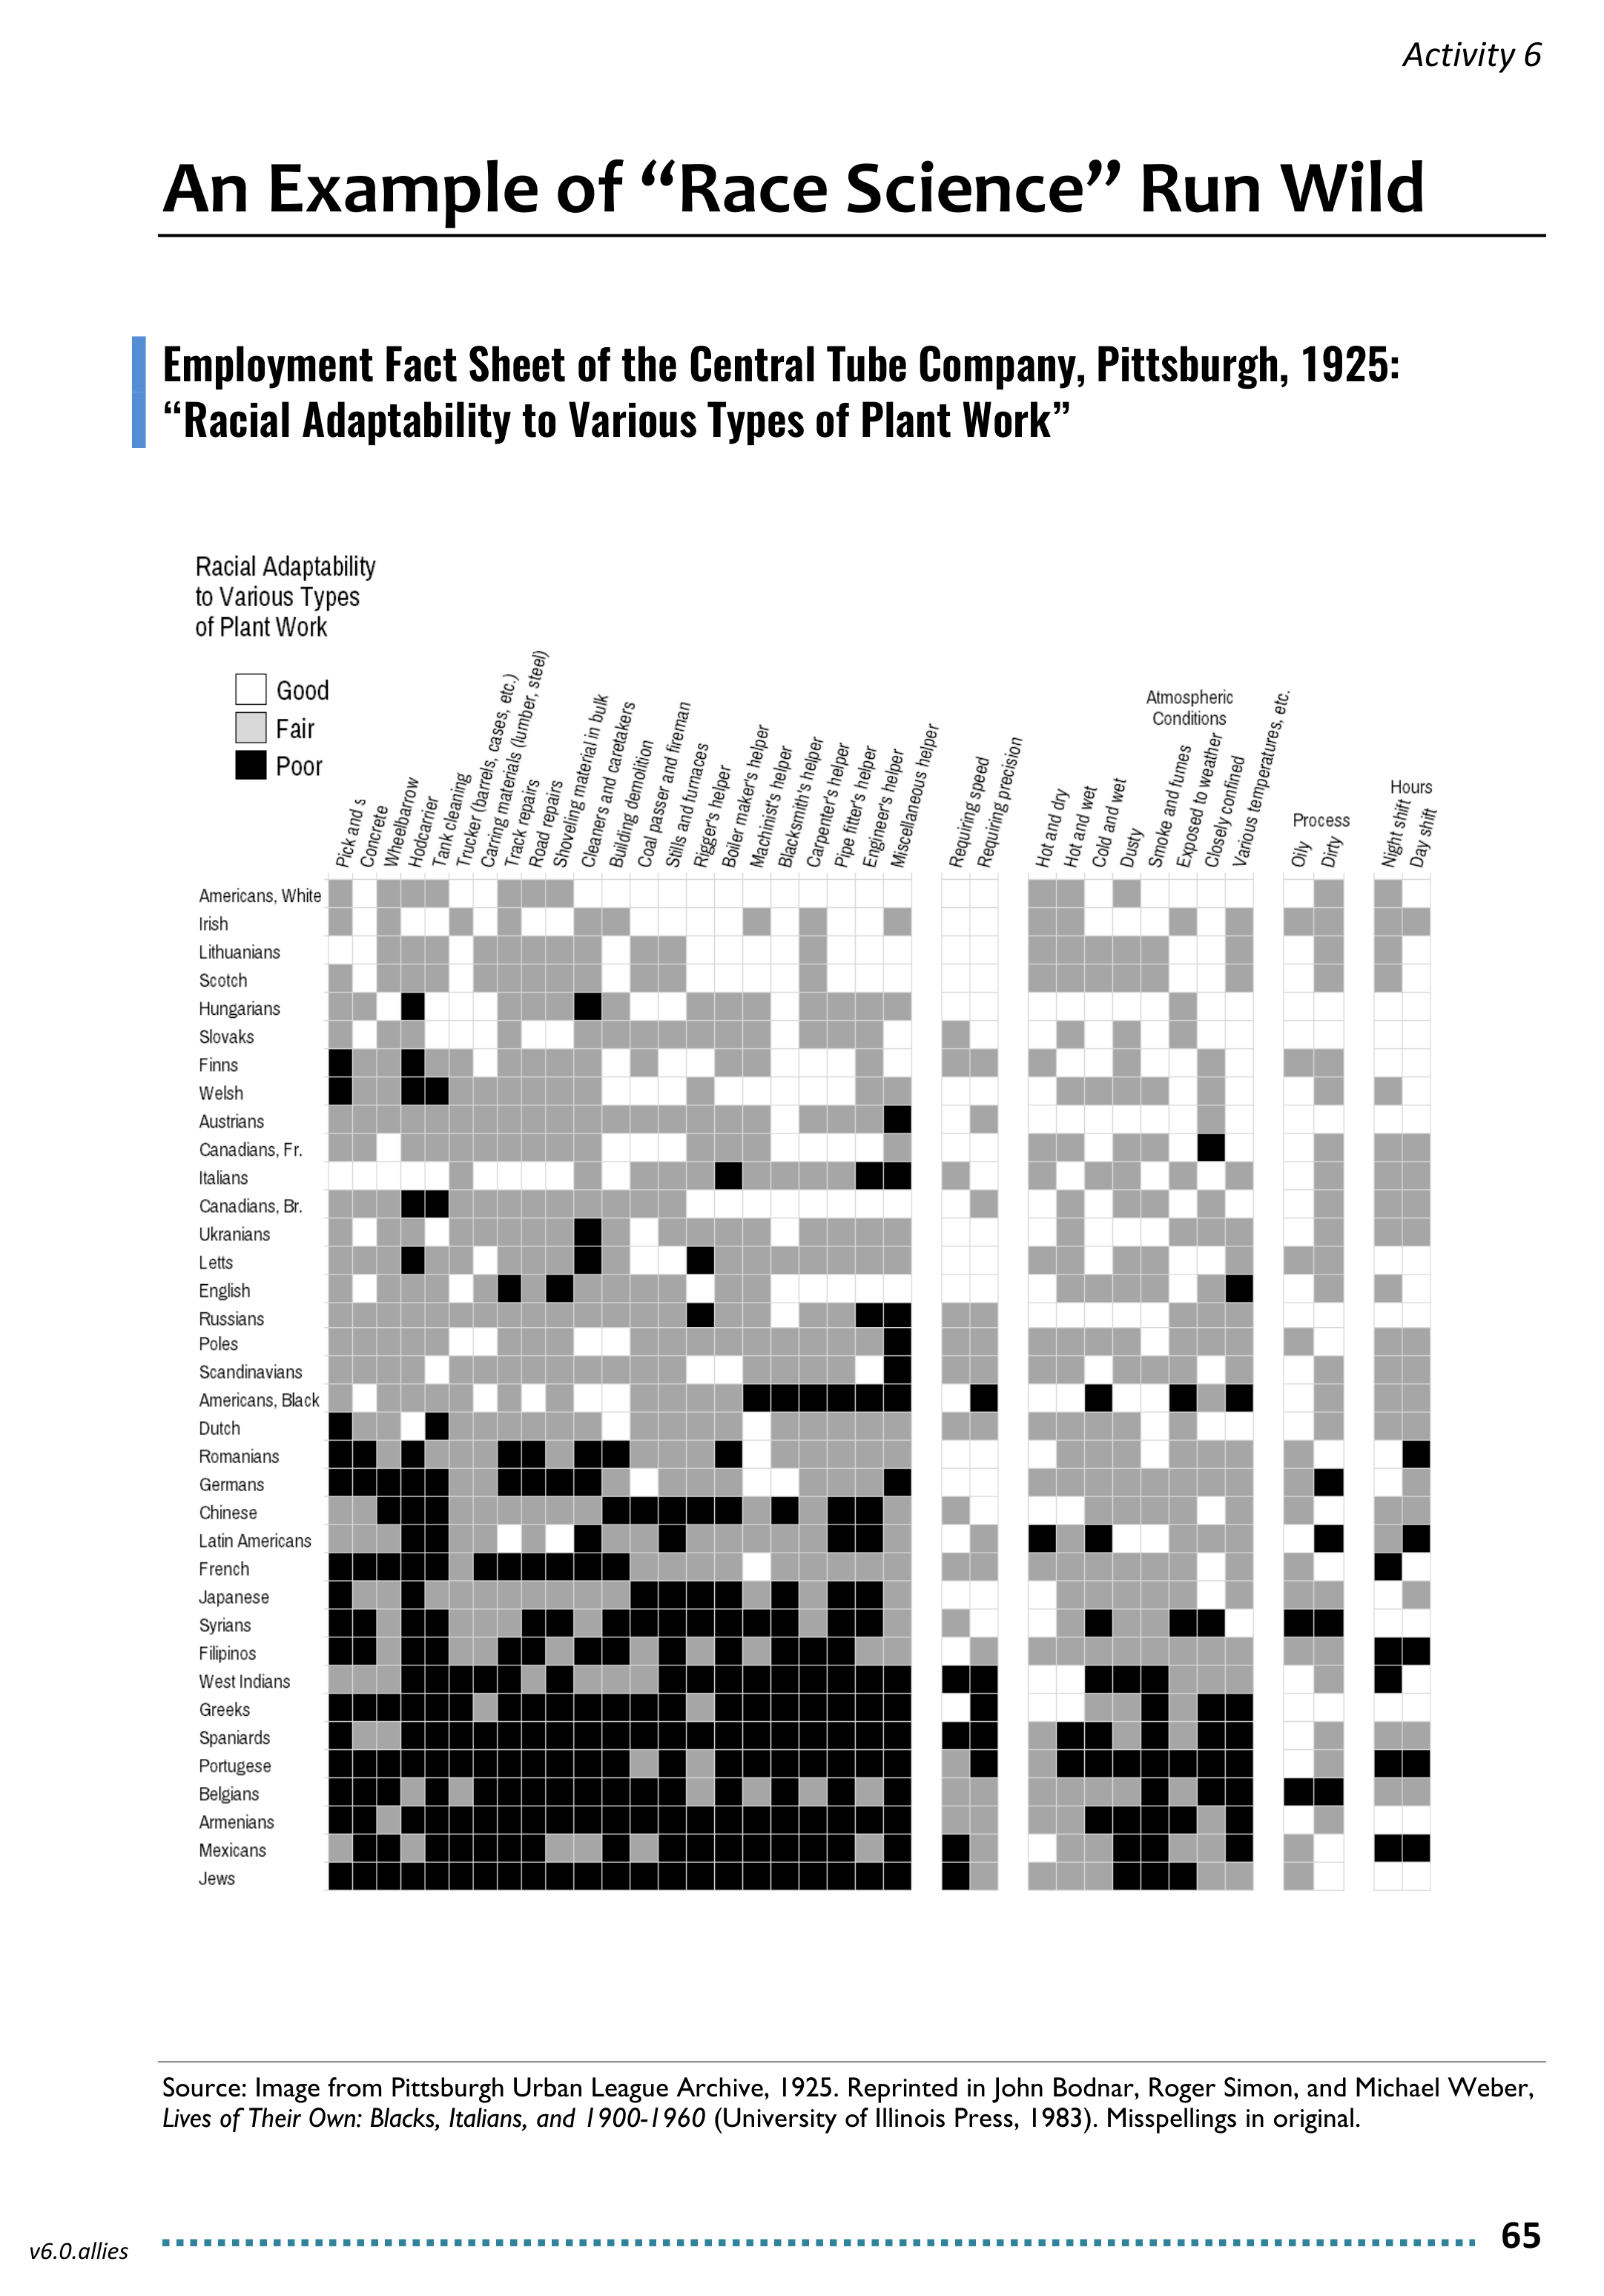
Table Talking
Look for “White Americans” on the chart. What does this category tell us about who was white in 1925? Who is white today?
Do you see any legacies of this thinking in your work today? If so, how?
Bonus: If you were an organizer during this time, how would you use this data to organize your worksite?

Slide 11
Tell us about your talking
What did you hear or say that you think needs to be shared out to the larger group?

Slide 12

Key Points
In our society, people have been taught that we should not say the word, “race.”
Race is a construct developed to support oppression within a system of white supremacy.
Once you recognize the existence of oppression and understand how it operates, you can learn how to resist and challenge oppression in all forms.

