Slide 1
Labor Notes
Race and Labor
Notes:
Who we are:
Labor Notes is a media and organizing project that has been the voice of activists who want to put the movement back in the labor movement since 1979. Through our magazine, website, books, regional troublemaker schools, bi-annual conferences, and workshops, we promote organizing, aggressive strategies to fight concessions, alliances with worker centers, and unions that are run by their members. This is our Race and Labor workshop where we will talk about how racism shows up in our workplaces, unions and society and discuss how to overcome division to strategies of building solidarity and unity. There's a lot of you here so we’ll do our best to have great discussions but I’m going to go over some quick group agreements before we get started.
Introductions: Name & pronouns, Organization, & where you are in the world
Group Agreements:
Move at the speed of trust
Have courage to trust each other
Racial justice work in our movement is hard. And in order to make real change and do the work in community, we have to trust each other. Some of us are strangers entering this space today, some may be coworkers, so while we want to assume the best in one another, it takes work to build trust and show one another, particularly folks of color - that we are committed to the work of racial justice for the long haul. And that takes trust. Another way to think about this agreement is “meeting people where they are at.”
Brave space vs safe space
Building trust rather than managing discomfort
create a space where we can speak the truth to each other and not be punished
Impact vs Intent - while intent is what we mean, impact is how our words affect others
Vegas Rules - Let’s keep what happens at the training and what people say confined to the training. Feel free to share all the great lessons and ideas with others, but don’t reveal personal details that others share with the group.
Active participation - not a lecture, we are all learners and teachers, this is a conversation to facilitate perspectives and frameworks and build an understanding of this work through your experiences
One Mic
I’m going to ask everyone to stay on mute unless they are sharing. You can use the reaction buttons at the bottom to raise your hand and I’ll call on you.
Land the Plane
These conversation will bring up confusion and pain and thats going to make it hard to be succinct. And its going to make it harder for me to have to interrupt but I am committed to hearing as many voices as possible so I’m going to ask everyone when you share to get to your point quickly!
Take Space, Make Space
We want everyone to contribute, so after you speak up, wait for everyone else to have an opportunity to speak before speaking again.
Alphabet Soup: No Acronyms!
If someone says an acronym, immediately ask “What’s that?”
Respect the Agenda
Let’s stick to task and to time (can be coupled with parking lot).
“I” Statements / Speak from Your Own Experience
If you are giving your opinion or expressing a feeling, then try to use “I” statements to avoid assuming that others think or are feeling the same. Speak for yourself!

Slide 2
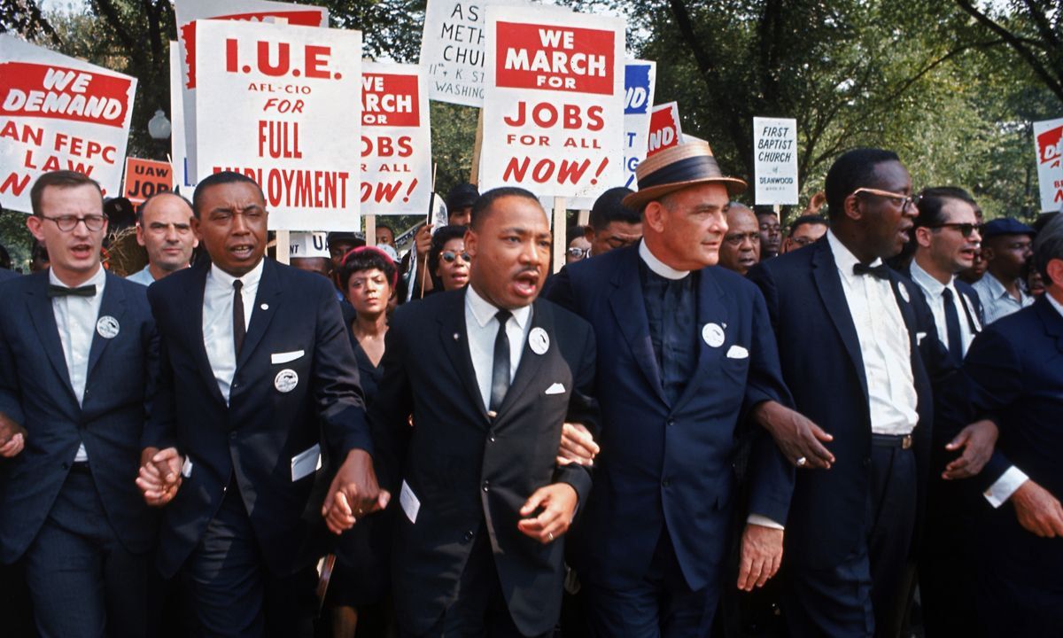
Why it matters to me
“In our glorious fight for civil rights, we must guard against being fooled by false slogans, such as ‘right to work.’ It is a law to rob us of our civil rights and job rights.
Its purpose is to destroy labor unions and the freedom of collective bargaining by which unions have improved wages and working conditions of everyone…Wherever these laws have been passed, wages are lower, job opportunities are fewer and there are no civil rights.”
Martin Luther King

Slide 3
Racism Definition
Racism is an ideology that is used to justify the racial disparities we see in society today and used as a tool to divide the working class so that the wealthy can consolidate their wealth and power at the very top.

Slide 4
How does racism show up in the workplace and in unions?
Notes:
Large group discussion: How does racism show up in the workplace, society and unions?
Racism shows up in a lot of different ways, what are some ways that it shows up?
Pulling from a multitude of ways that it manifests itself
Jot down answers from participants - attempt to synthesize
Use people’s responses as a springboard for the rest of the discussion
Find the power dynamics in the examples they give
Who does it work for?
Who does it benefit?

Slide 5
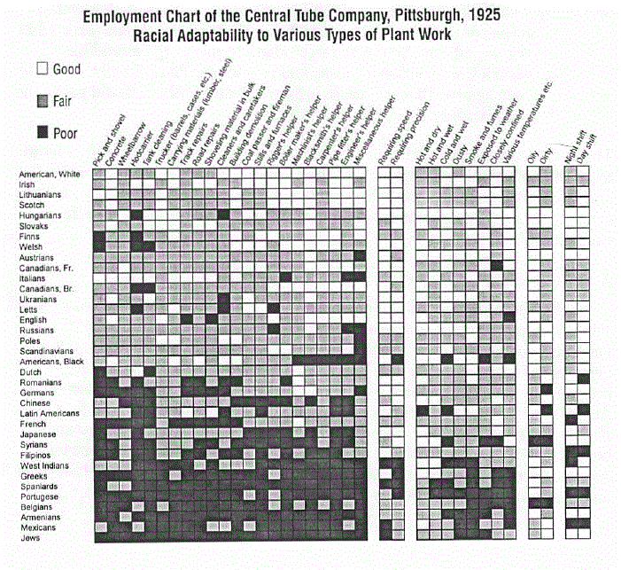

Slide 6
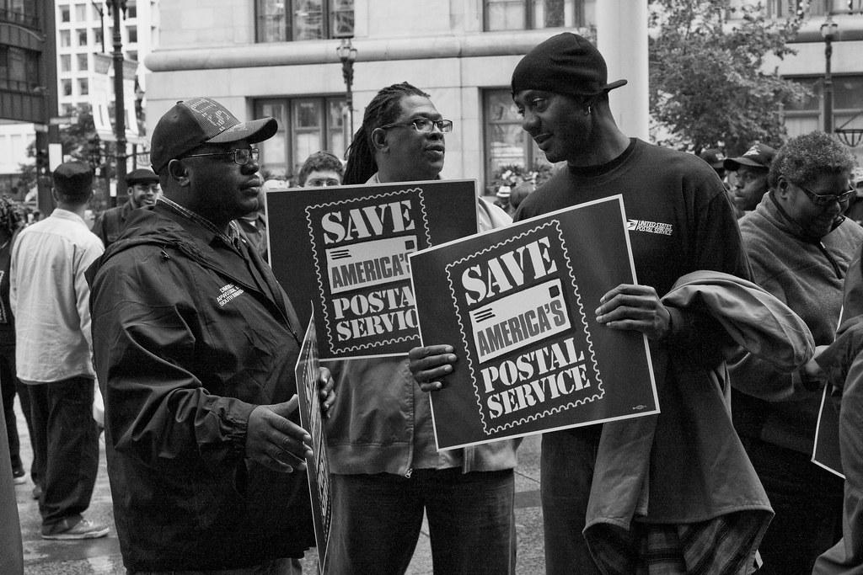
The Reality
Unions are the most racially diverse institutions in America despite society still being segregated
-Black workers are 11.6% of union members
-Latinos make up another 8.8% of union members
-AAPI are 8.3% of union members
Notes:
Unions are the most racially diverse institutions in America despite society still being pretty segregated -
African Americans are 15% of union members compared to 11% of the employed workforce.
Latinos make up another 9% of union members, slightly less than their share of the employed workforce but the fastest growing ethnic group in unions.
AAPI are 3.6% of the workforce and 3.3% of union members.
***Exclude all these people of color and organized labor would lose a quarter of its membership. **
Our jobs are the only place where you don’t get to choose who you work with therefore unions might be the only place where all groups of people are being brought together and where you would interact with people of color
If the workplace is the place where people are using race to support their ideology of superiority to divide workers and extract more profit than the worksite is the site for workers to come together around capital to push back.
Being in a union isn’t in itself anit-racist work but how we are in our unions make it a very powerful space to do organizing across racial lines. Maximum participation is key to building strong, militant, multi-racial democratic unions because unions have a structures in place to help us break down racial barriers .

Slide 7
Union Values
Unity
Solidarity
Trust
Justice
Worker Power
Notes:
A union is one of the few places in society where people of all races work together for common goals. So the union context tends to bring the best out of people. I have here a few values of unions. Does anyone have any other values they can think of?

Slide 8
Small group discussion…
What are some barriers to getting more workers of color involved in the union?
What are some ways that race or racial division is holding back your organizing?
Notes:
Jot down answers

Slide 9
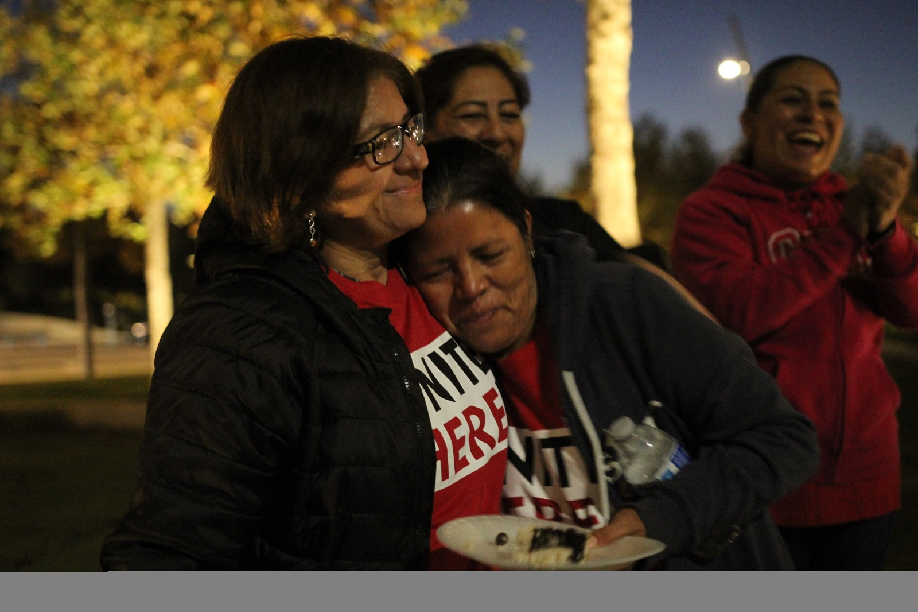
Two Sides of the Problem
Fighting racism from the boss or among co-workers
Involving more workers of color and building leaders at ALL levels of the union

Slide 10
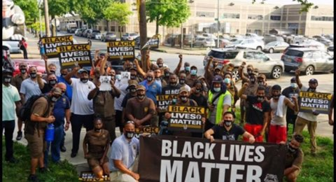
Nothing about us without us!
What is an issue in your workplace that would build unity and involve more workers of color?
Notes:
What is the issue?
Who does it affect?
What members need to be mobilized to address it?
How will you reach out to and involve members who are not normally involved?

Slide 11
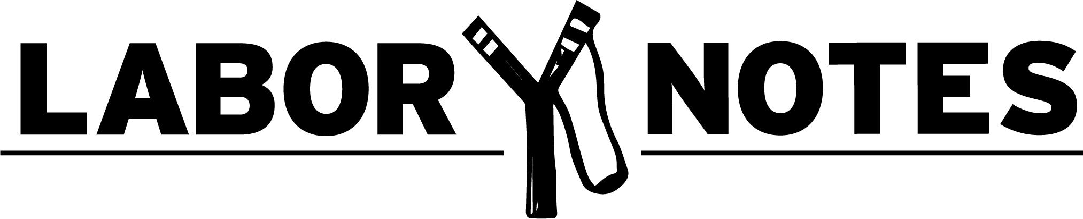
Secrets of a successful organizer tenets
Apathy isn’t real! Everyone cares about something.
Aim for the Bullseye
You can’t do it alone!: Map your workplace and find your leaders
Issue: Widely felt, deeply felt and winnable
Build a campaign

