Slide 1


Race and Labor
Notes:
Who we are:
Labor Notes is a media and organizing project that has been the voice of activists who want to put the movement back in the labor movement since 1979. Through our magazine, website, books, regional troublemaker schools, bi-annual conferences, and workshops, we promote organizing, aggressive strategies to fight concessions, alliances with worker centers, and unions that are run by their members. This is our Race and Labor workshop where we will talk about how racism shows up in our workplaces, unions and society and discuss how to overcome division to strategies of building solidarity and unity. There's a lot of you here so we’ll do our best to have great discussions but I’m going to go over some quick group agreements before we get started.
Introductions: Name & pronouns, Organization, & where you are in the world
Group Agreements:
Move at the speed of trust
Have courage to trust each other
Racial justice work in our movement is hard. And in order to make real change and do the work in community, we have to trust each other. Some of us are strangers entering this space today, some may be coworkers, so while we want to assume the best in one another, it takes work to build trust and show one another, particularly folks of color - that we are committed to the work of racial justice for the long haul. And that takes trust. Another way to think about this agreement is “meeting people where they are at.”
Brave space vs safe space
Building trust rather than managing discomfort
create a space where we can speak the truth to each other and not be punished
Impact vs Intent - while intent is what we mean, impact is how our words affect others
Vegas Rules - Let’s keep what happens at the training and what people say confined to the training. Feel free to share all the great lessons and ideas with others, but don’t reveal personal details that others share with the group.
Active participation - not a lecture, we are all learners and teachers, this is a conversation to facilitate perspectives and frameworks and build an understanding of this work through your experiences
One Mic
I’m going to ask everyone to stay on mute unless they are sharing. You can use the reaction buttons at the bottom to raise your hand and I’ll call on you.
Land the Plane
These conversation will bring up confusion and pain and thats going to make it hard to be succinct. And its going to make it harder for me to have to interrupt but I am committed to hearing as many voices as possible so I’m going to ask everyone when you share to get to your point quickly!
Take Space, Make Space
We want everyone to contribute, so after you speak up, wait for everyone else to have an opportunity to speak before speaking again.
Alphabet Soup: No Acronyms!
If someone says an acronym, immediately ask “What’s that?”
Respect the Agenda
Let’s stick to task and to time (can be coupled with parking lot).
“I” Statements / Speak from Your Own Experience
If you are giving your opinion or expressing a feeling, then try to use “I” statements to avoid assuming that others think or are feeling the same. Speak for yourself!

Slide 2
As you settle in, share in the chat:
Your name, pronouns, affiliation and where you’re joining from
What is one organizing challenge that you’re facing that brings you here?

Slide 3
What is one organizing challenge that you’re facing that brings you here?

Slide 4
What is one organizing challenge that you’re facing that brings you here?

Slide 5
What is one organizing challenge that you’re facing that brings you here?

Slide 6
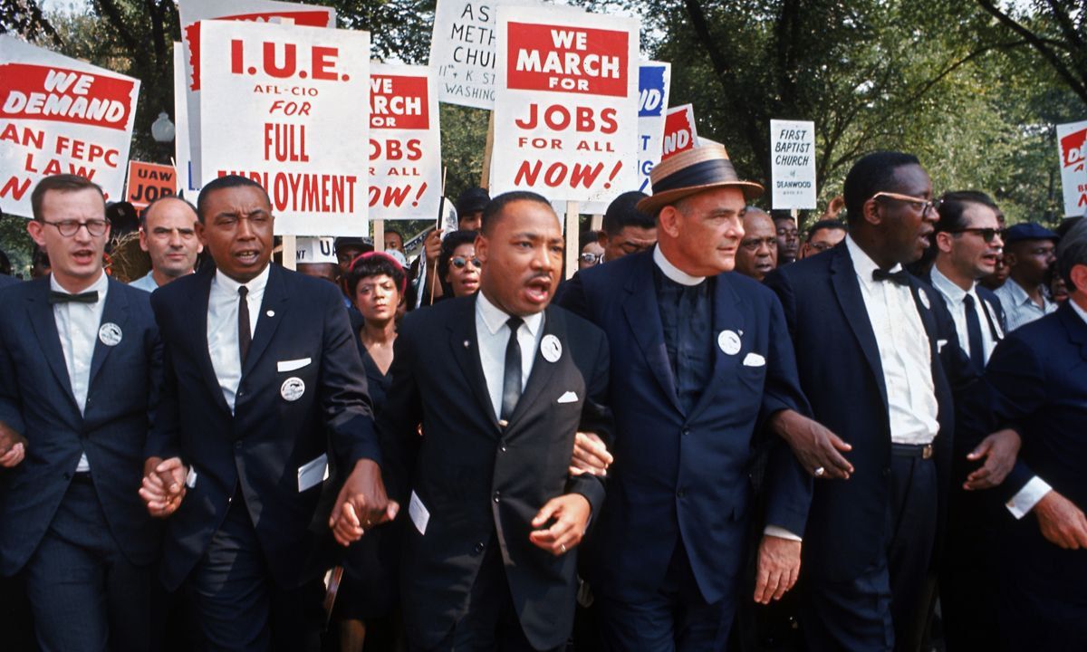
Why it matters to me
“In our glorious fight for civil rights, we must guard against being fooled by false slogans, such as ‘right to work.’ It is a law to rob us of our civil rights and job rights.
Its purpose is to destroy labor unions and the freedom of collective bargaining by which unions have improved wages and working conditions of everyone…Wherever these laws have been passed, wages are lower, job opportunities are fewer and there are no civil rights.”
Martin Luther King

Slide 7
Racism Definition
Racism is an ideology that is used to justify the racial disparities we see in society today and used as a tool to divide the working class so that the wealthy can consolidate their wealth and power at the very top.

Slide 8
How does racism show up in the workplace and in unions?
Workplace:
Management showing favoritism to a specific color or ethnicity over another
Management making racist remarks or jokes and expecting people not to mind
Outreach through human resources isn’t leading to a diverse group of candidates for openings
Makeshift nooses hung in bathrooms in plants / workplaces
Workplace
- Clients coming in and saying racial slurs, don’t want to deal with a person of colour
- Staff don’t reflect the children that they are dealing with
- No recruitment for persons of colour
- Harsher evaluations given to BIPOC staff
- White workers are getting less criticism
IN UNIONS:-
Tends to be very white do to access to jobs as white
- Resistance to equity seats
Union leadership choosing who gets to be at the bargaining table through favoritism
Tokenizing people of color in the union – management has accused the union of this but also in the management structure – a Black woman in a new DEI leadership position
BIPOC members who were elected to office and then not supported
Notes:
Large group discussion: How does racism show up in the workplace, society and unions?
Racism shows up in a lot of different ways, what are some ways that it shows up?
Pulling from a multitude of ways that it manifests itself
Jot down answers from participants - attempt to synthesize
Use people’s responses as a springboard for the rest of the discussion
Find the power dynamics in the examples they give
Who does it work for?
Who does it benefit?

Slide 9
How does racism show up in the workplace and in unions?
Workplace:
Sole POC in workplace, hearing coworkers say ignorant comments and always having to be person calling that out
Leadership not representative of workforce
Employer talks a lot about JEDI but not meaningfully doing the work
It’s not about what happens, it’s about what doesn’t happen.
Unions:
-Fighting for percentage changes in wages instead of dollar amounts
-not using their power to change curriculum in schools
-listening to white people over POC about POC experiences
- higher scrutiny for motions/proposals from racialized members
- Less participation in elections from racialized members
Notes:
Large group discussion: How does racism show up in the workplace, society and unions?
Racism shows up in a lot of different ways, what are some ways that it shows up?
Pulling from a multitude of ways that it manifests itself
Jot down answers from participants - attempt to synthesize
Use people’s responses as a springboard for the rest of the discussion
Find the power dynamics in the examples they give
Who does it work for?
Who does it benefit?

Slide 10
How does racism show up in the workplace and in unions?
Workplace:
Microaggressions
Death by a thousand cuts
Shows up in subtle ways / microaggressions
Shows up in million different ways
Thousands of little things
Extra workload placed on racialized employees to do antiracism work in the workplace.
Self-selection by white folks, creating in-groups and out-groups.
Unions:
White dudes with beards as staffers at union.
Shouldn’t put burden of proving racism on those experiencing it.
Think of themselves as progressive, which sometimes makes it harder for them to recognize their own racism.
Notes:
Large group discussion: How does racism show up in the workplace, society and unions?
Racism shows up in a lot of different ways, what are some ways that it shows up?
Pulling from a multitude of ways that it manifests itself
Jot down answers from participants - attempt to synthesize
Use people’s responses as a springboard for the rest of the discussion
Find the power dynamics in the examples they give
Who does it work for?
Who does it benefit?

Slide 11
How does racism show up in the workplace and in unions?
Workplace:
-White workers tend to be in the higher paid, more secure positions
-Evaluations biased
-”Cultural taxation”-- extra work supporting students of color
Unions:
Notes:
Large group discussion: How does racism show up in the workplace, society and unions?
Racism shows up in a lot of different ways, what are some ways that it shows up?
Pulling from a multitude of ways that it manifests itself
Jot down answers from participants - attempt to synthesize
Use people’s responses as a springboard for the rest of the discussion
Find the power dynamics in the examples they give
Who does it work for?
Who does it benefit?

Slide 12
How does racism show up in the workplace and in unions?
Workplace: Constant
Hiring policy
Job offers
Implicit bias
Workers are white; students are BIPOC
Unions: White staff
Notes:
Large group discussion: How does racism show up in the workplace, society and unions?
Racism shows up in a lot of different ways, what are some ways that it shows up?
Pulling from a multitude of ways that it manifests itself
Jot down answers from participants - attempt to synthesize
Use people’s responses as a springboard for the rest of the discussion
Find the power dynamics in the examples they give
Who does it work for?
Who does it benefit?

Slide 13
How does racism show up in the workplace and in unions?
Workplace:
Sometimes racialized people who gain higher positions can’t speak out about issues out of fear of consequences or loosing position
Unions:
Sometimes performative language is used that doesn’t match actions
Notes:
Large group discussion: How does racism show up in the workplace, society and unions?
Racism shows up in a lot of different ways, what are some ways that it shows up?
Pulling from a multitude of ways that it manifests itself
Jot down answers from participants - attempt to synthesize
Use people’s responses as a springboard for the rest of the discussion
Find the power dynamics in the examples they give
Who does it work for?
Who does it benefit?

Slide 14
How does racism show up in the workplace and in unions?
Workplace:
Omission of racialized conversations, lower pay % rates between whites and POC, colonial curricular, pedagogical, school aesthetics, assumption of not being racist
Unions:
Notes:
Large group discussion: How does racism show up in the workplace, society and unions?
Racism shows up in a lot of different ways, what are some ways that it shows up?
Pulling from a multitude of ways that it manifests itself
Jot down answers from participants - attempt to synthesize
Use people’s responses as a springboard for the rest of the discussion
Find the power dynamics in the examples they give
Who does it work for?
Who does it benefit?

Slide 15
How does racism show up in the workplace and in unions?
Workplace:
Tamara
“How many of your friends are black?” “How many people do you reach out to that are a different race than you?” Especially in spaces that are predominantly white?
Old school folks are all white. Many folks that are new are trying to shift that.
Who are you effectively bringing into your union?
Clio
As a nonunion member on Hollywood film sets, have observed how having a minimum wage job and working long hours combined with the toxic culture of Hollywood serves to exclude people on the basis of economic and cultural background. Have observed straight up racism, coworkers of color have been called laxy and aggressive
Tamara
9 year old daughter part black, had to move her schools because her teachers were labeling her aggressive, to the point where she hated school. Indoctrinating children
Misha
Works in tech, hiring practices tend to skew against certain groups consistently, especially in entry level jobs.
Unions:
Ms. Ruiz:
What to do when the racialized behavior is coming from your friends (your union colleagues themselves), and you need to call it out and have that conversation?
Chelsea
As an IATSE member, the issue of Hollywood trying to keep people of color out is ever present, hiring is very insular/grandfathered in, who already is in the union is who gets to bring others in,
Notes:
Large group discussion: How does racism show up in the workplace, society and unions?
Racism shows up in a lot of different ways, what are some ways that it shows up?
Pulling from a multitude of ways that it manifests itself
Jot down answers from participants - attempt to synthesize
Use people’s responses as a springboard for the rest of the discussion
Find the power dynamics in the examples they give
Who does it work for?
Who does it benefit?

Slide 16
How does racism show up in the workplace and in unions?
Workplace:
Unions:
Notes:
Large group discussion: How does racism show up in the workplace, society and unions?
Racism shows up in a lot of different ways, what are some ways that it shows up?
Pulling from a multitude of ways that it manifests itself
Jot down answers from participants - attempt to synthesize
Use people’s responses as a springboard for the rest of the discussion
Find the power dynamics in the examples they give
Who does it work for?
Who does it benefit?

Slide 17
How does racism show up in the workplace and in unions?
Workplace:
Unions:
Notes:
Large group discussion: How does racism show up in the workplace, society and unions?
Racism shows up in a lot of different ways, what are some ways that it shows up?
Pulling from a multitude of ways that it manifests itself
Jot down answers from participants - attempt to synthesize
Use people’s responses as a springboard for the rest of the discussion
Find the power dynamics in the examples they give
Who does it work for?
Who does it benefit?

Slide 18
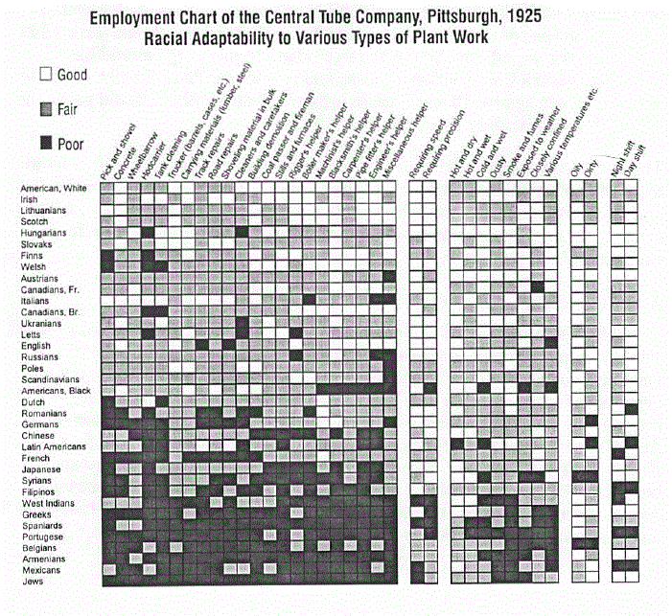
Notes:
https://drive.google.com/file/d/1wmYaGuept6NtugXF5vUCuEXC_23VWhyx/view

Slide 19
Why did the boss make this chart?
Look for “White Americans” on the chart. What does this category tell us about who was white in 1930? Who is white today?
Do you see any legacies of this thinking in work today?

Slide 20
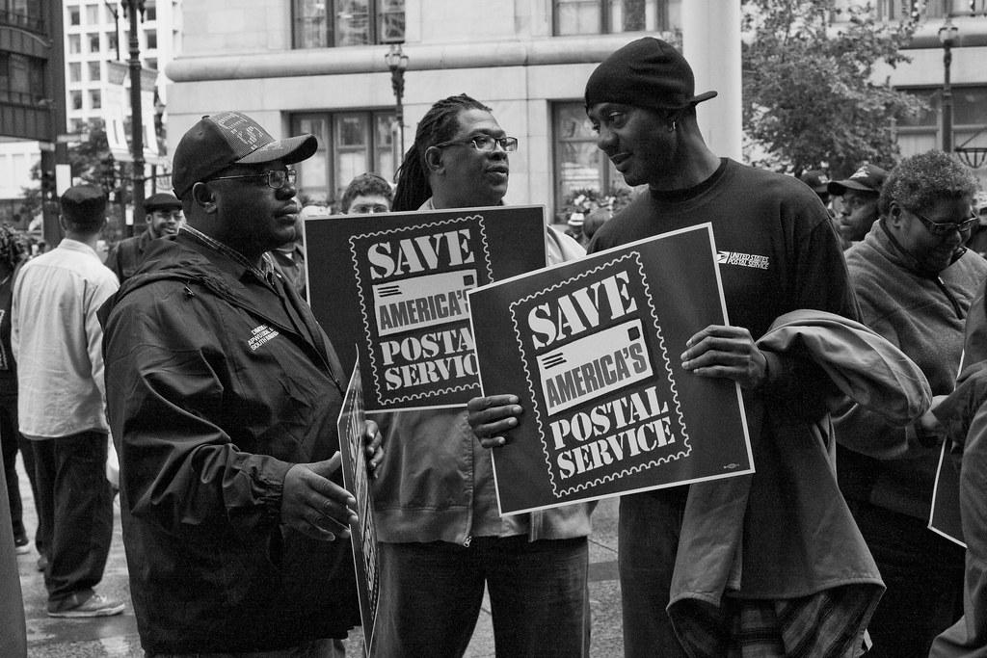
The Reality
Unions are the most racially diverse institutions in America despite society still being segregated
Black workers are 11.6% of union members
Latinos make up another 8.8% of union members
AAPI are 8.3% of union members

Slide 21
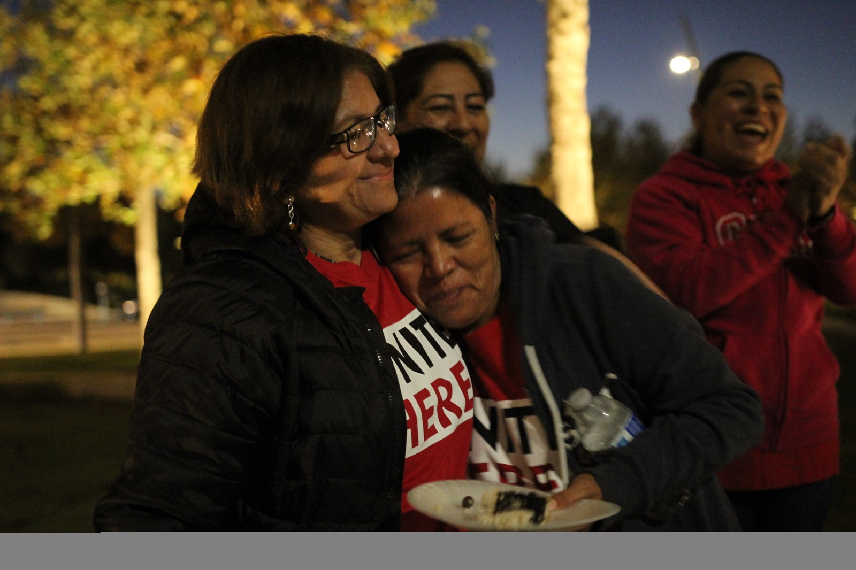
Two Sides of the Problem
Fighting racism from the boss or among co-workers
Involving more workers of color and building leaders at ALL levels of the union

Slide 22
What kind of values would you want to see your union practice?
Love
Solidarity
Justice
Accountability
integrity
Trust
Justice
Trust in members
Kindness
openness
Inclusion
Show respect each other
tranparency
Transparency
Bottom-up
Notes:
The union context tends to bring the best out of people. A union is one of the few places in society where people of all races work together for common goals. I have here a few values of unions. Does anyone have any other values they can think of?

Slide 23
What kind of values would you want to see your union practice?
Honest opinions rather than what is expected
Sharing Power
Inclusivity
Rank and file driven
Driven by the workers
Dealing with conflict directly and practice working through it together!
Accountable
Rising tide floats all ships
Empowerment
Notes:
The union context tends to bring the best out of people. A union is one of the few places in society where people of all races work together for common goals. I have here a few values of unions. Does anyone have any other values they can think of?

Slide 24
What kind of values would you want to see your union practice?
Mutual Aid
Caping leadership salaries
No concessions
Decolonization
Leadership turnover
Notes:
The union context tends to bring the best out of people. A union is one of the few places in society where people of all races work together for common goals. I have here a few values of unions. Does anyone have any other values they can think of?

Slide 25
What kind of values would you want to see your union practice?
Notes:
The union context tends to bring the best out of people. A union is one of the few places in society where people of all races work together for common goals. I have here a few values of unions. Does anyone have any other values they can think of?

Slide 26
Scenarios & Small groups
Pick 1 of these scenarios and discuss in small groups how this would exclude or prevent minority workers from participating in the union? Then discuss what are the steps you as the union (stewards, leadership, members) could take to address these scenarios and build solidarity among the members.

Slide 27
Scenario 1
A group of Latino members are sitting in the break room when another member walks in. A member who only speaks English gets agitated and tells them, “I know you’re talking about me. “We speak English in this country.”

Slide 28
Scenario 2:
You’re collecting photos for your slate’s Facebook page, website and campaign leaflets. All of the pictures you’re getting are of white members. You ask the other slate members if there are pictures of members of color and they say, “ We don’t have many members of color who are involved.”

Slide 29
Scenario 3:
Some racist graffiti is found scrawled on someone’s locker with a Sharpie, including the N word. Management cleans off the locker and moves on. Rumors fly about what the graffiti said and didn’t say.

Slide 30
Scenario 4:
The university announces layoffs to the custodial staff, a workforce that has many Black, Latino, and immigrant members in a different union. You discuss mobilizing for their rally and lending them staff support at the Executive Board meeting. One member protests, arguing that faculty don’t want to be associated with the custodial staff and it will hurt your reputation.

Slide 31
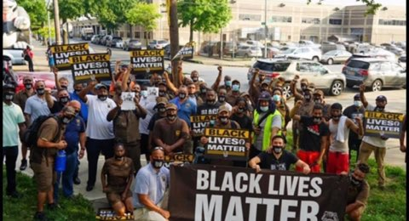
Nothing about us without us!
What is an issue in your workplace that would build unity and involve more workers of color?
Notes:
What is the issue?
Who does it affect?
What members need to be mobilized to address it?
How will you reach out to and involve members who are not normally involved?

Slide 32
Campaign 1: Teamster MLK Day Campaign
What were the issues they experienced?
What were the steps they took?
What makes this an example of racial justice?

Slide 33
Campaign 1: Teamster MLK Day Campaign
What were the issues they experienced?
What were the steps they took?
What makes this an example of racial justice?

Slide 34
Campaign 2: Racist Manager at Kroger
What were the issues they experienced?
What were the steps they took?
What makes this an example of racial justice?

Slide 35
Campaign 2: Racist Manager at Kroger
What were the issues they experienced?
What were the steps they took?
What makes this an example of racial justice?

Slide 36
Campaign 3: Workers at Twin Peaks
What were the issues they experienced?
What were the steps they took?
What makes this an example of racial justice?

Slide 37
Campaign 3: Workers at Twin Peaks
What were the issues they experienced?
What were the steps they took?
What makes this an example of racial justice?

Slide 38
Campaign 4: Minneapolis Strikers demand a living wage
What were the issues they experienced?
What were the steps they took?
What makes this an example of racial justice?

Slide 39
Campaign 4: Minneapolis Strikers demand a living wage
What were the issues they experienced?
What were the steps they took?
What makes this an example of racial justice?

