Slide 1

Your Experience with the National Civil Rights Museum
Remember to sit with your affinity groups to begin our day.

Slide 2

Advancing Racial Justice Day 3

Slide 3
NEA has adopted a Standard of Conduct Policy to ensure that all of our gatherings are welcoming to and free from discriminatory, harassing, or otherwise unacceptable behavior. Discrimination or harassment based on race, color, ethnicity, religion, sex, age, national origin, sexual orientation, disability, gender identity, or expression, or any other characteristic protected by law will not be tolerated. If you have experience any discriminatory or harassing behavior, please report the incident. Thank you for your commitment to ensuring a positive event for all.

Slide 4
By attending this training, you confirm that you are either an NEA affiliate staff person or NEA member in good standing. The information you receive here is only for your use in your capacity as an NEA affiliate staff person or NEA member.
This presentation and its contents are confidential and may not be further distributed or passed on to any other person or published or reproduced, in whole or in part, by any medium or in any form, for any purpose unless written consent has been provided by Ellen Holmes. Audio/video recording, copying of slides, and the use of AI note--taking tools are prohibited without written consent. Violation of these terms may result in legal action.

Slide 5

Community Agreements Pg 2-3
Encourage & Practice Awareness & Self-Knowledge
Listen for Understanding
Being Kind & Gracious
Stay Engaged
Staying Curious and Suspending Judgement
Say “I”- tell your truth
Leaning into Discomfort
Reach for Empathy
Expect Non-Resolution & Non-Closure

Slide 6
Feedback on Feedback
38% response rate, range of 5.0 for the museum to 4.6 for the facilitators
Themes:
Appreciation for the affinity groups and the museum
More time

Slide 7
Your Words
I appreciated staying in the affinity groups. It helped me really appreciate being in a group who understands without using words. I suggest to do a full day of training on day 2 and have more time at the museum on day 3. Is so much information and it felt rushed. I also understand NEA might not consider that “work”. I was disappointed that the group disregarded the allergy alert and came back to the room with the fruit smoothies. It was an example of the privilege vs the marginalized. As advocates, we failed our sibling.
Incorporating a trip to the National Civil Rights Museum as part of the curriculum was brilliant. Today allowed for deep conversations to occur; of course, more time for the conversations to happen within groups would have allowed everyone to have a voice. Perhaps, the affinity groups and the restorative circles could be been subdivided so that everyone would have had a chance to share on all the items. Overall, another very nice day in which a great deal of hard material was presented with style and grace. I am appreciative.

Slide 8

Overview Of Today’s Learning
Welcome & Introductions
Community Building
Setting the Stage
Talking Race
Actor/Ally/Accomplice
Interrupting Microaggressions
Being Anti-Racist
Case Studies in Racial Equity
Moving Forward
Closing
Agenda
Notes:
Lisa

Slide 9
Affinity Group: National Civil Rights Museum
What was your experience with the National Civil Rights Museum, and how does it relate to the type of self-care you need when doing this type of work?

Slide 10
Bekah and Linda

Slide 11
Environmental Justice
Notes:
Page 99
Previous pages take a look at other examples of structuralized racism – economy and housing

Slide 12
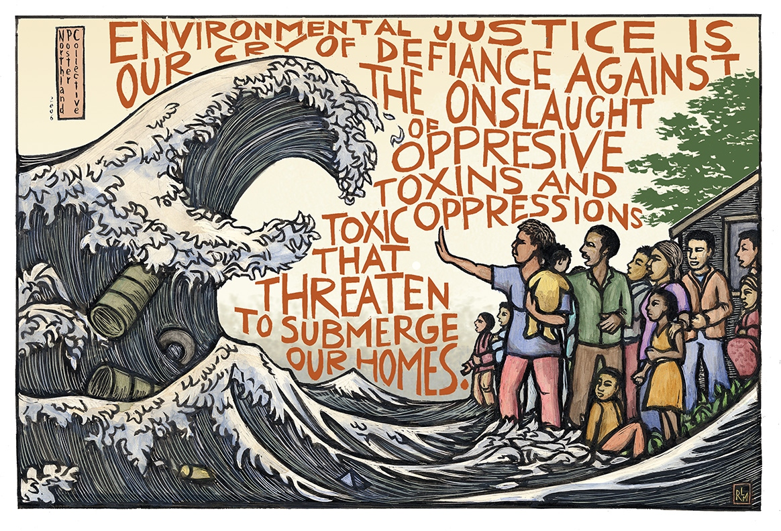
https://amazeworks.org/environmental-justice-countering-the-effects-of-environmental-racism/

Slide 13
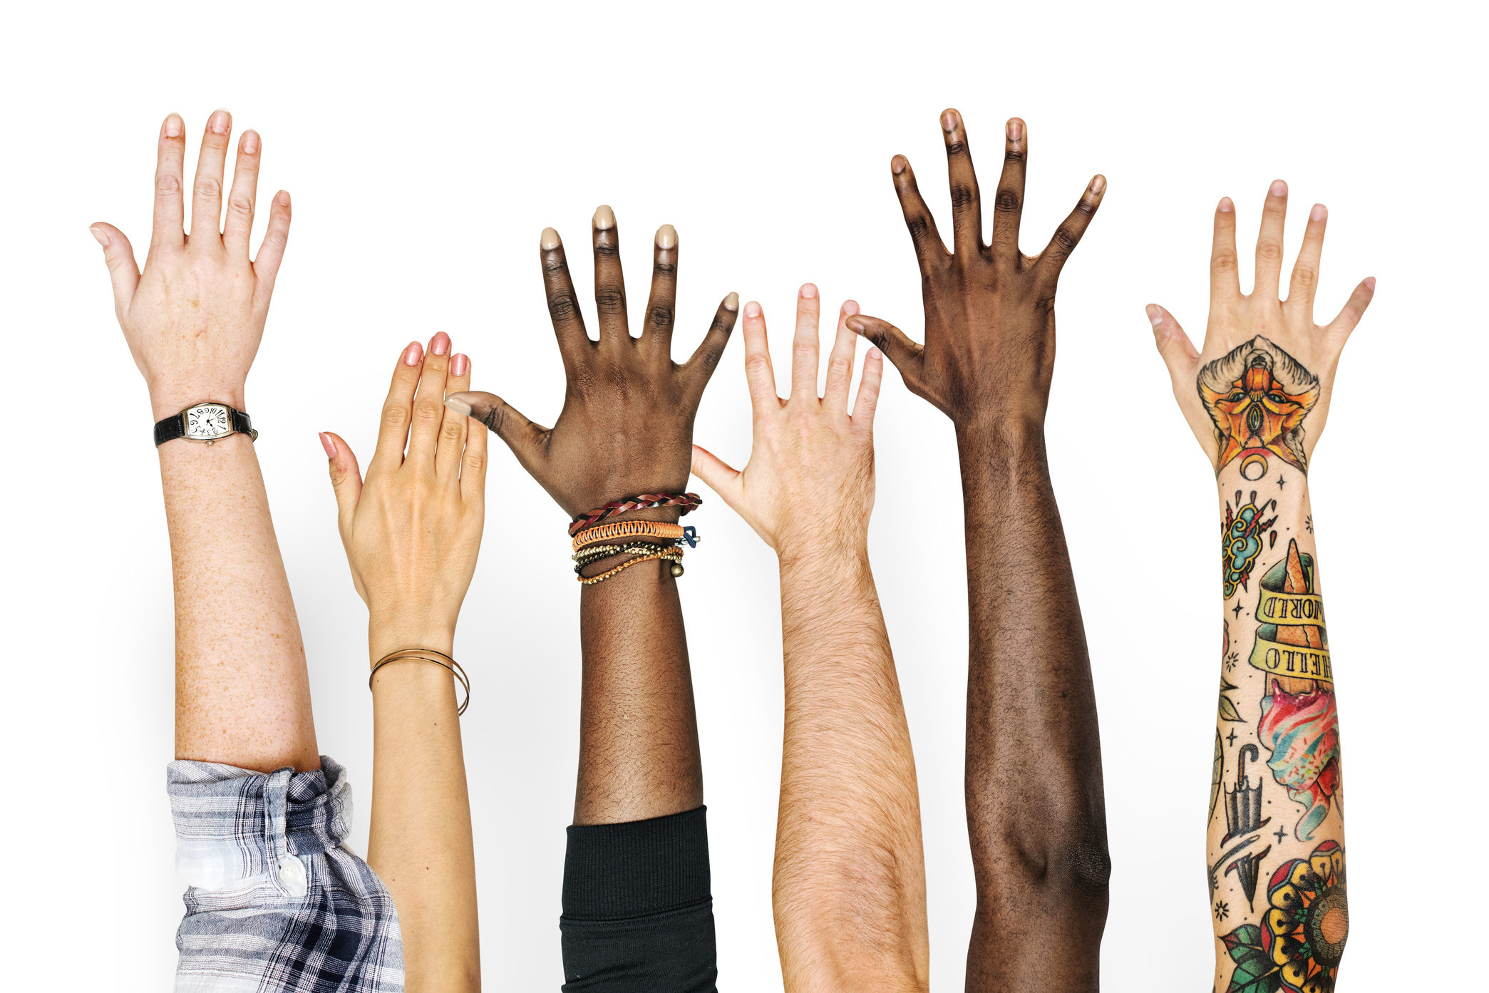
A Couple of Quick Thoughts
What do you think we mean when we say climate justice?
What do you think race has to do with climate justice?

Slide 14

Environmental Racism Explained

Slide 15
Environmental Injustice Defined
When a group bears a disproportionate share of the negative environmental consequences resulting from industrial, municipal, and commercial operations or the execution of federal, state, local, and tribal programs and policies (U.S. EPA, 1998).

Slide 16
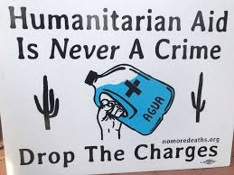
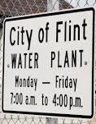
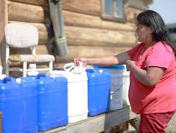
What is the best predictor that a person will be disproportionately, negatively impacted by environmental consequences?

Slide 17
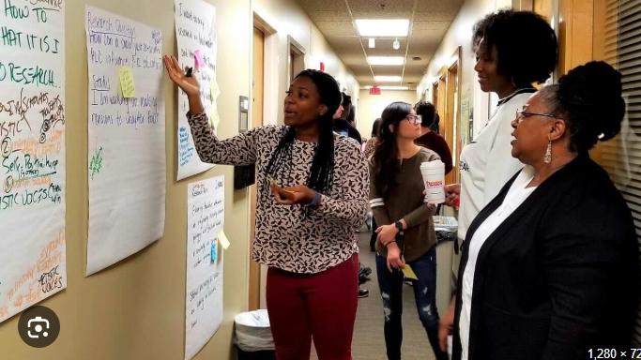
Picturing Climate Justice
Take two minutes to look at the pictures around the room, select one that speaks to you the most.
Three participants per picture
Five minutes to explain
Why did you choose the image?
How does your image relate to environmental racism?

Slide 18
Activity –
Types of Environmental Racism
Pg 27
Air Pollution
Lack of access to Clean Water
Climate Migration/Climigration
Extreme Weather
Food Production
Gentrification
Toxins
Question: How does your picture, linked to one of these terms, impact Black, Brown and Indigenous communities in the United States? Think about your home, community, workplace and/or union.
Notes:
PG 23 – types of environmental racism
3 pictures at each table
Ask tables to identify the type of environmental racism pictured and answer the question on butcher paper.

Slide 19
Types of Environmental Racism
Air pollution
People of color and the poor in urban area, who are likely to lack health insurance, are exposed to elevated levels of air pollutants that may lead to greater health impacts from air pollution.
Lack of Access to Clean Water
Due to decrease funding on infrastructure and regulation, many communities of color are exposed to high level of contamination of their water sources. Lack of accountability leads to water pipes on low-income neighborhoods to be outdated and containing harmful substances.

Slide 20
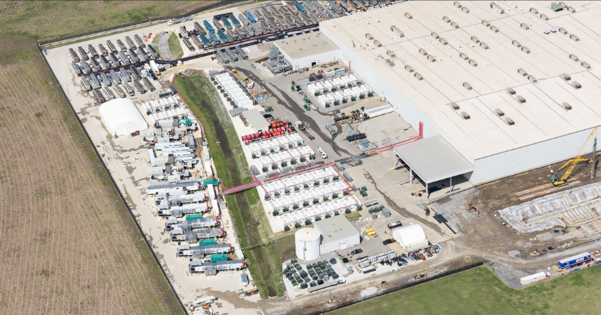
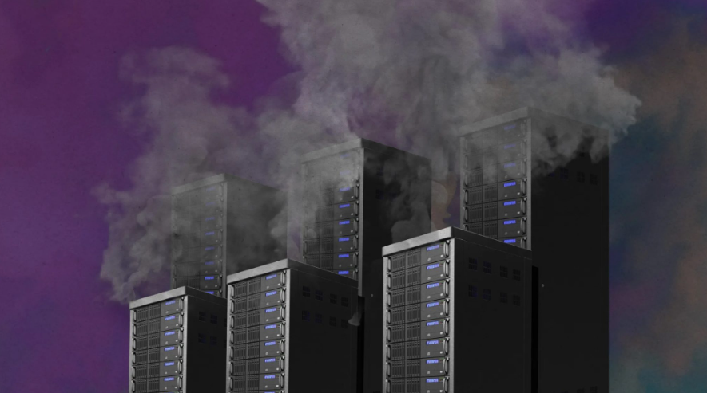
Air and Water—A "new" unholy union
Additionally, data centers required to generate AI tend to be located near poor urban centers; their water requirements and air pollution further strain already stressed areas.
Notes:
Poor indoor air quality impacts learning conditions and working conditions.
1.A study of 100 U.S. schools found a direct association between student academic achievement and classroom ventilation rates, and that measurable progress in math and reading scores were observed when school indoor air quality was improved.
2.Poor IAQ in schools has been linked to cognitive deficits and negative economic impacts in the workplace, including impacts on the number of employee sick days and job retention.
Poor IAQ can trigger asthma attacks and absences. Asthma is a leading cause of school absence, leading to nearly 10.5 million missed school days per year. Research indicates that many students lack an asthma action plan and, particularly in low-income areas, do not have a quick-relief inhaler at school. This leads to unplanned emergency room visits, hospital stays, and missed work and school days putting the greatest financial burden on people with asthma and their families.
Historical policies that resulted in the racial segregation of neighborhoods, workplaces, schools, and health care facilities continue to exacerbate asthma disparities today. Segregation limits resources and opportunities available to certain populations, affects access to health care, increases risk for exposure to environmental triggers, and increases chronic stress in certain populations.

Slide 21
Aging infrastructure is one of the root causes of poor indoor air quality in schools.
Poor IAQ can trigger asthma attacks and absences. Asthma is a leading cause of school absence, leading to nearly 10.5 million missed school days per year.
Research indicates that many students, particularly in low-income areas, do not have a quick-relief inhaler at school, leading to unplanned ER visits, hospital stays, and missed work/school days.
Historical policies that resulted in the racial segregation of neighborhoods, workplaces, schools, and healthcare facilities continue to exacerbate asthma disparities today. Limiting resources and opportunities, access to healthcare, and increasing the risk of exposure to environmental triggers.
Notes:
Poor indoor air quality impacts learning conditions and working conditions.
1.A study of 100 U.S. schools found a direct association between student academic achievement and classroom ventilation rates, and that measurable progress in math and reading scores were observed when school indoor air quality was improved.
2.Poor IAQ in schools has been linked to cognitive deficits and negative economic impacts in the workplace, including impacts on the number of employee sick days and job retention.
Poor IAQ can trigger asthma attacks and absences. Asthma is a leading cause of school absence, leading to nearly 10.5 million missed school days per year. Research indicates that many students lack an asthma action plan and, particularly in low-income areas, do not have a quick-relief inhaler at school. This leads to unplanned emergency room visits, hospital stays, and missed work and school days putting the greatest financial burden on people with asthma and their families.
Historical policies that resulted in the racial segregation of neighborhoods, workplaces, schools, and health care facilities continue to exacerbate asthma disparities today. Segregation limits resources and opportunities available to certain populations, affects access to health care, increases risk for exposure to environmental triggers, and increases chronic stress in certain populations.

Slide 22
Types of Environmental Racism
Climate Migration (Climigration)
As temperature and sea levels have risen due to climate change, governments around the world are facing massive human displacement without any mechanism to address it.
Food Production
Low income families, who tend to be disproportionately people of color, are forced to spend a bigger proportion of their income on food than higher income families. Food chain contamination occurs through introduction of toxic substances into the environment

Slide 23
Food Justice
Food justice is fundamentally about racial justice, because in the United States, race and racism not only structure everyday experiences but also influence the (under) development of neighborhoods and the implementation of policies that disproportionately disenfranchise Black communities... The desire to 'bring good food' to Black communities [as a primary solution]… reinforces the belief that these communities have little or no investment in creating their own place-making strategies toward food self-sufficiency.
Ashante M Reese (2019)
Black Food Geographies: Race, SelfReliance, and Food Access in Washington, D. C.

Slide 24
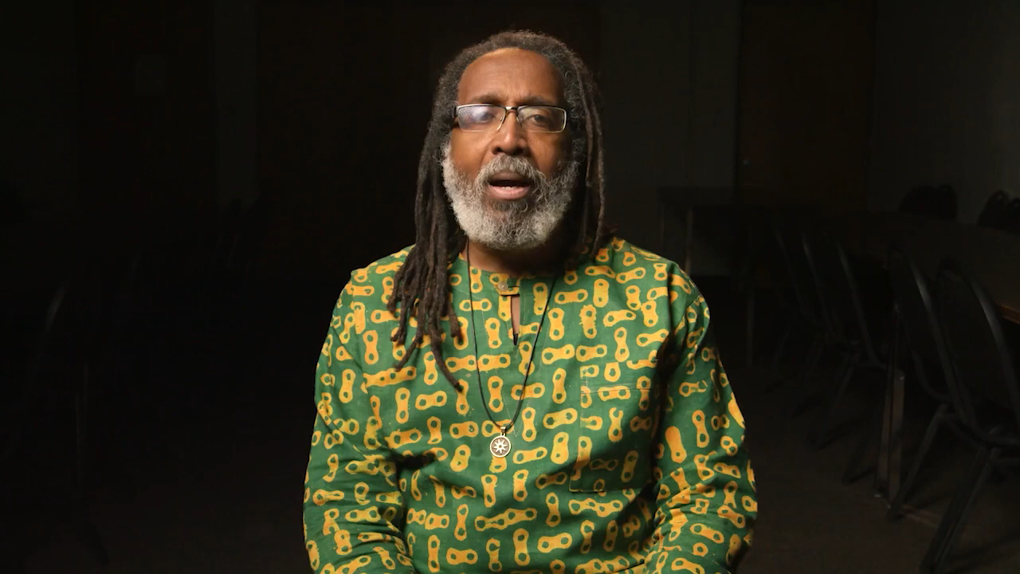
Food Apartheid

Slide 25
To ACT on Organizing around environmental racism and food apartheid
Ask Different Questions
What are the current environmental justice and food apartheid priorities in your union and/or labor council?
What steps can you take to support these priorities?
What are some projects you want your union and/or labor council to undertake in addressing environmental racism?

Slide 26
Types of Environmental Racism
Extreme Weather
Extreme weather events, such as heatwaves, extreme cold, droughts and floods are expected to increase in frequency and intensity due to climate change. Due to increase in the temperature, there is increased risk in cardiovascular deaths (with risks higher for African Americans). Low-income urban neighborhoods and communities of color are particularly vulnerable to because they are often segregated in the inner city, where dark-colored materials, such as asphalt, used for construction absorb heat and do not allow it to dissipate at the same rate as soil, grass, forests, and other less industrial materials. As heatwaves increase, low income families and people of color are less likely to have access to air-conditioning leading to disproportionate risk of heat-related illness and death.

Slide 27
Types of Environmental Racism
Gentrification
Gentrification describes the movement of wealthier individuals and families (often White) into urban, working class neighborhoods. This results in an increase in property values and rents that often displaces low-income, black and brown inhabitants and businesses who are then forced to move to other neighborhoods where environmental degradation is worse.

Slide 28
Types of Environmental Racism
Toxins in the Community and Workplace
The communities beset by hazardous pollution and toxins tend to be poor and disproportionately black, brown and indigenous communities. Due to entrenched segregation, many hazardous waste and toxic facilities end up in these communities, leading residents to experience health and wellness problems. Research describes the analysis of all permitted industrial facilities across the United States show that polluters, including commercial hazardous waste facilities, disproportionately expose communities of color and low-income populations to chemical releases.

Slide 29

Integrating Racial Justice Solutions
· Without an intentional focus on understanding how race and other social factors play into exacerbating the poor conditions of public schools, we could see a continuation of negative outcomes.
· School districts serving primarily students of color receive less funding than districts serving a majority white student population.
· An aging infrastructure is one of the root causes of poor indoor air quality in schools.
Notes:
Without an intentional focus on understanding how race and other social factors play into exacerbating the poor conditions of public schools, we could see a continuation of negative outcomes in school districts that primarily serve students of color. That is because it is more common for school districts serving primarily Native students or students of color to receive less funding than districts serving a majority white student population.
Districts serving white students living in poverty also tend to receive greater funding than districts serving students of color living in poverty. Those trends hold even when controlling for socioeconomic status. Inequitable financial resources contribute not only to inequitable academic resources such as educators, instructional materials, and technology but also to poor school facilities and critical infrastructure that directly affect student health. Aging infrastructure is one of the root causes of poor indoor air quality (IAQ) in schools, which is critically important for children’s health and academic performance.

Slide 30
To ACT on Organizing around environmental racism and climate change
Ask Different Questions
What are the current environmental justice and climate change priorities in your union and/or labor council?
What steps can you take to support these priorities?
What are some projects you want your union and/or labor council to undertake in addressing environmental racism?

Slide 31
Key Points
Black, brown, and indigenous people and their communities are more vulnerable to climate change because of the gap between the rich and the poor.
Climate change and environmental racism intensifies racial inequalities.
Low-income people are more likely to rent, are less prepared for extreme weather, less likely to be insured and have fewer financial resources to recover after events.

Slide 32
Albert and Bekah

Slide 33
Practicing Becoming
Anti-Racist
Case Studies

Slide 34
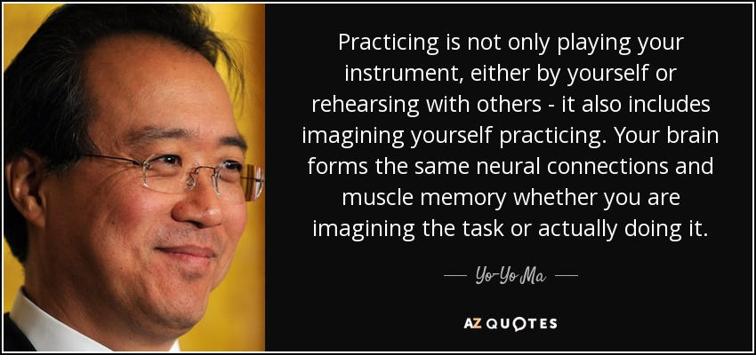
Notes:
The case method enables us to practice stepping through a process of considering a range of perspective and angles, to practice seeing the full complexity of school and classroom situations, and as a result to consider a more focused manner how we might respond.
It does not have ONE correct answer or obvious solution. We learn to think carefully, to listen to the points made by others and to evaluate those arguments, to review alternative courses of action and their efficacy, and to interpret real-world experience.
The case method provides opportunities to bolster our abilities to think, teach, lead, and advocate more equitably and justly.

Slide 35
Practicing Equity Literacy Abilities
Recognize inequity
Respond to inequity
Redress inequity
Actively cultivate equity
Sustain equity
Notes:
Equity literacy refers to the knowledge and skills we need as educators to be a threat to the existence of bias and inequity in our spheres of influence. It refers to the knowledge and skills that prepare us to root bias and inequity our of our classrooms, schools and communities.
Case studies allow us to practice what Paul Gorski of the Due East Educational Equity Collaborative calls the Equity Literacy abilities:
The purpose of the 5 abilities is to
allow us to apply a strong equity lens to everything we do; and
they provide an outline for what the thrust of equity professional learning ought to focus on
The ability to recognize even the subtlest bias and inequities. Equity literate educators notice even subtle bias in classroom materials, classrooms interactions and school policies and they reject deficit views that associate outcome inequalities (test scores, graduation rates) with students’ “mindsets” or “cultures” rather than disparate levels of access to resources and experiences in and out of school.
The ability to respond to biases and inequities in the immediate term. Equity literate educators have facilitation skills and content knowledge needed to interview effectively when biases or inequities arise in classrooms, faculty meetings and other contexts. They also foster conversations with colleagues about bias and inequity concerns at their schools.
The ability to redress biases and inequities in the long term. Equity literate educators advocate against inequitable school practices and identify ways to mitigate structural barriers that impede educational engagement.
The ability to create and sustain a bias-free and equitable learning environment. Equity literate educators express high expectations for all students and demonstrate a willingness to withstand complaints about changes meant to redistribute educational access and opportunity more equitably.
Apply an equity literacy lens and do a deep diversity and social justice drive into the situation and you will see things differently.

Slide 36
1. Recognize Racism
Do I recognize even the subtlest bias and inequity in my sphere of influence?
  I can’t respond to or redress an inequity I don’t recognize
Notes:
Red Honda Civic example
What leaders do: be vocal and transparent with your observations and thoughts and cultivate a practice of seeking many perspectives and experiences
We have to cultivate a practice of seeking that information from others so that we can recognize things

Slide 37
2. Respond to Racism
When a bias or inequity becomes apparent in a particular instance, do I have the skills and the will to respond?
  Reactive, in the immediate term
Notes:
Firefighter example
What leaders do: say things that need to be said; make sure harmed people are okay; offer resources; make connections between people; be an affirming listener; and bend inequitable policies

Slide 38
3. Redress Racism
Do I have the knowledge and skills to understand how individual instances of racial inequity are usually related to bigger sets of conditions related to individual ideology and institutional culture? Am I able to redress those instances by proactively addressing their root causes?
Notes:
Fire Prevention example
What leaders do: make public comments and commitments; plan for and offer community development; seek community input; establish ‘support’ programs
Not quite action yet

Slide 39
4. Actively Cultivate Antiracism
Do I have the knowledge, skills, and will to apply an antiracist lens to every discussion, every decision? Is racial equity an add-on or afterthought or do I actively cultivate it through every policy and practice and throughout institutional culture?
Notes:
Planting Seeds example
What leaders do: change policies and practices; hire antiracist and equity grounded staff; expand leadership; secure funding and expand resources

Slide 40
5. Sustain Antiracism
As we progress toward a full antiracist commitment, people who are used to the advantage of extra access and opportunity are going to complain and attempt to slow or reverse that progress. Do I know how to sustain equity efforts in the face of this push-back? Do I have the will to do so?
Notes:
Water and Feed example
What leaders do: implement evaluation and accountability measures; make systemic shifts to practices such as hiring, purchasing, policy development, leadership models, professional development, etc; adjust organizational budgets to prioritize equity

Slide 41
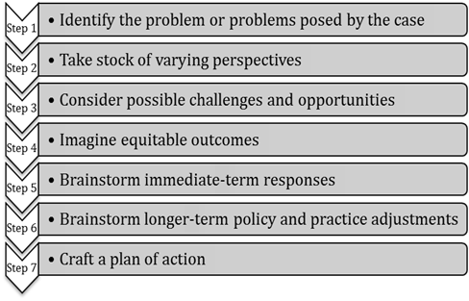
Seven Steps for Case Analysis pg. 60
Notes:
Note to self – 2, 5, 6
Process to help you to practice using your unique insights, your knowledge about students and their families, and our expertise wit school and classroom dynamics in order to respond as effectively and equitably as possible, to the types of bias and inequities that inevitable crop up on schools.
We go through these exercises as a group because it is important to reflect upon why people with different combinations of identities and life experiences might interpret the cases differently.
Step 1 – Many biases and inequities students face in school are implicit and unintentional, hidden in day-to-day practices, school traditions, and quiet interactions. It can be especially difficult to recognize the sorts of challenges students or families face when you have never faced those challenges yourself. During this step, I urge you to read between the lines. Practice recognizing conditions and contexts you might not usually recognize or seeing what you might be conditioned not to see. Begin by naming biases, inequities, or otherwise troublesome conditions that are immediately apparent to you. Once you have a grasp of the more surface level dynamics, dig deeper. Look for less explicit, not so obvious examples of existing or potiention bias, inequity, stereotypes or presumptions.
Ask yourself What does the case tell us about school or classroom policy, about instructional or leadership practices, about individuals’ attitudes and perspectives that might hint at something deeper than surface-level biases and inequities?
Step 2 – The cases have at least a couple of obvious stakeholders who might have different perspectives on what is happening. In every case, we should consider not only the people immediately involved, but also those within earshot and eyeshot. Start with the immediate participants and then, at the very least, the ring of constituents around them. Focus on marginalized communities and privileges communities. Then take it one step further. What if something was shared on social media – you have to consider the perspective of someone seeing this on SnapChat.
Step 3 – Our next task is to identify potential challenges and opportunities present by the situation. Start with the individuals involved. Remember to use your analysis from Steps 1 and 2 to inform your assessment of challenges and opportunities.
Step 4 – Building on the understandings we have gained by talking stock of stakeholders’ perspectives and considering possible challenges and opportunities, we begin imagining positive and equitable outcomes. [take time to clarify difference between equity (fair) and equality (same)]. Remember to think both immediate term and long term. What can be resolved right now, on the spot, and what will equity look like once it is resolved? Consider long-term outcomes as well. And finally, be specific – identify very specific, on-the-ground outcomes, How specifically will things be different in the school or classroom if we commit to resolving the issue and all its nuances equitably?
Step 5 – We begin brainstorming strategies to get us there.
Step 6 – We develop longer term strategies often for more substantive change. Record whatever ideas come to mind.
Step 7 – During our final step, we craft our brainstorms into specific actions we believe will result in the equitable outcomes we outlined in step 5 What would we do in the immediate terms? What would we do that might a little longer term equity project? How would we respond to ensure, to the best of our knowledge and power, justice for everybody involved?
In summary, the point is not to memorize these steps or to step through them carefully in every instance, rather the ideas is to use them to practice our equity literacy skills by reflecting on classroom and school conditions through a social justice lens.

Slide 42

Case Studies
Equity Case Analysis Process p. 60
Staff Training p. 61
Staff Meeting Microaggressions p. 62
Safe Space for White Members p. 63
Use of Racial Slur p. 64

Slide 43
Three Quick Thoughts
Is there anything that you said or that you heard that the room needs to hear?

Slide 44
Ellen

Slide 45
Campaign Lab

Slide 46

What would it take to achieve a systemic solution for all of these scenarios?

Slide 47
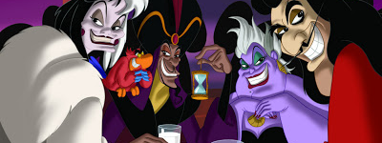
What or Who is preventing you from achieving this solution?
Notes:
Advocates, Mobilizers, Organizers Scenario

Slide 48

What do we focus on at NEA?

Slide 49
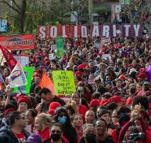
Strength and Growth to Win
Growth is a focus on building the base of members, leaders, structures, and partners.
Strength is the ability to use power to win.

Slide 50

Base Building Matters - Growth
We have to recruit 250,000 new members a year just to maintain current levels of union density. (Necessary)
Member Recruitment is a year-round, critical strategy.
Maintenance does not build. (Not Sufficient)

Slide 51
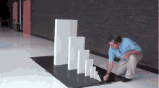
Exponential Base Building Matters More
With high member density, we can claim the wins we dream about AND control the outcomes of those wins across time.

Slide 52
3 Prevalent Theories of Change
Advocacy (relies on singular experts little risk required beyond them)
“Advocacy is the work of creating change through the actions of professionals or technical experts—lobbyists, pollsters, lawyers, communication specialists, researchers. Advocacy relies on the expertise, status, and know-how of these groups of people to make change. Advocacy usually happens in a closed-door room; ordinary people play a small to nonexistent role in its efficacy. Advocacy has become a dominant strategy for unions and liberals.”
Mobilizing (like a club, self-selecting, and typically those who are not risking much to participate)
“Mobilizing, by contrast, activates an already-convinced membership. Mobilizing encourages those who already support a cause or a mission to take action to defend their belief—for example, by attending a protest, wearing a button, or signing a petition.”
Organizing (strategic, always inviting more, taking risks to expand, trust is built through action together)
“To organize is to build mass support and strength among ordinary people. Organizing draws its power from working people’s biggest strength: our numbers. The work of organizing is systematic and rigorous: It requires connecting with every single worker in a shop, every educator in a building, every building in a district. At its core, it asks people to understand their own agency and to make choices about how they will exercise it.”

Slide 53
Advocacy is about using expertise of a few.
Mobilizing is about engaging the already committed.
These are necessary, but not sufficient to build the power we need.

Slide 54

Winning Matters Most - Strength

Slide 55
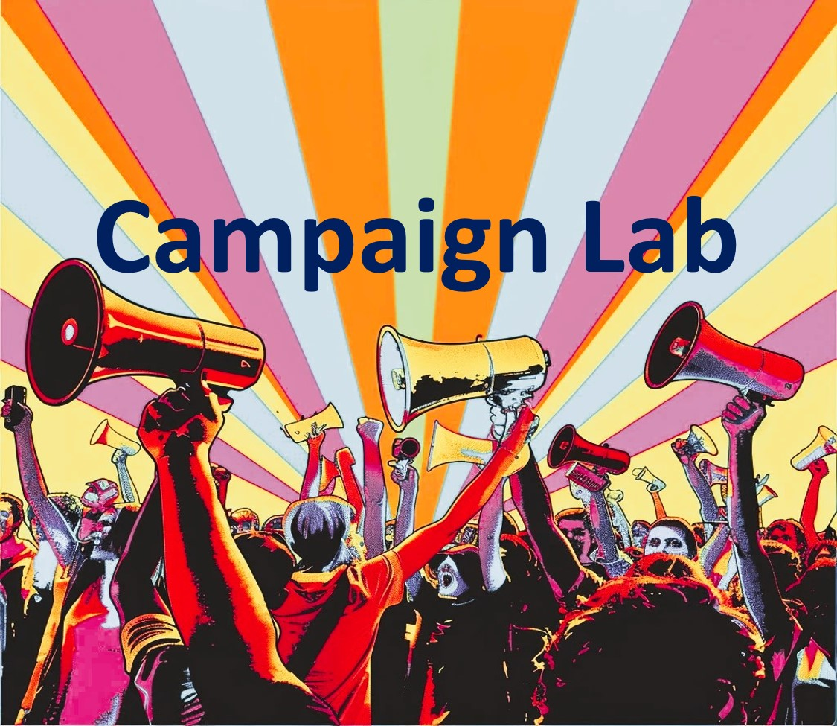

Information and Application
https://www.nea.org/resource-library/campaign-lab

Slide 56

Apply to be a Campaign Lab Coach
Possess an organizing and leadership mindset
Engages in peer problem solving and coaching
Campaign Coach
Holds coaching calls, with team 2 times a month
Coaches 1–2 local teams
Attends campaign coach training
Works with a mentor coach
https://forms.office.com/r/7yMBd7FLwM

Slide 57
Closing

Slide 58
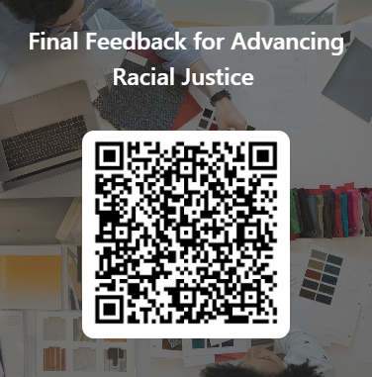
Give us your feedback!

Slide 59
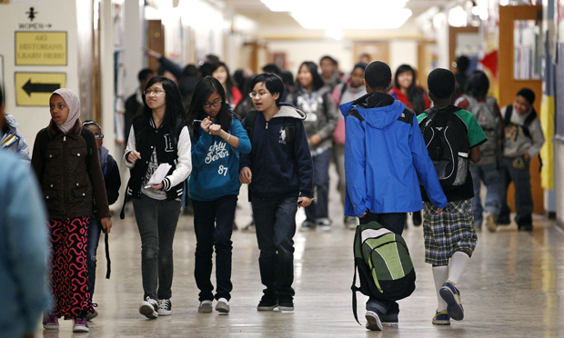
Our Vision of Now and the Future
What will your workplace, locals, community look like after we have achieved Racial Justice?

Slide 60

Final Reflections
What is one thing you are going to do “tomorrow”?
What is one thing you are going to do next month?
What is one thing you might do in six month?

Slide 61

One Word
Thinking back to your core value that you shared earlier and today’s experience:
What is one word that describes your spirit right now?

Slide 63
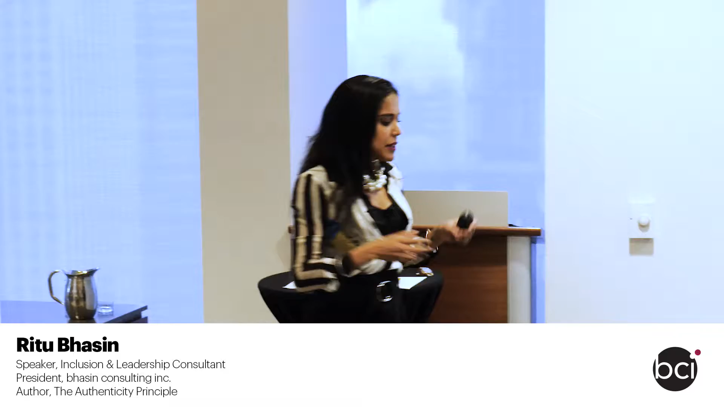
Option to replace above video

