Slide 1

Advancing
Racial Justice
Virtual Session

Slide 2


Honoring This Space
Every community owes its existence and vitality to generations from around the world who contributed their hopes, dreams, and energy to making the history that led to this moment. Some were brought here against their will, some were drawn to leave their distant homes in hope of a better life, and some have lived on this land for more generations than can be counted.
Truth and acknowledgment are critical to building mutual respect and connection across all barriers of heritage and difference. We begin this effort to acknowledge what has been buried by honoring the truth. We are standing on the ancestral lands of Indigenous People. We pay respects to their elders, past and present.
Please take a moment to consider the many legacies of violence, displacement, migration, and settlement that bring us together here today.

Slide 3
Why we are here:
NEA’s Framework For Change
Awareness
Capacity Building
Action
Notes:
Framework for Change:
The National Education Association is uniquely positioned to impact racial justice in education by focusing the work on awareness, capacity building, and action. We will build a union of members who, through their organization, are more aware of racial justice, receive and use racial justice tools, and who, together with other educators and key stakeholders, take action to address racial injustice in schools and related institutions:
If we build awareness about institutional racism and work towards creating racial justice in education, the National Education Association can provide shared knowledge and conceptual clarity in racially aware work;
If we continuously create and disseminate capacity building tools, skills, strategies, and resources to our members, leaders, staff, students and partners, a more racially aware National Education Association can be the leader in publically demanding racial justice in education in more powerful and meaningful ways;
If we support, lift, connect and take action with an intentional focus on movement building, we will create racial equity in our classrooms, worksites, and in our communities.

Slide 4

Overview Of Today’s Learning
Welcome & Introductions
Setting the Stage
Talking Race
Defining Race and Oppression
White Privilege
Race Science
Closing
Notes:
Lisa

Slide 5
WHY is this Our Work?

Slide 6
Resolution I: White Supremacy Culture
The National Education Association believes that, in order to achieve racial and social justice, educators must acknowledge the existence of White supremacy culture as a primary root cause of institutional racism, structural racism, and White privilege. Additionally, the Association believes that the norms, standards, and organizational structures manifested in White supremacy culture perpetually exploit and oppress people of color and serve as detriments to racial justice.

Slide 7
Resolution I: White Supremacy Culture
Further, the invisible racial benefits of White privilege, which are automatically conferred irrespective of wealth, gender, and other factors, severely limit opportunities for people of color and impede full achievement of racial and social justice. Therefore, the Association will actively advocate for social and educational strategies fostering the eradication of institutional racism and White privilege perpetuated by White supremacy culture.

Slide 8

Acknowledgement
The content we are going to explore may bring up strong feelings. Throughout our time together, we will explore examples of racism, ableism, heterosexism, and sexism. By exploring these together, we can begin the process of unlearning our own internal oppression.
The purpose of unlearning isn’t about forgetting what we know or about being wrong; it’s a conscious act which requires critically examining the ideas and assumptions that influence our expectations, behaviors and beliefs about ourselves and other people. By doing this, we can challenge the cultural and structural norms that perpetuate racism and oppression.
Unlearning is something we can all be committed to because we all have a part to play in dismantling everything that helps maintain racism within society.
Adapted from Transatlantic Notes

Slide 9
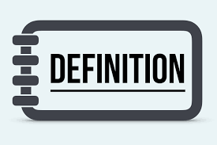
Defining Race
Race is not biological. Race is a powerful social construct that gives certain people more opportunity and advantages.

Slide 10
Defining Prejudice
According to Merriam-Webster: Prejudice is injury or damage resulting from some judgment or action of another in disregard of one's rights
especially : detriment to one's legal
rights or claims

Slide 11
Defining Racism
RACISM IS
PREJUDICE +
INSTITUTIONAL POWER

Slide 12
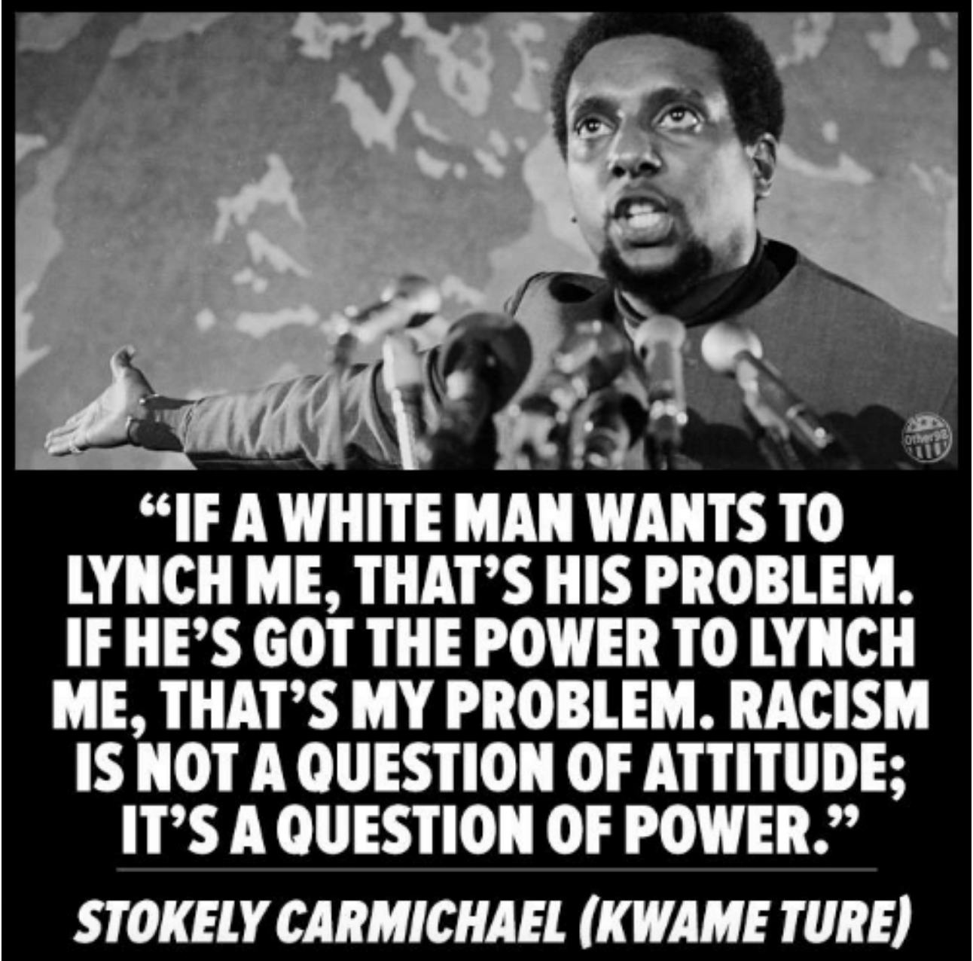
Group Chat
How does a confident and intentional knowledge of the terms we covered help you in your work?
What does this quote about power mean to your work in advancing racial justice?

Slide 13
Tell us about your talking
What did you hear or say that you think needs to be shared out to the larger group?

Slide 14
Privilege is:
An unearned right, favor, or immunity, granted to particular individuals or groups and withheld from others
A key element in perpetuating the power in oppressive systems

Slide 15
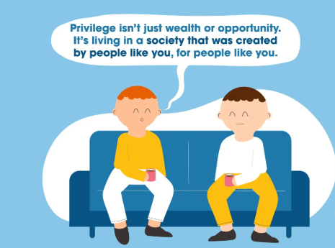
Privilege is...
  An unearned right, favor, or immunity granted to particular individuals or groups and withheld from others
  A key element in perpetuating the power in oppressive systems

Slide 16

Think About Your Life as a Ladder
Reflect on three opportunities you have received that were crucial to your climb.

Slide 17
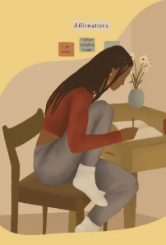
We have reflected... Now: Share
In groups, share one of the opportunities that allowed you to climb your ladder.
Include how that opportunity relates to one of your privileges.

Slide 18
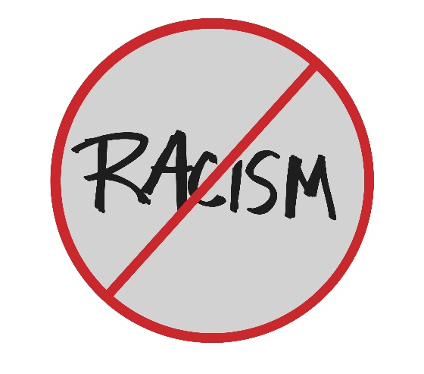
LET’S ADD TO OUR DEFINITION OF RACISM
Prejudice, discrimination, or antagonism directed against someone of a different race based on the belief that one’s own race is superior. Source: Oxford Dictionary
Historically rooted system of power hierarchies
based on race—infused in our institutions, policies
and culture.
Racism isn’t limited to individual acts of prejudice,
either deliberate or accidental. They are built into
systems and institutions that shape our lives. Source: Race Forward 2018

Slide 19
What is
White Culture?

Slide 20
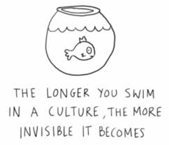
White Culture is…
By “white culture,” we mean the dominant, unquestioned standards of behavior and ways of functioning embodied by the vast majority of institutions in the United States.

Slide 21


Kyle "Guante" Tran Myhre : @guantesolo

Slide 22
White Fragility and
White Privilege Connections

Slide 23
White Privilege and White Fragility
White privilege is the societal privilege that benefits white people over non-white people, particularly if they are otherwise under the same social, political, or economic circumstances.
White fragility is defined as “a state in which even a minimum amount of racial stress becomes intolerable, triggering a range of defensive moves.

Slide 24
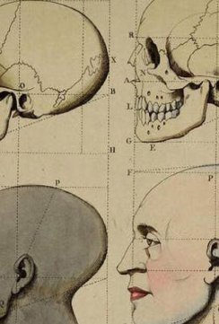
Tale as old as time: "RACE SCIENCE"
In the late 1800s the pseudoscience called “race science” developed arguing that race is a biological category. It linked capability to race.
In 1925, using this as the basis, the Central Tube Company (Pittsburgh) created a table claiming to connect race to adaptability to plant work.

Slide 25
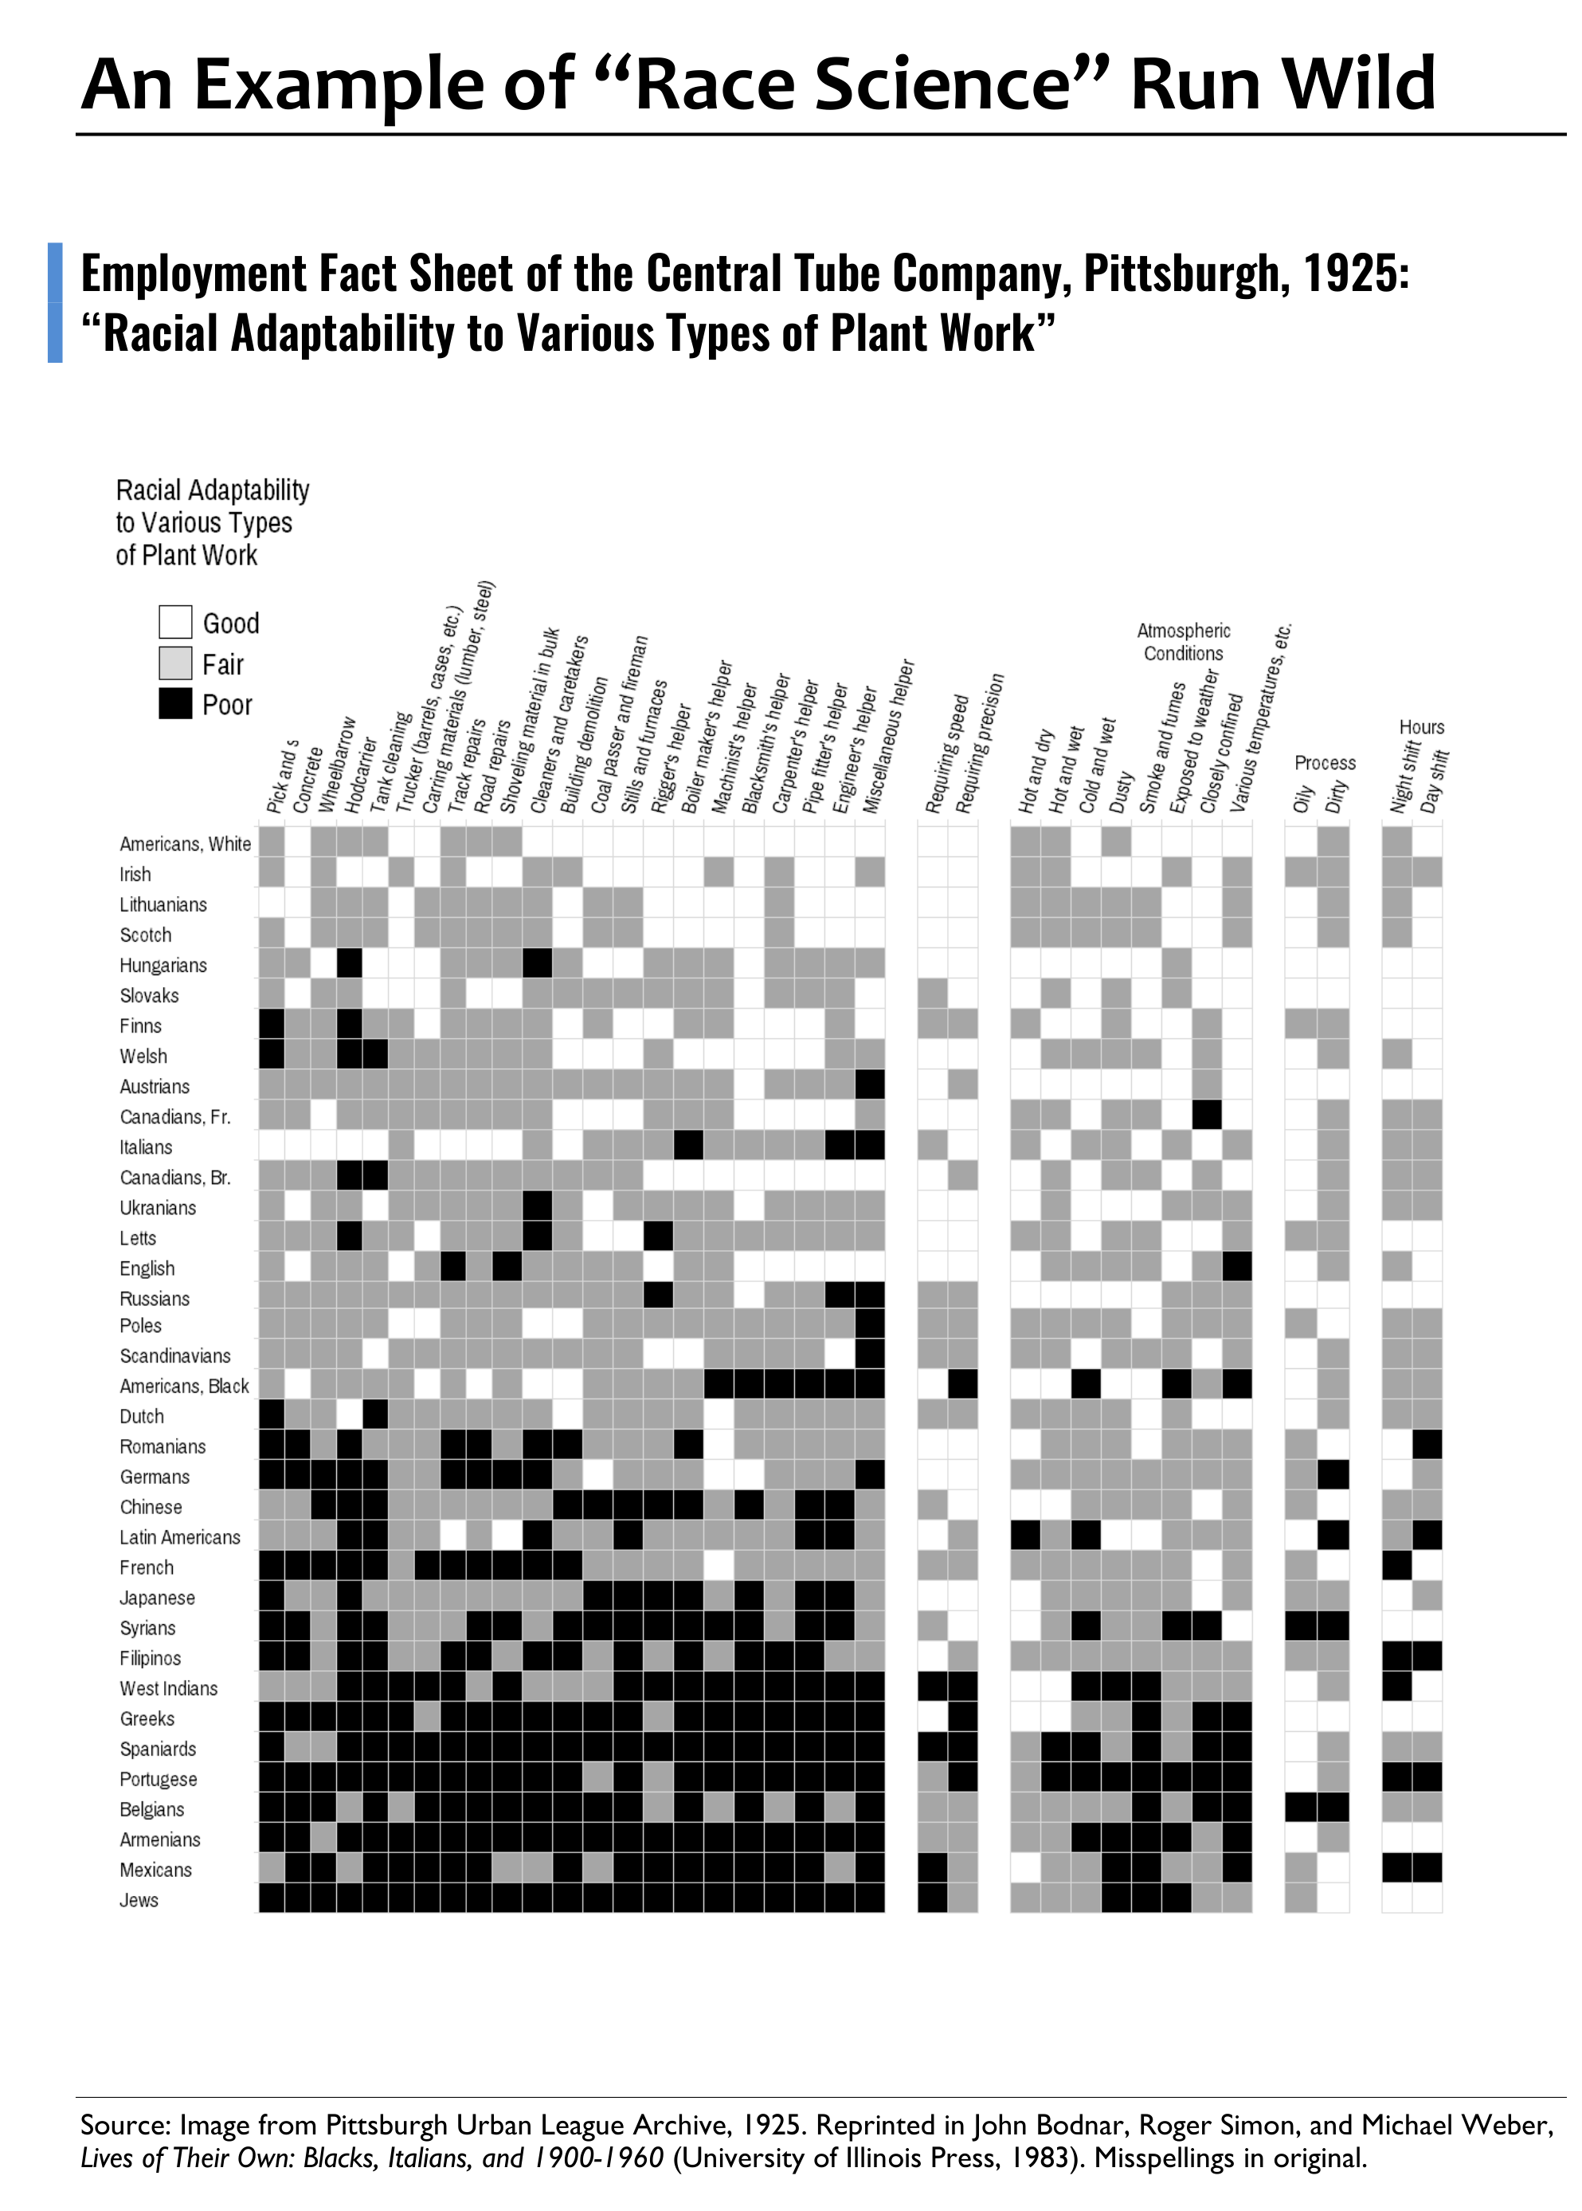
Group Chat
Look for “White Americans” on the chart. What does this category tell us about who was white in 1925? Who is white today?
Do you see any legacies of this thinking in your work today? If so, how?
Bonus: If you were an organizer during this time, how would you use this data to organize your worksite?

Slide 26
TELL US ABOUT YOUR TALKING
What did you hear or say that you think needs to be shared out to the larger group?

Slide 27

Key Points
In our society, people have been taught that we should not say the word, “race.”
Race is a construct developed to support oppression
within a system of white supremacy.
Once you recognize the existence of
oppression and understand how it operates,
you can learn how to resist and challenge
oppression in all forms.

Slide 28
Want to dive into this more?
January 12-14, 2027: Advancing Racial Justice
This training is appropriate for Affiliate Staff, Members, and Leaders working to build campaigns around Racial Justice. Registration priority will be given to teams of Staff and Members who are ready to work on an issue campaign. Participants should leave with a level of confidence, knowledge, methods, and resources allowing them to lead a campaign cycle focused on Racial Justice.
nea.org/UD-Org-Support/focus-academies
Notes:
https://www.nea.org/UD-Org-Support/focus-academies

