Slide 1

Advancing Racial Justice Day 3

Slide 2
NEA has adopted a Standard of Conduct Policy to ensure that all of our gatherings are welcoming to and free from discriminatory, harassing, or otherwise unacceptable behavior. Discrimination or harassment based on race, color, ethnicity, religion, sex, age, national origin, sexual orientation, disability, gender identity, or expression, or any other characteristic protected by law will not be tolerated. If you have experience any discriminatory or harassing behavior, please report the incident. Thank you for your commitment to ensuring a positive event for all.

Slide 3
By attending this training, you confirm that you are either an NEA affiliate staff person or NEA member in good standing. The information you receive here is only for your use in your capacity as an NEA affiliate staff person or NEA member.
This presentation and its contents are confidential and may not be further distributed or passed on to any other person or published or reproduced, in whole or in part, by any medium or in any form, for any purpose unless written consent has been provided by Ellen Holmes. Audio/video recording, copying of slides, and the use of AI note--taking tools are prohibited without written consent. Violation of these terms may result in legal action.

Slide 4

Community Agreements Pg 2-3
Awareness and Self-Knowledge
Listen for Understanding
Be Gracious
Stay Engaged
Be Open and Suspend Judgment
Say “I”- tell your truth
Lean into Discomfort
Reach for Empathy
Expect non- Resolution and non-Closure

Slide 5
Feedback on Feedback
Overall Response rate 75%
Range 5.0-4.9
Highs of 5.0 for both Content and Musuem
Lows of 4.9 for Materials and Facilitators
Themes -
Affinity groups and restorative circles were appreciated
Materials and content are good

Slide 6
Your Words
Opportunities to hear from my colleagues at the table was invaluable and I appreciate these times the most.
Today was well developed and and I appreciate the time spent delivering the nuggets about using restorative practices and how we can connect more.
Great session! Would love to see another additional session or expansion to address micro-aggression and the additional concepts among the same culture.
I appreciated the affinity grouping. Need to join SURJ so I have an affinity group in this work. I appreciate the brave space to express our thoughts!
The visit to the Museum was a great prerequisite for the training. The sessions were very engaging and allow participants to work together

Slide 7

Overview Of Today’s Learning
Welcome & Introductions
Community Building
Setting the Stage
Talking Race
Actor/Ally/Accomplice
Interrupting Microaggressions
Being Anti-Racist
Case Studies in Racial Equity
Moving Forward
Closing
Agenda
Notes:
Lisa

Slide 8

What would it take to achieve a systemic solution for all of these scenarios?

Slide 9
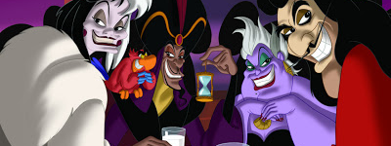
What or Who is preventing you from achieving this solution?
Notes:
Advocates, Mobilizers, Organizers Scenario

Slide 10

What do we focus on at NEA?

Slide 11
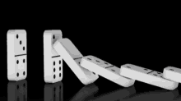
Base Building Matters - Growth
We have to recruit 250,000 new members a year just to maintain current levels of union density. (Necessary)
Member Recruitment is a year-round, critical strategy.
Maintenance does not build. (Not Sufficient)

Slide 12
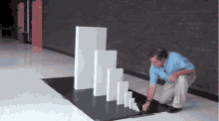
Exponential Base Building Matters More
With high member density, we can claim the wins we dream about AND control the outcomes of those wins across time.

Slide 13
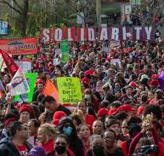
Strength and Growth to Win
Growth is a focus on building the base of members, leaders, structures, and partners.
Strength is the ability to use power to win.

Slide 14

Winning Matters Most - Strength

Slide 15
3 Prevalent Theories of Change
Advocacy (relies on singular experts little risk required beyond them)
“Advocacy is the work of creating change through the actions of professionals or technical experts—lobbyists, pollsters, lawyers, communication specialists, researchers. Advocacy relies on the expertise, status, and know-how of these groups of people to make change. Advocacy usually happens in a closed-door room; ordinary people play a small to nonexistent role in its efficacy. Advocacy has become a dominant strategy for unions and liberals.”
Mobilizing (like a club, self-selecting, and typically those who are not risking much to participate)
“Mobilizing, by contrast, activates an already-convinced membership. Mobilizing encourages those who already support a cause or a mission to take action to defend their belief—for example, by attending a protest, wearing a button, or signing a petition.”
Organizing (strategic, always inviting more, taking risks to expand, trust is built through action together)
“To organize is to build mass support and strength among ordinary people. Organizing draws its power from working people’s biggest strength: our numbers. The work of organizing is systematic and rigorous: It requires connecting with every single worker in a shop, every educator in a building, every building in a district. At its core, it asks people to understand their own agency and to make choices about how they will exercise it.”

Slide 16
Advocacy is about using expertise of a few.
Mobilizing is about engaging the already committed.
These are necessary, but not sufficient to build the power we need.We only achieve that through Organizing.

Slide 17
Campaign Lab

Slide 18


Information and Application
https://www.nea.org/resource-library/campaign-lab

Slide 19

Apply to be a Campaign Lab Coach
Possess an organizing and leadership mindset
Engages in peer problem solving and coaching
Campaign Coach
Holds coaching calls, with team 2 times a month
Coaches 1–2 local teams
Attends campaign coach training
Works with a mentor coach
https://forms.office.com/r/7yMBd7FLwM

Slide 20
Rita and Dr. Taraja

Slide 21
Practicing Becoming
Anti-Racist
Case Studies

Slide 22

What Anti-Racism Is
Anti-Racism Is Not:
Neutrality
Intentions
Individual niceness
Anti-Racism Is:
Naming racial inequity directly
Interrupting harm
Challenging racialized systems
Organizing to redistribute power
Notes:
The case method enables us to practice stepping through a process of considering a range of perspective and angles, to practice seeing the full complexity of school and classroom situations, and as a result to consider a more focused manner how we might respond.
It does not have ONE correct answer or obvious solution. We learn to think carefully, to listen to the points made by others and to evaluate those arguments, to review alternative courses of action and their efficacy, and to interpret real-world experience.
The case method provides opportunities to bolster our abilities to think, teach, lead, and advocate more equitably and justly.

Slide 23
Practicing Anti-Racism Requires the Ability To:
Recognize racialized bias and inequity
Respond in the immediate moment
Redress structural causes
Cultivate equitable systems long-term
Notes:
The case method enables us to practice stepping through a process of considering a range of perspective and angles, to practice seeing the full complexity of school and classroom situations, and as a result to consider a more focused manner how we might respond.
It does not have ONE correct answer or obvious solution. We learn to think carefully, to listen to the points made by others and to evaluate those arguments, to review alternative courses of action and their efficacy, and to interpret real-world experience.
The case method provides opportunities to bolster our abilities to think, teach, lead, and advocate more equitably and justly.

Slide 24
When Does Anti-Racism Require Escalation?
Escalation Becomes Necessary When:
Racial harm persists
Leadership refuses accountability
Policies reproduce disparities
Quiet conversations fail
Escalation = Organized, Strategic, Collective Pressure
Notes:
The case method enables us to practice stepping through a process of considering a range of perspective and angles, to practice seeing the full complexity of school and classroom situations, and as a result to consider a more focused manner how we might respond.
It does not have ONE correct answer or obvious solution. We learn to think carefully, to listen to the points made by others and to evaluate those arguments, to review alternative courses of action and their efficacy, and to interpret real-world experience.
The case method provides opportunities to bolster our abilities to think, teach, lead, and advocate more equitably and justly.

Slide 25
The 4-Step Anti-Racist Case Framework
1. Identify Racial Bias & Conditions
What inequity exists beneath the surface?
2. Analyze Stakeholders & Power
Who benefits? Who decides? Who influences narrative?
3. Define Equitable Outcomes
Immediate fairness + long-term structural change
4. Design Immediate and Structural Responses
If ignored internally — what would escalation look like?
Notes:
The case method enables us to practice stepping through a process of considering a range of perspective and angles, to practice seeing the full complexity of school and classroom situations, and as a result to consider a more focused manner how we might respond.
It does not have ONE correct answer or obvious solution. We learn to think carefully, to listen to the points made by others and to evaluate those arguments, to review alternative courses of action and their efficacy, and to interpret real-world experience.
The case method provides opportunities to bolster our abilities to think, teach, lead, and advocate more equitably and justly.

Slide 26
Group Instructions
In Your Groups:
Identify the racial inequity
Map stakeholders and power
Define equitable outcomes
If internal resolution fails — what would escalation look like?
Notes:
The case method enables us to practice stepping through a process of considering a range of perspective and angles, to practice seeing the full complexity of school and classroom situations, and as a result to consider a more focused manner how we might respond.
It does not have ONE correct answer or obvious solution. We learn to think carefully, to listen to the points made by others and to evaluate those arguments, to review alternative courses of action and their efficacy, and to interpret real-world experience.
The case method provides opportunities to bolster our abilities to think, teach, lead, and advocate more equitably and justly.

Slide 27
Case Work
Work Time – 20 Minutes
Pages 61-64 in the Handout
Notes:
The case method enables us to practice stepping through a process of considering a range of perspective and angles, to practice seeing the full complexity of school and classroom situations, and as a result to consider a more focused manner how we might respond.
It does not have ONE correct answer or obvious solution. We learn to think carefully, to listen to the points made by others and to evaluate those arguments, to review alternative courses of action and their efficacy, and to interpret real-world experience.
The case method provides opportunities to bolster our abilities to think, teach, lead, and advocate more equitably and justly.

Slide 28
Group Reporting
Report Back (3 Minutes Each):
What racial inequity did you identify?
Who holds power?
What would escalation look like?
Notes:
The case method enables us to practice stepping through a process of considering a range of perspective and angles, to practice seeing the full complexity of school and classroom situations, and as a result to consider a more focused manner how we might respond.
It does not have ONE correct answer or obvious solution. We learn to think carefully, to listen to the points made by others and to evaluate those arguments, to review alternative courses of action and their efficacy, and to interpret real-world experience.
The case method provides opportunities to bolster our abilities to think, teach, lead, and advocate more equitably and justly.

Slide 29
Key Takeaways
History Lives in Our Systems.
Racial patterns are embedded in policy and practice.
Insight Requires Action.
Anti-racism demands organized disruption when harm persists.
Notes:
The case method enables us to practice stepping through a process of considering a range of perspective and angles, to practice seeing the full complexity of school and classroom situations, and as a result to consider a more focused manner how we might respond.
It does not have ONE correct answer or obvious solution. We learn to think carefully, to listen to the points made by others and to evaluate those arguments, to review alternative courses of action and their efficacy, and to interpret real-world experience.
The case method provides opportunities to bolster our abilities to think, teach, lead, and advocate more equitably and justly.

Slide 30

Break

Slide 31
Eric, Ellen & Natasha

Slide 32
Campaign Planning

Slide 33
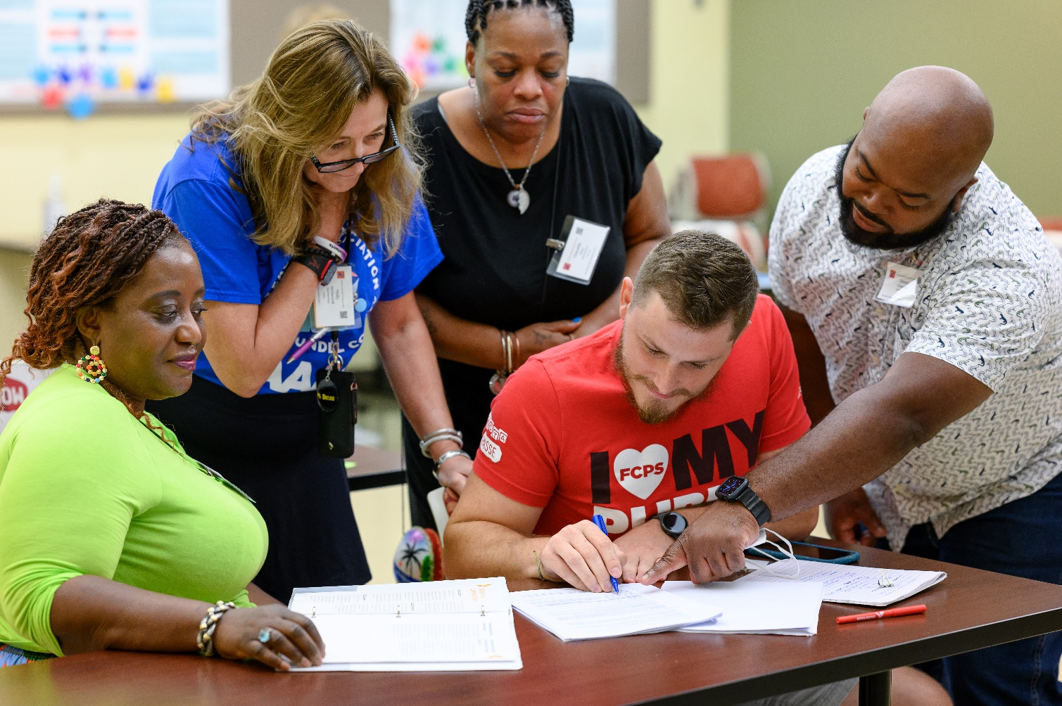
BUILDING
YOUR TEAM

Slide 34
Activity
Visualize teams you’ve been a part of:
  What made them successful?
  What made them less than successful?
  Create a T chart at your table showing the characteristics of each type of team
Unsuccessful | Successful

Slide 35
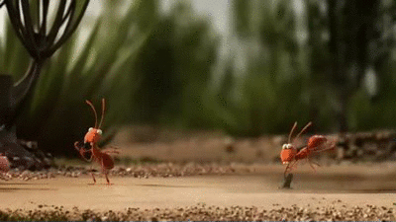
WHO ARE LEADERS
Leaders are those who take responsibility for enabling others to achieve purpose in the face of uncertainty.

Slide 36

THREE LEADERSHIP STRUCTURES
Snowflake Model
Interdependent Leadership
“I’m the Leader”
“We’re all Leaders”

Slide 37

POWER BUILDING TEAM IN THREE STEPS
Establish a shared purpose
Establish clear group agreements
Organize the work into interdependent roles

Slide 38
POWER BUILDING TEAM’S 3 CONDITIONS
YOUR TEAM IS
BOUNDED
YOUR TEAM IS
STABLE
YOUR TEAM IS DIVERSE

Slide 39
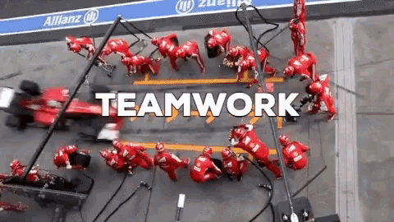
POWER BUILDING TEAM’S 3 OUTCOMES
The team accomplishes the goals they are responsible for
The team is operating in ways that make them a better team over time
The team contributes to the learning & well-being of individual members

Slide 40
COACHING: LEADERSHIP TEAM CYCLE & GROWTH
LEADER GROWTH
Accountable
Implement
Reflect Assess
Proceed
Make Change
Stop
RECRUIT
DEVELOP
IDENTIFY

Slide 41
Building a Campaign

Slide 42

What do you think a campaign is?

Slide 43
From Marshall Ganz
An issue campaign is the process through which the workers organize around leaders and structures to use their resources in accomplishing goals that achieve the change they need and want. It is public. It involves risk. It results in the story being about the workers.

Slide 44
So how do we assess if an issue campaign has built our power?

Slide 45
Strength AND Growth

Slide 46
Strength AND Growth
Achievement of public actions and campaign demands are a show of our strength.
Issue campaigns ALSO grow membership, engagement, and leadership experience. This is a measure of our growth
We support local leader teams in making campaign plans to ensure these experiences are successful and grow unifying relationships through public, positive actions for members and leaders.

Slide 47
Key Parts of an Issue Campaign p. 10
Problem and Issue
Power Analysis
Target
Demand
Strategy and Tactics
Escalation

Slide 48

Key Ideas
Issue Campaigns, designed well, result in the ability to achieve wins that make a positive, concrete difference in the lives of workers.
Issue Campaigns, Designed well, result in the growth of members, leaders, engagement, trust, unity, and all the nice things we want in a labor movement.
We measure both Strength and Growth

Slide 49
STEP 1:
Problem and Issue

Slide 50
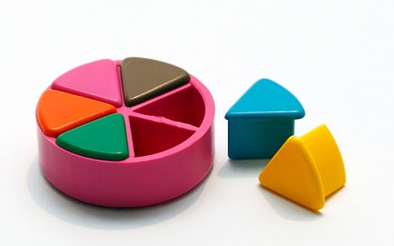
PROBLEM vs. ISSUE
A problem is the whole pie. Problems are vast, complex, and entrenched.
When we try to tackle a problem, we reinforce the hopelessness of the situation. We are trying to take on the full pie all at once.
Issues are the pieces of the pie. It’s a small chunk of the larger problem that we can make progress on, and in turn we are slowly taking on the full problem over time.
Notes:
What are some “red flags” to look out for when identifying the issue?

Slide 51
Issue
An issue is a slice of the larger problem that is manageable and solvable.

Slide 52


PROBLEM vs. ISSUE
Notes:
Problem: Racism in schools
Issues: 1. ban

Slide 53
Values
Values are fundamental beliefs that dictate behavior
Ideally, Unions advance the welfare of all members.
They are based on the universal ideal of human rights, the idea of justice, progress, and betterment of self and of society.
Through shared values, members build solidarity and commit to active participation in the labor movement.
Shared values transform individual members into part of something larger than themselves.
Notes:
On day one you shared your core values, they are posted up on the wall

Slide 54

How to Link Issues and Values
Investigating member issues is necessary but not sufficient – we also need to identify workers’ SHARED values –
WHY is this an issue?
WHY do you want to fix this?

Slide 55
EXAMPLES- Problems to Issues + Values
VALUES – Public Schools should be safe, equitable, and inclusive learning and working environments for all people.
PROBLEM -Our school reinforces racism by having a majority white teaching population
  ◦ Issue Cut – there are no intentional recruitment protocols
PROBLEM - Our school reinforces racism and devalues the experiences of marginalized populations
◦ Issue Cut– Books are being banned.
Notes:
Edit based on core values

Slide 56
TEAM WORK – The Problems
List the problems that you and your members want to improve – these are BIG
For each of the problems you identify – try to think what the values are that are behind WHY you see this as a problem.
Example Problem – We want safe schools for all students
Values behind wanting to fix this – equitable education, all children matter, inclusion
List your problems and values on your charts.
Notes:
Focus on race and how that shows up in your local

Slide 57
TEAM WORK – Problems into Issues
Example Problem – We want safe schools for all students
Values behind wanting to fix this – access, equity, democracy, dignity and respect
Possible Issues –
Banned Books
Values – options and equity
Erasure of History
Values – centering humanity, perseverance
Students don't see themselves in the staff
Values – community, purposeful impact
Cut your problems into issues on your charts.

Slide 58
Assessing Our Issues p.13
Widely felt and/or deeply felt.
  The pain can be felt by just one, but the injustice of that pain is shared by many.
  The pain AND the injustice of that pain is felt by many.
Winnable.
Builds the union and builds leaders.
Has a connection to students and the public.
Secrets of a Successful Organizer “A Good Organizing Issue” handout

Slide 59

Issue Criteria Checklist
p. 14- reference only

Slide 60
TEAM WORK – Problems into Issues
In your group, evaluate an issue you identified from your list

Slide 61
STEP 2:
Power Analysis

Slide 62
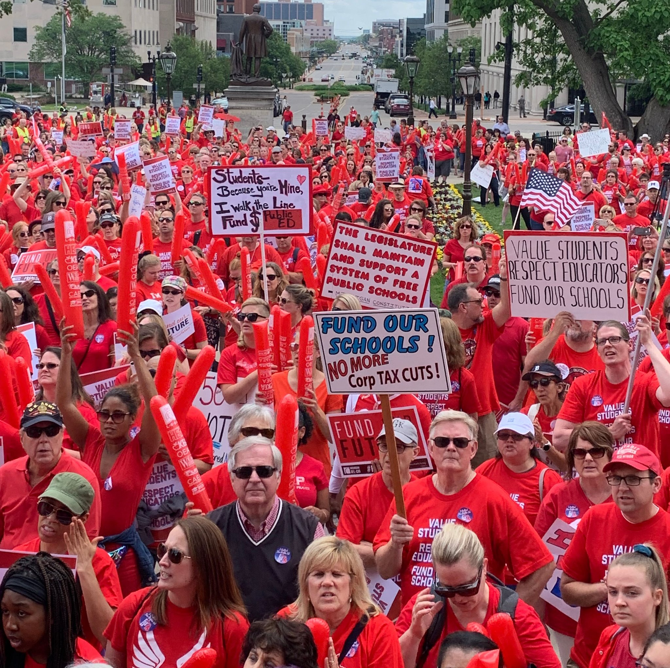

REMEMBER POWER
Power is the ability to control, create, and prevent change.
Power is organized people and organized resources (money).

Slide 63
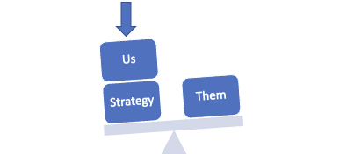
Purpose of Power Analysis
Understand how (& by whom) power is exercised to cause and maintain the problems & conditions that we seek to change
Develop effective strategies for:
  Permanently altering power relationships in favor of the people suffering from the problems & conditions that we seek to change
  Grassroots organizing to build power
  Issue campaigns that BOTH help to build power AND win change
  Connecting short term activities to LONG TERM goals

Slide 64



Process of Power Analysis
1. Issue Background
2. System Landscape
3. Identify & Analyze Target(s)

Slide 65
Key Ideas
Understanding our own power, or lack thereof, is a necessary starting point
Understanding who has the power to fix the issue is crucial to building a successful campaign

Slide 66
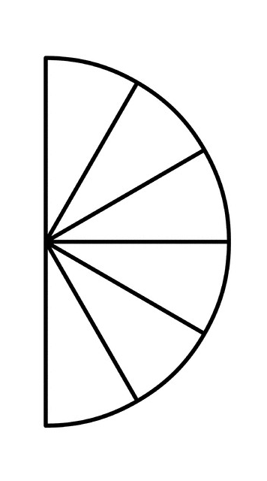
Spectrum of Allies

Slide 67

Spectrum of Allies Part 1
  Active allies: people who agree with you & are organizing alongside you
  Passive allies: people who agree but aren't doing anything about it (yet!)
  Neutrals: people who aren't sure, or are unengaged (they might just not know about you yet)
  Passive opponents: people who disagree, but aren't trying to stop you
  Active opponents: people who have done something to prevent you from reaching your goal

Slide 68

Share Out Spectrum of Allies

Slide 69
Focusing your tactics matters
Only the Opposition – cynicism
Only the Active Allies – stagnation
Generalizations about Slices – missed opportunities
DO FOCUS ON THE PASSIVE ALLIES
  These are folks who know or care about what you’re up to, but aren’t doing anything about it! Give them a chance to participate and build power with you.
THE GOOD NEWS
  It is only necessary to move some or all of the pie wedges one step in your direction. If we shift each wedge one step, we are likely to win, even if the hardliners on the opponent’s side don’t budge.

Slide 70
Spectrum of Allies Part 2
Develop a convincing argument or values based narrative that will appeal to each wedge.
2. Design one small achievable ask to engage one individual from that wedge to move closer to you.

Slide 71
Team Pair Share of Spectrum of Allies

Slide 72
Key Ideas
It is only necessary to move some or all of the pie wedges one step in your direction.
If we shift each wedge one step, we are likely to win, even if the hardliners on the opponent’s side don’t budge.

Slide 73
STEP 3:
Target

Slide 74

A Target Is
The person with the power to give you what you are demanding.
This person
Has a name
Has a face
Has an address

Slide 75
Targets also have VALUES
Values:
What are the target’s values?
What causes them to act?
What is behind their WHY?

Slide 76
TEAM WORK – Target and Analysis p.18
Using the issue that you built your spectrum of allies on identify the TARGET who has the power to fix this.
Name them and then build a chart that answers the following about the TARGET:
What are the target’s values?
What causes them to act?
What is behind their WHY?

Slide 77
Key Ideas
Everyone has values, each one of us, our members, our organizations, our allies, our opponents, and our targets.
Understanding the values of the members, of our Target, and our allies is critical in order to build an effective campaign.

Slide 78
STEP 4:
Demand

Slide 79
Demand:
“Hey TARGET,
we demand ACTION
because HARM or IMPACT!”

Slide 80
REVIEW
Issue: A slice of a workplace problem that is deeply/widely felt, winnable, and will build our power.
Power: The ability to control, create and prevent change. Power is organized people and organized resources (money).
Target: Is the person with the power to give you what you are demanding.
Demand: the outcome that addresses the issue that you are making directed at a target.

Slide 81
Demand:
Hey Superintendent Sam: "We demand a policy and procedure to address parent complaints about books because all students should have access to a diverse library. ”

Slide 82
TEAM WORK – Demand
Use your Issue and Target.
Draft at least one demand of your Target that resolves your issue and linked to YOUR VALUES

Slide 83
Key Ideas
A powerful demand makes clear who has the power to make the change that’s needed
We can only build a powerful demand when we have taken the steps to accurately identify the issue and determine who has the power to create change

Slide 84
Tying it all Together
An effective team identifies, recruits and develops new leaders while building power and capacity within your local.
  Well-designed teams put to productive use the unique talents of the individuals who make up the team
We intentionally work to connect members around issues and values to build Solidarity
Claim your Power
  Understanding our own power, or lack thereof, is a necessary starting point
  Understanding who has the power to fix the issue is crucial to building a successful campaign
Understanding the values of the members, of our Target, and our allies is critical in order to build an effective campaign.
We can only build a powerful demand when we have taken the steps to accurately identify the issue and determine who has the power to create change

Slide 85
Ellen

Slide 86
Closing

Slide 87
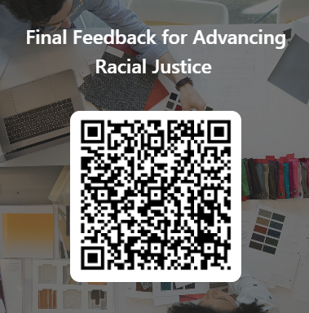
Give us your feedback!

Slide 88

Our Vision of Now and the Future
What will your workplace, locals, community look like after we have achieved Racial Justice?

Slide 89

Final Reflections
What is one thing you are going to do “tomorrow”?
What is one thing you are going to do next month?
What is one thing you might do in six month?

Slide 90

One Word
Thinking back to your core value that you shared earlier and today’s experience:
What is one word that describes your spirit right now?

