Slide 1

Entry Activity
Think of your primary CORE VALUE. The one that you always return to in your life – it centers your behaviors and key decisions ESPECIALLY in times of stress. This is a one or two-word expression of one value.
For example:
"Honesty" or "Family First"
NOT
"Truth and Justice" or "Equity and Love"

Slide 2

Advancing
Racial Justice
Day 1

Slide 3
Shelly & Chris

Slide 4

Honoring This Space
We begin by acknowledging that through a history of colonization and brutality, we currently reside on Tongva/Gabrieleno land and are connecting from the traditional lands stewarded by generations of indigenous people.
We honor these indigenous people, all elders, past, present, and emerging. We are called to learn and share these learnings about this tribal history, culture, and contributions that have been suppressed in the telling of the story of what we now call the United States of America.
Notes:
Gina

Slide 5

Acknowledgement
The content we are going to explore may bring up strong feelings. Throughout our time together, we will explore examples of racism, ableism, heterosexism, and sexism. By exploring these together, we can begin the process of unlearning our own internal oppression.
The purpose of unlearning isn’t about forgetting what we know or about being wrong; it’s a conscious act which requires critically examining the ideas and assumptions that influence our expectations, behaviors and beliefs about ourselves and other people. By doing this, we can challenge the cultural and structural norms that perpetuate racism and oppression.
Unlearning is something we can all be committed to because we all have a part to play in dismantling everything that helps maintain racism within society.
Adapted from Transatlantic Notes

Slide 6

Different Bargaining Units Training Together
Additional Affinity Groups
Race Forward Training
All Coming from a Different
Space of Privilege and Oppression
How do we Talk about this Space

Slide 7
Why we are here:
NEA’s Framework For Change p. 108
Awareness
Capacity Building
Action
Notes:
Framework for Change:
The National Education Association is uniquely positioned to impact racial justice in education by focusing the work on awareness, capacity building, and action. We will build a union of members who, through their organization, are more aware of racial justice, receive and use racial justice tools, and who, together with other educators and key stakeholders, take action to address racial injustice in schools and related institutions:
If we build awareness about institutional racism and work towards creating racial justice in education, the National Education Association can provide shared knowledge and conceptual clarity in racially aware work;
If we continuously create and disseminate capacity building tools, skills, strategies, and resources to our members, leaders, staff, students and partners, a more racially aware National Education Association can be the leader in publically demanding racial justice in education in more powerful and meaningful ways;
If we support, lift, connect and take action with an intentional focus on movement building, we will create racial equity in our classrooms, worksites, and in our communities.

Slide 8

Logistics to Remember
Questions to Ask
Breaks (AM/PM)
Bathroom
Materials
Food
Room Temperature

Slide 9

Agenda
7:30-8:00 AM Breakfast
8:00 AM Convene
Break
11:15- 12:15 PM LUNCH
Break
3:00 PM Adjourn

Slide 10

Overview Of Today’s Learning
Welcome & Introductions
Community Building
Setting the Stage
Talking Race
  Defining Race
  Systems Analysis of Racism
  Shifting Perspectives
  Identifying Institutional Racism
  Defining Racial Justice
Moving Forward
Closing
Notes:
Lisa

Slide 11
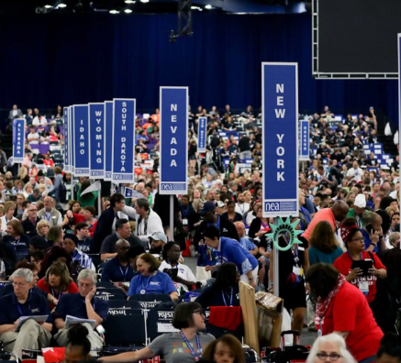
Why is this Our Work?

Slide 12
Resolution I: White Supremacy Culture
Additional Resources
The National Education Association believes that, in order to achieve racial and social justice, educators must acknowledge the existence of White supremacy culture as a primary root cause of institutional racism, structural racism, and White privilege. Additionally, the Association believes that the norms, standards, and organizational structures manifested in White supremacy culture perpetually exploit and oppress people of color and serve as detriments to racial justice.

Slide 13
Resolution I: White Supremacy Culture
Further, the invisible racial benefits of White privilege, which are automatically conferred irrespective of wealth, gender, and other factors, severely limit opportunities for people of color and impede full achievement of racial and social justice. Therefore, the Association will actively advocate for social and educational strategies fostering the eradication of institutional racism and White privilege perpetuated by White supremacy culture.

Slide 14
Honoring Native Lands NBI 64
New Business Item (NBI) 64 proposed:
"At the beginning of all NEA convenings, NEA will acknowledge the native people of whom this land originated."
It passed without opposition.

Slide 15

NEA Mission and Vision
Additional Resources
Vision…a great public school for every student.
Mission… advocate for education professionals and to unite our members and the nation to fulfill the promise of public education.
Core Values:
  Equal Opportunity
  A Just Society Democracy
  Professionalism
  Partnership
  Collective Action

Slide 16
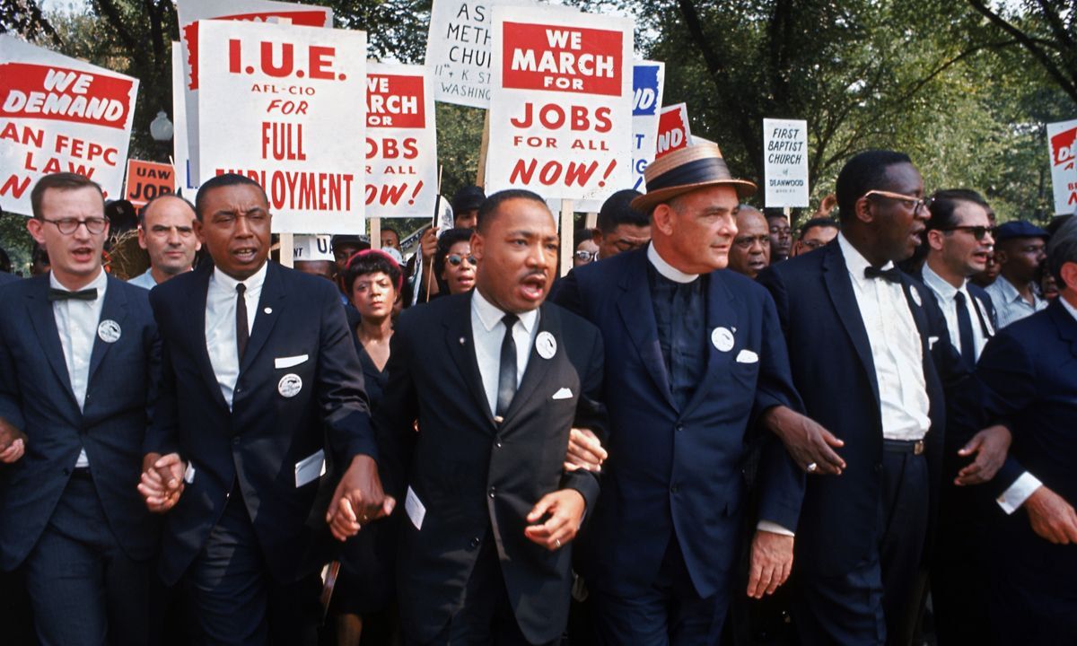
Why it matters to me
“In our glorious fight for civil rights, we must guard against being fooled by false slogans, such as ‘right to work.’ It is a law to rob us of our civil rights and job rights.
Its purpose is to destroy labor unions and the freedom of collective bargaining by which unions have improved wages and working conditions of everyone…Wherever these laws have been passed, wages are lower, job opportunities are fewer and there are no civil rights.”
Martin Luther King

Slide 17

How our work with you is framed
Racial justice is the systematic fair treatment of people of all races, resulting in equitable opportunities and outcomes for all.
To achieve this requires an explicit, though not exclusive, examination of race and ethnicity and a “race and ...” approach that examines how race compounds and intersects with other societal issues.

Slide 18
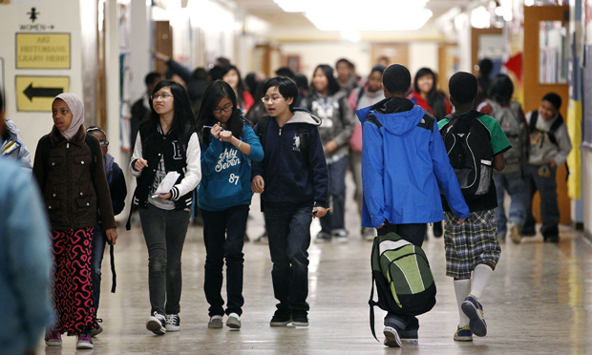
Guiding Question
Why is using a racial equity & social justice lens important for those who work with students?

Slide 19
Jessica

Slide 20
Introductions

Slide 21
Core values are the
fundamental beliefs of
a person. These guiding
principles dictate
behavior, choices, and
attitudes.
Our actions may not always reflect our stated core values.

Slide 22

Introductions
Community and relationships are important.
Please share
Name
Pronouns
Worksite
Core Value Leading Your Work
Notes:
Lisa

Slide 23
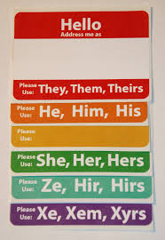
Why share your pronouns?
You can’t just assume by looking.
Asking and correctly using someone's pronouns is the easiest way to show your respect for their gender identity.
Wrong pronoun use can make a person feel disrespected, invalidated, dismissed, alienated, or dysphoric (or, often, all of the above.)
It is a privilege to not have to worry about which pronoun someone is going to use for you.

Slide 24

Community Agreements p. 2-3
Awareness & Self-Knowledge
Listen for Understanding
Be Gracious
Stay Engaged
Be Open & Suspend Judgment
Say “I”- tell your truth
Lean into Discomfort
Reach for Empathy
Expect Non-Resolution & Non-Closure

Slide 25
Halimah

Slide 26
Move Up

Slide 27

Move Up!
Listen
Listen to the following statements.
Move up
Move up (or remain up) if the statement describes you.
Move down
Move down(or remain down) if the statement does not describe you.
(Adapted from “Stand Up Activity A4.” Lindsey, R., Nuri Robins, K., & Terrell, R. (2009). Cultural proficiency: A manual for school leaders.)

Slide 28
Move Up!
  How did you feel when you heard the statements?
  How did it feel to move into the circle, and how did it feel to be left on the outside?
  Did anything surprise you? Did you notice anything new or different about yourself or the group?
  What have you learned from this activity?
  How does this relate to your work?
(Adapted from “Stand Up Activity A4.” Lindsey, R., Nuri Robins, K., & Terrell, R. (2009). Cultural proficiency: A manual for school leaders.)

Slide 29

Key Points
We all have a unique relationship to power and privilege.
Each relationship to power and privilege and the truths associated with that are valid.

Slide 30
Dr. Taraja

Slide 31
What is Oppression?

Slide 32
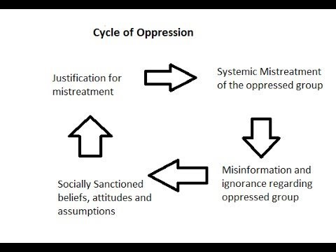
What is Oppression?
Oppression is the experience of repeated, widespread, system injustice.
Oppression may be extreme and violent or...
It may be "civilized" or "structural" that is...oppression which is a part of everyday life and built into the laws of society
A group that shares similar characteristics may be oppressed by a more powerful group that does not share those characteristics (race, gender, sexual orientation, ability)

Slide 33
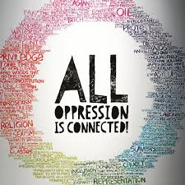
There is no hierarchy of oppressions.
  - Audre Lorde

Slide 34
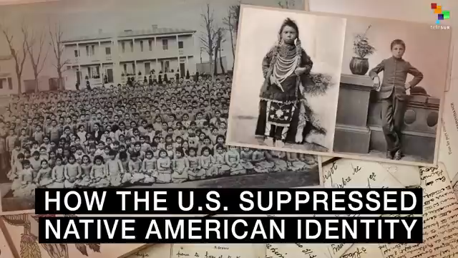

Slide 35

Table Talk
Take the next 10 minutes and discuss your answers to the following questions:
  1. How do you think individuals, institutions and the dominant American society justified this cruel and inhumane treatment?
  2. What kept those who had power and voice (government officials, priests & nuns, teachers, civic leaders, regular citizens) from acknowledging the humanity of these children and preventing this atrocity?

Slide 36
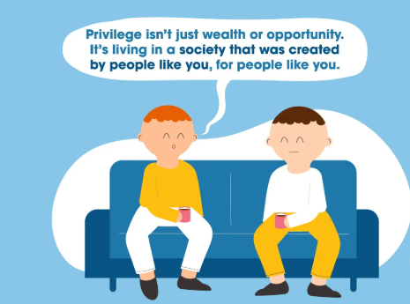
Privilege is...
  An unearned right, favor, or immunity granted to particular individuals or groups and withheld from others
  A key element in perpetuating the power in oppressive systems

Slide 37

Think About Your Life as a Ladder
Reflect on three opportunities you have received that were crucial to your climb.

Slide 38
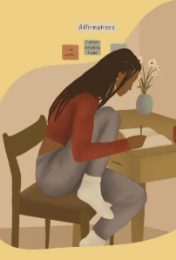
We have reflected...
Now: Share
At your table share one of the opportunities that allowed you to climb your ladder.
Include how that opportunity relates to one of your privileges.

Slide 39

Privilege: Turn to p. 104 of BCG –Racial Justice Guide
A set of advantages systemically conferred on a particular person or group of people.
White people are racially privileged, even when they are economically underprivileged.

Slide 40
Types of Oppression
Matrix of Oppression (pg. 20-21)
Table Talk
We will assign Oppression Categories for each table.
At your table, discuss how your organization (and/or individuals within the organization) might use privilege and power to perpetuate oppression against students, colleagues, and community members.
AND how these same individuals/organization might instead intercept that oppression.

Slide 41

Types of Oppression-Activity Debrief
Matrix of Oppression (pg. 20-21)
What was challenging?
What was easy?
What is going to keep you up at night?

Slide 42
Key Points
Most people do not question why things are considered morally good or evil, rather uncritically, and largely unconsciously, they adopt the "value judgments of good and evil" dominant within their society.
-Nietzsche
Please question. Do not just adopt.

Slide 43

Break

Slide 44
Shelly

Slide 45
What words matter?

Slide 46

Defining Race
Race is not biological. Race is a powerful social construct that gives certain people more opportunity and advantages.

Slide 47
Defining Prejudice
According to Merriam-Webster:
Prejudice is injury or damage resulting from some judgment or action of another in disregard of one's rights especially: detriment to one's legal rights or claims.

Slide 48
Defining Racism
RACISM =
PREJUDICE + INSTITUTIONAL POWER
Terms on page 103-105 in PH and
in the "Additional Participant Resources"

Slide 49


Slide 50
Key Points: Race, Nationality, Ethnicity
Race: A social construct that artificially divides people into distinct groups based on certain characteristics such as physical appearance (particularly skin color) ancestral heritage, cultural affiliation, cultural history, ethnic classification
Nationality: The status of belonging to a particular nation by origin, birth or naturalization
Ethnicity: A social construct that artificially divides people into smaller social groups based on characteristics such as shared sense of group membership, values, behavioral patterns, language, political and economic interests, history, and ancestral geographical base

Slide 51
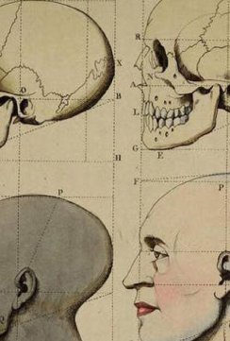
"Race Science,"
In the late 1800s the pseudoscience called “race science” developed arguing that race is a biological category. It linked capability to race.
In 1925, using this as the basis, the Central Tube Company (Pittsburgh) created a table claiming to connect race to adaptability to plant work.

Slide 52
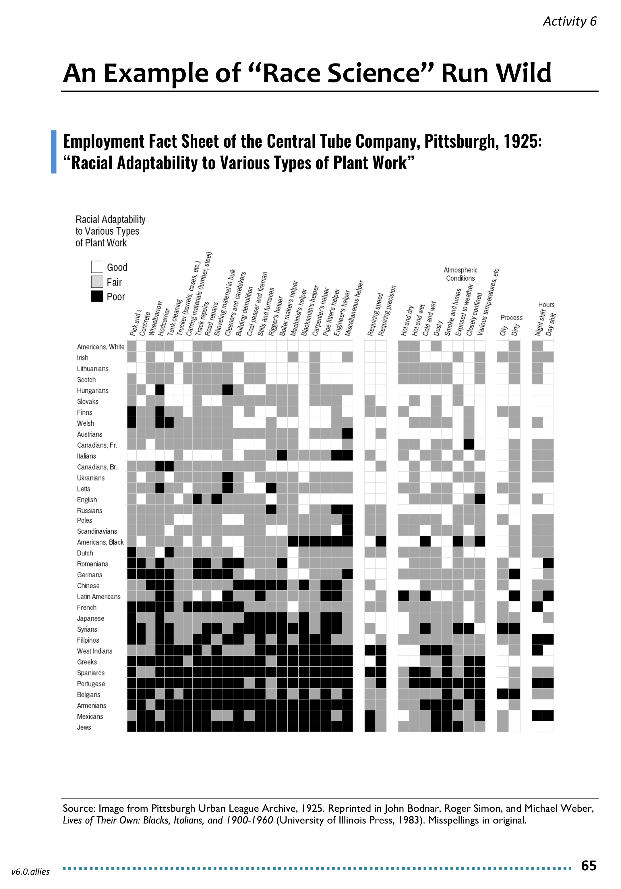
Table Talking
Page 4 of Participant Handout
Look for “White Americans” on the chart. What does this category tell us about who was white in 1925? Who is white today?
Do you see any legacies of this thinking in your work today? If so, how?
Bonus: If you were an organizer during this time, how would you use this data to organize your worksite?

Slide 53
What did you talk about?
What did you hear or say that you think needs to be shared out to the larger group?

Slide 54
Key Points
In our society, people have been taught that we should not say the word, “race.”
Race is a construct developed to support oppression within a system of white supremacy.
Once you recognize the existence of oppression and understand how it operates, you can learn how to resist and challenge oppression in all forms.

Slide 55

Lunch

Slide 56
Halimah

Slide 57
Expressions of Racism

Slide 58

Let’s Add to Our Definition of Racism
An historically-rooted system of power hierarchies based on race
—infused in our institutions, policies, and culture—that benefits white people and hurts people of color.
Racism isn’t limited to individual acts of prejudice. Rather, the most damaging racism is built into systems and institutions that shape our lives.
Most coverage of race and racism is not “systemically aware,” meaning that it either focuses on racism at the level of an individuals’ speech or actions (Central Park birdwatcher incident May 25, 2020), dismisses systemic racism, or refers to racism in the past tense.
*Source: Bargaining for the Common Good Racial Justice Guide

Slide 59


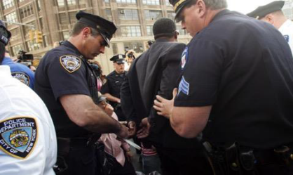
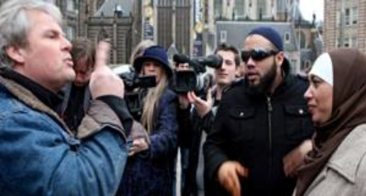
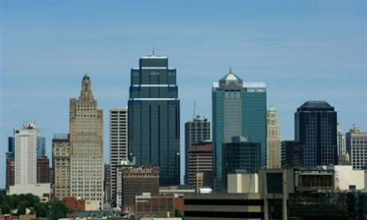
Expressions of Racism p. 5 of PH
Individual
Internalized
Interpersonal
Systemic
Institutional
Structural
Notes:
INDIVIDUAL-LEVEL RACISM
INTERNALIZED RACISM lies within individuals. These are our private beliefs and biases about race and racism, influenced by our culture. Forms: racial prejudice toward other people of a different race; internalized oppression, the negative beliefs about oneself by people of color; or internalized privilege, beliefs about superiority or entitlement by white people.
INTERPERSONAL RACISM occurs between individuals. These are biases that occur when individuals interact with others and their private racial beliefs affect their public interactions.
SYSTEMIC-LEVEL RACISM
INSTITUTIONAL RACISM occurs within institutions and systems of power. It is the unfair policies and discriminatory practices of particular institutions (schools, workplaces, etc.) that routinely produce racially inequitable outcomes for people of color and advantages for white people. Individuals within institutions take on the power of the institution when they reinforce racial inequities.
STRUCTURAL RACISM is racial bias among institutions and across society. It involves the cumulative and compounding effects of the interactions of institutions and policies that systematically privilege white people and disadvantage people of color.

Slide 60
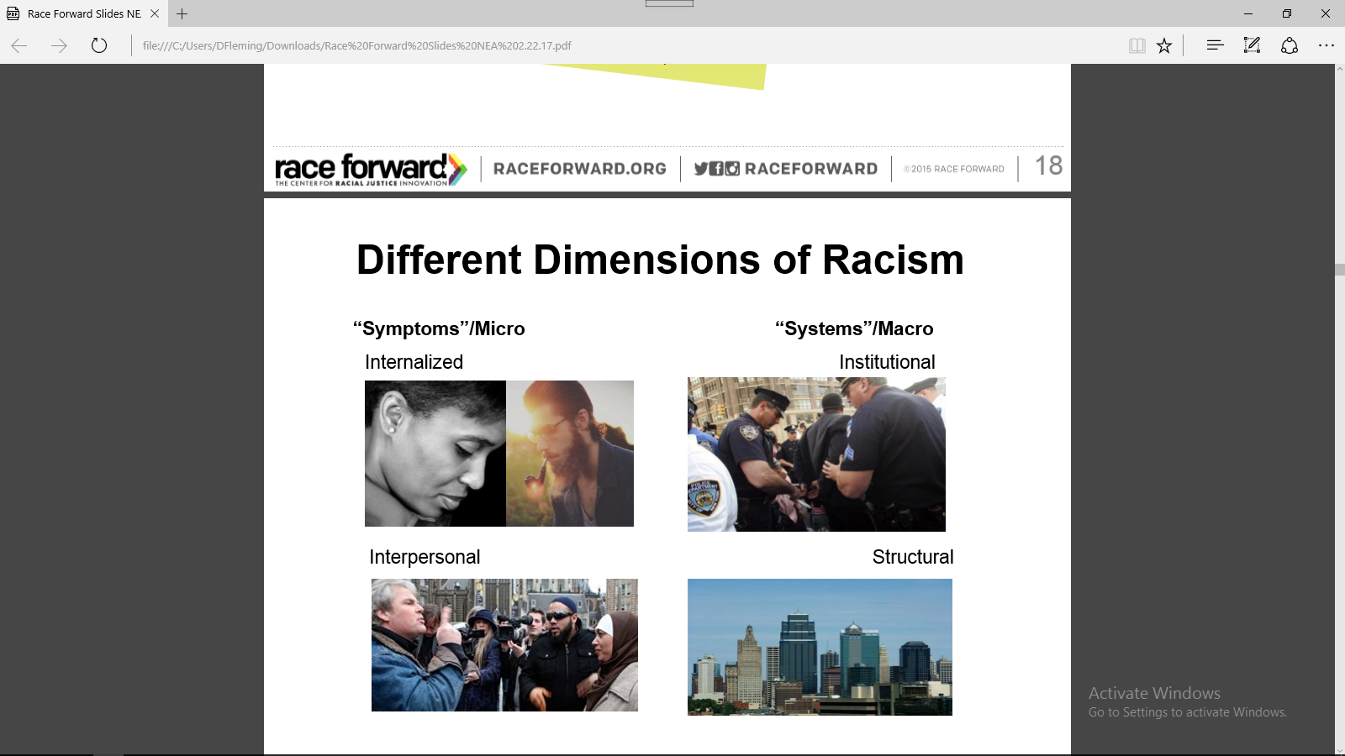
Internalized Racism
Internalized racism lies within individuals. These are private beliefs about race that reside inside our minds.
Examples: prejudice, xenophobia, internalized oppression and privilege, and biases (conscious and unconscious) about race influenced by the dominant culture.
Notes:
Internalized racism
All the prejudice, bias and blind spots you have within yourself as an individual

Slide 61
Interpersonal Racism
Interpersonal racism occurs between individuals. Once we bring our private beliefs about race into our interactions with others, we are now in the interpersonal realm.
Examples: public expressions of prejudice, hate, bias and bigotry between individuals.
Source: Race Forward 2018
Notes:
Interpersonal Racism
What happens when you act out those blind spots and bias on each other
This symptoms are recognized day to day, we talk about them most, and it’s easy to focus here

Slide 62
Institutional Racism
Institutional racism occurs within institutions. It involves discriminatory treatment, unfair policies and practices, and inequitable opportunities and impacts, based on race.
Examples: A school system that concentrates people of color in the most overcrowded, under-funded schools with the least experienced teachers.
Source: Race Forward 2018
Notes:
Institutional Racism occurs within institutions and systems of power. It is the norms, policies and practices that are structured into political, societal and economic institutions that have the net effect of imposing oppressive conditions and denying rights, opportunity, and equality to identifiable groups based upon race or ethnicity.
Resolution I new business item refers to the institutional racism
(white supremacy is structural)
We have worked on this, however, we focused on the personal and interpersonal versus focusing on the structural/institutional- make point.

Slide 63
Structural Racism
Structural racism is racial bias across institutions and society. It’s the cumulative and compounded effects of an array of factors that systematically privilege white people and disadvantage people of color.
Examples: The “racial wealth divide”(where whites have many times the wealth of people of color) results from generations of discrimination and racial inequality.
Source: Race Forward 2018
Notes:
Structural Racism is racial bias across institutions and society. It’s the cumulative and compounded effects of an array of factors that systematically privilege white people and disadvantage people of color.

Slide 64
Key Points
There are no hard and fast lines between the levels – and changing one can affect another.
While we believe that the individual is responsible for exploring personal bias …
The way to effect change is by addressing institutionalized and structural racism – this is where injustice lives.

Slide 65
Expressions of Racism Exercise p. 6-9 of PH
Applying your new knowledge:
We are going count off by 8’s
There are 8 Scenarios
Your team will be responsible for providing a two-sentence summary of the scenario, identifying the level of expression of racism – and providing “why” you came to this conclusion (total of one minute).
Notes:
There are 8 Scenarios. You will work in small groups to identify the level of racism in your scenario. Count off by 8. Find your new groups. Take your booklet along with a pen/pencil.
Assign group their Scenario
Each group will discuss and identify the level of racism in your scenario

Slide 66
Report and Debrief
1 Minute Report Outs
Please share…
    Two sentence summary
    What level did your group determine your scenario was at and why?
Notes:
Briefly describe the scenario to the larger group, we don’t have time to read them all. What level did your group determine your scenario was at and why? What did you struggle with? What was Clear to You? Let’s revisit our key point - there are not hard and fast lines between the levels – and changing one can affect another. While we believe that the individual is responsible for exploring personal bias – the way to effect change is by addressing institutionalized and structural racism – this is where injustice lives.
Remind them that they will return to this group again, so remember their assigned group number.

Slide 67
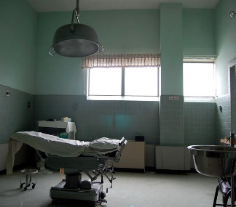
Understanding Expressions of Racism
Scenario #1: Racism in Medicine
Racism has influenced U.S. health care in the past and continues to do so today. The most shameful chapters in American history involve the U.S. government funding studies that allowed poor black men in Alabama to succumb to syphilis or Guatemalan prison inmates, mental health patients and soldiers to be afflicted with the disease and other sexually transmitted infections.
Government agencies also played a role in sterilizing black women in North Carolina, Puerto Rican women and Native American women.
What is the expression of racism?

Slide 68
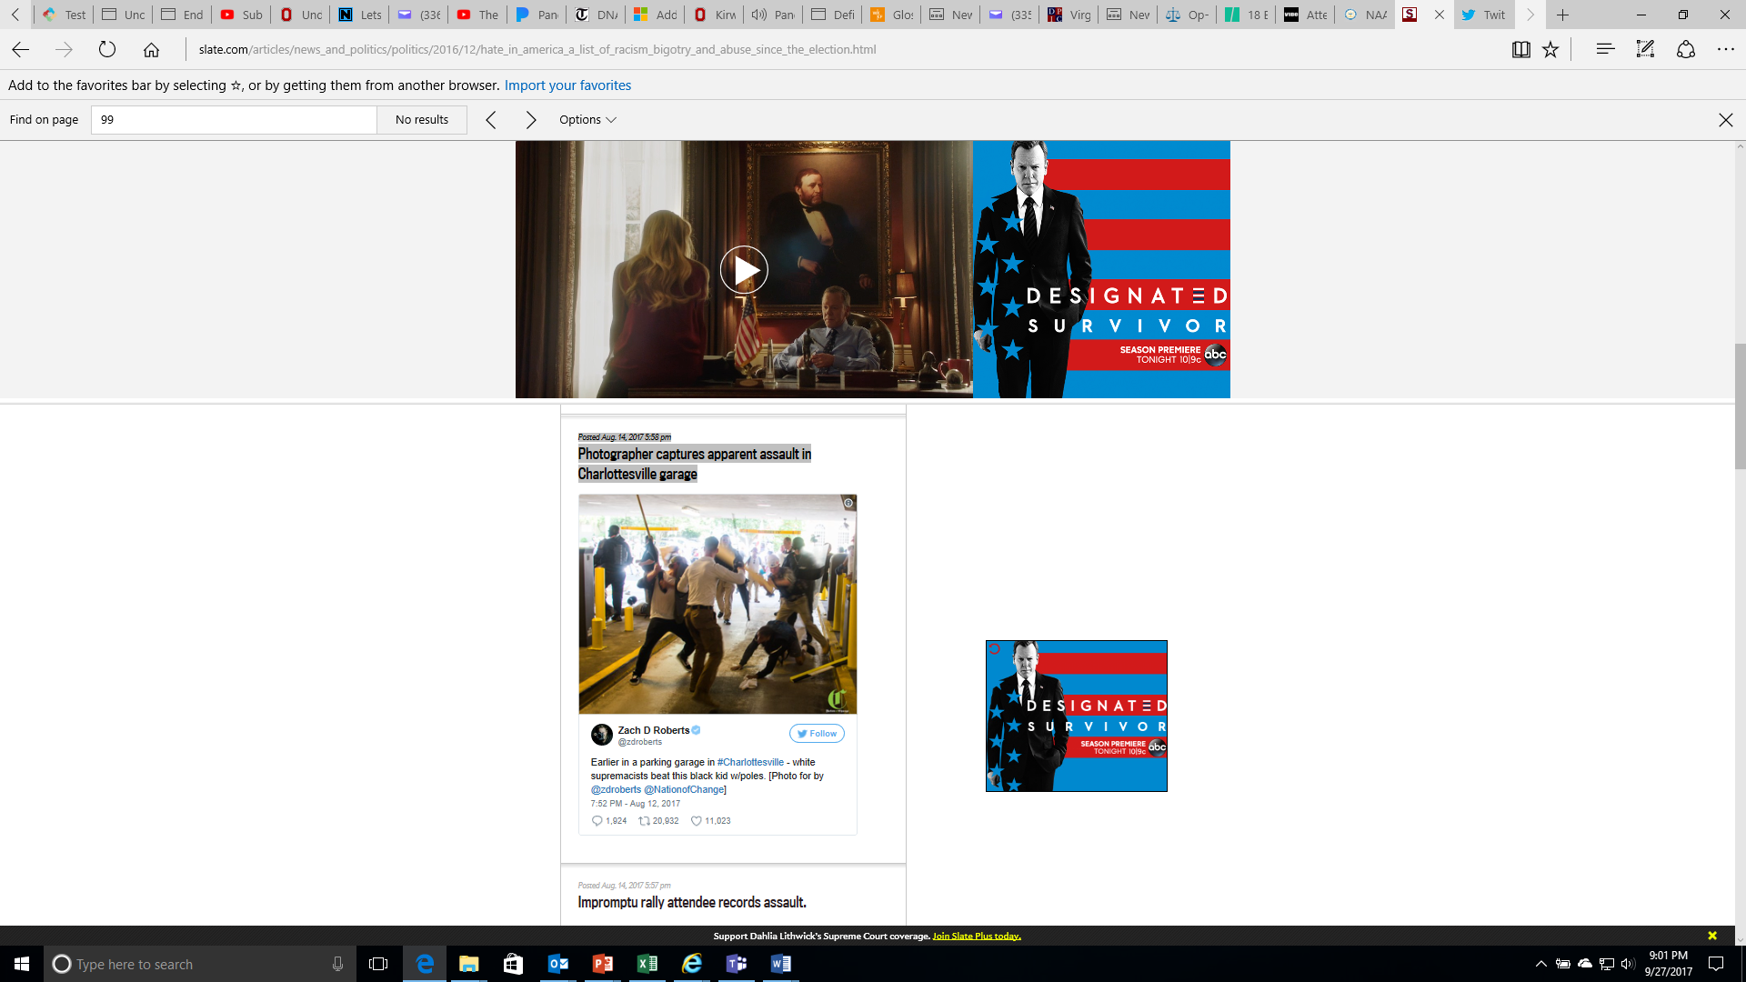
Understanding Expressions of Racism
Scenario #2: Assault in Charlottesville
What is the expression of racism?

Slide 69
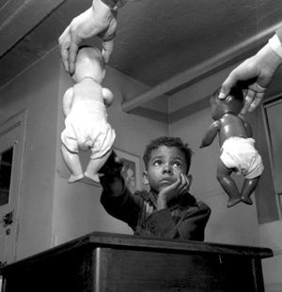
Understanding Expressions
of Racism
Scenario #3: The Doll Test
In the 1940s, psychologists Kenneth and Mamie Clark designed and conducted a series of experiments known colloquially as “the doll tests” to study the psychological effects of segregation on African-American children.
Drs. Clark used four dolls, identical except for color, to test children’s racial perceptions. Their subjects, children between the ages of three to seven, were asked to identify both the race of the dolls and which color doll they prefer. Most of the children preferred the white doll and assigned positive characteristics to it. The Clarks concluded that “prejudice, discrimination, and segregation” created a feeling of inferiority among African-American children and damaged their self-esteem.
What is the expression of racism?

Slide 70
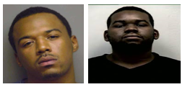
Understanding Expressions of Racism
Scenario #4: Looking Death Worthy
According to a 2006 report, Looking Death Worthy, defendants with the most stereotypically Black facial features (i.e. dark skin, large/full lips, etc.) served up to 8 months longer in prison for felonies than defendants who possessed the least stereotypical features.
In this same study, researchers investigated the role of race in capital sentencing, and in particular, whether the race of the defendant or victim influences the likelihood of a death sentence. The study concludes that in cases involving a White victim, the more stereotypically Black a defendant is perceived to be, the more likely that person is to be sentenced to death.
What is the expression of racism?

Slide 71
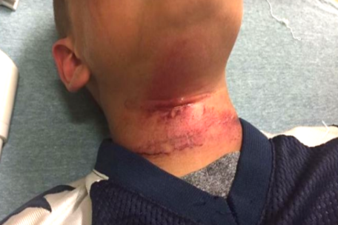
Understanding Expressions of Racism
Scenario #5: Biracial Boy Pushed Off Tape
Teenagers in New Hampshire taunted an 8-year-old biracial boy with racial slurs and then pushed him off a picnic table with a rope around his neck, injuring him, the boy’s family said.
The child was treated at a hospital for cuts to his neck following the near-hanging Aug. 28 in Claremont, the boy’s grandmother, Lorrie Slattery, told the Valley News of West Lebanon, N.H. He has since been released and has returned to school in Claremont…
… An expert on abuse who spoke to the boy at the hospital said he swung from his neck three times before being able to remove the rope, Slattery said. None of the teens came to his aid, she said.
What is the expression of racism?

Slide 72
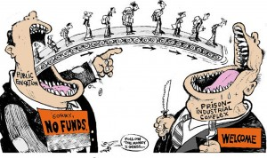
Understanding Expressions of Racism
Scenario #6: The School-To-Prison Pipeline
A significant number of Chicago students are pushed into the path of juvenile and adult prisons as a result of harsh disciplinary policies and high stakes testing. By harsh disciplinary policies, we mean excessive security procedures and police involvement as well as the overuse of suspensions and expulsion for minor infractions. These policies feed the “School to Prison Pipeline”, sometimes also called the “Schoolhouse to Jailhouse Track”.
Research suggests that students of color, in particular African American students, are disproportionately impacted by these punitive policies…These zero tolerance policies involve the police in minor incidents and often lead to arrests, juvenile detention referrals, and even criminal charges and incarceration.
What is the expression of racism?

Slide 73
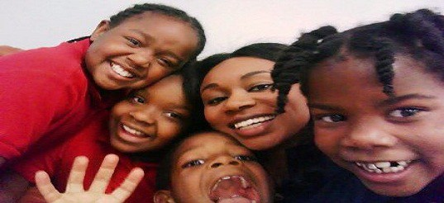
Understanding Expressions of Racism
Scenario #7: Woke Girls
Before school started every morning a 1st-grader student in my class, with very dark skin would visit me so I could apply cocoa butter lotion to his skin. I assumed it was just about the lotion, but when I tried to give him a bottle he could keep in his classroom, he cried and told me I was the only one who thought his skin was beautiful.
Just down the hall in the 3rd-grade ESL class, two Mexican American girls got into a fight. The cause? One girl called the other a “little Mexican girl.”…
…Besides modeling self-love and loving my students, I made an effort to fill my classroom library with books that would support my students to be who they already were. That was quite the challenge.
What is the expression of racism?

Slide 74
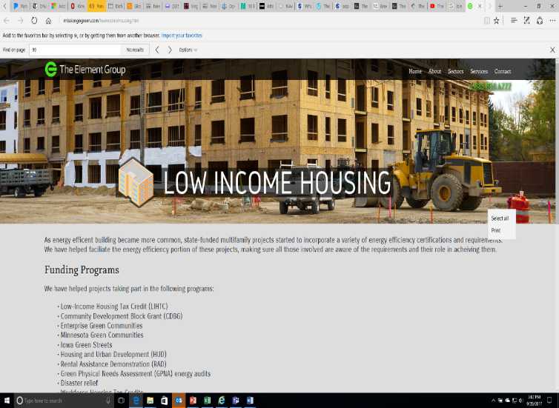
Understanding Expressions of Racism
Scenario #8: Doorway to a Better Life
A state government agency decides that low-income housing must be built, which will house low-income Blacks and Latinos. The agency fails to look for locations near jobs and important infrastructures, like schools, decent public transportation, and other services. In fact, it is built in a poor, mostly Black and Latino part of town. Often times the government locates the housing where it will have the least opposition. White neighborhoods tend to oppose public and affordable housing. Resources, whether public or private, often follow whites who flee urban problems for white suburbs
When the housing is built, the school district, already under-funded, has new residents too poor to contribute to its tax base. The local government spends its limited resources on transportation to connect largely white, well-to-do suburban commuters to their downtown jobs.
The public housing residents are left isolated, in under-funded schools, with no transportation to job centers. Whole communities of people of color lose opportunities for a good education, quality housing, living wage jobs, services and support-systems.
In this town, no one individual stands in front of the doorway to a better life and says, “No Blacks/Latinos/ Native Americans/Asians allowed.” Race, however, is the unspoken motivator behind a series of actions which lead to decisions about where to place the walls.
What is the expression of racism?

Slide 75
Key Points
1. There are no hard and fast lines between the levels – and changing one can affect another.
While we believe that the individual is
responsible for exploring personal bias …
2. The way to effect change is by addressing institutionalized and structural racism – this is where injustice lives.

Slide 76
Looking for Expressions of Racism

Slide 77
Group Chart Work
Is Angel thriving in their institutions (school/union)? What are examples from the story that leads you to this conclusion? | 2. What are examples of Systemic Racism (racism within institutions and across structures of power)?
3. What are examples of Indvidual racism (racism between individuals)? | 4. What race and gender is Angel? What evidence from the story leads you to these conclusions?
Everyday Racism in Union Work – (P. 12-13)
Angel’s Story
We will divide into four groups
Each group will focus on one question. (15 minutes)
Report out. (10 minutes)

Slide 78

What Must be Amplified?
What are some of the most key items you identified at each level?
What did your team struggle with?
What is something that is entirely new for you?
In your current role, how might you interrupt the instances of racism that you recognize?
What will you keep thinking about after this session is over?

Slide 79
Key Points
Oppression is always there.
We have to be intentional in looking for expressions of racism if we are going to redress them.
We have to recognize that we are likely unintentional contributors to the problem – and we have to choose to be intentional participants in the solution.

Slide 80
Dr. Taraja & Halimah

Slide 81
Systems of Oppression

Slide 82

Systems of Income and Wealth
Two guiding questions:
Are your community & colleagues doing better financially than they were 10 years ago? What “signs” would you see that support your answer?
What is the difference between income and wealth?
Notes:
We are going to look at one example of systemic racism that impacts our members and their jobs – income. Take just a moment in your mind and consider the following question – in the last decade, has the income that your members receive been improving? How do you know? We are going to look at the changes in family income during two recent periods of economic growth. First, let’s talk a little about income. What are some examples of income? (wages, salary, savings account interest, social security check, rent from owning real estate, capital gains from selling investments, dividends from stocks, gifts, etc.) Now let’s have five volunteers come to the front of the room. Please stand should to shoulder. Each gets a sign showing the income range — in pre-tax, year 2014 dollars — of the quintile they represent.

Slide 83
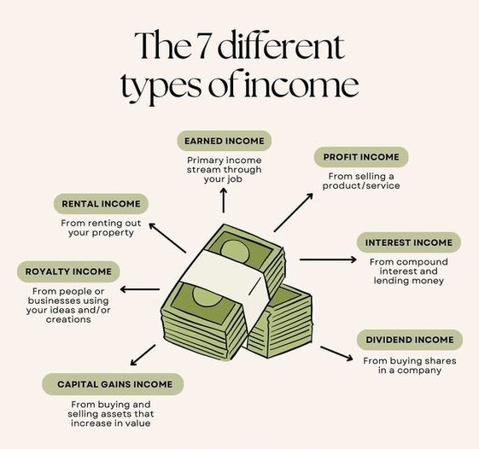
Income
Income is the revenue that a person can bring into their household.
Notes:
We are going to watch how income has changed over quintiles in the population – Economists talk about the U.S. population in “quintiles” or “fifths”. They imagine the entire population of the U.S. lined up in order, from the lowest income to the highest. They then divide that line into five equal parts. This activity looks at what happened to the incomes during two periods of economic growth: 1947-1979 and 1979-2014.
Look at the signs the volunteers are holding – this number represents median Family Income. What jobs would be under each of these categories? What economic challenges would each have? Where are our members (pay attention to job classes and state differences.) Each volunteer, representing a quintile or fifth (20 percent) of the U.S. population, will step forward or back according to whether their income gained or declined. Each step equals a five percent change, so, for example, two steps forward would indicate an income gain of 10%.

Slide 84

Wealth
Wealth is anything that can be liquidated and/or passed from generation to generation - minus debt.
Notes:
We are going to watch how income has changed over quintiles in the population – Economists talk about the U.S. population in “quintiles” or “fifths”. They imagine the entire population of the U.S. lined up in order, from the lowest income to the highest. They then divide that line into five equal parts. This activity looks at what happened to the incomes during two periods of economic growth: 1947-1979 and 1979-2014.
Look at the signs the volunteers are holding – this number represents median Family Income. What jobs would be under each of these categories? What economic challenges would each have? Where are our members (pay attention to job classes and state differences.) Each volunteer, representing a quintile or fifth (20 percent) of the U.S. population, will step forward or back according to whether their income gained or declined. Each step equals a five percent change, so, for example, two steps forward would indicate an income gain of 10%.

Slide 85
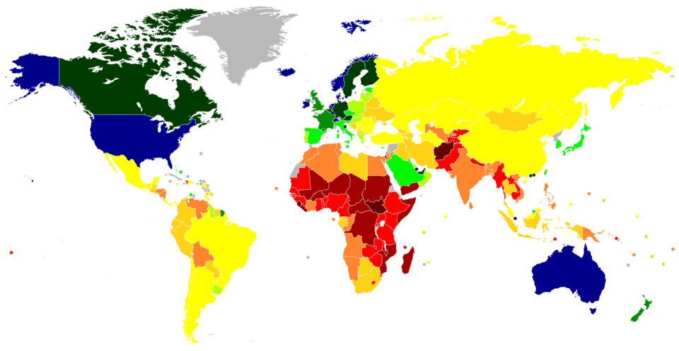
Per Capita Income
Per Capital Income is the average income earned by each person in a specific area, like a country.
What do you think the Per Capita Income is in the US?
  International Per Capita GDP Comparison

Slide 86
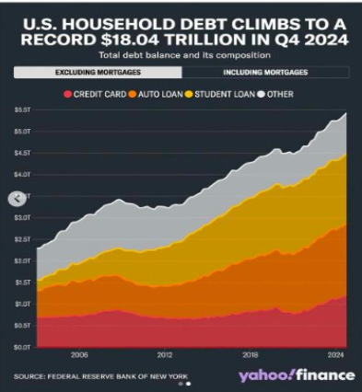
Negative Wealth
Negative Wealth is when you owe more than you own. It is created when your expenses are greater than your income (aka-Debt)

Slide 87
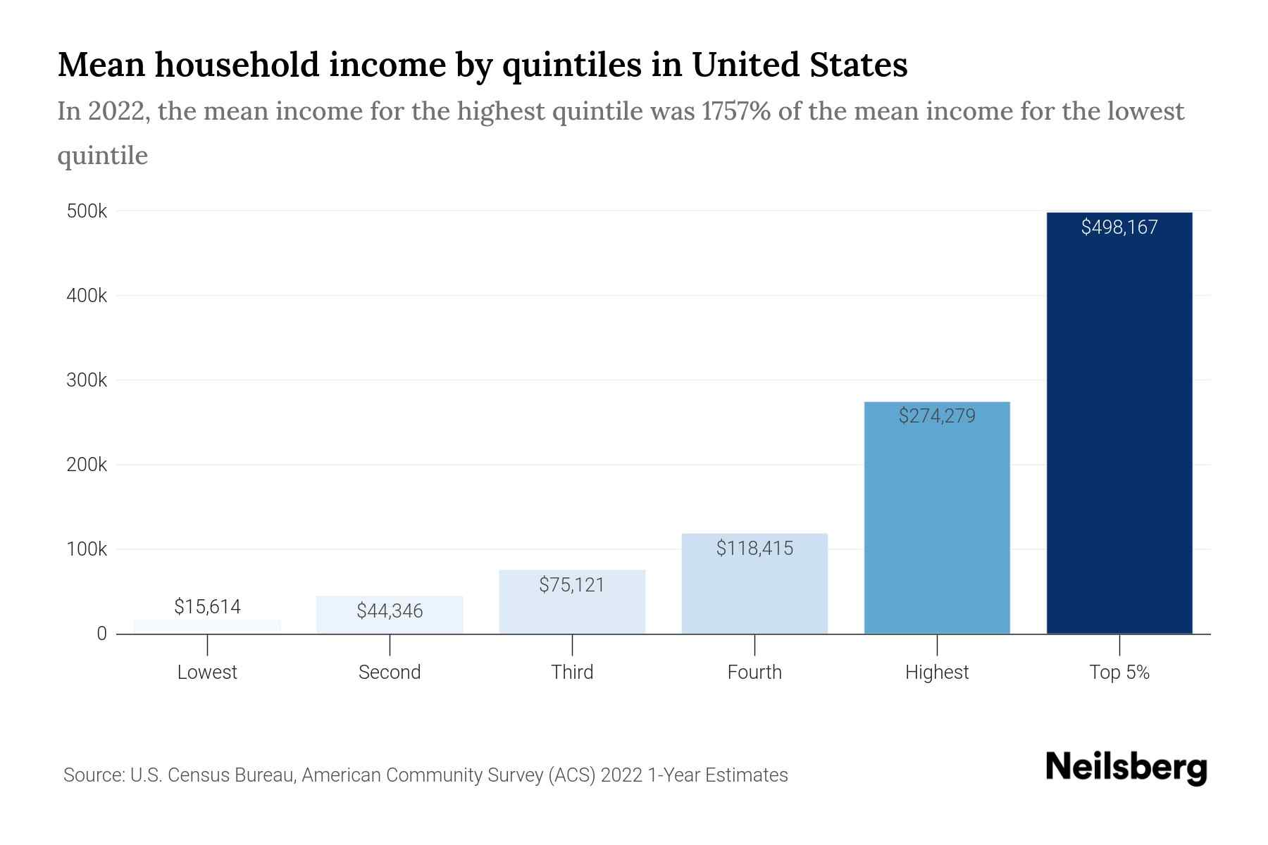
Income Quintiles
Income Divided into "quintiles" or "fifths" of a population.
Imagine the entire population of the U.S. lined up from the lowest income to the highest income.

Slide 88
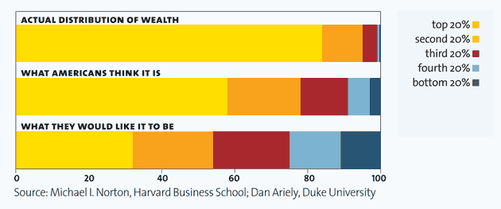
Actual v Perceived Wealth
Actual v Perceived Wealth is a study of what most Americans believe about inequities and wealth, what they actually are, and what they think is fair

Slide 89
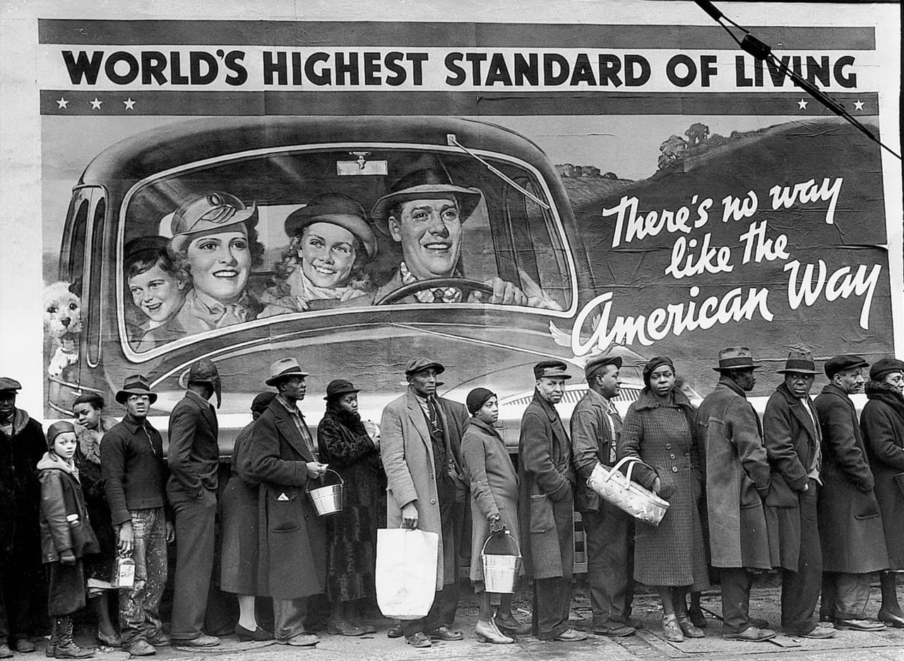
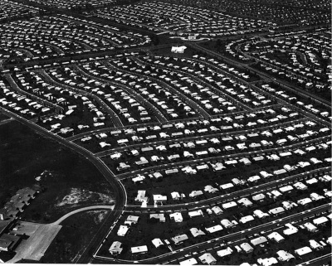
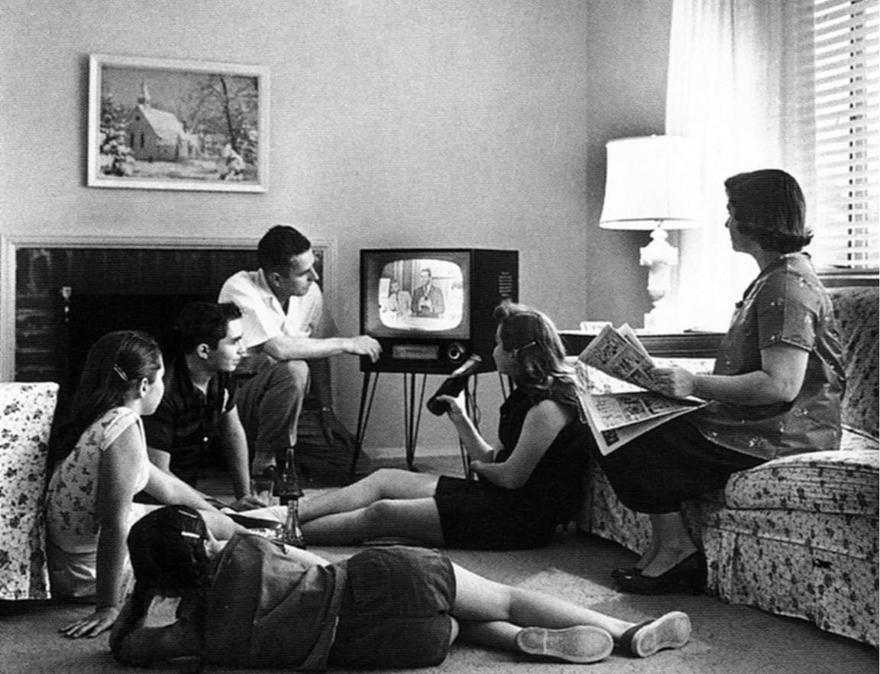
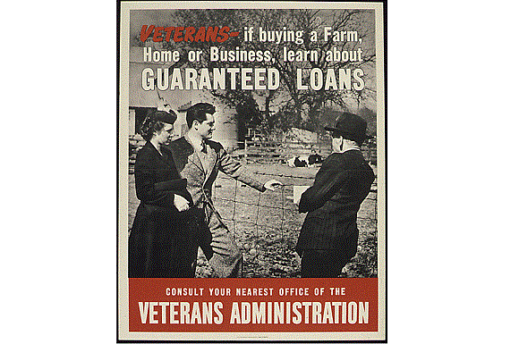
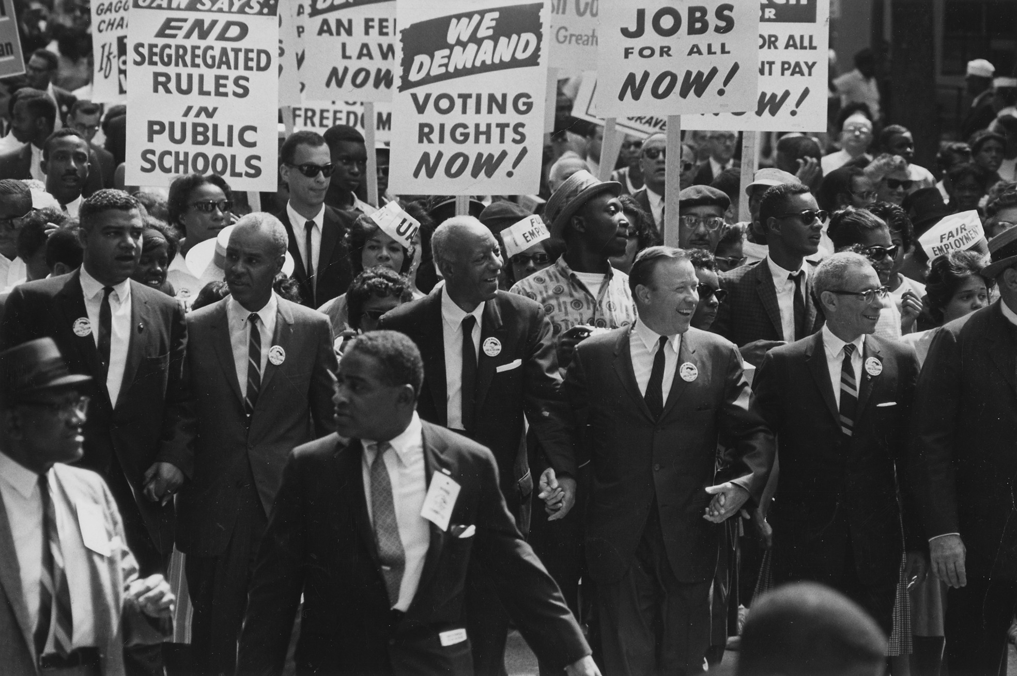
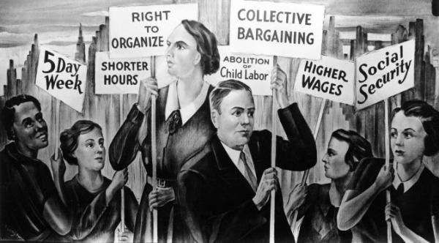
Income and Wealth Exploration
What characterizes this time period in America?
Politics/Historic Events/Unionism
1947-1979
Who was excluded?

Slide 90

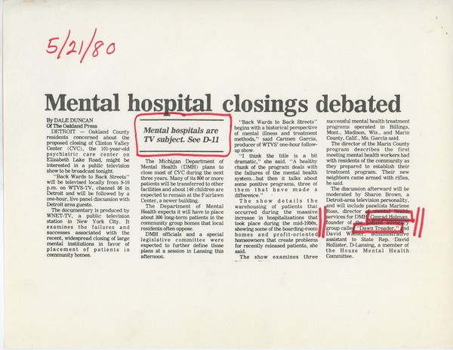
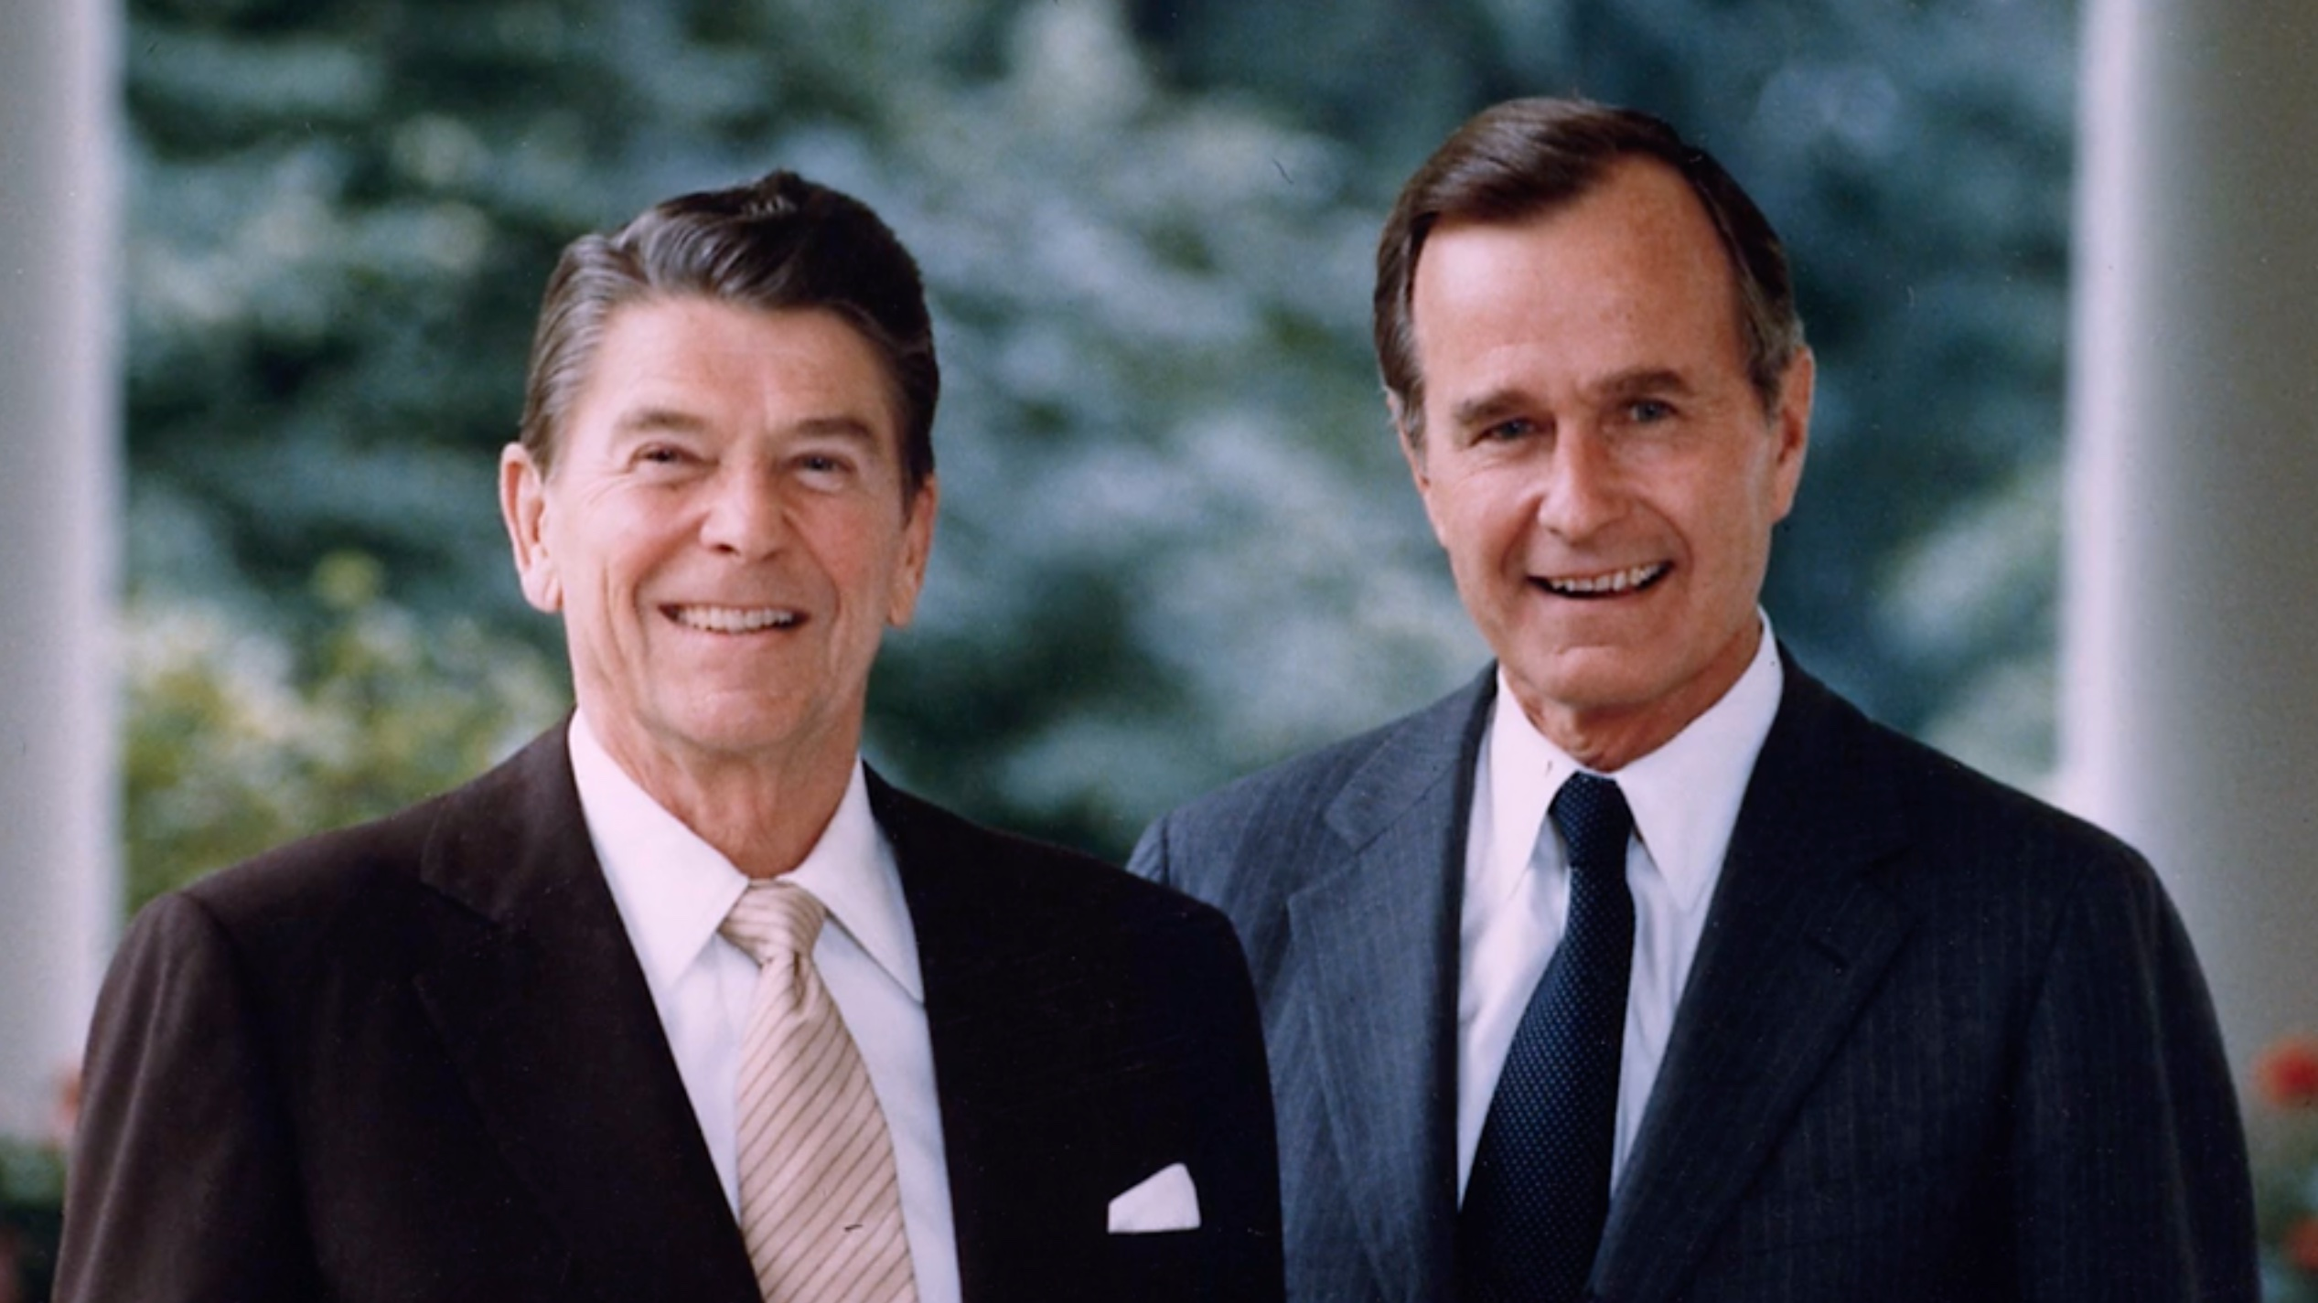
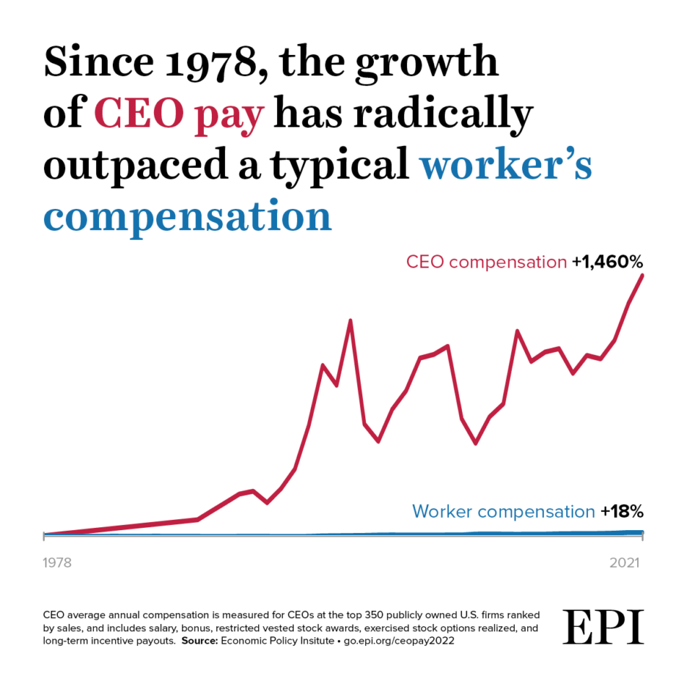
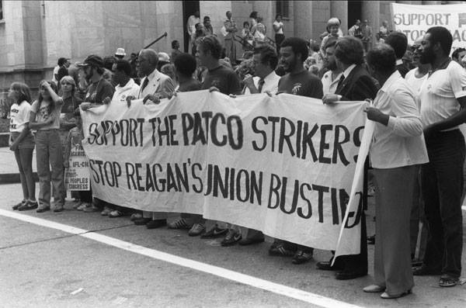
Income and Wealth Exploration
What characterizes this time period in America?
Politics/Historic Events/Unionism
1980-2016

Slide 91
Break

Slide 92
Quintile Quest
Time to Move
Income & wealth exploration

Slide 93
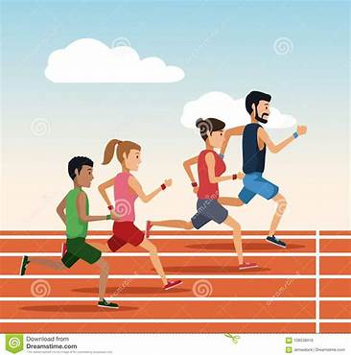
Directions for 1947-1979
Lowest: 12 Steps/Pace Forward (+116%)
Second: 10 Steps/Pace Forward (+100%)
Middle: 11 Steps/Pace Forward (+111%)
Fourth: 11.5 Steps/Pace Forward (+114%)
Highest: 10 Steps/Pace Forward (+99%)
  Top 5%: 8.5 Steps/Pace Forward (+86%)
Notes:
RESET…now let’s look at 1980-2014

Slide 94
Directions for 1979-2014
Lowest: 2 1/2 steps/paces backward (-12%; $0 - 29,100)
Second: 1/2 step/pace forward (+3%; $29,101 - 52,697)
Middle: 2 steps/paces forward (+12%; $52,698 - 82,032
Fourth: 5 steps/paces forward (+26%; $82,033 - 129,006)
Highest: 10 1/2 steps/paces forward (+54%; $129,007+)
Notes:
Between 1980 and 2014, here’s what happened

Slide 95
Top 5% and Top 1%
Top 5%: 15 1/2 steps/paces forward (+78%) $230,030 and up
Top 1%: 37 steps/paces forward (+185%) $423,090 and up
Notes:
And if we break down the top quintile even further and look at just the top 1%, we see exactly where the greatest income growth went. This small group gained 185%, 37 steps from the starting line.

Slide 96
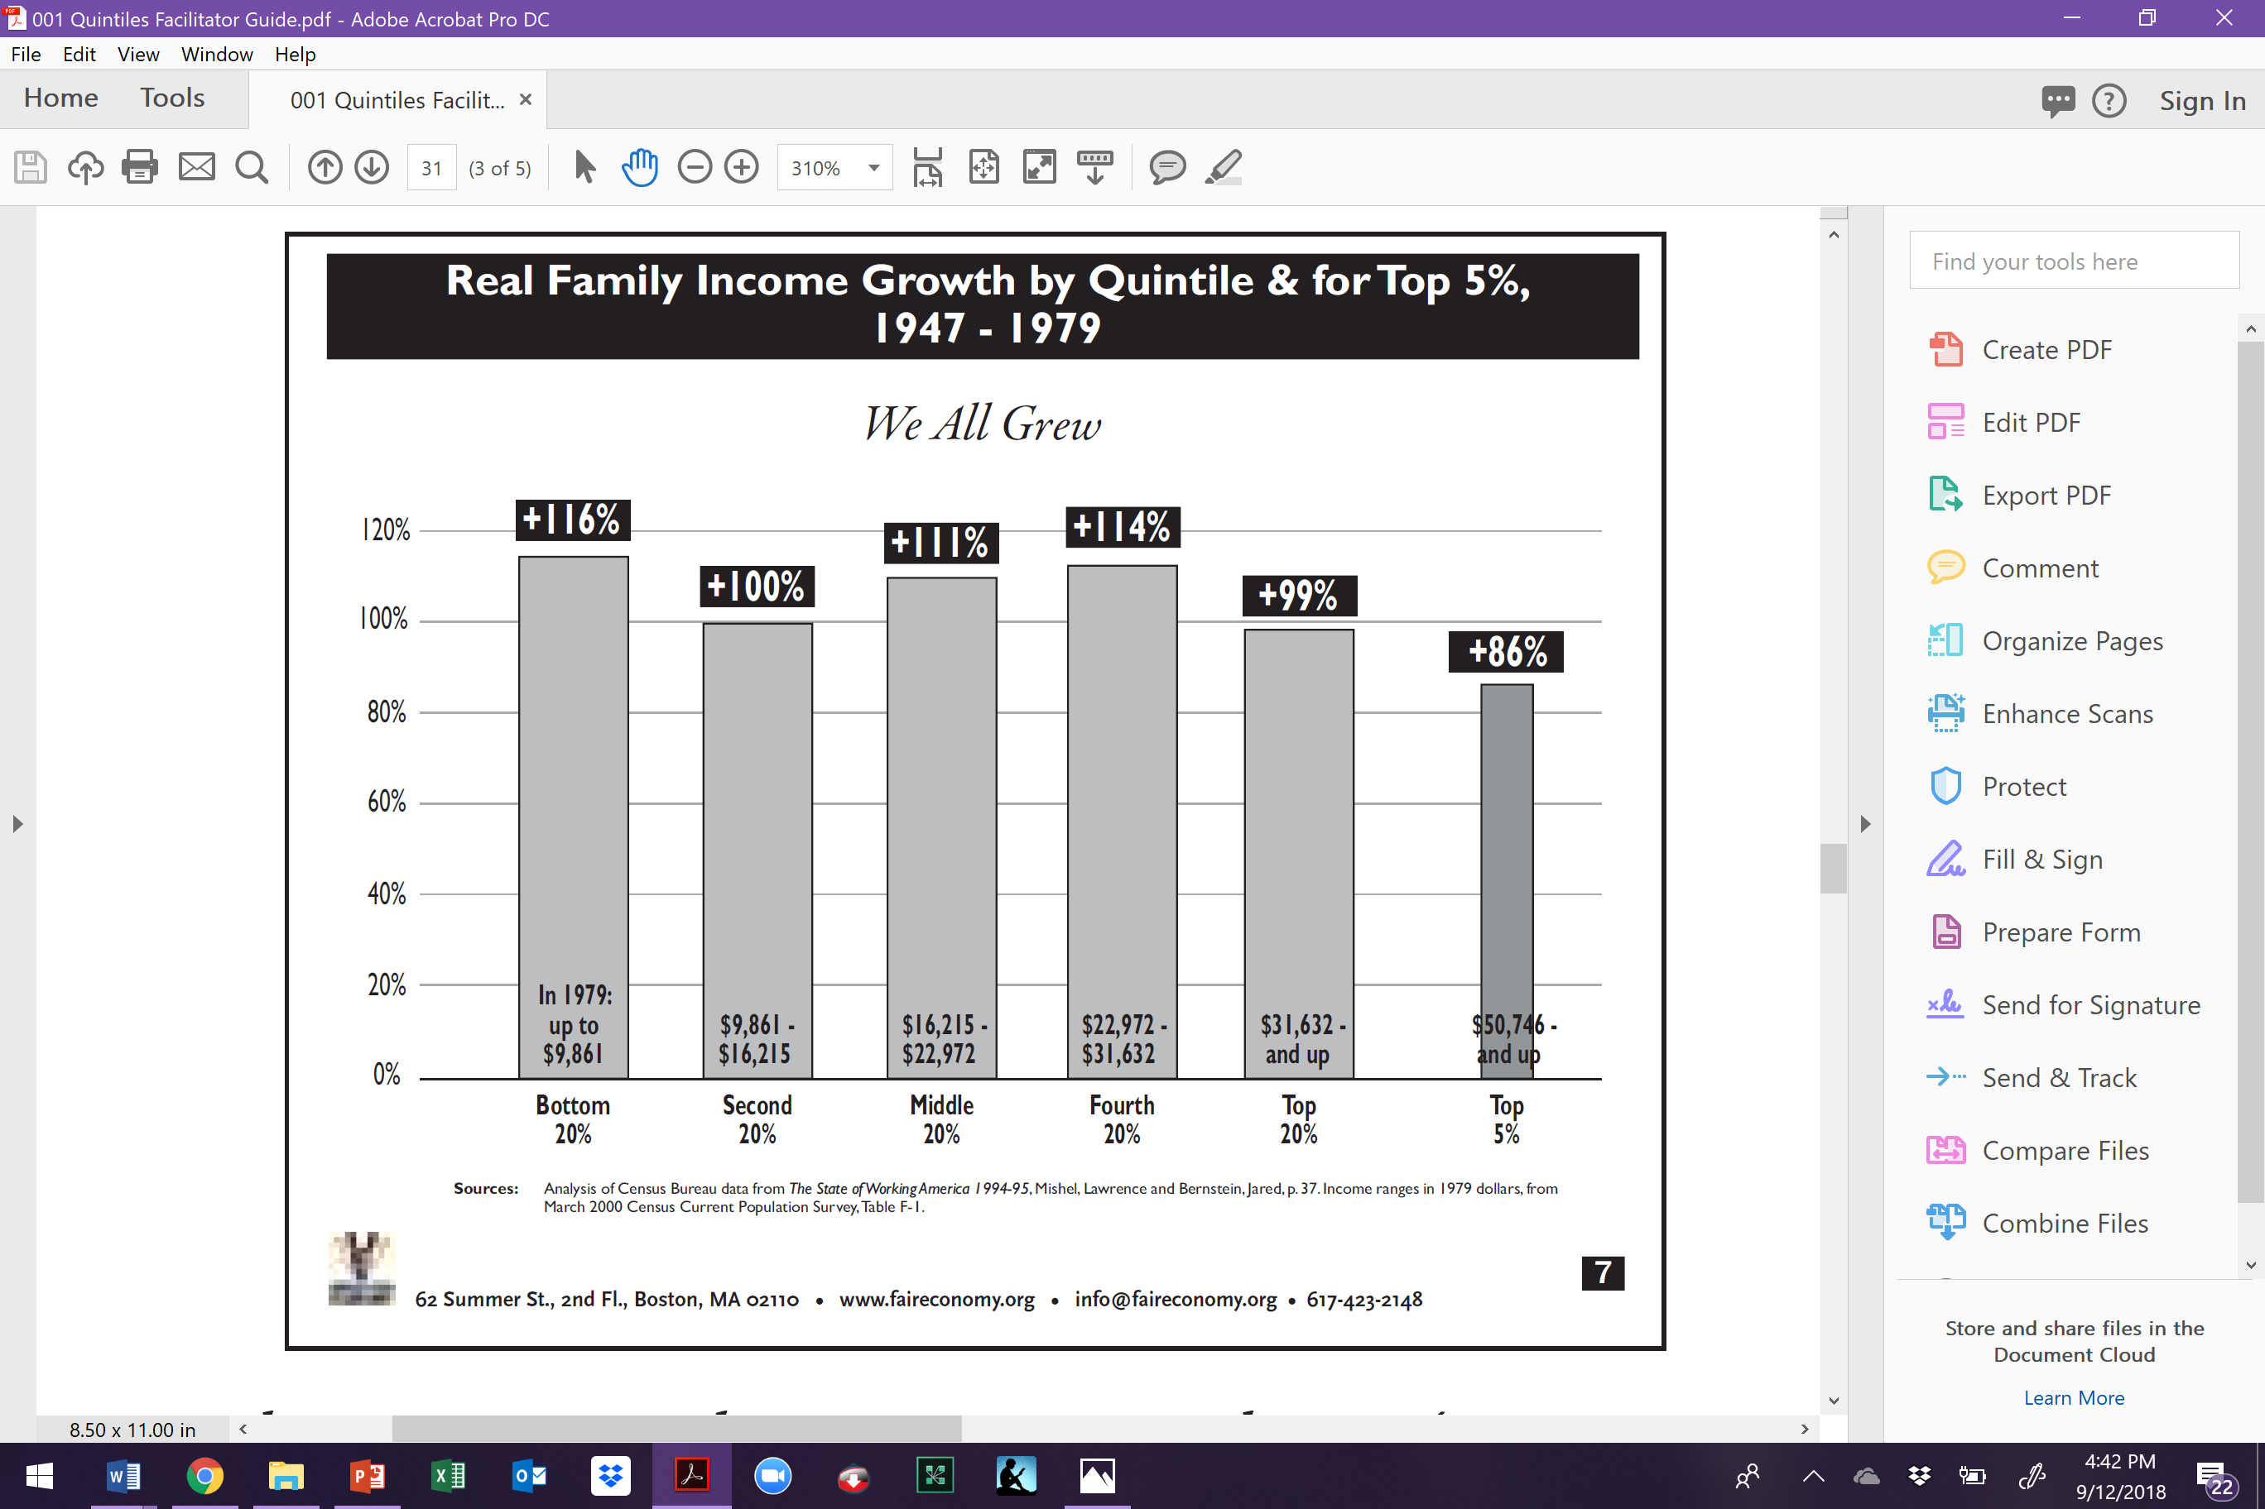
Income: Growth by Quintile 1947-1979
Notes:
During this period, the divide between the top and bottom in America actually narrowed during a period of substantial income growth.
One of the explicit goals of the federal government during early post was period was to build a middle class, people and families who could consume the output of the rapidly growing manufacturing capacity of the U.S programs such as the GI Bill of rights – which enabled hundreds of thousands of returned veterans to go to college and purchase homes – were funded in large part by relatively high taxes on the wealthy. It is important to acknowledge that these programs disproportionately favored white men. For example, the VA and FHA loan programs for housing, both of which utilized racially-restricted underwriting criteria, assured that hardly any of the $120 billion in housing equity loaned from the late 1940s to the early 1960s would go to families of color. These loans helped finance over half of all suburban housing construction in the country during this period, however less than 2% of this housing ended up being lived in by people of color.
In contrast to the post WWII period, the primary goal of economic policy since the 1980s was to let the rich accumulate great capital in the belief that it would trickle down.

Slide 97
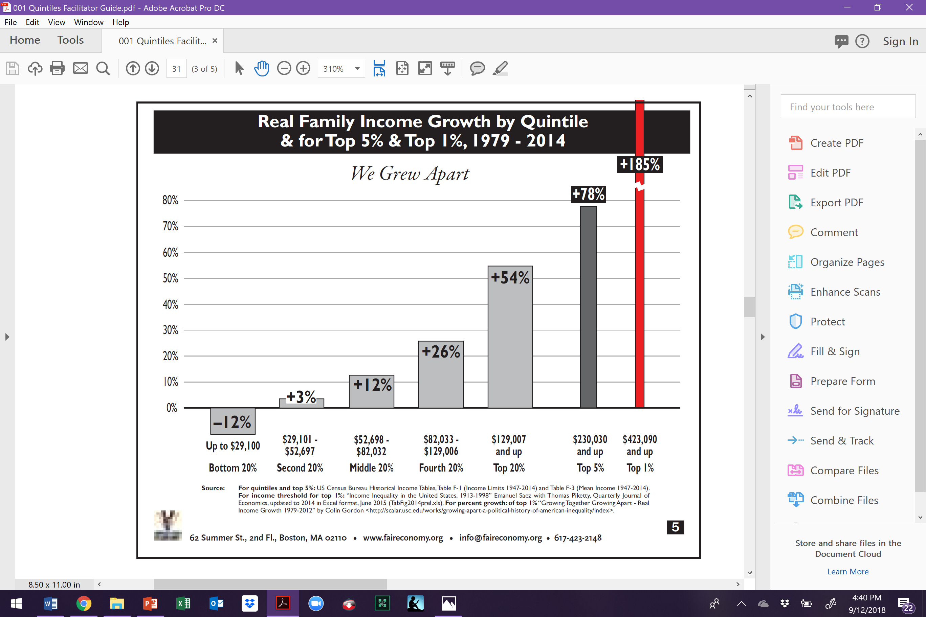
Income: Growth by Quintile 1979-2014
Notes:
During this period, the divide between the top and bottom in America actually narrowed during a period of substantial income growth.
One of the explicit goals of the federal government during early post was period was to build a middle class, people and families who could consume the output of the rapidly growing manufacturing capacity of the U.S programs such as the GI Bill of rights – which enabled hundreds of thousands of returned veterans to go to college and purchase homes – were funded in large part by relatively high taxes on the wealthy. It is important to acknowledge that these programs disproportionately favored white men. For example, the VA and FHA loan programs for housing, both of which utilized racially-restricted underwriting criteria, assured that hardly any of the $120 billion in housing equity loaned from the late 1940s to the early 1960s would go to families of color. These loans helped finance over half of all suburban housing construction in the country during this period, however less than 2% of this housing ended up being lived in by people of color.
In contrast to the post WWII period, the primary goal of economic policy since the 1980s was to let the rich accumulate great capital in the belief that it would trickle down.

Slide 98
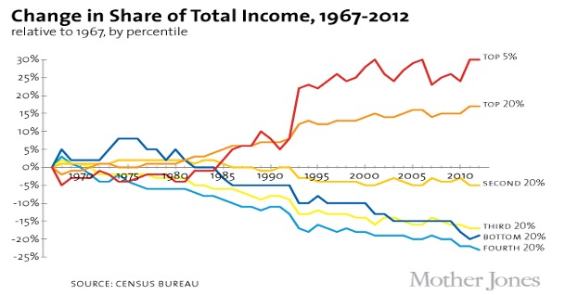
Notes:
During this period, the divide between the top and bottom in America actually narrowed during a period of substantial income growth.
One of the explicit goals of the federal government during early post was period was to build a middle class, people and families who could consume the output of the rapidly growing manufacturing capacity of the U.S programs such as the GI Bill of rights – which enabled hundreds of thousands of returned veterans to go to college and purchase homes – were funded in large part by relatively high taxes on the wealthy. It is important to acknowledge that these programs disproportionately favored white men. For example, the VA and FHA loan programs for housing, both of which utilized racially-restricted underwriting criteria, assured that hardly any of the $120 billion in housing equity loaned from the late 1940s to the early 1960s would go to families of color. These loans helped finance over half of all suburban housing construction in the country during this period, however less than 2% of this housing ended up being lived in by people of color.
In contrast to the post WWII period, the primary goal of economic policy since the 1980s was to let the rich accumulate great capital in the belief that it would trickle down.

Slide 99
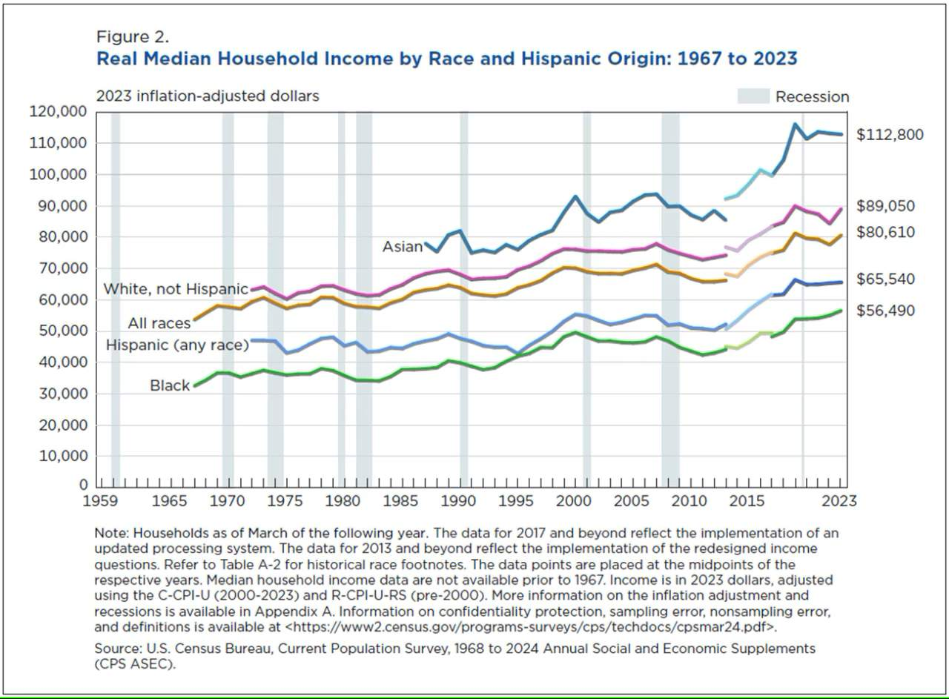
Notes:
In spite of claims made by opponents of affirmative action, there remains a huge chasm among racial groups in terms of income. For example, the income gap between White people one hand and African Americans on the other has actually increased since 1947. Neither of the two periods we looked at in the income quintiles activity were times of increasing racial income equality.

Slide 100
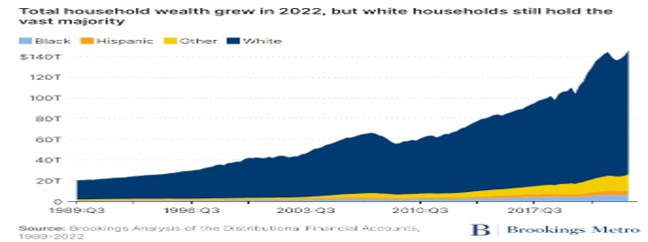
Notes:
During this period, the divide between the top and bottom in America actually narrowed during a period of substantial income growth.
One of the explicit goals of the federal government during early post was period was to build a middle class, people and families who could consume the output of the rapidly growing manufacturing capacity of the U.S programs such as the GI Bill of rights – which enabled hundreds of thousands of returned veterans to go to college and purchase homes – were funded in large part by relatively high taxes on the wealthy. It is important to acknowledge that these programs disproportionately favored white men. For example, the VA and FHA loan programs for housing, both of which utilized racially-restricted underwriting criteria, assured that hardly any of the $120 billion in housing equity loaned from the late 1940s to the early 1960s would go to families of color. These loans helped finance over half of all suburban housing construction in the country during this period, however less than 2% of this housing ended up being lived in by people of color.
In contrast to the post WWII period, the primary goal of economic policy since the 1980s was to let the rich accumulate great capital in the belief that it would trickle down.

Slide 101
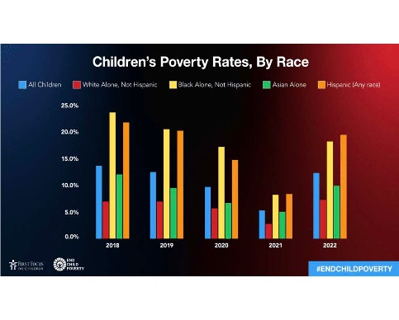
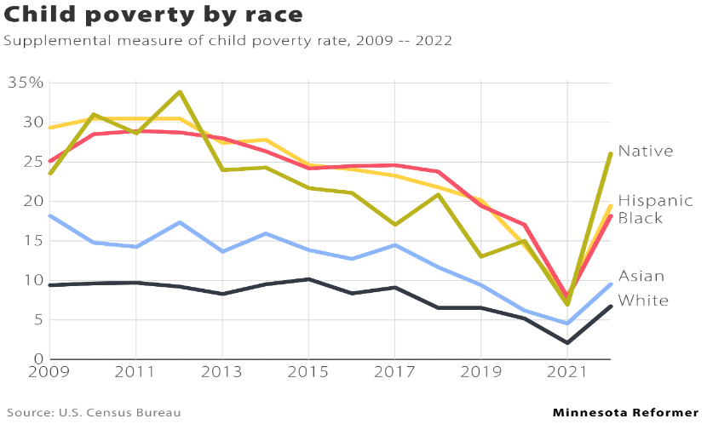
Notes:
During this period, the divide between the top and bottom in America actually narrowed during a period of substantial income growth.
One of the explicit goals of the federal government during early post was period was to build a middle class, people and families who could consume the output of the rapidly growing manufacturing capacity of the U.S programs such as the GI Bill of rights – which enabled hundreds of thousands of returned veterans to go to college and purchase homes – were funded in large part by relatively high taxes on the wealthy. It is important to acknowledge that these programs disproportionately favored white men. For example, the VA and FHA loan programs for housing, both of which utilized racially-restricted underwriting criteria, assured that hardly any of the $120 billion in housing equity loaned from the late 1940s to the early 1960s would go to families of color. These loans helped finance over half of all suburban housing construction in the country during this period, however less than 2% of this housing ended up being lived in by people of color.
In contrast to the post WWII period, the primary goal of economic policy since the 1980s was to let the rich accumulate great capital in the belief that it would trickle down.

Slide 102
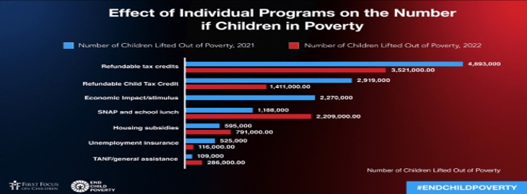
Notes:
During this period, the divide between the top and bottom in America actually narrowed during a period of substantial income growth.
One of the explicit goals of the federal government during early post was period was to build a middle class, people and families who could consume the output of the rapidly growing manufacturing capacity of the U.S programs such as the GI Bill of rights – which enabled hundreds of thousands of returned veterans to go to college and purchase homes – were funded in large part by relatively high taxes on the wealthy. It is important to acknowledge that these programs disproportionately favored white men. For example, the VA and FHA loan programs for housing, both of which utilized racially-restricted underwriting criteria, assured that hardly any of the $120 billion in housing equity loaned from the late 1940s to the early 1960s would go to families of color. These loans helped finance over half of all suburban housing construction in the country during this period, however less than 2% of this housing ended up being lived in by people of color.
In contrast to the post WWII period, the primary goal of economic policy since the 1980s was to let the rich accumulate great capital in the belief that it would trickle down.

Slide 103
Questions for Consideration
In which quintile do most of your students & families live?
In which quintile do you live?
In which quintile do your school board members live? Policy makers live? Business owners?
Why would anyone want to prevent the equitable distribution of wealth?

Slide 104
Key Points
Systems have been intentionally built to shift power, income, wealth, and opportunity away from those in the lowest quintiles toward those in the top quintile.
The impact is further compounded when you look at the intersection of race and income.
Collective action (people power) has led to any number of institutional solutions in the past and could do so again.
Changing tax and income policy is critical to create and sustain wealth for people of color.
Notes:
What strikes you about this information? What do you feel is the most significant takeaway?

Slide 105
Jessica

Slide 106
Shifting Perspectives

Slide 107

Dandelions…
Notes:
5 Mins – Dandelion analogy
Asking Different Questions
We can begin our work on planning to address racial justice by asking different questions that refocus our analysis at the systems level:
FROM: TO:
Blame – Who’s a racist? Causes – What is causing the racial inequity
Intentions – What did they mean? Effects - What were the What was their attitude? actions? What are the impacts?
Prejudice- What beliefs made them Systems – What institutions
do it? are responsible?
Grievances- How can we fix what happened?
Solutions- What are proactive strategies?

Slide 108
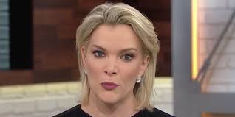

NBC and Gucci
Notes:
Gucci
1 – issued an apology
2 – sit down with Dapper Dan (African American designer in Harlem), members of community and other industry leaders
3 – full program of scholarships in major cities (NYC, Nairobi, Tokyo, Beijing, Seoul) to facilitate an increase of different communities within the creative offices
4 – set aside $5 million to invest in community programs in 10 NA cities
5 – formal policy that allows employees to spend company time volunteering in their communities
6 – hired a global director for diversity and inclusion
7 – formed an advisory council that includes Naomi Campbell, racial justice activists, academics and a sprinkling of celebritie

Slide 109
Asking Different Questions p.18
From: To:
Blame
Who’s a racist?
Causes
What’s causing the racial inequities?
Intentions
What did they mean?
What was their attitude?
Effects
What were the actions?
What are the impacts?
Prejudice
What beliefs made them do it?
Systems
What institutions are responsible?
Grievance
How can we fix what happened?
Solutions
What are proactive strategies and solutions?
Source: Race Forward 2018

Slide 110
Shifting Perspective p. 18, p. 7-10
Traditionally, we have placed more focus on individual and group acts of racism…
Why is it important to intensify our focus on systems (Racial Justice in Education, systemic racism, structural racism)?
Notes:
Validate Individual Racism – do not dismiss or ignore these issues, but pivot to why we need to focus on the systems. Systems give rise to situations that allow for racism and other inequities to flourish.

Slide 111
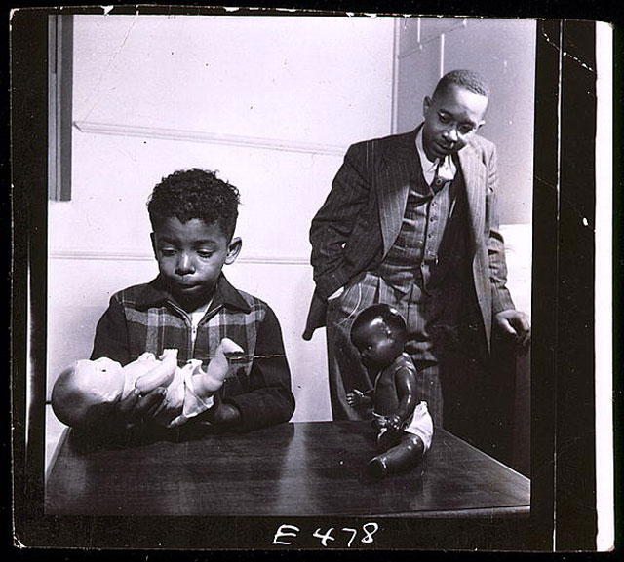
Asking different questions about the Doll Tests – p. 7

Slide 112
Asking Different Questions p.18
From: To:
Blame
Who’s a racist?
Causes
What’s causing the racial inequities?
Intentions
What did they mean?
What was their attitude?
Effects
What were the actions?
What are the impacts?
Prejudice
What beliefs made them do it?
Systems
What institutions are responsible?
Grievance
How can we fix what happened?
Solutions
What are proactive strategies and solutions?
Source: Race Forward 2018

Slide 113
Applying the Shift to the Scenarios, p. 7-10
Take five minutes to discuss your previous scenario through the "Asking Different Questions" lens.
Be prepared to share ONE of the questions.

Slide 114
Key Points
Advocating for racial justice requires us to shift perspectives and ask a different, much deeper set of questions.
Real change relies upon us spending more time and energy on defining systemic solutions.
Notes:
What strikes you about this information? What do you feel is the most significant takeaway?

Slide 115
Day One Homework
Pre-Attendance Assignments Packet: Tasks 1 & 2
Task 1: Implicit Association Test (online)
Task 2: Reflection & Racial Anxiety Test (pick yours)
We want to respect your evening time with your families, so
we've pared down the homework to just what is essential for Days 2 & 3.

Slide 116
Day One Closing
Leave One Word Behind

Slide 117

Leave One Word Behind
Thinking back to your core value that you shared earlier and today’s experience:
What is one word that describes your spirit right now?

