Slide 1
Campaign Academy:
Coaching and Leading Winning Campaigns
Baltimore, 2025

Slide 2

Campaign Academy
By attending this training, you confirm that you are either an NEA affiliate staff person or NEA member in good standing. The information you receive here is only for your use in your capacity as an NEA affiliate staff person or NEA member.
This presentation and its contents are confidential and may not be further distributed or passed on to any other person or published or reproduced, in whole or in part, by any medium or in any form, for any purpose unless written consent has been provided by Ellen Holmes. Audio/video recording, copying of slides, and the use of AI note-taking tools are prohibited without the written consent from Kyle Serrette. Violation of these terms may result in legal action.

Slide 3

ToDay’s Agenda and Outcomes
  7:30-8:30 Breakfast
  8:30-Noon Coaching and Teams
  12:00-1:00 Lunch
  1:00-4:30 Campaign
  4:30-5:00 Networking and Adjourn
Coaches and Mentor Coaches will understand the Campaign Cycle Planning document and how to coach into it.

Slide 4

Community Agreements
Using Self-Awareness and Self-Knowledge
Listening for Understanding
Being Gracious
Staying Engaged
Being Open and Suspend Judgment
Saying “I”- tell your truth
Lean into Discomfort
Reaching Empathy
Expecting Non-Resolution and Non-Closure
*Adapted from “Embracing equity and inclusion”, Annie E. Casey Foundation
Notes:
Community Agreements for Our Time
Awareness and Self-Knowledge
This requires self-knowledge and self-awareness. Self-knowledge allows you to see what causes you pain and conflict and enables you to embrace your contradictions and inconsistencies. It allows the space to work on things about yourself that you are not happy with. In turn, self-knowledge helps to prevent you from projecting your negative aspects onto other people. Bringing your best self also requires that you have a positive attitude, are willing to deeply explore your perspectives and remain open to the perspectives and experiences of others.
Listening for Understanding
Be an active listener. Active listening involves paying full and careful attention to the other person, looking him or her in the eye, avoiding interruptions, reflecting your understanding, clarifying information, summarizing the other person’s perspectives and sharing your own. Remember that most people need time to open up and might not be willing to immediately share their personal stories, hopes, fears and/or concerns.
Being Gracious
Being kind is a vital way of bringing meaning to our own lives, as well as the lives of others. Kindness is about caring genuinely for others around you, wanting the best for them and recognizing in them the same wants, needs, aspirations and even fears that you may have. Being kind and generous allows us to communicate better with others, to be more self-compassionate and to be a positive force in other people’s lives. This includes following the COVID protocols that are in place to protect the health of this learning community.
Stay Engaged
Staying engaged requires you to be morally, emotionally, intellectually and socially involved in the conversation. Staying engaged means that you are listening with curiosity and willing to deepen your understanding. Staying engaged might also require you to sustain the conversation even when it gets uncomfortable or diverted. This also means a commitment to keeping your electronic communications to a minimum with folks not present in this learning community.
Be Open and Suspend Judgment
Listening with an open mind includes being receptive to the influence of others. You can suspend judgment by becoming aware of preconceived notions and listening to everything someone has to say before jumping to conclusions. Most importantly, suspending judgment also means listening to what the speaker has to say for understanding, not just to determine whether the speaker is right or wrong.
Say “I”- tell your truth
Speaking your truth in authentic and courageous conversations about race requires a willingness to take risks. It means that you will be absolutely honest and candid about your own thoughts, feelings, experiences and opinions and not just saying what you perceive others want to hear. Speaking your truth will require you to speak from the “first person” and use “I” statements.
Seek Discomfort
Leaning in to discomfort will require you to let go of racial understandings and stereotypes that you may be holding onto in order to move forward. Leaning in means that you will avoid judgment, assume positive intent and be open to the kernel of wisdom in each individual’s experiences. Leaning in to discomfort will require you to sit through moments of embarrassment, confusion, anxiety and/or fear.
Reaching Empathy
Empathy and compassion allow you to understand the other person’s point of view. When you are empathetic, you are more understanding, patient and kind. Expanding your capacity to feel empathy will also allow others to enter your circle of human concern.
Resolution and Closure
Expect and accept that there may not be closure. It is not likely that you will resolve your personal understanding about race or another person’s racial experience in a single conversation. The more you talk about race with another person, the more you learn and the more they will learn. Authentic and productive conversations about race are continuous and always evolving.
*Adapted from “Embracing equity and inclusion”, Annie E. Casey Foundation

Slide 5
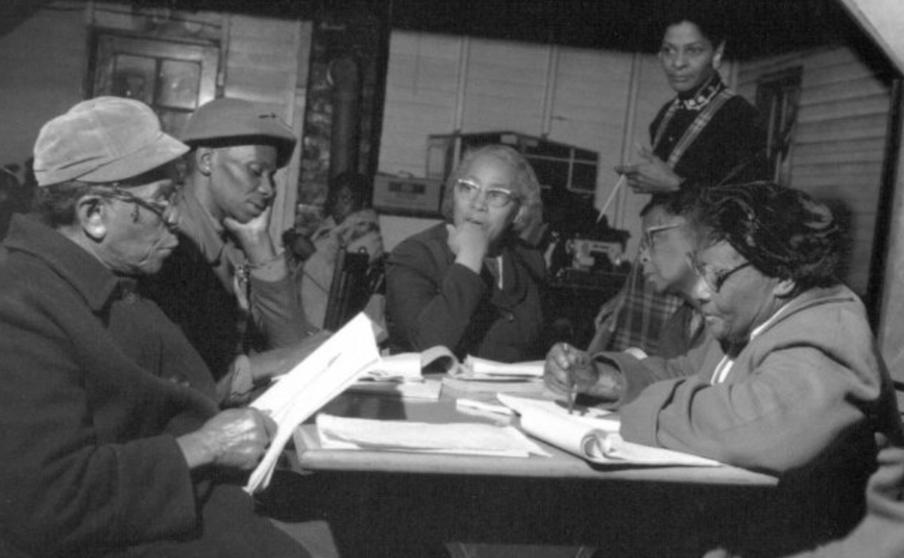
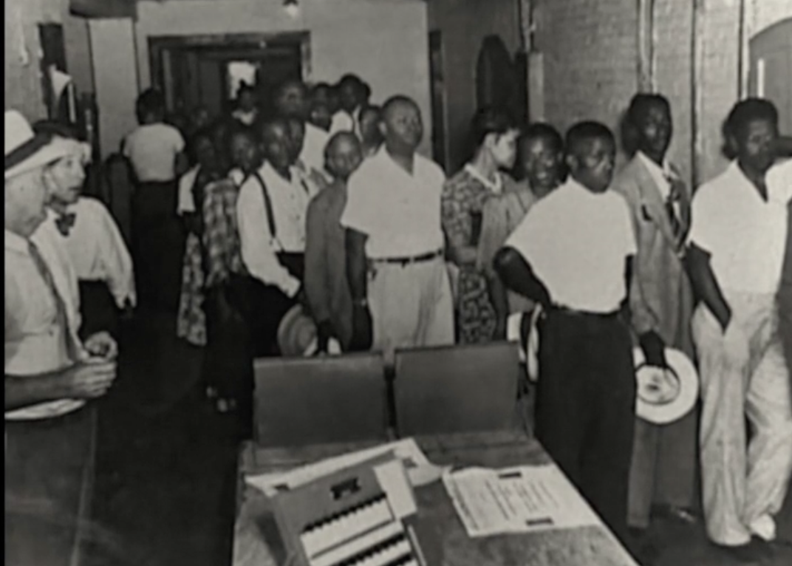
Our Coaching Lineage
Notes:
3 minutes
We know that the word ‘coaching’ gets used a lot these days. There’s life coaching, there’s athletic coaching, some of us might work with a personal trainer who coaches, and you can find a ton of coaching books written for corporate executives.
And some of you might have practiced or experienced the kind of coaching we are talking about – as mentor teachers or schools staff just learning your roles
But just to be clear, when we say ‘campaign coaching’, we believe any time groups take collective action to change their material conditions, there are some people playing a coach role, intentionally trying to develop the insights and skills of their peers, mentees and even top leaders to help empower and grow people to become independent to lead their own campaigns
We’re especially inspired by US social movements that made widespread use of volunteer-based leadership development networks
“As unionists, we are constantly… building agency, scaling movements, whereas with directive coaching you’re teaching dependence…”
As a mentor coach, you are task to ask questions and provide supports that will lead to locals building agency, engaging a variety of people, and creating campaigns that they can own and execute

Slide 6
Remember a time…
Notes:
3 minutes
Right now, I am going to ask you to close your eyes….Think of…
“Think of an experience you’ve had of effective coaching, or being supported by someone – this could have been an athletic coach, a teacher mentor, or anyone else in your life who supported you to learn and grow in some way. What’s a moment you remember them providing a kind of support that exemplifies the role of a coach?...(continue closed eye in your own style)”
What were you feeling as you came into coaching? How did you feel leaving the coaching session?
What did they say? And if you can’t remember - what has stuck with you now that this is the moment you’re recalling?
You can open your eyes….

Slide 7
At your tables:
Share a little about your experience:
What did the coach (or other person) do? What qualities did they demonstrate?
Notes:
10 minutes total -
We are now going to go to breakout rooms to break into pairs.
First, introduce yourself, briefly. Then, share with your partner a little about your experience: What did the coach, or other person, do? What qualities did they demonstrate? You will have 8 minutes, 4 minutes each.”
Cofacilitator paste in chat:
=========
Introduce yourself, briefly. Share a little about your experience: What did the coach (or other person) do? What qualities did they demonstrate?

Slide 8
Possible Interventions
Coach Centered
Campaigner Centered
Suggestions/Advice
Feedback
Stories
Observations
Questions

Slide 9
Campaigners can…
Read a political landscape
Assess their potential allies and opponents
“Cut an issue” from a big problem to a set a of winnable (local) demands
Pick fights that will build our base and develop new leaders
Use a tactic sequence to create a crisis for our targets
Notes:
2 minutes
This is the framework for campaigner skills and why coach them.
Campaigners can… (Slide)
Read a political landscape
Assess their potential allies and opponents
“Cut an issue” from a big problem to a set a of winnable (local) demands
Pick fights that will build our base and develop new leaders
Use a tactic sequence to create a crisis for our targets

Slide 10
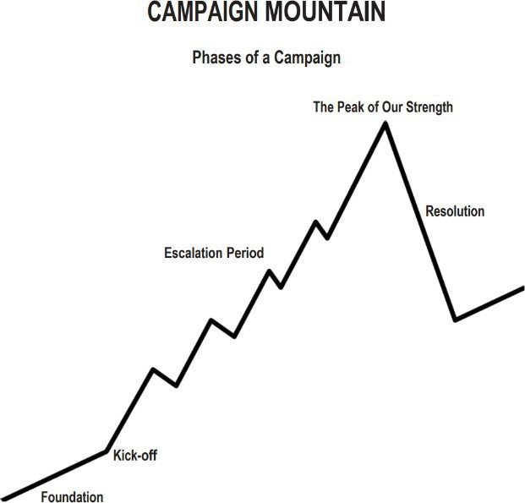
Coaching Campaign Cycle Planning
  Centering Equity
  Leadership Team
  Problem and Issue Identification
  Target and Demand
  Power Analysis
  Allies
  Communication
  Strategy
  Tactics
  Metrics
Timeline
Tactics (in order) of escalation
Benchmarks for each tactic
Timeline
Tactics (in order) of escalation
Benchmarks for each tactic

Slide 11
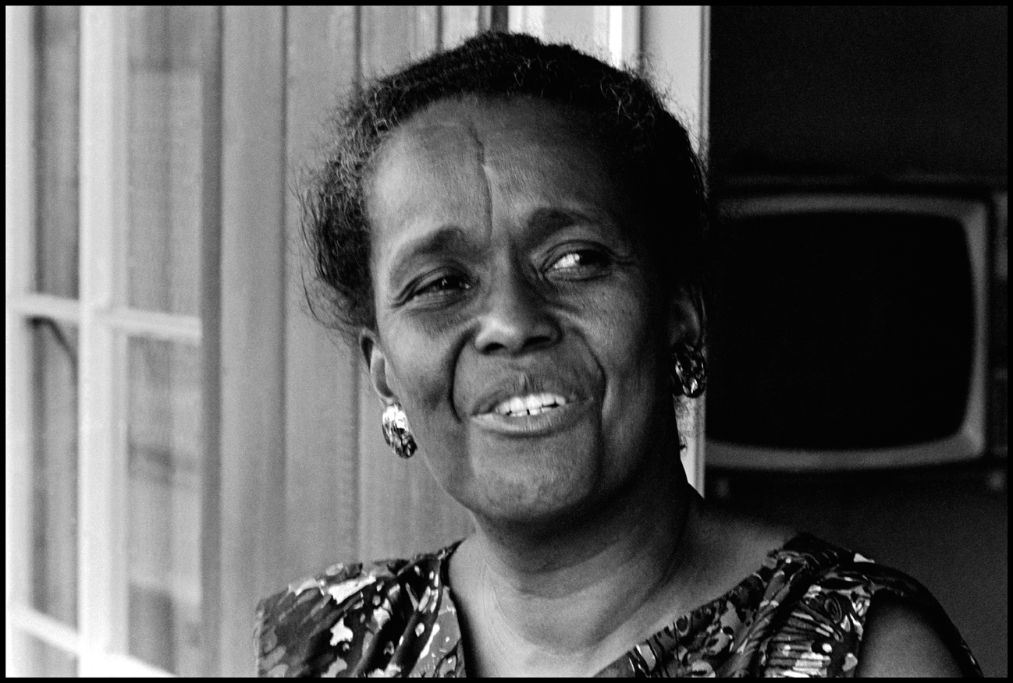

Key Point
Effective campaign coaches are not the leaders, instead they help campaigners uncover the realization:
“Strong people don’t need strong leaders.”

Slide 12
Basics of Coaching

Slide 13
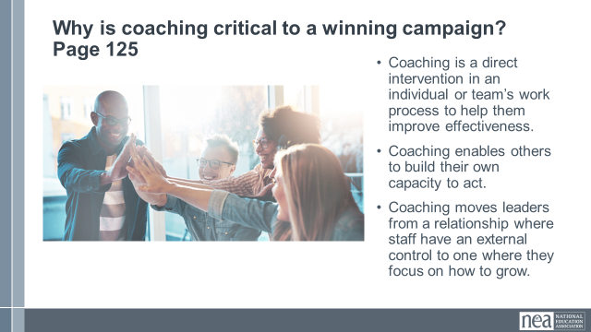
REMINDER Why is coaching critical to a winning campaign?
Coaching is a direct intervention in an individual or team’s work process to help them improve effectiveness.
Coaching enables others to build their own capacity to act.
Coaching transforms leaders from a relationship where someone else has external control to one where they focus on how to grow.

Slide 14
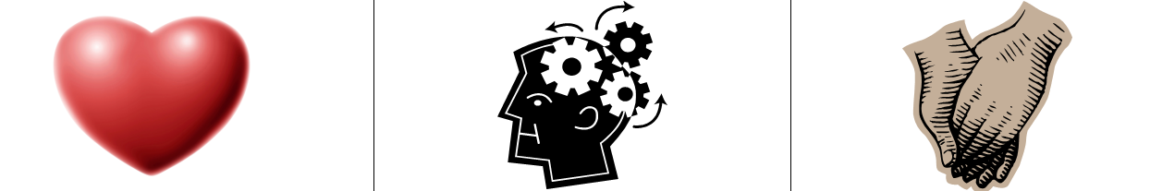
3 Kinds of Coaching
Motivational - Heart Coaching aimed at enhancing motivation
Strategic – Head Coaching aimed at helping plan, evaluate, strategize
Skills-based – Hands Coaching aimed at effective execution of a skill

Slide 15

Coaching Pairs
Regroup
You will need to get into groups of 2.
Problem of Practice or Challenge
Two 20-Minute Rounds
  Structure:
    Coachee presents Problem of Practice
    Coach begins inquiry and diagnosis
    Coach moves to debrief and monitor

Slide 16
Debrief in Pairs
What did you feel successful with as a coach or coachee?
What would you change the next time you coach/are the coachee?
What is a key takeaway from this for the next time you are coaching a Campaign Coach and/or Team Lead?

Slide 17
Key Points
Coaching is about releasing your external control and enabling the leader to grow.
Coaching is as much about you changing your behavior and growing your skill as it is about growing a leader.
We only get good at coaching by practicing it.

Slide 18
Coaching Into Team Development
Zac and Halimah

Slide 19
EFFECTIVE TEAMS
EFFECTIVE TEAMS
STEPS
STEPS
MEASURES
CONDITIONS
MEASURES
CONDITIONS
Bounded
Purpose
Goals
Stable
Norms
Capacity
(Team)
Diverse
Roles
Learning
(Individual)
Notes:
- When looking at effective teams, we should be paying attention to the conditions that make a great team, the steps to get there, and the measures that help us know we got there (30 sec)
- There is some research around this. Richard Hackman, Marshall Ganz, Ruth Wageman, out of Harvard University studied teams throughout the world, governments, sports, the military and their research is the basis for some of this thinking. Purpose assigned vs. Purpose developed collectively
Let’s start with the measures of an effective team
This work was done with Cabin Crews in airplanes (where they had been problems with crashes and miscommunications), Symphony Orchestras (where they were frustrated, being cogs in a wheel; Orpheus Orchestra where there’s no conductor, all led by leadership teams)
MEASURES
GOALS: A good team has goals AND takes action together to achieve the goal and effect the change they want to see.
CAPACITY: An effective team also builds capacity. Learns how to work together and how to develop new leadership to replace them when their gone.
LEARNING: Lastly, an effective team also includes a learning component. One way to know if your team is effective is if you walk away with a new skill or perspective on how to do the work.
CONDITIONS
Your team is bounded. You can name the people on it; they don’t come and go, whoever shows up doesn’t have the automatic right to participate in the team.
Your team is stable. It meets regularly. It’s not a different, random group of people every time. Membership of the team remains constant long enough that the team learns to work together better and better; each member is fully committed to be on the team and commits consistent time and effort to it.
Your team is interdependent. As on an athletic team, a string quartet, or an airplane cabin crew, the contribution that each person makes is critical to the success of the whole. Team members have a vital interest in each other’s success, looking for ways to offer support.
Finally, there are 3 Steps to reach these measures.
Crafting a SHARED PURPOSE.
Developing SHARED NORMS/COMMUNITY AGREEMENTS.
And establishing INTERDEPENDENT ROLES.

Slide 20
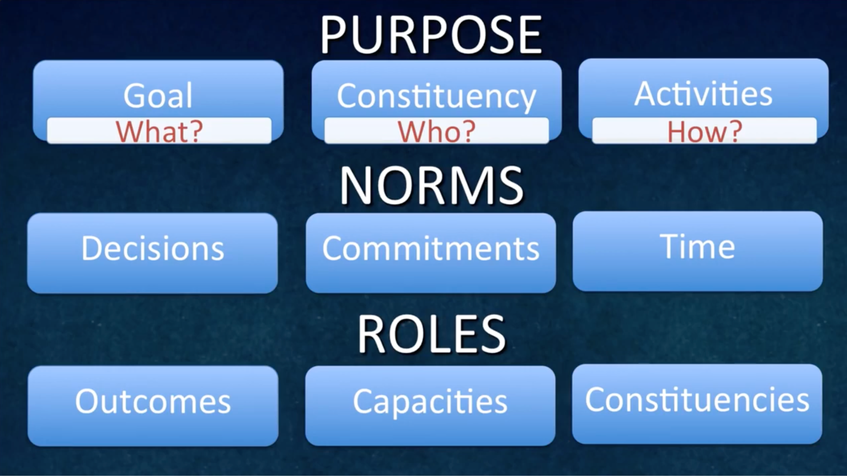

Slide 21
DEVELOPING A SHARED PURPOSE
OUR PEOPLE ARE...
OUR TEAM’S PURPOSE IS TO…
WE’LL ACHIEVE OUR PURPOSE BY...
WHO?
WHAT?
HOW?
Notes:
The first step is developing a shared purpose.
How many of you have had an experience trying to create a purpose statement for a team or organization you’ve been a part of?
Was that like a walk in the park? No. Once you got there, did it give your team clarity about the goals you were working towards?
So definitely worthwhile. In breakouts, you’ll have a chance to try this out. We’ll develop a statement using the What, How, and Who. Focusing on the shared purpose – why we’re together doing the work, how we want to achieve that purpose together, and who our people are.
Purpose is an interaction between these three things
Who – Who are we engaging to do this work with? How can we be specific in naming our people?
What — what is our north star? What broadly must occur in our world for it to look a little more like what we want? What part of that work are we taking on as a team? This should feel motivational to you as a team.
How – What kinds of activities will engage them in?
(organizing activities) – in an organizing language, what kinds of activities allow for our group to achieve the purpose we’ve set forth.

Slide 22
TEAMS - SHARED PURPOSE
STEP 1 - first draft (individual work) — 3 min
STEP 2 - (group work) — (8 min)
Include what your team is striving for, who you will organize, and how you’ll do it - the kinds of organizing activities you will engage in
NAME | WHO? Your constituency’s characteristics | WHAT? Your team’s reason for coming together | HOW? Specific organizing activities

Slide 23
STEP 3 - SHARED PURPOSE - second draft (individual work) (3 mins)
Include what your team is striving for, who you will organize, and how you’ll do it - the kinds of organizing activities you will engage in
Team Member: Team Member: Team Member: Team Member:

Slide 24
STEP 4 - SHARED PURPOSE - final draft purpose sentence (group work) (5 mins)
Include what your team is striving for, who you will organize, and how you’ll do it - the kinds of organizing activities you will engage in

Slide 25
Decision-making: What is the process by which we will make decisions?
Majority rules: Whatever gets the most votes wins. Consensus: Everyone must agree. Delegation: Nominate one or two people on your team to be the ultimate decision-makers. Coin flip: Leave the decision to fate! Fist to Five: Show a number of fingers to indicate whether you are in favor (five) or opposed (fist) to the proposal at hand. Other:
Discussion and Decision-making: How we will discuss options and reach decisions as a team to ensure vigorous input and debate?
Always Do Engage in open, honest debate Ask open-ended questions Balance advocacy with inquiry | Never Do Engage in personal attacks Fail to listen to what others say Jump to conclusions
Meeting Management: How will we manage meetings to respect each other’s time?
Always Do Start on time; stay on time Be fully present throughout the meeting Listen attentively | Never Do Come to meetings unprepared Answer mobiles or do email
Accountability: How we will delegate responsibilities for actions and activities? How will we follow through on commitments?
Always Do Provide follow-up on action items (have a goal checklist) Ask for/offer support when there is a need Weekly check-in | Never Do Assume you have agreement Assume tasks are getting done Commit to a task that you know you won’t do
Accountability Agreement:
**Regular meeting time:

Slide 26
Role | Responsibilities | You would be good for this role if you . . .Criteria? | Interested Team members & Related Skills/Talents
Team Coordinator
Understanding Team Roles (10 min.): Review the Team Coordinator role below as an example of what roles might look like in your individual campaigns. Thinking about how you should organize your constituency, discuss how your roles would fit together to create an interdependent leadership team that supports one another in your project. What would each role have to be good at? Based on the discussion about the roles, go around the circle and ask each person to tell others: 1) what experience and talents they have that might contribute to the leadership team and 2) what specifically they want to learn in more detail (30 seconds each). How might these talents match up to particular roles? Are there any clear “fits”?
Note: These team roles should not be seen as permanent. For the team to be strong, all leaders should have to earn leadership by carrying out responsibilities relevant to the role they seek.

Slide 27
Coaching it Up
How will you know that there is something not working around an aspect of the Leadership Team?
What possible observations could you see?
What questions could you ask the team lead?
What are intentional interventions you might take?

Slide 28
Key Points
The leadership team structure supports the campaign’s interests by meeting goals, and meeting each individual’s interests by giving them opportunities and support to learn and develop.
IF your team is not meeting these criteria then you need to return to the foundational blocks and refocus.
Your role is to support and develop the team.

Slide 29
Coaching into
Problem and Issue
Halimah and Ellen

Slide 30

PROBLEM vs. ISSUE
A problem is the whole pie. Problems are vast, complex, and entrenched.
When we try to tackle a problem, we reinforce the hopelessness of the situation. We are trying to take on the full pie all at once.
Issues are the pieces of the pie. It’s a small chunk of the larger problem that we can make progress on, and in turn we are slowly taking on the full problem over time.
Notes:
What are some “red flags” to look out for when identifying the issue?

Slide 31
Issue
An issue is a slice of the larger problem that is manageable and solvable.

Slide 32

PROBLEM vs. ISSUE

Slide 33
Values
Values are fundamental beliefs that dictate behavior
Ideally, Unions advance the welfare of all members.
They are based on the universal ideal of human rights, the idea of justice, progress, and betterment of self and of society.
Through shared values, members build solidarity and commit to active participation in the labor movement.
Shared values transform individual members into part of something larger than themselves.

Slide 34
Some Union Values
Fairness, honesty/integrity, responsibility, compassion/empathy, safety, health, generosity, hard work/responsibility, community, freedom, democracy, binding contracts, equality, opportunity, respect, stability/security, unity, quality work, justice, collective action, dignity/respect, charity/community service, and due process.

Slide 35
How to Link Issues and Values
Investigating member issues is necessary but not sufficient – we also need to identify workers’ SHARED values –
WHY is this an issue?
WHY do you want to fix this?

Slide 36
EXAMPLES- Problems to Issues + Values
VALUES – Public Schools should be safe, equitable, and inclusive learning and working environments for all people.
PROBLEM -Our school is hostile to LGBTQ+ staff and students
  ◦ Issue Cut – There are no gender inclusive bathrooms and/or transgender students and staff are forced to use the wrong restroom.
PROBLEM - Our school reinforces racism by silencing protestors
  ◦ Issue Cut– We need to stop law enforcement from arresting students and staff for exercising their Constitutional rights.

Slide 37
Key Points
Problems are big conditions of injustice
Issues are the smaller member identified components that make up the problem
Issues indicate a path to action
Values build a relatable why across people experiencing the pain of the problem
We intentionally work to connect members around issues and values to build Solidarity

Slide 38
TEAM WORK
Review the Tools on Problem into Issues on Page 42

Slide 39
Assessing Our Issues
Widely felt and/or deeply felt.
  The pain can be felt by just one, but the injustice of that pain is shared by many.
  The pain AND the injustice of that pain is felt by many.
Winnable.
Builds the union and builds leaders.
Has a connection to students and the public.
Secrets of a Successful Organizer “A Good Organizing Issue” handout

Slide 40

Issue Criteria Checklist
(as a resource)

Slide 41
Coaching it Up
How will you know that there is something not working around an aspect of the Problem or the Issue?
What possible observations could you see?
What questions could you ask the team lead?
What are intentional interventions you might take?
What are the ways that you have coached teams selecting the issue that was right for them?

Slide 42
Problems are big conditions of injustice
Issues are the smaller member identified components that make up the problem
Issues indicate a path to action
Values build a relatable why across people experiencing the pain of the problem
We intentionally work to connect members around issues and values to build Solidarity
Not Every Issue is an Organizing Issue
Key Points

Slide 43
Target and Demand
Zac and Amanda

Slide 44

A Target Is
The person with the power to give you what you are demanding.
This person
Has a name
Has a face
Has an address

Slide 45
Using Power Analysis to Create a Path
Likely Yes Vote
Likely no vote
SB Member
A?
SB Member
C
SB Member
B
SB Member
D
SB Member
E

Slide 46
Using Power Analysis to Create a Path
Likely Yes Vote
Likely no vote
SB Member
A?
SB Member
C
SB Member
B
SB Member
D
SB Member
E

Slide 47
Coaching up Power Analysis

Slide 48
Key Points
Understanding our own power, or lack thereof, is a necessary starting point
Understanding who has the power to fix the issue is crucial to building a successful campaign

Slide 49
Crafting Demands
Zac and Amanda

Slide 50
A Target Is
The person with the power to give you what you are demanding.
This person
Has a name
Has a face
Has an address

Slide 51
Demand
This should be an agitational phrase that creates a moral crisis (connected to values) for the listener and demands action

Slide 52
Demand
“Hey TARGET,
we demand ACTION
because HARM or IMPACT!”

Slide 53
Coaching up Power Analysis, Target, Demand
“Hey Superintendent Sam: We demand gender affirming bathrooms in every school because all students need to feel safe and included in our schools. ”

Slide 54
Coaching up Power Analysis, Target, Demand
“We demand safe and inclusive spaces for all staff and students!” lol or like Wear Red for Ed!!

Slide 55
Teamwork
Table talk - How could you coach a leader/team to a more effective demand?
What other examples have you heard, and how did you coach them?

Slide 56
Key Points
A powerful demand makes clear who has the power to make the change that’s needed
We can only build a powerful demand when we have taken the steps to accurately identify the issue and determine who has the power to create change

Slide 57
Coaching Into Power Analysis
Zac and Amanda

Slide 58
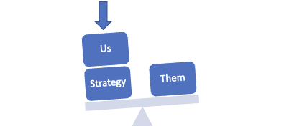
Purpose of Power Analysis
Understand how (& by who) power is exercised to cause and maintain the problems & conditions that we seek to change
Develop effective strategies for:
  Permanently altering power relationships in favor of the people suffering from the problems & conditions that we seek to change
  Grassroots organizing to build power
  Issue campaigns that BOTH help to build power AND win change
  Connecting short term activities to LONG TERM goals
Notes:
Yvie J:
Now why do we do a power analysis and what is it?
Power analysis is a systematic approach to understanding our own power and the power of our allies and opponents on the issue that we have identified. Doing a power analysis allows us to understand how and by whom power is being exercised to cause and maintain the problems and conditions that we seek to change. This allows us to identify and understand how to move the decision maker who can give us what we want and to develop effective strategies for:
Permanently altering power relationships in favor of our communities & the conditions that we seek to change
Grassroots organizing to build power
Developing Issue campaigns that BOTH help to build power AND win change
Connecting short term activities to LONG TERM goals

Slide 59




Process of Power Analysis
1. Issue Background
2. System Landscape
3. Identify & Analyze Target(s)
Notes:
Yvie J
Now we’ll move into Part 3 of the Power Analysis, identifying and analyzing the Target(s). Who has an idea of what we mean by a target in the context of a campaign?

Slide 60
A Target Is
The person with the power to give you what you are demanding.
This person
Has a name
Has a face
Has an address
Notes:
Yvie J
A target is the person who can make the decision to give you what you want. The target is the person who can meet your demands. We need to be very specific in identifying the target. A target is not an organization or a committee. A target is a person with a face, name, and an address.
Once you have done the system landscape and understand the decision making process, you will be able to identify the Target.

Slide 61
Values Triangle
Self-Interest
Power
alues
Relationships
Notes:
Zac J
First, we need to understand our own power. There is a helpful tool for power analysis that we call the Values Triangle. The triangle works from the bottom up and the inside out. At the bottom of the triangle, we have relationships. Everything starts with relationships because everything we do happens in, through, with and because of who we know and how we trust them. Inside the triangle is where we have values. Do you remember how we defined values this morning? Values are deeply-held beliefs that shape who you are. We are our best possible selves when we have clarity on our values. The world we want to see and how we define ourselves are based on our values. A person who is clear on their values knows who they are and what they believe in.
On the left of the triangle, we have self-interest. Self-interest is what our values look like in the world, the tangible manifestation of our values. When you understand your values you can discover your self-interest. Your self-interest is what you’re willing to fight for. For example, if one of your values is people over profits, one of your self-interests could include stronger unions, living wage policies, hazard pay for essential workers, and more. On the right side of the triangle is Power. Who remembers our definition of Power? Power is the ability to create, control, and prevent change. Power is made up of organized people and organized resources. Bringing it all together, we build relationships, so that we can agitate people to live up to their values and get clear on their self-interest so that we can build the power we need to make the world reflect our values. Understanding this triangle is key to your work and to making change. Every person and organization has one of these.

Slide 62
Values Triangle
Self-Interest
Democracy
Power
Worker Voice
People over profit
Member organizing
Living Wages
Democracy
Dues
Strong Public Schools
alues
Collective Bargaining
Relationships
Members
CWA
IAF
Great Ed CO
America Votes
UNE
Notes:
Zac J
One helpful tool for completing a power analysis of our own context is called the Values Triangle. The triangle works from the bottom up and the inside out. At the bottom of the triangle, we have relationships. Everything starts with relationships because everything we do happens in, through, with and because of who we know and how we trust them. Inside the triangle is where we have values. Do you remember how we defined values this morning? Values are deeply-held beliefs that shape who you are. We are our best possible selves when we have clarity on our values. The world we want to see and how we define ourselves are based on our values. A person who is clear on their values knows who they are and what they believe in.
On the left of the triangle, we have self-interest. Self-interest is what our values look like in the world, the tangible manifestation of our values. When you understand your values you can discover your self-interest. Your self-interest is what you’re willing to fight for. For example, if one of your values is people over profits, one of your self-interests could include stronger unions, living wage policies, hazard pay for essential workers, and more. On the right side of the triangle is Power. Who remembers our definition of Power? Power is the ability to create, control, and prevent change. Power is made up of organized people and organized resources. Bringing it all together, we build relationships, so that we can agitate people to live up to their values and get clear on their self-interest so that we can build the power we need to make the world reflect our values. Understanding this triangle is key to your work and to making change. Every person and organization has one of these.

Slide 63
Coaching Up Target, Demand, and Power Analysis

Slide 64
Key Points
During a campaign, understanding the values, self-interest, and power of those who we need to influence helps to underpin and strengthen our strategy, increasing our likelihood of success.

Slide 65
Coaching into the Spectrum of Allies and Messaging
Albert/Halimah/Carrie

Slide 66
Keep it in mind…
If campaigns put people at the center of solving the problems they are experiencing...
Then understanding the relationship people have with the win you seek is essential

Slide 67

Spectrum of Allies

Slide 68

Spectrum of Allies
  Active allies: people who agree with you & are organizing alongside you
  Passive allies: people who agree but aren't doing anything about it (yet!)
  Neutrals: people who aren't sure, or are unengaged (they might just not know about you yet)
  Passive opponents: people who disagree, but aren't trying to stop you
  Active opponents: people who have done something to prevent you from reaching your goal

Slide 69
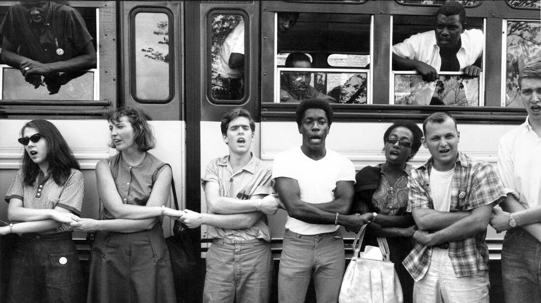
An example from history – Freedom Summer

Slide 70
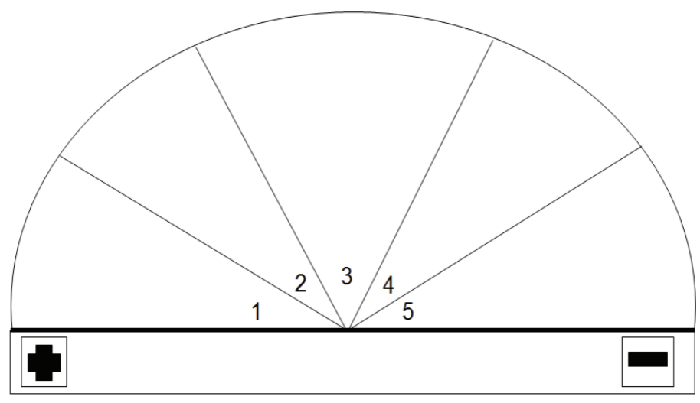
Spectrum of Allies Example
Issue: Removing payroll deduction for ESP members
Target: State Legislature
Demand: Stop bill that would remove payroll deduction for ESP members
Neutrals
-PTA/PTO
-Faith/Church Leaders
Passive opponents
Passive Allies
-Other Unions
-SIC
-School Board
-Admin/Sup. Association/Union
Active Allies
Active Opponents
-Other bargaining units
-County Council
-State Legislature

Slide 71
It is only necessary to move some or all of the pie wedges one step in your direction.
If we shift each wedge one step, we are likely to win, even if the hardliners on the opponent’s side don’t budge.
Key Points

Slide 72
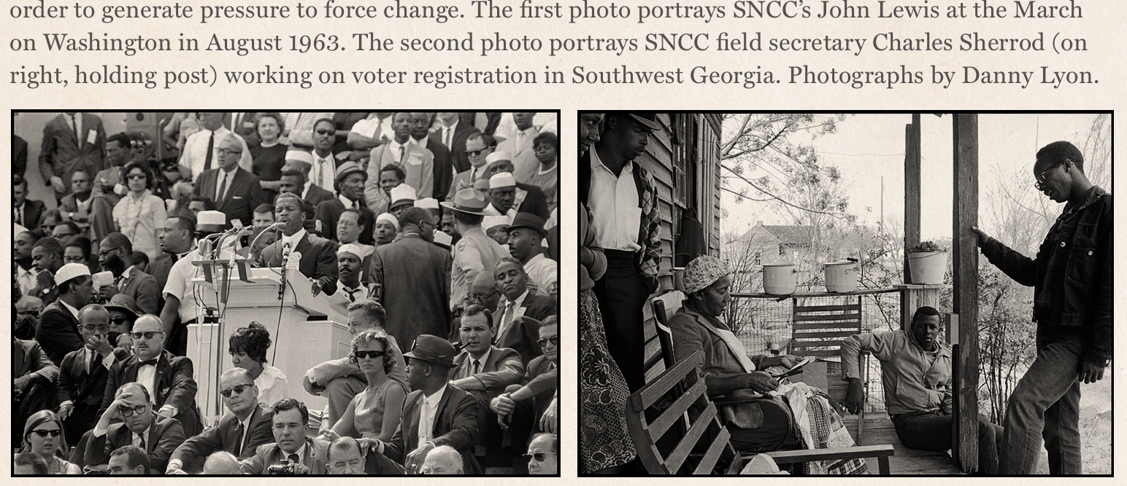
Messaging is Movement-Building
Messaging isn’t about arguing—it's about inviting.
Focus determines who gets included and who is left out.
Equity-centered messaging helps build power with, not for.

Slide 73
Messaging to Move People
Good messaging doesn't try to convince, it tries to connect
Use messaging to activate, not just inform
The goal is to message centering equity
  This means seeing and reaching people in their full humanity

Slide 74
Who Are You Talking To?
Spectrum | Needs Messaging That...
Active Allies | Deepens commitment
Passive Allies | Invites low-risk engagement
Neutrals | Frames values alignment
Passive Opponents | De-escalates with dignity
Active Opponents | Not the focus but you gotta say something and it needs to make sense

Slide 75
Spectrum of Allies Example
Issue: Removing payroll deduction for ESP members
Target: State Legislature
Demand: Stop bill that would remove payroll deduction for ESP members
Neutrals
-PTA/PTO
-Faith/Church Leaders
Passive opponents
Passive Allies
-Other Unions
-SIC
-School Board
-Admin/Sup. Association/Union
Active Allies
Active Opponents
-Other bargaining units
-County Council
-State Legislature

Slide 76
Coaching it Up
How will you know that there is something going on in the campaign related to an analysis of allies and how to message them?
What possible observations could you see?
What questions could you ask the team lead?
What are intentional interventions you might take?

Slide 77
Equity means naming nuance - be specific, be inclusive
Don’t center your opponent - build around your base
Good coaching = helping teams build power, not chase power
Key Points

Slide 78
Strategy, Tactics and Escalation
Zac and Amanda

Slide 79

What do you think is the difference between a strategy and a tactic?

Slide 80
Strategy
Strategy: The way we use our power to win our demand. It is a series of tactics aimed at putting pressure on the target to meet our demand.

Slide 81
Tactics
Tactic: Actions we take as a part of an escalation plan that increases pressure on the target to win our demand.

Slide 82
What makes good tactics?

Slide 83
Tactics Must:
Put pressure on your Target
(puts them out of their comfort zone)
Build your Power
(develops leaders, brings more people in, etc.)

Slide 84
Power is a function of Courage and Unity
Our Ultimate Power
Amount of Effort or Courage to Persist and Act
Unity - Number of People Sharing the Values, Pain, and Actions
Notes:
Katie B
The more the courage and the more people who are acting – the more power we have.

Slide 85
Low level of courage and high number of actors…
Amount of Effort or Courage to Persist and Act
Sign an online Petition
Unity - Number of People Sharing the Values, Pain, and Actions
Notes:
Katie B
high participation, low effort and courage – low power to cause the target to concede the demand

Slide 86
High level of courage and low number of actors…
Storm the Superintendent’s Office
Amount of Effort or Courage to Persist and Act
Unity - Number of People Sharing the Values, Pain, and Actions
Notes:
Katie B
a lot of courage and effort but low participation – low power to cause the target to concede the demand.

Slide 87
Tactics Must:
Put pressure on your Target
(puts them out of their comfort zone)
Build your Power
(develops leaders, brings more people in, etc.)
In other words …. be Strategic.

Slide 88
Coaching Up Strategy Tactics

Slide 89
Key Points
Tactics allow workers to:
Share Resources, Values, and Commitment
Take risks together and achieve shared wins
Build trust in their own agency and the collective effectiveness of their union

Slide 90
Coaching in for Compression Points &
Escalation
Zac and Amanda

Slide 91


Slide 92
Compression Points
Points on the calendar where you celebrate short term wins or escalate your tactics.
◦Naturally occurring deadlines- Breaks, Board Meetings
◦Artificial deadlines-target has till day X to act
◦Help us build urgency and crisis

Slide 93

Why do you think tactics escalate gradually?

Slide 94
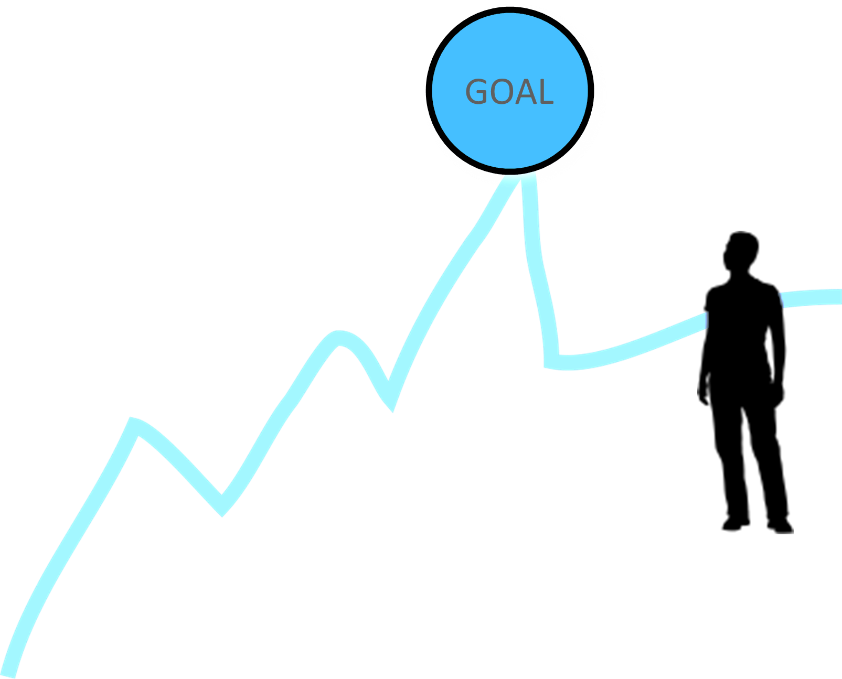
Less escalated actions prepare our people for more escalated actions
Gives us information about our readiness for the next step and how much pressure your target is able to sustain
Give the target the opportunity to do the right thing before things escalate
The threat of escalation can be as powerful as actual escalation

Slide 95
TEAM WORK – Escalation of Tactics
Return to the tactics chart you just made
Arrange them in an order that has the least visible, least risky tactic to highest visibility highest risk

Slide 96
Coaching Up Timeline, Escalation, and Compression Points

Slide 97
Key Points
An escalating campaign is held together by a set of values and shared commitment to a demand.
Escalating tactics are how we develop leaders, identify new leaders, move more people into our base.
If we are organizing, we are always climbing campaign mountain

Slide 98
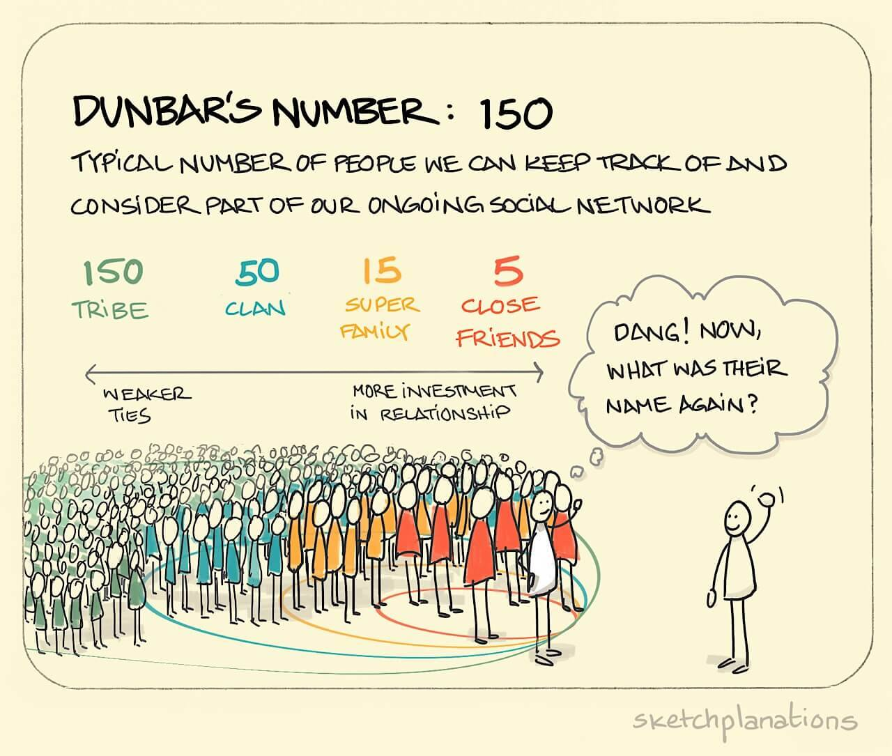

Slide 99
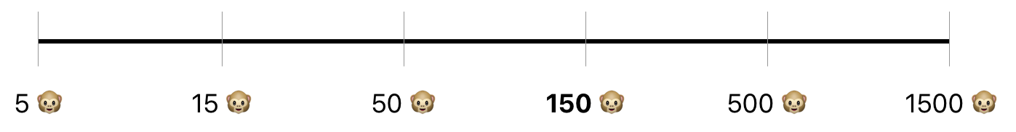
Dunbar’s Number
Stable - Relationship
Connections
Developing Leaders
Engaged Members
Aware Members
Disengaged Members - Supporters
“Driver” Leaders
Natural Leaders

Slide 100
Key Points
What are your key points

Slide 101

Closing the Day
What is becoming clearer?
What remains murky?
Housekeeping

Slide 102
Additional Unused Slides Follow

Slide 103
Basics of Coaching

Slide 104
How do children learn to tie their shoes?

Slide 105
What is coaching?
Coaching is a direct intervention in an individual or team’s work process to help them improve effectiveness.
Coaching enables others to build their own capacity to act.
Coaching transforms leaders from a relationship where someone else has external control to one where they focus on how to grow.

Slide 106
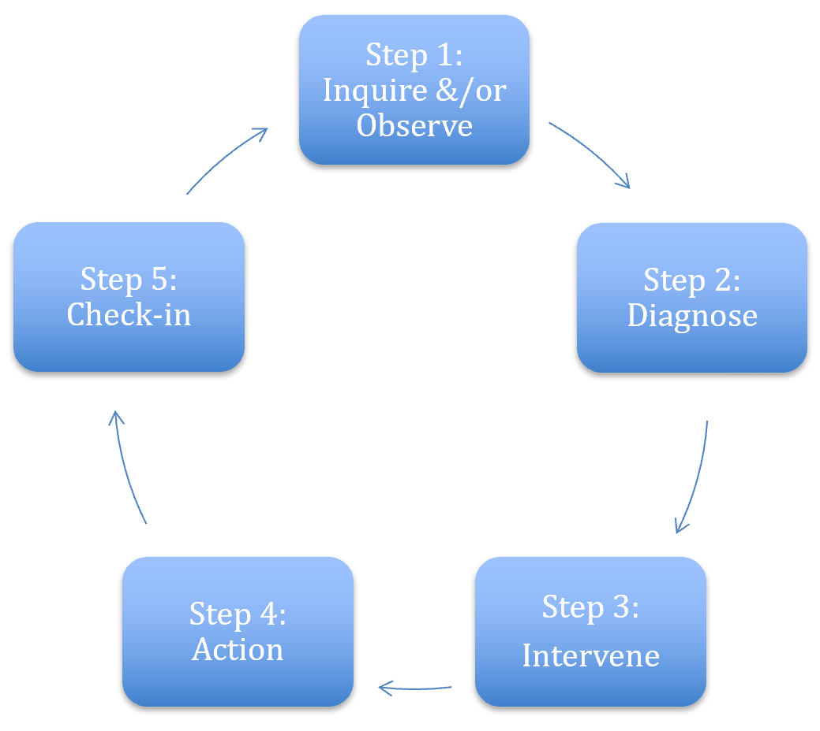
Coaching Meeting
Step 1 – The Coachee is sharing what they want from their work (their goal) and then they share what is actually happening (Reality)

Slide 107
Coaching Meeting
Step 2 – You pick one of the three diagnoses
Motivational - Heart Coaching aimed at enhancing motivation
Strategic – Head Coaching aimed at helping plan, evaluate, strategize
Skills-based – Hands Coaching aimed at effective

Slide 108
Coaching Meeting
Step 3 – Your diagnosis guides your practices through the Options portion of the coachee meeting.

Slide 109
Coaching Meeting
Step 4 – Support coaches’ leadership growth by letting them lead the intervention, resisting the urge to step in, and using your observations to guide a thoughtful debrief.

Slide 110
Coaching Meeting
Step 5 – Facilitate reflection by asking coaches what went well, what challenged them, possible solutions, and next steps—then schedule regular check-ins to track progress, assess impact, and celebrate successes.

Slide 111
MOVES ONLINE

Slide 112

Craft of Coaching
Questions vs statements
Guideposting
Emotional presence
Holding authority
Soccer vs ping pong.
Strategy is also a fundamental element of the craft -- that is, choosing which content area you will dive in on.

Slide 113
Questions vs. Statements
Why are questions important?
What do questions do for the coachee that statements can’t?
How might you as a coach strategically use questions to your advantage?

Slide 114
Guideposting
Let’s the coachee know where they are going before they get there
Be explicit about what you are intervening on

Slide 115
Emotional Presence
Coach modeling vulnerability in their own campaign work
Holding tensions in a productive way so that learning can happen

Slide 116
Holding Authority
Tight leadership and focus
Your role is to challenge AND support
Keep time
Hold coachee accountable

Slide 117
Soccer vs ping pong
Soccer = Group Facilitation: Engage the whole group to reflect, resonate, and coach one another.
Ping Pong = One-on-One Deep Dive: Use focused back-and-forth to explore vulnerability or key insights with the coachee.
Be Intentional: Use clear, purposeful questions to guide group (soccer) time effectively.
Balance Both: Strategically alternate between soccer and ping pong to maximize group learning and individual growth.

Slide 118
Within each of these Craft are Techniques
Active Listening
Mirroring – Reflecting Back
Debriefing - Summarizing and Restarting
The Art of Questions
Coaching Across Differences

Slide 119
Active Listening
Pro-actively look and listen for what someone else is trying to communicate, while trying not to project our own thoughts and expectations onto them.

Slide 120
Mirroring – Reflecting Back
Mirroring is the technique of reflecting back the EXACT WORDS that the coachee has just said and then leaving a room for silence.

Slide 121
Debriefing: Summarizing and Restating
After listening to someone we can offer them a short summary of what we’ve heard.
Boil things down into one or two short sentences.
This is essential if your summary is intended to clarify the situation and move a discussion on.

Slide 122

The Art of Questions
Open
Closed
Probing
Funnelling
Appreciative Inquiry
Reality Check
What if

Slide 123
Open Questions
Longer reasoning or answers.
TED: Tell, Explain, Describe.
Good for:
  Open conversation
  Detail
  Opinions, issues or experience

Slide 124
Closed Questions
Reduces options so as to receive a single word or very short, factual answer.
Best avoided when a conversation is in full flow.
Good for:
  Check understanding.
  Concluding i.e. a discussion.
Setting a frame i.e. Introducing an Issue

Slide 125
Probing
Two step process:
1. Limiting scope (Let’s talk about that item)
2. Asking an open question within that scope. (Why do you think …)

Slide 126
Funnelling
Refers to a sequence of specific questions that narrows down to a specific answer:
What, where, with whom, why, when (often with use if some closed questions).
Refers to more of a sequence of questions
Great for Root Cause Analysis (5 Whys)

Slide 127
Appreciative Inquiry
Ask questions based on people’s own experience like:
What have you experienced before that worked?
What successes have you experienced ?
Have you experienced a similar situation before? How was it?
If you are to give yourself an advice, what would it be?
From where do you get the courage and patience to continue?

Slide 128
Reality Check
Coaching questions that helps better evaluate the situation accurately
Questions that can put numbers on challenges and measure quantitatively and not just qualitatively.
Questions that can shed light on the half full of the cup to see the positive side not just the challenge to enable possibilities of solutions

Slide 129
What if questions
What if questions open a light of possibility

Slide 130
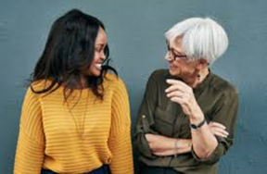
Coaching Across Differences
1. Curiosity and Compassion
Develop you Own Emotional Intelligence
Invite Conversations about Differences

Slide 131
Coaching Questions to Ask
What do you need me to understand about your identity in this work?
What would you like to know about me that would help you to work with me?
Tell me a story that will help me understand a part of your identity that you feel impacts you in this work.
What might be challenging about us working together?
What can I do to support you when those challenges arise?

Slide 132
Coaching Triads
Regroup!
You will need to get into groups of 3.
Problem of Practice
Three 20-Mnute Rounds
  5 Coachee presents Problem of Practice
  5 Coach begins inquiry and diagnosis
  5 Coach moves to debrief and monitor
  5 Observer

Slide 133
Debrief
What worked well?
What would you change the next time you coach/ are the coachee?
What is one key takeaway from this?

Slide 134
Key Points
Coaching is about releasing your external control and enabling the leader to grow.
Coaching is as much about you changing your behavior and growing your skill as it is about growing a leader.
We only get good at coaching by practicing it.

Slide 135
Why is coaching critical to a winning campaign?
Coaching is a direct intervention in an individual or team’s work process to help them improve effectiveness.
Coaching enables others to build their own capacity to act.
Coaching moves leaders from a relationship where staff have an external control to one where they focus on how to grow.

Slide 136
3 Kinds of Coaching
Motivational - Heart Coaching aimed at enhancing motivation
Strategic – Head Coaching aimed at helping plan, evaluate, strategize
Skills-based – Hands Coaching aimed at effective execution of a skill

Slide 137
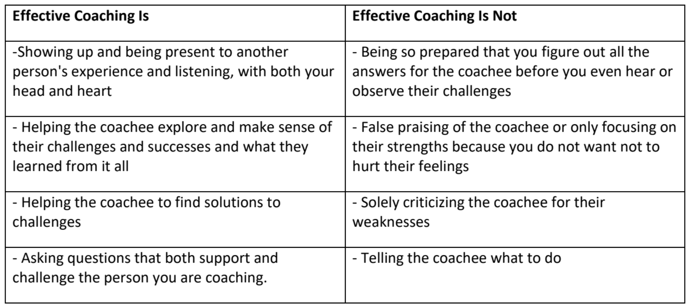
Handouts
to hurt their feelings

Slide 138
Coaching Cycle-
The reason to apply this cycle is to stop yourself from providing THE answer.
Leaders grow from productive struggle.

Slide 139
Key Points
Coaching is about releasing your external control and enabling the leader to grow.
Coaching is as much about you changing your behavior and growing your skill as it is about growing a leader.
We only get good at coaching by practicing it.

Slide 140
Campaign Cycle Overview

Slide 141
4 Core Concepts for Winning Campaigns
1. Structure NOT Self-Selecting
2. Leaders NOT Activists
3. Majorities NOT Minorities
4. Organizing NOT Mobilizing/Activism

Slide 142

Small Group Charting
Think about a time you were part of a team.
Was it a good team? Why?
Was it a not so good team? Why
Make two columns “good” and “not good”
List the characteristics of each

Slide 143
When groups of people come together, conflict is always present. Effective teams are structured to channel that conflict in productive ways, allowing the team to achieve the goals it needs to win.
Our role is to support team development.

Slide 144

What do Effective teams do?
Meet goals
Engage others
Learn and
improve
Coordinate

Slide 145
Three Conditions for Team Success
Diverse People
Clear Boundaries
Stable Membership

Slide 146
Three Conditions for Measuring Team Effectiveness
Achieve Goals
Build Capacity
Always Learning

Slide 147
Three Steps for Building Effective Teams
Shared Purpose
Community Agreements
Clear Roles

Slide 148

Key Ideas
The leadership team structure supports the campaign’s interests by meeting goals, and meeting each individual’s interests by giving them opportunities and support to learn and develop.
IF your team is not meeting these criteria then you need to return to the foundational blocks and refocus.
Your role is to support and develop the team.

Slide 149
How do we develop a shared purpose?

Slide 150
DEVELOPING A SHARED PURPOSE
“Ends”- destination
“Means”- journey
OUR TEAM’S PURPOSE IS TO…
OUR PEOPLE ARE...
WE’LL ACHIEVE OUR PURPOSE BY...
WHAT?
WHO?
HOW?
Notes:
Suggested time: 3 min
The first step is developing a shared purpose.
How many of you have had an experience trying to create a purpose statement for a team or organization you’ve been a part of.
Was that like a walk in the park? No. Once you got there, did it give your team clarity about the goals you were working towards?
So this practice is definitely worthwhile. In breakouts, you’ll have a chance to try this out. We’ll develop a statement for the work we’re doing together by using the What, Who, and How structure.
Purpose is an interaction between these three things
What is our north star? What broadly must occur in our world for it to look a little more like what we want? What part of that work are we taking on as a team?
Who – Who are we engaging to do this work with? How can we be specific in naming our people? What characteristics do they have in common? Remember that organizing is about enabling leadership so this is about who do we plan to work with NOT who do we want to do the work for.
How – What kinds of activities will we engage them in?
(organizing activities) – in an organizing language, what kinds of activities allow for our group to achieve the purpose we’ve set forth.
One key factor in creating effective shared purpose is knowing the difference between the “what” and the “how”. The “what” is a statement of our “end goal”-- the destination that represents the world looking more like what we want. The “how” is a statement of our “means goals” -- the journey to get to the world we want, represented by the major organizing activities we’ll engage in along the way.

Slide 151
We are organizing WHO SPECIFICALLY that believe VALUES / ISSUES to do WHAT ARE THE ACTIONS THEY WILL TAKE to demand WIN by DATE.

Slide 152
We are organizing the special education teachers, para-professionals and parents of special education students at the Pine Prairie Middle School who believe all students should experience humane conditions during state testing to write joint letters to Parish Leaders, post member and parent stories on social media, and pack public meetings to demand humane accommodations on the spring administration of English and Math state tests.

Slide 153
Whole Group Practice
Non-examples – What’s missing?
We are organizing our members to stand against testing for special education.
We are organizing teachers to take on the politicians so that testing for student in special education programs can be made better.

Slide 154
Small Group Purpose Statement Peer Coaching
We are organizing Baca Elementary educators to reduce monthly district math and reading testing requirements and small group lesson planning requirements to secure time for teaching and learning through collective actions by the start of negotiations, March 2022.
We are organizing special educators and educators that teach special education students to secure planning time through collective action by the start of contract negotiations, March 2022.

Slide 155
Peer Coaching Example 1
We are organizing Baca Elementary educators (this is a big group – what percent do you need?)(what do they believe? Why would they want this) to (What are you demanding? By When and from whom?) reduce monthly district math and reading testing requirements and small group lesson planning requirements to secure time for teaching and learning through collective actions (What are they going to do?) by the start of negotiations, March 2022.

Slide 156
Peer Coaching Example 2
We are organizing special educators and educators that teach special education students (this is a big group – what percent do you need?) (what do they believe? Why would they want this) (What are you demanding? By When and from whom?) to secure planning time through collective action (What are they going to do?) by the start of contract negotiations, March 2022.

Slide 157
Key Ideas
A team needs to know their purpose
Their purpose is linked to their own WHY and this builds the likelihood for a longer commitment and better relationship to each other
A team that can succinctly state why, with whom, and how meaningful change can be achieved will build more committed followers.

Slide 158
How do we develop community agreements?

Slide 159
Establish Team Agreements
How will we decide?
How will we have discussions?
How will we handle time?
How will we handle our commitments?
Notes:
Suggested time: 3 min
Who has set agreements or norms?
What has been effective?
If there’s no accountability, the status quo becomes the new normal…
So establishing team agreements becomes a crucial step in the process of forming an effective team.
We want to share in creating accountability for one another on the journey so we need to know “How”! How will we decide? How will we have discussions? How will we handle time? How will we handle our commitments?
In the justice league, it’s Batman and Superman who are in the center of the snowflake. As founding members they often convene the league meetings and coordinate missions. They meet as a team and vote when considering whether or not they should add new members. Everyone gets a say.
They know who leads the discussions.
Superheroes are pretty busy, they have a lot going on. So time is important. They know how to be efficient.
They usually partner up on league missions to ensure support. They commit to the work and report back.

Slide 160
How do our agreements support the most marginalized voices of our team?
Do we know what each of these look like?
What happens when we break our commitment to these agreements?
Reflections
Notes:
Suggested time: 3 min
Who has set agreements or norms?
What has been effective?
If there’s no accountability, the status quo becomes the new normal…
So establishing team agreements becomes a crucial step in the process of forming an effective team.
We want to share in creating accountability for one another on the journey so we need to know “How”! How will we decide? How will we have discussions? How will we handle time? How will we handle our commitments?
In the justice league, it’s Batman and Superman who are in the center of the snowflake. As founding members they often convene the league meetings and coordinate missions. They meet as a team and vote when considering whether or not they should add new members. Everyone gets a say.
They know who leads the discussions.
Superheroes are pretty busy, they have a lot going on. So time is important. They know how to be efficient.
They usually partner up on league missions to ensure support. They commit to the work and report back.

Slide 161
How would you coach these agreements?
Respect and accept all ideas
Complete all assigned duties on time
Attend all meetings
All decisions will be voted on – majority rules

Slide 162
Coaching Ideas
What does it look like to live up to this agreement?
What will happen when this agreement is not kept?
What does this mean to you?
Do these cover you in the easy times and the difficult times?
What is missing?
Will you be able to revisit, review, and revise?
How do these allow each person to be fully present and participatory?
How will these boost inclusion of marginalized voices?

Slide 163
How do the processes of majority rules and seeking consensus shift the relationships within a team?
Team Commitment
Notes:
Suggested time: 3 min
Who has set agreements or norms?
What has been effective?
If there’s no accountability, the status quo becomes the new normal…
So establishing team agreements becomes a crucial step in the process of forming an effective team.
We want to share in creating accountability for one another on the journey so we need to know “How”! How will we decide? How will we have discussions? How will we handle time? How will we handle our commitments?
In the justice league, it’s Batman and Superman who are in the center of the snowflake. As founding members they often convene the league meetings and coordinate missions. They meet as a team and vote when considering whether or not they should add new members. Everyone gets a say.
They know who leads the discussions.
Superheroes are pretty busy, they have a lot going on. So time is important. They know how to be efficient.
They usually partner up on league missions to ensure support. They commit to the work and report back.

Slide 164
Key Ideas
Agreements are best made through consensus.
Applying an understanding of privilege and power can improve our agreements.
These are not about control as much as communication and commitment.
All commitments need space for grace and repair.

Slide 165
How do we establish roles?

Slide 166
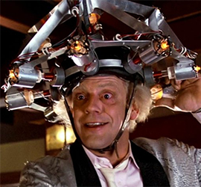
Task Design to Support Personal Agency
“Social scientists have found that tasks designed to yield “intrinsic” rewards (inherently satisfying) produces great motivation, commitment, and adaptive learning than tasks that only yield financial, recognition or status rewards.”
-Hackman and Olham, 1980

Slide 167
3 Conditions of Motivational Role Design
Experience meaningfulness: the role is important in the overall scheme of things.
1
Experience responsibility: how well the role gets done is up to me.
2
Experience results: as I do the work I can see whether or not I am doing well.
3

Slide 168
Establishing Roles
Establish roles with real responsibilities.
Ask: who could take on this responsibility based on their talents and experiences?
Team Assigns roles and follow up.
Notes:
Suggested time: 3 min
Have any of you been on a team where you didn’t feel a whole lot of responsibility? How did that affect your level of engagement?
Making sure to have clear roles is important.
How about being on a team where your talents and expertise wasn’t utilized? Did that feel good?
Much like the justice league, it would be hard for someone like batman to engage if his tactical and logisitcal skills weren’t being used. It can be isolating and ensure a lack of participation.
Have you been on a team where you didn’t really have a role other than to show up?
Each person should know their role and the team should know it too. Each player knows how to engage and is aware of what they bring to the table. Superman brings a different perspective than the flash, their age, abilities, personalities, and background make them very unique but they are both very sure of why their on the Justice League.

Slide 169
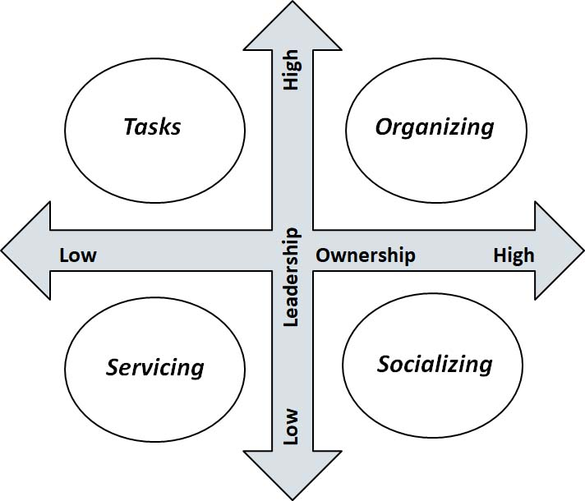
Meaningful Engagement is a function of Leadership and Ownership
What are typical roles that team members do in a campaign?
…Let’s sort it out

Slide 170
Coaching it Up
Writing the team communication (Which quadrant?)
Is anyone else going to help you?
Who is giving you feedback?
Entering Rally Attendance Data (Which quadrant?)
How is this going to help us meet our goals?
Do you have to do it all by yourself?
How do you want to be supported?
Is there someone else you could teach to do this?

Slide 171
Coaching Towards
Leadership and Ownership Rich
What aspects of the role do you coach to move it through the quadrants?
How do you help move them into quadrants with more leadership and ownership?

Slide 172
Coaching Examples
How will you know that you are doing your role well?
Are you engaging others in this role with you?
Who else is sharing the outcomes for this role?
How do you see this supporting the goals we have?
How are you planning to teach someone else to do this role?
What support do you need to do this role?
Why do you want to do this?

Slide 173
Key Ideas
People grow when they have to stretch. When leaders step back, members can step forward.
Tasks have to be meaningful and members need to own them not be directed to them.
Our job is to look for opportunities to coach people towards ownership and leadership wherever possible.

